Slide 1

The road ahead for wireless technology:
Dreams and Challenges
Andrea Goldsmith
Wireless Systems Laboratory
Stanford University
W
L
S
Xi Dian University
Xi’an, China
August 19, 2011

Slide 2
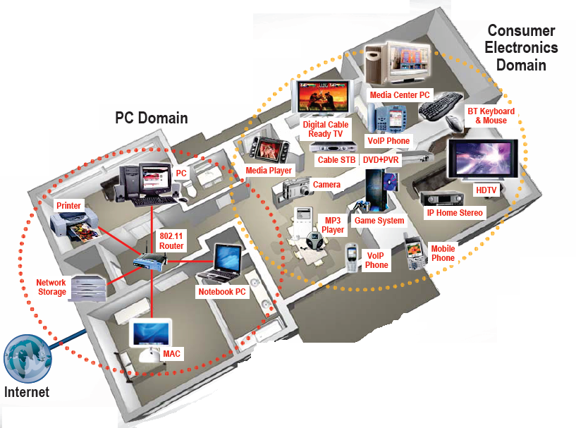

Future Wireless Networks
Ubiquitous Communication Among People and Devices
Next-generation Cellular
Wireless Internet Access
Wireless Multimedia
Sensor Networks
Smart Homes/Spaces
Automated Highways
Smart Grid
Body-Area Networks
All this and more …

Slide 3

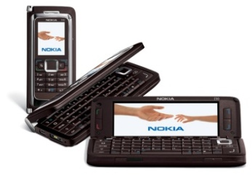
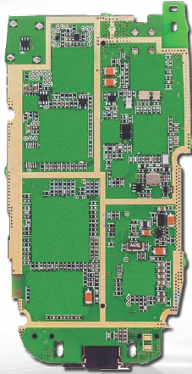

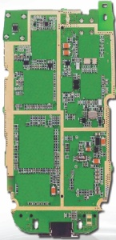





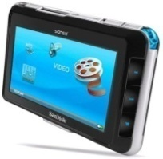
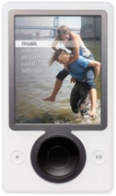
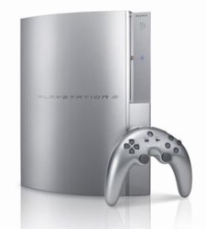
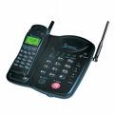
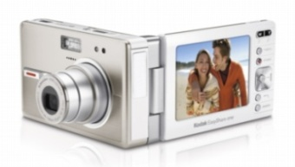
Future Cell Phones
Everything wireless in one device
Burden for this performance is on the backbone network
San Francisco
BS
BS
Internet
New York
N^{th}-Gen
Cellular
Phone
System
N^{th}-Gen
Cellular
BS
Much better performance and reliability than today
- Gbps rates, low latency, 99% coverage indoors and out

Slide 4
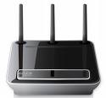


Future Wifi:
Multimedia Everywhere, Without Wires
Performance burden also on the (mesh) network
802.11n++
Streaming video
Gbps data rates
High reliability
Coverage in every room
Wireless HDTV
and Gaming

Slide 5
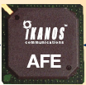
Device Challenges
Size and Cost
Power and Heat
Multiband Antennas
Multiradio Coexistance
Integration
BT
FM/XM
GPS
Cellular
DVB-H
Apps
Processor
WLAN
Media
Processor
Wimax

Slide 6
Software-Defined (SD) Radio:
Is this the solution to the device challenges?
BT
FM/XM
A/D
Cellular
GPS
A/D
DVB-H
DSP
Apps
Processor
A/D
WLAN
Media
Processor
Wimax
A/D
Wideband antennas and A/Ds span BW of desired signals
DSP programmed to process desired signal: no specialized HW
Today, this is not cost, size, or power efficient
Compressed sensing may be a solution for sparse signals

Slide 7
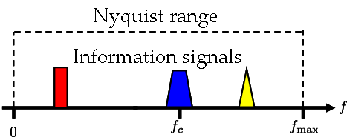
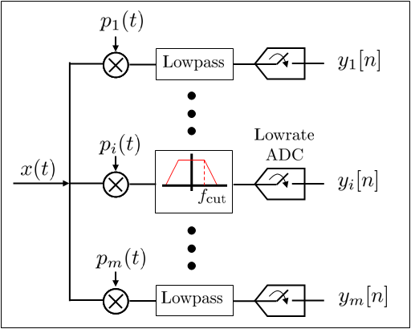
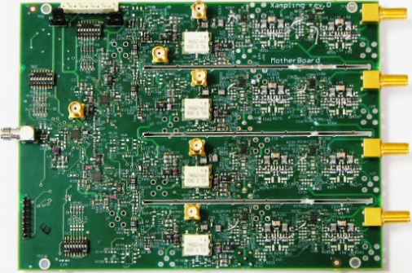
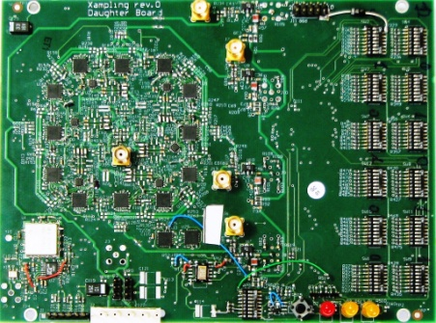
Compressed Sensing
Basic premise is that signals with some sparse structure can be sampled below their Nyquist rate
Signal can be perfectly reconstructed from these samples by exploiting signal sparsity
This significantly reduces the burden on the front-end A/D converter, as well as the DSP and storage
Might be key enabler for SD and low-energy radios
  Only for incoming signals “sparse” in time, freq., space, etc.

Slide 8
Scarce Wireless Spectrum
$$$
Hence regulated, and expensive

Slide 9

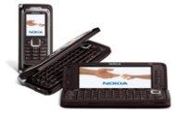

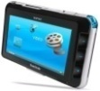
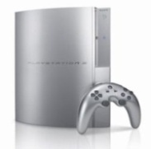

Spectral Reuse
Due to its scarcity, spectrum is reused
In licensed bands
and unlicensed bands
BS
Cellular, Wimax
Wifi, BT, UWB,…
Reuse introduces interference

Slide 10
Interference: Friend or Foe?
If treated as noise: Foe
If decodable: Neither friend nor foe
Increases BER, reduces capacity
Multiuser detection can
completely remove interference

Slide 11
Ideal Multiuser Detection
Signal 1
-
=
Signal 1
Demod
Iterative
Multiuser
Detection
Signal 2
Signal 2
Demod
-
=
Why Not Ubiquitous Today?
Power and A/D Precision

Slide 12
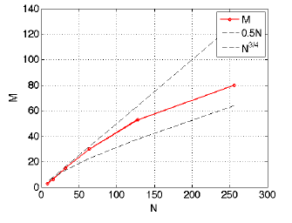
Reduced-Dimension MUD
Exploits that number of active users G is random and much smaller than total users (ala compressed sensing)
Using compressed sensing ideas, can correlate with M~log(G) waveforms
Reduced complexity, size, and power consumption
10% Performance Degradation
Linear
Transformation
Decision
Decision
Decision

Slide 13
If exploited via cooperation and cognition
Interference: Friend or Foe?
Friend
Especially in a network setting

Slide 14
Rethinking “Cells” in Cellular
How should cellular
systems be designed?
Coop
MIMO
Femto
Relay
Will gains in practice be
big or incremental; in
capacity or coverage?
DAS
Traditional cellular design “interference-limited”
  MIMO/multiuser detection can remove interference
  Cooperating BSs form a MIMO array: what is a cell?
  Relays change cell shape and boundaries
  Distributed antennas move BS towards cell boundary
  Femtocells create a cell within a cell
  Mobile cooperation via relaying, virtual MIMO, analog network coding.

Slide 15
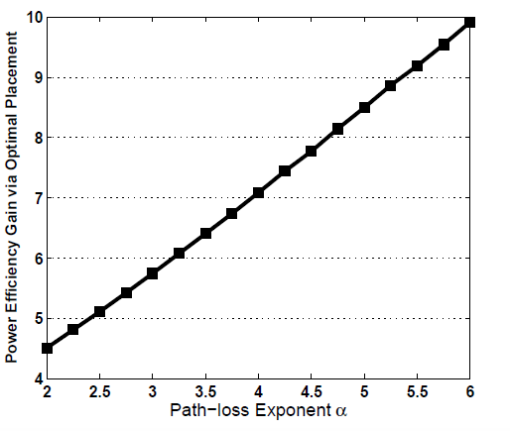
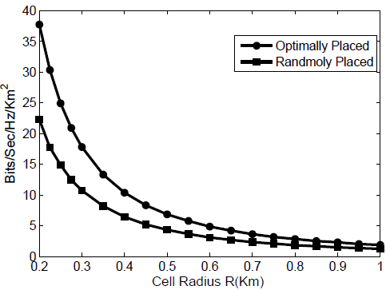
Gains from Distributed Antennas
10x power efficiency gain with 3 distributed antennas
3-4x gain in area spectral efficiency
  Small cells yield another 3-4x gain
DAS
---- Optimal Placement
---- Random Placement
---- Central Placement

Slide 16
Cooperation in Ad-Hoc Networks
Similar to mobile cooperation in cellular:
  Virtual MIMO , generalized relaying, interference forwarding, and one-shot/iterative conferencing
Many theoretical and practice issues:
  Overhead, half-duplex, grouping, dynamics, synch, …

Slide 17
Generalized Relaying
TX1
RX1
X₁
Y₄=X₁+X₂+X₃+Z₄
relay
Y₃=X₁+X₂+Z₃
X₃= f(Y₃)
Analog network coding
Y₅=X₁+X₂+X₃+Z₅
X₂
TX2
RX2
Can forward message and/or interference
  Relay can forward all or part of the messages
    Much room for innovation
  Relay can forward interference
    To help subtract it out

Slide 18
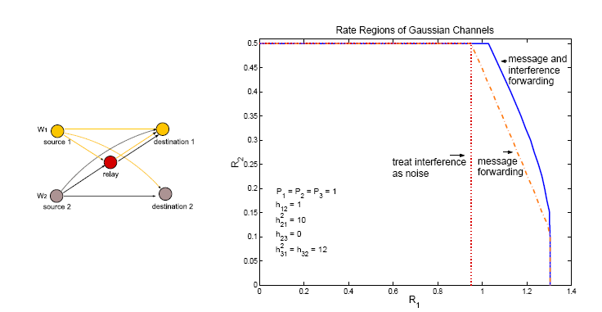
Beneficial to forward both interference and message

Slide 19
In fact, it can achieve capacity
P₁
P₃
P_{s}
S
D
P₂
P₄
For large powers P_{s,} P₁, P₂, analog network coding approaches capacity

Slide 20
Intelligence beyond Cooperation: Cognition
Cognitive radios can support new wireless users in existing crowded spectrum
  Without degrading performance of existing users
Utilize advanced communication and signal processing techniques
  Coupled with novel spectrum allocation policies
Technology could
  Revolutionize the way spectrum is allocated worldwide
  Provide sufficient bandwidth to support higher quality and higher data rate products and services

Slide 21
Cognitive Radio Paradigms
Underlay
  Cognitive radios constrained to cause minimal interference to noncognitive radios
Interweave
  Cognitive radios find and exploit spectral holes to avoid interfering with noncognitive radios
Overlay
  Cognitive radios overhear and enhance noncognitive radio transmissions
Knowledge
and
Complexity

Slide 22
Underlay Systems
Cognitive radios determine the interference their transmission causes to noncognitive nodes
  Transmit if interference below a given threshold
The interference constraint may be met
  Via wideband signalling to maintain interference below the noise floor (spread spectrum or UWB)
  Via multiple antennas and beamforming
I_{P}
NCR
NCR
CR
CR

Slide 23
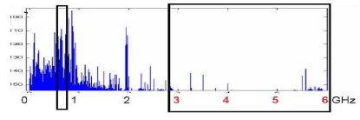
Interweave Systems
Measurements indicate that even crowded spectrum is not used across all time, space, and frequencies
  Original motivation for “cognitive” radios (Mitola’00)
These holes can be used for communication
  Interweave CRs periodically monitor spectrum for holes
  Hole location must be agreed upon between TX and RX
  Hole is then used for opportunistic communication
Compressed sensing reduces A/D and processing requirements

Slide 24
Overlay Cognitive Systems
Cognitive user has knowledge of other user’s message and/or encoding strategy
  Can help noncognitive transmission
  Can presubtract noncognitive interference
CR
RX1
RX2
NCR

Slide 25
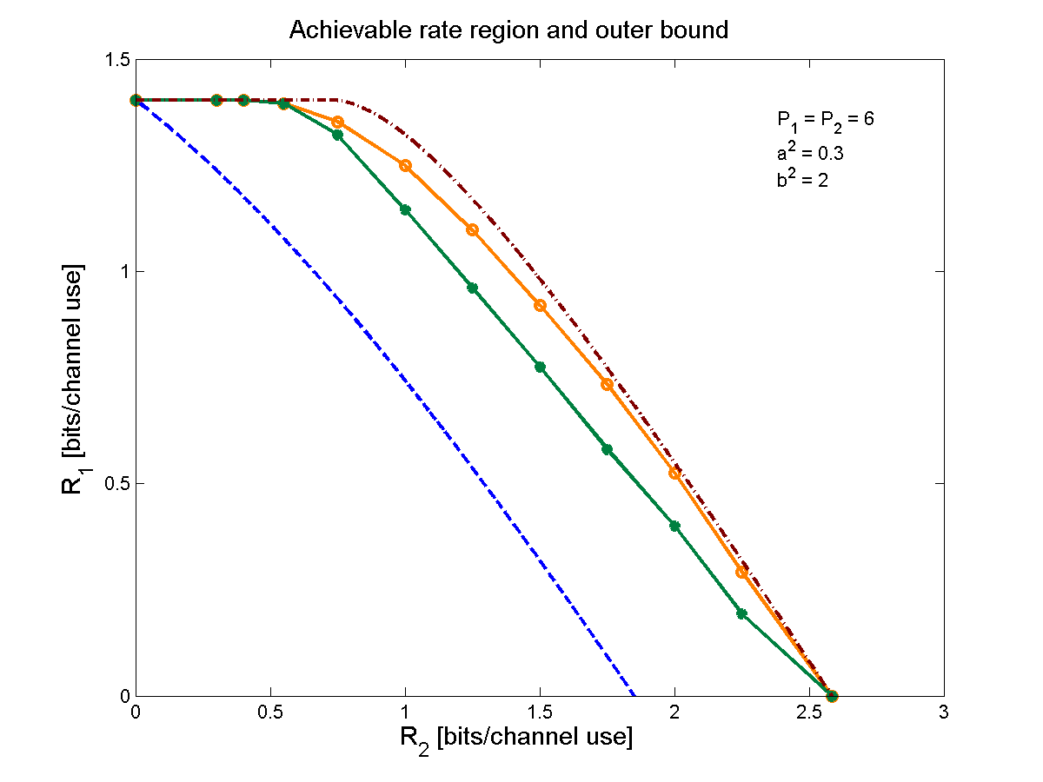
Performance Gains from Cognitive Encoding
  outer bound
  our scheme
  prior schemes
  Only the CR
  transmits

Slide 26

Cellular Systems with Cognitive Relays
Cognitive Relay 1
Enhance robustness and capacity via cognitive relays
  Cognitive relays overhear the source messages
  Cognitive relays then cooperate with the transmitter in the transmission of the source messages
  Can relay the message even if transmitter fails due to congestion, etc.
data
Source
Cognitive Relay 2
Can extend these ideas to MIMO systems

Slide 27
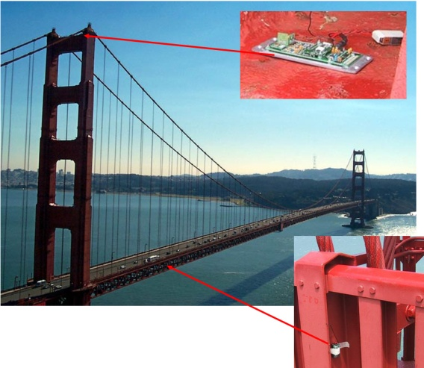
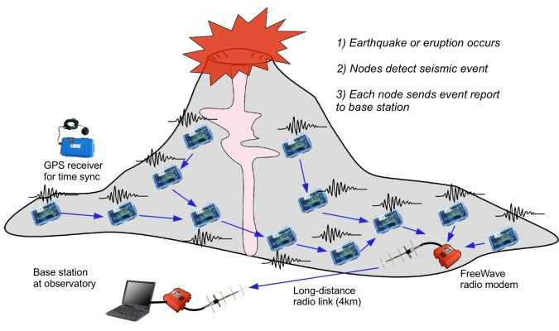
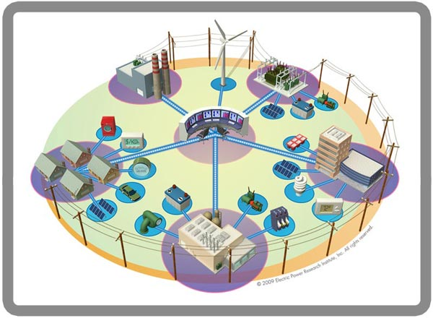
Wireless Sensor Networks
Smart homes/buildings
Smart grid
Search and rescue
Homeland security
Event detection
Battlefield surveillance
Energy (transmit and processing) is the driving constraint
Data flows to centralized location (joint compression)
Low per-node rates but tens to thousands of nodes
Intelligence is in the network rather than in the devices

Slide 28
Cross-Layer Tradeoffs
under Energy Constraints
Hardware
  All nodes have transmit, sleep, and transient modes
  Each node can only send a finite number of bits
Link
  High-level modulation costs transmit energy but saves circuit energy (shorter transmission time)
  Coding costs circuit energy but saves transmit energy
Access
  Power control impacts connectivity and interference
  Adaptive modulation adds another degree of freedom
Routing:
  Circuit energy costs can preclude multihop routing

Slide 29
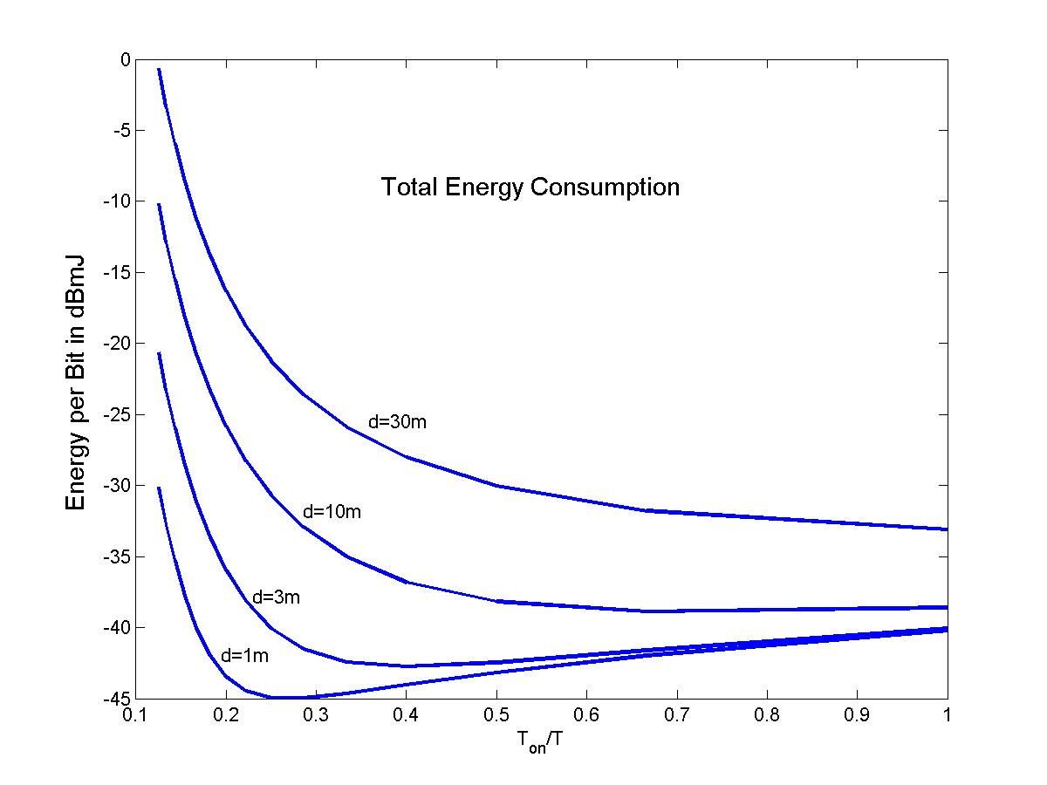
Total Energy (MQAM)

Slide 30
Green” Cellular Networks
Pico/Femto
How should cellular
systems be redesigned
for minimum energy?
Coop
MIMO
Relay
Research indicates that
signicant savings is possible
DAS
Minimize energy at both the mobile and base station via
  New Infrastuctures: cell size, BS placement, DAS, Picos, relays
  New Protocols: Cell Zooming, Coop MIMO, RRM, Scheduling, Sleeping, Relaying
  Low-Power (Green) Radios: Radio Architectures, Modulation, coding, MIMO

Slide 31
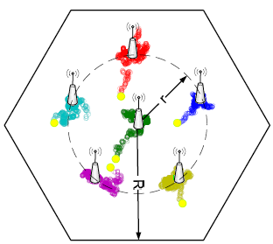
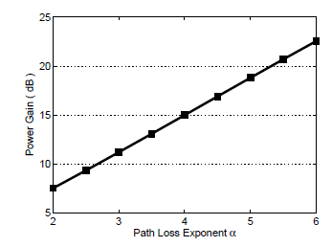
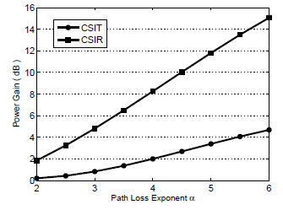
Antenna Placement in DAS
Optimize distributed BS antenna location
Primal/dual optimization framework
Convex; standard solutions apply
For 4+ ports, one moves to the center
Up to 23 dB power gain in downlink
  Gain higher when CSIT not available
6 Ports
3 Ports

Slide 32

Distributed Control over Wireless
Automated Vehicles
- Cars/planes/UAVs
- Insect flyers
  Interdisciplinary design approach
    Control requires fast, accurate, and reliable feedback.
    Wireless networks introduce delay and loss
    Need reliable networks and robust controllers
    Mostly open problems
: Many design challenges

Slide 33

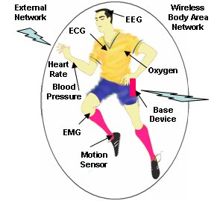
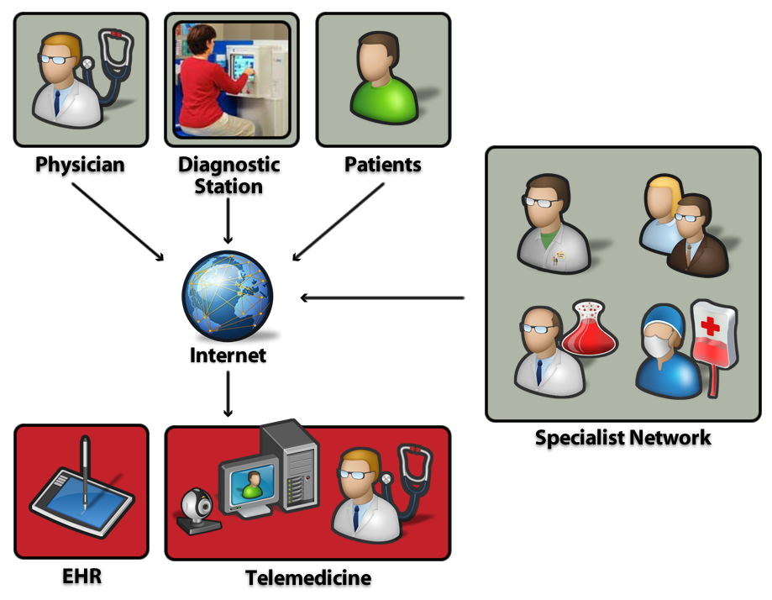
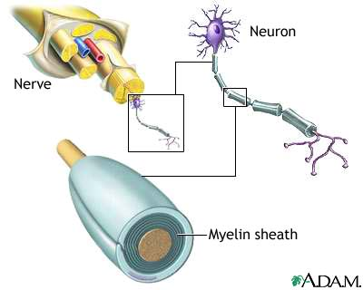
Wireless and Health, Biomedicine and Neuroscience
Body-Area
Networks
Doctor-on-a-chip
Cell phone info repository
Monitoring, remote
intervention and services
The brain as a wireless network
EKG signal reception/modeling
Signal encoding and decoding
Nerve network (re)configuration
Cloud

Slide 34
Summary
The next wave in wireless technology is upon us
This technology will enable new applications that will change people’s lives worldwide
Design innovation will be needed to meet the requirements of these next-generation systems
A systems view and interdisciplinary design approach holds the key to these innovations

