Slide 1
Tier 4 Emission update February, 2013 IEEE Presentation

Slide 2
Agenda
Background
EPA emissions regulations
Tier 4 technology
CPG Tier 4 Solution
Product architecture
Models description
Key features/differentiators
Scope of supply
Competitive landscape

Slide 3
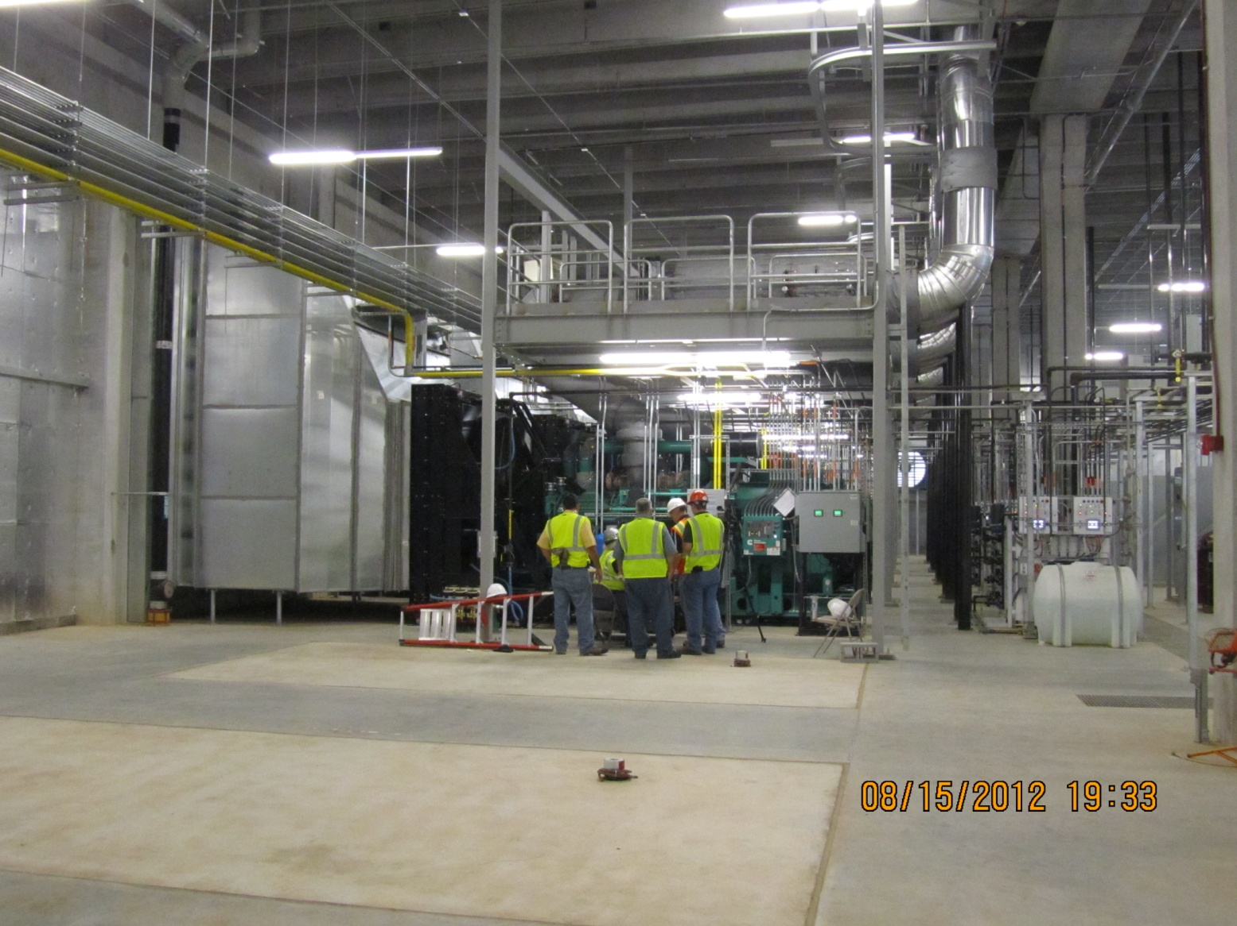
EPA Tier 4 interim certified
Confidential

Slide 4
Emissions Regulations

Slide 5
EPA New Source Performance Standards (NSPS) for Stationary CI Engines, Part 60, Subpart IIII
60.4219 What definitions apply to this subpart?
Emergency stationary internal combustion engine means any stationary internal combustion engine where operation is limited to emergency situations and required testing and maintenance.
Examples include stationary ICE used to produce power for critical networks or equipment (including power supplied to portions of a facility) when electric power from the local utility (or the normal power source, if the facility runs on its own power production) is interrupted, or stationary ICE used to pump water in the case of fire or flood, etc.
Notes:
This is the language of the actual EPA law applying to the power generation market. This law applies to engines manufactured and used on the off highway stationary market. Engines manufactured in 2011 and newer fall under this NSPS law.
Note the EPA text centers on the engine. The Engine manufacturer is responsible to certify it’s product meets emission levels in place during the year the engine is manufactured.
40CFR60 subpartIIII
http://ecfr.gpoaccess.gov/cgi/t/text/text-idx?c=ecfr&sid=632adb35e4dd20b1c5c6d5dae0c7909e&rgn=div6&view=text&node=40:7.0.1.1.1.97&idno=40

Slide 6
EPA New Source Performance Standards (NSPS) for Stationary CI Engines, Part 60, Subpart IIII
Stationary CI ICE used to supply power to an electric grid or that supply power as part of a financial arrangement with another entity are not considered to be emergency engines.
http://www.epa.gov/ttn/oarpg/new.html
Notes:
This is the language of the actual EPA law applying to the power generation market. This law applies to engines manufactured and used on the off highway stationary market. Engines manufactured in 2011 and newer fall under this NSPS law.
Note the EPA text centers on the engine. The Engine manufacturer is responsible to certify it’s product meets emission levels in place during the year the engine is manufactured.
40CFR60 subpartIIII
http://ecfr.gpoaccess.gov/cgi/t/text/text-idx?c=ecfr&sid=632adb35e4dd20b1c5c6d5dae0c7909e&rgn=div6&view=text&node=40:7.0.1.1.1.97&idno=40

Slide 7
EPA New Source Performance Standards (NSPS) for Stationary CI Engines, Part 60, Subpart IIII
The EPA law defines actual product use by the end-user:
Stationary Emergency
All other use not considered emergency can be classified as:
Stationary Non-Emergency
Non-road Mobile
The EPA law is directed to actual site application and does not address traditional industry application descriptions found in ISO, NEC, NFPA and other reference agencies.
The January 1, 2011 law affects usage type AND varies in Tier requirements by engine horsepower.
The EPA law compliance is the responsibility of the engine manufacturer and the end-user is responsible to use the product as it is intended.
Notes:
EPA law centers on how the user intends to operate the generator set.
The EPA recognizes stationary mounted engine driven product used in emergency situations. All other applications that are considered outside of the defined emergency use language are subject to more stringent emissions levels.

Slide 8
Nomenclature – EPA Terminology Power Generation Classification: Stationary Emergency
Stationary Emergency
Emergency standby (safe evacuation, life support)
Legally-required standby (fire-fighting operations)
Optional standby (could cause an economic loss)
Prime power rated generator set (at loss of utility electricity supply)
EPA does not allow mounting a stationary emergency generator on a trailer or mobilized in any way
Notes:
Much confusion surrounds the difference between the EPA definition of how the product is used verses how the product is rated. These factors are separate and not related. EPA use overrides any rating characteristic of the generator set.

Slide 9
Nomenclature – EPA Terminology Power Generation Classification: Stationary Non-emergency (subject to higher emission standards)
Stationary Non-emergency
Peak shaving (reduce or flatten peak electricity use)
Rate curtailment (favorable energy rates)
Interruptible rate programs (favorable energy rates)
Continuous base load (const. power to utility grid)
Co-generation (capture and use waste heat)
Prime power rated generator set (to be used as a primary source of power)
Notes:
IMPORTANT – There is one exception to prime rated genset used as a primary source of power that is considered stationary emergency. Any generator set used as the primary power source for pumps used in fire or flood prone areas operated only in emergency situations are not required to meet T4i at this time.

Slide 10
Nomenclature – EPA Terminology Power Generation Classification: Nonroad Mobile (subject to higher emission standards)
Nonroad Mobile
Portable (rental, trailorized, etc.) – Must comply with T4/T4i standards and/or utilize Transitioned Program for Equipment Manufacturers (TPEM)
Portables move once a year
Cannot mount designated stationary emergency generator on a trailer or mobilize in any way
Federal laws prohibits the use of TPEM-certified products in stationary emergency and stationary non-emergency applications.
Use of TPEM is defined under separate policy; consult your BDM for information.
Notes:
TPEM is allowed by the EPA and utilized by all engine manufactures. The EPA awards each engine manufacturer a certain amount of engines to be sold in the US which must comply with specific emissions levels but not necessarily the full tier level in affect at the time of manufacture. These amounts are limited by and highly regulated by the EPA.

Slide 11
Emergency vs Non-emergency
Stationary Emergency – Loss of utility power
Emergency standby
Safe evacuation, life support
Legally required standby
Fire fighting operations
Usage
Unlimited use during emergencies
Maximum 100 hr/yr for maintenance & testing
*50 hrs/yr of non-emergency operation allowed
Lots of record keeping
DEMAND RESPONSE
Stationary Non-emergency (Required Certified T4)
Peak shaving, continuous base load, primary power source, etc.
Storm avoidance
No restrictions on usage
Notes:
Stress on the fact that Even though certified Tier 4 is not required for Emergency applications, EPA has put restrictions on the use of Tier2 gensets for Emergency like Only 100 hr/yr restriction. It also comes with additional record keeping on part of owners and operators. This could be a big problem or hassle.
Use of certified Tier 4i gensets helps them get away from these hassles, can be used for selling power, no restriction on usage, gives them total operational flexibility.
Give an example of a Datacenter or a hospital building manager who turns on Gensets when he sees storms moving in. he does not want to wait for utility power to go out to turn on the gensets and even after the storms pass by, he still wants to run on generators for a while, till the grid becomes stable. This is called storm avoidance and can be done more hassle free when they have certified Tier 4 gensets.
Note* - EPA reviewing the 50 hrs of Non Emergency allowance. Maximum will still be 100 hours, they will increase the 50 hrs allowance to 100 hrs or less.

Slide 12
ENVIRONMENTAL PROTECTION AGENCY 40 CFR Part 63 [EPA-HQ-OAR-2008-0708, FRL-9756-4] RIN 2060-AQ58
Stationary Emergency – Demand Response (pub 1/14/2013)
Determined by the Reliability Coordinator issuance of Emergency Alert Level 2
EEA Level 2 defined by NERC standard EOP-002-3
Limited operation up to 100 hours per year
Counts against allowable 100 hours
50 hrs/yr of non-emergency operation allowed to avert interruption of normal power supply.
Lots of record keeping
Notes:
From 1/14/2013 Amendment: The limitation of 100 hours per year ensures that a sufficient number of hours are available for engines to meet regional
transmission organization and independent system operator tariffs and other requirements for participating in various emergency demand response programs and will assist in stabilizing the grid during periods of instability, preventing electrical blackouts and supporting local electric system reliability. The final rule also limits operation of certain emergency engines used to avert potential voltage collapse or line overloads that could lead to the interruption of power supply in a local area or region to 50 hours per year; this operation counts as part of the 100 hours of year permitted for
maintenance and testing of the engine. This rule also establishes fuel and reporting requirements for emergency engines larger than 100 horsepower (HP) used for this purpose or used (or contractually obligated to be available) for more than 15 hours of emergency demand response per calendar year.
The limited circumstances specified in the final rule for operation of stationary emergency engines for emergency demand response purposes include periods during which the Reliability Coordinator, or other authorized entity as determined by the Reliability Coordinator, has declared an Energy Emergency Alert (EEA) Level 2 as defined in the North American Electric Reliability Corporation (NERC) Reliability Standard EOP-002-3 Capacity and Energy Emergency, and during periods where there is a deviation of voltage or frequency of 5 percent or more below standard voltage or frequency. During EEA Level 2 alerts there is insufficient energy supply and a true potential for electrical blackouts. System operators must call on all available resources during EEA Level 2 alerts in order to stabilize the grid to prevent failure. Therefore, this situation is a good indicator of severe instability on the system, which the EPA believes is appropriately considered an emergency situation.
If the total time spent for maintenance and testing, emergency demand response, and system reliability operation exceeds 100 hours per year, the engine will not be considered an emergency engine under this subpart and will need to meet all requirements for non-emergency engines.

Slide 13
SCR Inducement Background
Source: http://www.epa.gov/otaq/cert/documents/nrci-scr-web-conf.2011-07-25.pdf

Slide 14
Emergency mode - - Short Term Relief
General SCR Inducement sequence
Specific inducement triggers
DEF level
DEF quality
Tampering
Repeat offence inducement
Emergency operating mode remains in selected approved sites
Notes:
Stress on the fact that Even though certified Tier 4 is not required for Emergency applications, EPA has put restrictions on the use of Tier2 gensets for Emergency like Only 100 hr/yr restriction. It also comes with additional record keeping on part of owners and operators. This could be a big problem or hassle.
Use of certified Tier 4i gensets helps them get away from these hassles, can be used for selling power, no restriction on usage, gives them total operational flexibility.
Give an example of a Datacenter or a hospital building manager who turns on Gensets when he sees storms moving in. he does not want to wait for utility power to go out to turn on the gensets and even after the storms pass by, he still wants to run on generators for a while, till the grid becomes stable. This is called storm avoidance and can be done more hassle free when they have certified Tier 4 gensets.
Note* - EPA reviewing the 50 hrs of Non Emergency allowance. Maximum will still be 100 hours, they will increase the 50 hrs allowance to 100 hrs or less.

Slide 15
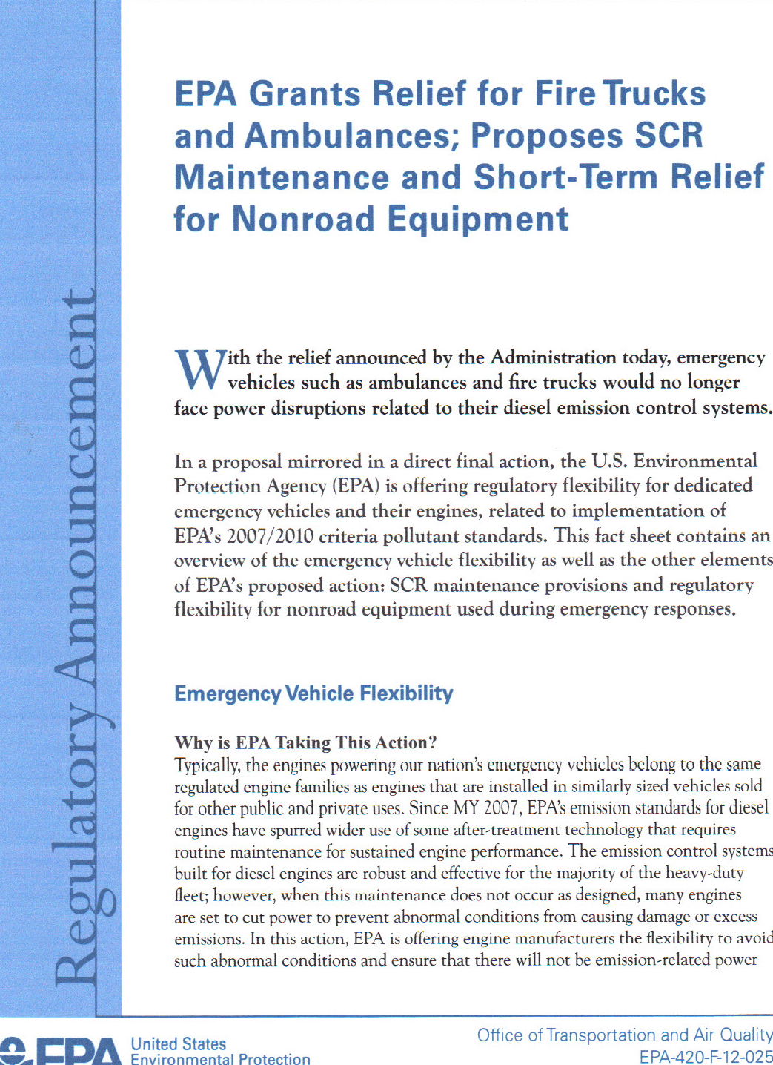
EPA Short Term Relief Announcement May 2012
Confidential

Slide 16
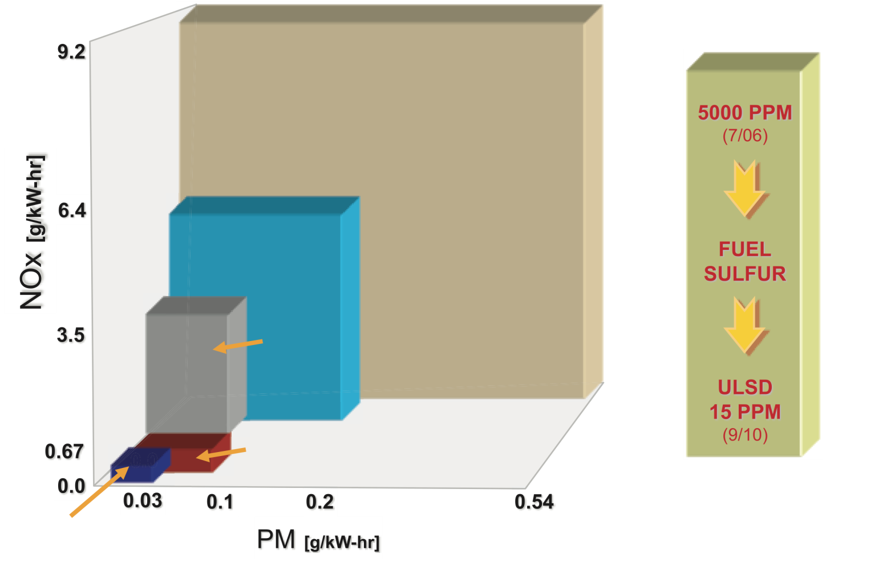
EPA regulations
Evolution of EPA Off-Highway Emission Standards: Approx. 550kWe standby and above (>751 HP) (excludes Stationary Emergency)
2000 Tier 1
2006 Tier 2
2011 Tier 4i (751 – 1207 HP)
2011 Tier 4i (>1207 HP)
2015 Tier 4f (>751 HP)
Notes:
How Emissions have evolved over the years.

Slide 17
EPA Generator Set Engine allowed Emissions
Exhaust Constituent T2 T4i (2011) T4F (2015)
All values in g/kw-hr average per EPA test regulations
Nitric Oxides (NOx NMHC) (6.4) 0.67 .067
Hydrocarbons (HC) 0.40 0.19
Carbon Monoxide (CO) 3.50 3.50 3.50
Particulate Matter (PM) .20 0.10 0.03

Slide 18
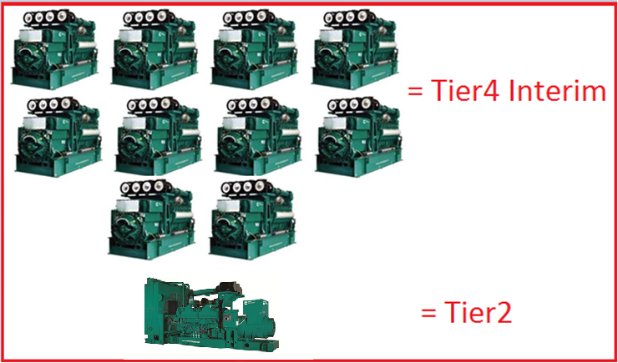
Achieving “Near-Zero” Emissions
Emissions from 1 x Tier 2 genset is equivalent to 10 x Tier 4 Interim gensets.
Notes:
Another way to show how GREENER Tier 4 engines are compared to Tier2.
Give an example of a situation where the local air regulatory board gives air permits to a certain installation to emit only so many Tons of NOX per year.
Lets say they have a Tier2 genset that can run only 100 hours and it meets NOX limits set by the ARB. On the other hand if they have a Tier 4 which releases one tenth of the emissions of a Tier2, can run for 1000hours before it meets the NOX limit

Slide 19
What is Tier 4i Certified
Certification is rigorous.
Cummins and CAT have it.
5 Mode EPA Test
Accelerated life test/DF Test Cycle
14 hrs per day 1034 hrs 5 mode test at 0, 250, 500, 750, 1034 hrs
Compliance is a statement
Read the fine print from aftermarket suppliers
Typically publish emission limits at rated power condition(not 5 modes of data).
Notes:
Difference between EPA Tier 4i certified vs Tier 4 Compliant products (Johnson Matthey, Miratech etc)
EPA Tier 4 certification is very rigorous, EPA Test procedures have to be used by engine manufacturers, genset has to be run at 5Modes (at different loads).
EPA DOES NOT APPROVE Tier 4 COMPLIANT products.

Slide 20
Federal EPA Emissions Measurement*
Weighting factors
Torque (%)
D2
100%
5%
75%
25%
50%
30%
25%
30%
10%
10%
Engine
Speed
Idle
Peak Torque
Rated
*Local requirement measurement method may be different.
Notes:
This chart signifies the testing requirements of the EPA on engine manufacturers. The EPA requires an average level over the operating range of the engine. Local requirements may demand emission data at a single or multiple load factor levels. Most reputable engine manufacturers provide information both ways.

Slide 21
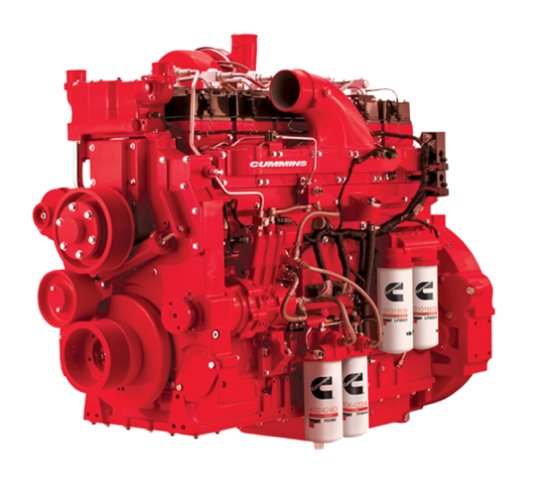
Emission Control Options
Exhaust and Emission Control Systems
Diesel oxidation catalyst (DOC)
Catalyzed soot filter
Active regenerating filter
CRT
Miller Cycle
EGR
Lean NOx
Lean NOx + HC
Plasma-assisted lean NOx
NOx adsorber
Selective catalytic reduction (SCR)
PM
NOx
RED: Most commonly used

Slide 22
Tier 4 Technology

Slide 23
How SCR Works
Exhaust
Tailpipe
Selective Catalytic Reduction
DEF is injected ahead of the catalyst. This converts to ammonia in the exhaust stream above 392ºF (200ºC).
The ammonia reacts with Oxides of Nitrogen (NOx) over the SCR catalyst to form harmless nitrogen & water.
Urea is injected at a ratio of typically 5% to diesel fuel use, depending on duty cycle. Urea tank sizes vary, but must be refilled to ensure emissions compliance.
DEF Injector
SCR Catalyst
Dosing Unit
(pump, metering, filter)
DEF Tank
DEF
Tank Heater
Notes:
SCR is a Flow through, NOX reduction device.
Process: SCR is a proven NOx-reduction technology that utilizes diesel exhaust fluid (DEF). The DEF solution, when injected in precise amounts into the exhaust flow at regulated temperatures, can reduce NOx by 90%.

Slide 24
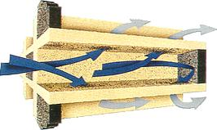
How the Diesel Particulate Filter (DPF) Works
Exhaust
Tailpipe
Diesel Oxidation Catalyst
Diesel Particulate Filter
DOC catalytic material reacts above 572ºF (300ºC) in passive regeneration mode to generate Nitrogen Dioxide (NO₂) which oxidizes the carbon soot
Ceramic wall flow filter captures up to 95% of the carbon soot (PM) carried by the NO₂. This collects on the filter to form Carbon Dioxide (CO₂ ) which leaves the tailpipe as clean gas
Active Regeneration
Build up of incombustible ash will eventually require filter service cleaning, though only required at very long intervals
When soot accumulation in the DPF exceeds soot oxidation a periodic active regeneration mode is performed to prevent filter plugging. This is actuated by small quantities of fuel from a dosing injector or HPCR injection pulse during exhaust blow down. The heat released (no flame or burning) at 1022ºF( 550ºC) ensures sufficient oxidation to remove soot
Filter Service
Notes:
PM Reduction device, reduces upto 90% of the PM
Not a flow through device like SCR, one end blocked off, so exhaust enters from one side and has to push through the Ceramic wall filter, where the Particulate Matter gets trapped and the exhaust flows through.
Over time the particulate matter has a potential to accumulate and clog the filter. When that happens the Filter will need to be regenerated by raising the temperature of the exhaust stream for oxidation of the PM (also called as soot). This process is called Regeneration.

Slide 25
What is Diesel Exhaust Fluid?
Diesel Exhaust Fluid is
Reactant used in the SCR system
32.5% urea in 67.5% deionized water
Non-toxic
Non-polluting
Non-flammable
DEF has purity requirements defined by American Petroleum Institute (API)
DEF freezes at 12° F (-11° C)
Thaws at consistent concentration
Equipment tanks and lines will be heated
When stored at extreme temperatures DEF remains non-toxic
0
1
0
Notes:
What is DEF: SCR technology uses DEF in its liquid state, along with a catalytic converter to significantly reduce nitrogen oxide (NOx) emissions in diesel exhaust. Pure Urea is solid at room temperature. DEF is prepared by dissolving solid Urea to create 32.5% solution in highly purified water.

Slide 26
DEF Available for All Markets Today
On-highway demand has inspired the manufacturing and distribution of DEF in North America
Supports the DEF needs with a broad CF product line
Bulk (>5000 gal.)
Plastic and disposable totes (330 and 275 gal.)
Drum (55 gal.)
Dispensing equipment
Over 40 brands of DEF and growing
From http://www.factsaboutscr.com/def/default.aspx
Notes:
DEF is used by On-Highway trucks, so there is good infrastructure available

Slide 27
Tier 4i Gensets www.Tier4Answers.com

Slide 28
Tier 4i (Base Architecture) Schematic
Air Filter
DEF Injection
Turbo
Mixing
SCR
Catalyst
NOx Sensing
Pressure sensing
Exhaust
Turbo After Cooler
Diesel Engine
Temp sensing
Generator
Control Panel
NOx Sensing
DEF Pump
DEF
Level sensing
Diesel Exhaust Fluid Tank
Notes:
28
Simulation of the exhaust Aftertreatment process – SCR Only configuration
We have pressure, temp, Nox sensors constantly measuring parameters to optimize the aftertreatment system.
NOT SHOWN IS CRANKCASE BREATHER RECIRCULATING SYSTEM. This breather system will add to width of genset engine approximately 12 inches.

Slide 29
Tier 4i (Tier 4 Final Ready) Schematic
Air Filter
DEF Injection
Turbo
Electric
Heater
Mixing
DPF
SCR
Catalyst
NOx Sensing
Pressure sensing
Exhaust
Heater Control
Turbo After Cooler
Diesel Engine
Generator
Temp sensing
Control Panel
NOx Sensing
DEF Pump
DEF
Level sensing
Diesel Exhaust Fluid Tank
Notes:
29
Simulation of the exhaust Aftertreatment process – SCR + DPF + Heater configuration
We have pressure, temp, Nox sensors constantly measuring parameters to optimize the aftertreatment system.

Slide 30
Product Architecture
Genset Model | AFT System | Genset Rating (kWe) | G-Drive Engine Rating | AFT System Certified T4i | AFT System Certified T4i+HTR | AFT System Certified T4i (T4F Ready)
DQFAE DQFAF DQFAG DQFAH | CA451 | 750 800 900 1000 | QST30-G17 | N/A | N/A | 1-leg 45" HTR/DPF/SCR
DQGAR DQGAS | CA452 | 1250 1500 | QSK50-G8 | 2-leg 45" SCR | 2-leg 45" SCR+HTR | 2-leg 45" HTR/DPF/SCR
DQKAK DQKAL | CA452 | 1750 2000 | QSK60-G16 | 2-leg 45" SCR | 2-leg 45" SCR+HTR | 2-leg 45" HTR/DPF/SCR
DQKAM | CA452 / CA542 | 2250 | QSK60-G17 | 2-leg 45" SCR | 2-leg 45" SCR+HTR | 2-leg 54" HTR/DPF/SCR
DQLG DQLH | CA542 | 2500 2750 | QSK78-G13 QSK78-G14 | N/A | N/A | 2-leg 54" HTR/DPF/SCR
Notes:
We have created new Genset Model numbers and Aftertertreatment Model for the Tier 4 Gensets.
Currently offering only One Configuration (T4F Ready) on the QST30 & QSK78, but there are plans to release remaining configurations soon.

Slide 31
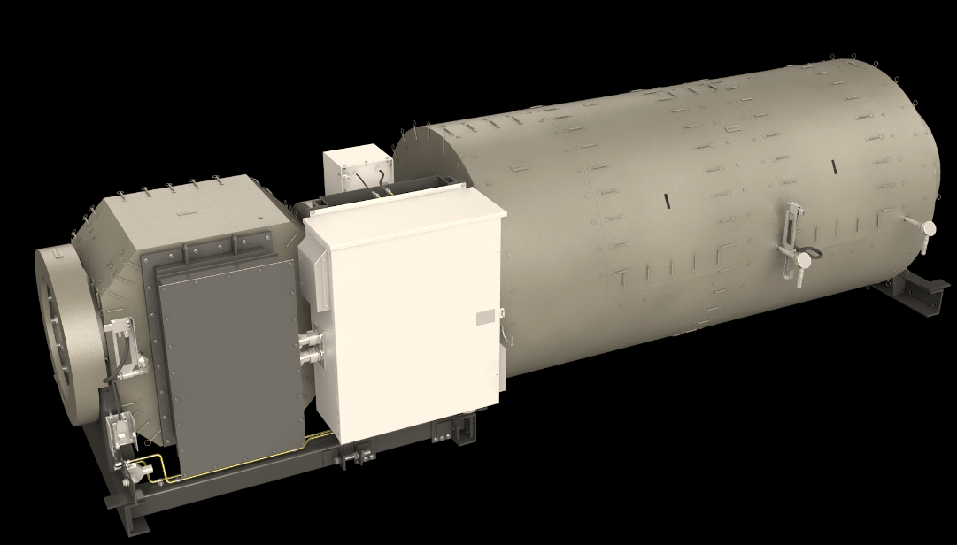
CPG T4F AFT: CA451
DEF Doser Assembly
DPF Section
SCR Section
Heater
Heater Control box
Notes:
Snapshot of the Single Duct system used on the QST30

Slide 32
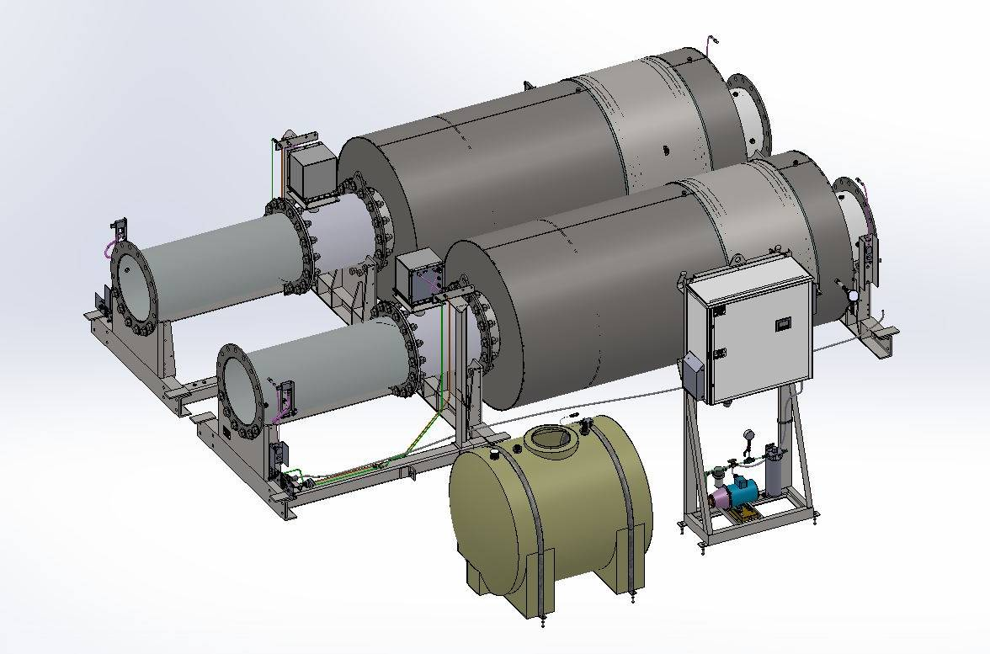
CPG T4i AFT: CA452 Base System
DEF Doser Assembly
SCR Section
AT Control Panel
DEF Tank
DEF Pump
Notes:
This is Tier 4i configuration
Dual duct system for 1250kW and above.

Slide 33
Sectional View of T4F ready CA451

Slide 34
Tier 4F Ready Configuration CA452

Slide 35
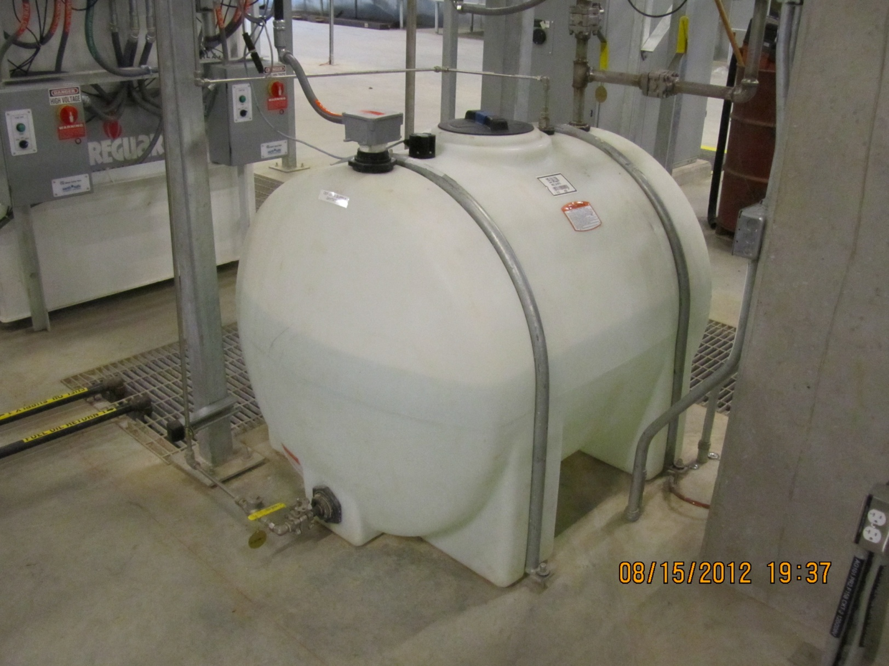
225 gallon DEF tank
Confidential

Slide 36
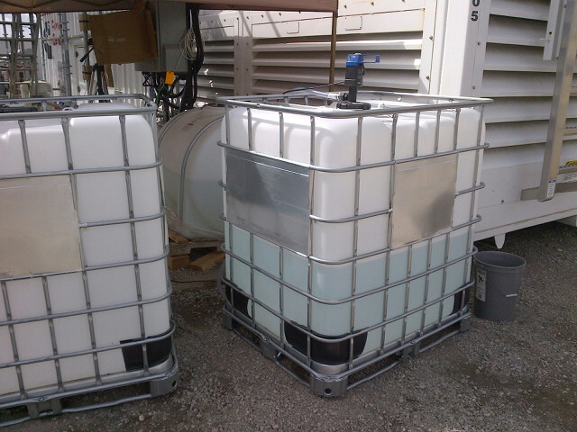
330 gallon DEF “tote”
Confidential

Slide 37
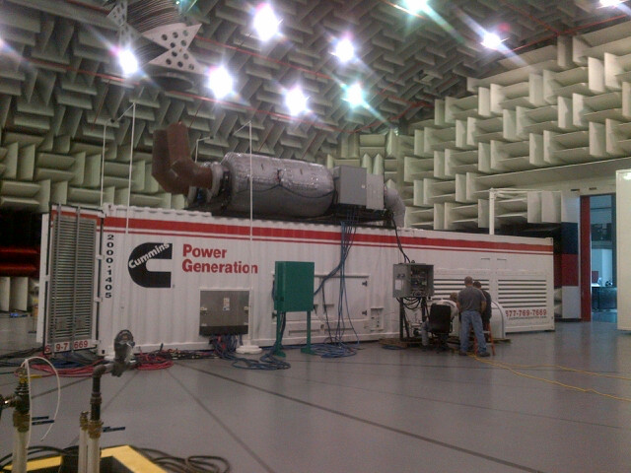
Noise considerations are greatly reduced.
Cummins Confidential

Slide 38
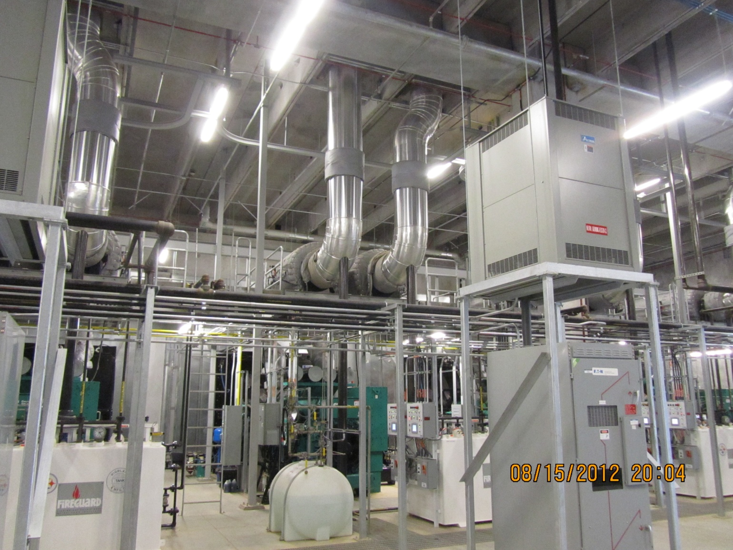
T4 installations require increased space for exhaust handling equipment.

Slide 39
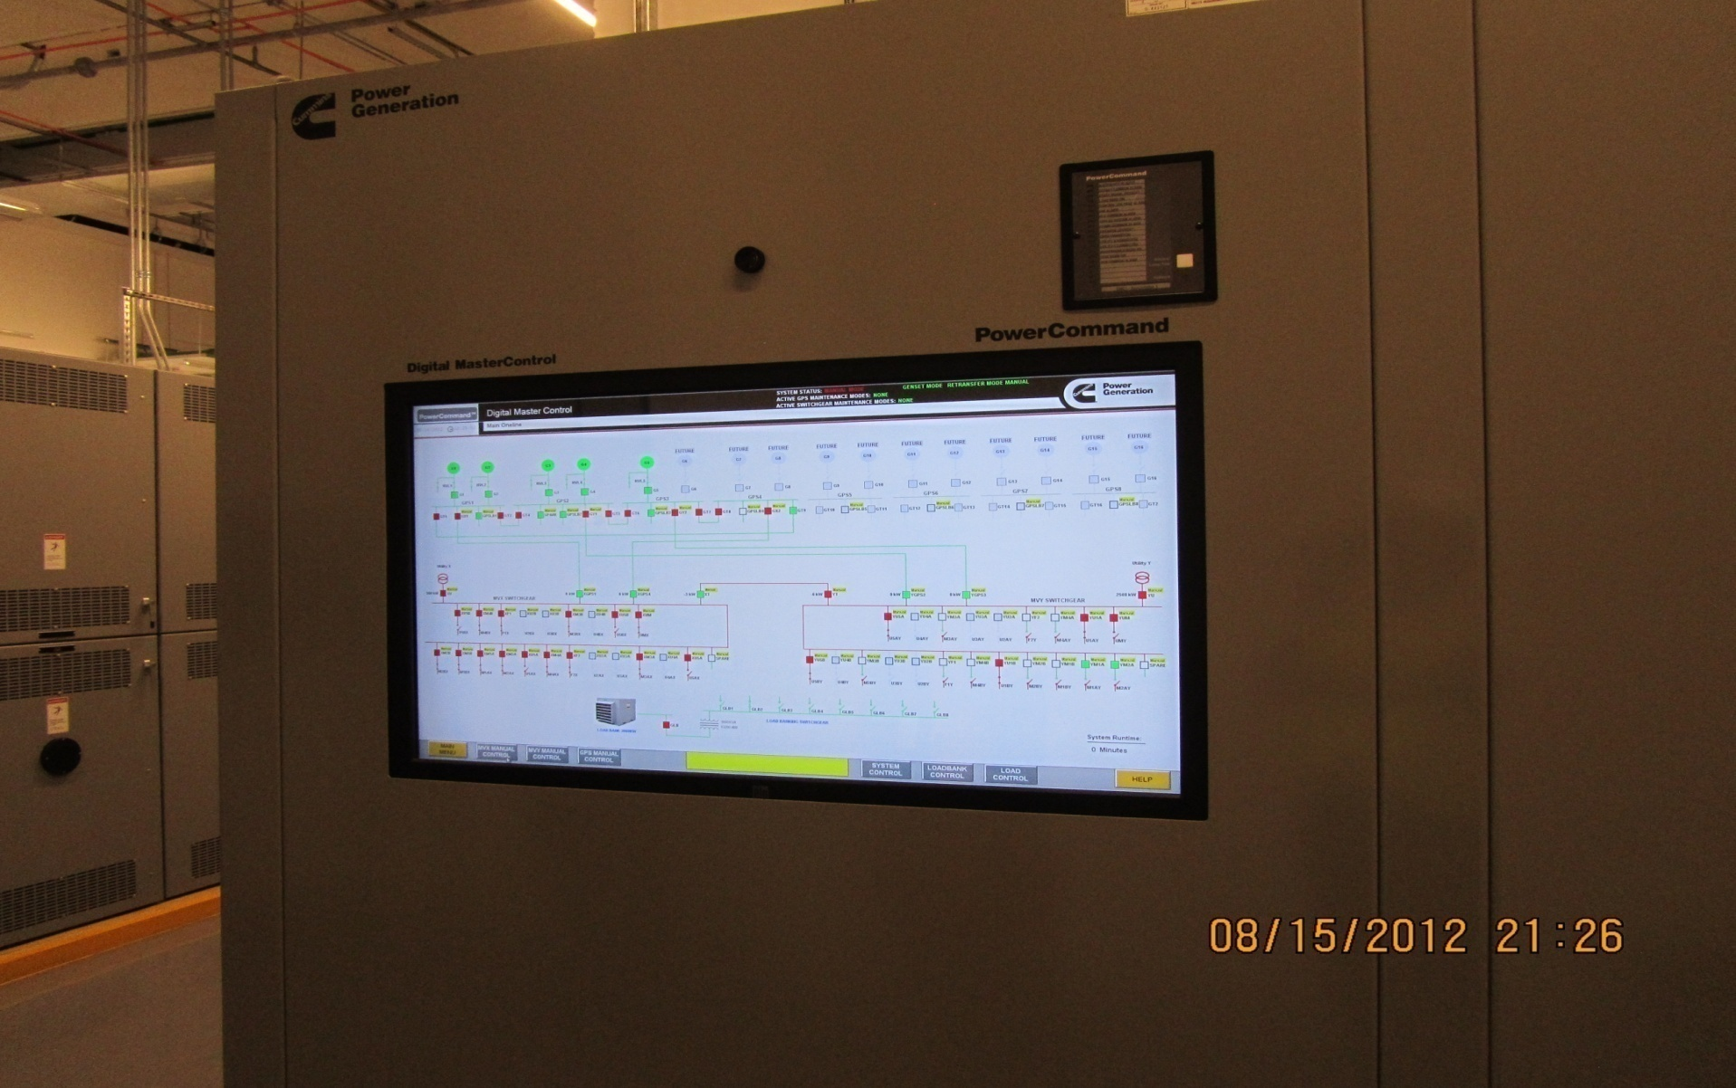
Communication of alarms is vital in T4 applications.

Slide 40
Key Features

Slide 41
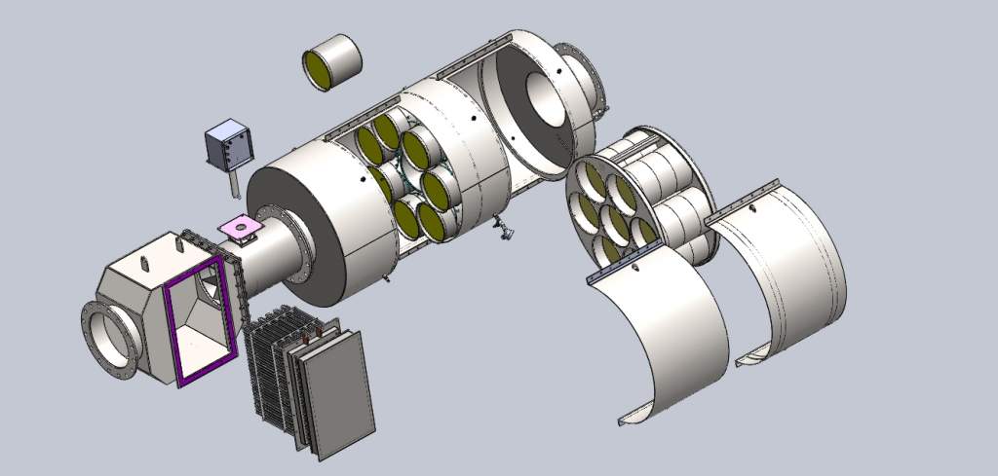
Ducting System
One solution for the range (minimize engineering/manufacturing complexity)
Duct orientation flexibility
Removable SCR cartridge
Maintainable DPF substrates
304 SS construction
Notes:
2 Ducts 45” and 54”
Very easy to service and maintain due to removable catalyst cartridges.
Easily Accessible
Stainless Steel Construction
Aftertreatment Fully insulated and Insulation offered as a Standard feature

Slide 42
Exhaust Heater
480v 3 phase
1 x 250kva for 750kW -1mW
2 x 250 kva for 1250kW-2mW,
2 x 330kva for 2250kW-2.75mW
Fully controlled by AFT
Controls, turns on when needed
Benefits of a heater
Increase exhaust gas temperature to enable regeneration of the DPF
Add heat on demand to optimize SCR system performance
Load Banking for exercising purposes
Reduce emissions faster with our unique solution!
Notes:
Fully Controlled by the Aftertreatment Controls. The after-treatment control always gives priority to the actual customer load. If it recognizes that the customer load has increased, it modulates the heater load bank to ensure that customer load is provided.
Benefits:
As mentioned on previous slide, when the there is enough PM/Soot accumulated in the DPF Filter, the exhaust stream temperature has to be raised to oxidise the soot and this is called Regeneration. If the genset is running at High load , the exhaust stream temperature increases automatically and oxidises the Soot. On the flip side, if gensets are running very lightly loaded, the temp of the exhaust stream is not high enough to Regenerate and that’s when these Exhaust heaters turn on.
On the Tier 4i configuration with Heaters, these heaters act as a means to keep the Temperature of he exhaust stream steady to optimize the SCR system and help to reduce the time it takes to meet the emissions limit.
The heater load bank can also be used to manually load the Genset for test and exercise purposes.

Slide 43
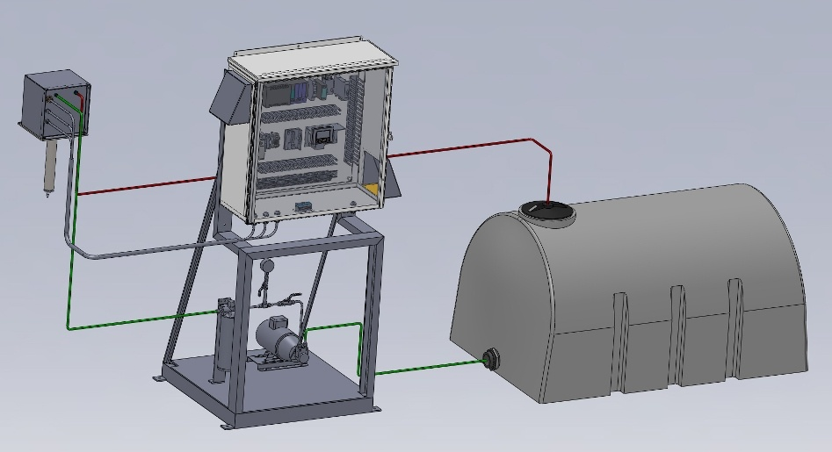
Dosing System
Airless Design
Single motor/pump (1 or 2 duct config)
Recirculation used for cold day freeze prevention.
Recirculation used in jacket cooler to keep injector from overheating. Continues to re-circulate DEF after shutdown to prevent heat soak back related failures.
Notes:
Airless Design: Our design does not need an air compressor to atomize the DEF into the exhaust stream like the Competition (CAT), so one less part in the system to maintain.
Mainly 2 modes of operation:
Recirculation Mode: 50 psi
Dosing Mode: 200 psi

Slide 44
CPG T4i/f AFT: Dosing System Flow Diagram
5 Micron
Filter
Solenoid
Shutoff
Position
Encoder
DEF Supply
50/200 PSI
26 gph
P
20%
Pressure
Transmitter
Injector
80%
Injector Cooler
Optional Inline Heater (Cold Weather Package)
DEF Return
5-10 PSI
22 gph
Operating modes:
Recirculation mode: 50 psi pressure set point
DEF is re-circulated to maintain temperature
Injector cooling
Freeze protection
Dosing mode: 200 psi pressure set point
Re-circulation flow continues to keep injector cool
Injector position determines flow rate of DEF to facilitate NOx reduction
Flow Orifice
Notes:
Recirculation mode: To help for injector cooling and even Freeze protection. In this mode the DEF just keeps recirculating in the system to main temp.
Dosing Mode: Mainly for injector cooling

Slide 45
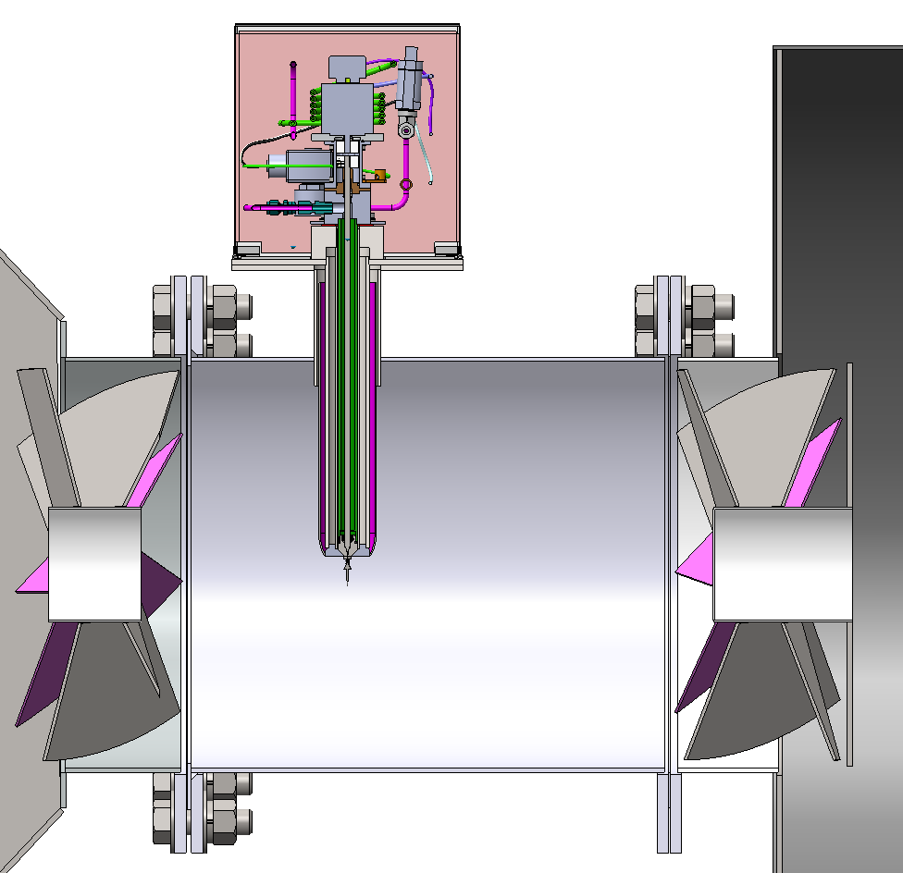
CPG T4i AFT: Mixing Section
Decomposition Reactor Tube (DRT)
Diesel Exhaust Fluid (DEF) Injector
Static Mixers
Notes:
Snapshot of the Decomp Tube

Slide 46
Control Loops
Temperature control
Start of injection- 450F
Regeneration temp setpoint 930F
Overtemperature shutdown
Back pressure (mainly applicable to T4f)
Overpressure warning and shutdown.
DEF pressure
50 psi non-injecting
200 psi injecting
Regeneration
Heater activation based on defined algorithm
NOx control
Open loop from engine out NOx sensor
Closed loop from SCR out NOx sensor
Notes:
Control loops put in place to make sure the system temp, pressure, NOX emissions etc are being monitored by the Aftertreatment Control and appropriate action is being taken by the system.

Slide 47
Annunciator Features
Dedicated annunciators
Standard system output:
System outlet temperature
DEF tank level
Integrated load bank load
System backpressure
Various alarms annunciation
Alarms displayed in order triggered (up to 32, alarms)
Time/date stamp for each alarm displayed

Slide 48
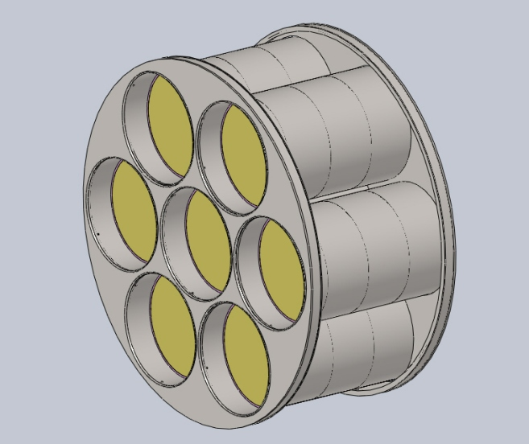
CPG T4i AFT: SCR Catalyst
Selective Catalytic Reduction (SCR) catalyst details
Vanadia based catalyst
13" diameter x 6" length
300 cpsi cell density
Used on ISM11 / ISZ13 automotive applications
3 catalyst elements per sleeve in the cartridge
No routine maintenance expected for SCR catalyst

Slide 49
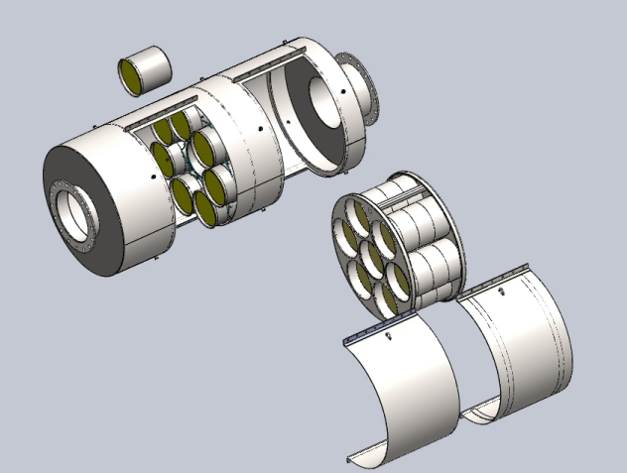
Diesel Particulate Filter Details
Used on ISX
automotive application
DPF canisters
individually serviceable
Utilizes existing
cleaning machines.
Large DPF surface area minimizes exhaust restrictions!

Slide 50
Options available
Freeze protection kit.
2kW heater, needs 120V AC
Inline heater
Designed to protect DEF down to -30DegF
DEF Supply and return lines
40ft supply and return
Stainless steel

Slide 51
Scope of Supply Tier 4I Certified Configuration
CPG
Customer
Genset
Aftertreatment
Saddle supports for AFT
Control panel (CP)
Heater (QST30 & QSK78)
Harness from CP to engine & AFT
AFT lifting tool
DEF Tank (225G)
Breather support Stand
Support structure for AFT
DEF piping from tank to AFT and return
Shore power for DEF pump (when genset stopped) and freeze protection kit
Ex. tubing from engine to AFT and AFT to atmosphere
Insulation on tubing from engine to AFT
Notes:
No Support structure provided by factory today

Slide 52
CPG T4i: Other Considerations
120VAC power is required when genset is stopped
AC power to drive DEF pump for recirculation
DEF freeze protection kit
Customer must supply support structure to attach AFT.
Customer must supply ducting in and out of AFT. Engine to AFT ducting should be insulated.
Customer must supply DEF tubing from SCR control panel to AFT and return to tank.
Notes:
120v Shore power required for Control Panel and DEF Freeze protection kit (if applicable)

Slide 53
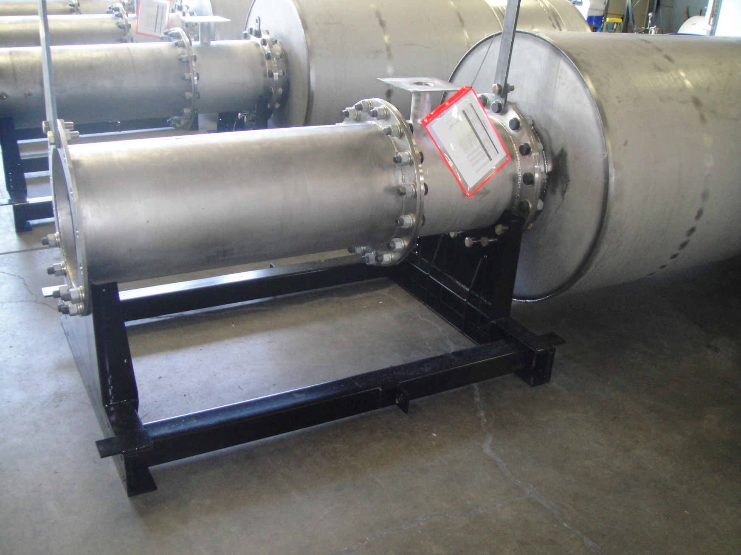
Aftertreatment Saddle
Support Tabs
(3rd support not shown)

Slide 54
Service / Maintenance

Slide 55
CPG T4i: Service Considerations
Scheduled maintenance items
DEF filters (35 micron, 5 micron, interval 500 hrs)
Interval will be aligned with existing genset schedule
DPF ash cleanout (interval >4000 hours)
Breather filter elements (target 1000 hrs)
Consumable items
Diesel Exhaust Fluid (DEF) per guidelines
ULSD fuel required (<15PPM)

Slide 56
Notes:
Snapshot of the service tool

Slide 57
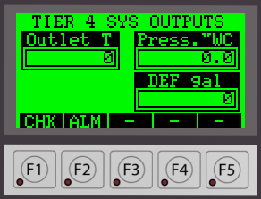
Annunciator Operation
Non-touch screen
Function keys (F1-F5) used to navigate per their designated function
Vary by screen, but clearly indicated above each key
Display
Function key descriptions
Function keys

Slide 58
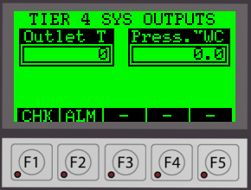
System Output Screen
Master Duct (A):
Slave Duct (B):
ALM – F2:
Navigates to alarm ccreen.
Banner will flash to press F2 when alarm triggered
CHK – F1:
Navigates to dosing system Daily check screen.
Notes:
For a 2 duct system

Slide 59
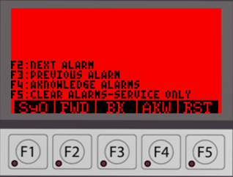
Alarm Screen
ALARM IS DISPLAYED HERE W/ TIME STAMP (SEE NEXT SLIDE)
RST – F5:
Navigates to alarm reset screen
AkW – F4:
Acknowledges alarm displayed
SyO – F1:
Navigates to system outputs screen
BK – F3:
Scrolls backward to the previous alarm in the sequence
FWD – F2:
Scrolls forward to the next alarm in the sequence

Slide 60
Questions
www.Tier 4answers.com

