Slide 1
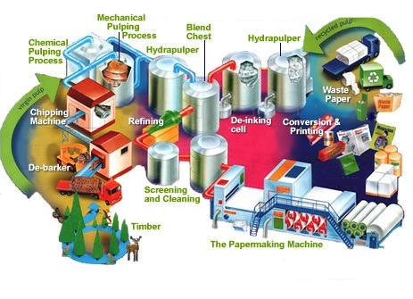
Electrical Power & Control in Pulp and Paper Mills

Slide 2
Electrical Power & Control in Pulp and Paper Mills

Slide 3
Electrical Power & Control in Pulp and Paper Mills
Distribution & utilization voltage levels
HV – 115kV, 230kV
MV – 15kV, 5kV, 2.4kV
LV – 480V, 600V, 277V
Misc. loads – 120V, 240V
Control – various voltages
(120VAC, 125VDC, 48VDC, 24VDC, 12VDC)

Slide 4
Electrical Power & Control in Pulp and Paper Mills
Utility supply
Single or multiple incoming line sources.
Generation
Co-generation typical for large steam use.
Process steam from generator turbine extraction.
Synchronous machines help with PF correction.
(utility penalty for low PF)

Slide 5
Plant W
13.8kV, 2,400V, and 480V distribution
160 distribution transformers –
20 MV (2,400V) and 140 LV (480V)
1 generator – 42MW @ 13.8kV
Three 15kV reactors (2MVA, 6MVA, &9MVA)
160MW total connected motor load
95MW motor load @ 2,300V
65MW motor load @ 460V
2 utility ties – 50MVA@230kV and 125MVA@230kV
2,700+ buses
250+ protective relays

Slide 6
Plant W – full system

Slide 7
Plant P
13.8kV, 4,160V, and 480V distribution
110 distribution transformers –
20 MV (4,160V) and 90 LV (480V)
4 generators – sizes 10MW up to 48MW
Two 15kV reactors (4MVA & 7MVA)
140MW connected motor load
95MW motor load @4000V
45MW motor load @460V
2 utility ties – 40MVA@115kV and 27MVA@230kV
1,100+ buses
500+ protective relays

Slide 8
Plant P – full system

Slide 9
Plant P – medium voltage simplified

Slide 10
15kV Switchgear

Slide 11
15kV Switchgear

Slide 12
15kV Switchgear

Slide 13
15kV Switchgear Ratings (constant MVA)

Slide 14
15kV Switchgear Ratings (constant kA)
Rated Maximum Voltage | (Ref.) Rated Voltage Range Factor K | (Ref.) Rated Short- Circuit Current I | Insulation Level |  | Rated Main Bus Continuous Current ®@ | Rated Short-Time Short-Circuit Current Withstand (2-Second) | Rated Momentary Short-Circuit Current Withstand (10-Cycle) (167 ms)
 |  |  | Power Frequency Withstand Voltage, 60 Hz, 1 Minute | Lightning Impulse Withstand Voltage [LIWV] (BIL)
 |  |  |  |  |  | K*I @ | 2.7 *K*I @ | 1.6 *K* I (j) (Ref. only)
kV rms |  | kA rms | kV rms | kV Peak | Amperes | kA rms Sym. | kA Crest | kA rms Asym.
4.76 | 1 | 25 | 19 | 60 | 1200, 2000, 3000, 4000 | 25 | 68 | 40
 | 1.24 | 29 |  |  | 1200, 2000, 3000, 4000 | 36 | 97 | 58
 | 1 | 40 |  |  | 1200, 2000, 3000, 4000 | 40 | 108 | 64
 | 1.19 | 41 |  |  | 1200, 2000, 3000, 4000 | 49 | 132 | 78
 | 1 | 50 |  |  | 1200, 2000, 3000, 4000 | 50 | 135 | 80
 | 1 | 63 |  |  | 1200, 2000, 3000, 4000 | 63 | 170 | 101
8.25 | 1.25 | 33 | 36 | 95 | 1200, 2000, 3000, 4000 | 41 | 111 | 66
 | 1 | 50 |  |  | 1200, 2000, 3000, 4000 | 50 | 135 | 80
15 | 1.3 | 18 | 36 | 95 | 1200, 2000, 3000, 4000 | 23 | 62 | 37
 | 1 | 25 |  |  | 1200, 2000, 3000, 4000 | 25 | 68 | 40
 | 1.3 | 28 |  |  | 1200, 2000, 3000, 4000 | 36 | 97 | 58
 | 1 | 40 |  |  | 1200, 2000, 3000, 4000 | 40 | 108 | 64
 | 1.3 | 37 |  |  | 1200, 2000, 3000, 4000 | 48 | 130 | 77
 | 1 | 50 |  |  | 1200, 2000, 3000, 4000 | 50 | 135 | 80
 | 1 | 63 |  |  | 1200, 2000, 3000, 4000 | 63 | 170 | 101

Slide 15
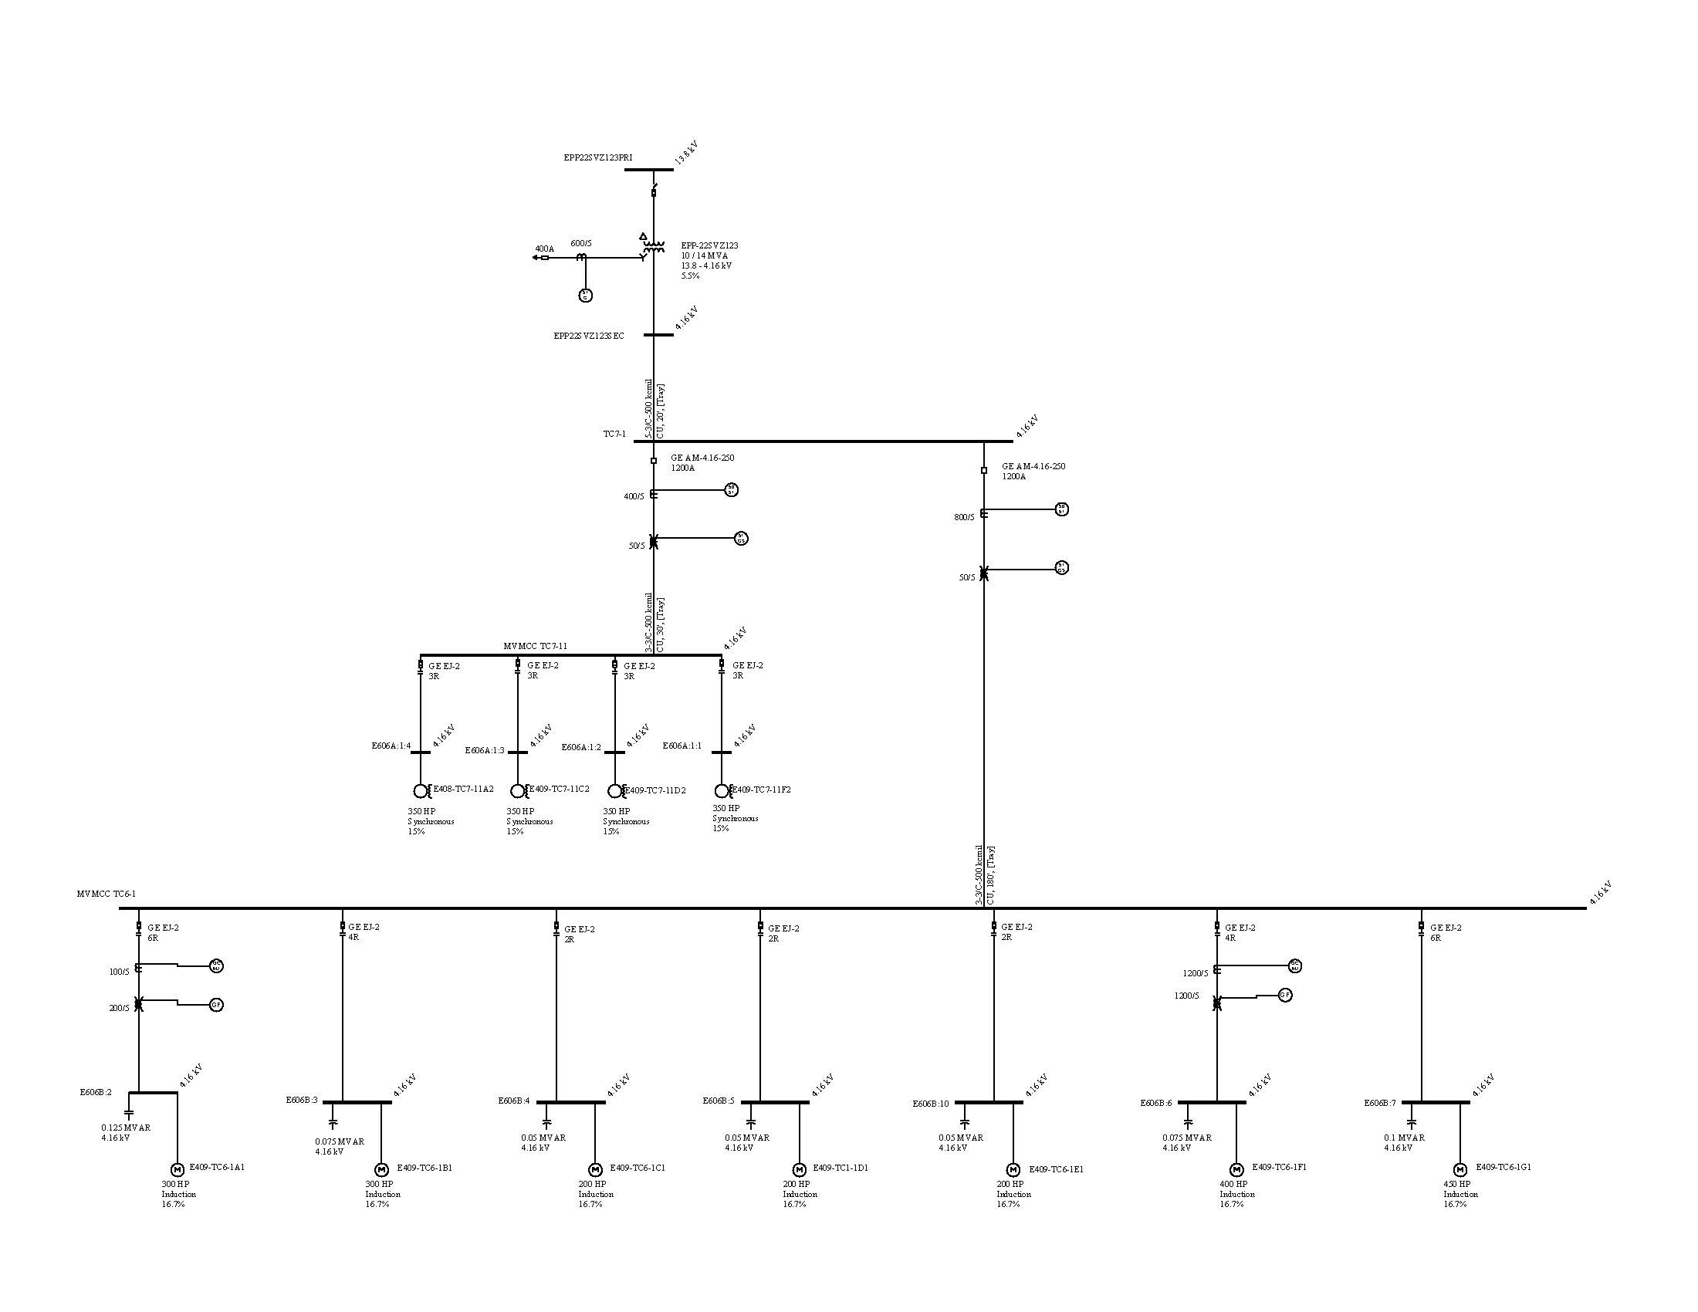
Typical MV substation

Slide 16
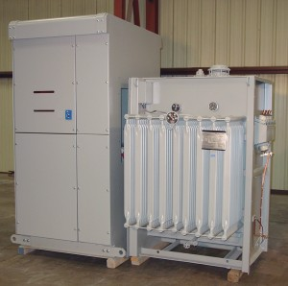
Typical Transformer & Primary Switch

Slide 17
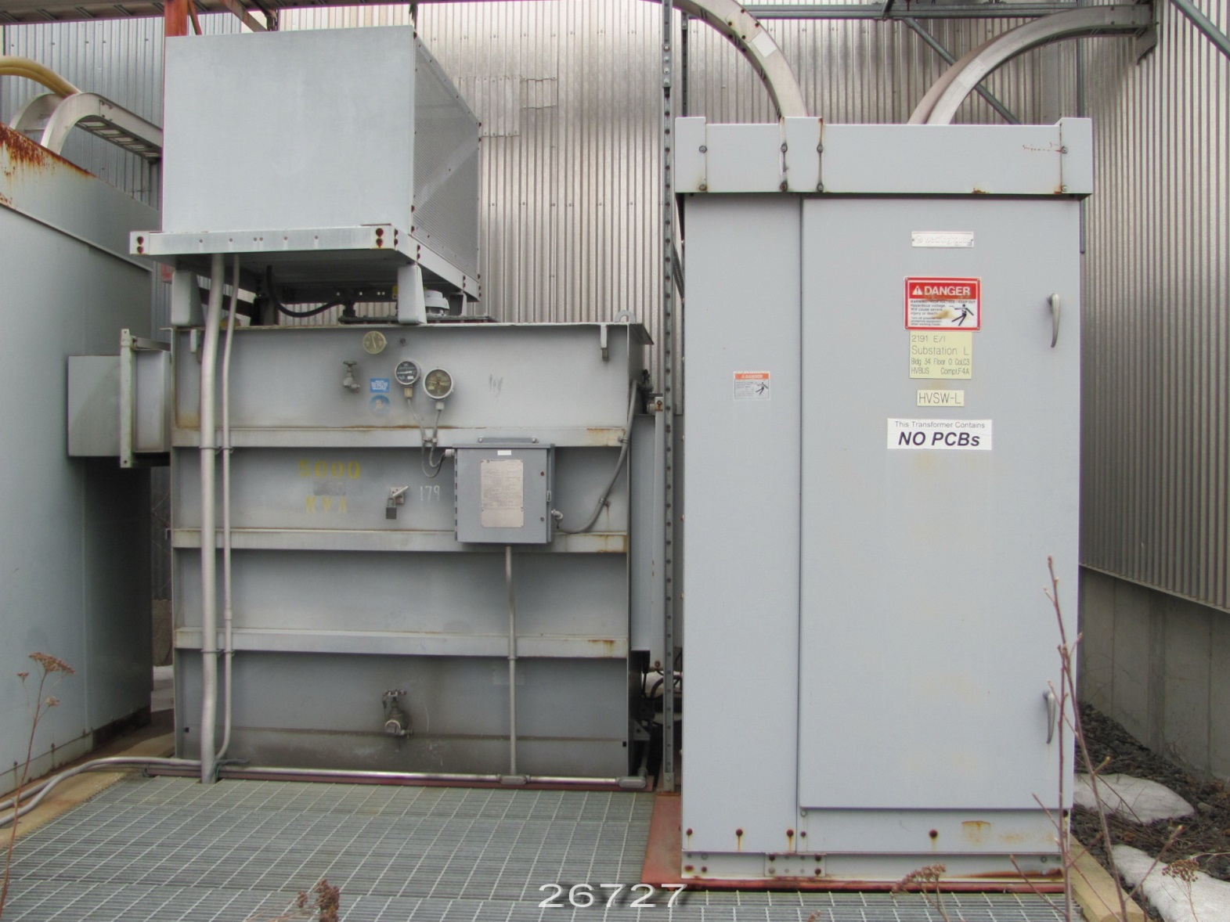
Typical Transformer & Primary Switch

Slide 18
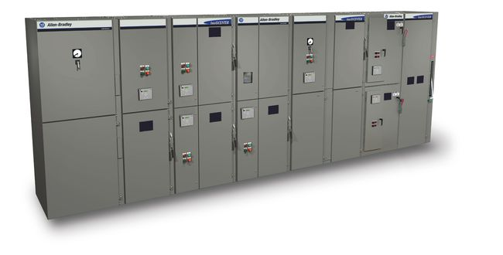
MV motor controllers

Slide 19
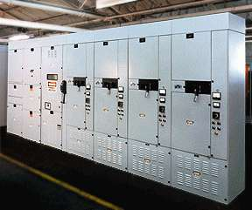
MV motor controllers

Slide 20
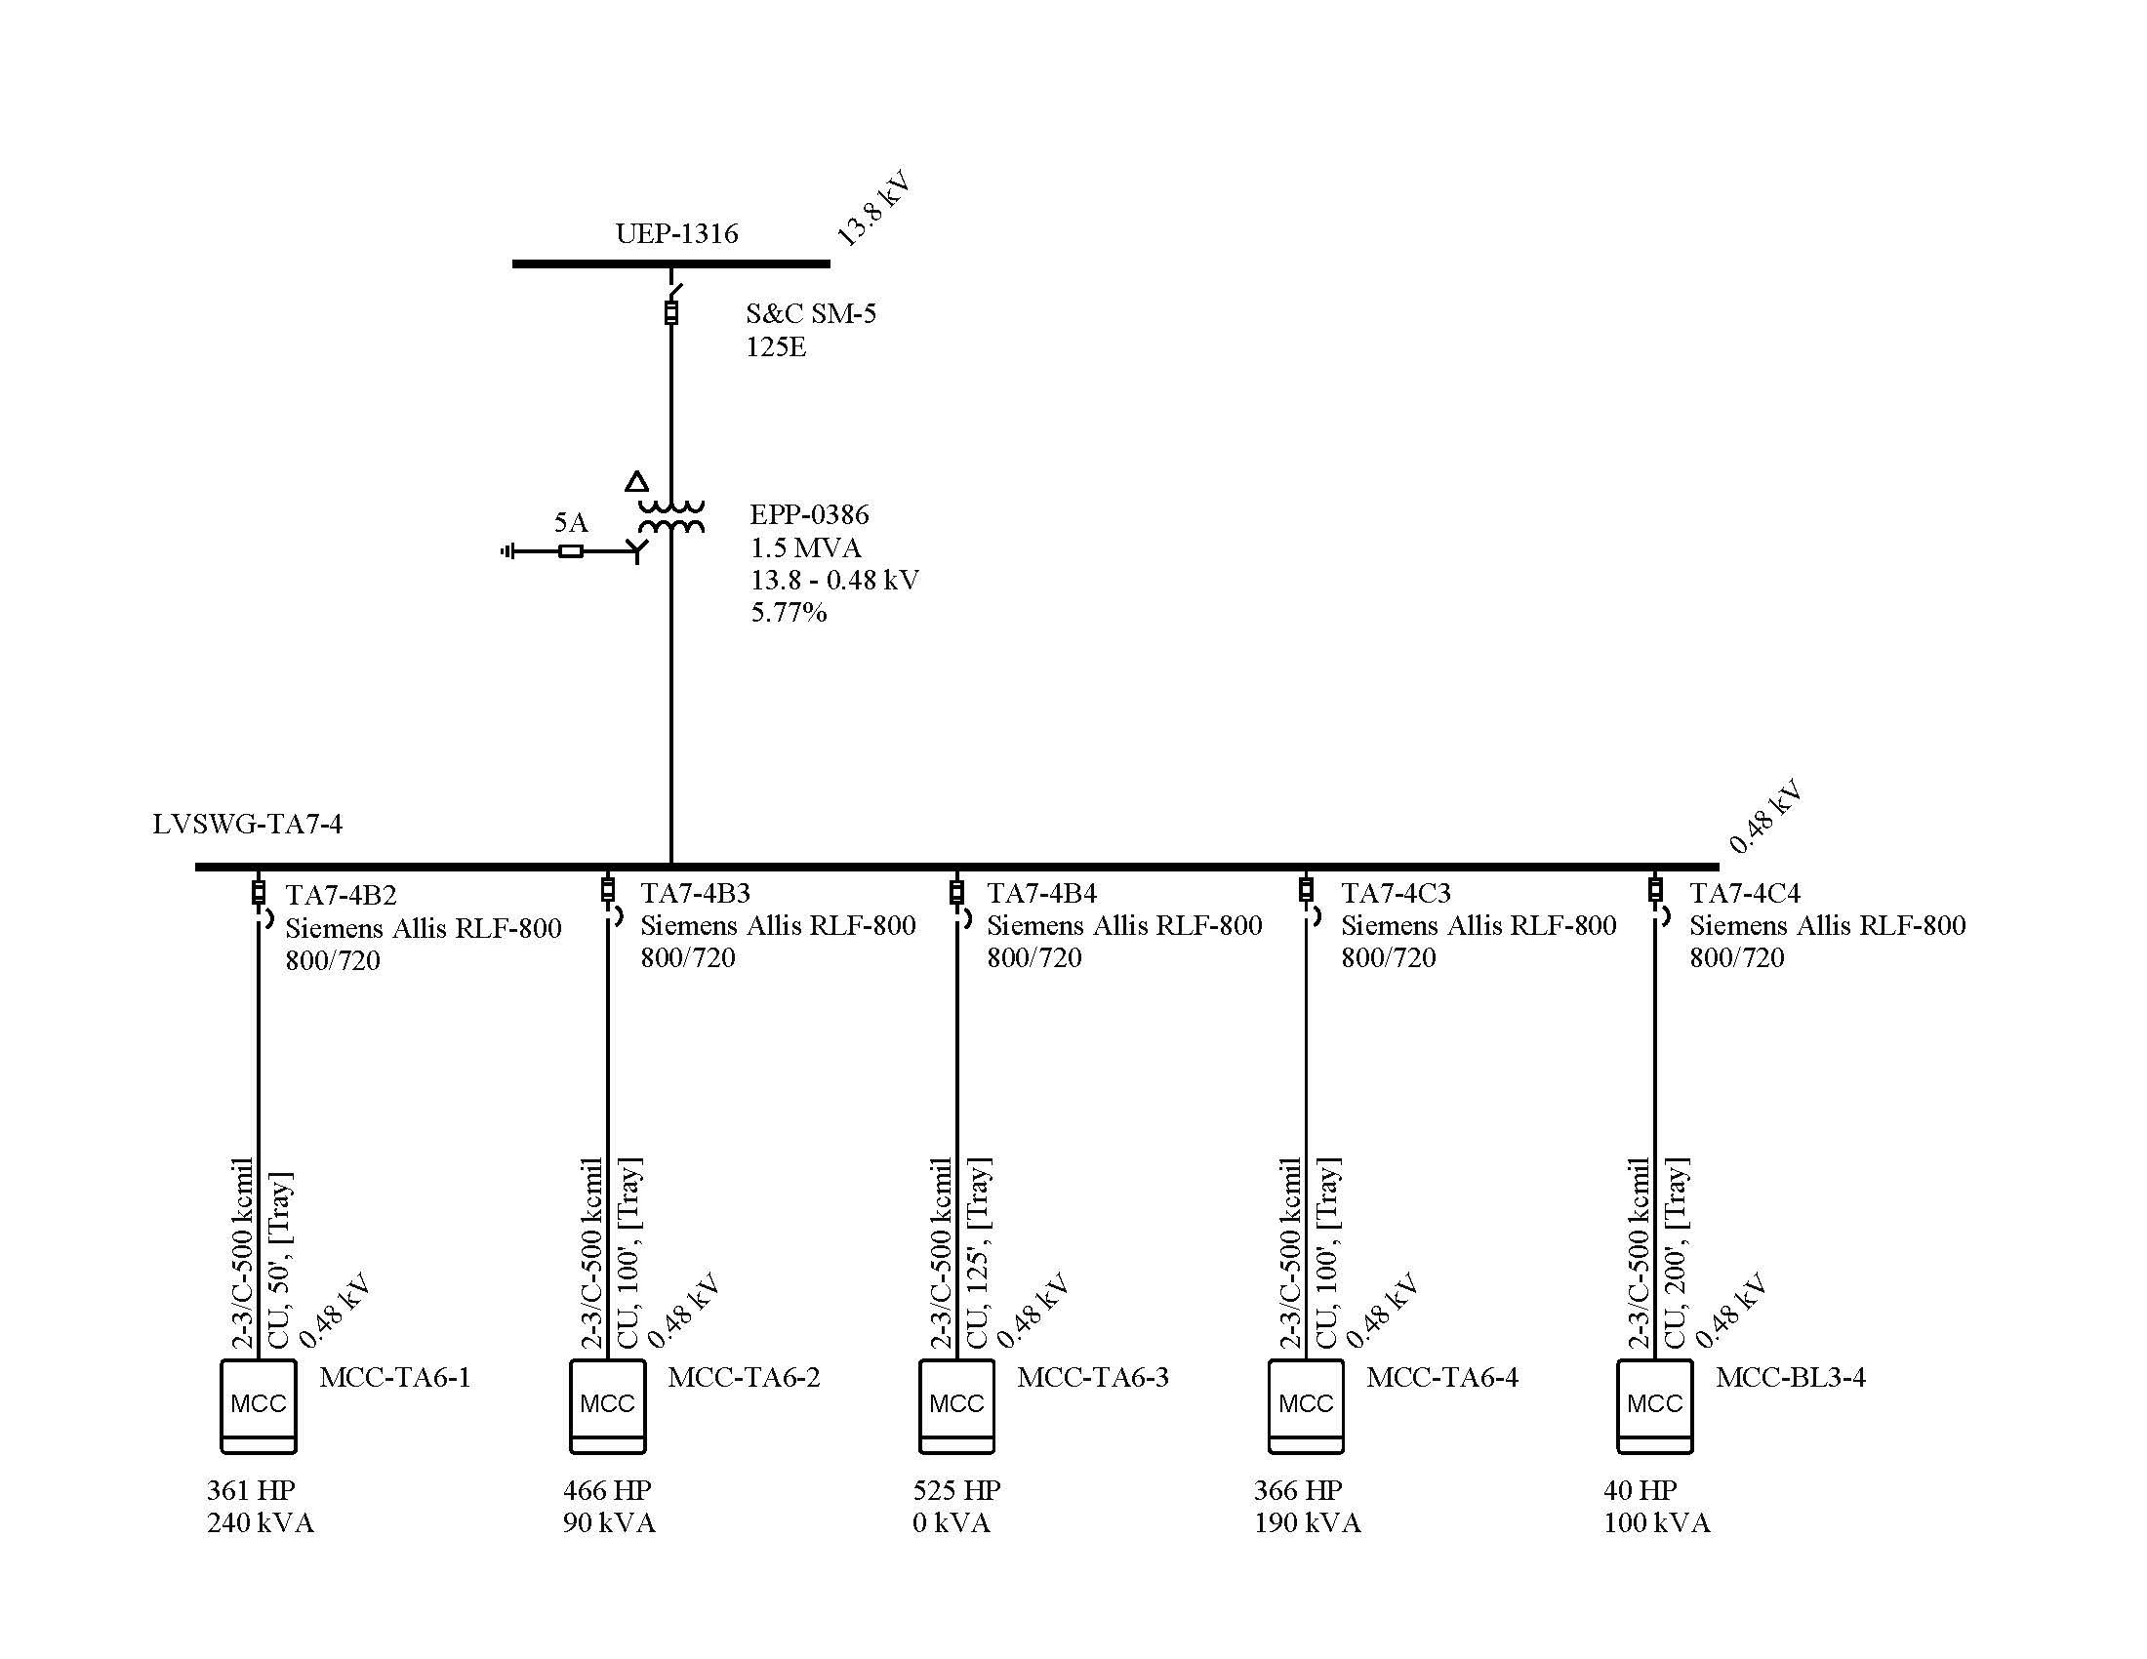
Typical LV substation

Slide 21
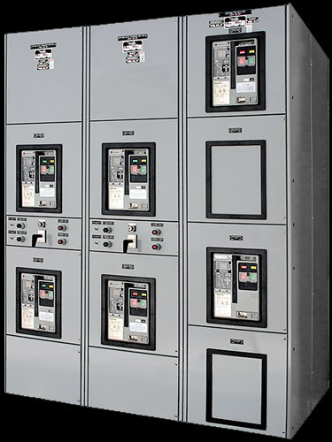
LV switchgear

Slide 22
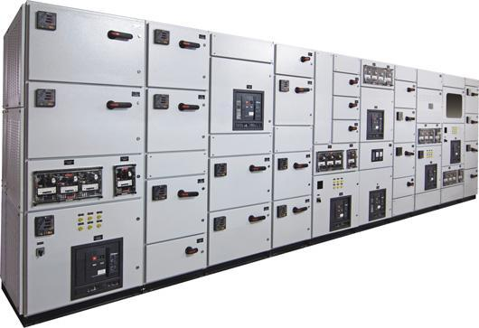
LV switchgear

Slide 23
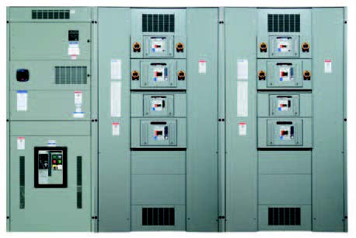
LV switchboard

Slide 24
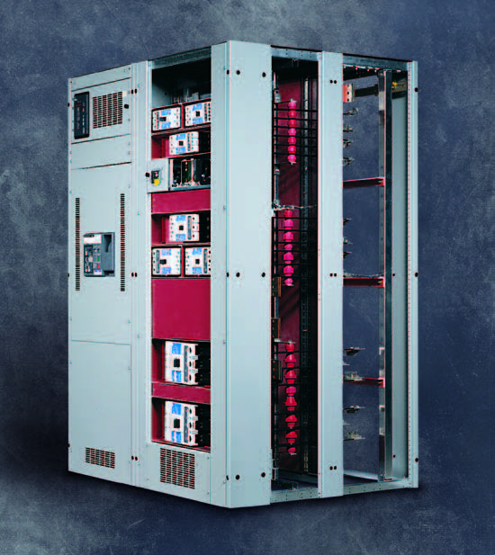
LV switchboard

Slide 25
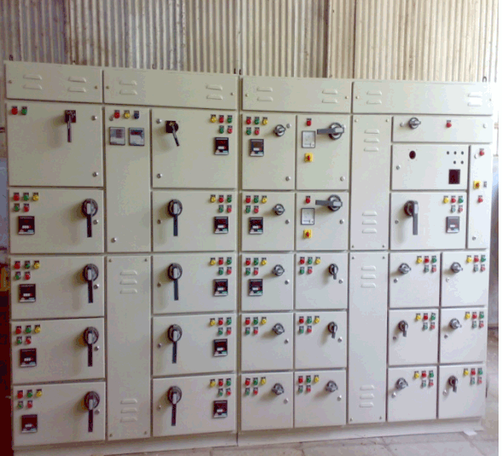
LV Motor Control Center

Slide 26
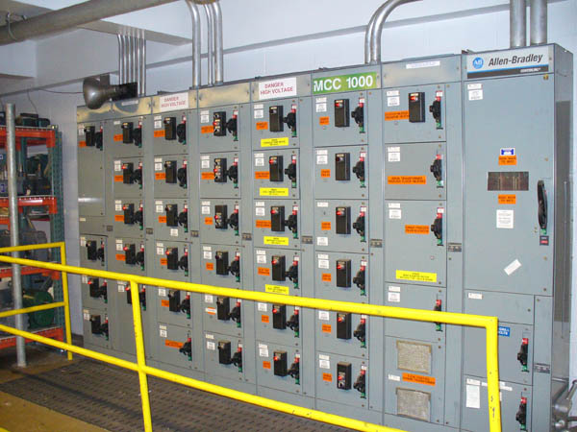
LV Motor Control Center

Slide 27
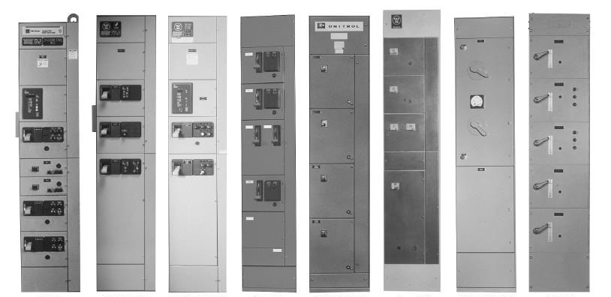
LV Motor Control Center

Slide 28
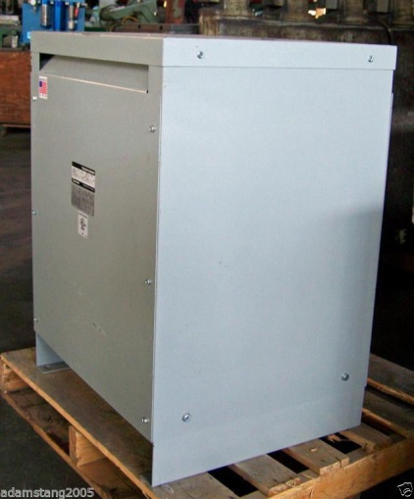
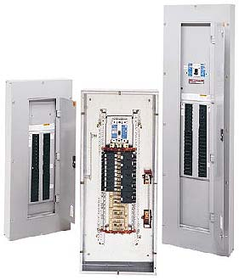
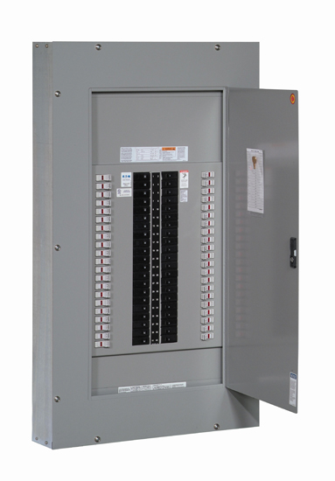
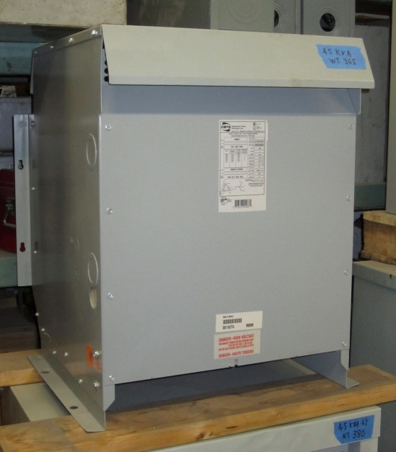
Downstream load distribution

Slide 29
Control Systems
Process Control Terminology
Basic Instrument Selection Considerations
Variables:
Pressure, Level, Temperature, Flow, Position, Velocity
DCS/PLC Systems, now called PCS,
(Process Control Systems)
Control Loop Variability & Tuning
Alarm Management
Advanced Process Controls
Interlocking

Slide 30
What is Process Control?
Measurement & instrumentation (transmitters, sensors, analyzers)
Controllers and control systems (DCS, PLC, local controllers)
Final control elements (control valves, dampers, VF drives)
Process control may be implemented by use of “hard wiring”, PLC systems, DCS systems, APC systems, wired and wireless networks, and by combinations of other measurement and control devices.

Slide 31
DCS Systems
Advantages of today’s DCS systems (recent vintage) :
Lower initial equipment cost.
Standard hardware & software – MS Windows & IBM compatible.
More powerful controllers (faster, more memory, better diagnostics, more execution space available).
Communicate using standard interfaces :
Ethernet, DeviceNet, ControlNet, Profibus.
Update of hardware costs much less than older proprietary systems - can be updated almost indefinitely (virtual servers, thin clients, etc.).
Provides easy data access for advanced applications.

Slide 32
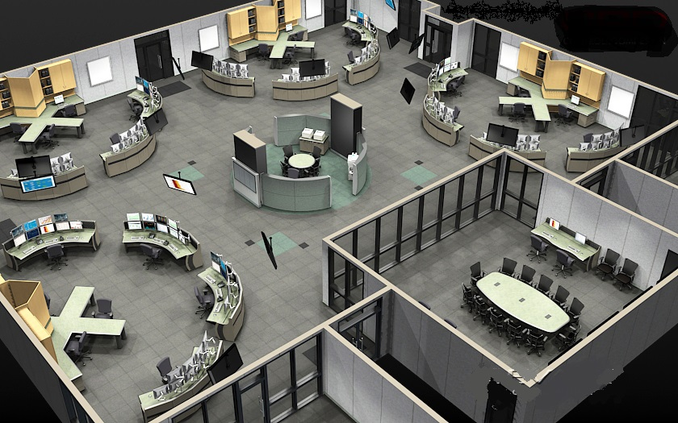
DCS – Control Rooms-To-Go?

Slide 33
DCS Systems
Disadvantages of today’s DCS
Open systems design requires frequent OS updating.
Susceptible to virus infiltration and malicious attacks.
Correct versions of software required for compatibility.
Flexibility of systems makes everyone want something different.
Contract update service may be needed to deal with issue of frequent software updates.
Need to consider cyber security. Only limited access to the process servers should be allowed, but business divisions think they must control the plant network.

Slide 34
DCS Systems
Strengths of DCS Systems
Handles both analog and discrete I/O well
Handles I/O interfaced via communication links well
Operator interfaces are well developed.
Integrated alarming and interlock functions can be customized as needed.
Great selection of control algorithms.
Control loop tuning applications available.
Control loop monitoring applications available.
Supports advanced control applications.
Direct HART compatibility with smart field devices.
Direct bus compatibility with MCCs and adjustable speed drives.

Slide 35
DCS or PLC? (differences are minimal, new term PCS)
Use PLC for small specialized discrete control tasks.
Almost exclusively discrete I/O and logic.
Minimal data reporting required.
Suitable for dedicated safety systems (BMS, other SIS).
Insist on using PLCs that are “plant standard”.
Still consider DCS if existing DCS in continuous process area.
PLC better for servo motor controls, vector control, positioning, etc.
Specialized PLC for SIS (Safety Instrumented Systems).
Safety rated requirement per ANSI/ISA S.84, IEC, etc.
Dual (or triple) redundancy, depending on criticality.

Slide 36
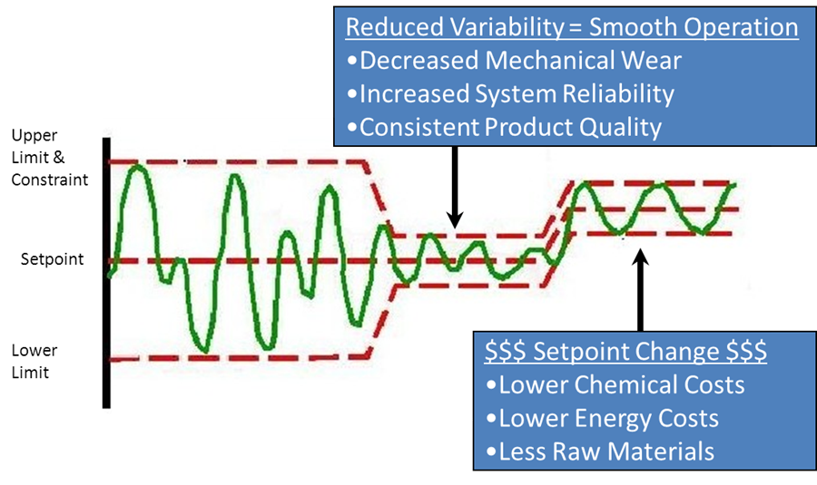
Advanced Process Controls
Reliability Process Controls System Vision: Optimize process control systems to capture maximum value.

Slide 37
Advanced Process Controls
Why APC?
Automates control of overall area processes.
Provides continuous control over existing manual changes.
Can provide consistent control “at least” as good as the best operator. (on all loops at the same time)
Optimize savings in energy, chemicals and raw materials.
Improve product quality and reduce variability.
Limit operations to safe and environmentally acceptable regions.
Very short payback.

Slide 38
Advanced Process Controls
Why not APC?
Cannot sustain savings long term if not applied correctly
Base process loops need to be tuned and operating correctly. (Only partial APC benefit can be realized with poorly maintained and tuned instrumentation.)
Correct program for application must be selected
Proper engineering procedures must be applied
Support program must be in place to sustain savings
Online monitoring by APC supplier must be included
Usage must be monitored by management and reported
Otherwise, investment is lost when program is abandoned

Slide 39
HART vs. Foundation Fieldbus protocols?
HART preserves the 4-20mA current loop, and adds digital information on top of this existing signal component.
Foundation Fieldbus extends control system architecture to the field device, via multi-drop bus configuration.
HART integrates easier than Fieldbus with existing, older systems.
Potential for precision tuning and accuracy of a control loop is greater for Fieldbus.
Electrically, robust signal is better with Fieldbus.
Discussion and comparison of these two protocols is likely to persist for a long time.

Slide 40
Motor Control via DCS or PLC
Device-Net or Profi-Bus networks today.
Ability to add (or troubleshoot) individual motor starters.
Single network to MCC lineup eliminates discrete I/O control wiring.
Diagnostic data is provided from smart starters to DCS.
Enables quick checkout, commissioning, and startup.
AF Drives and Motor Overload Modules included in network.
Other networks available.
Ethernet networks will become more prevalent very soon.
Wireless is gaining popularity for remote applications and mobile vehicles (manned, or unmanned).
Fiber optic links also available for drives and remote I/O.

Slide 41
Alarm Management
ANSI/ISA Standard 18.2-2009 - identifies alarm management lifecycle philosophy including:
Identification
Rationalization
Detailed Design
Implementation
Operation
Maintenance
Management Of Change (MOC)
Monitoring and Assessment
Audit

Slide 42
Interlocking
Interlocking is different from alarming.
Primarily used to prevent EH&S incidents - “Safety interlocks” and to prevent equipment damage
“Safety Interlocks” should always be “hardwired” or securely transferred
By-passing safety interlocks SHALL BE documented by SOPs and approved by management
Interlocks are also used to prevent operational events that could cause spills, flooding, plugging, trips and other inconveniences.
Interlocks can also be used to automate Operator functions to allow him/her to concentrate on more important tasks
Typical uses for conventional interlocks
Starting consistency transmitters, vacuum pumps, oil pumps, etc.. when the main drive starts
Shutting down vacuum pumps (or refiners), on loss of fluid to the mechanical seals
Shutting the equipment down preceding the failed piece in the sequential operation
Automatically initiate FLUSH upon shut-down (intentional, or unintentional)
Group, or one button starts, like vacuum system, feed system, showers, press, batch digester, screen system, etc….

Slide 43
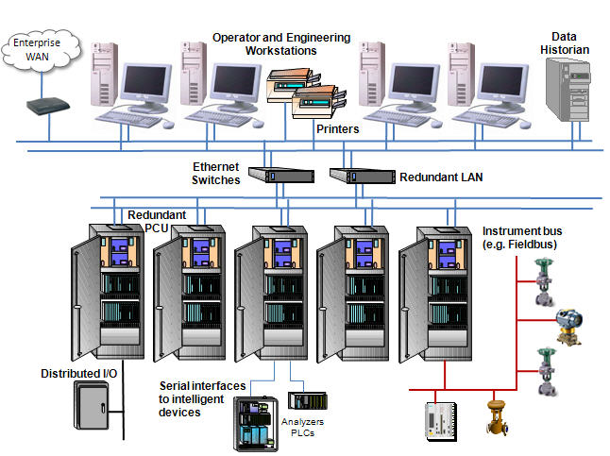
PCS Systems today

Slide 44
HMI Operator Station

Slide 45
Process variable periods/durations
Frequency | Period | Wavelength | Variables
10kHz | 0.1 ms | 0.06” | Fiber properties
1kHz | 1ms | 0.6” | Formation
100 Hz | 0.01 s | 6” | Vibration
10 Hz | 0.1 s | 5 ft | Pressure pulses
1 Hz | 1 s | 50 ft | Fan pump oscillation
0.1 Hz | 10 s | 500 ft | Pressure loops
0.01 Hz | 1.7 min | ~1 mile | Flow loops
0.001 Hz | 17 min | ~10 miles | Level loops
0.0001 Hz | 2.8 hours | ~100 miles | BW Loops
0.00001 Hz | 1.2 days | ~1000 miles | Long term variability

Slide 46
Questions?
Thank you
for your attention!

