Slide 1
Selective Coordination of Overcurrent Protective Devices
“A Change is Gonna Come”
Notes:
Special thanks to NFPA 70 – excerpts from NEC 2014.

Slide 2
What Happened in the NEC 2014?
Big Changes, Big Headaches!

Slide 3
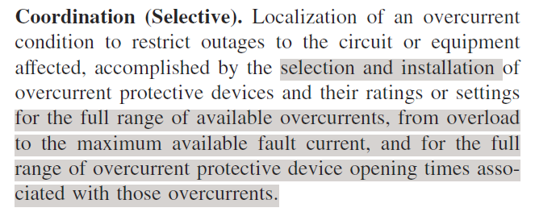
NEC 2014 - Article 100 – Definition

Slide 4
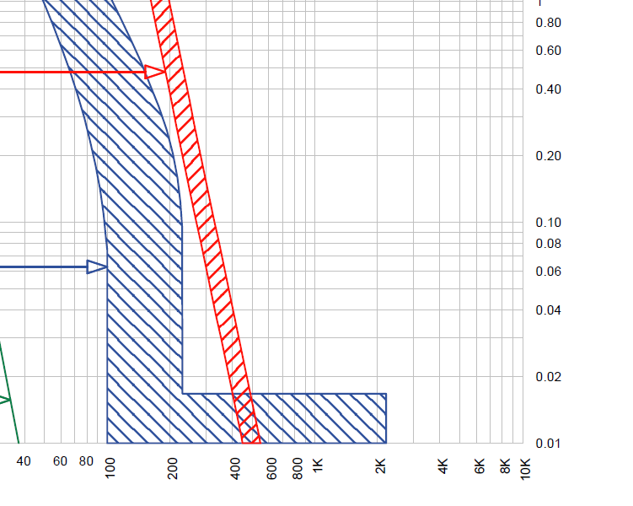
What You See, Is What You Get…
Article 100 implies full range = 0.01 sec

Slide 5

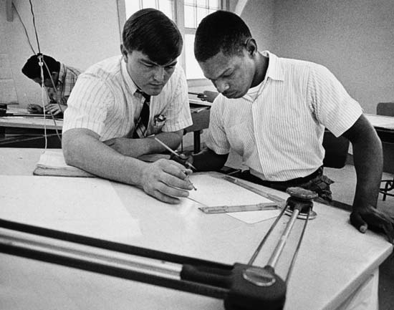
Change How You Think About Designing…
Elevator Circuits
Emergency Systems
Health Care Facilities
Legally Required Systems
Critical Operation Data Centers
Critical Operation Systems

Slide 6

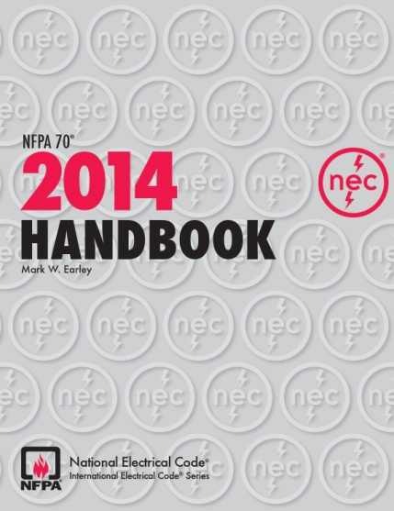
You Will Have to Change How You Think About…
Elevator Circuits - 620.22
Health Care Facilities – 517.26
Emergency Systems – 700.28
Legally Required Systems – 701.28
Critical Operation Data Centers – 645.27
Critical Operation Systems – 708.28

Slide 7
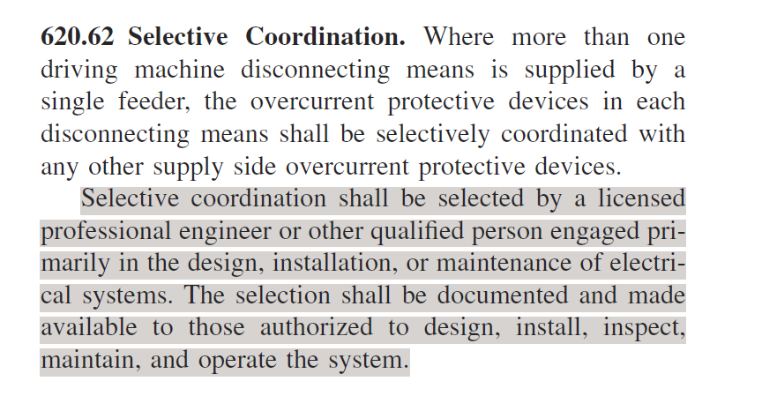
Elevators

Slide 8
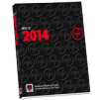
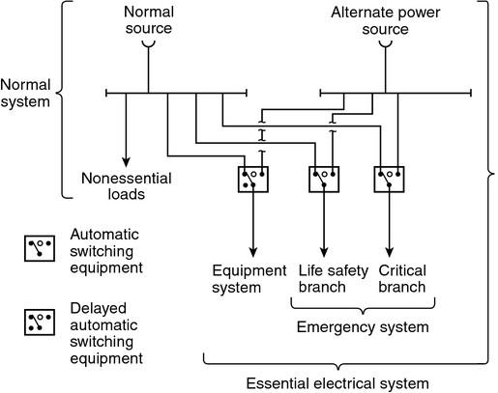
Typical Health-Care Facility Electrical System (Informational Note Figure 517.30)
Change
Must meet Article 700 per 2014 edition
Changed to “branch” in 2014 edition
Deleted in 2014 edition
Must meet Article 700 per 2005-2011 editions

Slide 9
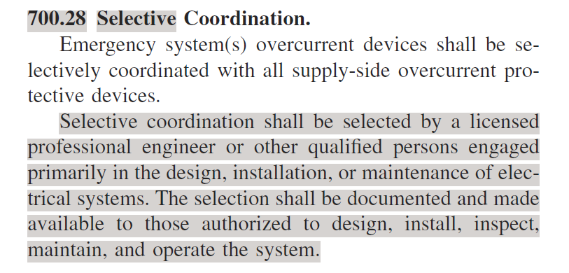
Emergency Systems

Slide 10
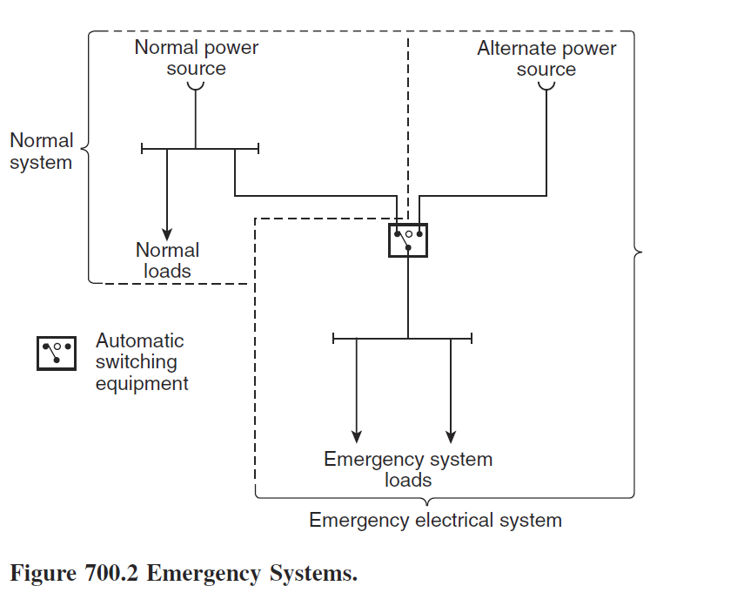
Emergency Systems

Slide 11
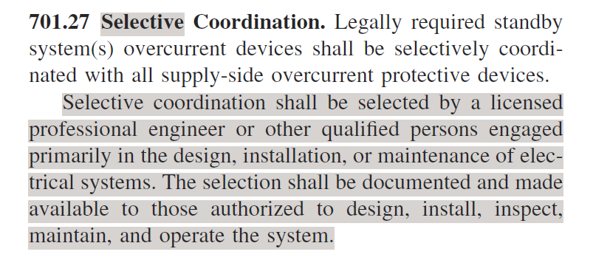
Legally Required Systems

Slide 12
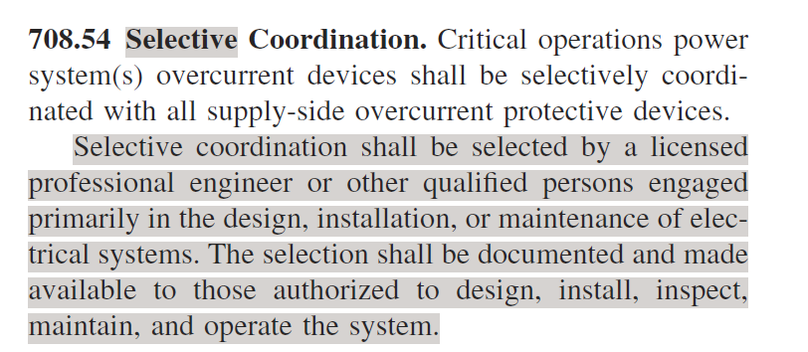
Critical Operations Power System (COPS)

Slide 13
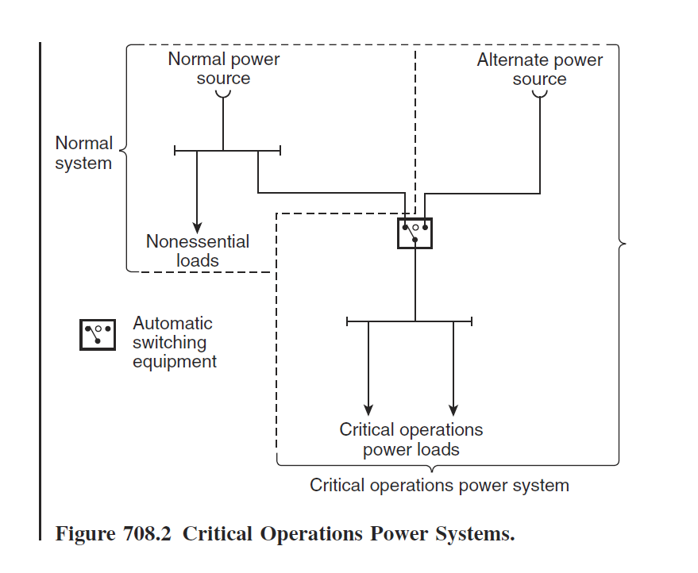
Critical Operations Power System (COPS)

Slide 14

What Does These NEC Code Articles Have in Common?
Theses articles all state, “selective coordination shall be selected by a licensed professional engineer”.
You have the power!

Slide 15
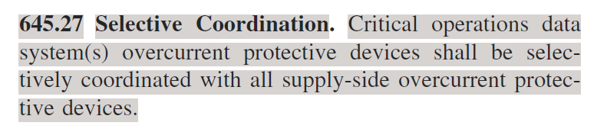

Data Centers

Slide 16
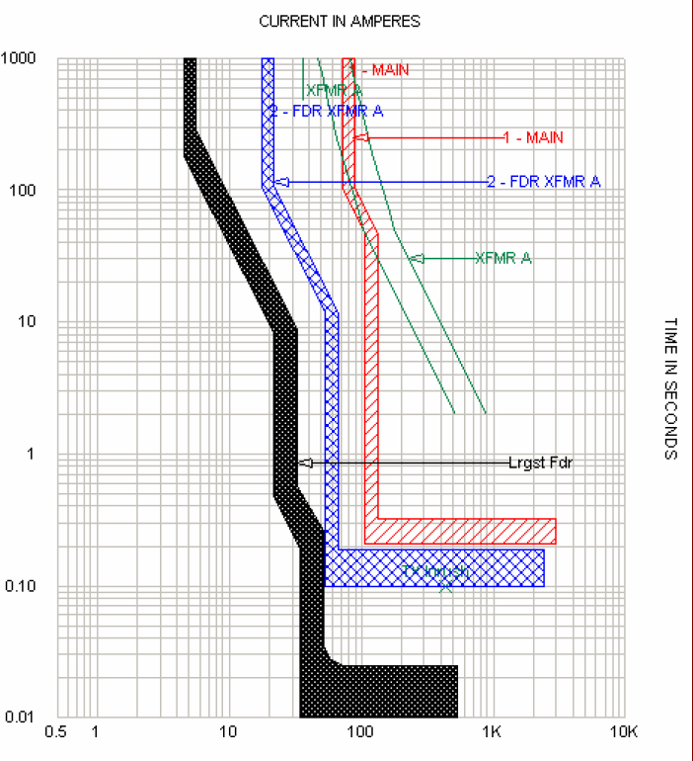
How Often Does This Happen?
3 - breakers in series
No overlapping of TCC’s.
60°F day in August in Atlanta

Slide 17
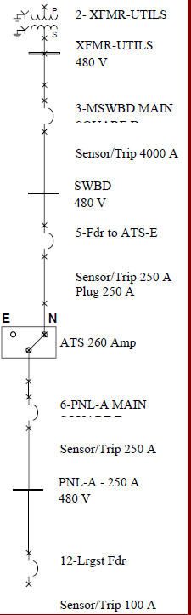
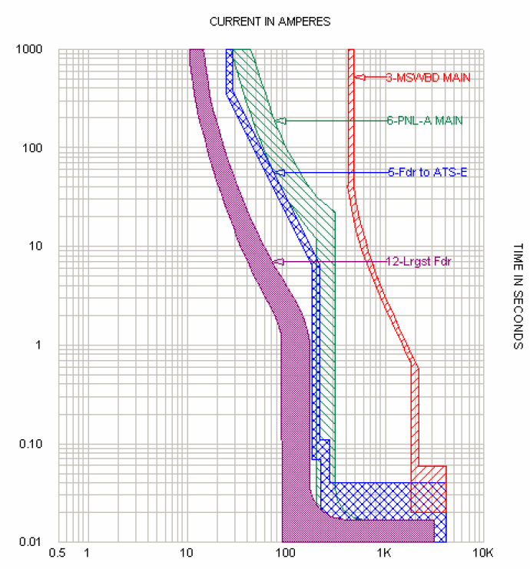
If It Was Easy Anyone Could Do it…

Slide 18
Circuit Breaker Challenges
Higher fault currents makes it more difficult to selectively coordinate breakers down to 0.01 seconds.
Most breakers have instantaneous trips
Only UL 1066 LVPCB’s come w/o instantaneous trip, i.e. turn off the “I” function in LSI trip.
UL 1066 are larger frame sized breakers with solid state trips (800A -6000A).
Larger breakers = larger electrical apparatus = less revenue producing space.
Not all mfr’s trip units function the same.
How do you level the mfr’s technical differences.
Molded case switches have lower instantaneous levels & lower interrupting ratings.

Slide 19
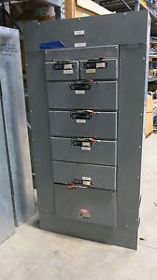
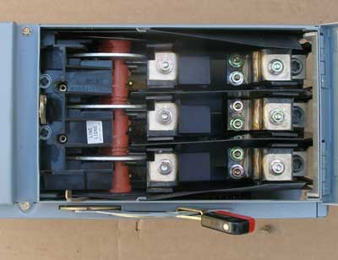
Fusible Equipment Challenges
Typically larger than circuit breaker equipment.
Larger electrical rooms = less revenue producing space
Fusible panelboards & Elevator Modules with CLF’s are more expensive than comparable breaker equipment.
Stocking and maintenance concerns with fuses.
GFP is difficult on standard switches.
GFCI – forget about it!
Easier to coordinate when using fuses ratio tables.

Slide 20
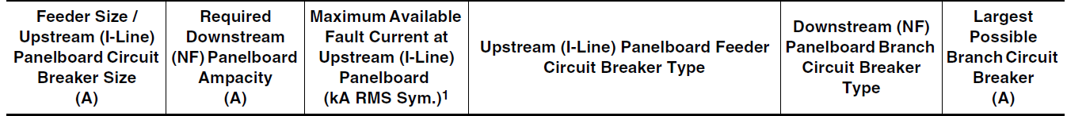
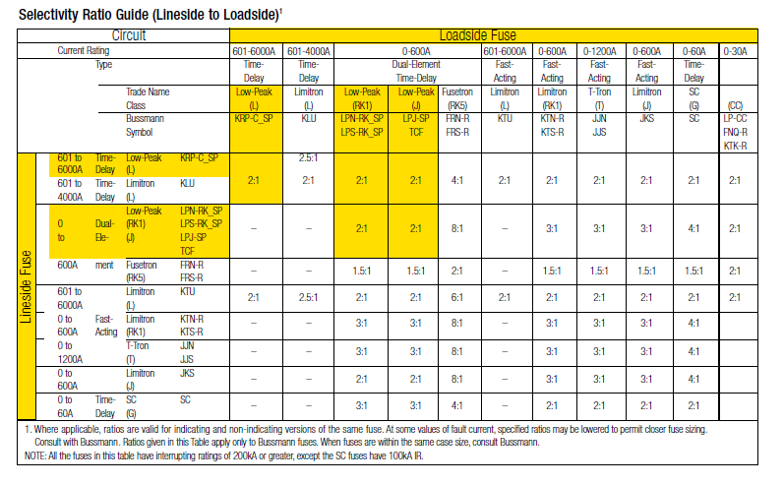
Current Limiting Fuses
Circuit Breakers have tables, too!
Easier to selectively coordinate.
Selective Ratio Charts
2:1 ratio of upstream to downstream fuse

Slide 21

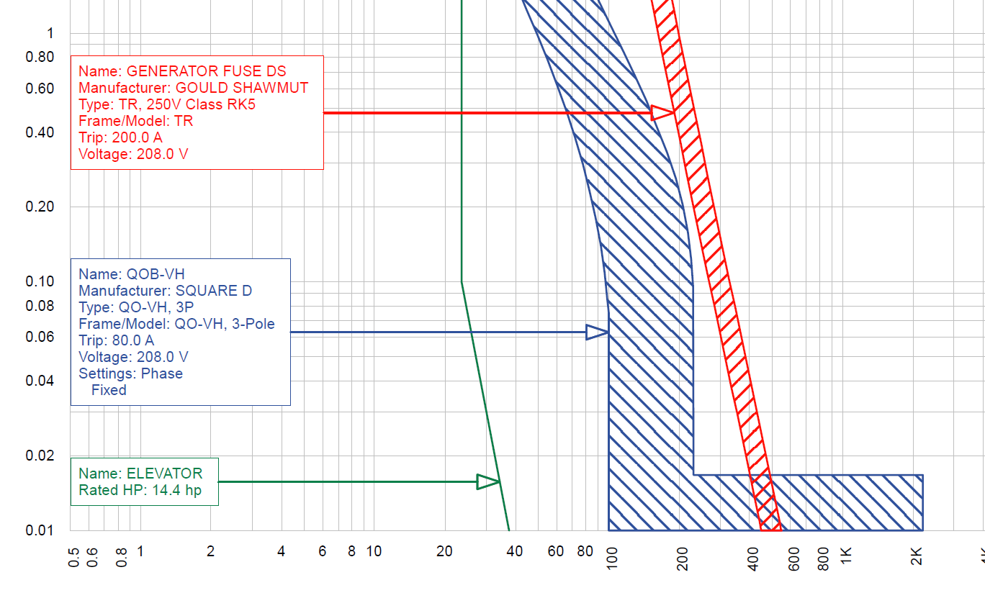
Avoid Mixing Fuses & Breakers
Avoid using upstream fuses and downstream circuit breakers.
Why?
The fault current must be less than the current limiting threshold of the fuse.
The CL threshold is below the .01 time band on the fuse curve.

Slide 22
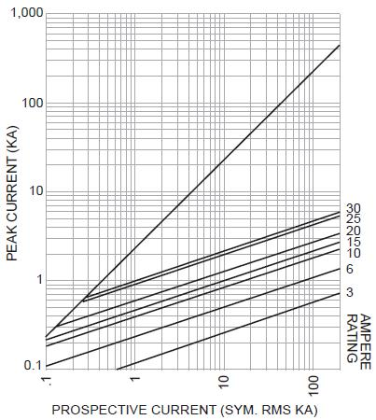
Where is the Current Limiting Threshold Point?

Slide 23
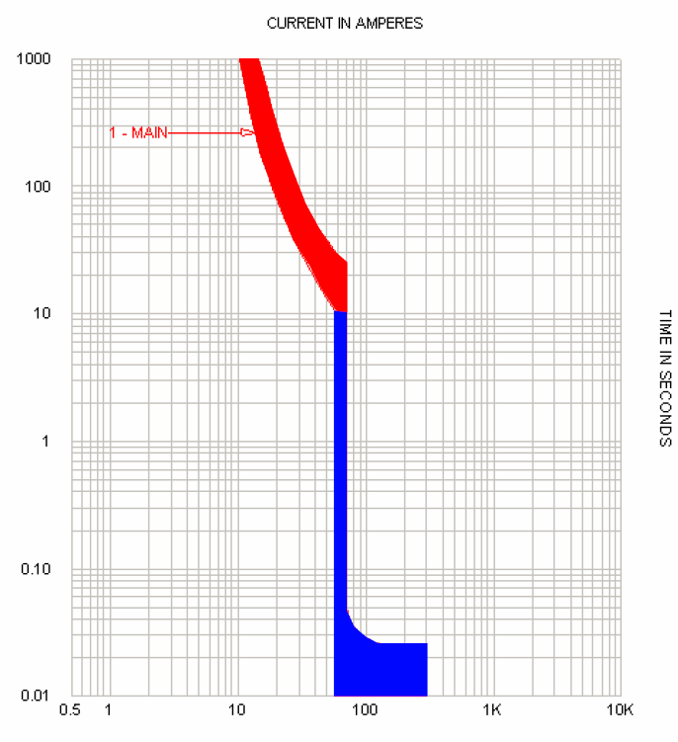
Thermal Magnetic Circuit Breaker
Thermal (overload) element is fixed. It cannot be adjusted.
Instantaneous can either fixed or adjustable.
20/1 CB –“Q” frames are fixed.
150A frame – some adjustability with most mfrs.
So, it’s really all about the Instantaneous trip.
Do they overlap at 0.01 seconds?

Slide 24
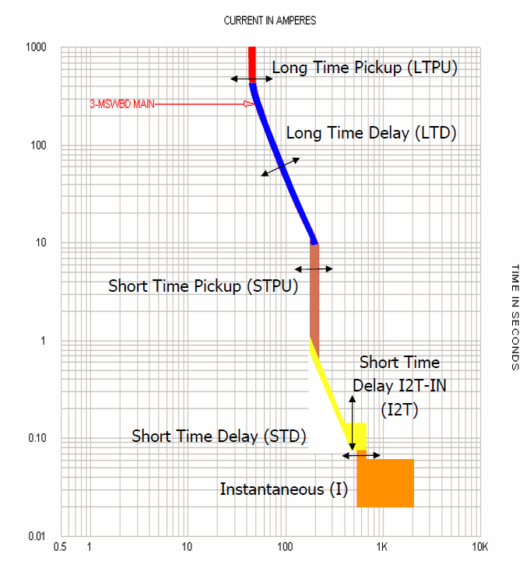
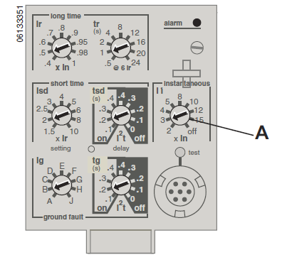
Solid State or Microprocessor Trip Units
Trip Unit Adjustments
TCC Adjustability

Slide 25
Methods to eliminate the overlapping effect of the instantaneous trip units
Reduce the available fault current
Set the instantaneous trip above the actual fault current
Select a breaker will an instantaneous over ride higher than the fault current.

Slide 26
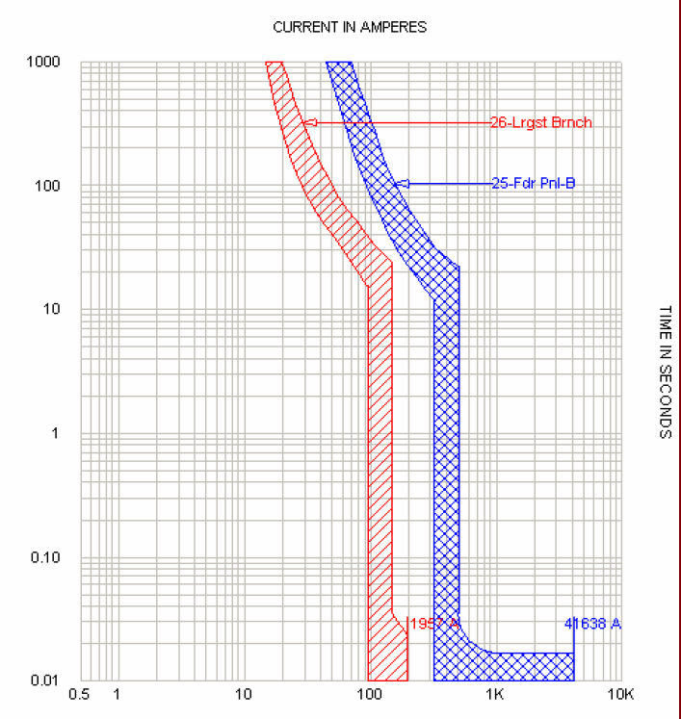
Thermal Mag Breakers CAN Be Selectively Coordinated
If you can reduce the fault current level below the instantaneous level of the downstream breaker, then selective coordination is possible.
Add transformer
Add impedance
Use the 3:1 ratio rule

Slide 27

3:1 Ratio Rule for Breakers
The frame size of the up stream breaker should be 3X as large as the downstream breaker.
Don’t confuse trip with frame size.
A 20A breaker is typically a 60A frame.
Example: 40/3 breaker should be fed from a 250A frame breaker.
Check with the breaker manufacturer – tighter ratios are possible.

Slide 28
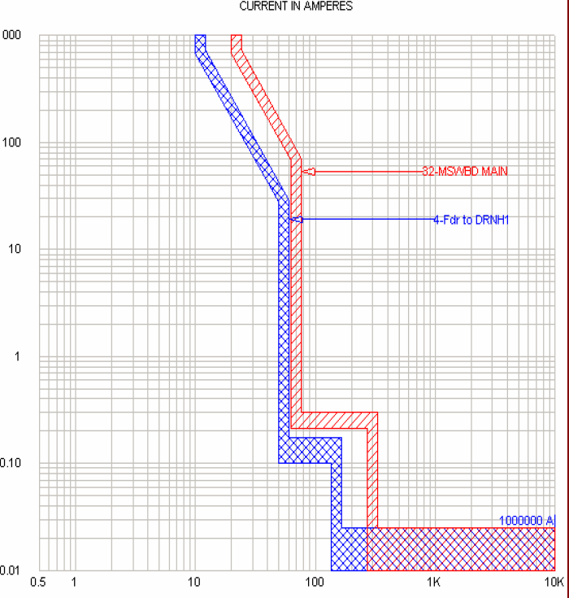
Solid State Trip Unit
100,000 A rms sym fault current
Instantaneous curve ends at the max fault current point

Slide 29
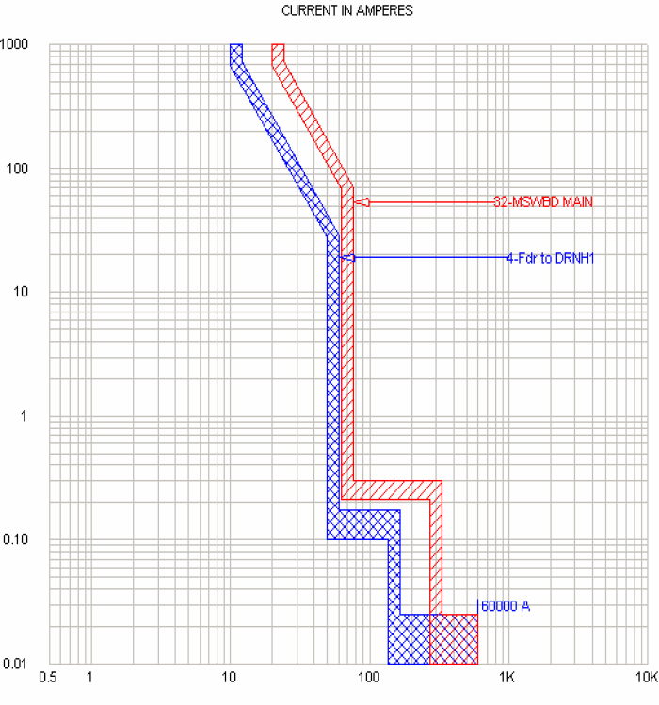
Solid State Trip Unit
60,000 A rms sym fault current
Instantaneous curve ends at the max fault current point

Slide 30
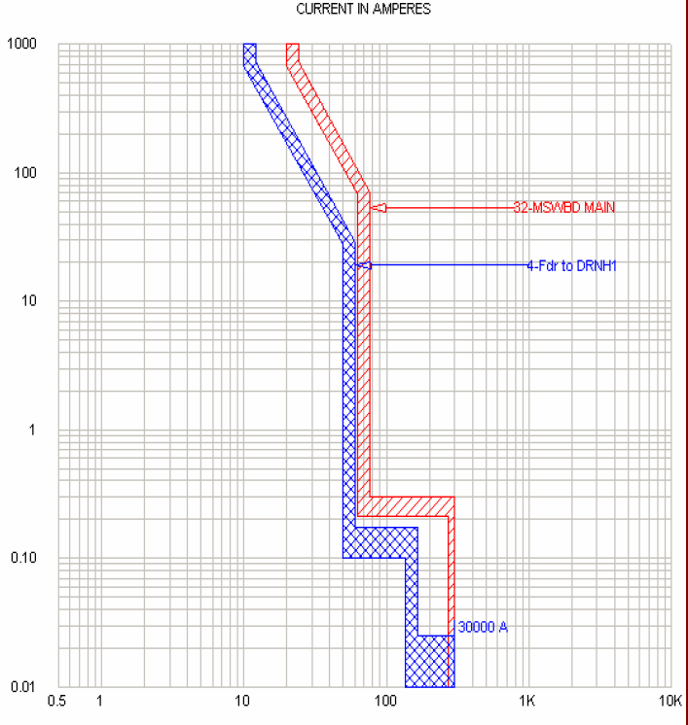
Solid State Trip Unit
30,000 A rms sym fault current
Instantaneous curve ends at the max fault current point

Slide 31
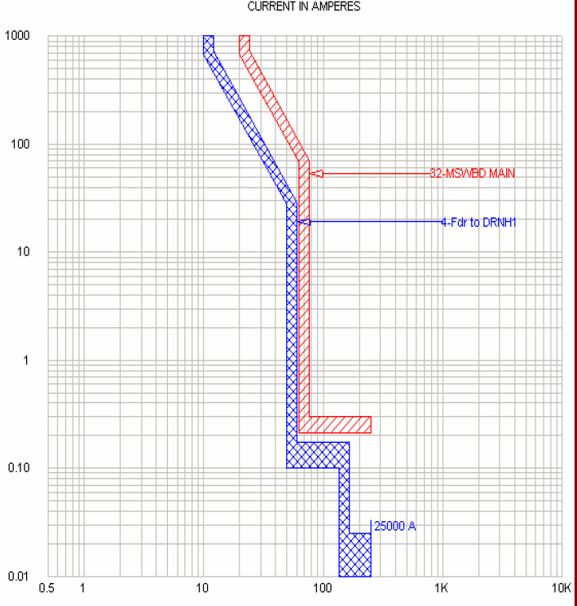
Solid State Trip Unit
25,000 A rms sym fault current
Instantaneous curve ends at the max fault current point.
What happened?
25kA was less than the instantaneous trip rating of the upstream breaker.
Electro-magic!

Slide 32
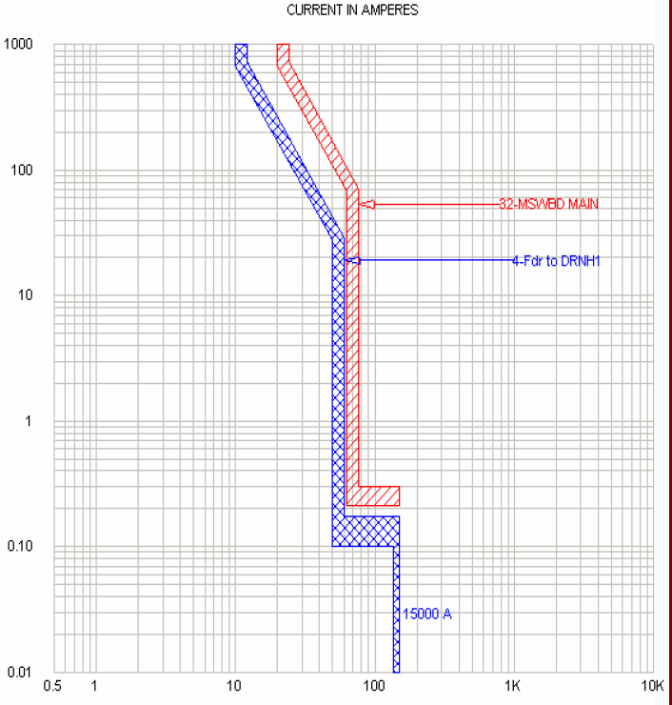
Solid State Trip Unit
15,000 A rms sym fault current
Instantaneous curve ends at the max fault current point

Slide 33
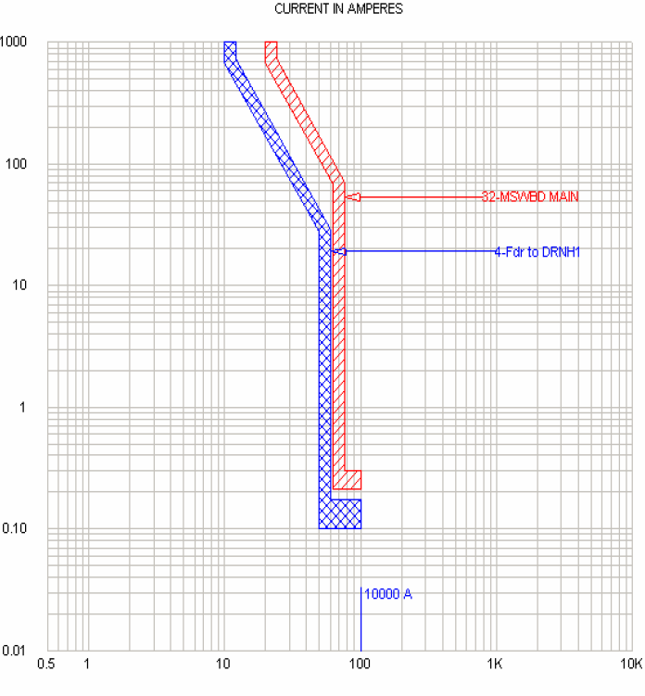
Solid State Trip Unit
10,000 A rms sym fault current
Instantaneous curve ends at the max fault current point
Now, you can slide those 20/1 breakers in and underneath the curves of the two upstream breakers
That’s what I’m talkin’ ‘bout, Willis!

Slide 34
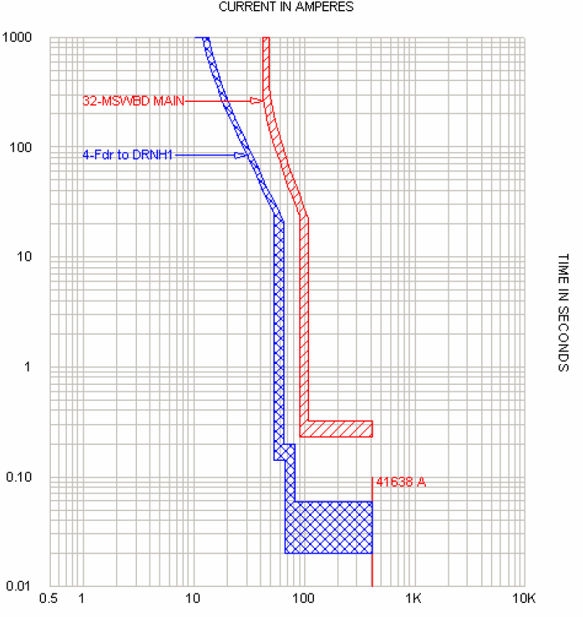
Solid State Trip Unit
Adjust the upstream breaker’s instantaneous trip unit above the available fault current.
Fault current = 41,638
Instantaneous trip set to 12X

Slide 35
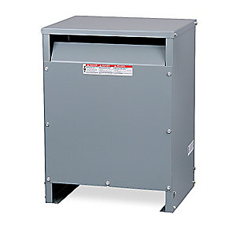
Eliminate main breakers in panelboards.
Molded case switches aren’t an improvement.
Use the 3:1 ratio rule with downstream thermal magnetic breakers.
Impedance is your friend- it helps with selective coordination.
Dry type transformers are your friend – it adds impedance & reduces fault current.

Slide 36
Use breakers with adjustable solid state trip units (LSI) – turn off the “I”
UL 489 listed breakers (molded case, insulated case) with adjustable solid state trips (LSI) have an “instantaneous over ride” built in.
Example: Manufacturer “S”, 1200A frame 50kAIC @ 480V
Instantaneous over ride is 24kA. Turn off the “I”
Allow for +/- 10% tolerance, use on circuits with available faults below 22kA.

Slide 37
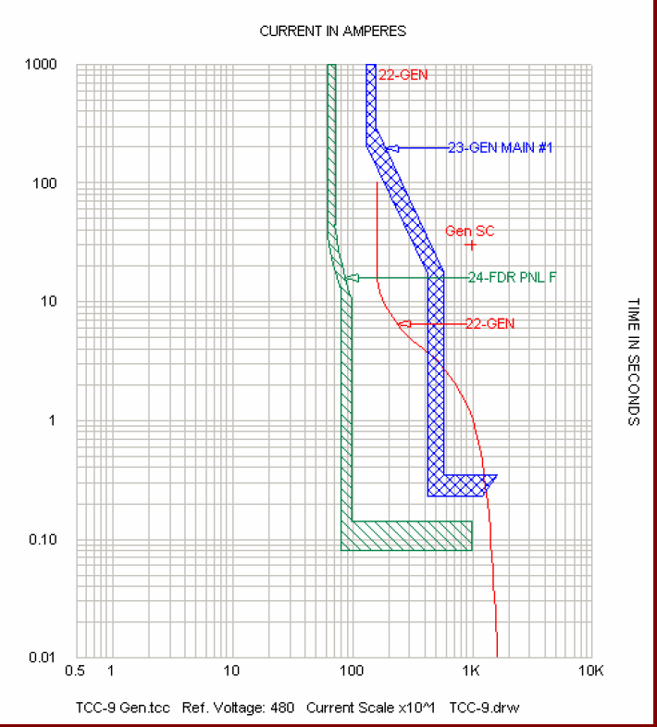
Generator Main Breakers (UL 489)
Fault currents are relatively low unless large sets in parallel.
Use breakers with adjustable solid state trip units (LSI).
Raise short time delay. Inst off.
Maximize the “space” below and to the left of the gen breaker curve.
In many cases the inst. over ride will be higher than the fault current produced by the genset

Slide 38
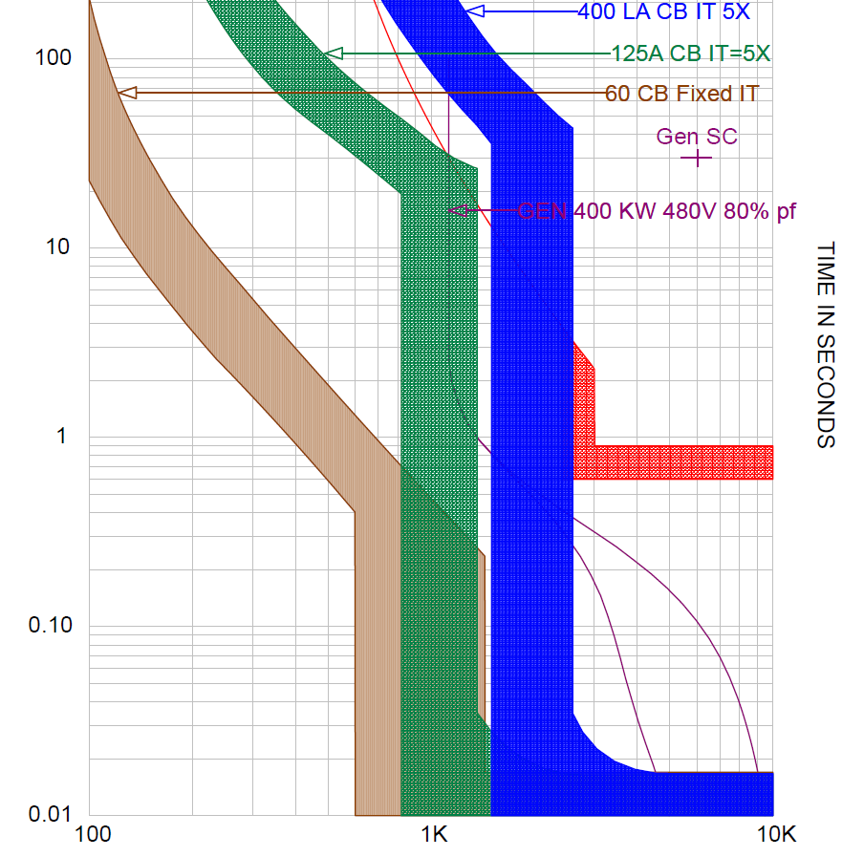
Generator Main Breaker – How Do I Fix This?

Slide 39
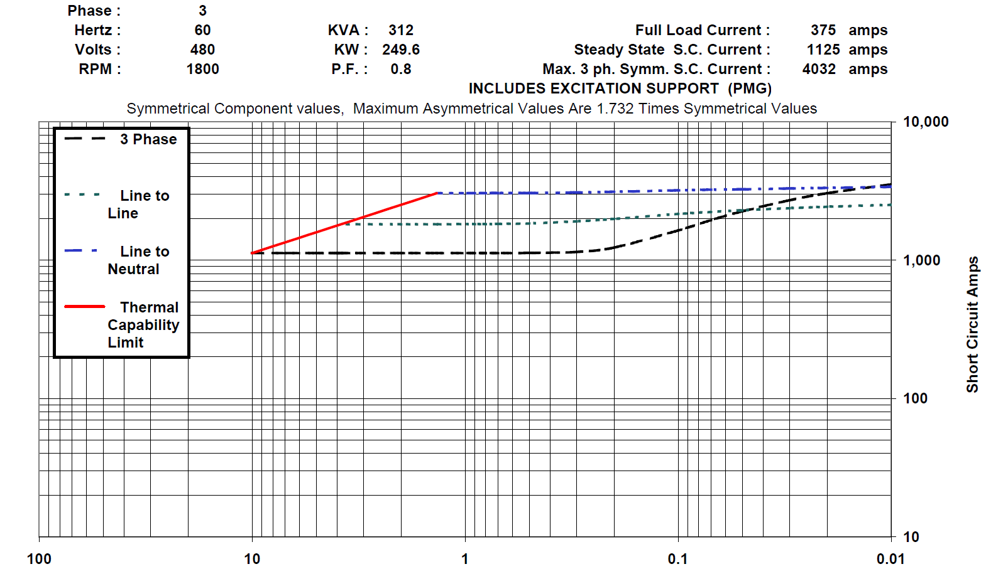

Slide 40
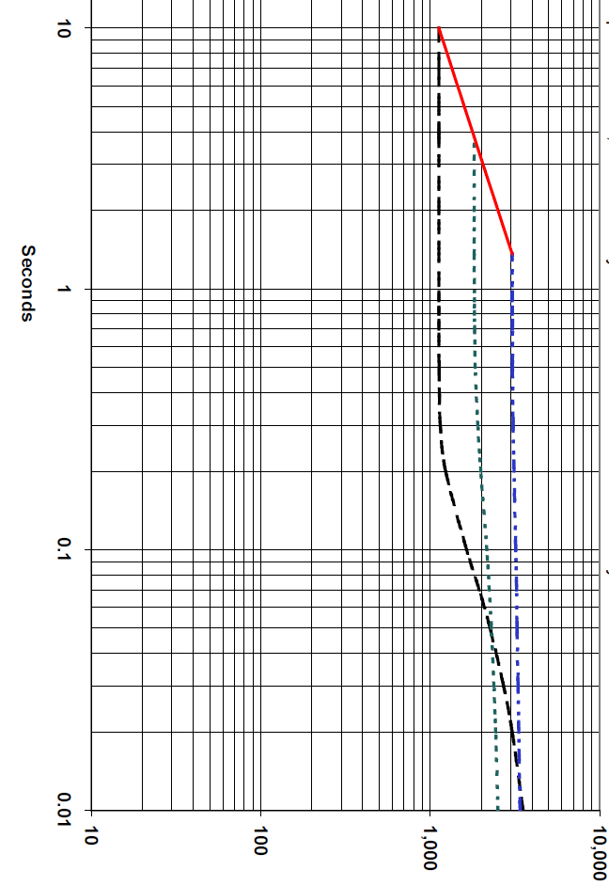
Use Solid State Breakers on Gensets
Adjustable LSI trip units
The “Red” diagonal line is the thermal damage curve for the alternator.
1.5 seconds is a critical an inflection point.
Ideally we want our breaker trip curve between the green and black lines.
But ,we also want our “I” turned off.
Set the STD to about 0.15 seconds.

Slide 41
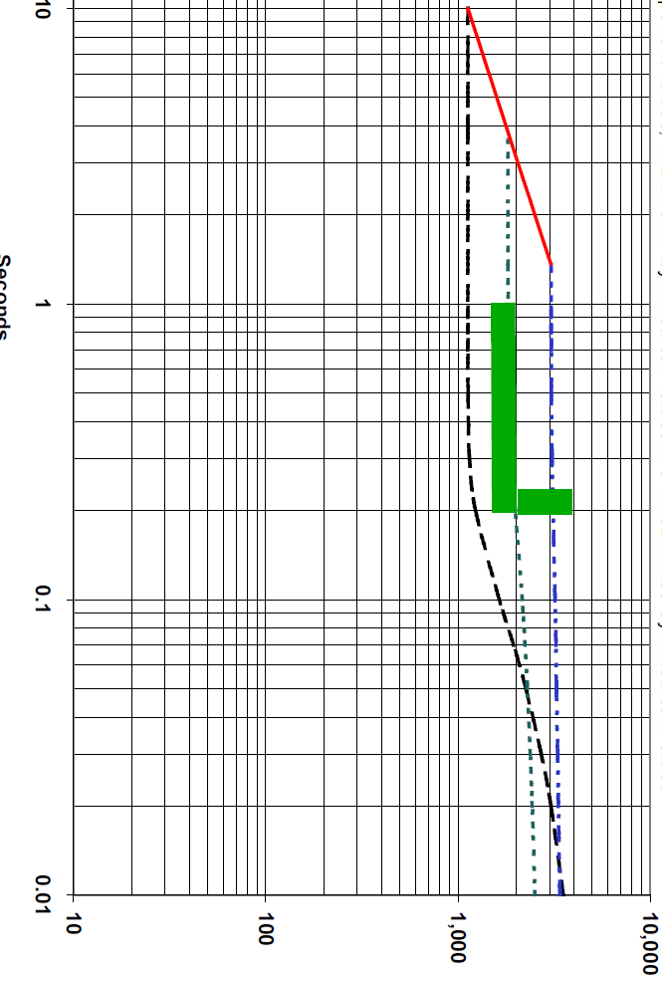
Use Solid State Breakers on Gensets
The last thing you ever want to happen is tripping the main breaker on the generator when running in emergency mode.
The idea is to create as much space below and to the left of the alternator damage curve.
Turn off the “I”
Set the STD high
Use a solid state breaker with the instantaneous over ride higher than the decrement curve fault current > 4000A.
That’s easy!

Slide 42
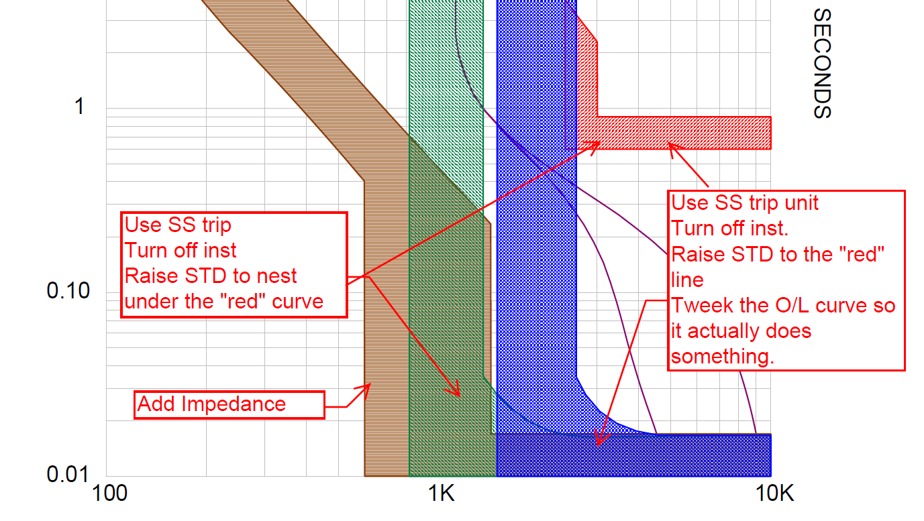
Generator Main Breaker – How Do I Fix This?

Slide 43
Summary
Avoid mixing breakers & fuses.
Reduce the available fault current.
Add impedance to the circuit.
Use breakers with solid state trip units.
Set the instantaneous trip above the actual fault current.
Select a breaker will an instantaneous override higher than the available fault current.
Use the 3:1 Ratio Rule for Breakers
Eliminate main breaker panelboards where possible.
Check with the breaker manufacturer for hybrid breakers that improve coordination.

Slide 44

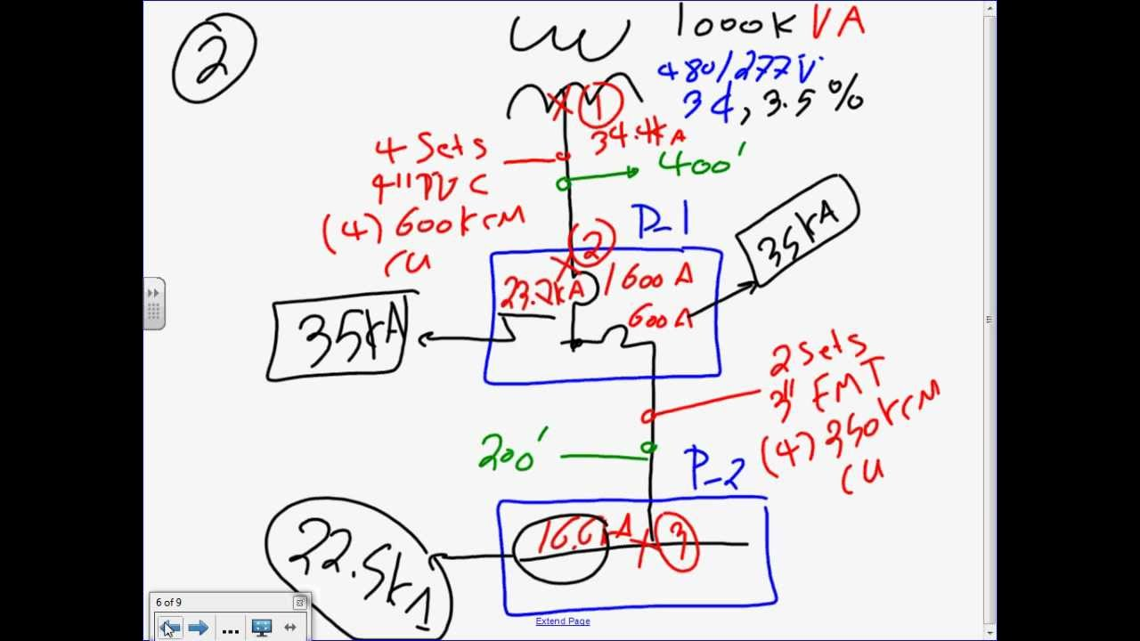
Please list the available short circuit currents on the single line diagram.

Slide 45
Thank you!!!
Ken Box, P.E.
Schneider Electric USA
30000 Mill Creek Avenue, Suite 300
Alpharetta, GA 30022
Phone: 770-792.4839
Ken.Box@schneider-electric.com

Slide 46
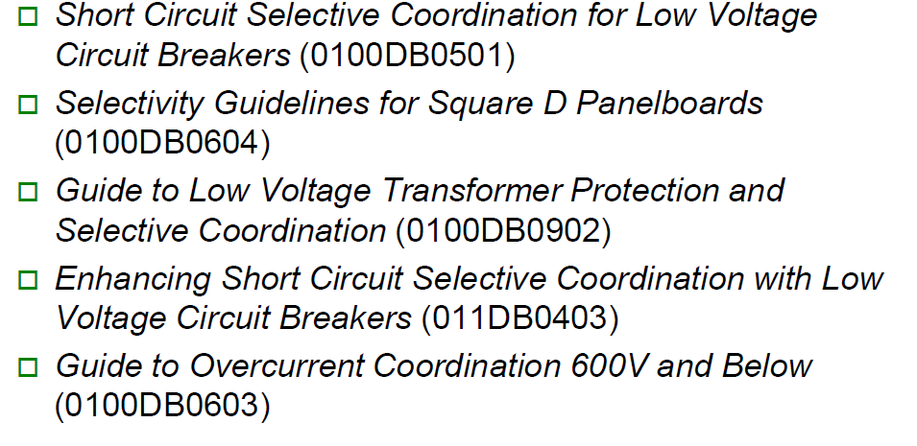
References & Specials thanks to
National Fire Protection Association – NFPA-70 The National Electrical Code 2014 edition.
Robert E. Fuhr, P.E. – Power Systems Engineering, Covington, WA – Meeting the NEC Requirements for Selective Coordination.
Square D/Schneider Electric Data Bulletins

