Slide 1
Verification of ANSI O5.1 Strength Values for Southern Pine Poles Through Current Full-Sized Destructive Testing

Slide 2
Resource Testing Project

Slide 3
Project Plan

Slide 4
Growth Rate Study

Slide 5
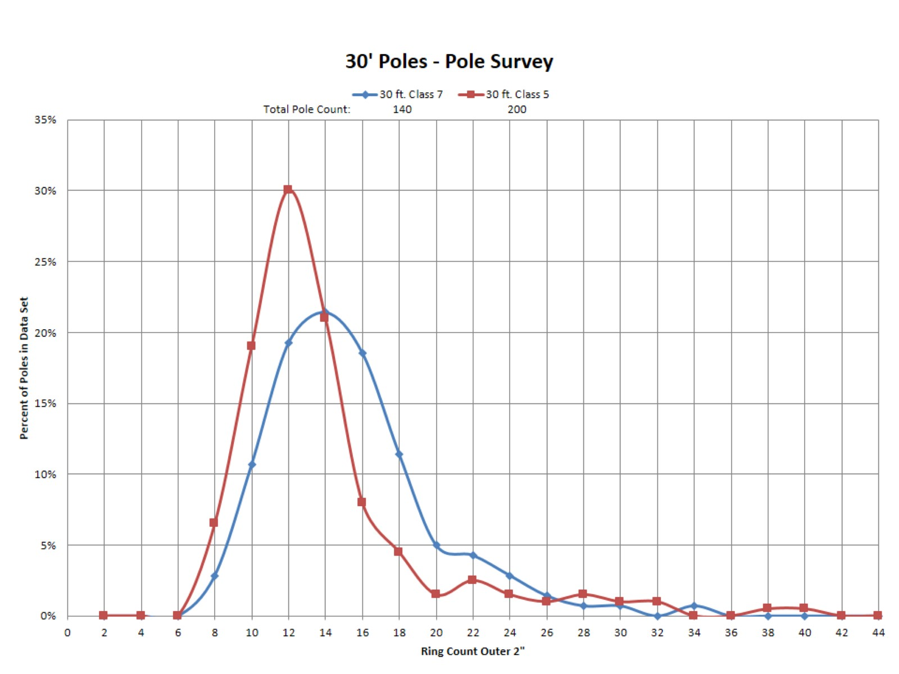

Slide 6
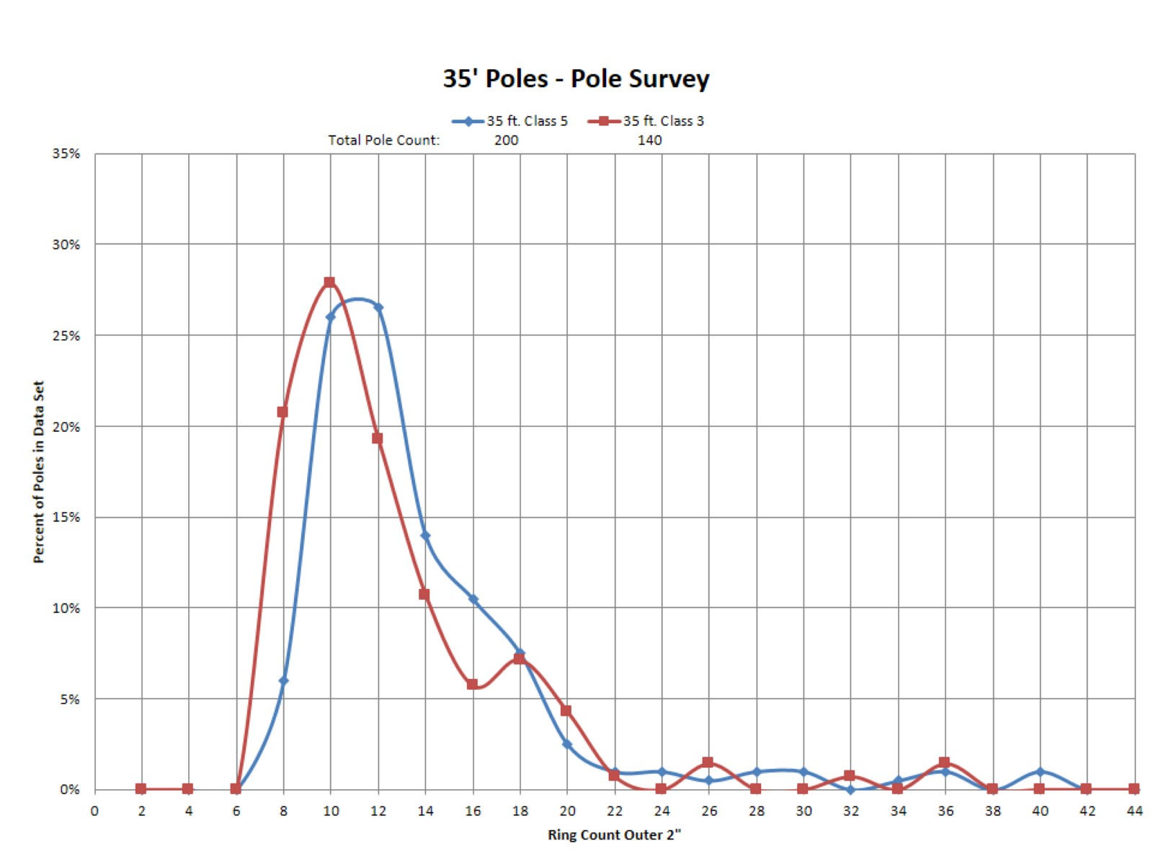

Slide 7
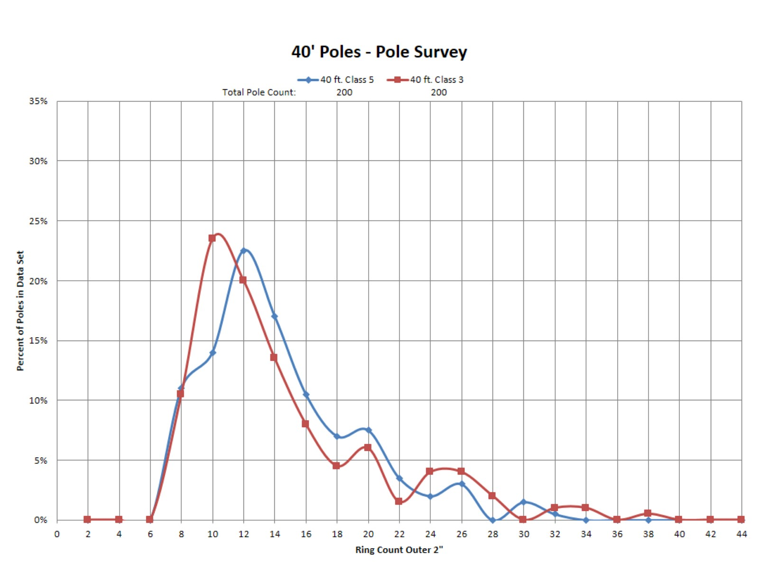

Slide 8
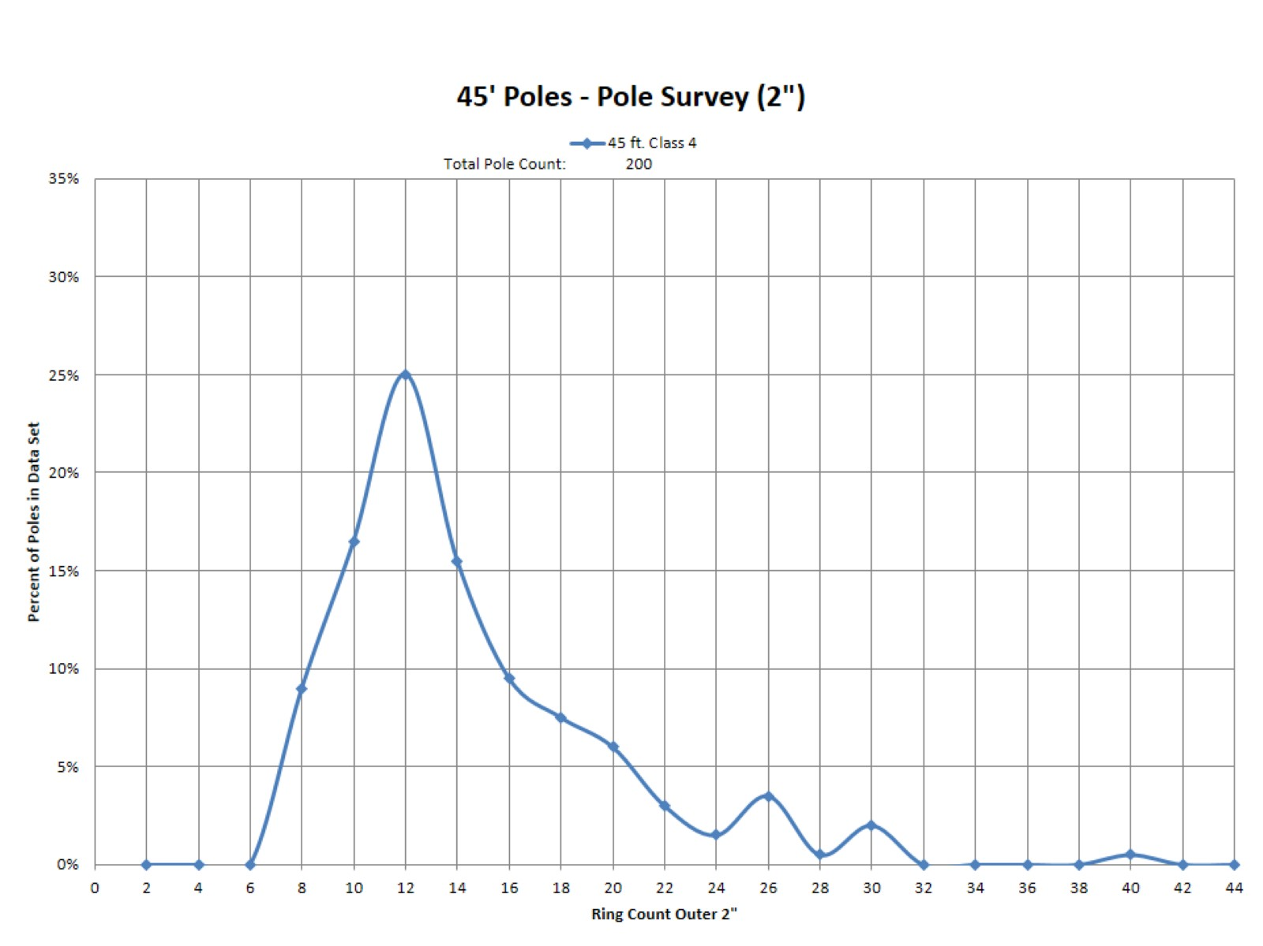

Slide 9
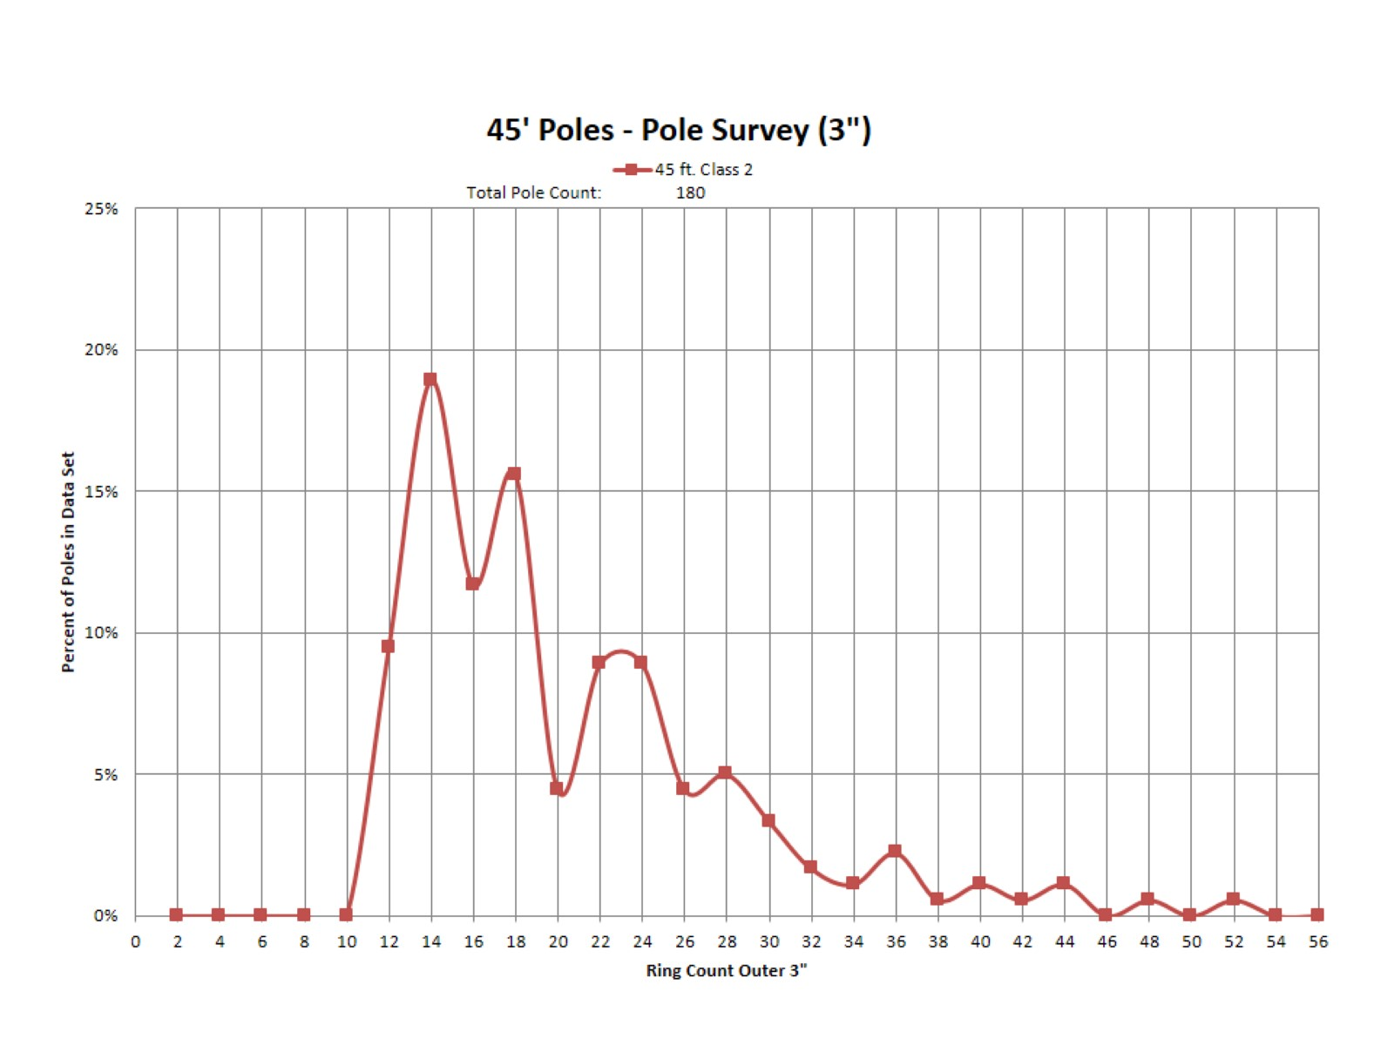

Slide 10
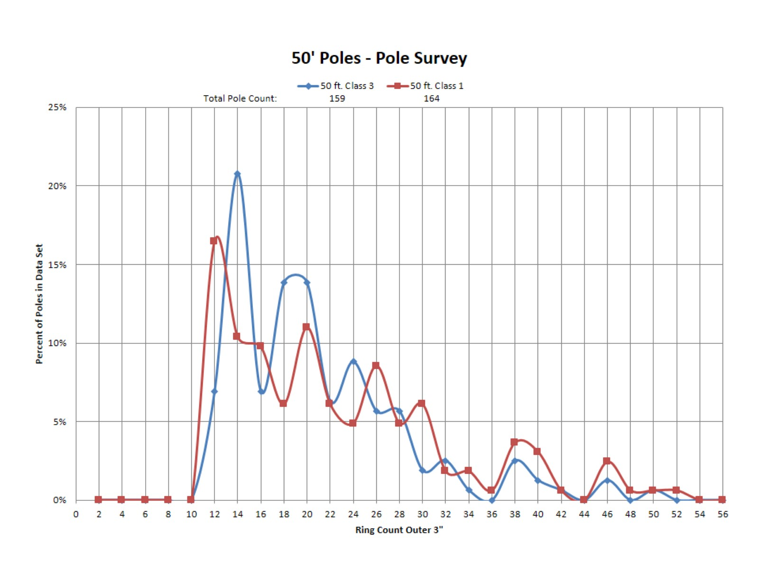

Slide 11
Results of Growth Rate Study

Slide 12
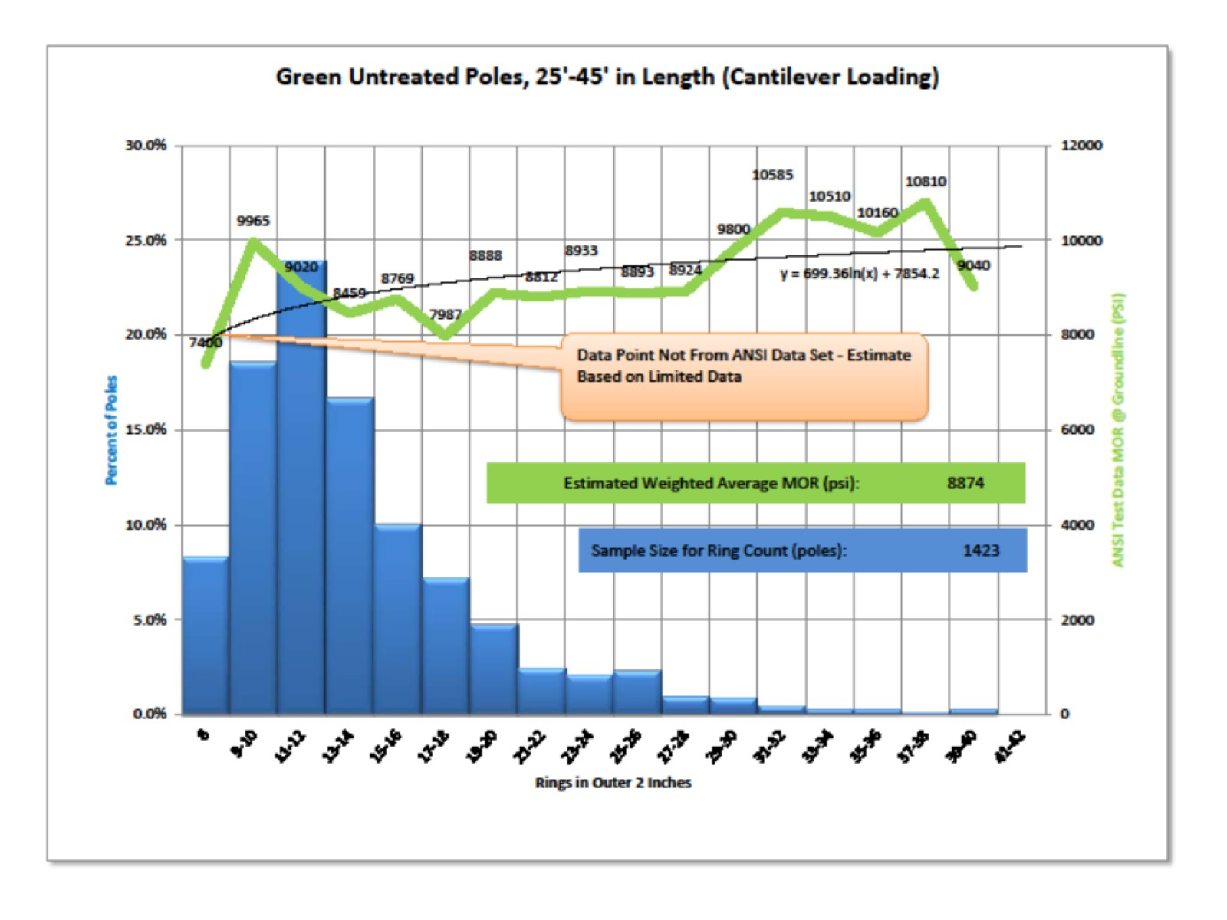

Slide 13
Specimen Selection

Slide 14
Specimen Quality

Slide 15
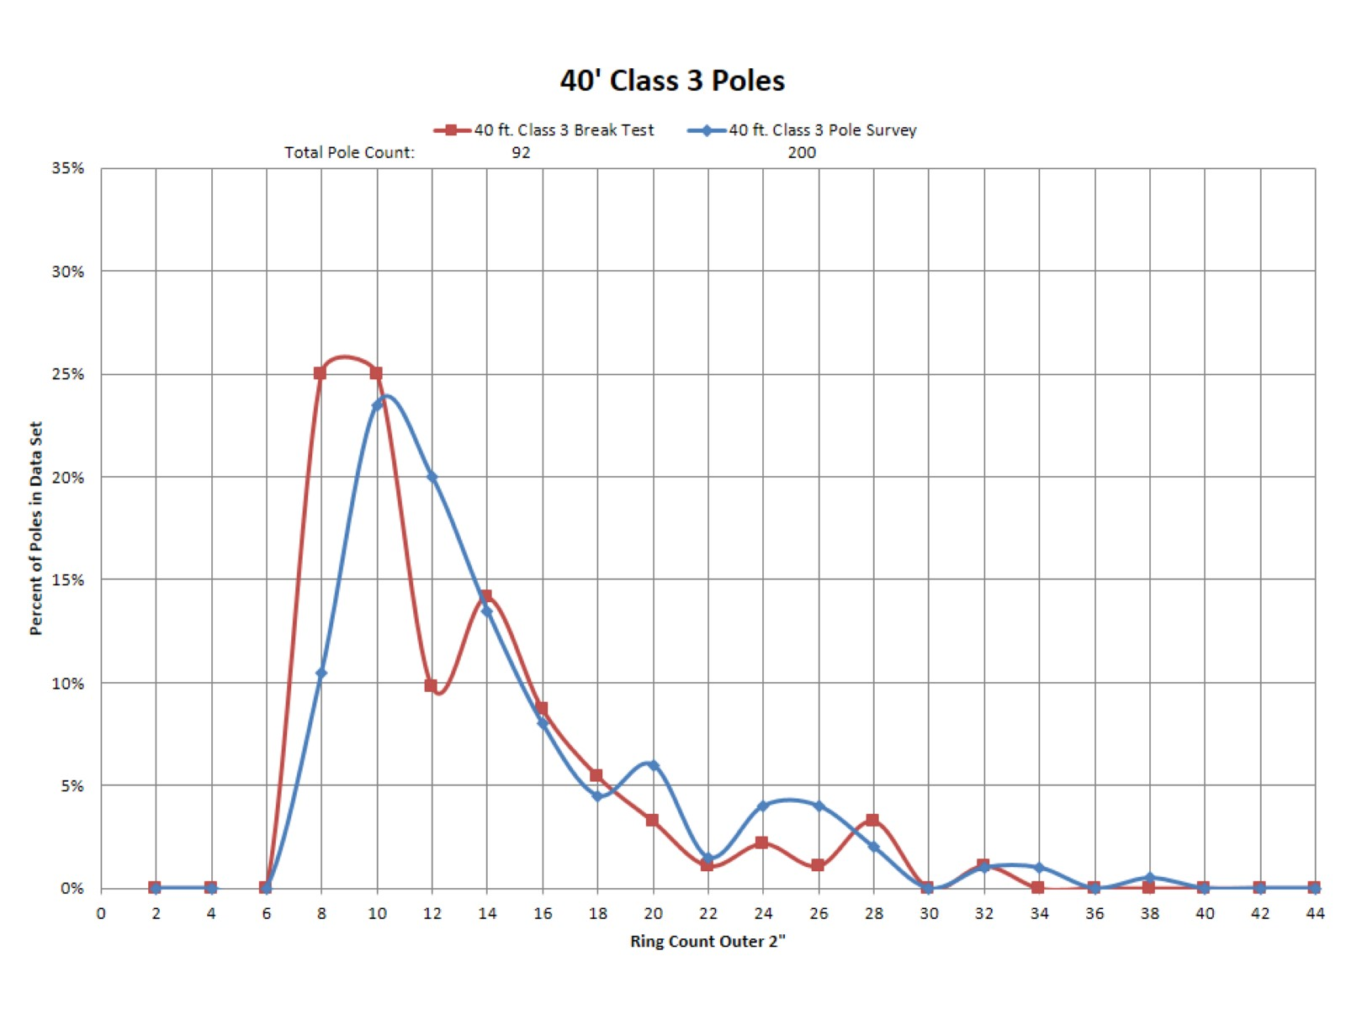

Slide 16
Break Test Procedure

Slide 17
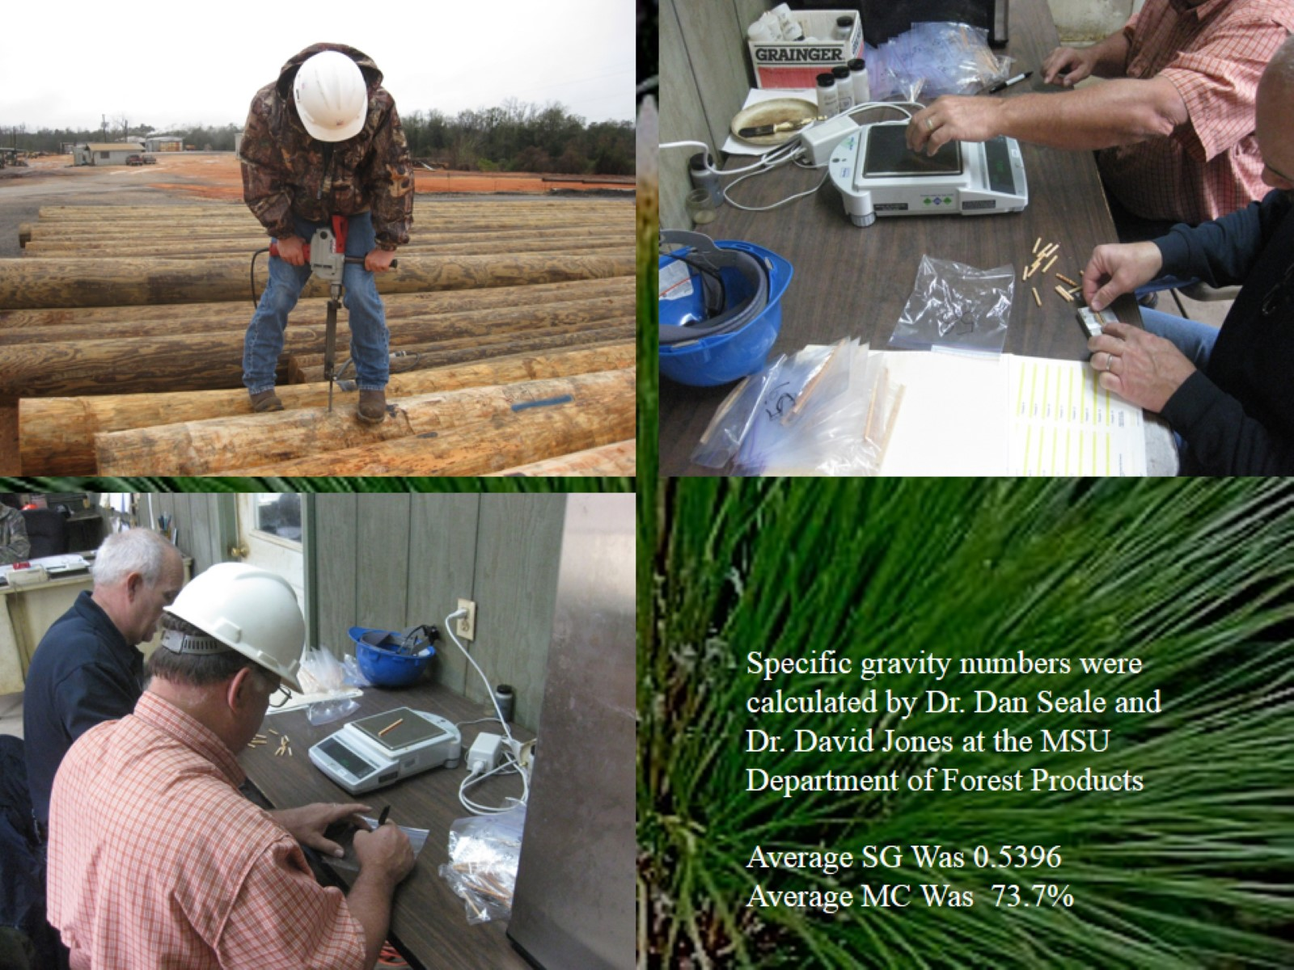

Slide 18
Break Test

Slide 19
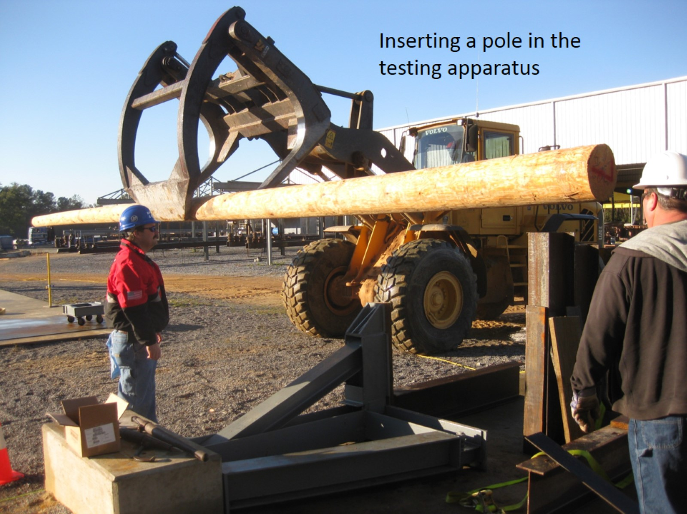

Slide 24
Break Test Data

Slide 25
Data Analysis

Slide 28
Break Test Facts

Slide 29
Development of ANSI O5.1 Strength Value

Slide 30
Break Test Results

Slide 31
Break Test Results

Slide 32
What Else Did We Learn?

Slide 33
What Else Did We Learn?

Slide 34
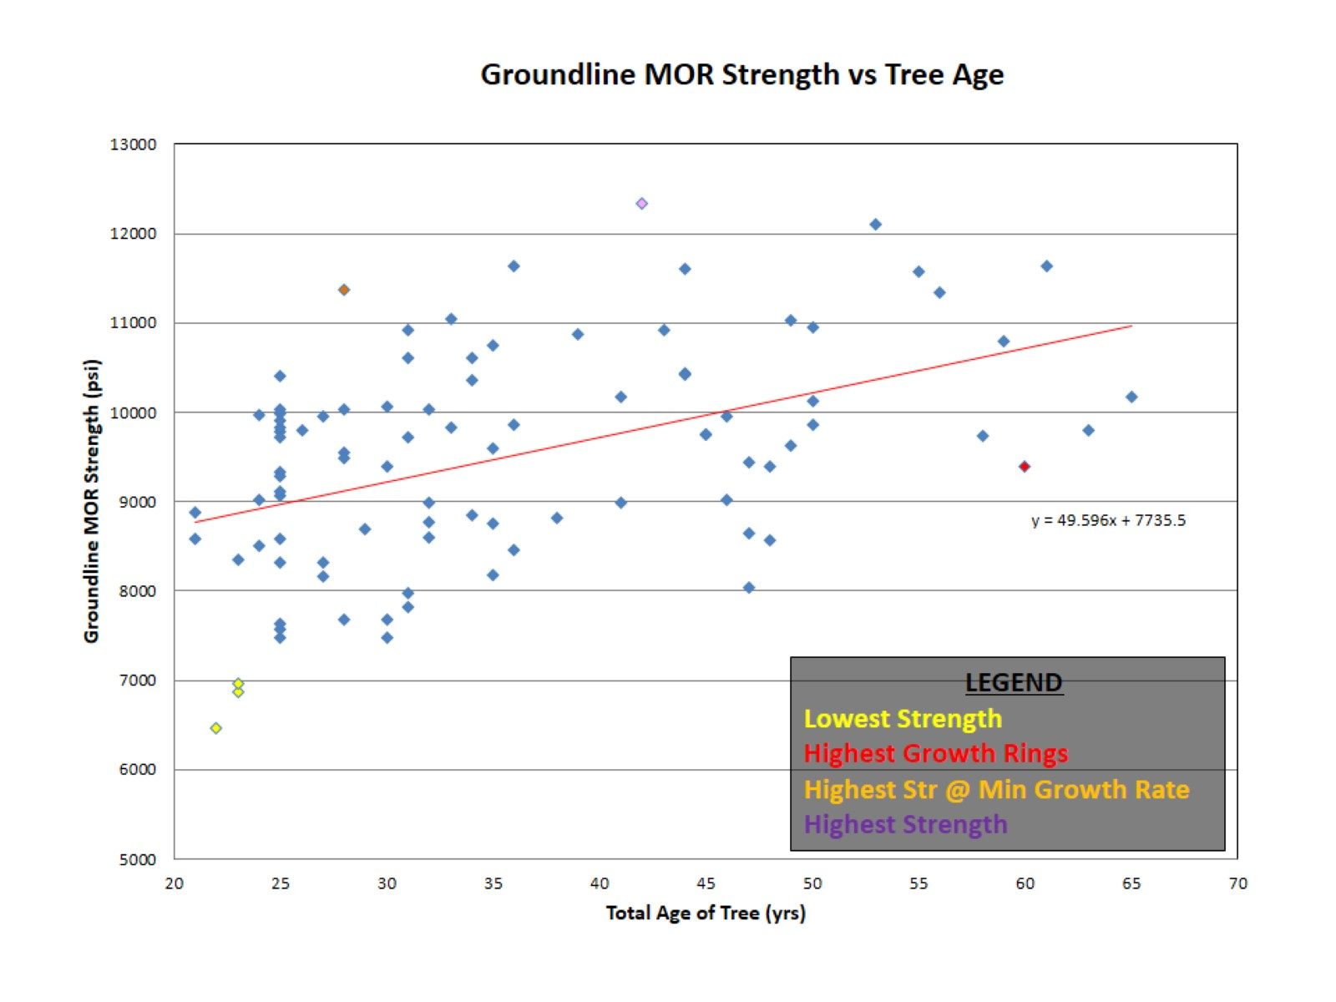

Slide 35
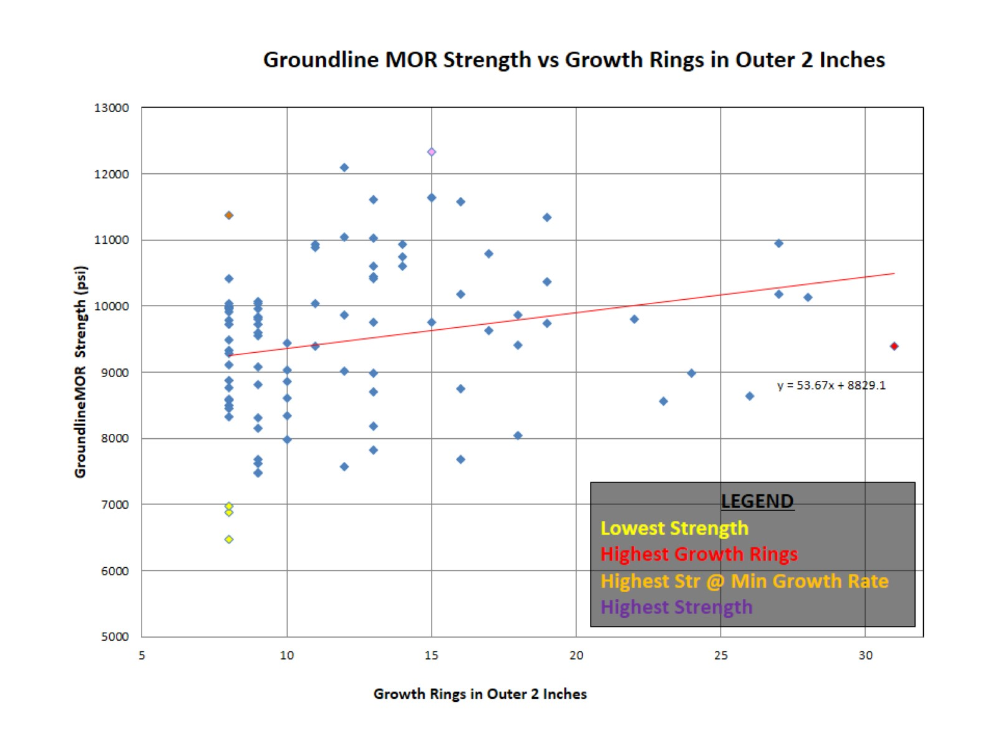

Slide 37
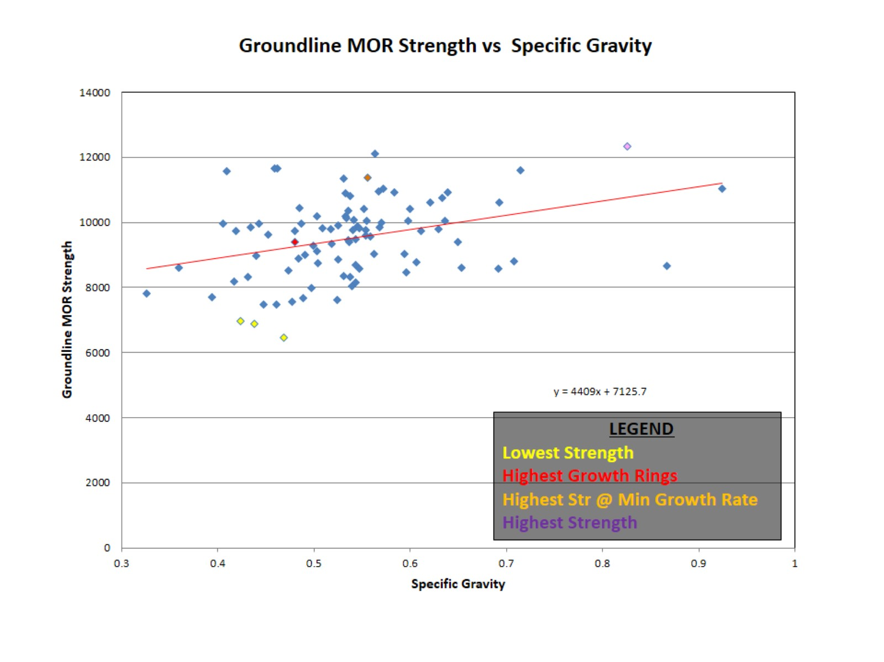

Slide 39
Summary

Slide 40
Questions?

