Slide 1
Jackson PES November 2012 Meeting
November 14, 2012
Taylor Power Systems
Corporate Headquarters Building

Slide 3
August and October Attendance

Slide 4
Elections
Chair – Chris Sistrunk
Vice Chair – Jeremy Blair
Treasurer – Naveen Bokka
Secretary – John Stevens
Any other volunteers to be a candidate?

Slide 6
Technical Presentation

Slide 7
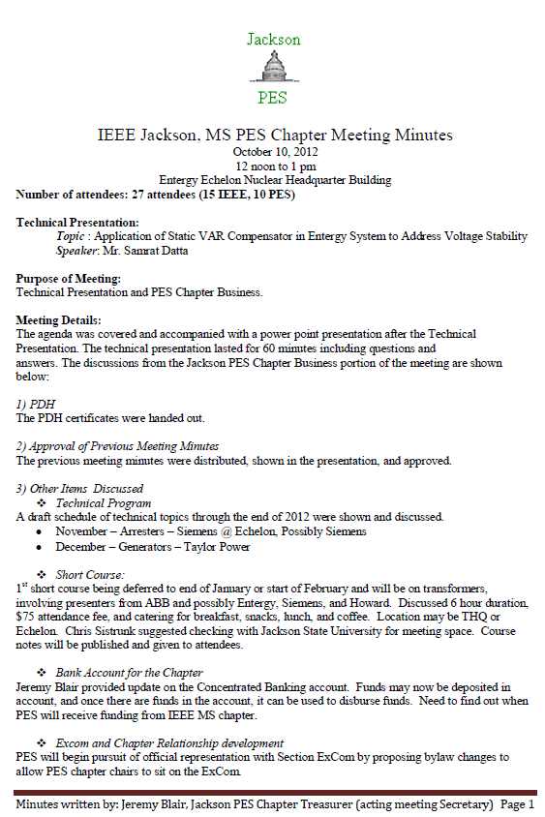

Slide 8
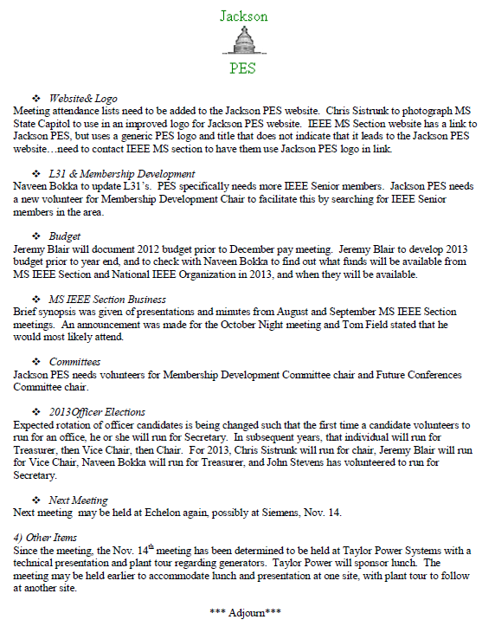

Slide 9
Technical Program
December –Arresters – Siemens
Tour – Siemens Plant
2013
Short Course – Transformer Short Course
2013
Participants: ABB, GE, Industry Expert/s?
Short Course – Surge Arresters Short Course
2013
Participants: Siemens, Cooper?, Industry Expert?

Slide 10
2013 Meeting Topics
GE – Arc Flash – committed
Substation Batteries – committed
Distinguished lecturer, PQ – committed
Capacitor Switching and capacitors – GE or S&C
DA, Volt VAR control, transformer DGA, Voltage Regulators and network transformers – GE?
Circuit Breaker TRV – Toshiba?
Utility Cyber Security – MSU?
Generator Topic?
Other Topics?

Slide 11
Website http://ewh.ieee.org/r3/mississippi/pes/

Slide 12
Mississippi Website (homepage) Link to Jackson PES Chapter

Slide 13
Website
Update from Chris S. on Revised Logo for Section Website Link

Slide 14
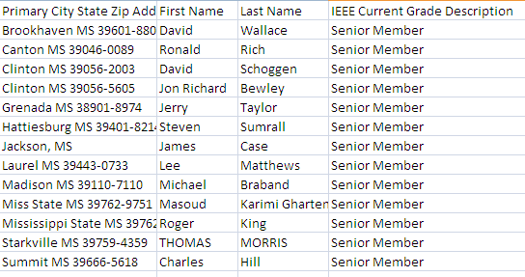
Membership Development
New Membership Chair – Hedayat Darbandi
IEEE PES Membership Brochures
Pay Events – encourage membership
Discount for PES Members
Senior membership

Slide 15
Officers
Secretary
L31 Status
Attendance Posting Location
Treasurer
Concentrated Banking Account Status
2012 and 2013 Budget Status

Slide 16
2012 Budget

Slide 17
2013 Budget Assumptions

Slide 18
2013 Budget

Slide 19
Committees
Technical Program – Charles Ingram, Chair
Membership Development – Hedayat Darbandi, Chair
Future Conferences – William Solano
Webmaster – Jameson Mitchell
Committees should have more than 1 person on them. Please let Tom Field or the Committee Chair know if you would like to be on a committee.

Slide 20
New Items
Next Meeting – December 12, noon
Next Meeting Location – Entergy Nuclear HQ if available?
Catering if Siemens location?
Corporate Sponsor?
Next Presenter
Siemens
Surge Arresters
2013 Elections

Slide 21
September 26 Mississippi Section Meeting

Slide 22
Updates on Excom Meeting
Concentrated Banking Account Setup
Website Logo needs to be put on seciton website
Bylaws of Section Draft written – other bylaw changes found
Irmari working on format for newsletter

Slide 23
Current Section Bylaws

Slide 24
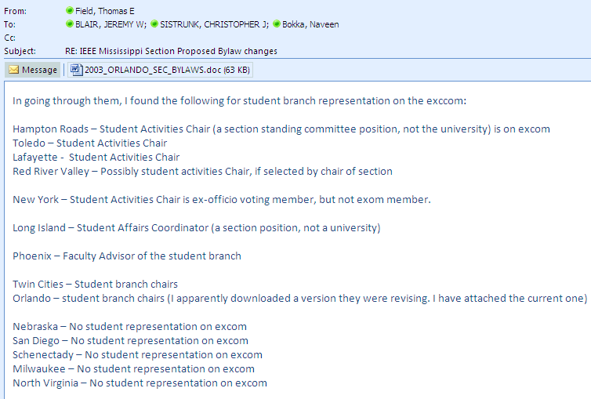
Other Sections and Student Branches

Slide 25
New Items
Other New Items?

Slide 26
Adjourn

