Slide 1
Phase I Funding Proposal IEEE Student Branch at The University of Texas at Austin
IEEE Central Texas Section
Fall Planning Meeting 2016
San Marcos, Texas
Adviser: Sriram Vishwanath, sriram@ece.utexas.edu

Slide 2
Branch Overview
Over 500 total members
Developing a closer relationship with community, college, department, section, and corporate supporters
Working closely with student Society chapters: ComSoc, CS, Power & Energy, RAS, HKN, and WECE
Increasing active membership, member retention, and founding of new sub-societies.

Slide 3
Branch Executive Officers
Haley Alexander, Chair
Hannah Peeler, Vice Chair
Rob Misasi, Executive Director
Taylor Zhao, Corporate Director
Ali de Jong, Treasurer
Sean Kirmani, Secretary
All officers serve terms of one school year.

Slide 4
Budget and Costs
Major source of funds: corporate support
Other sources include student organization grants and the Central Texas Section
Some costs recouped through participation fees and other charges (ex: T-shirt Sales)
Expected expenditures ~$16,000 for all activities during 2015-2016 school year, with a stronger focus on social outreach, professional development, and student mentorship

Slide 5
Previous CTS Contributions
Last year’s CTS Phase I funding ($1000):
IEEE Welcome Week ($400): The 7th annual Welcome Week consisted of activities that targeted incoming freshmen and transfer students, with the goal of introducing them to the ECE Department and the IEEE Student Branch.
Leadership Retreats ($300): A way for students to participate in IEEE and other leadership roles, and receive some training on the responsibilities of UT student branch officers
IEEE Region V Conference ($300): Allow students to view IEEE in action post graduation and participate in competitions against fellow IEEE Branches.

Slide 6
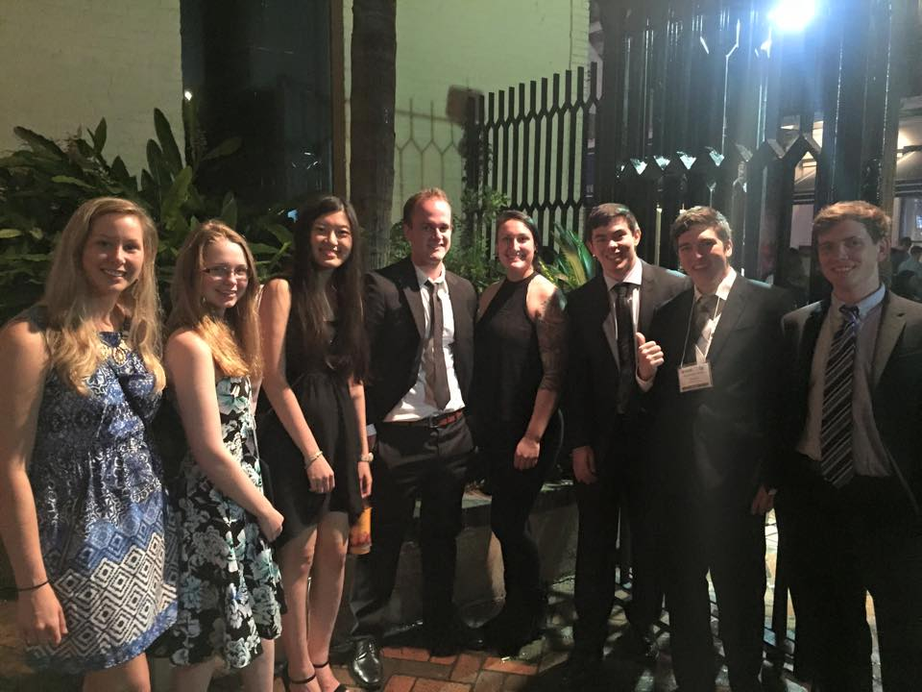
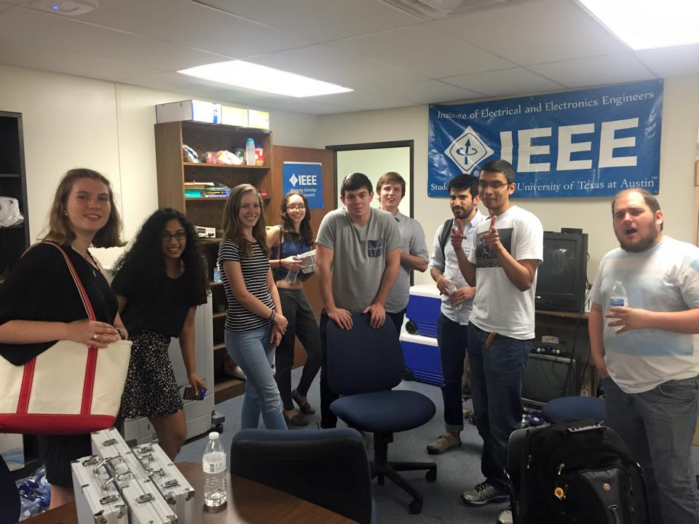
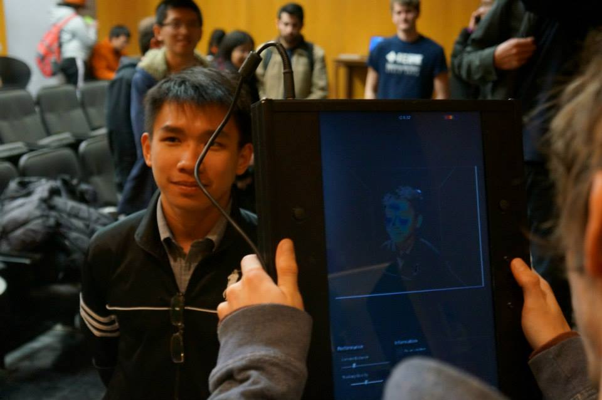

Slide 7
CTS Commitment
Request for 2015 is $1,000, to be divided as follows:
IEEE Welcome Week ($400): Continuing our successful events from last year to boost our membership and retain membership. Due to being moved 3 times in the past 4 years, our office has lost projectors and TV-B Gone Kits.
Leadership Retreats ($300): Expanding the leadership retreats to accommodate more students interested in becoming active in IEEE and the ECE community as we had a record breaking number of Assistant officers and heavily involved members
Region V ($300): Attend Region V Competition in force for next year to increase presence in CTS, give upperclassmen a better understanding of IEEE post graduation, and interact with other Student Branches.

Slide 8
Conclusion
Great prospects for this school year
CTS funding is crucial for several branch programs
New Membership Program(Spark)
Officers are reachable for further questions:
Haley Alexander, chair@ieeeut.org
Hannah Peeler, vice@ieeeut.org
Taylor Zhao, corporate@ieeeut.org

