Slide 1
Spring Planning Meeting Leslie Martinich Section Chair IEEE Central Texas Section January 16, 2016 San Marcos, Texas

Slide 2
Budget: Two Primary Sources of Revenue
Member Dues
Surplus from Conferences and Workshops
Other lesser sources
PACE (Professional Activities)
Region
Societies-> Chapters
Industry (none yet!)
Attendees’ fees at meetings

Slide 3
Members’ Dues
How does the money flow?
IEEE
Rebate to Section
Chapter Budgets

Slide 4
Surplus from Conferences and workshops
How does the money flow from Conferences and Workshops?
Section
Section & Chapter Travel Pool, Training, Coffee Cups, Awards & Dinner, Student Liaison, K-12 Support

Slide 5
What’s the Process?
October-November
Chapters construct budget plans for following year, submit to Treasurer
December
Treasurer and ExCom plan the budget for the following year, rolling up the Chapter Budgets
January
Budget is circulated to Chapter Chairs and is finalized at Spring Planning Meeting

Slide 6
How Hard is it to Construct the Chapter Budget Plan?
Rebate to Section
Starting point:
From the Rebate $ 200
Active Chapter Bonus $ 75
Revenue
From Society support, corporate support, etc
Expenses
For meetings, supplies
This is all about normal monthly meetings

Slide 7
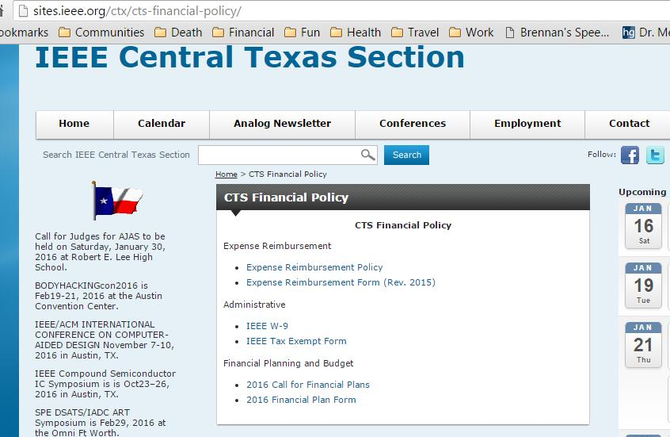
Where do I get these forms?

Slide 8
Things To Note
Planning a workshop or conference is separate, see
http://sites.ieee.org/ctx/conferences/
If you provide AWARDS worth more than $100, the recipient will have to fill out a form for IRS.

