Slide 1
Joint Chapter Systems, Man, and Cybernetics Society Aerospace and Electronic Systems Society
16 January 2016
Notes:
Notes:

Slide 2
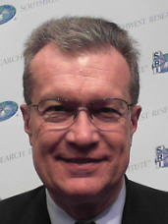
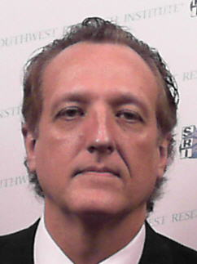
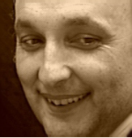
2016 Leadership Team
Chair – Walt Downing, SwRI
Vice Chair – Dr. Sos Agaian, UTSA
Secretary/Treasurer – Nils Smith, SwRI
Notes:
Notes:

Slide 3
SMC28/AES10
New Joint Chapter (only just established)
Formed from existing SMC28 Chapter
SAMIEEE Central Texas Section Members
SMC28 ~ 86 members
AES10 ~ 124 members
Web Presence
https://webinabox.vtools.ieee.org/wibp_home/index/CH05200
Notes:
Notes:

Slide 4
Areas of Common Technical Interest
Systems Engineering
Systems Integration
Complex Systems
Cooperative Systems
System of Systems
Cybernetics
Human-Machine Systems
Signals and Systems
Control Systems
Guidance Systems
Aerospace Systems
Autonomous Systems
Unmanned Systems
Drones and Robots
Communication Systems
Others?

Slide 5
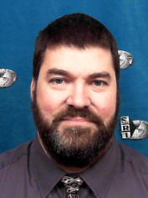
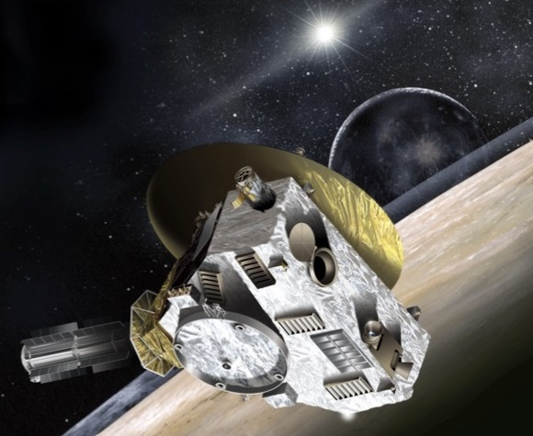
2H 2015 Kickoff Meeting
16 November 2015
Speaker: Dr. Scott Weidner, SwRI
Topic: The New Horizons Mission to Pluto
Location: UTSA
16 Attendees
14 IEEE members
2 non-members
Also webcast
Notes:
Notes:

Slide 6
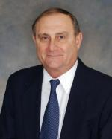
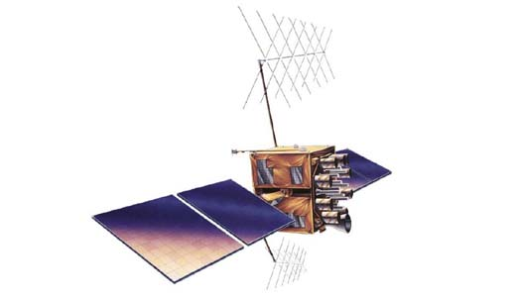
Plans for 2016
22 January 2016
Speaker: Dr. George Schmidt
AESS Distinguished Lecturer
IEEE Fellow and AIAA Fellow
Topic: Navigation Sensors and Systems in GNSS Degraded and Denied Environments
Two Presentations
SwRI (9:00 am) & webcast?
UTSA (2:00 pm)
AIAA Participation
Notes:
Notes:

Slide 7
Other Plans for this coming year
UTSA College of Engineering Technology Symposium
26 April 2016
HEB University Center
Joint SMC/AES Chapter Meeting
Student Project Award Planned
Summer Social Activity - TBD
Fall 2016 Meetings – TBD
Opportunistic Ad Hoc Meetings
Notes:
Notes:

Slide 8
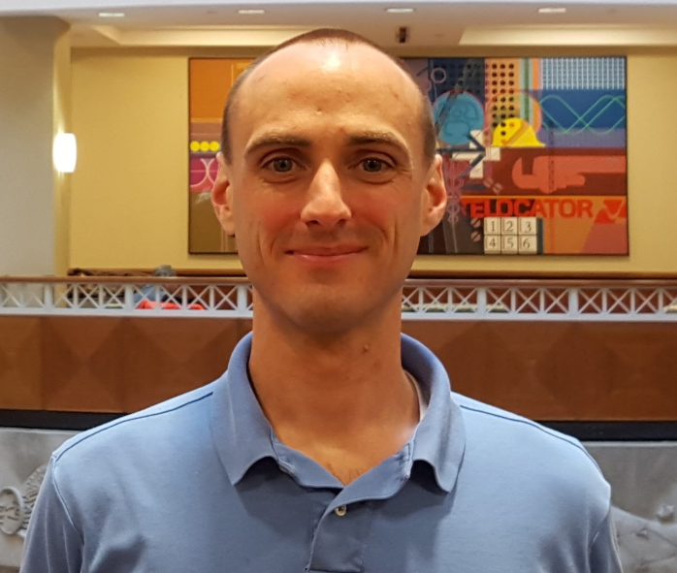
Unique Recognition
Garrett Hall appointed undergraduate student representative to the AESS Board of Governors
Born: Austin, Texas
USAF veteran
Medical Laboratory Technician
Deployed to Iraq
Associate’s Degree in Chemistry from
Austin Community College
UTSA College of Engineering Student
Participant in NASA’s Reduced Gravity Flight Program
Undergraduate research in brain-computer interface using EEG signals to control UAV’s
President of IEEE HKN Kappa Upsilon Chapter
Notes:
Notes:

Slide 9
Open Issues
Future Meeting Dates & Locations
Rebate Funding From SMC and AES
Possible Future Collaboration with:
AIAA
AUVSI
SAE
IEEE Systems Council
Other Societies in IEEE Systems Council
Notes:
Notes:

Slide 10
QUESTIONS??? Thanks!
Notes:
If you’d like to learn more about electronic services, you’ll want to attend the session on the Electronic Services being presented this afternoon by Christian Borgert (BORE-GERT) and Chip Dawson. If you miss this afternoon’s session, you can see it tomorrow morning.
Now I’d like to answer your questions about newsletters and electronic services . . .
(After Q&A)
I’m sorry we don’t have time to answer all of your questions, but we have an abundance of expertise with us this weekend, and much of it is in the Computer Lab upstairs. Stop by and get more information anytime.

