Slide 1
IEEE Central Texas Section 2018 Fall Leadership Planning Meeting August 25, 2018 San Marcus, TX
Section Committee/Officer Name: Jody Everett
Chapter/Affinity Name: Central Texas Consultants Network
Prepared by: Jody Everett

Slide 2
Mission and Leadership Team
Mission/2018 Focused Initiatives*
The Consultant Network promotes the development of members careers through professional and social networking, including publicizing members skills and sharing potential professional opportunities, and support the IEEE Central Texas Section.
Leadership Team
Position Name Email
Chair Jody Everett peverett@austin.rr.com
Vice Chair Luis Basto basto@hotmail.com
Treasurer Jody Everett peverett@austin.rr.com
Secretary Bill Martino bill.martino@ieee.org
Webmaster/vtools Luis Basto lbasto@ieee.org
Program Lester Johnson l.johnson@ieee.org
Member at large Kai Wong kaiwong@ieee.org
Member at large Sergio Liberman sergio.liberman@gmail.com
(*) These can be technical meetings, workshops, networking events, etc.

Slide 3
2018 Key Accomplishments
Meetings (month, topic, L31):
January, The Drone of Drones, L31 Filed.
February, Light-field Display, Architecture and Properties, L31 filed.
March, Using Blockchain for AI Authenticity, L31 filed.
April, Black Holes and Their Degenerate Friends--Explosive new information revealed, L31 Filed
May, FPGA Chips: Introduction, History, and Applicatins ,L31 Filed
June, Ultra-paranoid Computing for the Consumer, L31 Filed
July, AI edge inference, L31 filed.
August, -Planned-Audio Forensics: A Brief Survey and Personal Experience, (Future meeting)
Other Activities/Events:
Planned September 8 workshop-
Successful Consulting in 2018: an IEEE Workshop-
Risk control: Protecting your business from financial threats

Slide 4
2018 Chapter Vitality & Help Needed
Chapter Vitality Assessment (Strong, Ok, Need Improvement)
Examples: Attendance, Topical & Relevance, membership recruitment, finance, volunteers, ….
Strong, good meeting attendence.
Top Help Needed/Issues
Examples: Attendance, Speakers, Training, Finance, Events, collaboration with STEM/Students/PACE/YP/Life Mem, …
Continued Funding.
Need to attract younger members.

Slide 5
Others/Backup
Xxxxx
xxxx

Slide 6
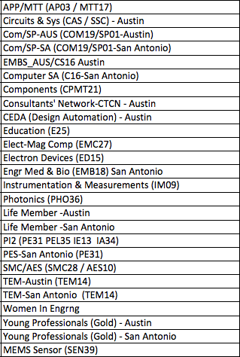
CTS Leadership
CTS Officers
Chapters/Affinity
Standing Committees/Coordinators
Chair
Fawzi Behmann
Vice Chair – A
Fabio Gomez
Vice Chair – SA
Ehsaneh Sunny Shahhaidar
Secretary
Raymond Choo
Treasurer
Bill Martino
Past Chair
Leslie Martinich
Past Past Chairs
Kenny Rice
Strategic Plan
Policies and Procedures PARP
Awards and Recognition
Membership Development
Electronics Communications
Website
vTools
Communications Portal
Conferences/Events
Section-Chapter Vitality Chair
Finance
K-12/STEM Educational Activities
Students Activities
Professional Activities – PACE
Outreach Program
Humanitarian

