Slide 1
IEEE Central Texas Section 2018 Fall Leadership Planning Meeting August 25, 2018 San Marcos, TX
Officer Name: James Brakefield
Chapter Name: San Antonio Computer Chapter (C16)
Prepared by: James Brakefield

Slide 2
Mission and Leadership Team
Mission/2018 Focused Initiatives
Speakers for all except summer and December
Of interest to both working IEEE and college students
Leadership Team
Position Name Email
Chair James Brakefield jim.brakefield@ieee.org
Vice Chair Webin Lou wlou@stmarytx.edu
Treasurer T. Scott Atkinson t.atkinson@ieee.org
Secretary Tom O’Brien t.p.obrien@ieee.org
Webmaster not yet

Slide 3
2018 Key Accomplishments
Meetings (month, topic, L31):
January: no meeting, ice on roads
February(4): Securing your Domain in DNS, Paul Guido
March(13): Unmanned Aviation in the Lone Star State,
David Hook, Planehook Aviation Services
April(21): Soft-Core CPUs, Jim Brakefield
May: no meeting, school is out
September: UTSA Student Success Center, Jill Ford
Other Activities/Events:
Planning meeting: Topics & Speakers

Slide 4
2018 Chapter Vitality & Help Needed
Chapter Vitality Assessment
Attendance OK: Varies considerably
Three active IEEE Student chapters in SA
No Webmaster
Same suite of officers next year
St. Marys Un. provides meeting room and most of student attendees
Top Help Needed/Issues
New website
Would like to use some speakers from Austin
Fawzi: IOT
Mitch Alsup: Computer Architecture
Topical subjects: Deep Learning, Security threats

Slide 5
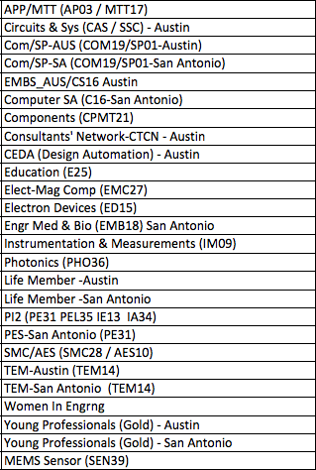
CTS Leadership
CTS Officers
Chapters/Affinity
Standing Committees/Coordinators
Chair
Fawzi Behmann
Vice Chair – A
Fabio Gomez
Vice Chair – SA
Ehsaneh Sunny Shahhaidar
Secretary
Raymond Choo
Treasurer
Bill Martino
Past Chair
Leslie Martinich
Past Past Chairs
Kenny Rice
Strategic Plan
Policies and Procedures PARP
Awards and Recognition
Membership Development
Electronics Communications
Website
vTools
Communications Portal
Conferences/Events
Section-Chapter Vitality Chair
Finance
K-12/STEM Educational Activities
Students Activities
Professional Activities – PACE
Outreach Program
Humanitarian

