Slide 1
IEEE Central Texas Section 2019 Fall Planning Meeting August 24, 2019 San Marcos, TX
Section Committee/Officer Name: Aaron Ferrer, BRIDGE Correspondent
Chapter/Affinity Name: UTSA Eta Kappa Nu Kappa Upsilon Chapter
Prepared by: Aaron Ferrer, Garret Hall

Slide 2
Mission and Leadership Team
Leadership Team
Position | Name
President | Justin Bisignano
Vice President | Harrison Hill
Webmaster | Alonzo Ramon
BRIDGE Correspondent | Aaron Ferrer

Slide 3
Spring 2019 Accomplishments
Brandeis High School Bronco Botz Outreach
Scheduled Space Science SwRI tour – 15 in attendance
Mentored students on an individual basis weekly
UTSA Workshops
Anaconda/Python
Install Anaconda and Python on Windows, Linux, MAC
Machine Learning/Deep Learning
Binary Classification (Cat and Dog images) with Keras
UTSA Speakers
Sara Ahmed: Modeling, simulation and analysis of power electronics systems with a focus on stability, fault analysis, and integration of renewables. Design and control of three phase converters and AC drives.
Ricardo Ramirez: Deep Learning Bioinformatics

Slide 4
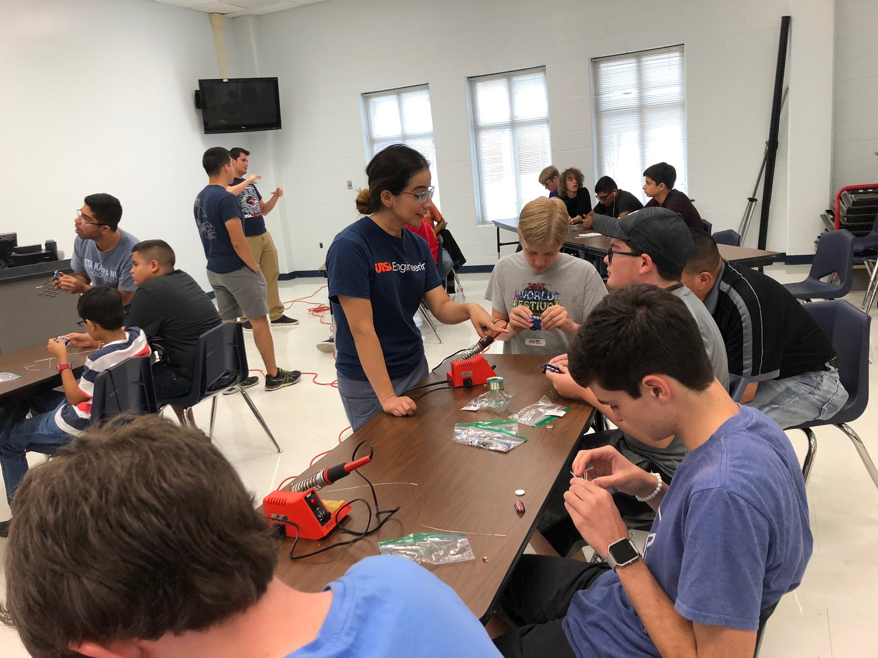
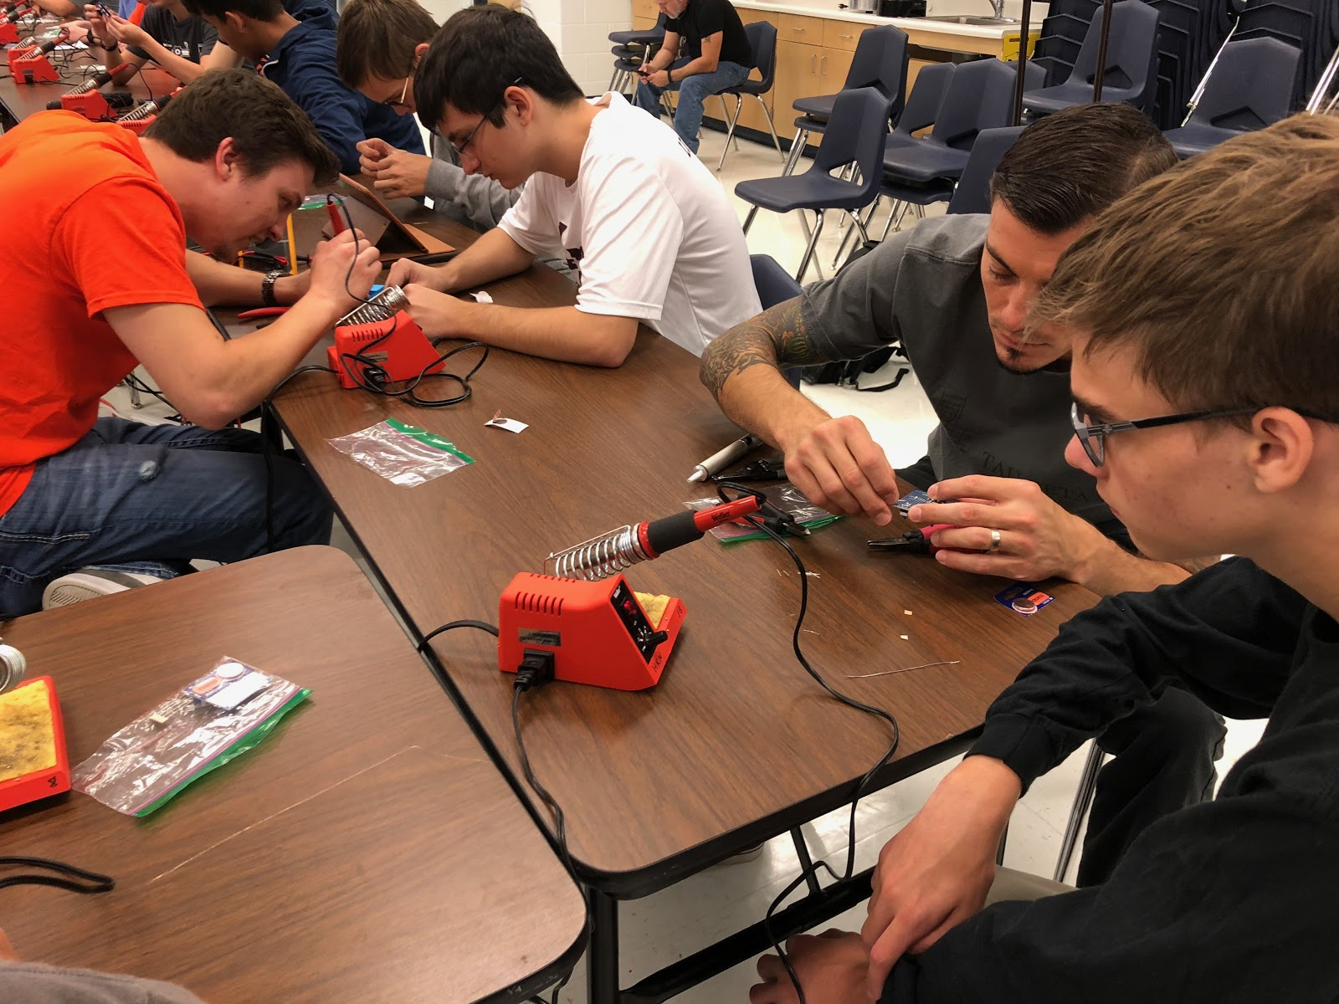
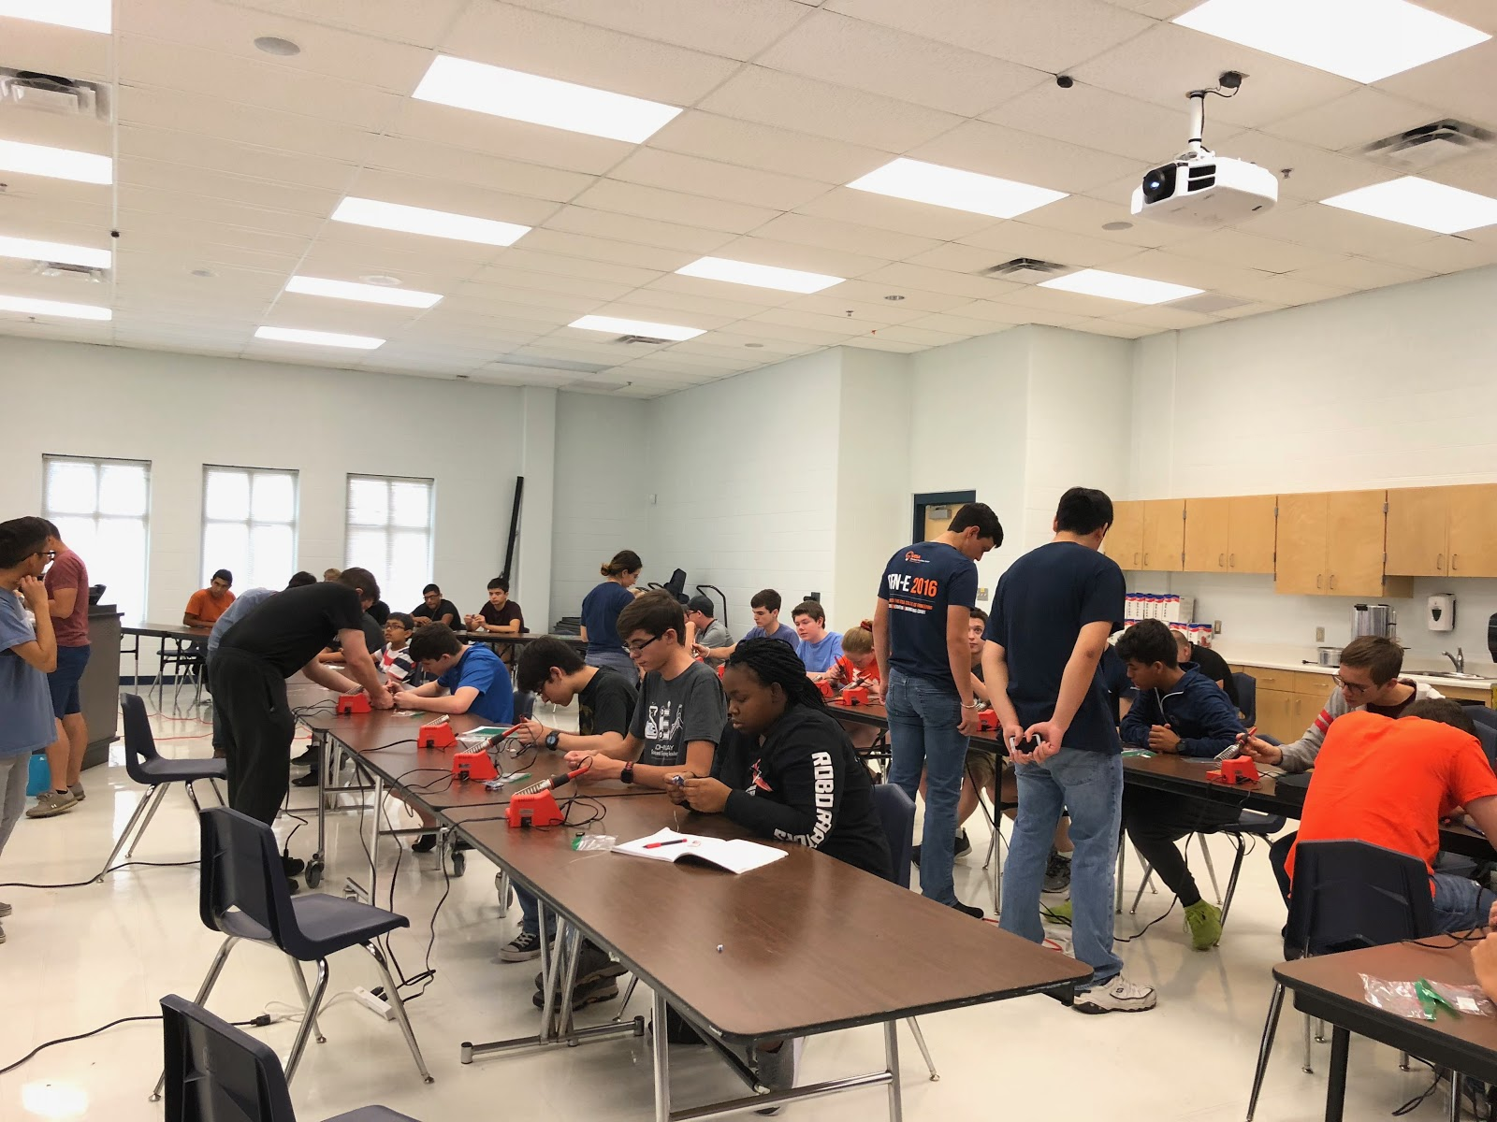
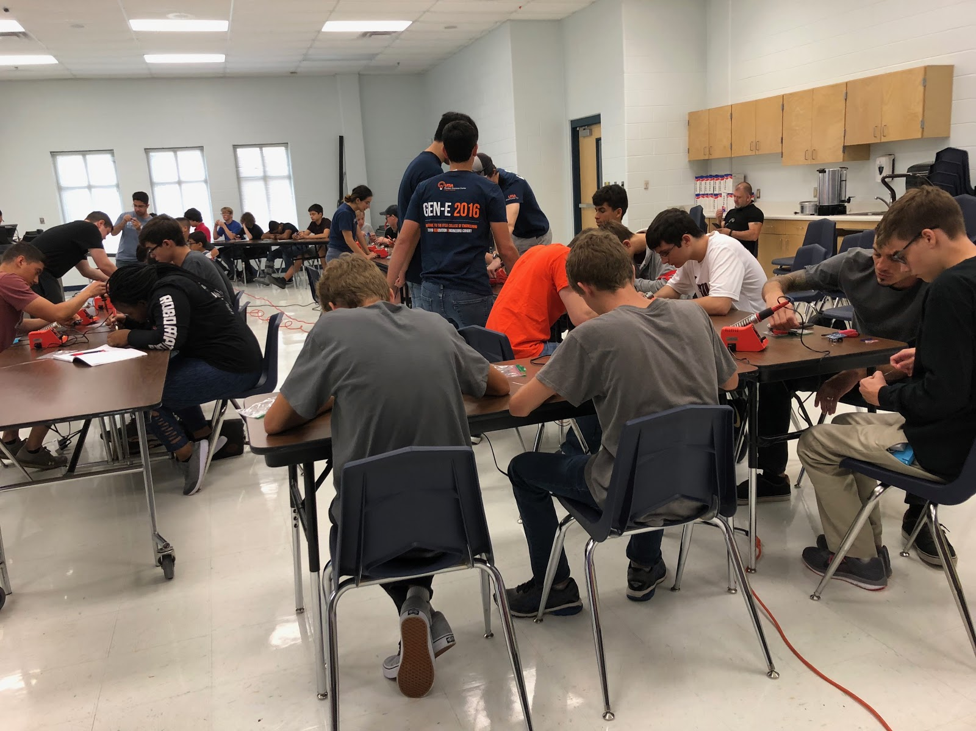
Bronco Botz Outreach

Slide 5
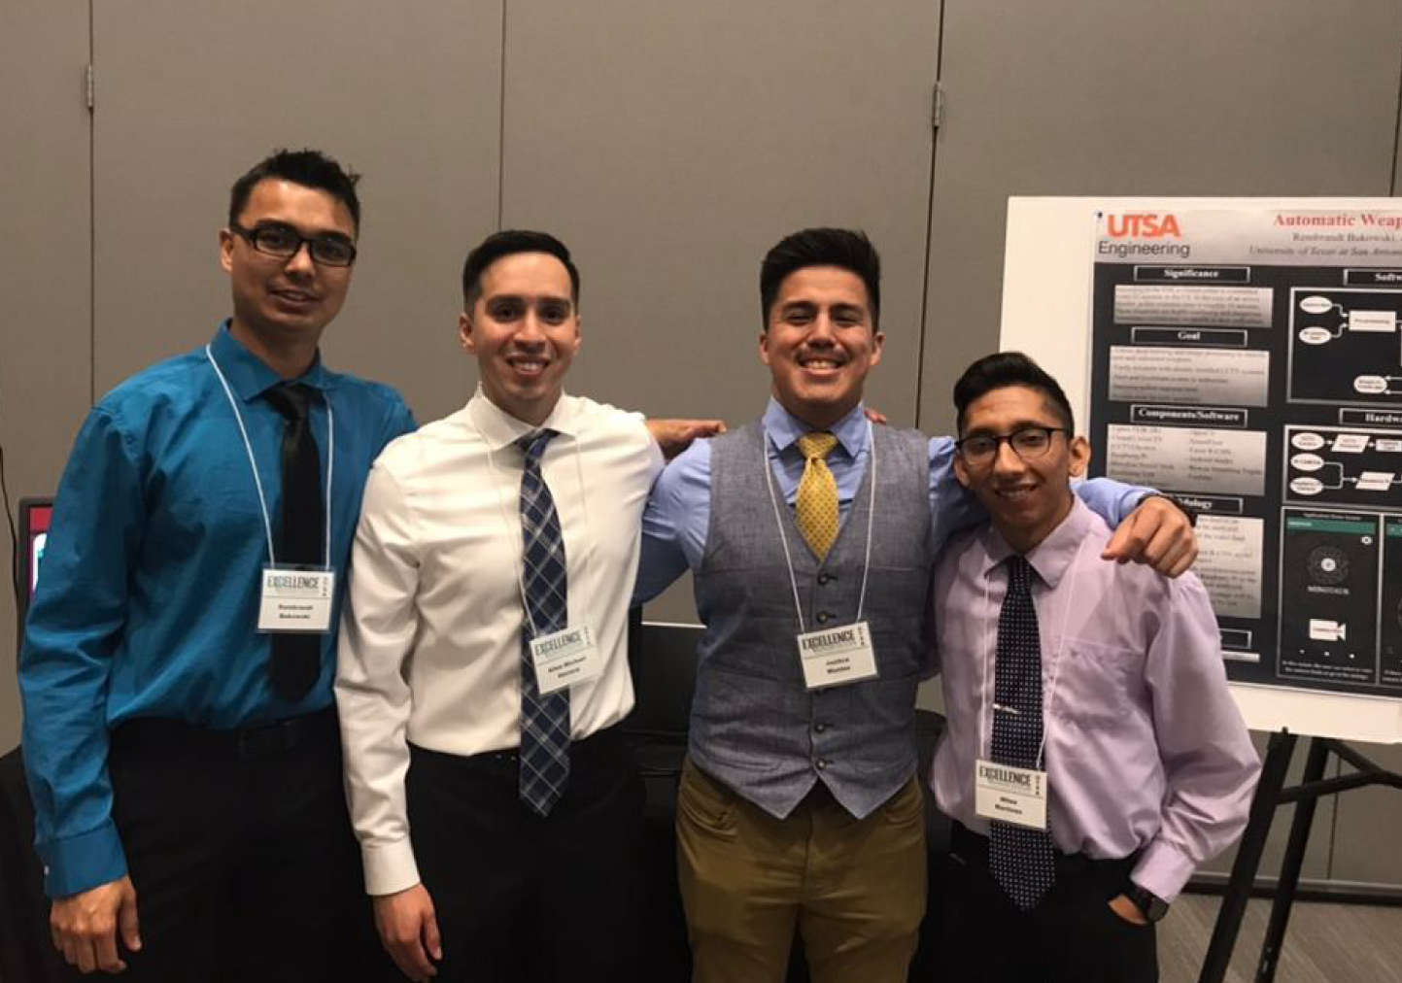
Spring 2019 Accomplishments
Senior Design Outreach
Justice Montes, Allen Herrera, Miles Martinez, Rembrandt Bukowski
Daedelus Automatic Weapon Detection System
Previous HKN officer accomplishments
ExCEllence in Senior Design
Advisor: Raymond Choo

Slide 6
Chapter Goals
Vision
Collaborate with professional societies (SPS, ACM, ACM-W, TBP)
Working with leadership to discuss interdisciplinary projects
Connect students to mentors (SwRI, AESS)
Network with Professionals to develop skills outside of the classroom
Promoting member contribution within HKN and between societies
Organizing friendly events (video game tournaments, hackathons, socials)
Hosting technical speaker events to introduce companies and inspire members through their work

