Slide 1
IEEE Central Texas Section 2019 SPRING Planning Meeting January 19, 2019 San Marcus, TX
Section Committee/Officer Name: Jim Brakefield
Chapter/Affinity Name: San Antonio Computer Chapter
Prepared by: Jim Brakefield

Slide 2
Mission and Leadership Team
Mission/2019 Focused Initiatives*
Leadership Team
Position Name Email
Chair Jim Brakefield jim.brakefield@ieee.org
Vice Chair Wenbin Luo wbluo@ieee.org
Treasurer Scott Atkinson s.atkinson@ieee.org
Secretary Tom O’Brien t.p.obrien@ieee.org
(*) These can be technical meetings, workshops, networking events, etc.

Slide 3
2018 Key Accomplishments
Meetings (month, topic, L31):
Feb. Domain Name Security 4
Paul Guido, Broadway Bank
Mar. Drones: Unmanned Aviation in the Lone Star State 13
Dave Hook, Planehook Aviation Services
April Soft Core Microprocessors 21
Jim Brakefield
Sept. An Introduction to Wireless Communications in the 5G Era 6
Dr. Brian Kelly, UTSA
Oct. Biosensors 23
Tom Jobe, SensiQ Technologies, distinguished speaker
Nov. Bioinformatics in Biology and Medicine 9
Dr. Sourav Roy, St. Marys University
Average 13
Feb. Planning meeting 6
Sept. Planning meeting 6

Slide 4
2018 Chapter Vitality & Help Needed
Chapter Vitality Assessment (Strong, Ok, Need Improvement)
Examples: Attendance, Topical & Relevance, membership recruitment, finance, volunteers, ….
Attendance depends on topic
Tried different location: no students attended
Tried different date: fewer non-students attended
Joint meetings work OK: one with SA-COMM/SP and one with SA-EMB
Top Help Needed/Issues
Examples: Attendance, Speakers, Training, Finance, Events, collaboration with STEM/Students/PACE/YP/Life Mem, …

Slide 5
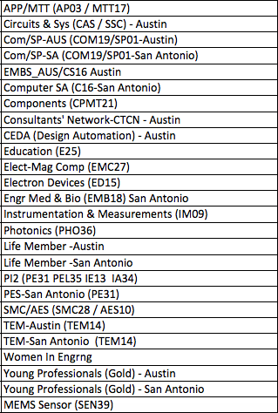
CTS Leadership
CTS Officers
Chapters/Affinity
Standing Committees/Coordinators
Chair
Fawzi Behmann
Vice Chair – A
Fabio Gomez
Vice Chair – SA
Ehsaneh Sunny Shahhaidar
Secretary
Raymond Choo
Treasurer
Bill Martino
Past Chair
Leslie Martinich
Past Past Chairs
Kenny Rice
Strategic Plan
Policies and Procedures PARP
Awards and Recognition
Membership Development
Electronics Communications
Website
vTools
Communications Portal
Conferences/Events
Section-Chapter Vitality Chair
Finance
K-12/STEM Educational Activities
Students Activities
Professional Activities – PACE
Outreach Program
Humanitarian

