Slide 1
IEEE Central Texas Section 2019 SPRING Planning Meeting January 19, 2019 San Marcus, TX
Section Committee/Officer Name: Jim Brakefield
Chapter/Affinity Name: San Antonio Life Members
Prepared by: Jim Brakefield

Slide 2
Mission and Leadership Team
Mission/2019 Focused Initiatives
Texas Technical Tour http://sites.ieee.org/ieee-tx-technical-tour/
Houston/NASA, San Antonio, Austin, Waco, Dallas and points in between
Bus tour with hotel stops
Lead by Scott Atkinson
IEEE Grant for SAMSAT exhibits: https://samsat.org/
SA-LM (with help) to do Exhibit Planning, Design & Construction
SAMSAT is expanding into a larger facility
Lead by Ernest Franke
Leadership Team
Position Name Email
Chair Jim Brakefield jim.brakefield@ieee.org
Vice Chair Garrett Polhamus polhamus@ieee.org
Treasurer John Lyons jlyons@ieee.org
Secretary Scott Atkinson s.atkinson@ieee.org
With assistance by: Wiggins, Harris, Franke & O’Brien

Slide 3
2018 Key Accomplishments
Meetings (month, topic, L31):
Jan. Recreation of Joule's experiment of the heat equivalent of work 18
John Engelbrecht
Feb. STEM Mentoring Opportunities at NEISD, Amanda Galvin 9
Mar. The Defense Laboratories Office and Defense Research Assessment 12
Garrett Polhamus
April Tour of 10BitWorks, Mike Garis 11
May Our Love of the River Runs Deep 16
Chelsea Giles, San Antonio River Authority
June CPS Energy talk: Energy Industry Past, Present and Future 18
Mike Harris, CPS Energy
July Tour of Tri-Service Research Laboratory (TSRL) at Fort Sam Houston 15
Aug. Bletchley Park and Cryptography, Michael Gershman, SAC 27
Sept. Vehicle Electrification and Energy Storage Technology at SwRI 19
Christopher Chadwell, Southwest Research Institute
Oct. Provisioning a 64-bit computer, Jim Brakefield 13
Nov. Appreciation Dinner 28
Average attendance 17
Five planning meetings ~6

Slide 4
2018 Chapter Vitality & Help Needed
Chapter Vitality Assessment (Strong, Ok, Need Improvement)
Examples: Attendance, Topical & Relevance, membership recruitment, finance, volunteers, ….
Attendance could be better
Topical & Relevance: OK
Membership recruitment:
Top Help Needed/Issues
Examples: Attendance, Speakers, Training, Finance, Events, collaboration with STEM/Students/PACE/YP/Life Mem, …
Looking for help on SAMSAT effort

Slide 5
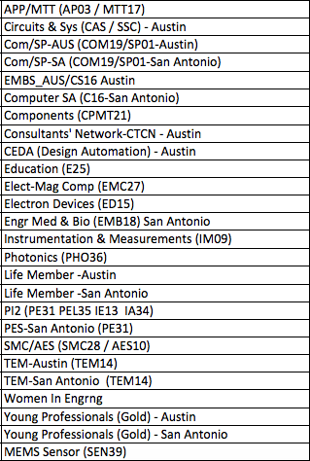
CTS Leadership
CTS Officers
Chapters/Affinity
Standing Committees/Coordinators
Chair
Fawzi Behmann
Vice Chair – A
Fabio Gomez
Vice Chair – SA
Ehsaneh Sunny Shahhaidar
Secretary
Raymond Choo
Treasurer
Bill Martino
Past Chair
Leslie Martinich
Past Past Chairs
Kenny Rice
Strategic Plan
Policies and Procedures PARP
Awards and Recognition
Membership Development
Electronics Communications
Website
vTools
Communications Portal
Conferences/Events
Section-Chapter Vitality Chair
Finance
K-12/STEM Educational Activities
Students Activities
Professional Activities – PACE
Outreach Program
Humanitarian

