Slide 1
IEEE Central Texas Section 2019 SPRING Planning Meeting January 19, 2019 San Marcus, TX
Treasurer’s Report
Bill Martino

Slide 2
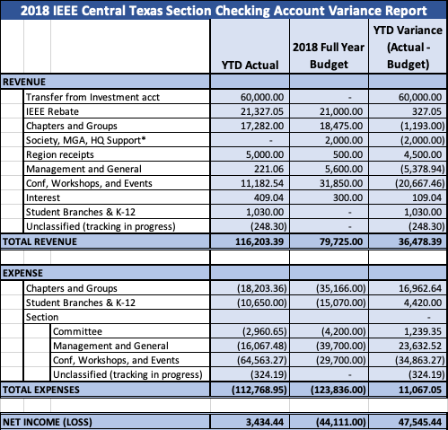
2018 Variance Report

Slide 3
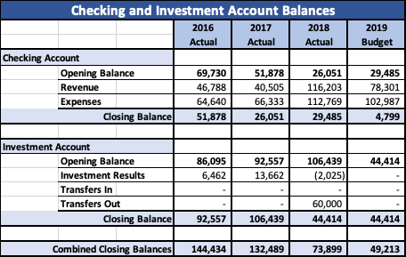
Account Balances

Slide 4
Chapter and Group Funding
“I was asked manage budget and expenses – Can someone just tell me
Where am I getting money from, what to budget for and expenses and budget control can be achieved?”
Request in FinPlan
Active Chapter or Group share of the IEEE Dues Rebate to the Section
$200 or $275
Additional Central Texas Section Support
Society Support
Surplus from Chapter or Group Managed Conferences, Workshops, or Events
Other Sources – Corporate Sponsorship, Donations, etc.
Dollars available to your Chapter or Group

Slide 5
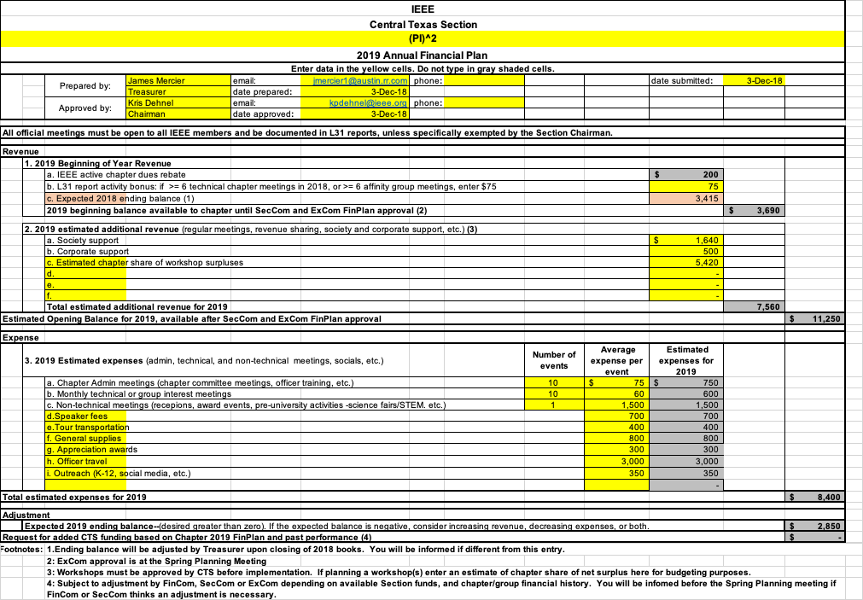
Chapter and Group Funding
“I was asked manage budget and expenses – Can someone just tell me
Where am I getting money from, what to budget for and expenses and budget control can be achieved?”
Once the CTS budget is approved your Chapter or Group FinPlan is your budget for the year.
All expenses within your budget can be approved by your chair. Expenses beyond your budget must be approved by the Section Chair.

Slide 6
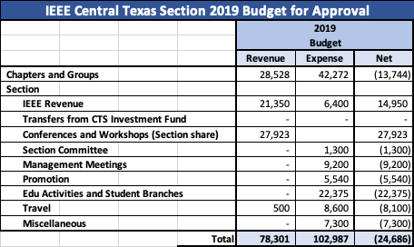
2019 Budget for Approval

Slide 7
Account Balances

Slide 8
Thank you
Questions?

Slide 9
Chapter and Group Funding
Annual Chapter and Group Carryover
Each year chapters and groups may receive funds by way of:
Share of the IEEE Rebate
Surplus from events
Grants, awards, and other support from Societies
Revenue from other entities outside of CTS, e. g., corporate support
Unspent funds from these sources will carryover to the following year and be part of the opening balance of the chapter or group.

