Slide 1
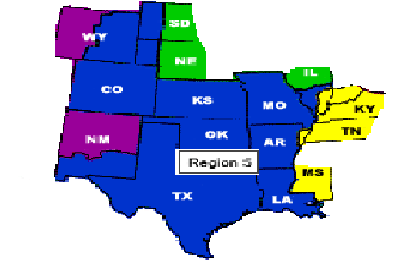
IEEE & IEEE-USA
Organization and Governance
T. Scott Atkinson, IEEE LSM
South Area Chair, IEEE Region 5

Slide 2

IEEE’s Organizational Chart
(Bottom Up Approach)
IEEE Members
IEEE Board of Directors
IEEE Assembly
Chaired by the President and CEO
IEEE Major Boards
Publication Services and Products
Technical Activities
Member and Geographical Activities
Educational Activities
Standards Association
Technical Societies
Chapters
IEEE USA
Regions
Local Sections
Chapters
?

Slide 3
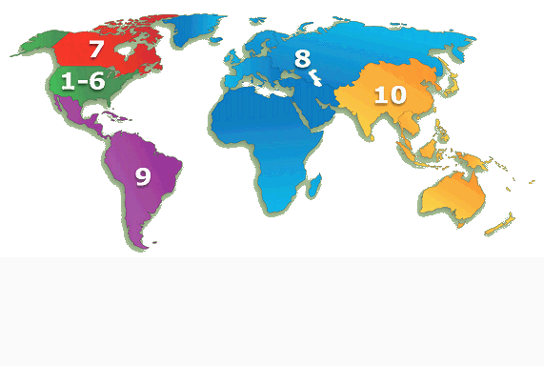
IEEE Regions
Notes:
Provided by John Day from MDC Meeting Feb 07. Based on Year end data.
November 2015 Region 5 had 26,235 total members – 22,925 higher grade.

Slide 4
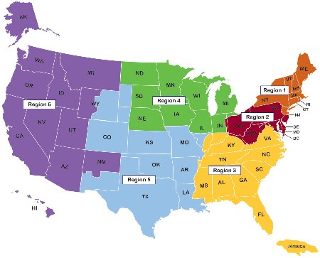
Region 5 Area
26 Sections

Slide 5
Sections: South Area, Region 5
(Region support split into 4 Areas to assist sections, chapters & student branches)
Corpus Christi (& Rio Grande Valley Sub-Section)
Central Texas (Austin/San Antonio)
Fort Worth (originally a part of Dallas)
Dallas
Galveston Bay (originally a part of Houston)
Houston (& Freeport Sub-Section)
(4 large & 2 medium in size)

Slide 6
IEEE Governance For Geo Units
New York State Not-For-Profit Corporation Laws
Certificate of Incorporation
Constitution and Bylaws / Policies (incl Finance)
IEEE-USA Operations Manual (Policies & Procedures)
MGA Board – MGA Operations Manual
  (Section 9 covers Regions, Sections & Chapters)
Region By-Laws (for Region Structure)
CTS Local Operating Procedures (Approved by Excom)
Chapter Policies & Procedures (most are un-documented)

Slide 7
Region 5 Director’s Remarks
The Region provides planning and funding support as well as working to assure sections have vibrant programs to support members careers and meet the IEEE mission of Advancing Technology for Humanity.
As Region Director, it is my job to better serve the needs of all members in Region 5. If you have thoughts on how to do that, please share them as we look for ways to expand your engagement with IEEE.
Francis Grosz
Region 5 Director
2016-2017

Slide 8
About IEEE-USA
IEEE-USA is an organizational unit of the Institute of Electrical and Electronics Engineers to support the career and public policy interests of IEEE's U.S. members.
IEEE-USA is primarily supported by an annual assessment paid by USA IEEE members.
IEEE-USA's mission, as outlined in the IEEE Bylaws, is to recommend policies and implement programs specifically intended to serve and benefit the members, the profession and the public in the United States in appropriate professional areas of economic, ethical, legislative, social and technology policy concern.
Our vision is to serve the IEEE U.S. member by being the technical professional's best resource for achieving lifelong career vitality and by providing an effective voice on policies that promote U.S. prosperity.

Slide 9
IEEE-USA Vision
Is to serve the IEEE U.S. member by being the technical professional's best resource for achieving lifelong career vitality and by providing an effective voice on policies that promote U.S. prosperity.

Slide 10
IEEE USA – Professional Activities
Areas of Emphasis
  Career and Professional Resources
  Engagement of Students and Young Professionals
  Government Relations
  Financial support to Geo Units for specific activities (generally known as PACE)

Slide 11
Presentations Available Upon Request
*Running a Successful Technical Chapter *R5 Directors Vision & Goals *R5 Standards Report *R5 SPAC Report *R5 Industry Liaison Report *R5 Outreach Report *R5 Membership Development Report *IEEE Young Professionals Report | *R5 Treasurers Report *R5 South Area Report *R5 Awards & Recognition *IEEE-USA Future Leaders Forum *R5 Life Members Report *R5 PACE Report *R5 Communications Report *MGA Financial Operations Report

Slide 12
Handy Links
IEEE: ieee.org
Governing Docs: http://www.ieee.org/about/index.html
IEEE-USA: ieeeusa.org
IEEE MGA: ieee.org/MGA
Current MGA Ops Manual: http://www.ieee.org/documents/section_09_february_2016.pdf
Region 5: ieeer5.org

Slide 13
Thanks.
Any questions??
Contact Info: T. Scott Atkinson
S.atkinson@ieee.org / 210-410-0382

