Slide 1
IEEE Central Texas Section
Chapter Chair Training
-SAMIEEE-
Joe Redfield
J.Redfield@ieee.org
March 4, 2016
Austin, Texas

Slide 2
SAMIEEE—Our database of members
How to access SAMIEEE
How to get an export of your members
How to save that export as an Excel spreadsheet

Slide 3
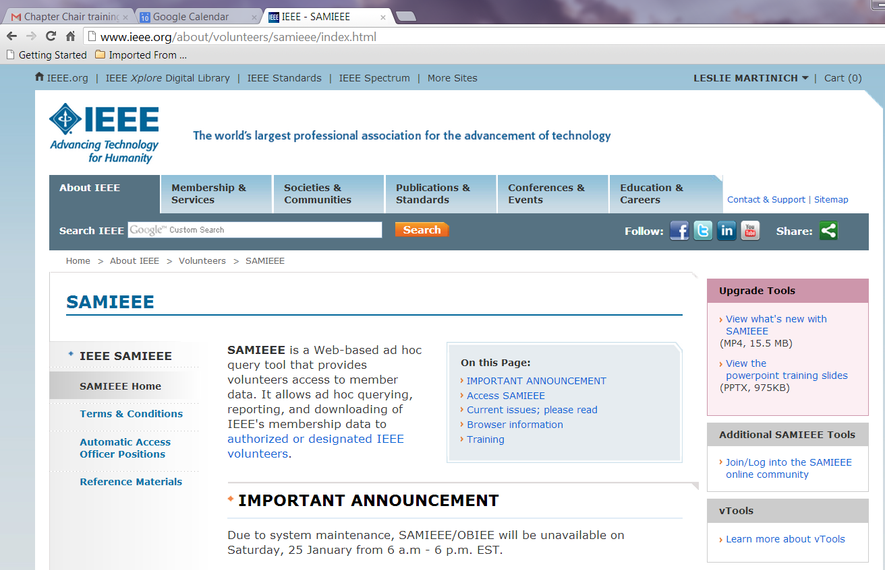
Search for SAMIEEE training
Training!
Training!

Slide 4
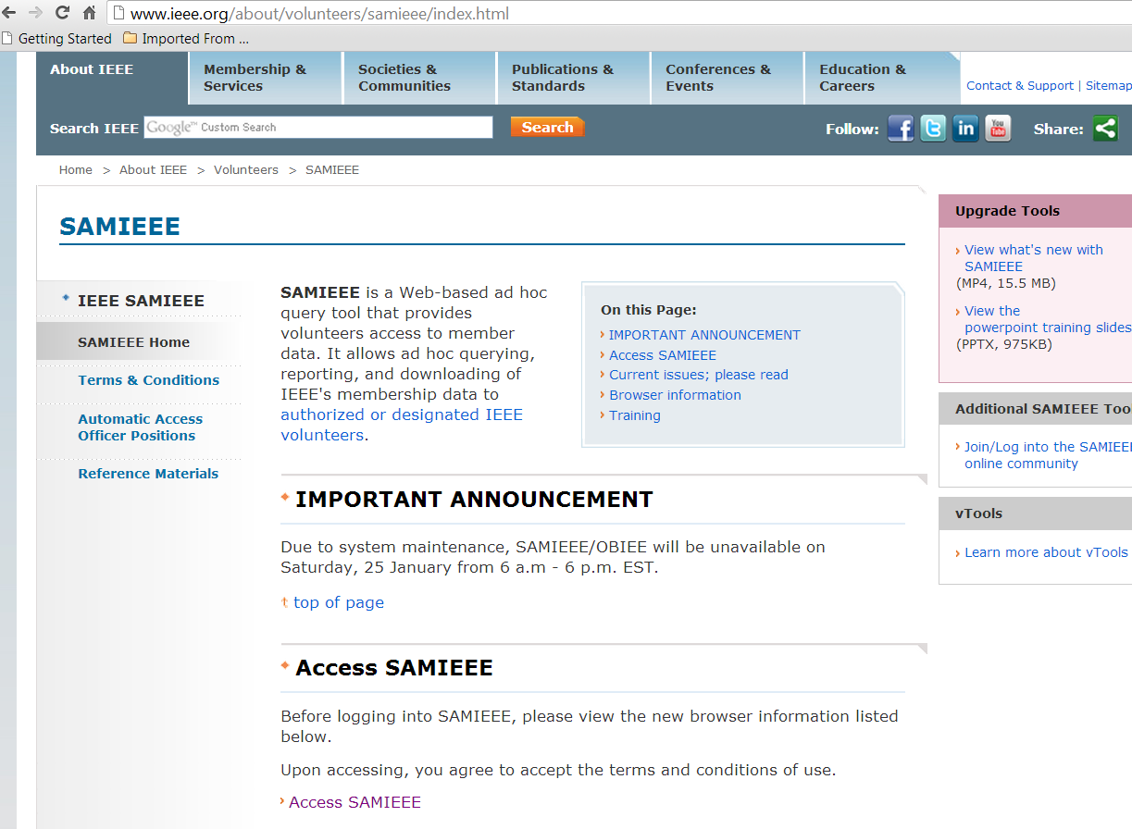
Access SAMIEEE

Slide 5
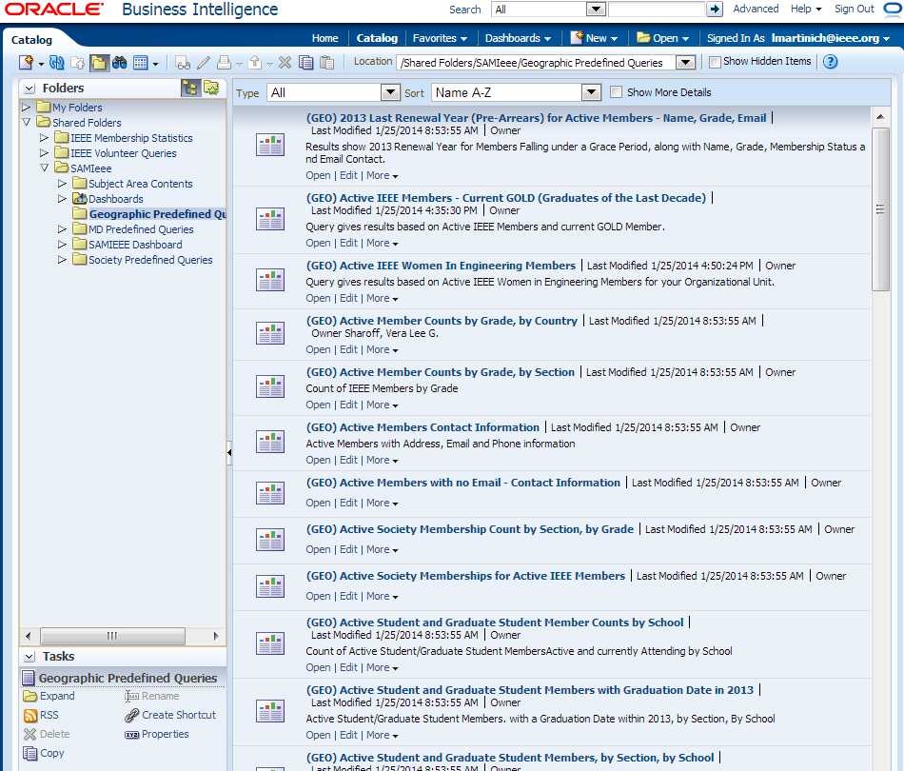
1 Catalog
2 Shared Folders
3 SAMIeee
4 Geographic …
5 Active Members Contact Info

Slide 6
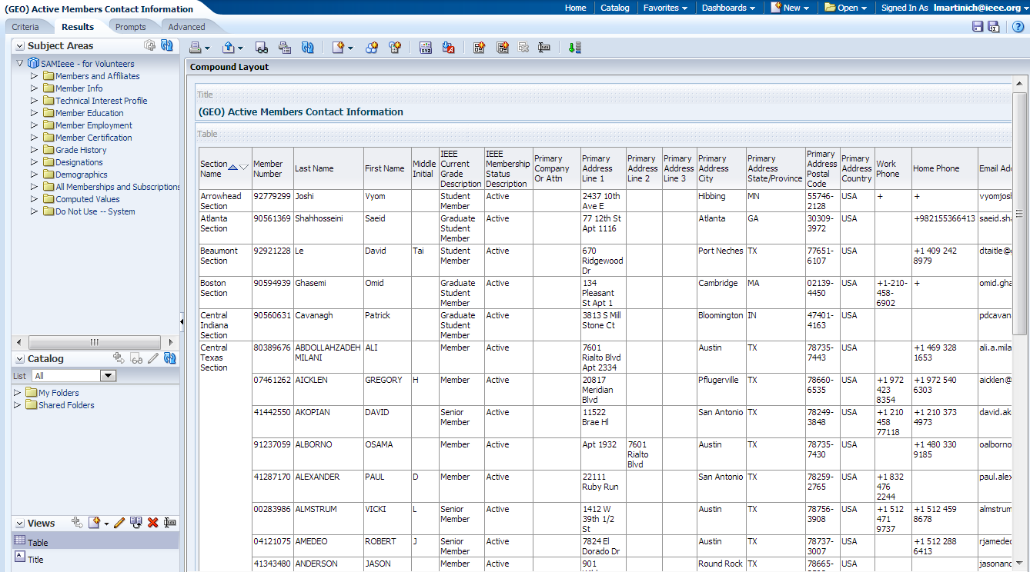
5 Active Members Contact Info

Slide 7
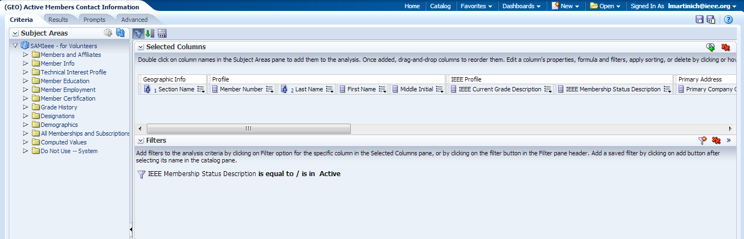

Slide 8
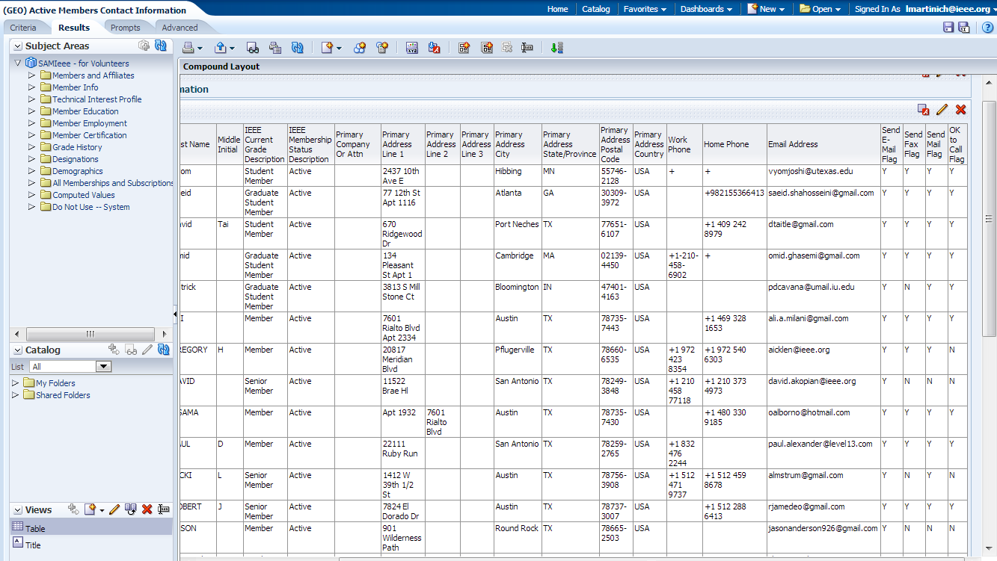

Slide 9
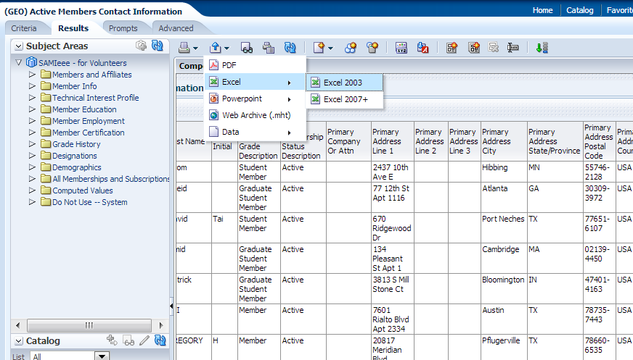
Export this analysis

Slide 10
Finally….
Save your Excel file
Use MailMerge to send email to your members
BUT, do not send email if the “Send E-Mail Flag” is N

Slide 11
Thank you!
Questions: contact me:
Joe Redfield
J.Redfield@ieee.org
210.744.2916

