Slide 1
Progress Report for Spring 2013
Texas State University – San Marcos
Dr. Larry Larson, Advisor
LL25@txstate.edu

Slide 2
Branch Information
Officers:
Chair Adrian Fabian af1362@txstate.edu
Vice-Chair Chris Crichton cc1807@txstate.edu
Secretary Aaron Horn ah1615@txstate.edu
Treasurer Deborah Williams dsw47@txstate.edu
Four years old
Participation:
In our fourth year of existence we have more than 30 members participating in our events.

Slide 3
2012-2013 Program Activities
Completed Program Activities:
BEST Robotics @ Dripping Springs HS 11/30/12 14 members participated
Book Parade for Boys & Girls Club 11/02/12 5 members participated
Future Cities @ Texas State University 01/19/13 14 members participated
Ongoing & Upcoming Program Activities:
Recycling Bins for LBJ Student Center (09/03/13)
High School Student Tours (02/22/13)
IEEE R5 Conference (04/06/13)
Arduino Microcontroller Tutorials
Internship Initiatives
Social Events (Poker Tournaments, Movies, etc.)

Slide 4
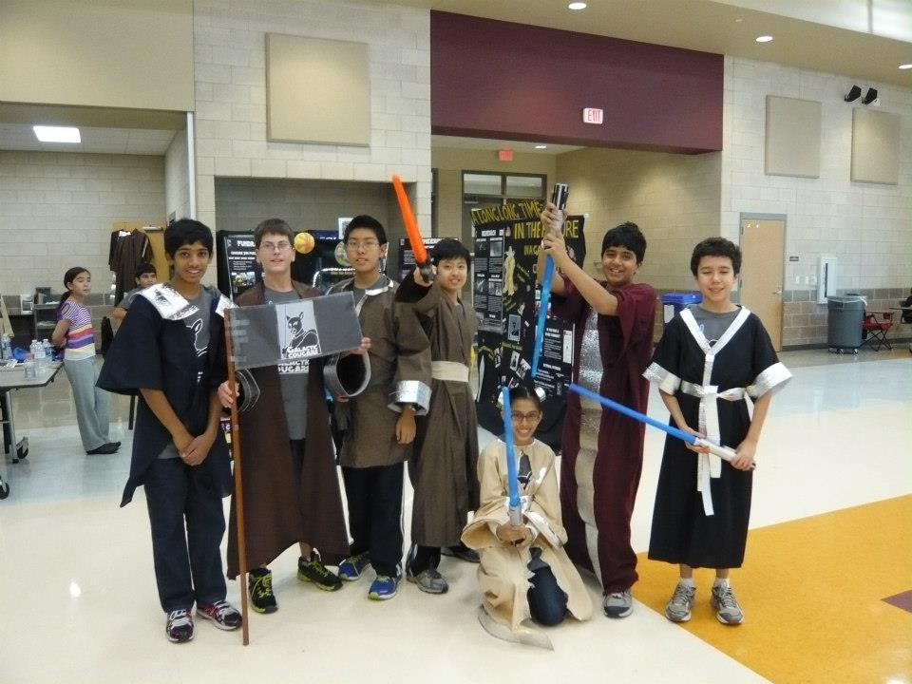
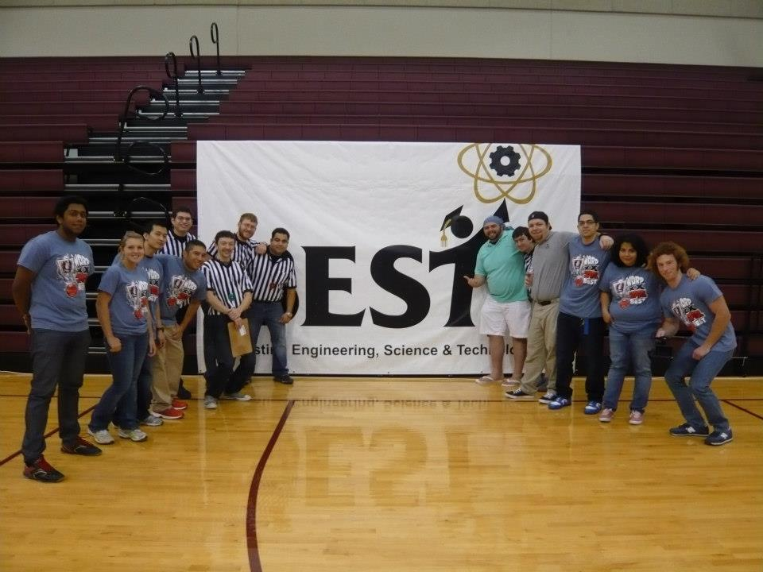
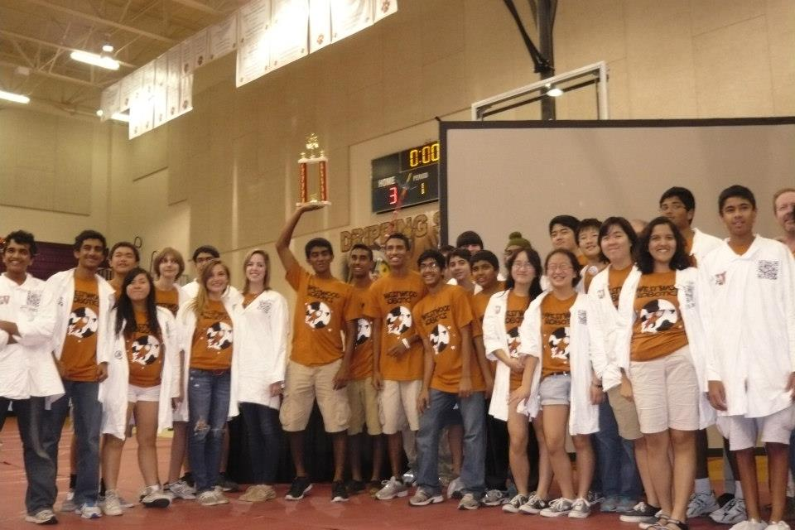
BEST Robotics
-Leadership Development
-Promoting STEM
(Science, Technology, Engineering, & Math)

Slide 5
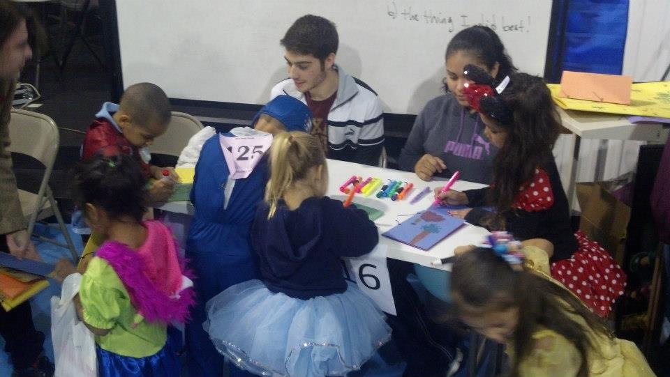
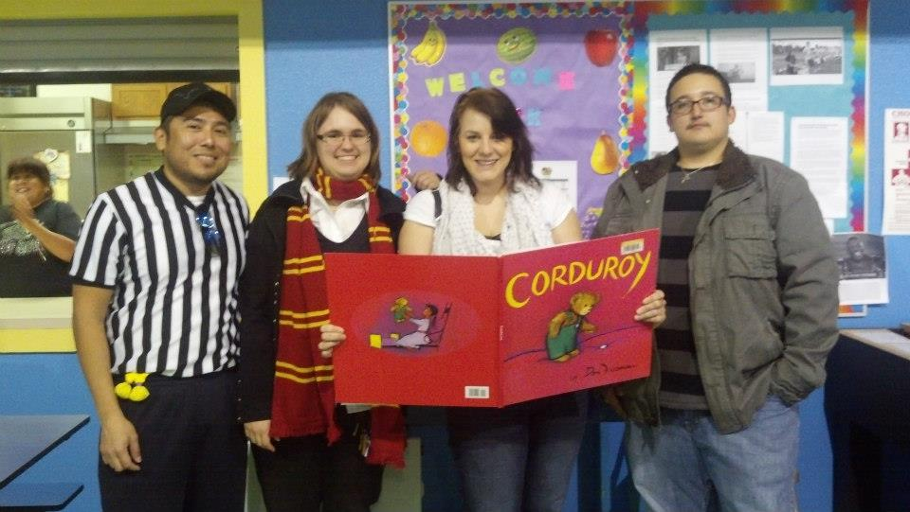
Book Parade
-Community Service
-Philanthropy

Slide 6
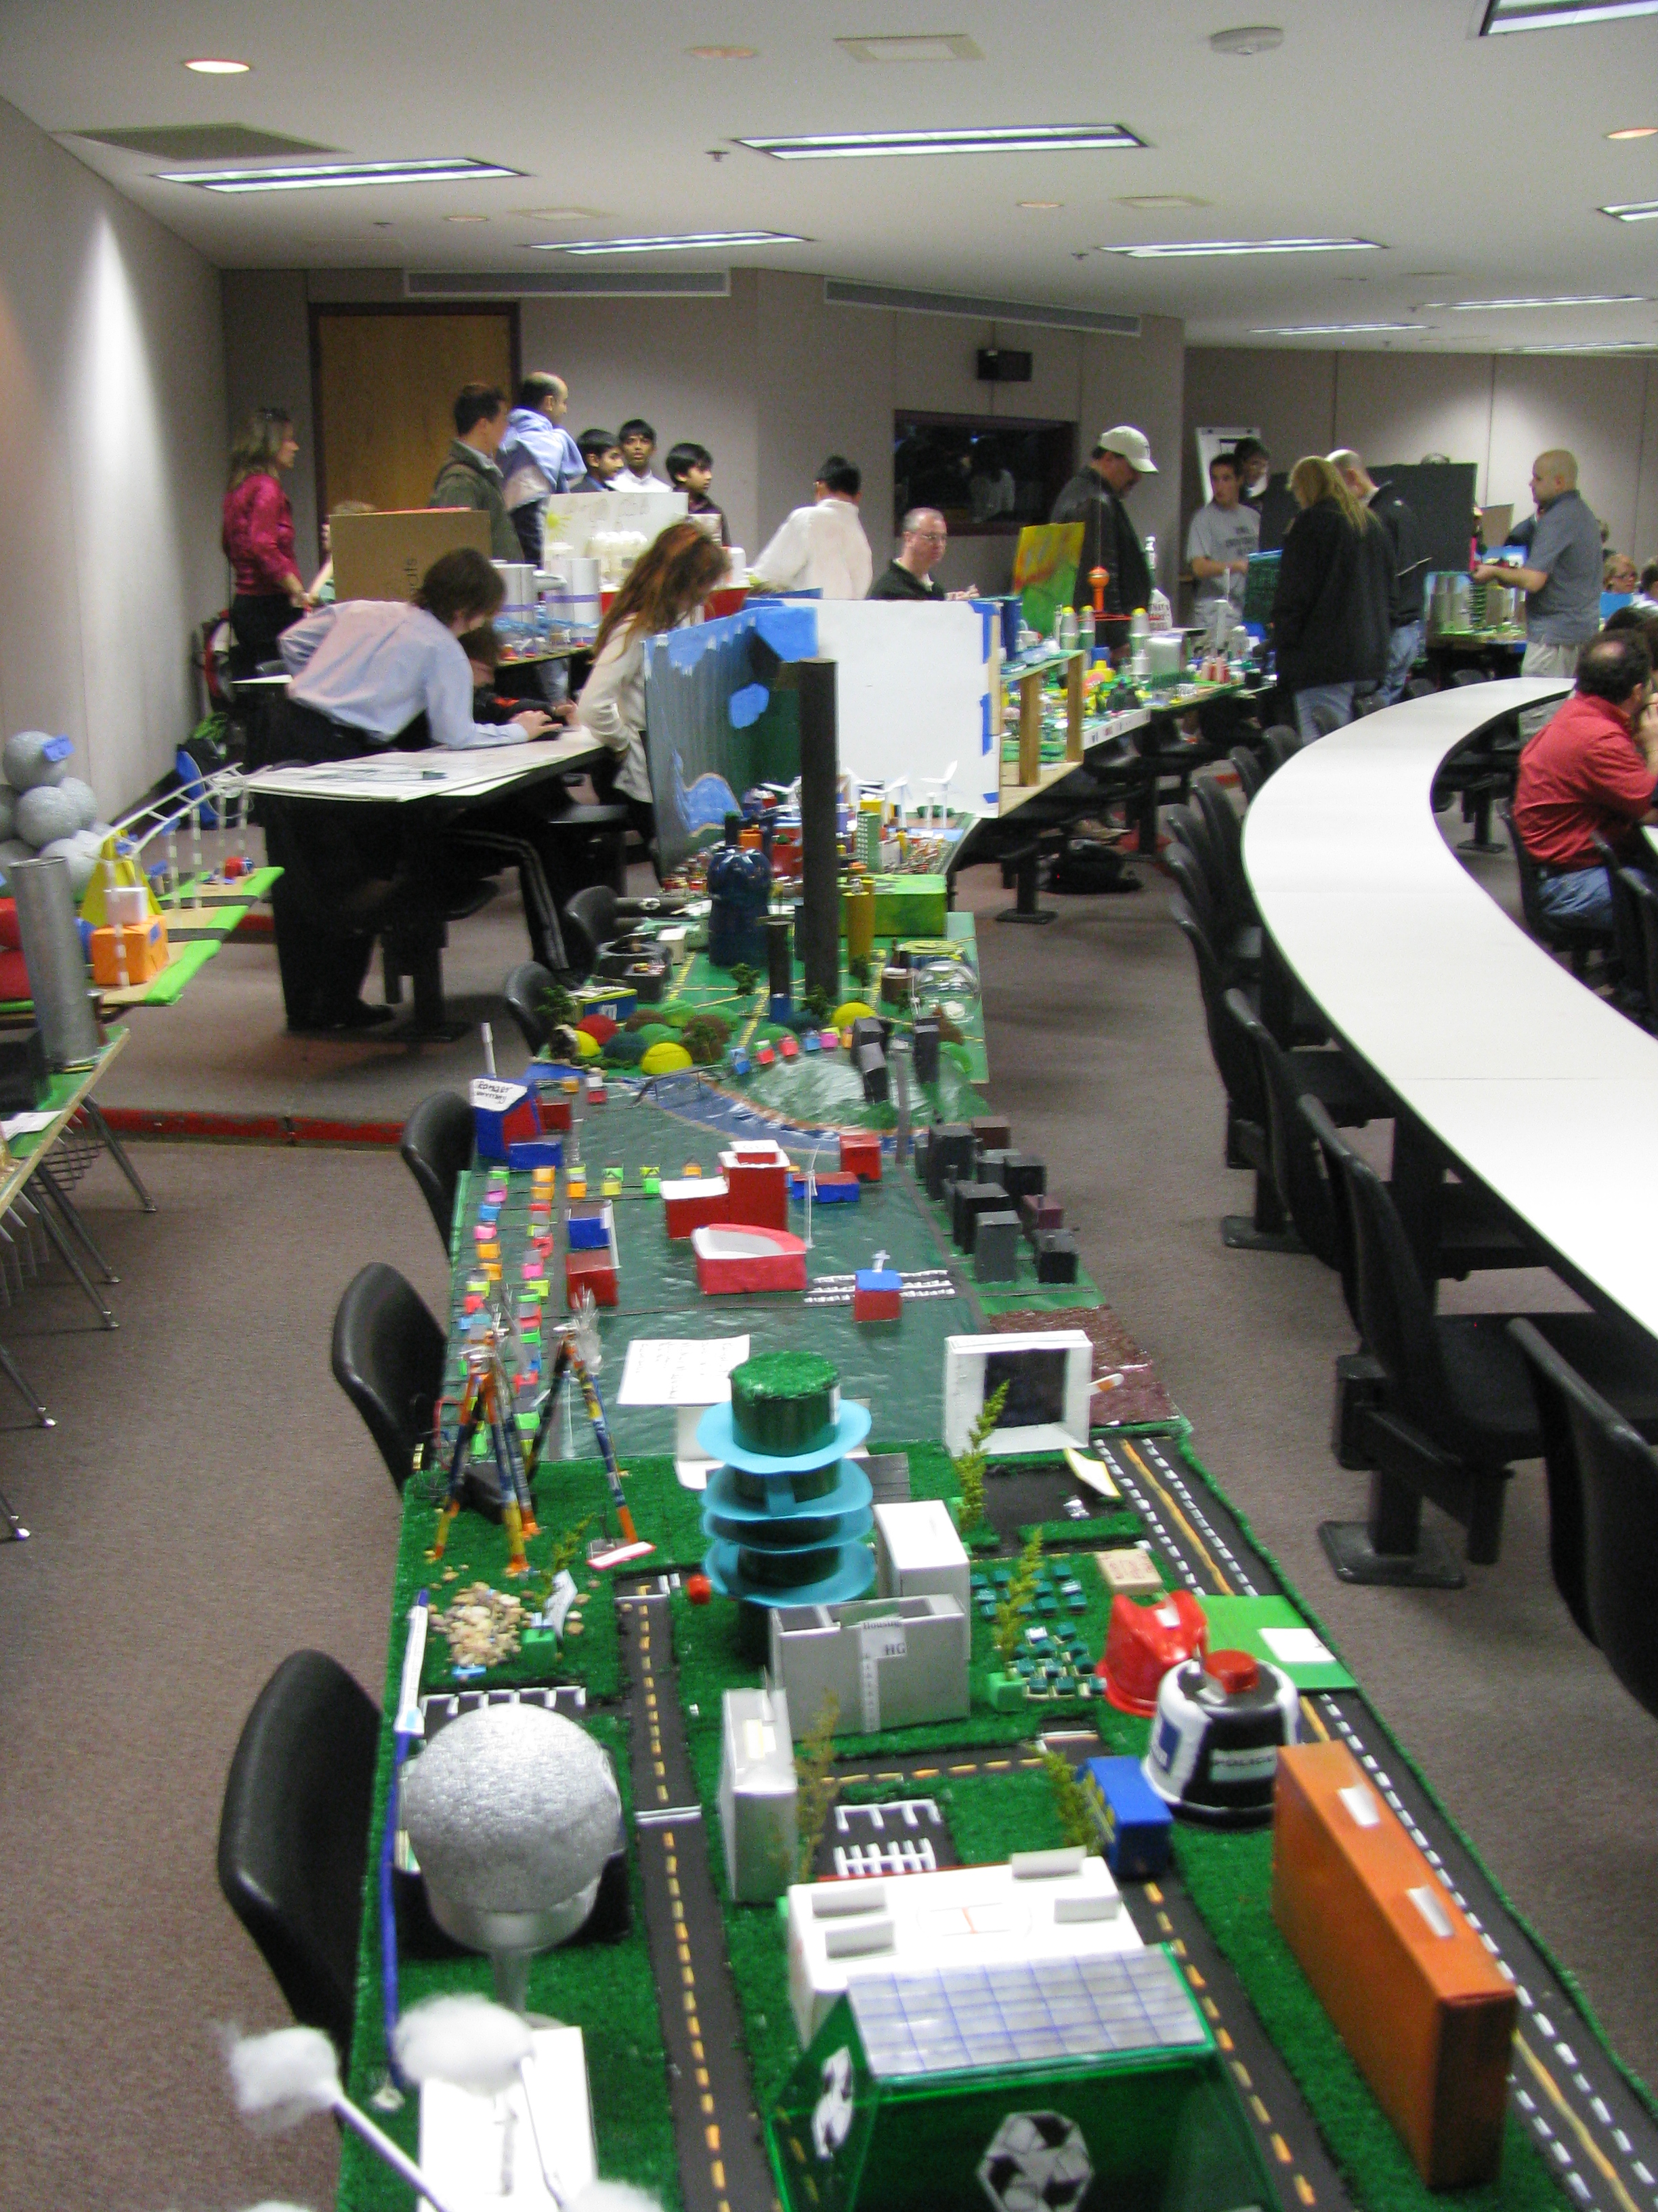
Future City @ Texas State University
15 volunteers from our student group participated in making this event another success!

Slide 7
2012-2013 Program Funding
 | IEEE | Other | Total
2012-213 Program Plan (Budget)
BEST Robotics @ Dripping Springs HS | $15.00 |  | $15.00
Future Cities @ Texas State University | $21.73 |  | $21.73
IEEE Region 5 Conference (8 Participants) | $81.51 |  | $81.51
Arduino Tutorials (5 Arduino Unos)
R5 Robotics |  | $761.55 | $761.55
Social Events / Food | $204.98 |  | $204.98
Initial Funds | $63.60
Receipts
IEEE Phase I | $1,000.00 |  | $1000.00
IEEE Phase II | $750.00 |  | $750.00
SURF Grant |  | $1000.00
Expenditures, Year-To-Date | $323.22 | $761.55 | $1084.77
Current Funds On Hand | $1490.38 | $238.45 | $1728.83
Expenditures, Projected for Remainder 2012-2013 | $6756.00 |  | $6756.00
Projected Surplus (Shortfall) | $5265.62 | $238.45 | $5027.17
Note: Expect to close “Shortfall” through fundraising activities.

Slide 8
Thank you for your continuing support!
Questions?

