Slide 1

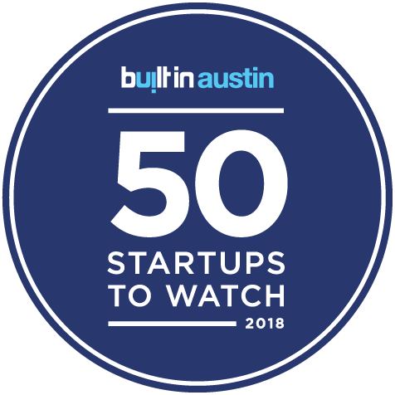

Slide 2
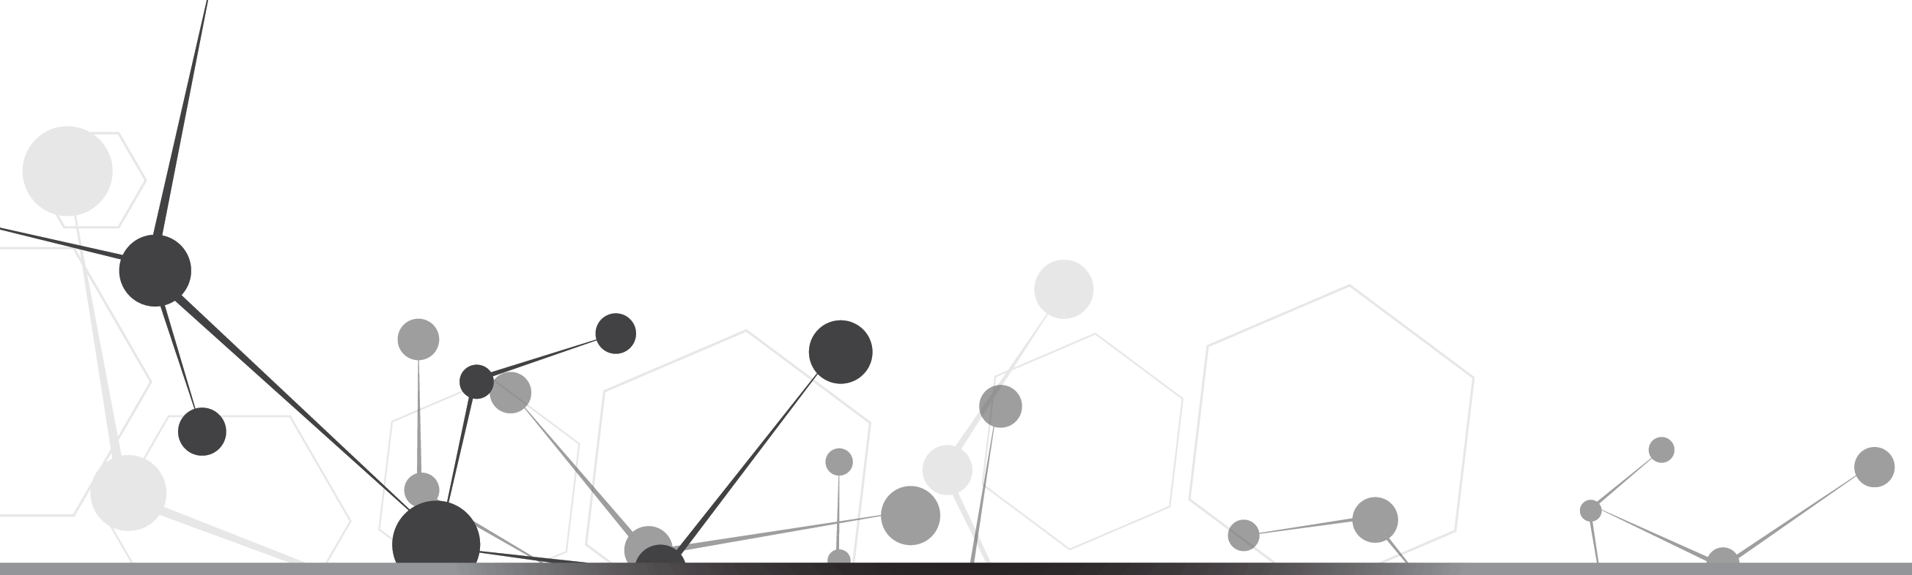
About Us
Built on more than technology, everything we do stems from purpose.
And our purpose is very simple:
Leave the world better than you found it.

Slide 3
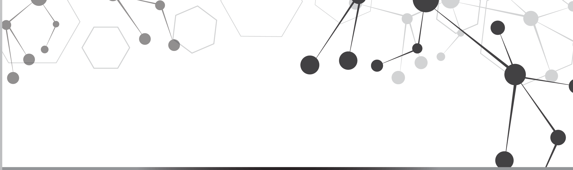
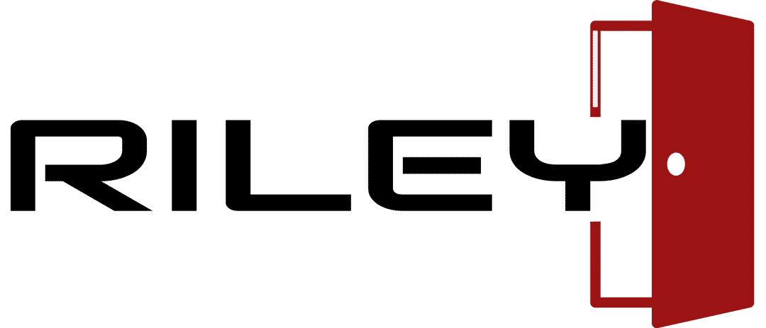
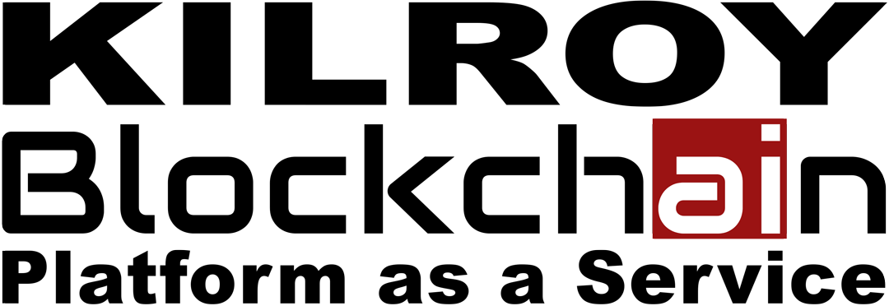

Products

Slide 5
Riley App
Riley Server
Opens doors for people who are blind and visually impaired by describing objects and places.
Opens doors to the NEW COLLAR WORKFORCE - people who can do jobs not possible without the help of artificial intelligence.
You can create a stronger, more independent workforce with Riley and Watson!

Slide 6
Use of Blockchain
Riley uses blockchain to verify the authenticity of crowd sourced data.

Slide 7


Where did we get the idea?
Riley was inspired by the students of the Texas School for the Blind and Visually Impaired.

Slide 8
What Makes the Magic?
Riley uses IBM Watson Visual Recognition, Watson Text-to-Speech, and Watson Content Hub.

Slide 10
Enhanced knowledge and a trail of truth
Kilroy Blockchain PaaS
• A connecting layer that provides you a link to proven AI and blockchain solutions by trusted partners.
Enterprise-level solutions and proven methodologies for creating a cognitive trail of truth.

Slide 11
Use of Blockchain
Kilroy Blockchain PaaS helps regulated industries build an audit trail.

Slide 12
Where Did We Get the Idea?
Kilroy Blockchain PaaS was inspired by the 2016 blockchain meetups and weekend-long blockchain hackathon.

Slide 13
What Makes the Magic?
Kilroy Blockchain PaaS embeds IBM Blockchain, IBM Cloud Infrastructure and other IBM Cloud components.

Slide 15
Cognitive Roadway Knowbot
Predictive analysis simulator for traffic issues.
• A customizable framework that aggregates live, static, and roadway data from multiple city, county, or regional systems.
• Ask us how Carnak can be customized to your data!
Preventing traffic deaths through predictions

Slide 16
Use of Blockchain
Carnak uses blockchain to verify the authenticity of its historical data.

Slide 17
Where Did We Get the Idea?
Carnak was inspired by a Smart Cities workshop held by National Institute of Standards and Technology.

Slide 18
What Makes the Magic?
Carnak uses IBM Data Science Experience, Jupyter Notebooks, and Python.

Slide 19
Accurate and Reliable AI

Slide 20
Accurate and Reliable AI
AI is based on DATA
There are no standards for data authenticity
AI will be wrong if data is wrong
Need a way to proactively prove authenticity
Develop a BLOCKCHAIN standard that will allow authenticity of AI data to be verified
This will give us accurate, reliable AI

Slide 21
The Balloon Tower
“The balloon tower is outside the movies”
“When the kids are in the movie, the tower opens”
“Thousands of helium balloons come out into the sky”
Well, you can’t see it, you’ll be in the movie”
I know this was true because my dad told me it was

Slide 22
I predicted to my friends that the balloons would come out again at the next movie
My prediction was wrong

Slide 23
The Balloon Tower
Artificial Intelligence is made to simulate human thought
AI reasons based on data
If the data is wrong, the prediction is wrong
For the time being, it could be as naïve as a 5 year old

Slide 24
The Crops
Expert system for growing food
Says to plant crops on May 14
Based on historical crop data, historical weather data, weather forecasts, and other factors
What happens if the data is wrong?

Slide 25
The Crops
How would the farmers know to trust the system?

Slide 26
Problems with Data
Data is often wrong
Data is frequently messy
Data often has chunks missing
Data is only as valid as its source

Slide 27
Historical Data Always
Stays the Same
The past never changes
    e.g., The high temp in Nepal will always be 29 degrees Celsius in July 2017

Slide 28
Data Accuracy vs.
Data Authenticity
Data accuracy is a completely different topic
Data authenticity involves whether the data set used is the the data intended
      Developer/architect knows the source of data
  How does someone consuming the AI verify the data being used is the data intended to be used?

Slide 29
Verifiable Data Size
Can I get verification that the historical data wasn’t altered by testing a checksum of the data?

Slide 30
Verifiable Developer Identity
Who introduced this data source into the corpus of AI data?
Has their identity been verified?
How do we contact this person with questions?

Slide 31
Verifiable Timeframe
When was this data downloaded?
What is the historical time?
?

Slide 32
Verifiable Source
?
Where did the developer get the data?
Where did the data originate?
Where is the data currently stored?

Slide 33
Verifiable Audit Trail
Has this data set been made inactive?

Slide 34
The Solution:
Checksum/Hash
Create a hash to prove database characteristics and origin

Slide 35
The Solution:
Responsible Data Network
Create a network of concerned parties to verify the data authenticity at the time of its inclusion into the corpus of AI data.
Potential participants are:
    Application developer
    Application architect
    Data originator
    Subject matter expert/researcher
    Public interest group

Slide 36
The Solution:
Semi-Private Blockchain
Create a blockchain network that can be used by concerned parties to verify authenticity of data used AI corpus
Note: we don’t actually store the databases on the blockchain, just the method of checking to see if the data is authentic.

Slide 37
The Solution:
AI Users See if Data is Authentic
Make public verification of the blockchain
Visual icon or audible clue to let users know if authenticity of data is in question

Slide 38
Moving Forward
Start a consortium of blockchain and AI companies to work out standards
Work with existing standards bodies like IEEE to leverage existing works

Slide 39
Contact me
Karen Kilroy, CEO karen@kilroyblockchain.com
Direct: 330-289-1351
Twitter: @KilroyBlckchain

Slide 40
Summary
AI relies on data
Data is a weak link in AI
Blockchain can help reduce risk
Users of AI should be able to verify data
Standards setting should be a community effort

Slide 41
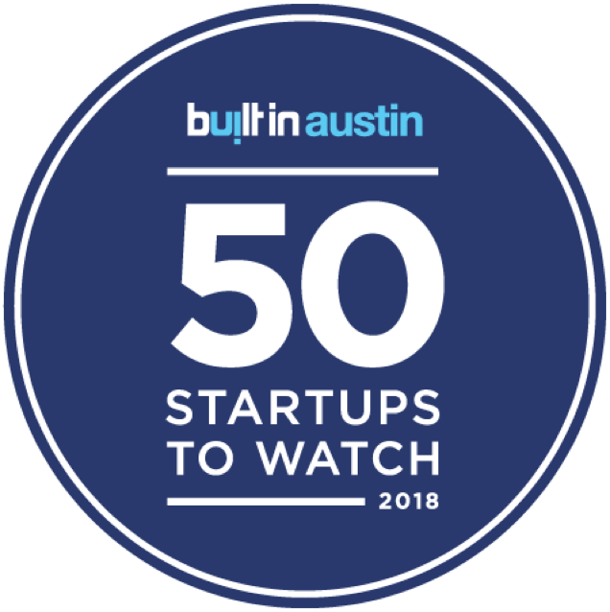
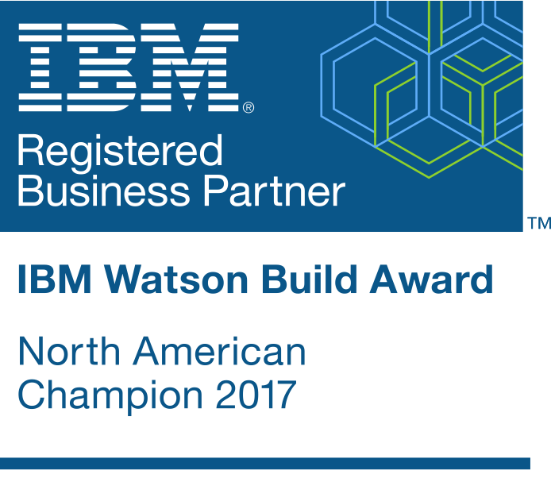
Thank You

