Slide 1
Beamforming for DOA and Localization in Sensor Networks
Dr. Kung Yao
Distinguished Professor
Electrical Engineering Dept.
NSF Center for Embedded Networked Sensing
UCLA
Presentation at Aerospace Corp.
Nov. 3, 2011

Slide 2
Contents
Introduction to beamforming
Our experiences using beamforming in 6 projects
Introducing the Approximate ML (AML) algorithm for high performance acoustical beamforming to perform detection, localization, SINR enhancement, source separation, and tracking
Various simulations, practical field measured data, and two sound demonstrations illustrate the usefulness of acoustical beamforming

Slide 3
Introduction to Beamforming
In this presentation, we present an evolution of our own experiences on 6 projects of beamforming using acoustic/ seismic arrays and related wireless sensor system issues
Beamforming based on arrays can achieve:
Detect - declare whether one (or more) acoustic/seismic source(s) is (are) present
Increase SINR by enhancing desired signal
&/or reject/reduce unwanted signals/noises

Slide 4
Cont. of App. of Beamforming
3. Localize one (or more) source(s) (by finding the direction-of-arrivals (DOAs) and their cross-bearings in the far-field) and range(s) and DOA(s) in the near-field
Separate two spatially distributed sources
5. Classify the source(s) based on spectral, spectrogram or HMM methods
6. Track one (or more) sources by Kalman/ Ext. Kalman or particle filtering methods

Slide 5
Examples using Beamforming
Smart hearing-aid (relative to 1 microphone)
Steer camera toward a speaker in teleconference application
Detect/locate/track human speaker(s) in home security and military surveillance applications
Detect/locate/track moving vehicle(s) in civilian/military applications
Detect/locate/track/classify animal(s) in field biological studies

Slide 6
Narrowband Beamformer
to Achieve Coherent Combining
sensor
input
sensor output
1
Sensor 1 delay= 0
x₁(t)
t₁₂
2
Propagation
delays
x₂ (t)
Sensor 2 delay= t₁₂
Source
+
coherently
combined
output y(t)
t_{1R}
R
Sensor R delay= t_{1R}
x_{R}(t)
For a tone (with a single freq.), time delays can be easily
achieved by phase control using a complex multipling weight

Slide 7
Wideband (WB) Beamforming
x₁(n)
x₂(n)
x₃(n)
w₁₀*
w₂₀*
w₃₀*
D
w₁₁*
D
w₂₁*
D
w₃₁*
+
+
+
D
D
D
D
w_{1(L-1)}*
D
w_{2(L-1)}*
D
w_{3(L-1)}*
+
+
+
+
Wideband beamformer needs multiple weights per channel
Various methods can be used for the array weights

Slide 8
Project 1: Max. Energy (ME) Array
We proposed a user controlled steerable non-adaptive array that collects max. energy of a desired source toward a desired DOA with low gain toward an unwanted DOA
The weights of the WB beamformer are obtained as the solution of a generalized eigenvalue problem

Slide 9
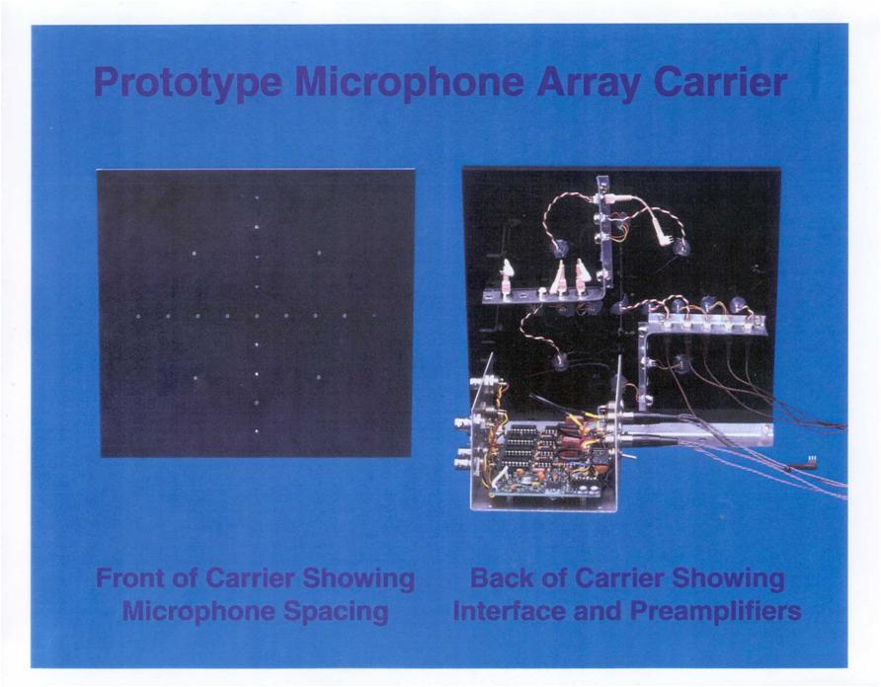
Four-element Microphone Array Built at
HEI as Hearing-Aid Pre-Processor

Slide 10
Hearing Aid Beamformer
Hearing aid pre-processor steers a main beam toward the desired speaker; also forms a low-gain beam toward the interferer
Beamforming maximum energy criterion array uses
4 microphones as configured in the previous picture
Desired signal at 0°;Interferer -30°
Cases 1-3: S/I are both speeches;SIR=0 dB;
Cases 4-6: Intfererence is CN; SIR=-10dB
Case 1 Free space: Single microphone
Case 2 Free space: Array ΔSIR = 22 dB
Case 3 Low/med. Reverberation: Array ΔSIR = 12 dB
Case 4 Free space: Single microphone
Case 5 Free space: Array ΔSIR = 21 dB
Case 6 Low/med. Reverberation: Array ΔSIR = 12 dB

Slide 11
Project 2: Randomly Placed Sensors for
Space-Time-Freq.Wideband Beamforming
Data from D (e.g., 2) number of
sources collected by N (e.g., 3)
randomly distributed sensors
x₁(n)
x₂(n)
x₃(n)
w₁₀*
w₂₀*
w₃₀*
D
w₁₁*
D
w₂₁*
D
w₃₁*
Output of the beamformer
+
+
+
D
D
D
D
w_{1(L-1)}*
D
w_{2(L-1)}*
D
w_{3(L-1)}*
+
+
+
t_{d,n} - time-delay
L - number of FIR taps
w - array weight
+
y(t) = filtered array output
Various methods are available to find array weights

Slide 12
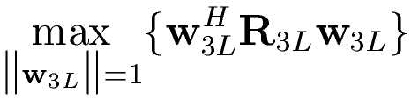
Array Weight Obtained by Dominant Eigenvector of Cross-Correlation Matrix
Auto- and Cross-Correlation Matrices
Maximizing Beamformer Output
where
w_{3L} = [w₁₀, w₁₁,…,w_{1(L-1)},…,w₂₀,…,w_{2(L-1)},…,w₃₀,…,w_{3(L-1)}]^{T}
is
the eigenvector of largest eigenvalue of R_{3L}w_{3L}=λ_{3L}w_{3L} (Szego Th.)
Time delays t_{d, n} est. from the w_{3L} (Yao et al, IEEE JSAC, Oct. 1998)

Slide 13
TDOA - Least-Squares
Least-squares solution is then given
as follows after algebraic manipulation
We write , where
An overdetermined solution of the source location and speed of propagation can be given from the sensor data as follows
, where the pseudoinverse

Slide 14
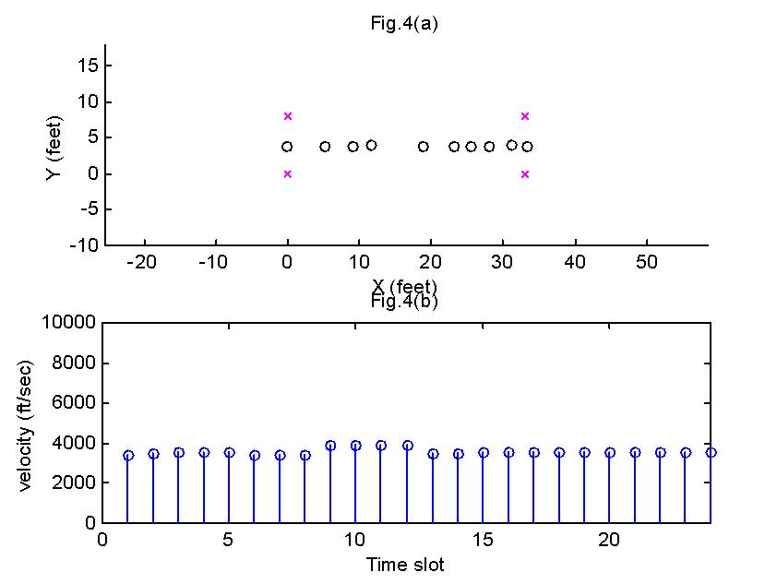
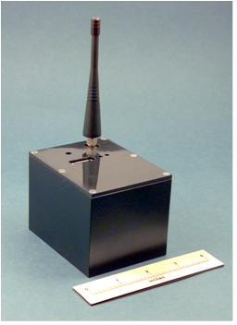
Source Localization and Speed of Prop.
Results Using Geophone Sensors

Slide 15
Project 3: Approximate Maximum
Likelihood (AML) Estimation Method
ML method is a well-known statistical
estimation tool (optimum for large SNR)
We formulated an approx. ML method for
wideband signal for DOA, source
localization, and optimal sensor placement
in the freq. domain (Chen-Hudson-Yao,
IEEE Trans. SP, Aug. 2002)
AML method generally outperforms many
suboptimal techniques such as closed-form
least squares and wideband MUSIC solutions
Has relative high complexity

Slide 16
Near-Field Data Model
noise
Near-Field Case
Wavefront is curved
Gain varies
Can estimate source
location
Better estimate if
inside the convex
hull of the sensors
time delay
gain
source 1
sensor 1
source M
centroid
sensor P

Slide 17
Far-Field Data Model
noise
time delay
Far-Field Case
Wavefront is planar
Gain is unity
can only estimate
bearing
source 1
source M
sensor 1
sensor P
centroid

Slide 18
Wideband AML Algorithm (1)
Data Model
FFT
WGN
Freq Domain
Model
Each column is a steering vector for each source
Likelihood
function

Slide 19
Wideband ML Algorithm (2)
Likelihood
function
Summation in Frequency
Simpler
Likelihood
function
Estimated DOA
Source
Estimate

Slide 20
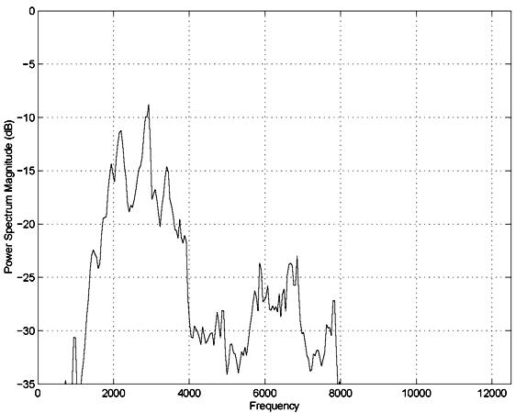
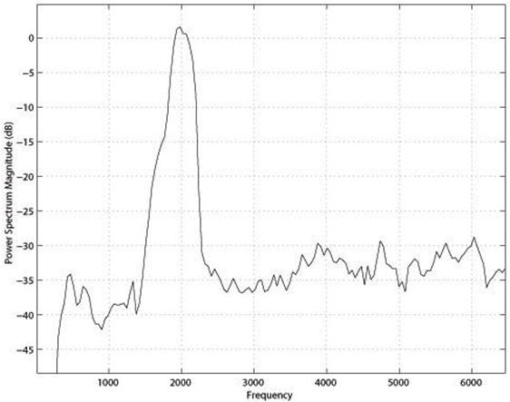
Source Spectra of Two Birds
Woodpecker
Mexican Antthrush
Frequency bins with higher PSD will contribute more to the likelihood
Single source:

Slide 21
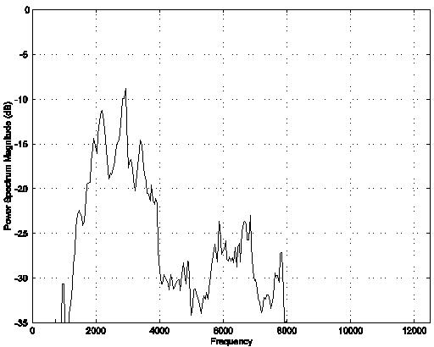
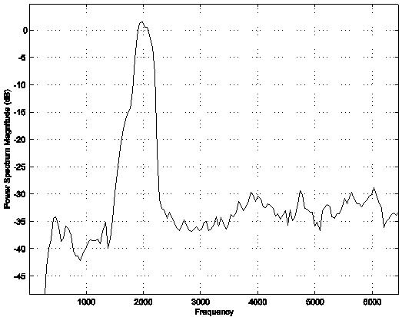
Select Few High Spectral Power Bins
For Complexity Reduction
Vocalization of Acorn Woodpecker
Vocalization of Mexican Antthrush

Slide 22
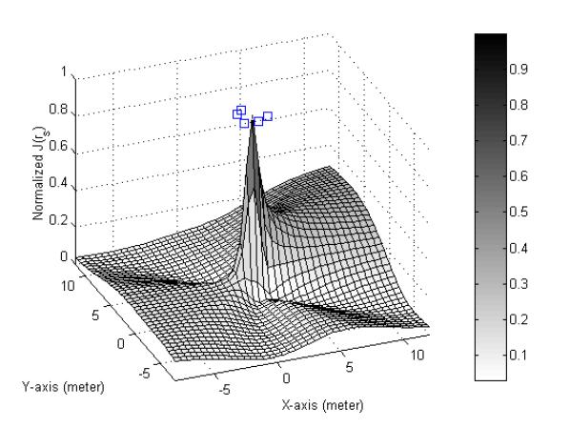
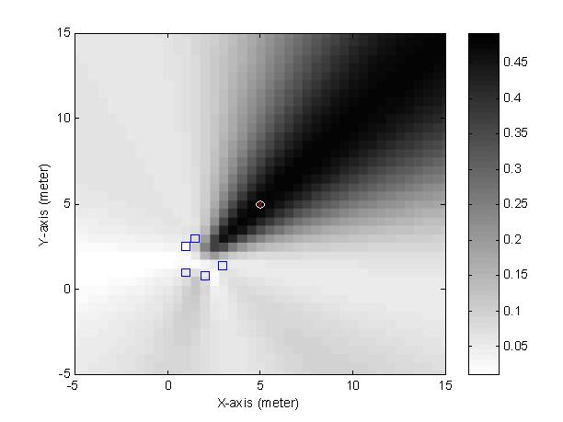
AML Metric Plot
Peak at source location in near-field case
Broad “lobe” along source direction in far-field case
Sampling frequency f_{s} = 1KHz, SNR = 20dB
Near-field case
Far-field case
− sensor locations

Slide 23
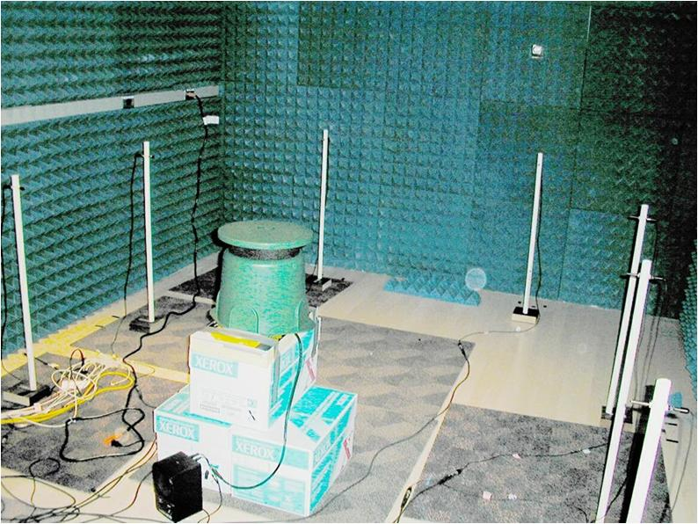
Data Collection in Semi-Anechoic
Room at Xerox-Parc

Slide 24
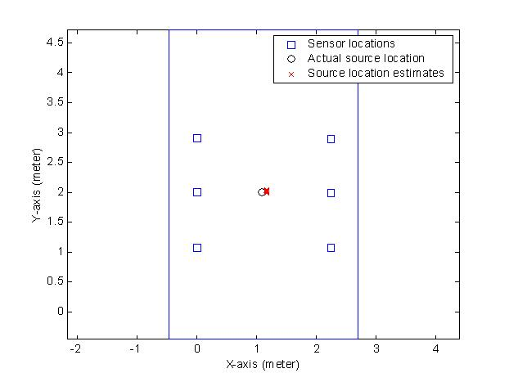
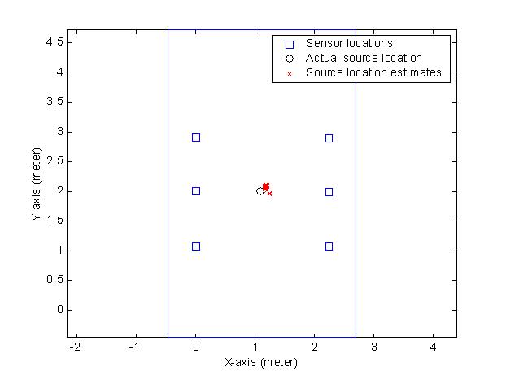
Indoor Convex Hull Exp. Results
Semi-anechoic room, SNR = 12dB
Direct localization of an omni-directional speaker playing the LAV (light wheeled vehicle) sound
AML RMS error of 73 cm, LS RMS error of 127cm
AML
LS

Slide 25
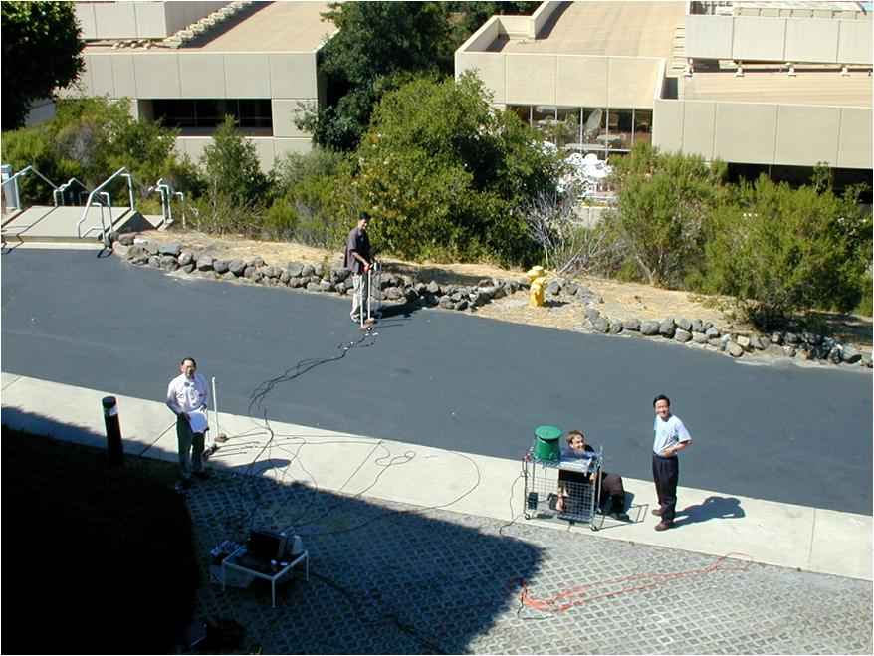
Outdoor Testing at Xerox-Parc

Slide 26
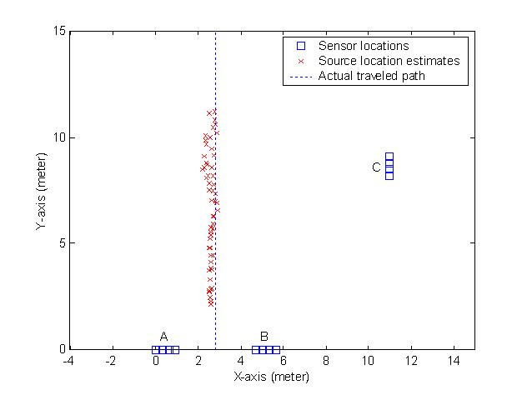
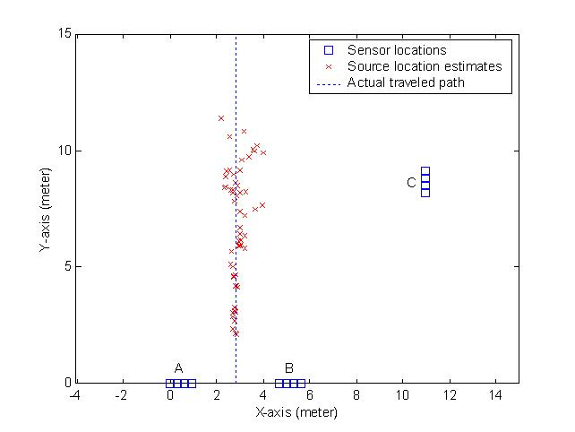
Outdoor Moving Source Exp. Results
Omni-directional speaker playing the LAV sound while moving from north to south
Far-field: cross-bearing of DOAs from 3 subarrays
AML
LS

Slide 27
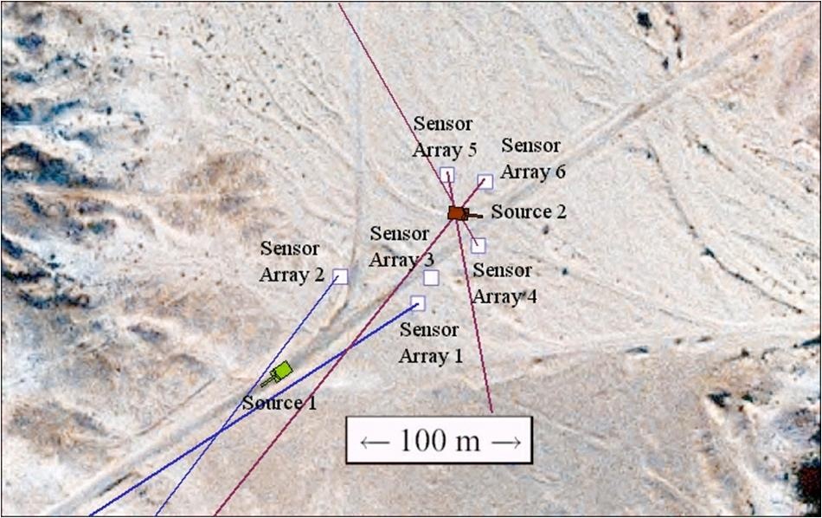
AML Sensor Network at 29 Palms

Slide 28
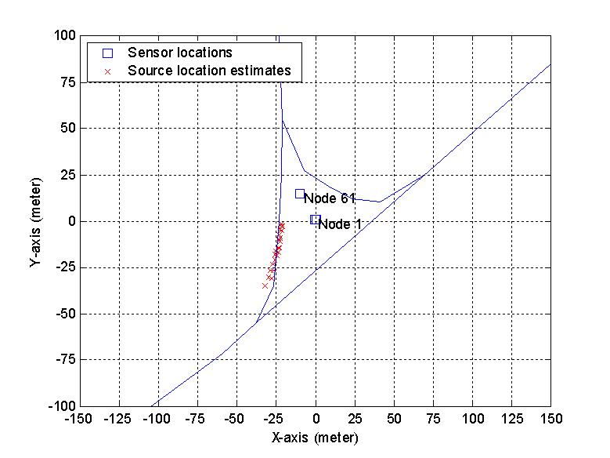
29 Palms Field Measured Localization
Single AAV traveling at 15mph
Far-field situation: cross-bearing of DOAs from two subarrays (square array of four microphones, 1ft spacing)

Slide 29
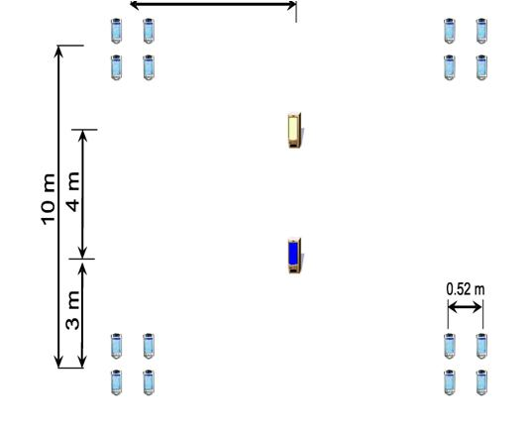
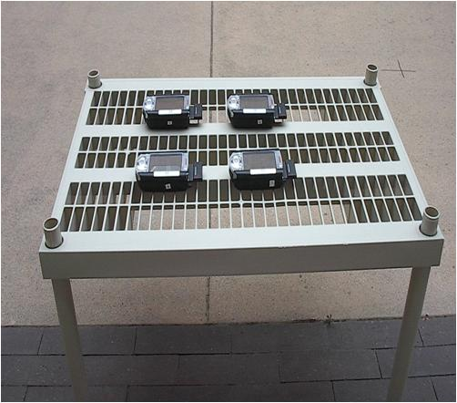
Free Space Experiment using iPAQS
Square subarray
configuration
Each subarray consists of four iPAQs with its microphone, cps, and 802.11b wireless card

Slide 30
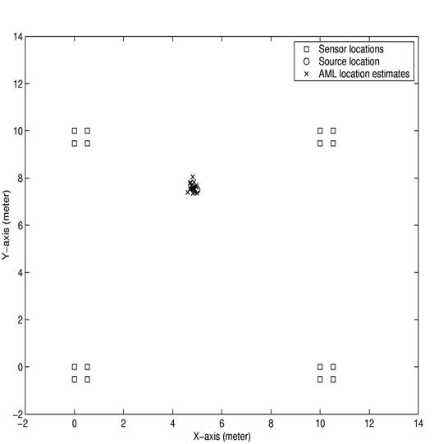
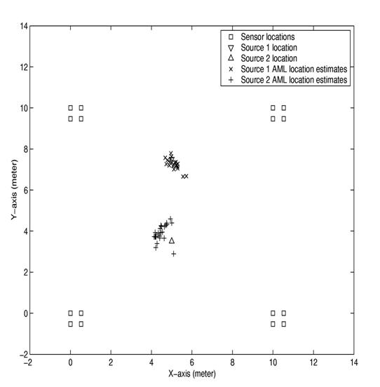
Free Space Experimental Results

Slide 31
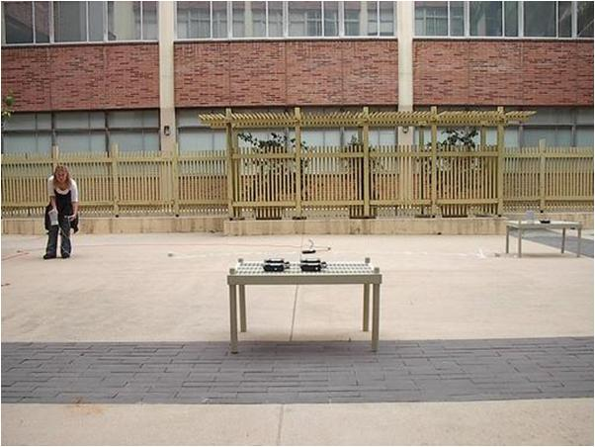
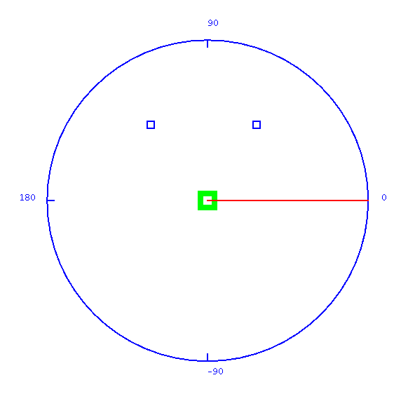
Demo of a Real-time Source
DOA Estimation
No source active
This audio source
is playing here
This audio source
is playing here
Now the source is moving towards 90 degrees !

Slide 32
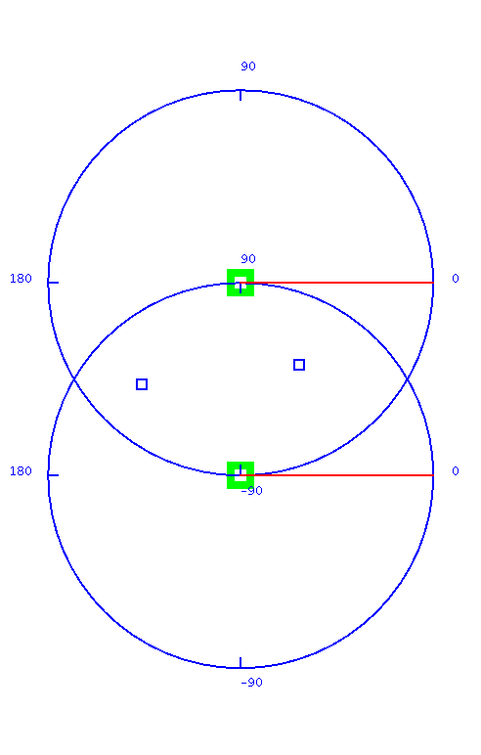
Demo of a Real-time Source Localization
This audio source
is playing now
This audio source
is playing now

Slide 33
Review of narrowband beamforming of a uniform linear array (ULA)
Consider a narrowband source with wavelength λ
  If the inter-element spacing d >λ/2, grating lobes (lobe of the same height of the mainlobe) will appear in the beampattern and results in ambiguities in the DOA estimation. (spatial aliasing effect)
  The width of the lobes become narrower as d increases. (resolution improves)
For wideband signals, the beam-pattern is an average of the beam-pattern of all frequency components.
(grating lobes become side-lobes)
Uniform circular array is considered in our design, since we have no preference in any azimuth angle.

Slide 34
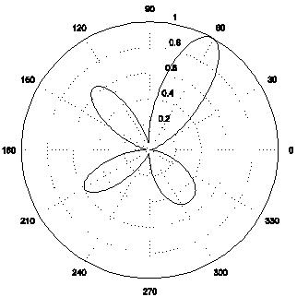
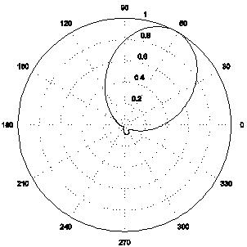
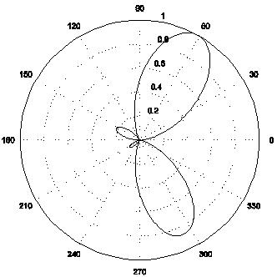
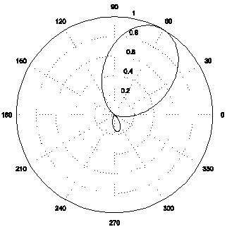
Beampattern of a 4-element UCA (1)
True DOA=60 degree
Some facts:
Aperture
1)Width of mainlobe
(better resolution)
2)Number of
sidelobes
(less robust)
Optimal array size is
highly dependent on
the source spectrum
Woodpecker, r=7.07 cm
Woodpecker, r=2.83 cm
Antthrush, r=6.10 cm
Antthrush, r=4.24 cm

Slide 35
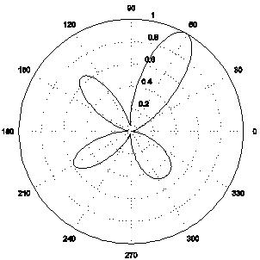
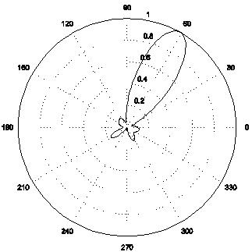
Beampattern of a 4-element UCA (2)
For fixed aperture size,
sidelobes as
number of elements
In our applications of interest,
there will always be reverberation
and ambient noise, which can
increase the magnitude of
sidelobes and result in false
estimate.
Therefore parameters of a robust
Array should be chosen s.t.
Woodpecker, r=7.07 cm, 4 elements
Magnitude of main lobe
>
Threshold
Magnitude of largest sidelobe
Woodpecker, r=7.07 cm, 8 elements

Slide 36
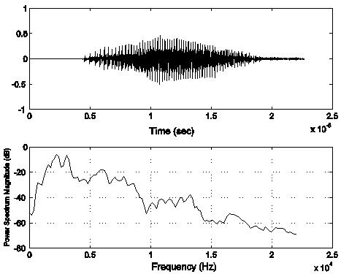
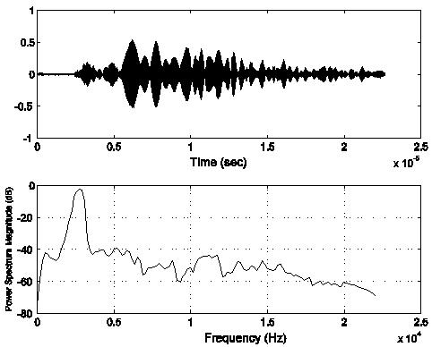
Project 4: Separation of Two Sources by Beamforming for Bio-Complexity Problems
Fig. 1 (Left top) Woodpecker waveform;
(Right top) Dusky AntBird waveform;
(Left bottom) Woodpecker spectrum;
(Right bottom) Dusky AntBird spectrum.

Slide 37
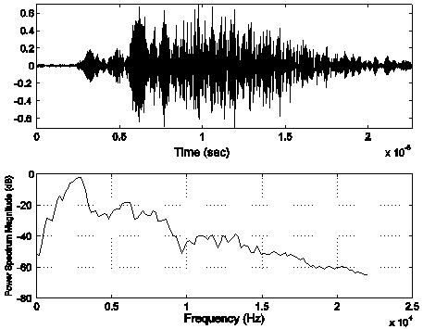
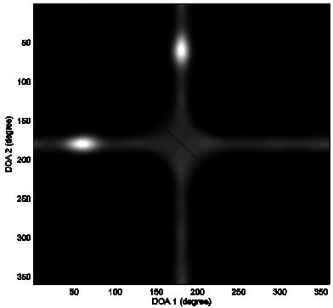
DOA Estimation of Combined Source
Fig. 2 (Left top) Combined Woodpecker and Dusky AntBird waveform ; (Left bottom) Combined Woodpecker and Dusky AntBird spectrum;
(Right) Estimated DOAs of two sources at 60 deg. and 180 deg.

Slide 38
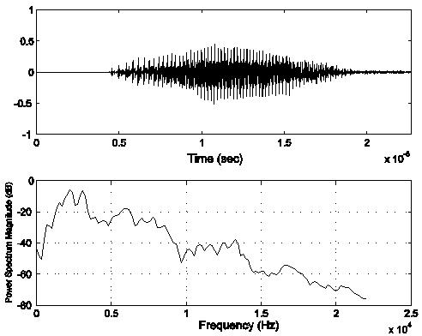
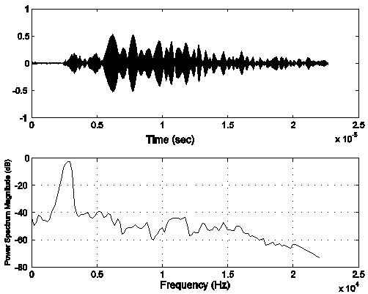
Separating Two Sources by AML Beamforming
Fig. 3. (Left) Separated Woodpecker waveform and spectrum;
(Right) Separated Dusky AntBird waveform and spectrum.

Slide 39
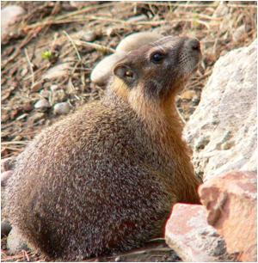
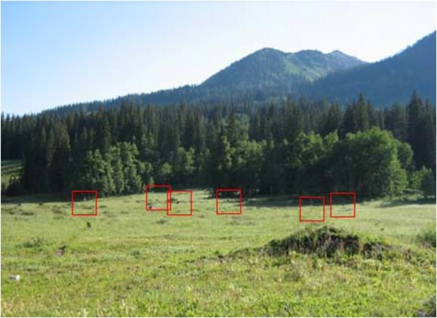
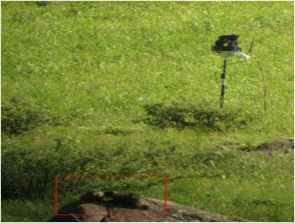
Studying Marmot Alarm Calls
Rocky Mountain Colorado Lab (RMBL)
Biologically important
Infrequent
Difficult to observe
30% identified by observation
Marmot at RMBL

Slide 40
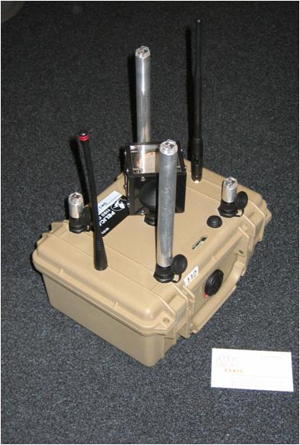
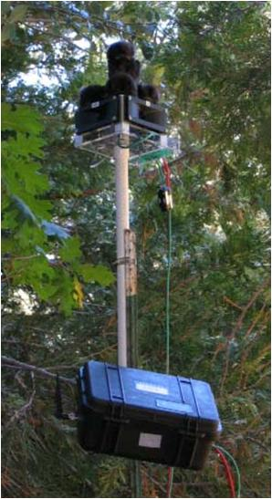
Acoustic ENS Box Platform
Acoustic ENSBox V1
(2004-2005)
Wireless distributed system
Self-contained
Self-managing
Self-localization
Processors
Microphone array
Omni directional speaker
V2 (2007)

Slide 41
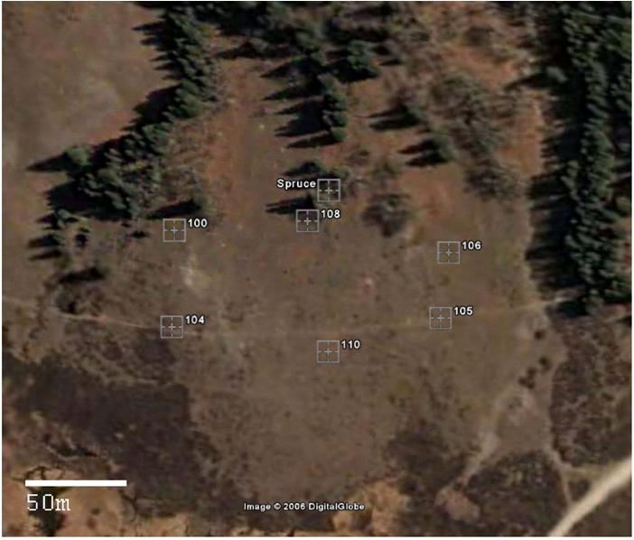
Satellite Picture of Deployment
Rocky Mountain Biological Laboratory (RMBL), Colorado
6 Sub-arrays
Burrow near Spruce
Wide deployment
  Max range ~ 140 m
Compaq deployment
  Max range ~ 50 m

Slide 42
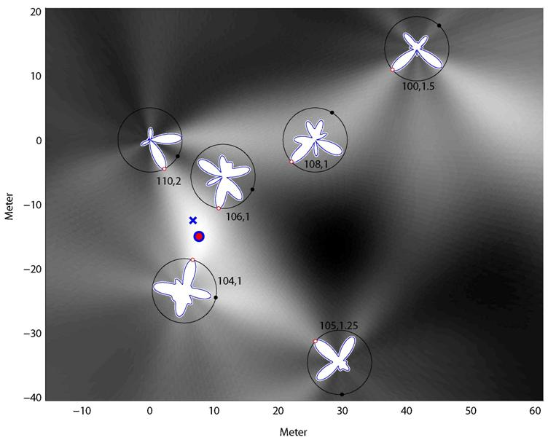
Pseudo Log-Likelihood Map
Compaq deployment
location estimate
spruce location
Normalized beam pattern
Collective result mitigate individual sub-array ambiguities
Marmot observed near Spruce

Slide 43
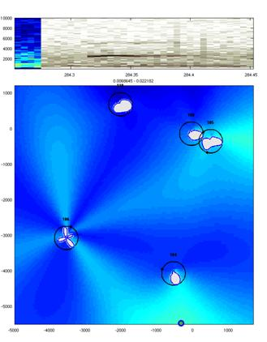
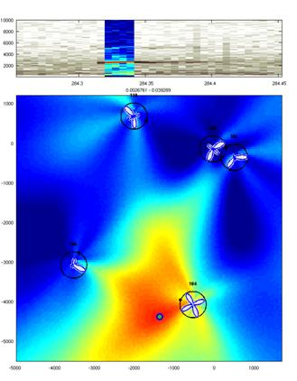
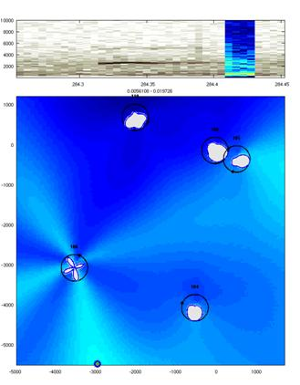
Field Measurements at RMBL
Plots of the spectrogram as a function of time (top figures) and plots of the AML array gain patterns of five wireless subarray nodes (bottom figures).
When the marmot call is present in the middle figure, all DOAs point toward the marmot, yielding its localization. The redness of an area indicates a greater likelihood of the sound. (IPSN07)

Slide 44
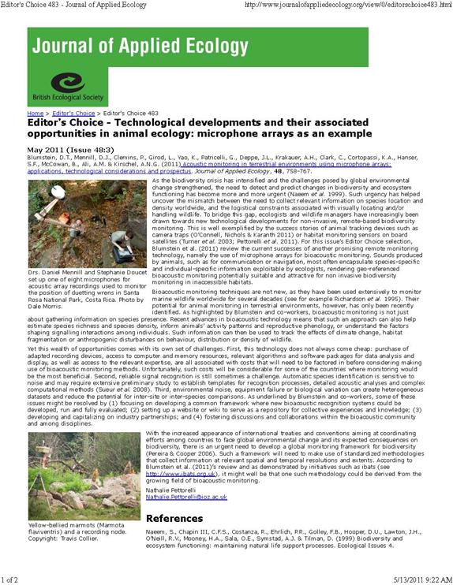
Editor’s Choice

Slide 45
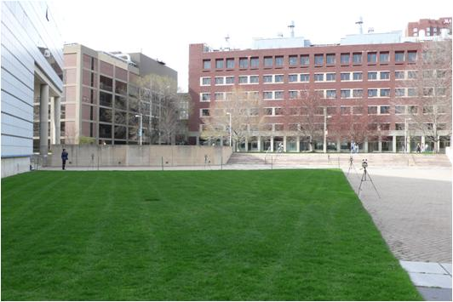
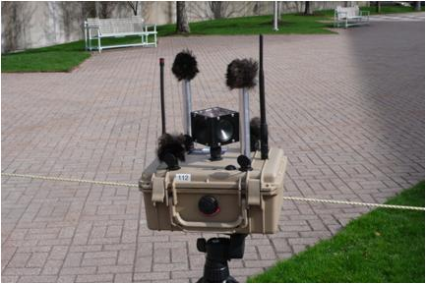


Demo at IPSN07(MIT) - 5/4/07

Slide 46

Project 5: 3-D AML Array Study
An array with four sensors as shown on the figure.
The Source signal is a male Dusky ant bird call with sampling frequency of 44100 Hz. SNR=20 dB.
So this array is isotropic .

Slide 47

CRB (Isotropic Example)

Slide 48

CRB (Comparison)

Slide 49


Experiment Setup
Array1 at point O and Array2 at point E.
Speaker hanging from point A with different heights, and plays a woodpecker call.

Slide 50
Experimental Results
speaker on the roof (h=8.8 m)
AZ EL
Girod_1 93 (90) 51 (54)
Iso_1 89 (90) 53 (55)
Girod_2 132 (130) 50 (46)
The accuracy of estimated DOAs for all the
three subarrays is acceptable.
(error<4 degrees).
Performance of iso_1 is a little bit better
than Girod_1.
Red numbers are true angles in degree
Black numbers are estimated angles in degree.
speaker with height of 7.8 meter
AZ EL
Girod_1 91 (90) 53 (50)
Iso_1 90 (90) 50 (52)
Girod_2 127 (130) 46 (42)
The accuracy of estimated DOAs for all the
three subarrays is acceptable.
(error<4 degrees).
Performance of iso_1 is a little bit better than
Girod_1.
Red numbers are true angles in degree
Black numbers are estimated angles in degree.

Slide 51
Project 6: Particle Filtering for Tracking
a Moving Acoustic Source
Source tracking:
  Extended Kalman filter:
    Uni-modal assumption
    Gaussian assumption
    Linearization leads to suboptimal performance
  Particle filter:
  It is a sequential Monte Carlo method which recursively computes the pdf through importance sampling and approximated with discrete random measure
  It incorpoates the likelihood function computed using the AML method in a recursive manner
  Particle filtering does not have many the above restrictions and therefore is more flexible

Slide 52


Tracking Experiment in a
Reverberant Room

Slide 53

Experimental Results

Slide 54
Acoustical Array in a Practical Wireless Sensor Network
Wireless sensor systems are challenged by:
Battery constraints
Low-data rate transfer capability (not suitable for central processing systems)
Local proc. systems may have computational resources/capability at the nodes
4. Severe RF propagation degrade close to ground
5. Sensor activation, multi-hop routing challenges
6. Robust stand-alone SN systems impose self- adaptive and self-learning requirements

Slide 55
Conclusions
Introduced wideband acoustical beamforming
Presented six project experiences in utilizing acoustical beamforming
AML beamforming algorithm can be used for:
detection, localization, source separation, and tracking
Acoustical beamforming has been used for:
hearing aid application; vehicle/personnel detection/tracking; multiple animal source separation; etc.

Slide 56
Acknowledgments
The contributions of various people, agencies, and acoustic sources are highly appreciated
Funding agencies: DARPA, NSF, UC-Disc., STM
UCLA: Prof. C. Taylor, Prof. D. Blumstein, Dr. R.E. Hudson, Dr. F. Lorenzelli, and Dr. L. Girod
Past and present UCLA Ph.D. students
Other contract/grant partners: RSC; Xerox-Parc, BAE
Acoustic/seismic sources: Various tracked vehicles; woodpeckers; dusty ant birds; marmots

