Slide 1
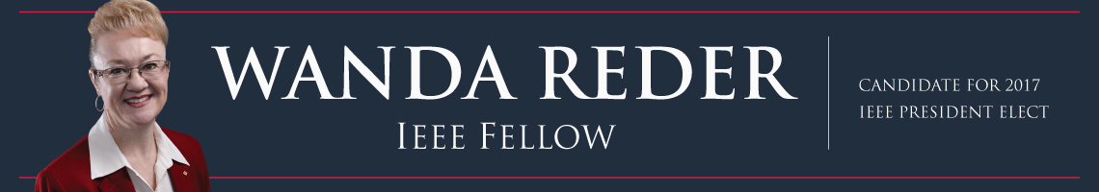
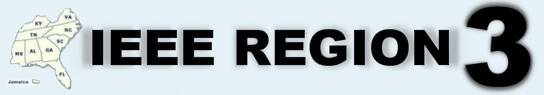
2017 IEEE President-Elect Candidate
IEEE Region 3 Meeting
Norfolk, VA
31 Mar 2016

Slide 2









Global Reach, Technical Breadth
Our Global Reach
426,000
Members
45
Societies and Councils
300
Sections. Global offices
160+
Countries
Our Technical Breadth
1,600+
Annual Conferences
100+ Million
Annual Xplore Usage
4 Million
Xplore Documents
160+
Top-cited Periodicals
1600
Standards
Together, we can do anything!

Slide 3
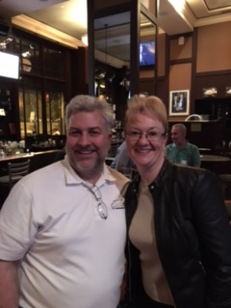
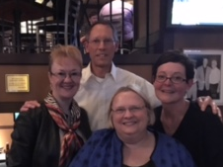

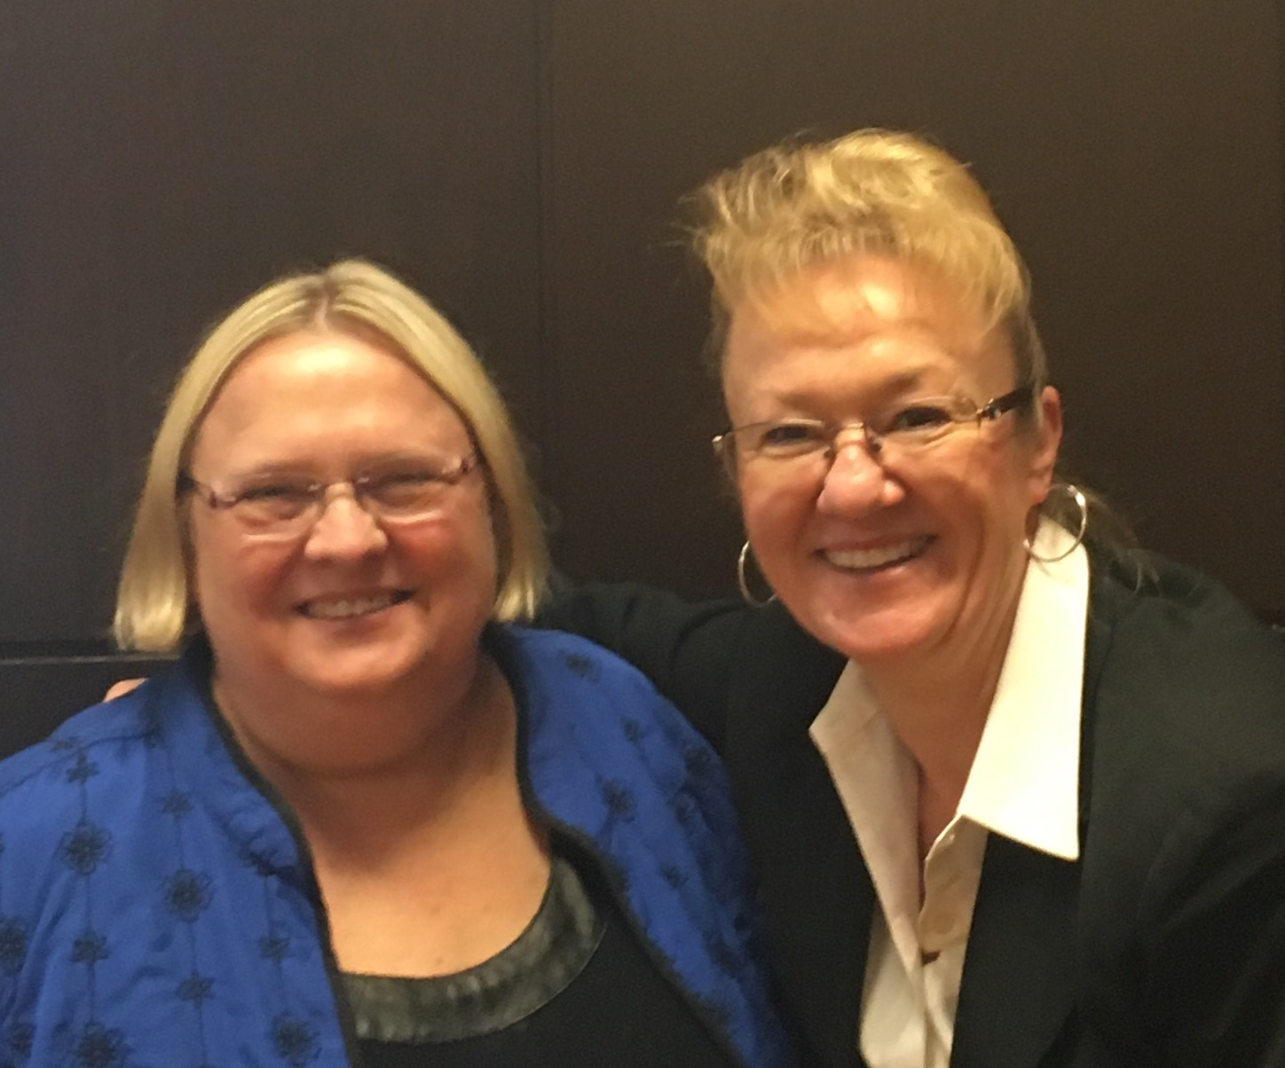

My Aim
Advocate, support, and recognize IEEE members
Build on strategic planning to increase IEEE growth
Advance IEEE through focused initiatives

Slide 4



Increase Global Engagement
Enhance engagement globally, especially focused on industry
  Continue outreach
  Build channels, seek feedback
  Implement Industry Ad Hoc recommendations

Slide 5


Improve Relevancy
Be a leader in new technology development and adopt tools to make information available
        Actively participate in the convergence of technical disciplines
        Enhance search engines, access, interactive capability, mobile apps
        Support continued adoption of tools

Slide 6


Add Membership Value
Bolster competency-based education to facilitate career progression
      Seize the market opportunity
      Offer competency-based education
      Become essential to professional development

Slide 7




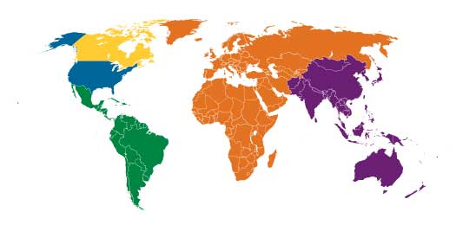



Leadership, Experience and Vision
Strong technical vision for IEEE
In-depth knowledge of IEEE
Global membership connection
Proven leadership track record

Slide 8
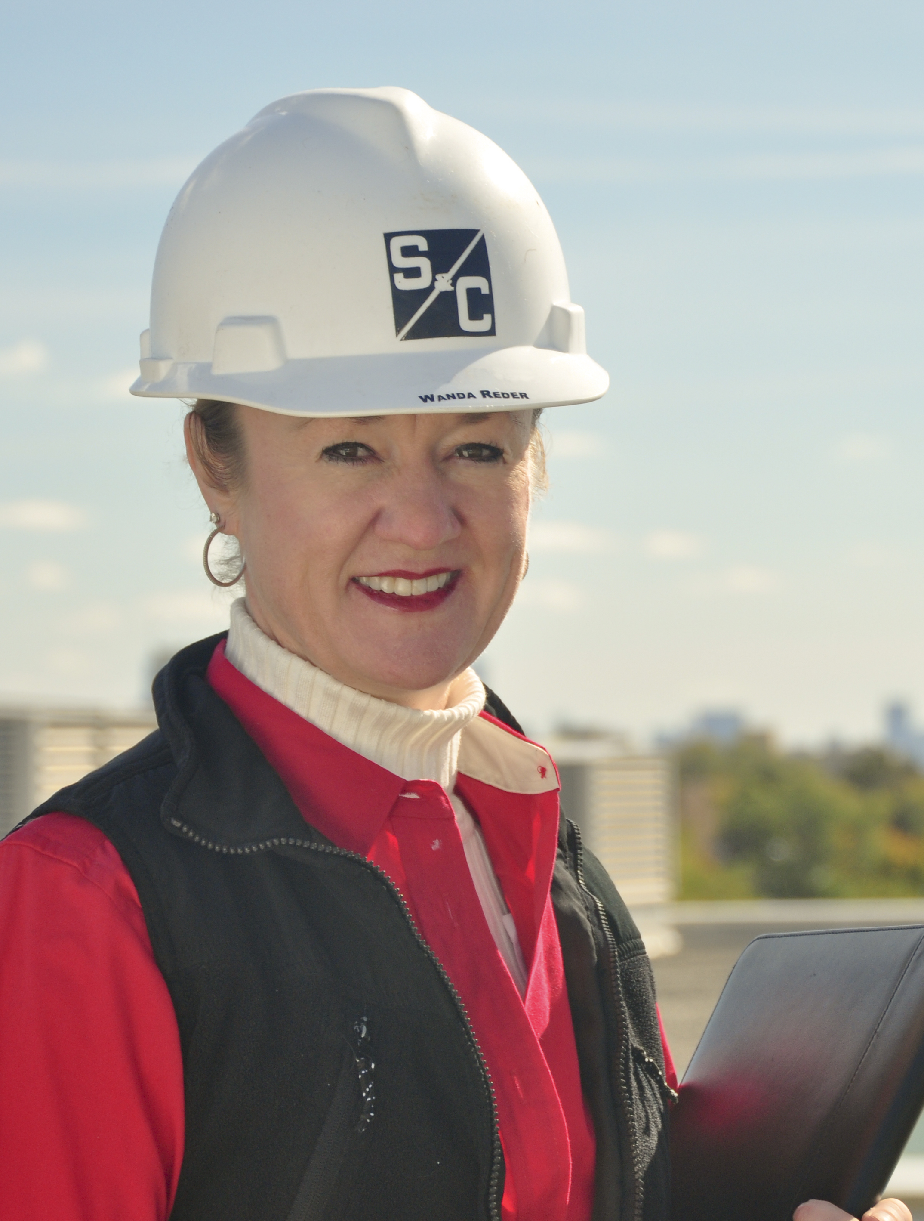








My Career Experience
Power Industry Career Progression
1985
1990
1995
2000
2005
2010
2015
Intern
Engineer
Team Leader
Manager, Director
President
CEO
Vice President
Vice President
Vice President
Chief Strategy Officer

Slide 9
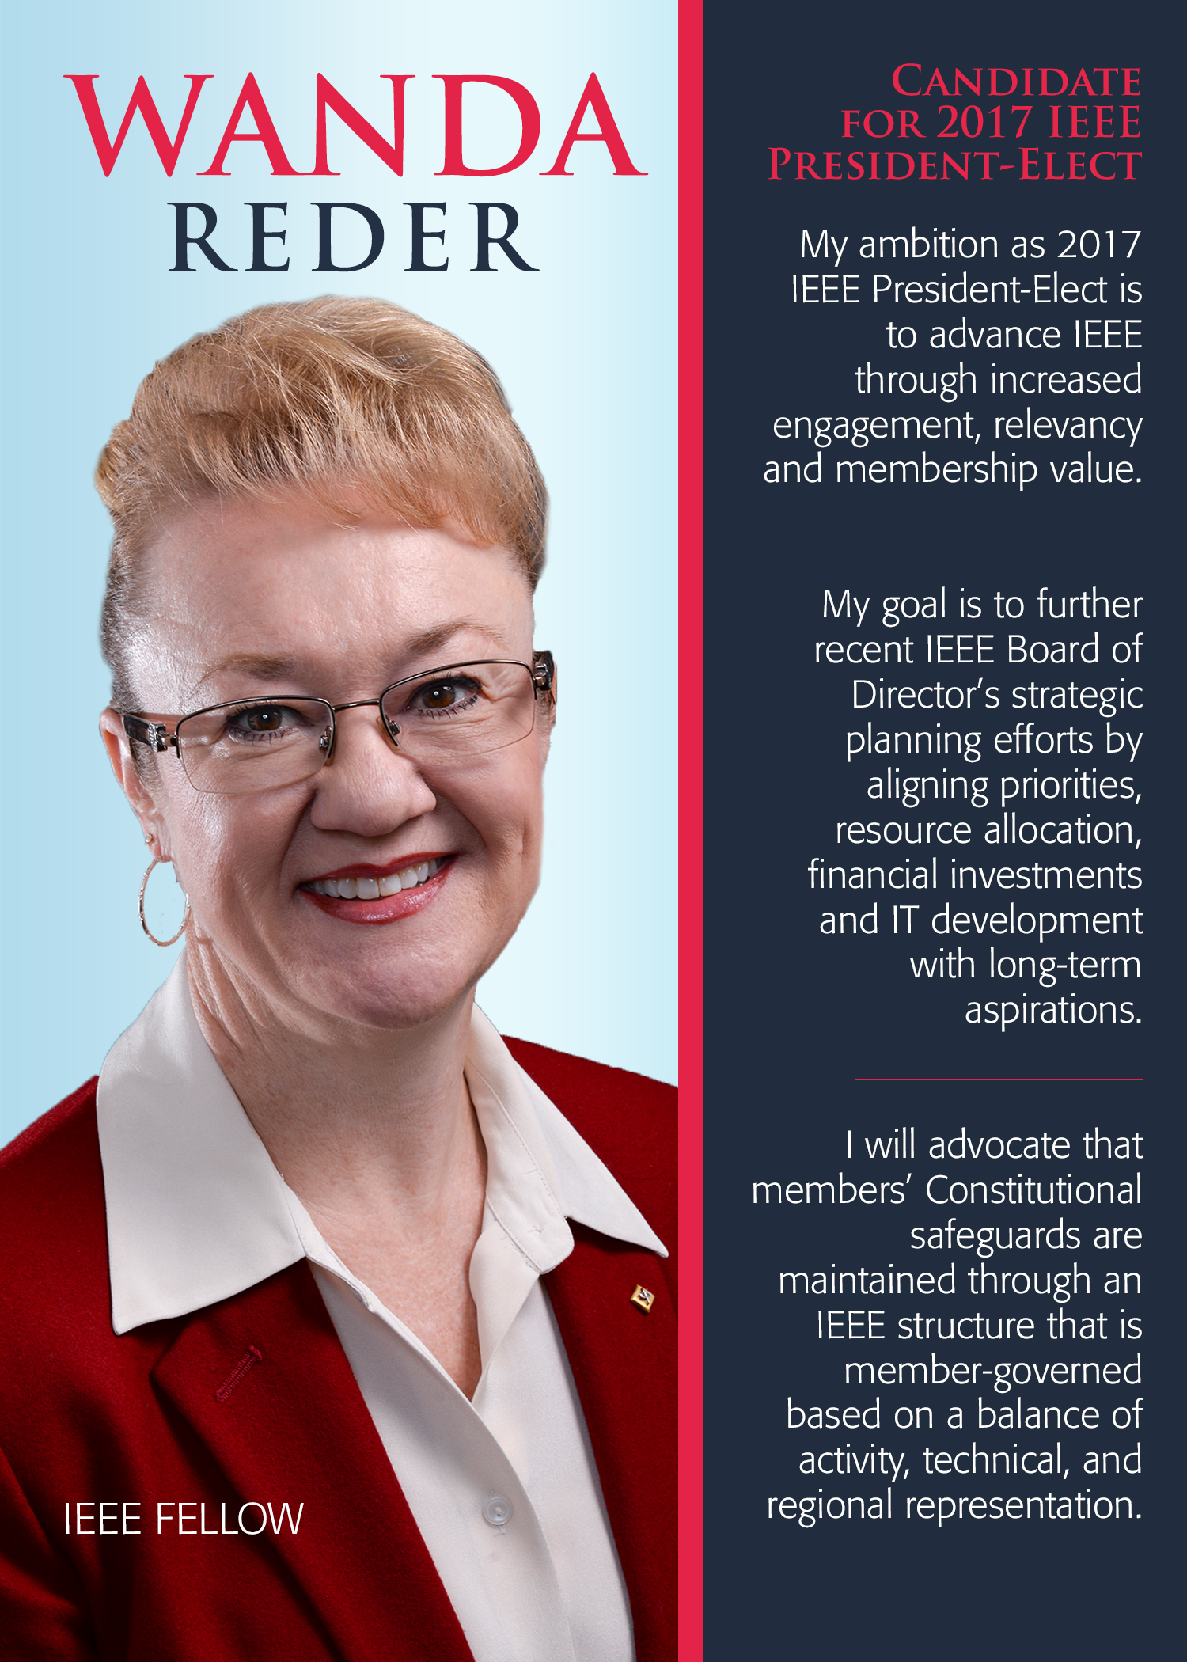



2017 IEEE President-Elect Candidate
Leadership, Vision , Experience
Learn more at
www.WandaReder.com
@WandaReder
w.reder@ieee.org
I want to hear from you!
IEEE Election Period
Aug 15, 2016 – Oct 3, 2016
Available at – www.wandareder.com

