Slide 1
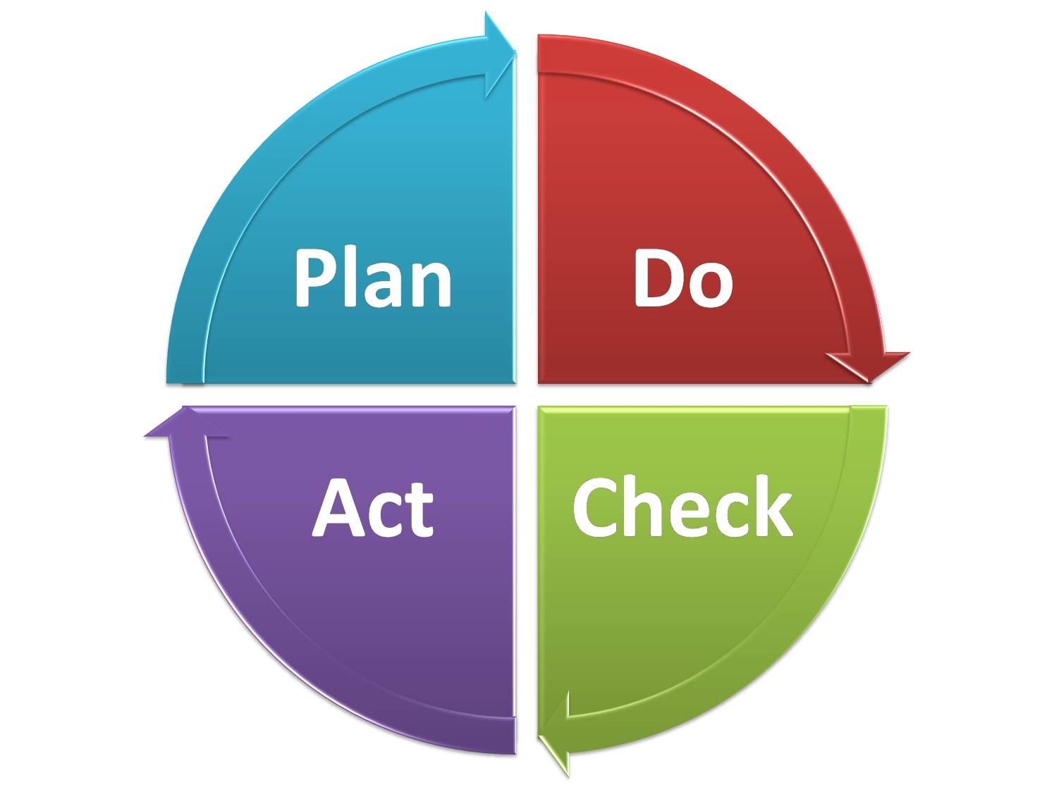
Membership Development – Growth for 2016 and Beyond
Each attendee will leave with an understanding of:
Membership development
Member value
Membership planning
Easy-to-use 3 to 4 step
processes to develop your plan
The end goal is to develop a Section Strategy to share and discuss with your ExCom that can be used as a succession plan.

