Slide 1
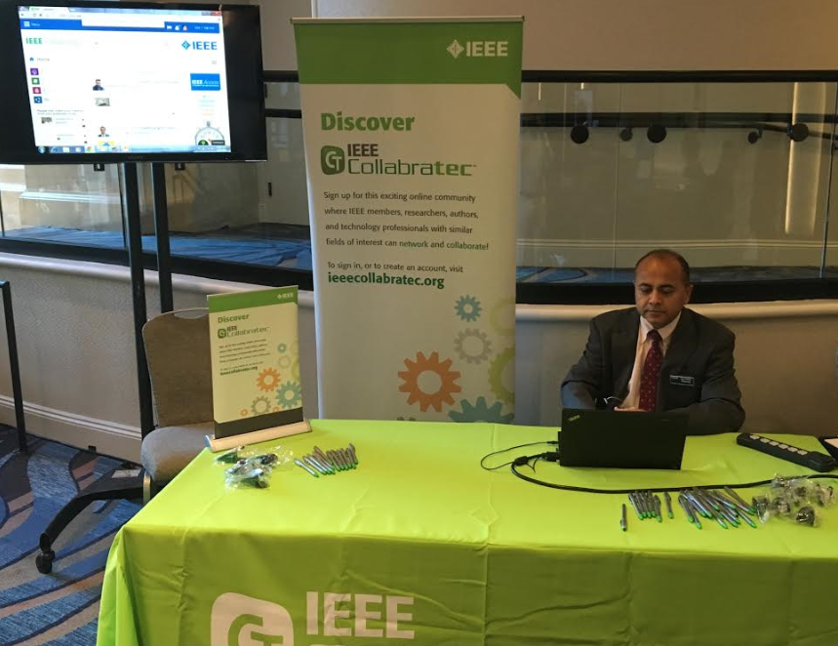
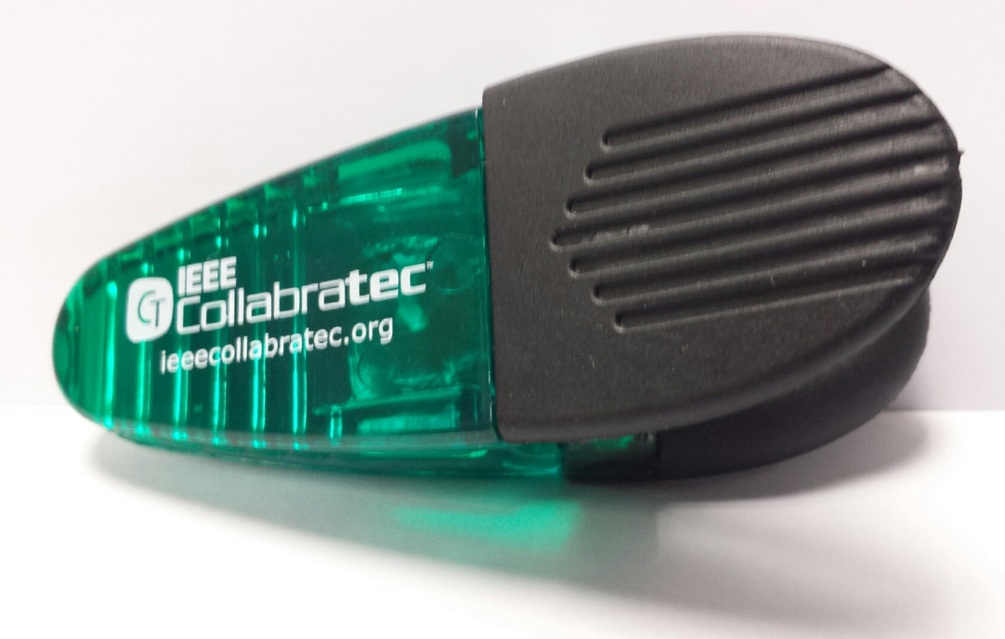
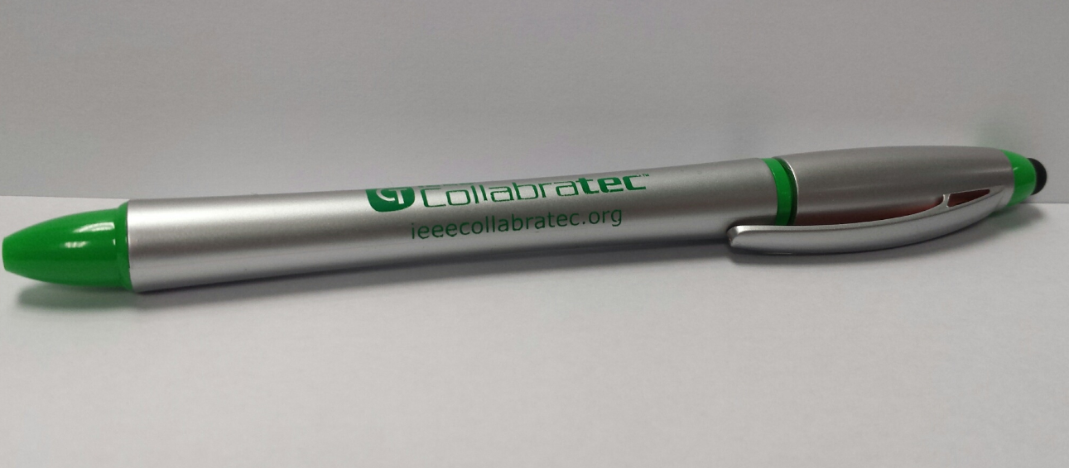
IEEE Collabratec™ IEEE SouthEastCon 2016
Serves Unmet Needs All on One Platform
ieeecollabratec.org
Networkers
Researchers
Scope and depth of expertise in engineering and technology not found in general social networks
Authors
Career Developers
Please Stop by Collabratec Booth
talk to Terence & take these items
Collaborate with IEEE Members & Non-Members Worldwide

