Slide 1
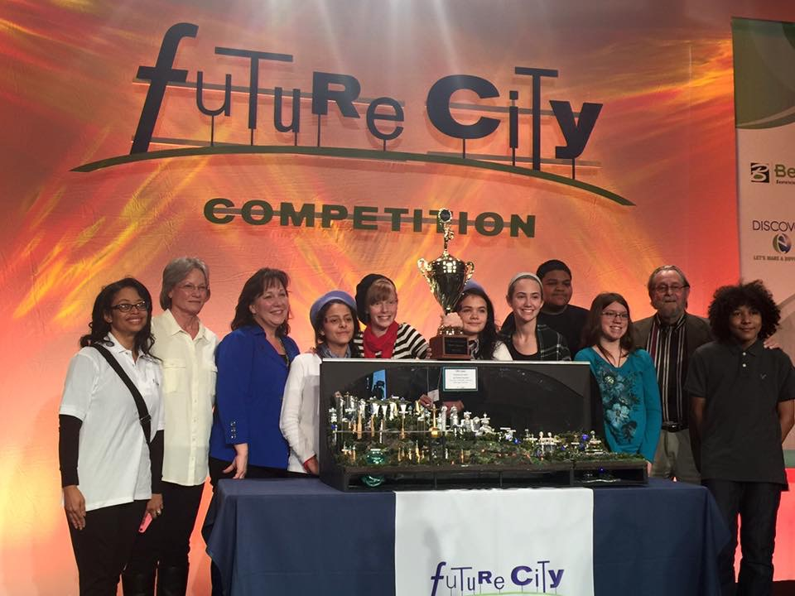
IEEE Huntsville Section Report – SoutheastCon2016
Most Successful Initiatives:
Held a Senior & Life Member Round Up on IEEE Day October 6th, 2015 which resulted in 59 new Senior Members, and 6 Life Members serving as references.
Currently proposing to host IEEE SoutheastCon 2019 in Huntsville, Alabama by this year. Work still in progress, so stay tuned!
Local EMC Society continues to be successful at hosting technical monthly meetings with 7 – 8 sponsored dinner meetings per year, each averaging 40 – 50 attendees.
Initiated and hosted a Distinguished Lecturer Tour (DLT) on Wideband Sensing making 3 stops in Auburn, Birmingham and Huntsville, Alabama.
Successful completion of the 12th annual Alabama Regional Future City Competition at the USSRC.
Highlight: Alabama team won 1st place at Future City National Finals, during Engineer’s Week in D.C.

