Slide 1
Sections Congress 2017
Report to Region Committee
01 April 2017

Slide 2
What is Sections Congress?

Slide 3
Sections Congress 2017
Who am I?
Sean Haynes
IEEE Volunteer since college
Do I really want to age myself?
This is my 6th Sections Congress
Attending since 1999
Whatcha lookin’ at?

Slide 4
IEEE Sections Congress
What is Sections Congress?
A triennial gathering of Section leadership sponsored by the Member and Geographic Activities (MGA) Board.
Three days of working sessions and networking
Gathering of section delegates from all ten Regions
A forum for section leaders to speak as collective voice to IEEE leadership
Issues generated at Sections Congress have had a major impact on the future of IEEE
Each Region gets to put forward 3 recommendations for consideration for action by MGA
Delegates vote for the top recommendations on Sunday

Slide 5
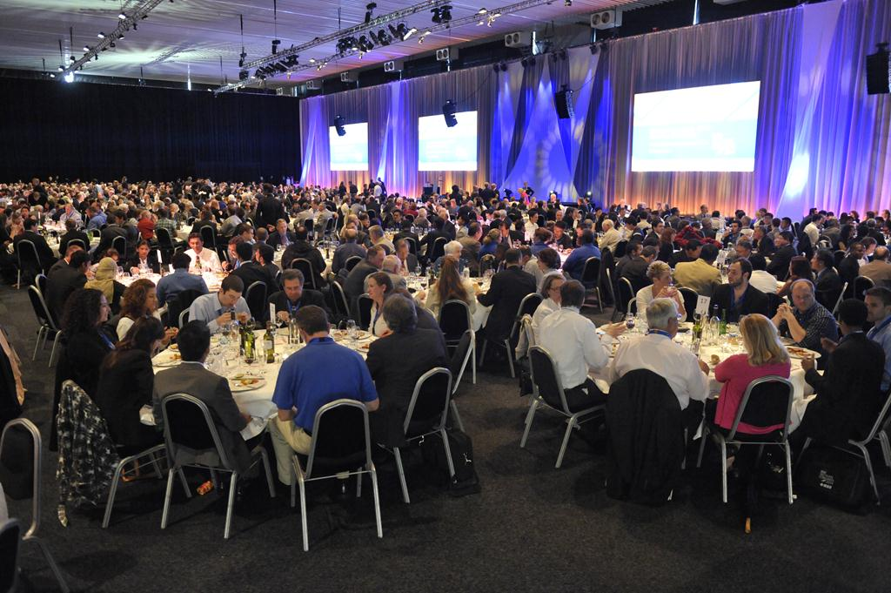
Sections Congress 2014
Some Selected Photos
Region 3 attendees at Sections Congress 2014 in Amsterdam, Netherlands
The banquet at Sections Congress 2014 in Amsterdam, Netherlands

Slide 6
IEEE Sections Congress
Trust me its worth it
Sections Congress can feel like you are drinking from a fire hose
A lot of information is provided
Many concurrent sessions
Don’t squander this opportunity
Ignite Sessions
Tutorials
Best Practices
What’s New
Most Importantly
Have Fun!

Slide 7
Sections Congress 2017
Logistics

Slide 8
Section Congress
General Information
International Convention Centre Sydney, Australia (ICC Sydney)
14 Darling Drive, Sydney NSW 2000
11 – 13 August 2017
Registration Fee for Primary Section Delegate (PSD) will be waived
Registration codes are available
Must provide name of PSD to Sean Haynes (s.a.haynes@ieee.org) to receive
PSD Hotel for 4 nights will be reimbursed
10 Aug through 14 Aug
PSD Meals outside of conference will be reimbursed (up to US$200)
Lowest Fare Coach airfare for dates of conference will be reimbursed
Upgraded fare reimbursement requests must include a printout of lowest fare coach airfare
Extended stay airfare reimbursement request must include a printout of lowest fare coach for dates of conference
Depart 8 Aug for 10 Aug arrival return 14 Aug
Discount codes for airlines will be provided (Delta, United, Qantas)
Will save 5-15% off of published airfares
See Registration Site for Available Codes and Instructions

Slide 9
Sections Congress Registration
Conference Registration
Sections Congress Registration is Open
http://www.cvent.com/d/0vq2wz
Please Register ASAP
No cost for Primary Section Delegate
$350 for other attendees
$100 for extra tickets for companions to Friday Dinner
Other companion events & meals are in the works

Slide 10
Sections Congress Registration
Hotel Registration
Hyatt Regency Sydney selected by Region 3 as Preferred Hotel
You must stay at one of the Congress hotels to be reimbursed
Registration is booked through housing authority
http://www.etouches.com/ieeesectionscongress2017
No upfront costs to register
Primary Section Delegate will be reimbursed for 4 nights
10 Aug – 14 Aug

Slide 12
Sections Congress Travel
Airfare
Lowest cost coach airfare will be reimbursed
Discount codes for Delta and United are available online.
Plan to Arrive Thursday 10 August (depart US Tuesday 8 August) and Depart Monday 14 August
http://www.cvent.com/events/ieee-sections-congress-2017/custom-35-b5a409782ebe4d6eb52d3f26e19b0744.aspx
You may book upgraded, extended stays, or multi-segment trips HOWEVER
You must printout lowest cost DIRECT coach airfare for a 10 Aug Arrival and 14 Aug departure must be submitted with your expense report
Comparison airfare should be generated at the same time as the actual booking
The LOWEST cost airfare submitted will be reimbursed
You should book your airfare as soon as feel comfortable
Airfare expenses for Primary Section Delegate can be submitted preconference for reimbursement.

Slide 13
Sections Congress Travel
Visa & Travel Authorisation
United States Passport holders must apply for an Electronic Travel Authorisation (eTA) to travel to Australia
Cost is AU$20 (US$15)
https://www.eta.immi.gov.au/ETAS3/etas
Jamaica Passport holders require e600 Visa to travel to Australia
Cost AU$135
https://www.border.gov.au/Trav/Visa-1/600-/Visitor-e600-visa-online-applications
Non-US Passport holders should visit the Australian Department of Immigration and Border Protection website
Cost various by visa type
https://www.border.gov.au/.

Slide 14
Sections Congress Travel
Ground Transportation
Airport Transfer
Train service is available from airport
http://www.airportlink.com.au
Get off at Town Hall Station
About 4 blocks walk from Hyatt
AU$18 each way
Shuttle
Redy2Go Shared Van
https://www.redy2go.com.au/
Up-to AU$22/person each way (My fare was AU$83.60 for 2 ppl round-trip)
Drops off directly at Hyatt

Slide 15
Sections Congress Reimbursement
Overview
All Primary Section Delegates’ expenses will be reimbursed solely by HQ
All supporting documentation is required in order to receive reimbursement in accordance with SC2017 travel policy
Individual expense reports to be submitted to HQ with all supporting documentation
Reimbursement for airfare early purchase is allowed.
All other expenses will be reimbursed after the congress

Slide 16
Sections Congress Reimbursement
Process
Submit the name of your Section’s Primary Section Delegate to Sean Haynes by 30 April
s.a.haynes@ieee.org
If you do not do this MGA will not reimburse you!
Still waiting for PSD from Melbourne, Eastern North Carolina, and Richmond Sections
All expenses will be reimbursed directly by MGA
You may submit for airfare reimbursement preconference!
All travel reimbursements MUST be closed out by 15 December 2017!
Use expense report form located at:
https://www.ieee.org/about/volunteers/committee/finance/finance_expense_report.html
Submit expense reports to MGA at:
sc-coordinator@ieee.org

Slide 17
IEEE Sections Congress 2017
Recommendations from Area/Council Meetings

Slide 18
Recommendation Criteria Matrix

Slide 19
Area 1
Virginia
IEEE to investigate the ability to provide sections with options for child care/children’s programs at Section events to help increase attendance
ASEE has provided a service through Kiddie Corp at their events
IEEE to provide a Professional Engineering Preparation “class in a box” that can be used by Sections to assist local members to become licensed PE’s.
IEEE to facilitate creating a fleet MOVE Disaster Response vehicles to increase visibility of the profession across the globe

Slide 20
Area 2
North Carolina Council
Facilitate and promote engagement in:
Challenging Projects
Ken the Robot, MOVE community outreach
Friendly Competitions
Membership, hacking contests, robotic competitions
Fun Activities
Ballgames, picnics
Interesting Programs
Out of the Box Activities

Slide 21
Area 3
Georgia
Create a “Junior IEEE” membership program targeted at middle and high school students
Provide training and information to members to help better explain the benefits of IEEE memberships to Student and Graduate Student members. Facilitate communications between sections and students to keep students that move after graduation.
Use something like the MOVE truck as model for other geographic areas in IEEE to use for disasters, STEM, networking, and as a public service.
Coordinate businesses in geographic areas to help sections fund community projects.

Slide 22
Area 4
Florida Council
Provide a method to help eliminate the $9 fee associated with offering CEUs.
Virtual delivery of DLP for society members to allow for recorded playback or virtual attendance to save travel costs
Provide new members better orientation on continuing education opportunities
Create a member-get-a-member to a meeting to help increase attendance at section meetings
Increase section rebates to allow sections to provide more opportunities for networking activities
Develop a cookbook for delivery of STEM activities to elementary and middle schools
Share lists of ways that sections can provide humanitarian support to local charitable organizations (e.g. Habitat for Humanity, etc.)

Slide 23
Area 5
Tennessee Council
WIE membership should be free
Provide reduction in dues to offset volunteer’s time

Slide 24
Area 6
Alabama/Mississippi
Create an “IEEE University” that can provide structured accredited distance learning.
Provide more applied educational opportunities (Technology vs Engineering).
“Skills Tech in Box”
Reward Sections that host social meetings (include metrics to assess impact and track number of meetings)
Encourage “collaborative working nights”
Move technical talks to online webinars and use face-to-face time for social events
Leverage existing YP events
Require sections to have at least one public service event per year to receive full section funding

Slide 25
Area 7
South Carolina Council
Survey high interest skill areas to create short course and certificate for members
Implement or grow 1-2 major STEM initiatives like MOVE and grow MOVE capability
Discussion board for officers to share sections ideas
Create an introduction for business networking course for members. Make it vibrant, edgy, and teach networking soft skills

Slide 26
Areas 8 & 9
Kentucky, Indiana, Illinois, Jamaica
Expand industrial engagement throughout the region to encourage more members getting help from their industry.
Encourage student members to be teamed with local section members for continuous contact throughout the year.
Encourage more faculty to be engaged with their students about benefits of IEEE.
We need better speakers at the local section level.
We need more joint meetings with other engineering disciplines.

Slide 27
Recommendations
Common Themes
MOVE
IEEE to facilitate creating a fleet MOVE Disaster Response vehicles to increase visibility of the profession across the globe and provide disaster relief, STEM education, networking, and public service to our local communities.
IEEE University
IEEE to establish accredited life-long distance learning opportunities to provide members with the ability to take courses for credit. This should include subjects such as Professional Engineering preparations courses, CEU opportunities. Sections should be given the resources to be able to host the courses offered as a service to their membership either as a “canned” presentation or hosting of remote courses.
Rebates
Increase the rebate to sections to allow them to provide more networking opportunities to members. Provide additional rebate funds for sections that hold certain types of meetings, including educational, social, young professional and other types of underserved areas as determined by MGA.

Slide 28
Recommendations
Common Themes
Pre-College STEM Programs
Create a “Junior IEEE” membership program targeted at pre-college students. Develop (or expand existing) training programs to allow members to provide STEM activities to pre-college students. Provide “canned” or “in a box” style demonstrations and presentations that local sections can deliver to pre-college students.
Humanitarian Support
Provide a way for sections to help identify, contact, and work with local, regional, national, and international humanitarian organizations. Help sections identify members that may have skills that are needed by these organizations. Create an incentive program for sections to provide support to humanitarian organizations.

Slide 29
Recommendations
Common Themes
Communication
Provide training and information to members to help better explain the benefits of IEEE memberships to Student and Graduate Student members. Facilitate communications between sections and students to keep students that move after graduation. Explore ways of better communicating the benefits and existing services of IEEE to members including public service campaigns.
Mentoring
Encourage student members to be teamed with local section members for continuous contact throughout the year.
Industry Relations
Expand industrial engagement to encourage more members getting help from their industry.

Slide 30
Recommendations
Other Interesting Recommendations
Assistance to IEEE Member Families
IEEE to investigate the ability to provide sections with options for child care/children’s programs at Section events to help increase attendance at section events
Member-Get-A-Member Expansion
Create a member-get-a-member incentive program that rewards member for bringing a new member to section meetings or event to help increase attendance and membership
Volunteer Incentive Program
Provide a reduction or credit of membership dues for active volunteers as defined by MGA. Additional credit can be awarded for years of volunteer service.
Section Officer Collaboration
Expand or advertise the available IEEE collaborative tools to allow sections to create discussion board for section officers to collaborate and share best practices with other section leaders locally, regionally, and internationally.

Slide 31
Recommendations
Other Interesting Recommendations
WIE
Make WIE membership free to join.

Slide 32
Your Thoughts
Your thoughts here…

