Slide 1
Join the 2017 New Challenges!
Marina Ruggieri
2017 Vice President, Technical Activities

Slide 2
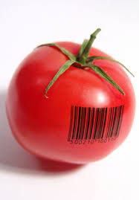
IEEE IN FOOD ENGINEERING
Preparing a Healthy, Sustainable and Enjoyable Future for Mankind

Slide 3
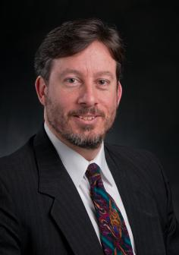
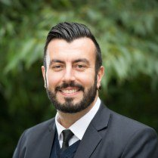
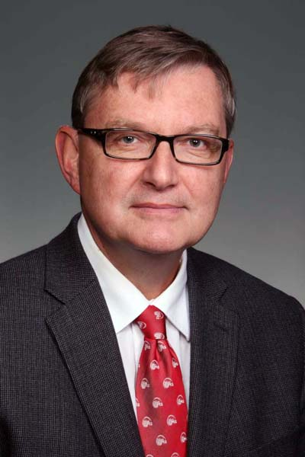
2017 AdHoc Committee on the Topic
FOOD ENGINEERING
John Verboncoeur (Chair), NPS
Damir Novosel (Vice Chair), PE
Eddie Custovic, YP Rep
Melba Crawford, GRS
Toshio Fukuda, DDX, RA
Meng Zhen Kang, SMC
Nigel Lovell, EMBS
Mark Maynard, PSE Antonio Rizzi, RFID
Tomy Sebastian, IA Fei-Yue Wang, ITS, SMC
Daniel Zeng, ITS Doug Zuckerman, COM
Scott Woodhouse (staff)
John Verboncoeur
CHAIR
Eddie Custovic
YP REP
Damir Novosel
VICE CHAIR

Slide 4
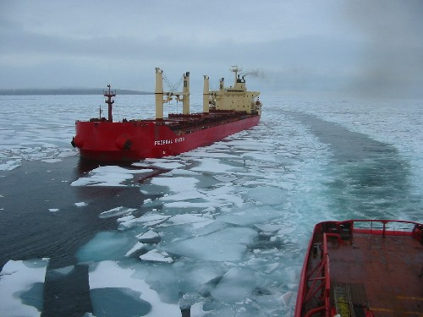
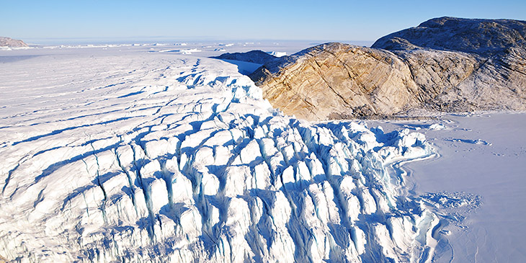
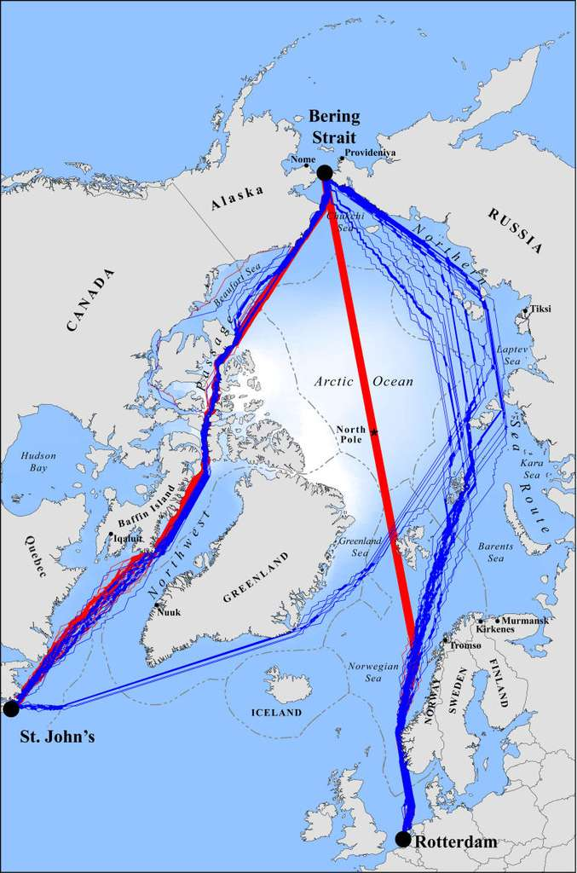
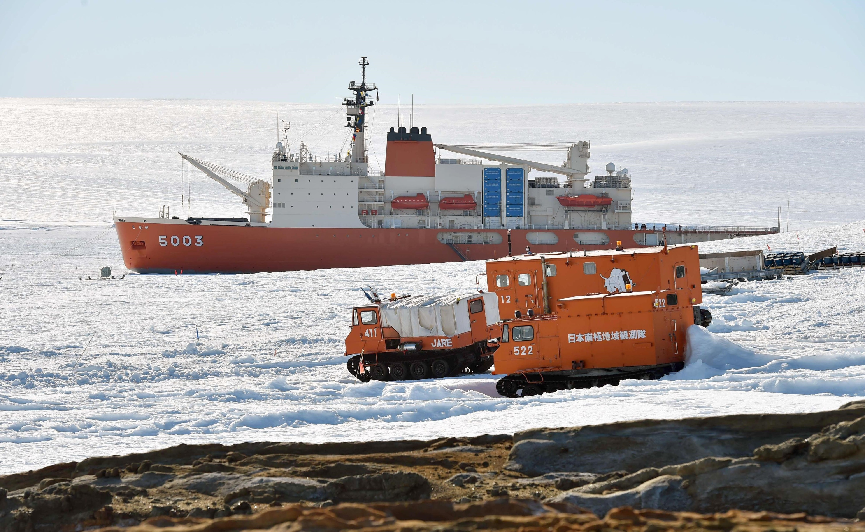
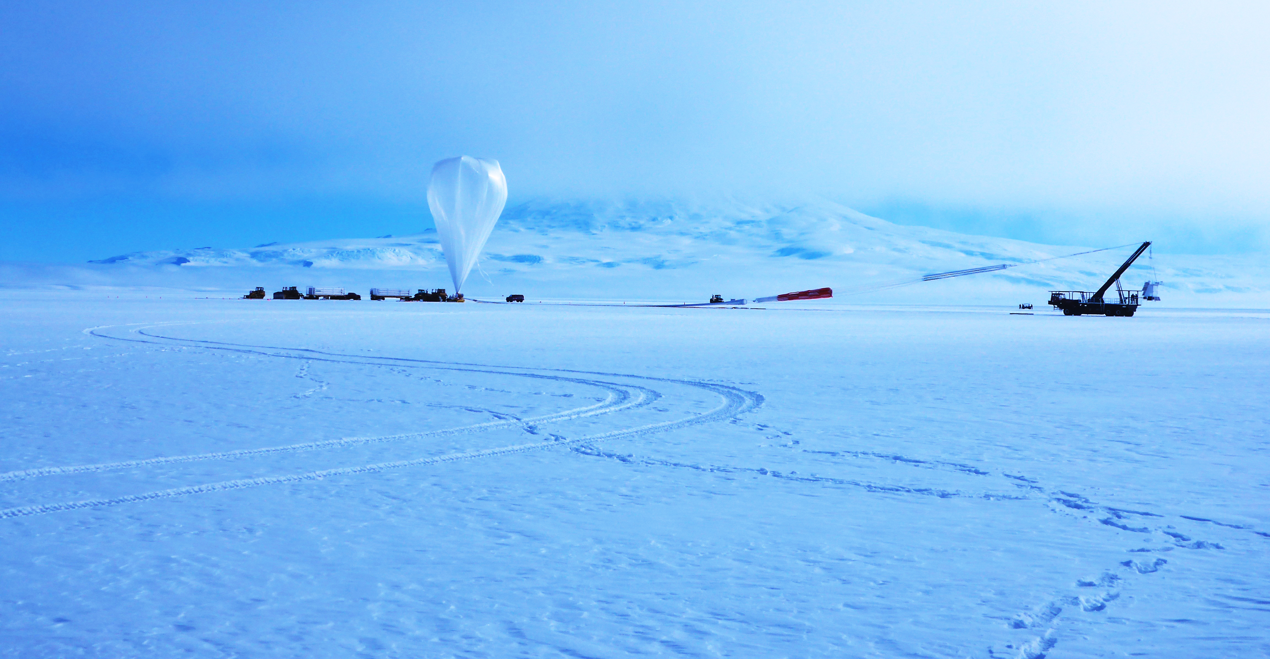
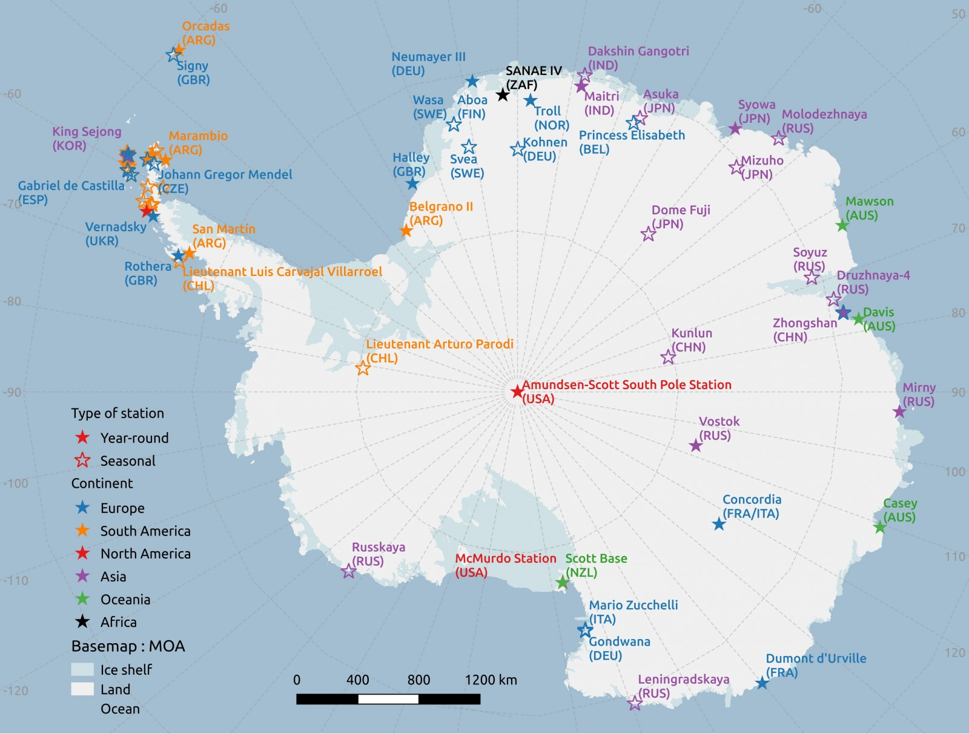
CHALLENGES
New Routes
Oil and Gas
Environment
Social
Public Policy
Technology
Science
IEEE IN THE NORTH AND SOUTH POLES

Slide 5
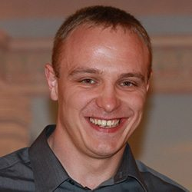
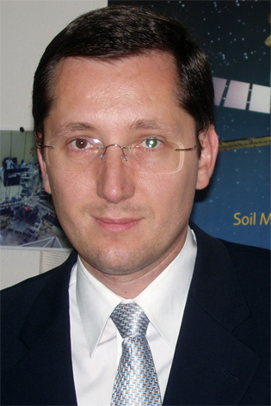
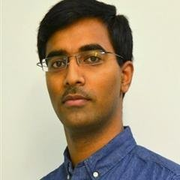
2017 AdHoc Committee on the Topic
NORTH AND SOUTH POLES
Adriano Camps (Chair), GRS Rafal Sliz, YP Rep
Samarth Deo, YP Rep
Claudio R. Brito, EDU Paul M Cunningham, SSIT Teresa Pace, AES Javier Gozalvez Sempere, VT
Christoph Waldamann, SEN
Daniel Zeng, ITS Kristen Russell (staff)
STEERING GROUP:
William J. Emery (U. Colorado, Boulder, USA)
Al Dunlop (Crossbow Consulting, LLC, USA)
Antonio Quesada (U. Autónoma Madrid, Spain)
Yubao Qiu (RADI, Chinese Academy of Sciences)
Julie Friddell (U. Waterloo, Canada)
Tony Milne (UNSW, Australia),GRS liason to GEO
Rafal Sliz
YP REP
Adriano Camps
CHAIR
Samarth Deo
YP REP

Slide 6
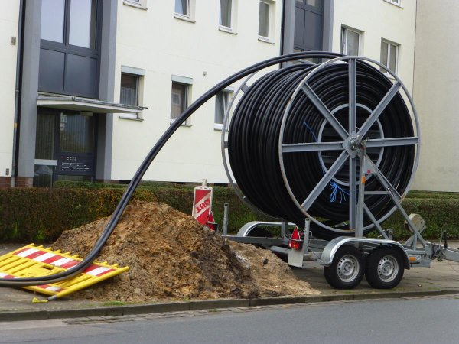
Connect the next Billion to Internet
by an effective and holistic digging for the deployment of infrastructures.
IEEE IN DIG ONCE
Multi Regional
Global and Local
Crucial Public Policy dimension

Slide 7
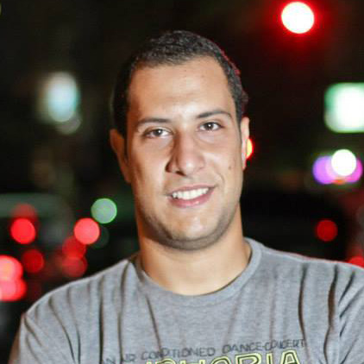
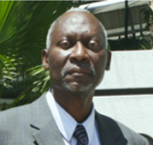
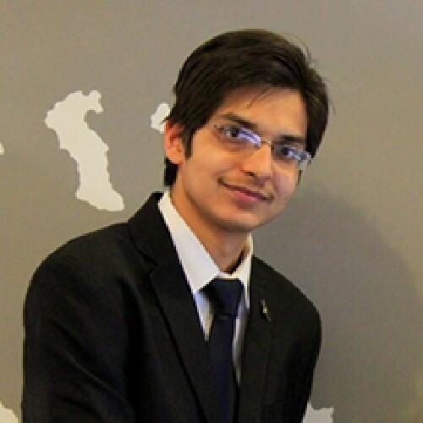
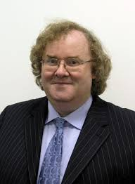
2017 TAB AdHoc Committee on the Topic
DIG ONCE
Bai Blyden (Chair) , PES
Paul M Cunningham (Vice Chair), SSIT Mohammed El Dallal, YP Rep
Shashank Gaur, YP Rep
Claudio R. Brito, EDU Paolo Carbone, SYS Fred Douglis , COMP Harvey A. Freeman, COM Alan Rotz , DDVII – PE, Liaison GPPC Tomy Sebastian, IA Christopher Jannuzzi (staff & 3I Rep)
Mohammed El Dallal
YP REP
Bai Blyden
CHAIR
Paul Cunningham
VICE CHAIR
Shashank Gaur
YP REP

Slide 8
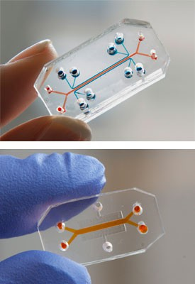
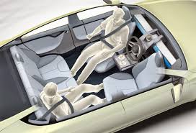
IEEE IN DESIGN FOR ETHICS
T
T
T
T
PH
Ethics as a basic Requirement in the Design of Any Device and Application
T

Slide 9
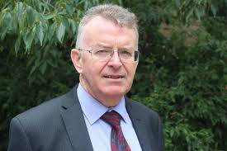
2017 TAB AdHoc Committee on the Topic
DESIGN FOR ETHICS
Greg Adamson (Chair), SSIT Sara Barros, YP Rep
Ruth Dyer, IM Toshio Fukuda, DDX, RA Jean-Luc Gaudiot, COMP Javier Gozalvez Sempere, VT
Satoshi Tadokoro, RA Mark Vasquez (staff)
Greg Adamson
CHAIR
Sara Barros
YP REP

Slide 10
TA
MGA
IEEE-SA
PSPB
EAB
IEEE-USA
PUBLIC VISIBILITY COMMITTEE
GLOBAL PUBLIC POLICY COMMITTEE

Slide 11
NORTH & SOUTH POLES
FOOD ENGINEERING
Thank you!
DIG ONCE
DESIGN 4 ETHICS

