Slide 1
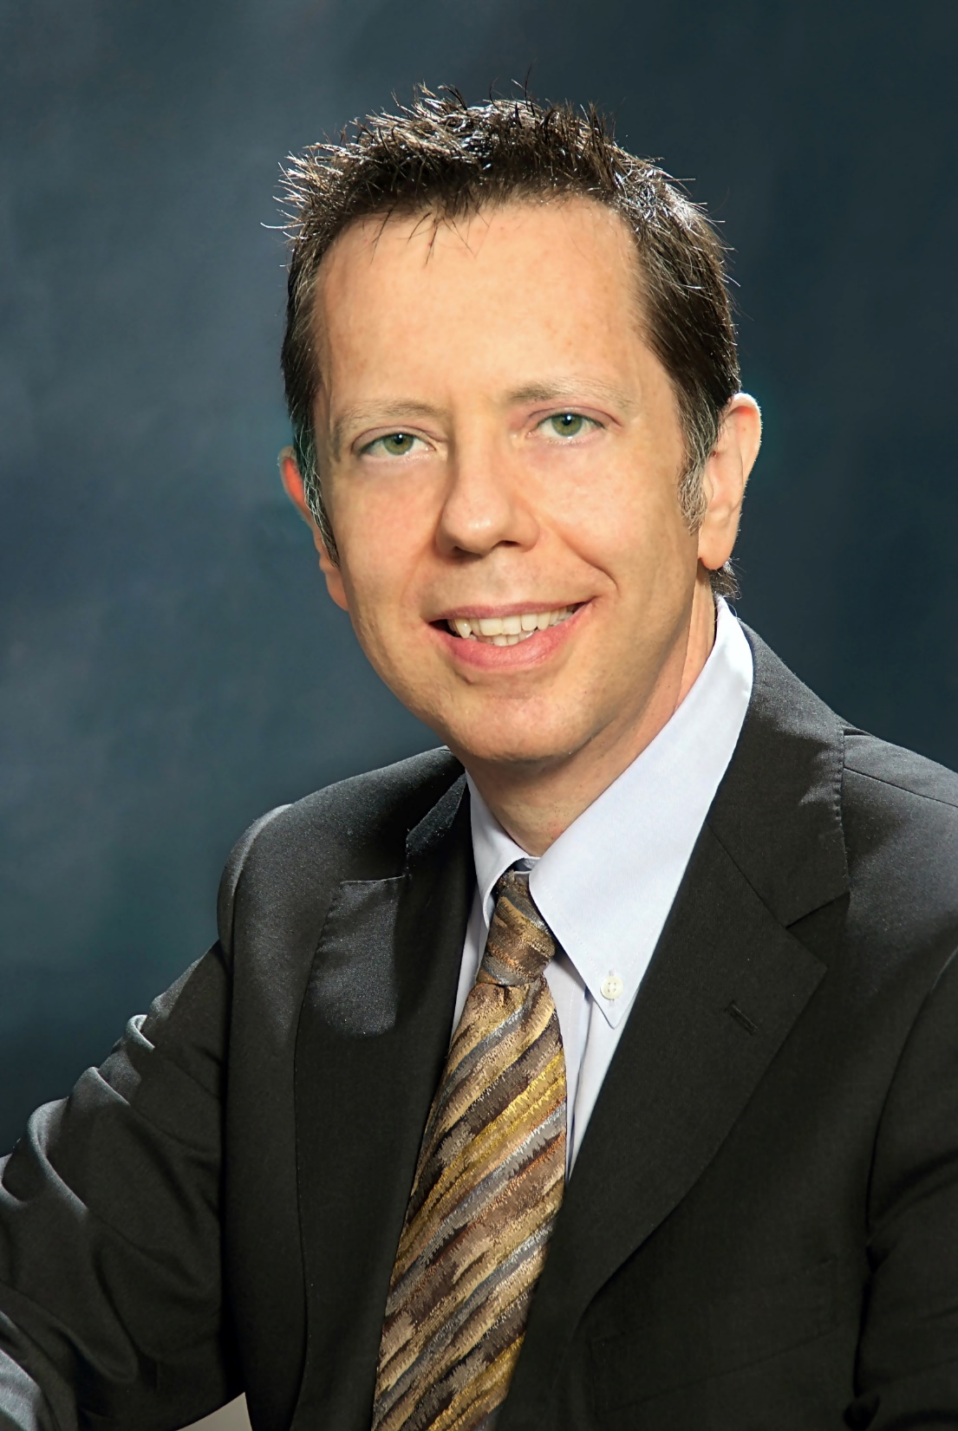
Vincenzo Piuri
2019 IEEE President-Elect Candidate
Volunteering in IEEE for 34 years

Slide 2
Strategic Actions
Be the leaders in innovation
More value to members
Specialized people networking
Empower
and Engage
More focus on young generations
Human-centric approach

Slide 3
Strategic Actions
High-quality knowledge
Where and when needed
Emerging technologies and needs
Be the
Trusted Source
Practical knowledge for professionals
Curated content

Slide 4
Strategic Actions
Local communities
Underserved groups and areas
Promote
Inclusivity
Services for industry and entrepreneurs
Standards in emerging areas
Public services and policies

Slide 5
Strategic Actions
All IEEE members and volunteers
Cooperation among all groups
Nurture the diverse scientific, technical, and professional global community with strong local roots
Transparency, trust, actual participation of IEEE members and volunteers in decision processes
Empower and Engage
Be the Trusted Source
Promote Inclusivity
ONE

Slide 6
Academic Experience
Industrial Experience
Academic research in intelligent systems
PI/Co-PI national/international projects
400+ publications
Industrial research
Project manager for industrial research
Founder of a start-up company
Experience and Competences
Recognitions
Leadership & Management
IEEE Fellow (2001) & IEEE-HKN Member
ACM Distinguished Scientist (2008)
Honorary Professor
Manager of a start-up company
Department Chair & PhD Program Director
IEEE VP-TA & S/C President/Vice President

Slide 7
Members Activities
Technical Activities
MGA SDEA
IEEE Awards
Sections Congress
Chapters
Student Branches
TAB Strategic Planning
S/C President/Vice President
Environmental Engineering Initiative
S/C Technical Committees
Future Directions Committee
TAB Committees
Governance
Conferences
IEEE VP Technical Activities
Director/Delegate
Strategic Planning Ad Hoc
Global Strategies Ad Hoc
S/C AdCom
Steering Committees
General Chair
Program Chair
Finance Chair
Local Arrangement Chair
Education
Publications
S/C VP Education
Biometrics Certification
E-Learning Library
Tutorials
Summer Schools
PSPB Strategic Planning
TAB/PSPB
S/C VP Publications
Editor-in-Chief
Associate Editor

Slide 8
Holistic view for ONE IEEE
Technical background
Management experience
Leadership skills
International visibility
Understanding of IEEE activities
Positive attitude in leadership
Ability to listen to people
Value and respect diversity
Catalyze people efforts
Promote cooperation and trust
Work in a collegial way

