Slide 1
IEEE R3 YP Plan

Slide 2
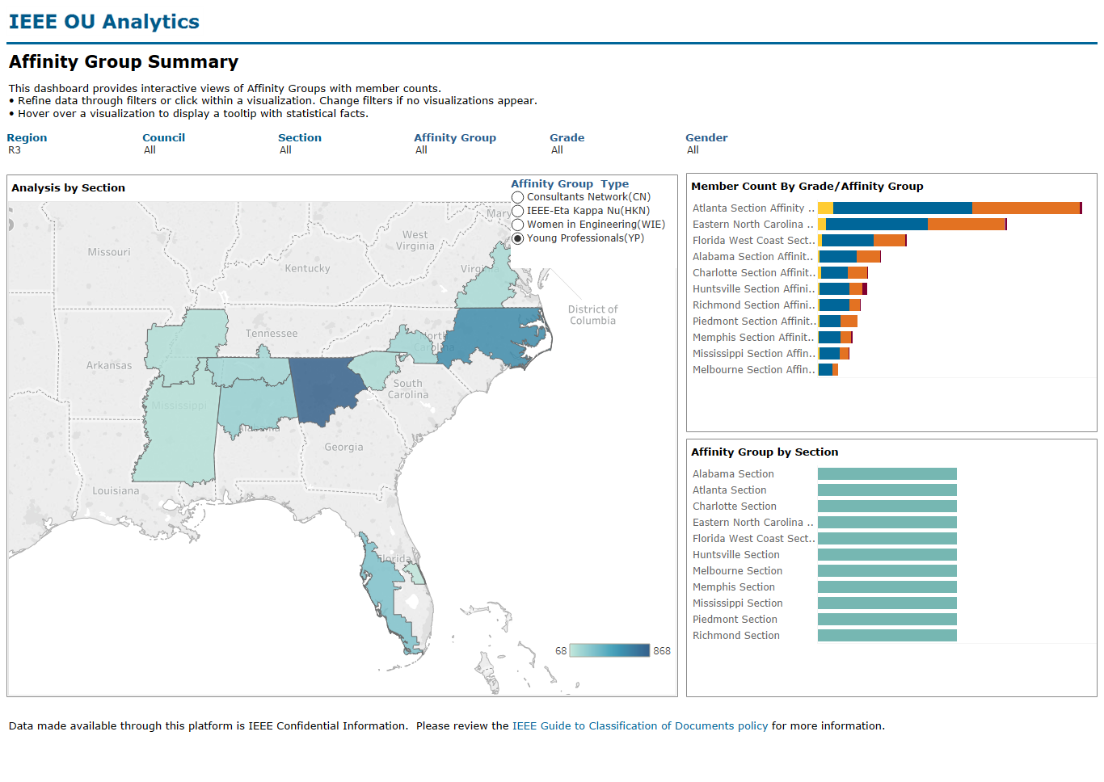
Current Status
Total YPs in R3 – 5607
11 AGs
Serving 2882 members
~50% unserved by AGs
30 events
3 events per year [er AG
~5 AGs on probation for 2020 from total 11

Slide 3
R3 YP

Slide 4
Section Name | AG Status | # of Members | Year Formed | # of YP funded activities | 2019 | 2018 | 2017 | 2016 | AG Chair | Position Start
Alabama Section Affinity Group, YP | Active | 210 | 2000 |  | 1 | 2 | 0 | 0 | John Ward | 1-Jan-18
Richmond Section Affinity Group, YP | Active | 141 | 2017 |  | 5 | 9 | 0 | 0 | Shellie Lundquist
Atlanta Section Affinity Group, YP | Active | 864 | 2012 |  | 6 | 4 | 7 | 2 | Edwin Mastache | 6-Apr-15
Huntsville Section Affinity Group, YP | Active | 161 | 1999 |  | 0 | 1 | 2 | 2 | Thomas Heckwolf | 2-May-16
Mississippi Section Affinity Group, YP | Active | 102 | 2014 |  | 2 | 6 | 0 | 0 | Ayesha Bari | 12-February-16
Charlotte Section Affinity Group, YP | Active | 168 | 2017 |  | 0 | 2 | 2 | 0 | Anthony Candarini | 8-Aug-18
Eastern North Carolina Section Affinity Grp, YP | Active | 620 | 2012 |  | 0 | 4 | 0 | 2 | INAMULLAH BHUTTO | 4-Feb-19
Piedmont Section Affinity Group, YP | Active | 131 | 2017 | 1 | 4 | 0 | 0 | 0
Florida West Coast Section Affinity Group,YP | Active | 290 | 2002 | 2 | 10 | 7 | 3 | 2 | Anthony Ross | 5-Jan-16
Melbourne Section Affinity Group,YP | Active | 68 | 2006 |  | 2 | 2 | 1 | 4
Memphis Section Affinity Group, YP | Active | 117 | 2013 |  | 1 | 2 | 1 | 2 | Patrick McGinnis | 2-February-16

Slide 5
Section | Category | Title
ALABAMA | Nontechnical | May 2019 - Alabama IEEE Young Professional Social Event
RICHMOND | Technical | Prosthetics group meeting
RICHMOND | Technical | Prosthetics group meeting (WebEx)
RICHMOND | Nontechnical | Social Event : IEEE Young Professionals
RICHMOND | Technical | Tekscan Presents their Pressure Mapping System for Prosthetics
RICHMOND | Technical | Prosthetics group meeting
ATLANTA | Nontechnical | 2019 Spring YP Networking
ATLANTA | Nontechnical | IEEE TEMSCON Atlanta Young Professionals Social Event
ATLANTA | Administrative | Atlanta YP Planning Meeting
ATLANTA | Nontechnical | Atlanta Young Professionals - Top Golf
ATLANTA | Administrative | Atlanta Young Professionals meeting with ASME
ATLANTA | Professional | Atlanta STEM Networking Happy Hour-Hosted by WIE/Co-Sponsored by YP
MISSISSIPPI | Nontechnical | PATHWAYS TO LEADERSHIP
MISSISSIPPI | Nontechnical | How Best Leaders Make Everyone Smarter
PIEDMONT | Nontechnical | IEEE Young Professionals Meeting at Clemson University
PIEDMONT | Professional | Key Insights in Career Management - Professional Development Webinar
PIEDMONT | Technical | Mount Holly Microgrid Tour and Piedmont Section YP November Meeting (Co-hosted with PES)
PIEDMONT | Administrative | IEEE Piedmont YP General Meeting
FLORIDA WEST COAST | Administrative | YP Feb Planning Mtg
FLORIDA WEST COAST | Nontechnical | FWC WIE and YP Technical Gossips social
FLORIDA WEST COAST | Nontechnical | YP and USF joint Spring Picnic
FLORIDA WEST COAST | Administrative | YP Planning session
FLORIDA WEST COAST | Administrative | YP May Planning Meeting
FLORIDA WEST COAST | Nontechnical | IEEE YP June Social Event: Top Golf!
FLORIDA WEST COAST | Professional | Becoming an Independent Consultant
FLORIDA WEST COAST | Nontechnical | IEEE YP and WIE trip to NASA
FLORIDA WEST COAST | Administrative | YP July Planning Meeting
FLORIDA WEST COAST | Professional | YOUR RESUME --- YOUR STRENGTHS
MELBOURNE | Professional | IEEE Melbourne Section Senior Member Elevation Event and 2020 Elections
MELBOURNE | Administrative | YP Administrative Meeting

Slide 6
Conservative Operational Plan 2020
Revitalization – Bring 2 AGs back to active status
Quarterly webinar
Annual Town hall
Increase R3 funding from MGA YP from 3 to 4
Annual Survey
YP Presence at SoutheastCon
Award – 2 awards
Website-blog/Listserv
Facebook – Linkedin
Can operate with only YP Coordinator, Succession plan?

Slide 7
Cycle of Success
High quality events
Increase brand value
Attract talented volunteers

Slide 8
Potential Ambitious Addons to the Operational Plan 2020
No | Item | Description | Requirements/effort | Value
1 | Town hall with Region Director, President Elect and IEEE-USA President |  | SSC WebEx |20 | Brand, Governance 20
2 | Mentoring Program | 10 mentors to 10 mentees pilot | Collabratec , 1 volunteer $ 250 |40 | Membership benefits | 60
3 | YP Event – SoutheastCon | Entrepreneurship, leadership, communication and networking – ½ day event | 1 volunteer, coordination with Conference committee, fund $500 |60 | Membership benefits, Brand Will not be enough to attract new participants to SC20, could be organized with local YP AG, Increase Student transition and retention by 5% |30
4 | R10 - 8 SYP | Send at least one R3 leader to R8 and R10 SYW Congresses in 2020 | 2 volunteers, fund $ 2500-3500 |30 | Volunteer training, succession planning |40
5 | R3 SYPWLM | 2.5 day Congress | 4 member core team |100 | Brand, strong member benefits, succession planning, negative – Risk |100

Slide 9
Atlanta Section | 2,963
Eastern North Carolina Section | 2,135
Florida West Coast Section | 1,140
Orlando Section | 917
East Tennessee Section | 813
Huntsville Section | 734
Alabama Section | 639
Central Tennessee Section | 608
Richmond Section | 553
Charlotte Section | 529
Central Virginia Section | 471
Virginia Mountain Section | 448
Hampton Roads Section | 426
Miami Section | 400
Piedmont Section | 389
Palm Beach Section | 360
Gainesville Section | 333
Mississippi Section | 331
Melbourne Section | 330
Memphis Section | 319
Broward Section | 305
Lexington Section | 282
Columbia Section | 281
Chattanooga Section | 262
Coastal South Carolina Section | 261
Louisville Section | 243
Jacksonville Section | 233
Tallahassee Area Section | 233
No | Item | Description | Requirements/effort | Value
5 | Start new YP AGs | 9 potential new YP AGs | 1 Volunteer – Target 2 annually |20 | Local member benefits |60
6 | Revitalization – Maintain all 11 YPs in active status |  | 1 volunteer |20 | Volunteer training, succession planning | 20

Slide 10
Prioritization

Slide 11
Performance Metrices
YoY YP growth %
Student to YP transition growth %
% Decrease in AGs in probation
%Increase in activities
%increase in activities per AG
Social Media Reach % increase
Website/blog visits

Slide 12
Recommendations
YP Liaison to SAC and SEC – Observer/Ex-Officio
Create YP Committee to ensure smooth succession plan
Encourage Joint YP-WIE AGs for smaller sections – only 6 YP/WIEs required
Strategic plan for further discussion

