Slide 1
Resolutions Regarding MGA Surplus Funds Opportunity
March 24, 2024

Slide 2
Main Rules for MGA Surplus Funds Projects
MGA will not consider requests for less that $10k.
Requests must be submitted by the Region’s ExCom using MGA’s form no later than April 14.
To be viable:
  Projects must have the buy-in of more than one Region.
  Regions must show they support the proposal by committing some of their own funds.
Proposals cannot violate IEEE Finance Operating Manual (e.g., no cash awards.)
MGA Board will decide which proposals to approve in June.
Funds must be used this year. Unused funds must be returned to MGA.

Slide 3
Special Need for Flexibility
Total spending requirements for each proposal will depend upon how many Regions want to join the proposal.
For each proposal, Eric will need flexibility to negotiate with other Region Directors to develop
  an agreed-upon total funding request for MGA
  as well as the cost sharing for each proposal
  while still meeting the filing deadline.

Slide 4
International Multi- Discipline Hackathon using Communications, Robotics, Computing, Cyber Security and AI technologies.
Regions 3, 5, 9

Slide 5
Hackathon
Main Features
“IEEE Student members would identify a problem that needs to be addressed in their region, develop an applicable solution, and describe the benefit of using their solution that would occur for their region. The students will define the problem to solve and produce a working prototype to be presented and discussed with their peers.”
“The requirements would be for each team to have to incorporate 3 of the 4 areas of Communications, Computing, Robotics, and AI.”
Projects would be judged by panel of judges.
Up to 100 projects would be funded at up to $200 per project for parts.
Teams would initially work remotely for ~ 3 months followed by 1-2 day event in each Region.
$28,000 total spend – $20k project supplies, $5k food, $3k SWAG.
Regions to provide venues.

Slide 6
Hackathon
Impact
Member engagement, retention, and/or recruiting
  All contestants must be IEEE members. Will pair with recruiting effort.
Describe the short-term and long-term impact of the project.
  The goal is to increase the awareness of IEEE programs and leave a legacy with equipment being donated to STEM organizations within the participating regions.
  The short-term goals are to expand the skills and interest of students in the areas of Communications, Computing, Cyber Security, Robotics and AI technologies.
  The project will test and enhance their abilities of creative and critical thinking with projects that are of interest that fit their skill so they can expand their development and experiences.
  Longer term, the plan would be to get them to be advocates for their solution and get it deployed in the real world to make a difference. The involvement and promotion of IEEE will be part of the theme.

Slide 7
Hackathon
Motion
Move that Director Grigorian, in consultation with [Director-elect Dillard, and Past Director Brunasso], be authorized to negotiate with the Directors of the other Regions for the purpose of submitting a request to the MGA for the funding of the “International Multi-Discipline Hackathon using Communications, Robotics, Computing, Cyber Security and AI technologies” activity. Director Grigorian is authorized to submit this proposal in the name of the Region 3 ExCom providing that the total Region 3 financial commitment does not exceed ______.

Slide 8
XRP Robots for STEM Outreach
Could be easily extended to almost all Sections in R1-10, with the exception of one’s where prohibited by export controls.

Slide 9
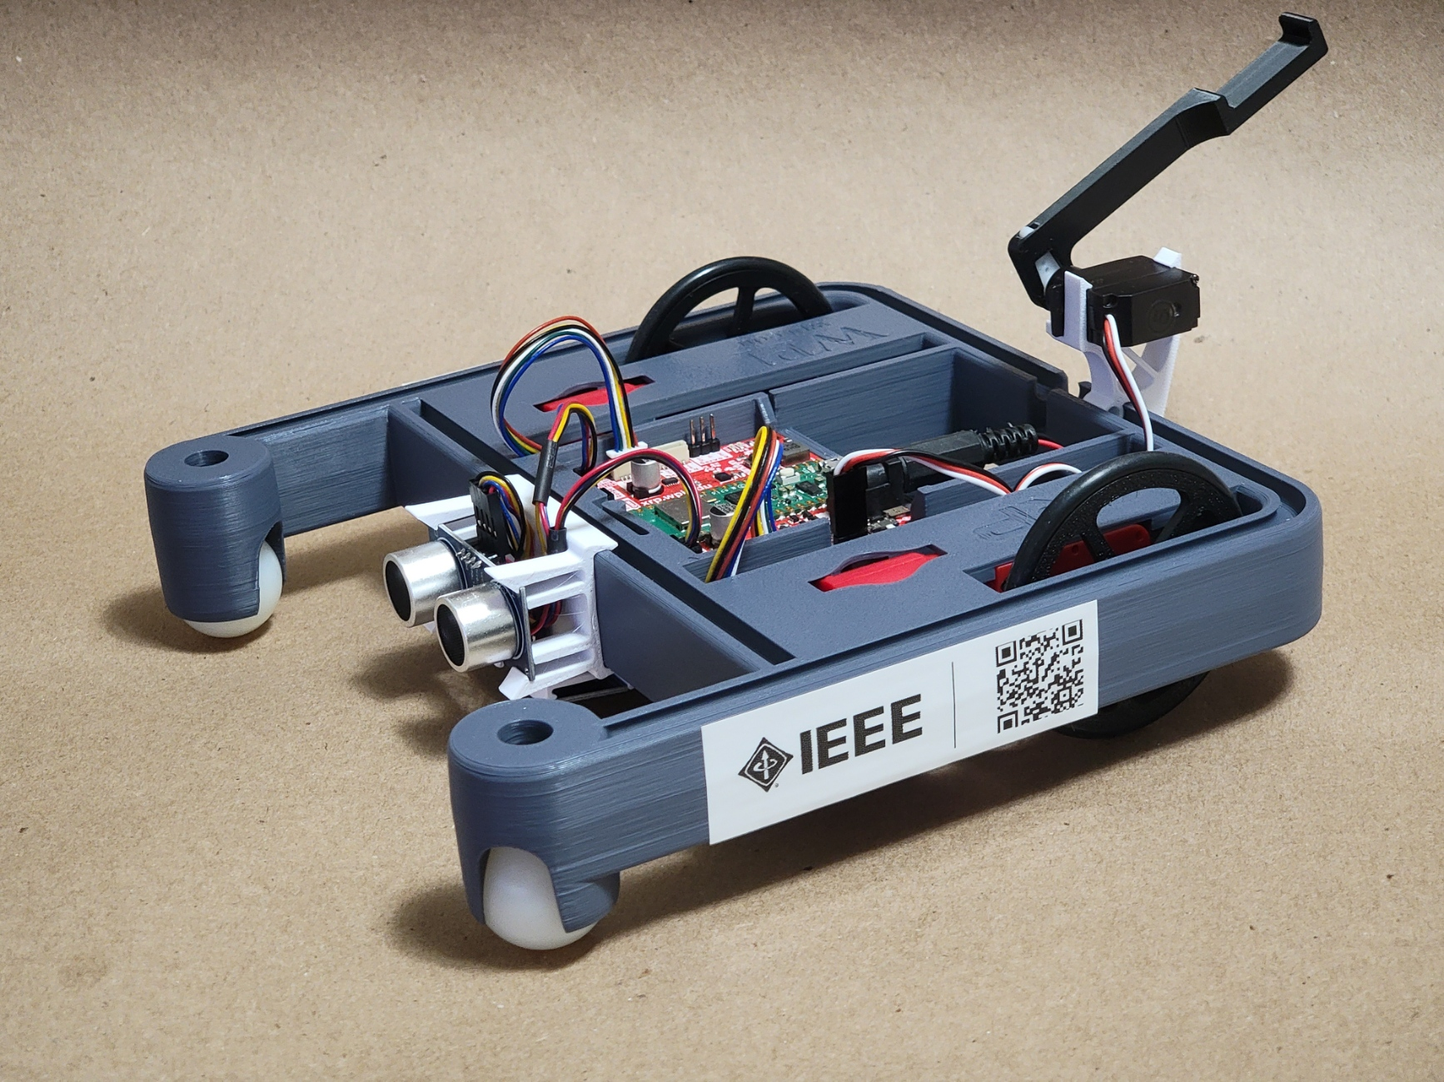

XRP Robot
https://experientialrobotics.org/
Developed by Worcester Polytechnic Institute and DEKA Research & Development Corp under a grant from the National Science Foundation.
Designed to be low-cost platform useable by a wide range of ages and skill levels.
Supported by wide group of partners

Slide 10
XRP Robot
Free online tutorials and lesson plans available through WPI’s OpenSTEM platform.
Developers are looking for the user community to develop more learning content.
IEEE student and higher grade members would develop additional training materials and make it available through TRYEngineering.org.
Robots would be provided to libraries, schools, etc.
Cost per robot w/ batteries, charger, cable is < $100 each.
200 robots could be funded with MGA paying up to $50 per robot, Regions paying up to $25 per robot, and Sections paying up to $25 per robot.
Project is easily scaled up or down depending upon the number of Regions that joined.

Slide 11
XRP Robot
Impact
How does the project address member engagement, retention, and/or recruitment?
  Many children who already participate in STEM events have parents or relatives who are already engineers but may not be IEEE members. Letting these parents or relatives see that IEEE is interested in supporting their children's learning may make them see IEEE in a new light and encourage them to join.
  Providing free opportunities for some students to learn about robotics who would otherwise never have the opportunity to do so can be life-changing for students in underrepresented communities.
  Having Sections actively developing learning materials gets the Sections more engaged.
  Having these materials freely distributed to the public increases their awareness of IEEE's important work in these fields.
  Letting students become familiar with the IEEE name early in their STEM learning makes them more likely to think of IEEE as they become university students and professionals.
Describe the short-term and long-term impact of the project.
  Increased exposure of children and their parents to robotics and IEEE's involvement in the field.
  Increased association in the public's eye between robotics and IEEE's critical involvement.

Slide 12
XRP Robot
Motion
Move that Director Grigorian, in consultation with [Director-elect Dillard, and Past Director Brunasso], be authorized to negotiate with the Directors of the other Regions for the purpose of submitting a request to the MGA for the funding of the “XRP Robots for STEM Outreach” activity. Director Grigorian is authorized to submit this proposal in the name of the Region 3 ExCom providing that the total Region 3 financial commitment does not exceed ______.

