Slide 1
ModRED: A Modular Self-Reconfigurable Robot for Autonomous Exploration
Carl Nelson*, Khoa Chu*, Prithviraj (Raj) Dasgupta**
University of Nebraska
*: Mechanical Engineering, University of Nebraska, Lincoln
**: Computer Science, University of Nebraska, Omaha

Slide 2
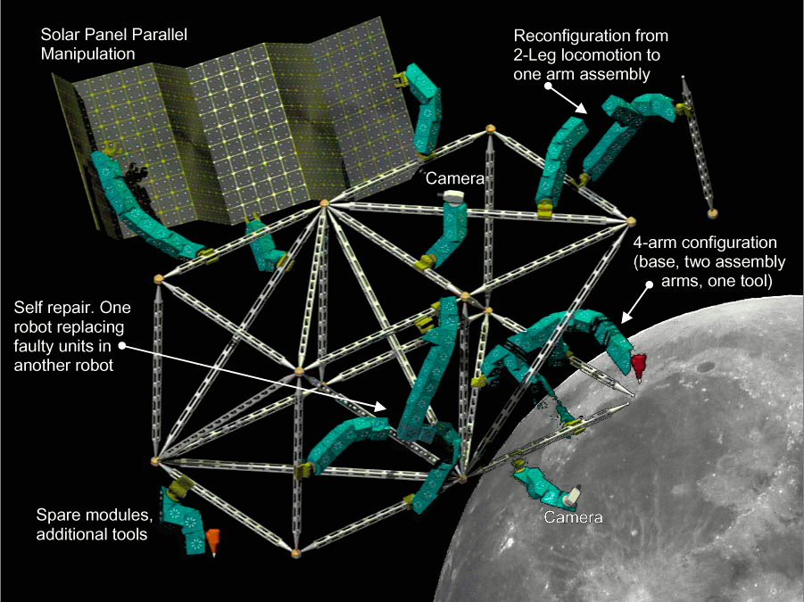
Introduction
Modular self-reconfigurable robots (MSRs) are robots consisting of identical programmable modules capable of reconfiguration.
To enable long-term robotic support of space missions, MSRs needed for:
  unstructured environments
  changing tasks
  self-repair
MSR capabilities can
result in savings in:
  time
  money
  lives

Slide 3
Design Motivation
Types of MSR
  Mobile – CEBOT & S-bot
  Chain – CONRO, Polypod, & PolyBot
  Lattice – Telecube, Molecule, & Stochastic
  Hybrid – Superbot & MTran II
Advanced chain-type MSRs have up to three degrees of freedom (DOF)
More tasks are possible with higher numbers of DOF

Slide 4
Existing MSRs
Focusing on chain-type (as opposed to lattice-type)
Desire light, small package with high task adaptability and dexterity
System | Class | DOF | Motion Space
YaMor | chain | 1 | 2-D
Tetrobot | chain | 1 | 3-D
PolyBot | chain | 1 | 3-D
Molecube | chain | 1 | 3-D
CONRO | chain | 2 | 3-D
Polypod | chain | 2 | 3-D
MTRAN II | hybrid | 2 | 3-D
Superbot | hybrid | 3 | 3-D

Slide 5
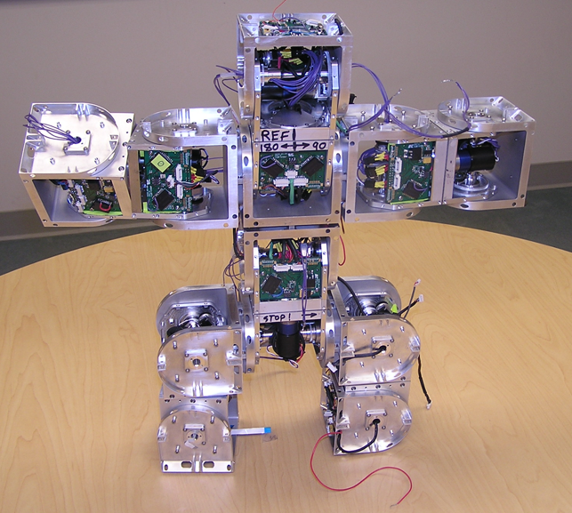
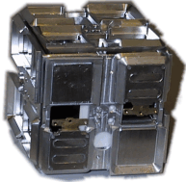
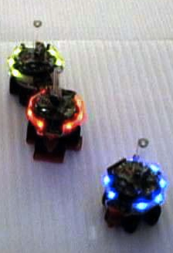
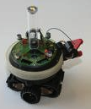
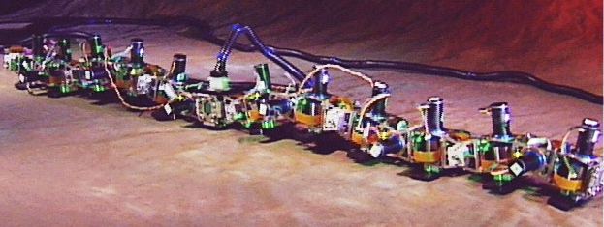
Design Motivation

Slide 6
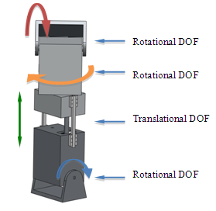
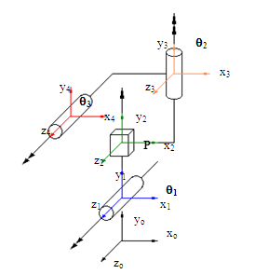
4-DOF Architecture

Slide 7
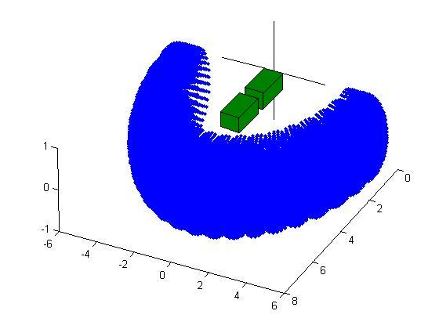
Kinematics
Toroidal position
workspace of one
module end w.r.t.
the other
Some embedded
orientation workspace

Slide 8
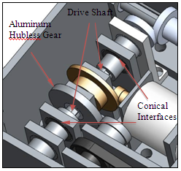
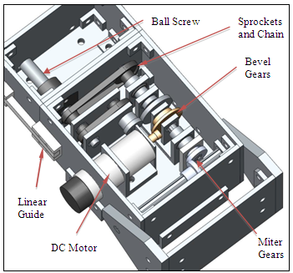
Transmission
2 motors
Solenoids (dis)engage DOF

Slide 9
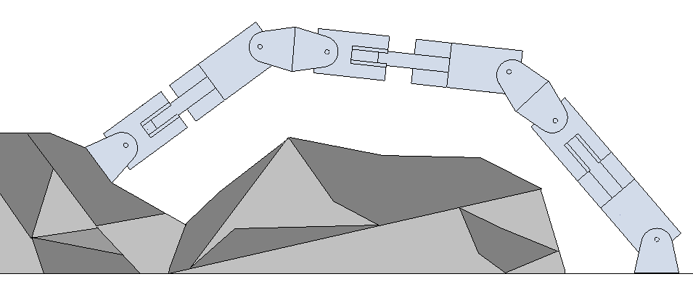
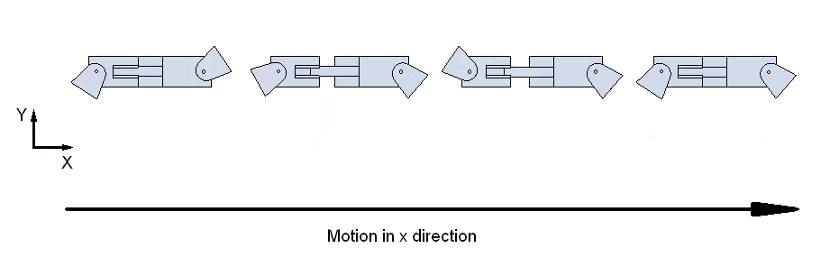
Reconfiguration and Locomotion
Intended to handle unstructured environments
Needs to be able to form useful configurations for task accomplishment as well as locomotion (multi-module or single-module)

Slide 10
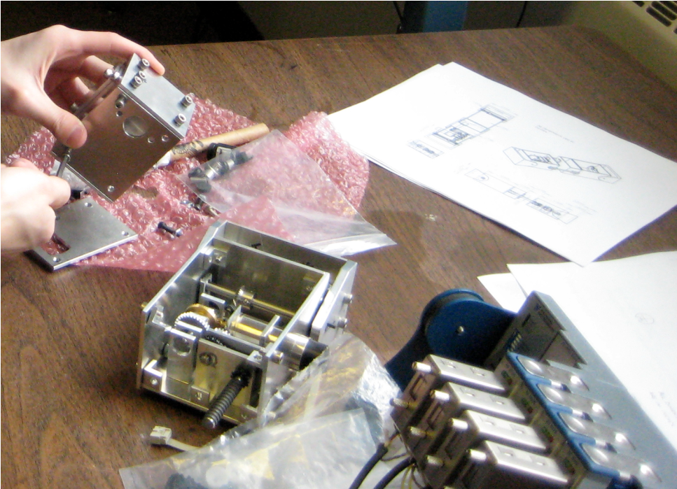
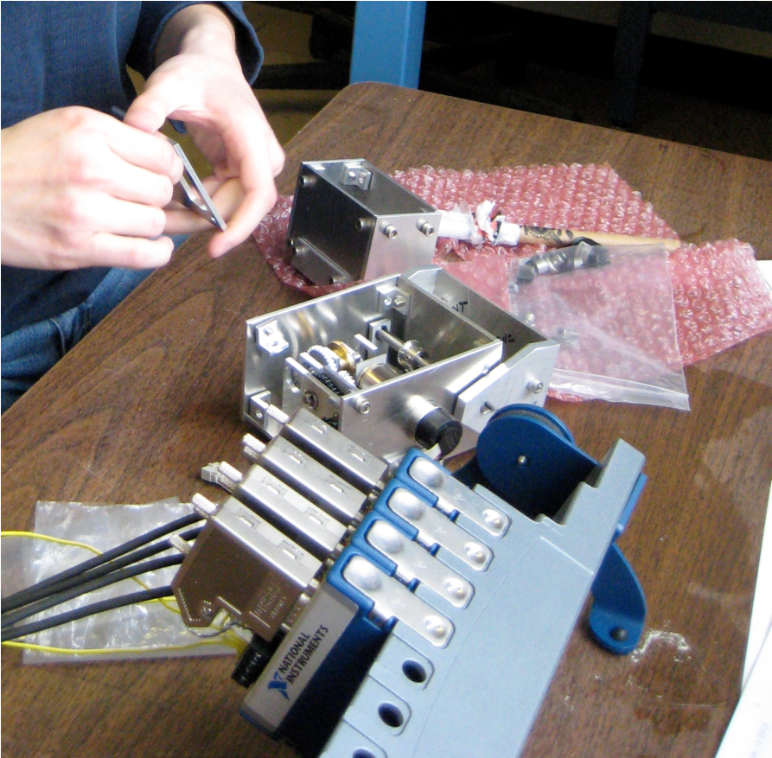
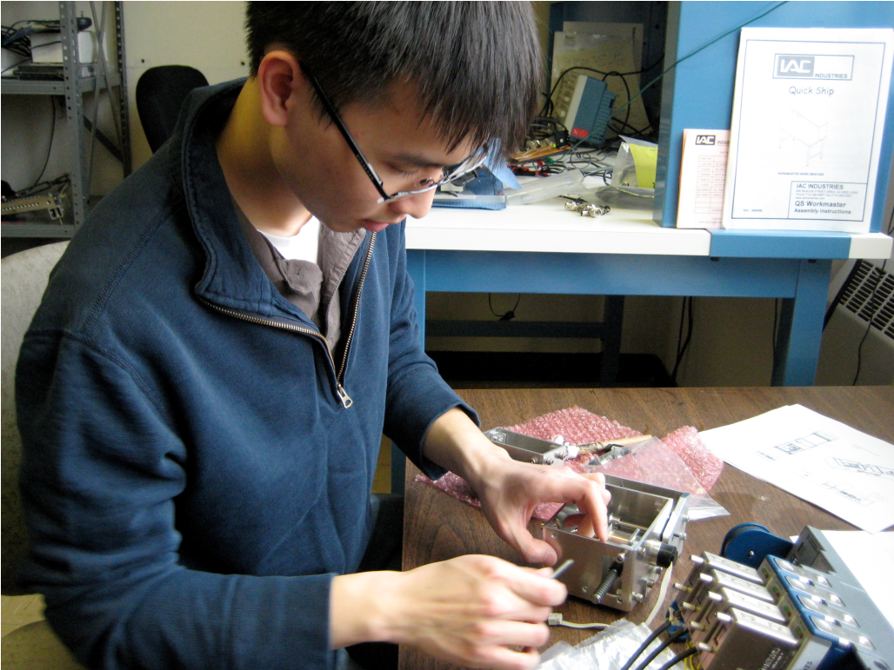
Prototype System

Slide 11
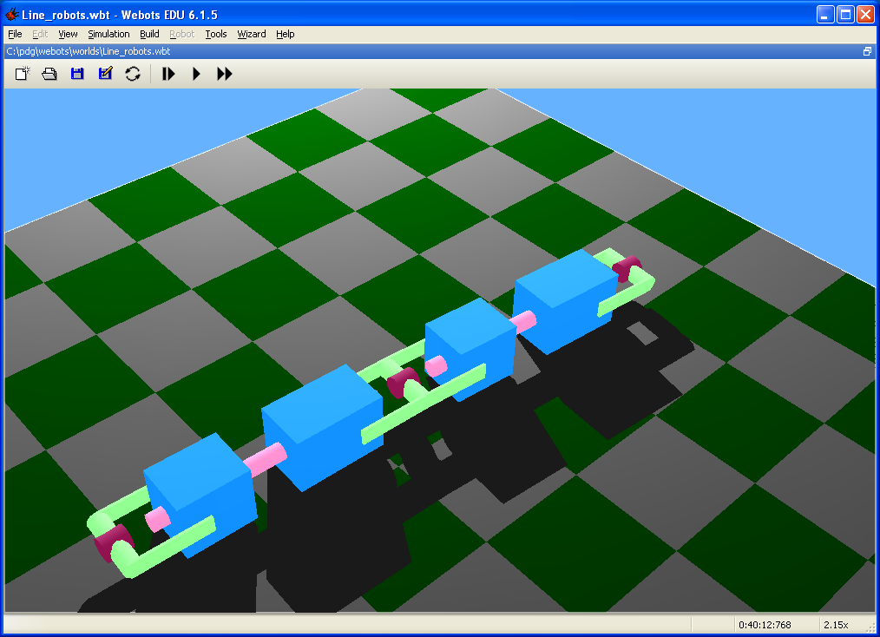
Robot Simulator
Webots
Accurate models for environments, robots
  Physics engine can be used to simulate external forces
Simulations in real or accelerated time
Cross-compiler features with some robot hardware like e-puck, Khepera, etc.

Slide 12
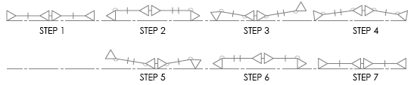
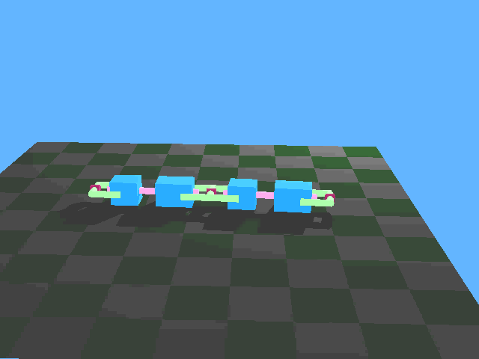
Video Demo: 2-module inchworm

Slide 13
Current Issues
Currently the gaits of ModRED are configured by hand
Autonomous, dynamic reconfiguration
Issues involved:
  What is the best module or set of modules to pair with?
  What is the best set of connections to have with neighboring modules?
Plan to adapt techiques from research on multi-robot team formation to answer these questions

Slide 14
Research Objective: Exploration
Use the ModRED MSR to perform complete coverage of an initially unknown environment in an efficient manner
Efficiency is measured in time and space
  Time: reduce the time required to cover the environment
  Space: avoid repeated coverage of regions that have already been covered

Slide 15
Research Objective: Exploration
Use the ModRED MSR to perform complete coverage of an initially unknown environment in an efficient manner
Efficiency is measured in time and space
  Time: reduce the time required to cover the environment
  Space: avoid repeated coverage of regions that have already been covered
Tradeoff in achieving both simultaneously

Slide 16
Major Challenges
Distributed – no shared memory or map of the environment that the robots can use to know which portion of the environment is covered
Each ModRED module is frugal...limited storage and computation capabilities
  Can’t store map of the entire environment
Other challenges: Sensor and encoder noise, communication overhead, localizing robots

Slide 17
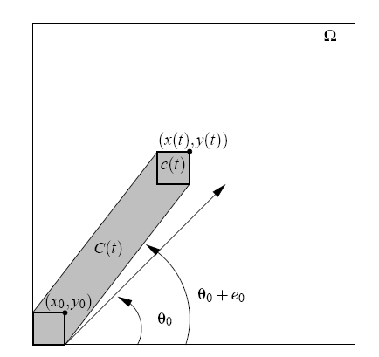
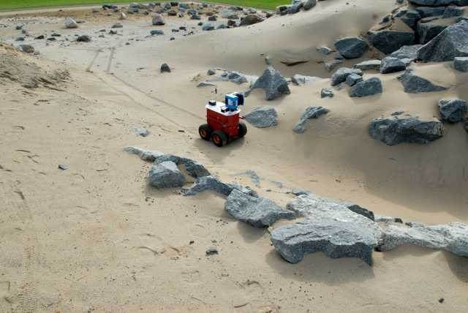
How does a robot do area coverage?
Using an actuator (e.g., vacuum) or a sensor (e.g., camera or sonar)
Robot’s coverage tool
The region of the environment that passes under the swathe of the robot’s coverage tool is considered as covered
Source: Manuel Mazo Jr. and Karl Henrik Johansson, “Robust area coverage using hybrid control,”, TELEC'04, Santiago de Cuba, Cuba, 2004
Single robot, centralized planner doing a graph traversal:
Does not address constraints of multi-robot systems given on last slide
Source: Ioannis Rekleitis, Jean-Luc Bedwani, and Erick Dupuis, “Autonomous Planetary Exploration using LIDAR data”, IEEE ICRA2009

Slide 18
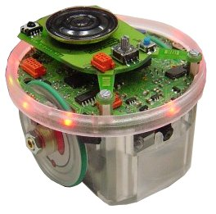
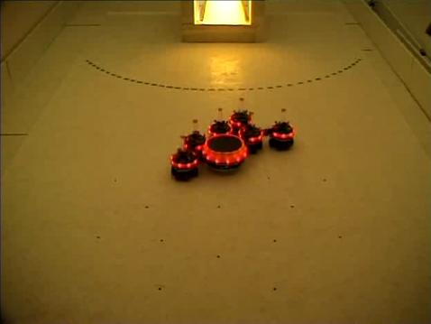
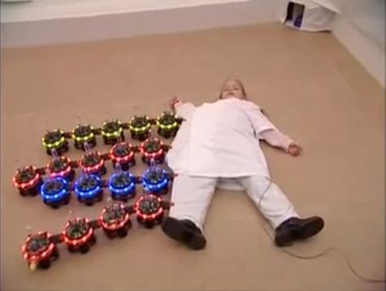
E-puck Mini Robot
Bluetooth wireless
communication
Mic + speaker
E-puck robot’s capabilities are comparable to the proposed ModRED module
144 KB RAM
dsPIC processor@14MIPS
LEDs
4.1 cm
Camera; 640 X 480 VGA
7 cm
IR sensors (8); range ~ 4 cm
Photo courtesy: Mobots group@EPFL http://mobots.epfl.ch

Slide 19
Multi-robot coverage: Individually coordinated robots using swarming
Global Objective: Complete coverage of environment

Slide 20
Multi-robot coverage: Individually coordinated robots using swarming
Global Objective: Complete coverage of environment
Local coverage rule of robot
Local coverage rule of robot
Local coverage rule of robot
...
...
...
Local coverage rule of robot
Local coverage rule of robot
Local coverage rule of robot

Slide 21
Multi-robot coverage: Individually coordinated robots using swarming
Global Objective: Complete coverage of environment
Local interactions
between robots
Local coverage rule of robot
Local coverage rule of robot
Local coverage rule of robot
...
...
...
Local coverage rule of robot
Local coverage rule of robot
Local coverage rule of robot

Slide 22
Multi-robot coverage: Individually coordinated robots using swarming
Global Objective: Complete coverage of environment
Done empirically
How well do the results of the local interactions translate to achieving the global objective?
Local interactions
between robots
Local coverage rule of robot
Local coverage rule of robot
Local coverage rule of robot
...
...
...
Local coverage rule of robot
Local coverage rule of robot
Local coverage rule of robot
References:
K. Cheng and P. Dasgupta, "Dynamic Area Coverage using Faulty Multi-agent Swarms" Proc. IEEE/WIC/ACM International Conference on Intelligent Agent Technology (IAT 2007), Fremont, CA, 2007, pp. 17-24.
P. Dasgupta, K. Cheng, "Distributed Coverage of Unknown Environments using Multi-robot Swarms with Memory and Communication Constraints," UNO CS Technical Report (cst-2009-1).

Slide 23
Multi-robot coverage: Team-based robots using swarming
Global Objective: Complete coverage of environment
Flocking technique to maintain team formation
Local coverage rule of robot-team
Local coverage rule of robot-team
Local coverage rule of robot-team
...
...
...
Local coverage rule of robot-team
Local coverage rule of robot-team
Local coverage rule of robot-team

Slide 24
Multi-robot coverage: Team-based robots using swarming
Global Objective: Complete coverage of environment
Done empirically
Flocking technique to maintain team formation
How well do the results of the local interactions translate to achieving the global objective?
Local interactions
between robot teams
Local coverage rule of robot-team
Local coverage rule of robot-team
Local coverage rule of robot-team
...
...
...
Local coverage rule of robot-team
Local coverage rule of robot-team
Local coverage rule of robot-team
Relevant publications:
K. Cheng, P. Dasgupta, Yi Wang ”Distributed Area Coverage Using Robot Flocks”, Nature and Biologically Inspired Computing (NaBIC’09), 2009.
P. Dasgupta, K. Cheng, and L. Fan, ”Flocking-based Distributed Terrain Coverage with Mobile Mini-robots,” Swarm Intelligence Symposium 2009.

Slide 25
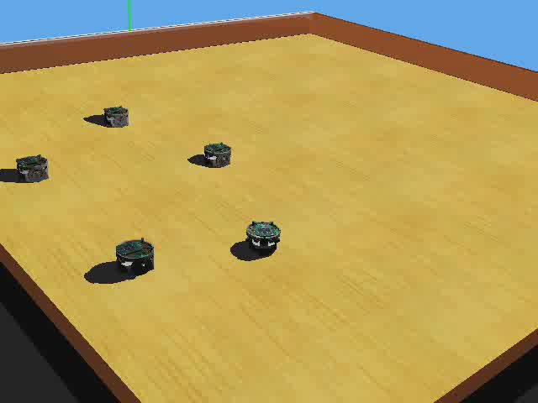
Multi-robot teams for area coverage
Theoretical analysis: Forming teams gives a significant speed-up in terms of coverage efficiency ☺
Simulation Results: The speed-up decreases from the theoretical case but still there is some speed-up as compared to not forming teams

Slide 26
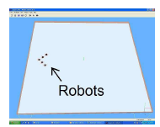
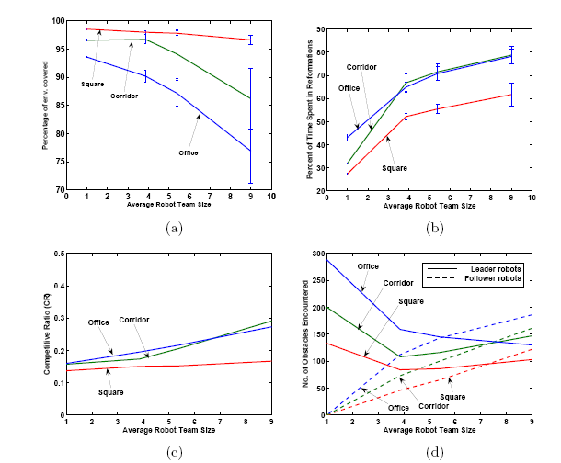
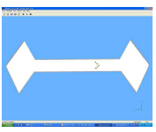
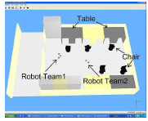
Coverage with Multi-robot Teams
Square
Corridor
Office

Slide 27
Dynamic Reconfigurations in ModRED
Having teams chains of modules is efficient for coverage
Having large teams chains of modules doing frequent reformations is inefficient for coverage
Can we make the modules change their configurations dynamically
  Based on their recent performance: If a large chain is doing frequent reformations (and getting bad coverage efficiency), split the chain into smaller chain and see if coverage improves

Slide 28
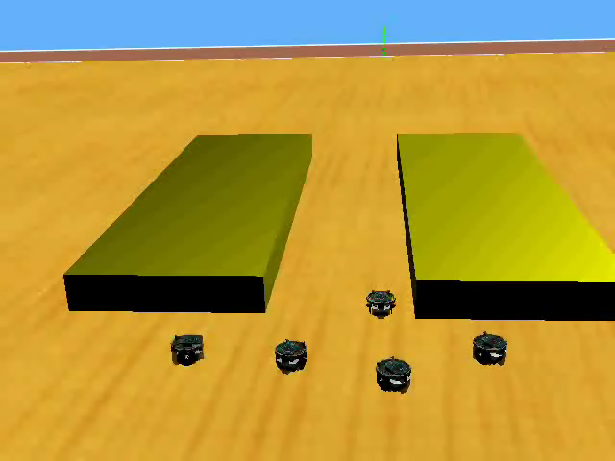
Robot Team Formation for Coverage:
Agent Utility-based Approach
Each robot/agent tries to get into a configuration that maximizes its utility
Calculate the configuration that gives highest utility
Utility-function of each robot in a team
Check inconsistencies
Large team…inefficient coverage: low individual utility
Mediator
Flocking-based
Controller
A team needs to reconfigure
Reference:
P. Dasgupta and K. Cheng, “Coalition game-based distributed
coverage of unknown environments using robot swarms, “ AAMAS 2008.

Slide 29
Coalition game-based team formation
Utility-based team formation works, but it is ad-hoc; depends on careful design of utility function
Is there a more structured way to form teams?
We used coalition games to solve the multi-robot team formation problem
  Coalition games provide a theory to divide a set of players into smaller subsets or teams
  We used a form of coalition games called weighted voting games (WVG)

Slide 30
Robot Team Formation for Coverage:
Weighted Voting Game
Calculate the best partition of a team using WVG rules
Coalition Game Layer
Maintain consistency between WVG result and team formations
Mediator
A team needs to split
OR
Two teams need to merge
Flocking-based
Controller

Slide 31
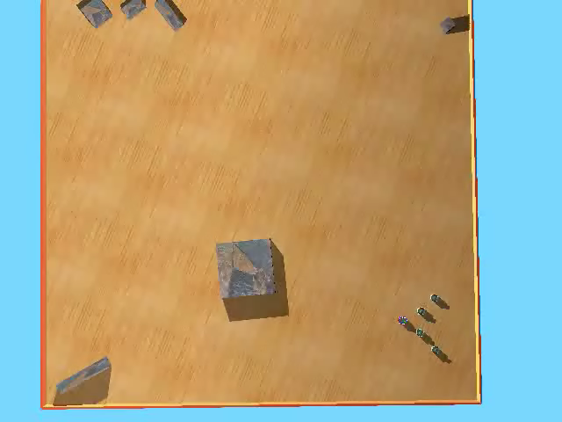
Robot Team Formation for Coverage:
Weighted Voting Game
Reference:
K. Cheng and P. Dasgupta, “Weighted Voting Game based multi robot team formation for distributed area coverage, “ PCAR Workshop 2010.

Slide 32
Ongoing and Future Work
Further develop the prototype of ModRED
  Sensors, actuators, comms, processor
Adapt the results from multi-robot team formation to chain robot formation using ModRED
Terrain simulation
Test hand-crafted and autonomous gait patterns
Testing motion algorithms in variety of terrains on prototype ModRED

Slide 33
Acknowledgements
We are grateful to the sponsors of our projects:
  Nebraska Space Grant Consortium
  Office of Naval Research
  UNL McNair Scholars Program
  UNL Undergraduate Creative Activities and Research Experiences (UCARE) Program
  U. S. DoD NavAir
Students involved:
  Ke Cheng, Taylor Whipple (UN Omaha)
  Khoa Chu (UNL)

Slide 34
Thank You!
For more information:
Dr. Nelson’s lab at UNL: http://robots.unl.edu/Nelson/www/index.htm
Dr. Dasgupta’s lab at UNO: http://cmantic.unomaha.edu

Slide 35
Backup Slides

Slide 36
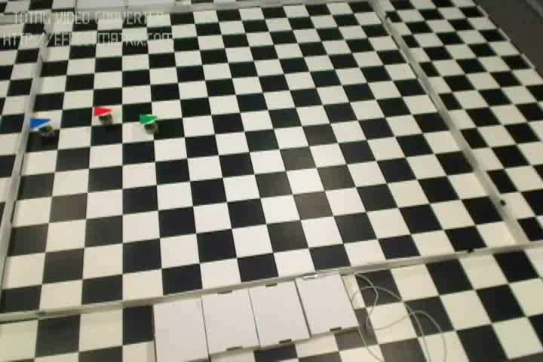
Multi-robot teams for area coverage

Slide 37
Multi-robot coverage: Individually coordinated robots using swarming
Each robot moves individually
Records the coordinates of the location it has covered in a local coverage history
Intermittently exchanges the locations (region) it has covered with other robots in its communication range
Fuses the coverage information from itself + other robots in a coverage map
Uses an hill-climbing + information gain based heuristic based on the information in the coverage map to choose an uncovered or least-covered location to cover
Global Objective: Complete coverage of environment
Done empirically
How well do the results of the local interactions translate to achieving the global objective?
Local interactions
between robots
Local coverage rule of robot
Local coverage rule of robot
Local coverage rule of robot
...
...
Local coverage rule of robot
Local coverage rule of robot
Local coverage rule of robot
...
Local coverage rule of robot

Slide 38
Multi-robot coverage: Individually coordinated robots using swarming
Each robot moves individually Robots move as teams
Records the coordinates of the location it has covered in a local coverage history
Intermittently exchanges the locations (region) it has covered with other robots teams in its communication range
Fuses the coverage information from itself own team + other robots teams in a coverage map
Uses an hill-climbing + information gain based heuristic based on the information in the coverage map to choose an uncovered or least-covered location to cover
Global Objective: Complete coverage of environment
Done empirically
How well do the results of the local interactions translate to achieving the global objective?
Local interactions
between robots
Local coverage rule of robot
Local coverage rule of robot
Local coverage rule of robot
...
...
Local coverage rule of robot
Local coverage rule of robot
Local coverage rule of robot
...
Local coverage rule of robot team

Slide 39
Coverage with Multi-robot Teams
Square
Corridor
Office

Slide 40
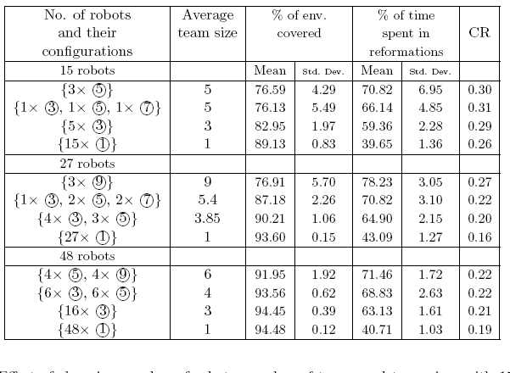
Comparison of Different Team-based and Individual configurations

Slide 41

Lunar Surface Demo with E-pucks

