Slide 1
Rover Trajectory Planning Constrained Global Planning and Path Relaxation
Mihail Pivtoraiko
Robotics Institute
Carnegie Mellon University
Notes:
The topic of this presentation is field exps of an automatic motion planning system for wheeled rover vehicles

Slide 2
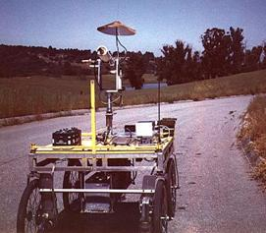
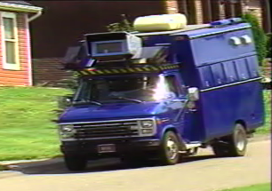
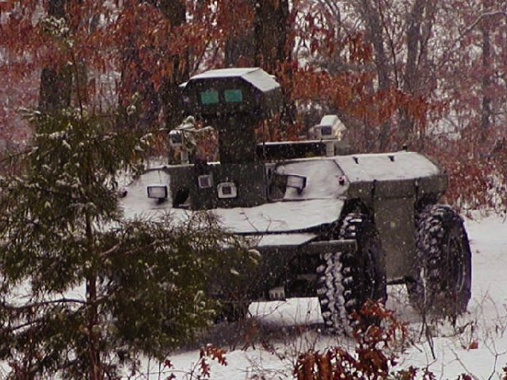
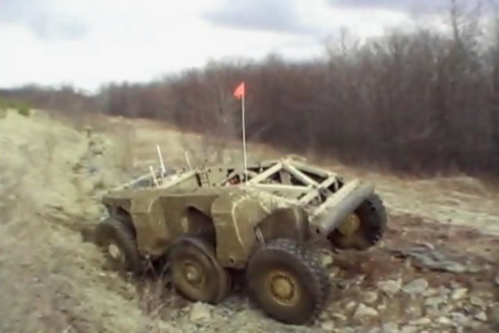
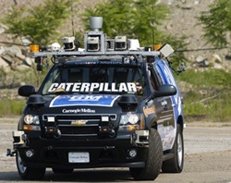
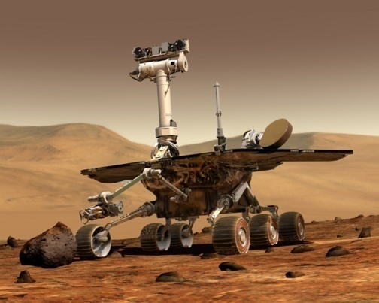
Autonomous Navigation
The Challenge:
Outdoor Autonomous Robots
Stanford Cart, 1979
XUV, 1998
ALV, 1988
NavLab, 1985
Crusher, 2006
Boss, 2007
MER, 2004
Notes:
*Hard problem*
20 sec.
We will talk about motion planning for an important class of robots, those operating autonomously outdoors. Despite 30 years of active work in this domain, planning remains an open problem.
Before we go into detail, let’s review a few definitions that I”ll use in the rest of the talk.

Slide 3
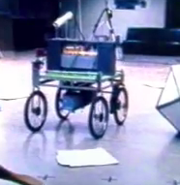
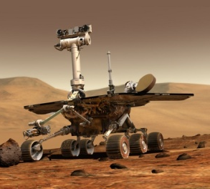
Introduction
Ground-based rover operation
Time-consuming
Costly
Rover autonomy
Risky
In development…
Notes:
TODO:
- Terrain is not compelling, can drive straight -> add better terrain
Particularly well motivated for space
System is designed to aid in rover operations
Esp. tough in extreme environments.
Auto nav failures due to conservative

Slide 4
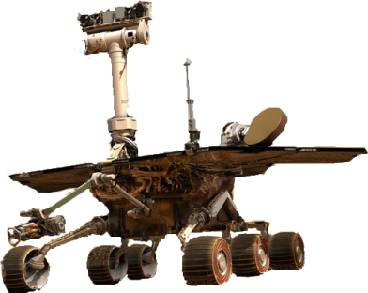
Unstructured Environments
ALV (Daily et al., 1988)
Global
Local
Notes:
TODO:
Follow waypoints somehow
RHMPC

Slide 5
Unstructured and Unknown
ALV (Daily et al., 1988)
?
Global
Local
Notes:
TODO:
Follow waypoints somehow
RHMPC

Slide 6
Unstructured and Unknown
ALV (Daily et al., 1988)
?
Global
Local
Notes:
TODO:
Follow waypoints somehow
RHMPC

Slide 7
Unstructured and Unknown
D*/Smarty (Stentz & Hebert, 1994)
Ranger (Kelly, 1995)
Morphin (Simmons et al., 1996)
Gestalt (Goldberg, Maimone & Matthies, 2002)
Global
Dynamic replanning
D* (Stentz ’94, others)
Local
Notes:
TODO:
Follow waypoints somehow
RHMPC

Slide 8
Outline
Introduction
Global planning
Representation limitations
Improvements
Results
Local planning
Representation limitations
Improvements
Results
Summary

Slide 9
Unstructured and Unknown
D*/Smarty (Stentz & Hebert, 1994)
Ranger (Kelly, 1995)
Morphin (Simmons et al., 1996)
Gestalt (Goldberg, Maimone & Matthies, 2002)
Global
Dynamic replanning
D* (Stentz ’94, others)
Local
Notes:
TODO:
Follow waypoints somehow
RHMPC

Slide 10
Unstructured and Unknown
D*/Smarty (Stentz & Hebert, 1994)
Ranger (Kelly, 1995)
Morphin (Simmons et al., 1996)
Gestalt (Goldberg, Maimone & Matthies, 2002)
Global
Dynamic replanning
D* (Stentz ’94, others)
Local
Notes:
TODO:
Follow waypoints somehow
RHMPC

Slide 11
Challenges
2D global planners lead to nonconvergence in difficult environments
Robot will fail to make the turn into the corridor
Global planner must understand the need to swing wide
Issues:
Passage missed, or
Point-turn is necessary…
Plan Step n
Plan Step n+1
Plan Step n+2
Notes:
We’re doing all this to avoid point turns…

Slide 12
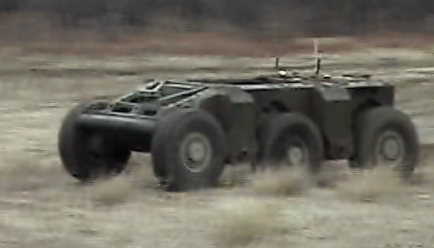
Turn-in-place Difficulties
Extremal control
Energy expenditure: High

Slide 13
Turn-in-place Difficulties
Extremal control
Energy expenditure: High
Perception difficulties
Sudden view change
Loss of features (e.g. for VO)

Slide 14
Turn-in-place Difficulties
Extremal control
Energy expenditure: High
Perception difficulties
Sudden view change
Loss of features (e.g. for VO)

Slide 15
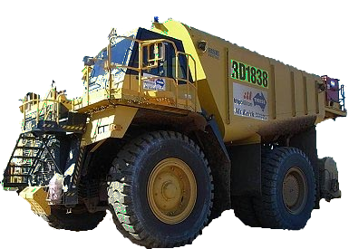
Turn-in-Place Difficulties
Extremal control
Energy expenditure: High
Perception difficulties
Sudden view change
Loss of features (e.g. for VO)
Infeasibility

Slide 16
In the Field…
PerceptOR/UPI, 2005
Rover Navigation, 2008

Slide 17
Heading-Aware Global Planner
Problem:
Mal-informed global planner
Vehicle constraints ignored
Heading
Proposing:
Satisfying vehicle constraints
Heading-aware planning
Notes:
We’re doing all this to avoid point turns…

Slide 18
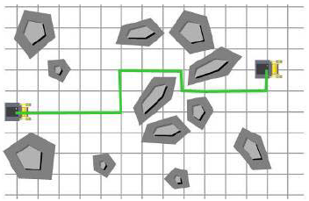
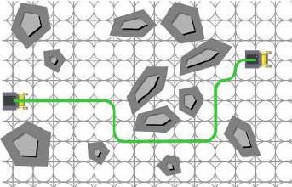
Heading-Aware Global Planner
Notes:
Real-time means different things to different people. What we mean here is that this drove an actual rover without stopping to replan.

Slide 19
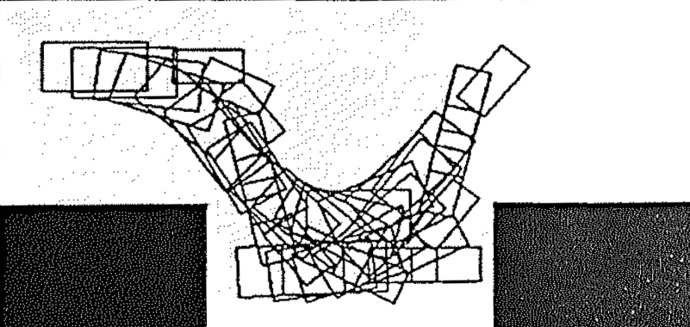
Heading-Aware Planning
✗
✗
Barraquand & Latombe:
3 arcs (+ reverse) at κ_{max}
Discontinuous curvature
Cost = number of reversals
Dijkstra’s search
Barraquand & Latombe, 1993
LaValle, 2006
Notes:
*Arbitrary path culling*
54 sec.
In the early nineties, Jerome Barraquand and Jean-Claude Latombe proposed a different method that trades “divide and conquer” for generating discrete models of robot’s motion and its environment. In fact, the entire maneuverability of the robot is approximated as only three forward and three reverse arcs. This set of motion alternatives is used as a node expansion in best-first search. The search proceeds until the goal cell is discovered. Since arc endpoints are dense in position, the same state cell can be “claimed” by several motions, and all but one such motions are removed.
Steve’s book presents a much more general treatment of this algorithm. However, from the point of view of search space design, it is interesting to ask if this planner would work much better if we used a different set of motion alternatives. Such questions are not often asked, unfortunately, and we would like to explore them here.
OPTIONAL:
To summarize, this planner avoids the difficulties we’ve seen previously at the cost of a reduced capacity to find potential paths (if the discretization is too coarse to “see” them). Nevertheless, this trade-off appears to be supported in outdoor mobile robotics, and this planner was used in a number of applications, including the Groundhog project right here in RI. Simultaneous satisfaction of both vehicle and environment constraints appears to justify some loss in completeness of the planner.

Slide 20
Robot-Fixed Search Space
Moves with the robot
Dense sampling
Position
Symmetric sampling
Heading
Velocity
Steering angle
…
Tree depth
1: Local/Global
5: Egograph (Lacaze et al, ‘98)
∞: Barraquand & Latombe
20
Notes:
Two classes of state lattice search spaces can be distinguished.
One is a search space whose origin coincides with that of the robot. We’ll refer to it as “robot-fixed”.
Such a search space is designed as a set of motion alternatives that a vehicle can execute. Similar motion sets are concatenated, forming a tree of motions. Without taking special care, the endpoints of these motions are dense in position. However, other state variables can admit useful symmetries.
To illustrate that the state lattice concept can serve as the basis of a search space taxonomy, we note that we can recover previous search space designs as special cases.
OLD:
This is simplest variant: pre-compute a set of motion alternatives. Simulate the vehicle along them, collect results, and pick the one likely to bring the best result.
- Even though edges are pre-computed, the location of each graph vx is unknown before the search, so the graph is constructed online.
- No need to store edges explicitly (only on PQ), so implicit.
- Since structure depends on the query, it’s single-query
Example of convenient symmetries
This is local/global (dynamic programming interpretation of the arc selection?) Or, allow a depth of several (get Egograph). Or don’t limit depth (get B&L).

Slide 21
World-Fixed Search Space
Fixed to the world
Dense sampling
(none)
Symmetric sampling
Position
Heading
Velocity
Steering angle
…
Dependency
Boundary value problem
Pivtoraiko & Kelly, 2005
Examples of BVP solvers:
Dubins, 1957
Reeds & Shepp, 1990
Lamiraux & Laumond, 2001
Kelly & Nagy, 2002
Pancanti et al., 2004
Kelly & Howard, 2005
Notes:
*Definition of world-fixed search space*
Alternatively, we can permanently fix the origin of the search space in the world. Decoupling the search space from the vehicle has some advantages. Vehicle position independent search space can serve as a potential field function. Also, it admits symmetric sampling of all state variables, including position. The last move comes at a cost: generating motions that satisfy position constraints is a boundary value problem. Fortunately, a number of boundary value problem solvers have been proposed over the years. Some of them work fast, some very slow, but it’s OK since they are only used off-line during search space design.
TODO:
- Make it more similar to previous slide
OLD:
A way to leverage (free-space) BVP solvers for applications in obstacles

Slide 22
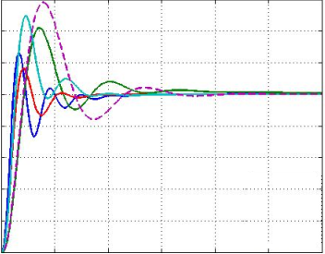
Robot-Fixed vs. World-Fixed
Barraquand
& Latombe
State Lattice
CONTROL
STATE
STATE
CONTROL
Notes:
Despite the BVP dependency of position symmetry, world-fixed search spaces enable a number of nice properties, particularly attractive for outdoor mobile robots. They stem from the fact that position symmetry of the search space leads to position invariance of its motions.
In planning, as much as 90% of computation is expended simulating vehicle’s motion over each motion alternative in order to predict the outcome of the motion. Complex systems must resort to sophisticated methods, such as Runge-Kutta, for accuracy. However,

Slide 23
Dynamic Re-planning
State Lattice
Regularity
Position invariance
Enables D*
?

Slide 24
Dynamic Re-planning
State Lattice
Regularity
Position invariance
Enables D*
Notes:
D* for world-fixed also makes sense intuitively: D* computes a policy (potential field). It doesn’t make much sense unless it is exactly fixed in the world (position-wise).

Slide 25
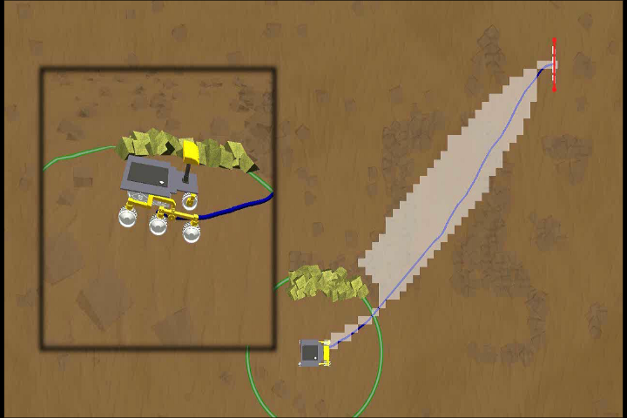
Nonholonomic D*
Expanded States
Motion Plan
Perception Horizon
Graphics: Thomas Howard

Slide 26
Nonholonomic D*
Pivtoraiko & Kelly, 2007
Graphics: Thomas Howard
Notes:
Significance here is marriage of two classic ideas that knew of each other, but never met. Classic D* for decades was used in grids that violate nonholonomic constraints. Also, for decades we had nonholonomic planners that couldn’t do plan repair. This is the pairing of the two, easily accomplished through a search space that satisfies constraints.

Slide 27
Dynamic Search Space

Slide 28
8-Connected Grid Alternative
Space & time complexity
Linear with heading resolution
θ
8-connected
grid
8-connected
state lattice
y
x

Slide 29
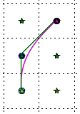
8-Connected Grid Alternative
Space & time complexity
Linear with heading resolution
Optimality
W.r.t. path length
Nearly identity
8-connected
grid
8-connected
state lattice

Slide 30
8-Connected Grid Alternative
Space & time complexity
Linear with heading resolution
Optimality
W.r.t. path length
Nearly identity
Completeness
Random point-obstacles
Nearly identity
8-connected
grid
8-connected
state lattice
100
Rel. Plan Failure, %
20
30
40
45
50
Obstacle Density, %

Slide 31
Outline
Introduction
Global planning
Representation limitations
Improvements
Results
Local planning
Representation limitations
Improvements
Results
Summary

Slide 32
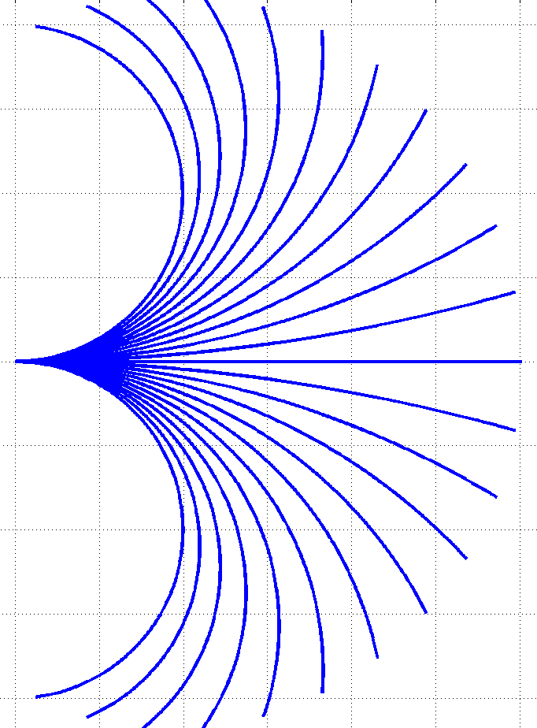
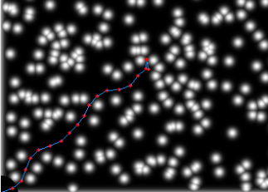
Following Global Guidance
Local planning
Receding-Horizon MPC
Common in rover navigation
Sampling discrete controls
Parameterized representations
Natural environments
Pose challenges
“Beat” a set of discrete controls

Slide 33
Following Global Guidance
Local planning
Receding-Horizon MPC
Common in rover navigation
Sampling discrete controls
Parameterized representations
Natural environments
Pose challenges
“Beat” a set of discrete controls

Slide 34
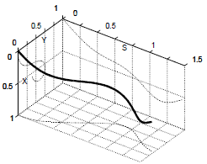
Parameterized Representations
Polynomial curvature functions
κ(s) = κ₀ + κ₁s + κ₂s² + … + κ_{n}s^{n}
In the limit, represents any motion
By Taylor remainder theorem
Constant-curvature arcs
κ(s) = κ₀
Coupled position and heading
Limited expressiveness
First-order clothoids
κ(s) = κ₀ + κ₁s
De-coupled position and heading
Simplest such parameterization
Kelly & Nagy, 2002

Slide 35
Arcs vs. Clothoids

Slide 36
Following Global Guidance
Local planning
Receding-Horizon MPC
Common in rover navigation
Sampling discrete controls
Parameterized representations
Natural environments
Pose challenges
“Beat” a set of discrete controls

Slide 37
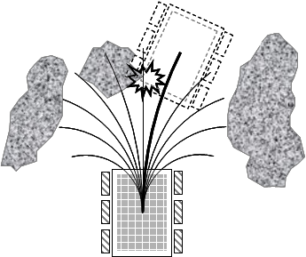
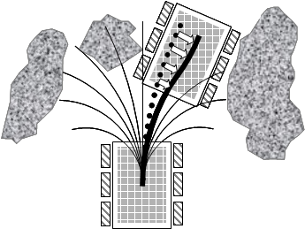
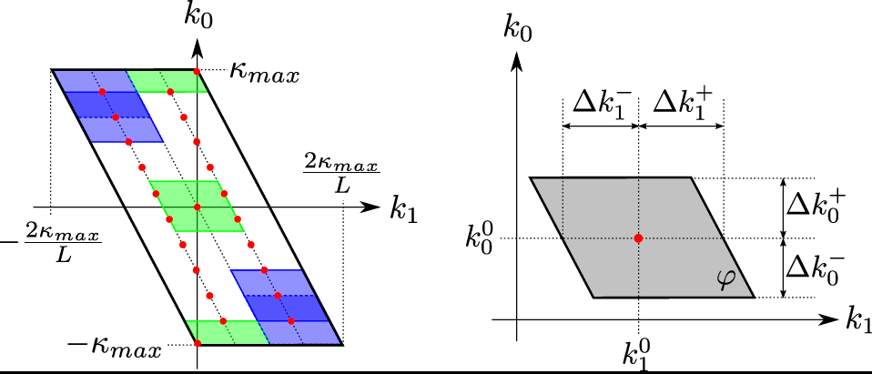
Path Relaxation
Natural optimization problem
Local nature of motion primitives
Parameterization
Available obstacle-aware objective functions
Distance transform
Obstacle modeling
Constrained, Regulated Gradient Descent
Modified gradient descent optimization
Completeness considerations
Constraints imposed
Regulated step size

Slide 38
Fixed vs. Relaxed

Slide 39
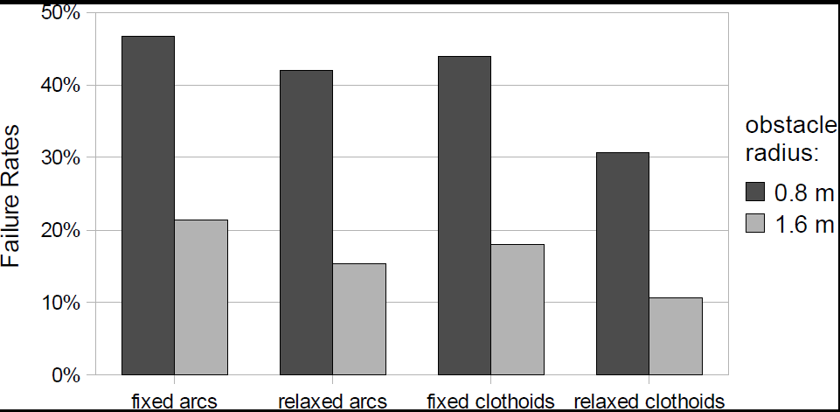
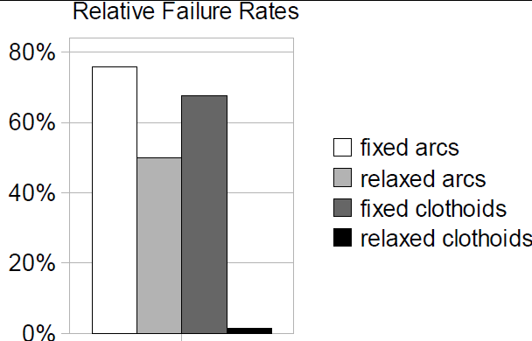
Experimental Results
“Random Pose” Experiments
Testing Local decoupled from Global
8784 trials
Rover Navigation Experiments
Testing Local + Global
150 trials

Slide 40
Outline
Introduction
Global planning
Representation limitations
Improvements
Results
Local planning
Representation limitations
Improvements
Results
Summary

Slide 41
Summary
Global planning
Heading-aware planning
Deliberative, intelligent decisions
Local planning
Expressive clothoids
Decoupling heading & position
No cost!
Relaxation
Continuum: arbitrary obstacles
Acknowledgement
Jet Propulsion Lab MTP and SURP
Notes:
Esp. tough in extreme environments.
Auto nav failures due to conservative

Slide 42
State Lattices for Planning with Dynamics

Slide 43
Backup

Slide 44
State Lattice Benefits
State Lattice
Regularity
Position invariance
Pivtoraiko & Kelly, 2005
Notes:
Despite the BVP dependency of position symmetry, world-fixed search spaces enable a number of nice properties, particularly attractive for outdoor mobile robots. They stem from the fact that position symmetry of the search space leads to position invariance of its motions.
In planning, as much as 90% of computation is expended simulating vehicle’s motion over each motion alternative in order to predict the outcome of the motion. Complex systems must resort to sophisticated methods, such as Runge-Kutta, for accuracy. However,

Slide 45
Path Swaths
State Lattice
Regularity
Position invariance
Benefits
Pre-computing path swaths
Pivtoraiko & Kelly, 2007
Notes:
Despite the BVP dependency of position symmetry, world-fixed search spaces enable a number of nice properties, particularly attractive for outdoor mobile robots. They stem from the fact that position symmetry of the search space leads to position invariance of its motions.
In planning, as much as 90% of computation is expended simulating vehicle’s motion over each motion alternative in order to predict the outcome of the motion. Complex systems must resort to sophisticated methods, such as Runge-Kutta, for accuracy. However,

Slide 46
World Fixed State Lattice
State Lattice
Regularity
Position invariance
Benefits
Pre-computing path swaths
Pre-computing heuristics
HLUT
Pivtoraiko & Kelly, 2005
Knepper & Kelly, 2006
Notes:
TODO:
- Say this in more detail

Slide 47
World Fixed State Lattice
State Lattice
Regularity
Position invariance
Benefits
Pre-computing path swaths
Pre-computing heuristics
Parallelized search
GOAL
START
Notes:
TODO:
It would be good to have some results on this (dig up the mtp report)
Matt McNaughton has shown impressive results by planning with such search spaces using GPUs.

Slide 48
World Fixed State Lattice
State Lattice
Regularity
Position invariance
Benefits
Pre-computing path swaths
Pre-computing heuristics
Parallelized search
Dynamic replanning
Dynamic search space
G₅
G₄
G₃
G₁
G₀
Search graph ≡ G₀ ∪ G₁ ∪ … ∪ G_{n}
Pivtoraiko & Kelly, 2008

Slide 49
Dynamic Search Space
Pivtoraiko & Kelly, 2008
Graphics: Thomas Howard
Notes:
Significance: multi-resolution quality to previous movie. Scalable ND*. Tremendous runtime improvement for similar quality of motions. Not a global/local: single planner with different fidelities.
Also a dynamic search space, to complement dynamic replanning.
Low-fidelity is grid here for visualization, but for a car would be replaced with a feasible search space, sampled at low fidelity for efficiency on global scale.

