Slide 1
Introduction to IEEE
<audience/event> < date> <Name> <Title> <IEEE Asia-Pacific Limited>
Notes:
Updated on 31 March 2020
Presentation Templates prepared by Ewell Tan, IEEE Asia-Pacific Limited

Slide 2
The Institute of Electrical and Electronics Engineers (IEEE) Advancing Technology for Humanity
About IEEE
Mission Statement
Vision Statement
IEEE at a Glance
The Organization

Slide 3
About IEEE
IEEE is the world's largest technical professional association dedicated to advancing technological innovation and excellence for the benefit of humanity.
IEEE and its members inspire a global community through IEEE's highly cited publications, conferences, technology standards, and professional and educational activities.

Slide 4
MISSION
IEEE's core purpose is to foster technological innovation and excellence for the benefit of humanity.
VISION
IEEE will be essential to the global technical community and to technical professionals everywhere, and be universally recognized for the contributions of technology and of technical professionals in improving global conditions.

Slide 5
IEEE at a Glance
Over 409,000 members in more than 160 countries, more than 60 percent of whom are from outside the United States
More than 125,000 Student members
343 Sections in ten geographic Regions worldwide
2,615 Chapters that unite local members with similar technical interests
3,565 Student Branches at colleges and universities in over 100 countries
3,182 Student Branch Chapters of IEEE technical societies
608 Affinity Groups;
IEEE affinity groups are non-technical sub-units of one or more Sections or a Council. The affinity group patent entities are the IEEE-USA Consultants' Network, Young Professionals (YP), Women in Engineering (WIE), Life Members (LM), and IEEE Entrepreneurship
Notes:
Source: https://www.ieee.org/about/today/at-a-glance.html
Data as of December 2021

Slide 6
IEEE at a Glance (continued:-)
Has 39 Societies and seven technical councils representing the wide range of IEEE technical interests
Has more than 5 million documents in the IEEE Xplore® Digital Library, with more than 15 million downloads each month
Sponsors more than 1,900 conferences and events in 96 countries
Has an active portfolio of nearly 1,076 standards and more than 900 projects under development
Publishes approximately 200 transactions, journals, and magazines
Notes:
* Source: http://www.ieee.org/about/today/at_a_glance.html
Data as of December 2021

Slide 7
IEEE Technical Societies
Aerospace and Electronic Systems Society
Antennas and Propagation Society
Broadcast Technology Society
Circuits and Systems Society
Communications Society
Computational Intelligence Society
Computer Society
Consumer Electronics Society
Control Systems Society
Dielectrics and Electrical Insulation Society
Education Society
Electromagnetic Compatibility Society
Electron Devices Society
Electronics Packaging Society
Engineering in Medicine and Biology Society
Geoscience and Remote Sensing Society
Industrial Electronics Society
Industry Applications Society
Information Theory Society
Instrumentation and Measurement Society
Intelligent Transportation Systems Society
Magnetics Society
Microwave Theory and Techniques Society
Nuclear and Plasma Sciences Society
Oceanic Engineering Society
Photonics Society
Power Electronics Society
Power & Energy Society
Product Safety Engineering Society
Professional Communication Society
Reliability Society
Robotics and Automation Society
Signal Processing Society
Society on Social Implications of Technology
Solid-State Circuits Society
Systems, Man, and Cybernetics Society
Technology and Engineering Management Society
Ultrasonics, Ferroelectrics, and Frequency Control Society
Vehicular Technology Society

Slide 8
Total IEEE Membership (1963 – 2021)
as at 31st December 2021

Slide 9
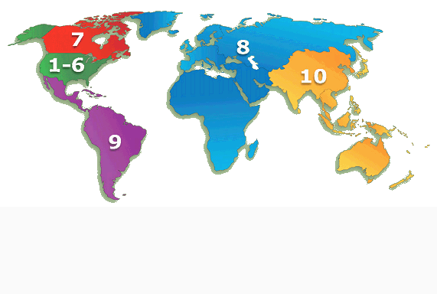
IEEE Membership By Region 31 December 2021
R7 – 14,179
(3.5%)
R10 – 151,421
(37.0%)
R1 to 6 – 153,177
(37.4%)
R1 – 24,938
R2 – 21,795
R3 – 24,202
R4 – 16,836
R5 – 22,317
R6 – 43,089
R8 – 74,451
(18.2%)
Reflecting the global nature of IEEE, R10 and R8 are now the two largest IEEE Regions
R9 – 16,426
(4.0%)
TOTAL MEMBERSHIP – 409,654

Slide 10
IEEE Region 10 (Asia-Pacific Region)
Organizational Units - 31 Dec 2021
TOTAL R10 MEMBERSHIP – 151,421
Areas
Region 10
Councils (6)
Sections (60)
Chapters (779)
Subsections (41)
Student Branches
(1,704)
Affinity Groups
(119)
Student Branch Affinity
Groups (429)
Student Branch Chapters
(1,531)
Notes:
This slide represents one part of the IEEE.
It is intended to help you visualize the relationships between the Technical and Geographic organizations of the IEEE.
For example, a technical Chapter is the responsibility of both the Section where it is located and the particular technical Society, while Student Branch Chapters are the responsibility of the particular Student Branch and the Society.
Note that Councils can have Chapters and/or Affinity Groups, just like a Section.
In an effort to better understand the way the IEEE volunteer organization works, it’s important to understand the relationships between units as explained here.
Note that while Councils can have subunits just like Sections, they are managed by their member Sections, and, as per IEEE Bylaws, exist at the pleasure of the Sections.
In the last three years, we have seen the growth of Affinity Groups. Right now, there are three types of approved Affinity Groups: Women in Engineering, Consultants’ Networks and Graduates of the Last Decade, or GOLD. Like Chapters, the Affinity Groups have two “parents” . . . The Section and the sponsoring parent committee.
Geographic Unit Relationships
Regions oversee Sections
Sections oversee Subsections, Chapters, Student Branches and Affinity Groups
Councils are comprised of Sections, and exist at the pleasure of the member Sections
Some Councils (but not all) have Chapters and Affinity Groups, and therefore oversee them

Slide 11
Organization Chart
IEEE MEMBERS
IEEE Board
of Directors
IEEE Executive
Committee
Executive Director
Staff
Member & Geographic Activities
Educational Activities Board
IEEE-USA Board of Directors
Publication Services & Products Board
Standards Association
Technical Activities Board
Notes:
First, here is the overall structure of the IEEE.
This chart depicts the major organizational units within the IEEE, in addition to the regional and technical entities we have just been discussing. Each volunteer organization has a Board or committee which oversees its area.
For instance, for regional activities, our highest level is represented by the Member & Geographic Activities Board, or MGA for short.

Slide 12
How does IEEE Work?
Volunteers
Staff
Members
Efforts are accomplished through a partnership between Volunteers, Members, and Staff
Volunteers are the key to all IEEE activities

Slide 13
Notes:
Prepared by IEEE Asia-Pacific Ltd., Ewell Tan (ewell.tan@ieee.org)

