Slide 1
Windows Programming Overview
IEEE Computer Society

Slide 2
Introduction
Frank Hubbell
Hubbell Consulting
585-392-5293
fhubbell@rochester.rr.com
frhiee@rit.edu

Slide 3
Windows Presentation Foundation
Latest Windows Development Environment
Replaces Windows Forms?
Better Graphics
Better Multimedia Support
Different Kinds of Applications
Desktop
Web page
Web Application
Silverlight
Foundation For Other Environments

Slide 4
WPF Features
 | Windows Forms | PDF | Windows Forms/ GDI+ | Windows Media Player | Direct3D | WPF
Graphical interface, e.g., forms and controls | X |  |  |  |  | X
On-screen documents | X |  |  |  |  | X
Fixed-format documents |  | X |  |  |  | X
Images |  |  | X |  |  | X
Video and audio |  |  |  | X |  | X
Two-dimensional graphics |  |  | X |  |  | X
Three-dimensional graphics |  |  |  |  | X | X

Slide 5
Microsoft Windows Operating Systems
1985 Windows 1.0
1987 Windows 2.0
1990 Windows 3
1993 Windows NT
1995 Windows 95
1998 Windows 98
1999 Windows 98SE
2000 Windows ME
2001 Windows XP
2005 Windows Vista
2009 Windows 7

Slide 6
Microsoft Windows Development Platforms
WIN16 API
WIN32 API
Window Foundation Class (WFC)
.NET Window Forms (WinForms)
.NET Window Presentation Foundation (WPF)

Slide 7
Windows Programming Languages
1985 C or VB Windows Application Program Interface (API)
1992 C++ or VB Microsoft Foundation Class (MFC) library
2001 C# or C++ Windows Forms (.NET Framework) or VB
2006 C# or VB Windows Presentation Foundation (WPF)

Slide 8
Visual Basic
Are you now, or have you ever been a basic programmer?

Slide 9
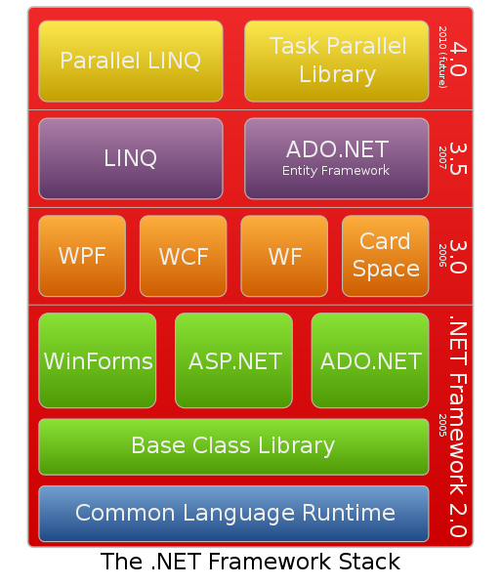
Microsoft Architecture

Slide 10
First Demonstration
Creating a default application in Visual Studio 2010
Half Code, Half XAML

Slide 11
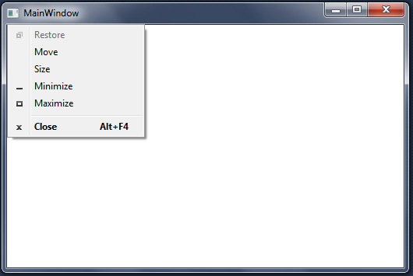
Window Structure
Icon
Title
Minimize
Button
Maximize
Button
Close
Button
Drop
Down
Menu
Client
Area
Resize
Border

Slide 12
WPF Architecture
Separation of User Interface from rest of the application
Object Oriented Architecture
Extensible Application Markup Language (XAML)
Code-behind (C# or Visual Basic)
Partial Classes
Event Driven Logic

Slide 13
Extensible Application Markup Language (XAML)
Pronounced /ˈzæməl/ rhymes with camel
A declarative XML-based language
Created by Microsoft
Used mostly for Windows Presentation Foundation (WPF)
Subset of code functionality
Can not execute functions

Slide 14
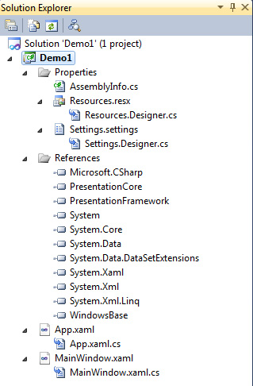
Project Structure
Summary
33 Files
8 Folders
Size 133 KB

Slide 15
Object Structure
Window.xaml
App.xaml
Window.xaml.cs
App.xaml.cs
User Interface
Application

Slide 16
Object Structure
Window.xaml
App.xaml
Markup
Window.xaml.cs
App.xaml.cs
Code

Slide 17
Second Demonstration
Minimal application that still does something
Enter text and build a list of words
Control Components
Label Control
TextBox Control
ListBox Control
Button Control
Need to process button click event
Half Code, Half XAML

Slide 18
Demo2 Logical Tree
Window
Grid
Label
TextBox
ListBox
Button

Slide 19
WPF Class Hierarchy
Object
DispatcherObject
Application
DependencyObject
Visual
1600 Public Types
3500 Classes
5100 Total
UIElement
FrameworkElement
Control
ContentControl
Window

Slide 20
Demo2 Design Analysis
Entered value remains in textbox
No control is selected when application starts
User must click in textbox to enter a value
User must move to button to submit value
Button can be eliminated
Words in listbox are not sorted in order
Form in static, should be dynamic
Needs color

Slide 21
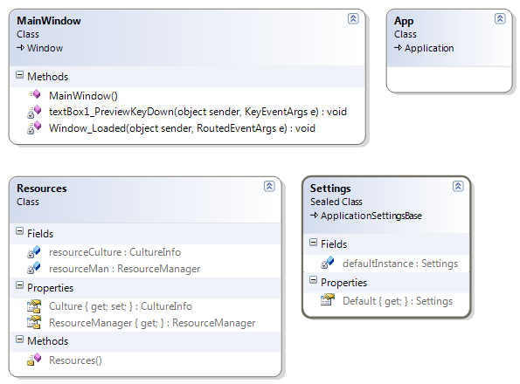
Demo2 Class Diagram

Slide 22
Third Demonstration
Demonstration of two dimensional graphics
Koch curve
Right and left mouse buttons to interact with graphic display
No XAML, All C# Code
Fixed size window

Slide 23
2D Graphic Controls
Ellipse Draws an ellipse
Line Draws a line
Path Draws a series of lines and curves
Polygon Draws a series of line segments that connect a series of points. It finishes by connecting the last point to the first
Polyline Draws a series of line segments that connect a series of points
Rectangle Draws a rectangle

Slide 24
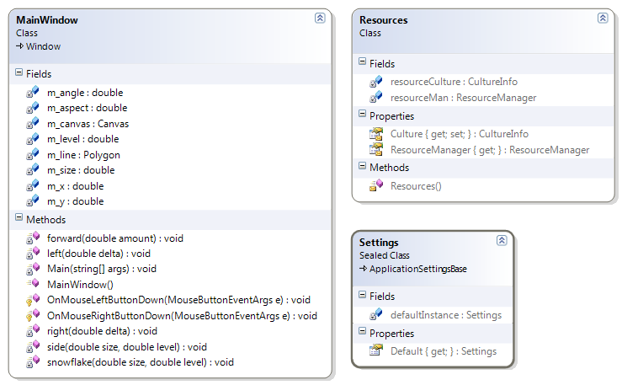
Demo3 Class Diagram

Slide 25
Fourth Demonstration
Layout Control Examples
StackPanel
WrapPanel
DockPanel
Grid
Canvas
All XAML, No Code

Slide 26
User Input Controls
Button
Calendar
CheckBox
ComboBox
DatePicker
PasswordBox
RadioButton
RichTextBox
Slider
TextBlock
TextBox

Slide 27
Data Display Controls
Border
ContentControl
DataGrid
DocumentViewer
Expander
Image
Label
ListBox
ListView
MediaElement
ScrollViewer
TabControl
TreeView
Viewbox
WebBroswer
WindowsFormsHost

Slide 28
Window Component Controls
Frame
GrideSplitter
GroupBox
Menu
ProgressBar
ScrollBar
Separator
StatusBar
ToolBar
ToolBarPanel
ToolBarTray

Slide 29
Control Summary
45 different controls in toolbox

Slide 30
Fifth Demonstration
Controls
Slider
Textbox
Data Binding
All XAML, No Code

Slide 31
Sixth Demonstration
3D Graphics and Animation
Reference:
MagicBox
3D Programming for Windows
Charles Petzold
All XAML, No Code

Slide 32
Seventh Demonstration
3D Graphics and Animation
Reference:
Gasket3D
WPF Programmer’s Reference
Rod Stephens

Slide 33
Reference Material

Slide 34
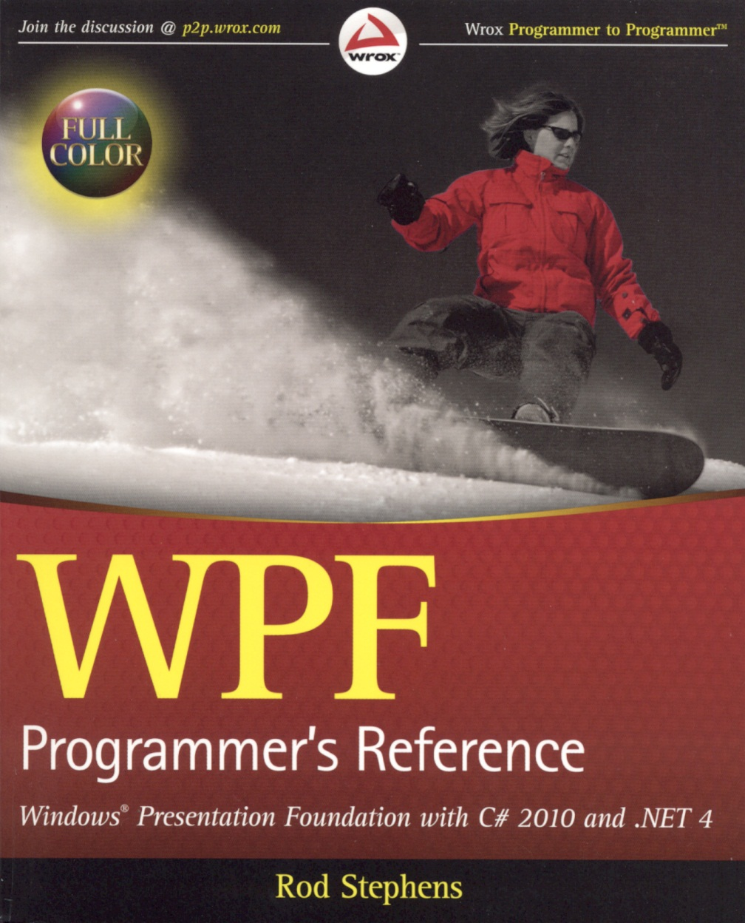
WPF Programmer’s Reference
Rod Stephens
ISBN: 978-0-470-47722-9
Published: 2010
241 Small Examples
587 Pages
Color

Slide 35
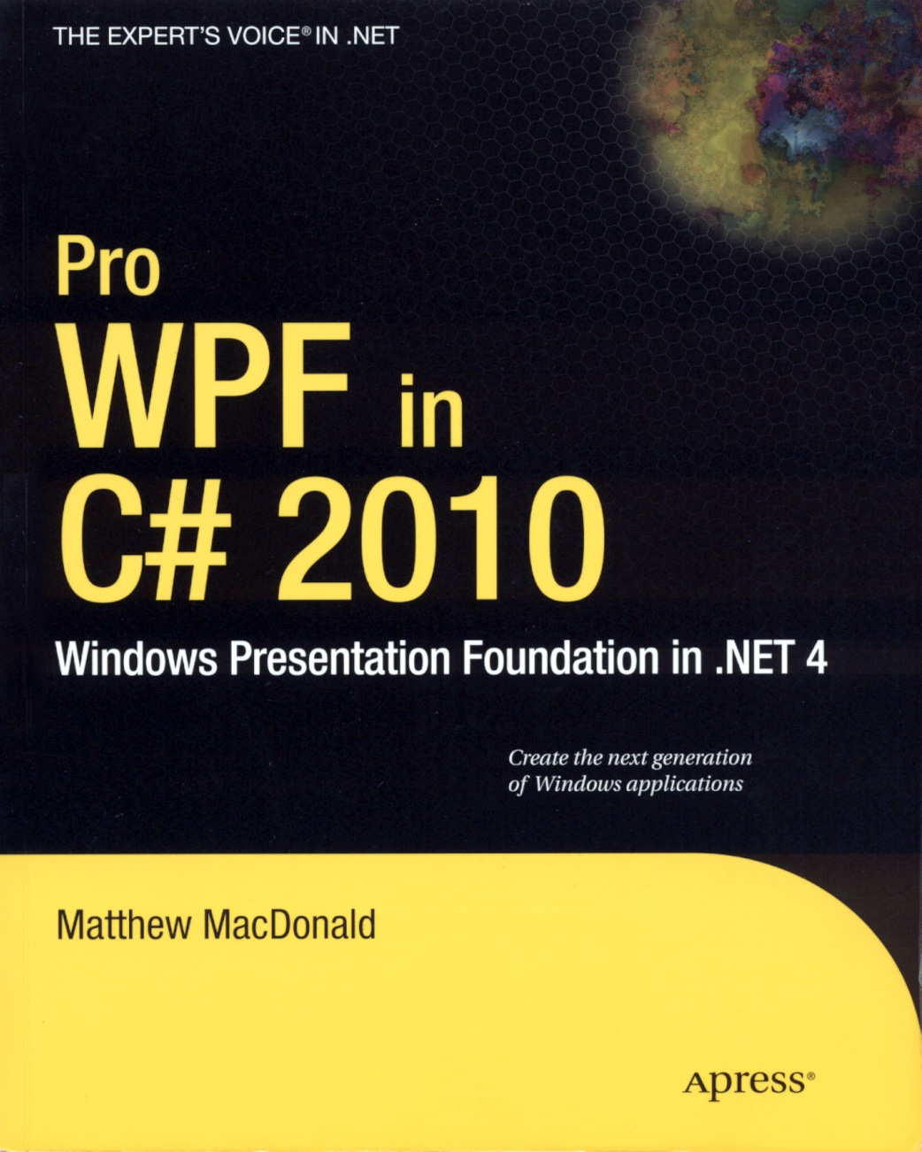
Pro WPF in C# 2010
Matthew MacDonald
ISBN: 978-1-4302-7205-2
Published: 2010
55 Large Examples
1181 Pages

Slide 36
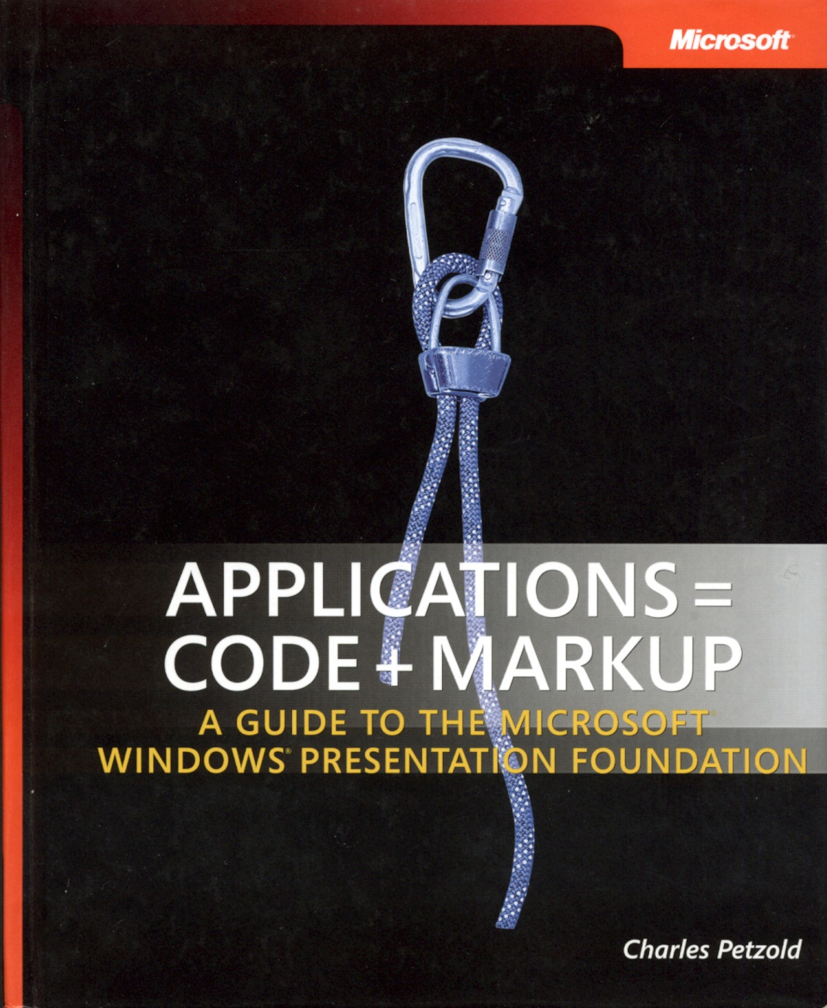
Applications = Code + Markup
Charles Petzold
ISBN: 978-7356-1957-9
Published: 2006
504 Examples
50% Code, 50% XAML
1002 Pages

Slide 37
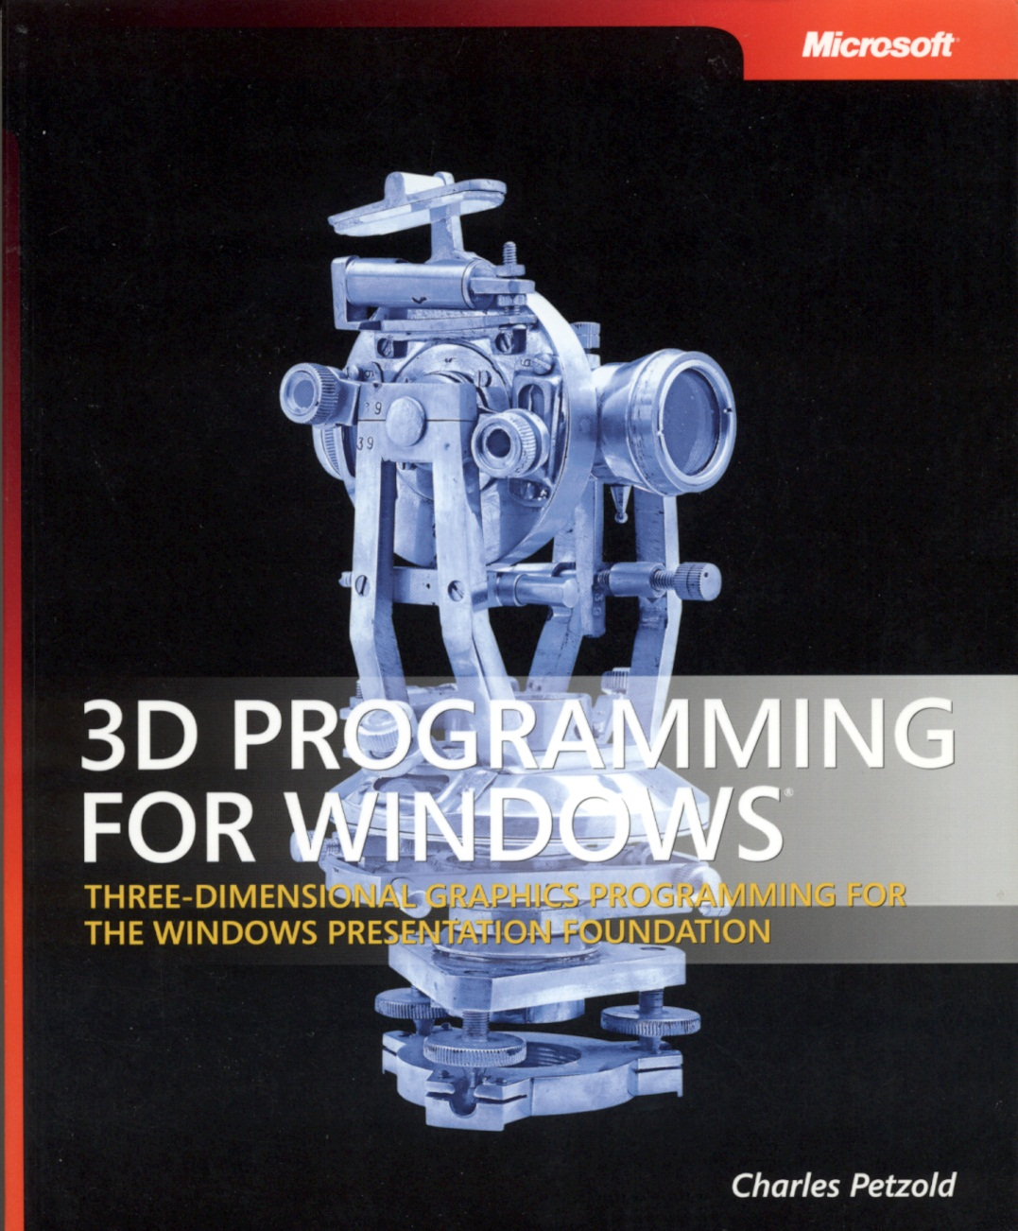
3D Programming for Windows
Charles Petzold
ISBN: 978-07356239
Published: 2007
77 Examples
Mostly XAML
430 Pages

Slide 38
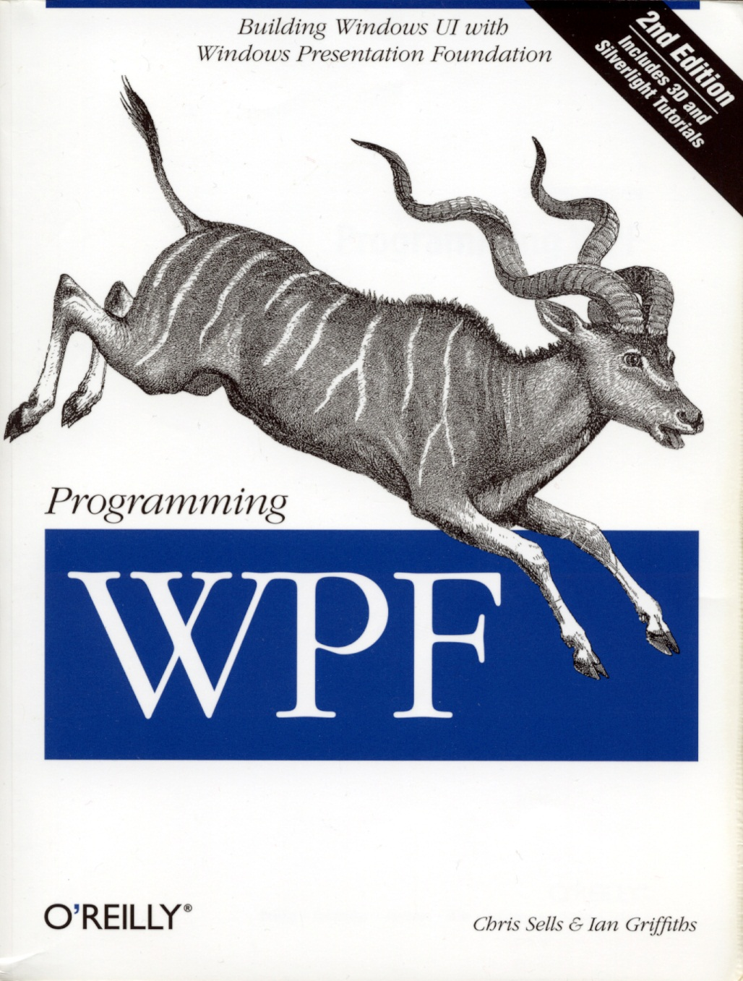
Programming WPF
Chris Sells & Ian Griffiths
ISBN: 978-0-596-51037-4
Published: 2005
358 Examples
835 Pages
Book is getting dated

Slide 39
Web Links
http://windowsclient.net/default.aspx
http://msdn.microsoft.com/en-us/library/ms754130.aspx
http://www.codeproject.com/
http://visualstudiomagazine.com/Home.aspx

Slide 40
Special Thanks
To Tom Kurtenbach for his help in preparing this talk

