Slide 1

CODED COOPERATIVE TRANSMISSION FOR WIRELESS COMMUNICATIONS
Prof. Jinhong Yuan
原进宏
School of Electrical Engineering and Telecommunications
University of New South Wales
Sydney, Australia

Slide 2
Cooperative Communications with Superposition Coding
INTRODUCTION
SYSTEM MODEL
SUPERPOSITION BASED COOPERATIVE TRANSMISSION
ITERATIVE MAP RECEIVER
LOW-COMPLEXITY RECEIVER
RESULTS

Slide 3
INTRODUCTION
Practical cooperation schemes:
  Amplify and Forward (AF)
  Decode and Forward (DF)
  Compress and Forward (CF)
Several transmission schemes for DF provide promising achievements
Taking turns in forwarding only the partner’s information (conventional DF) is not an efficient way to use the radio channel → a new DF cooperative transmission based on superposition technique

Slide 4
NEW SCHEME
Two users take turns in being the relay for each other
The forwarded signal is the superimposed data of both users, relayed information and its own information
Interleavers introduced in the superimposing process as an efficient user separation tool
  Provide an improvement in system performance
  Facilitate the decoding process at the destination
Two types of iterative receivers are investigated
  Iterative MAP receiver
  Low-complexity receiver

Slide 5
OVERVIEW
INTRODUCTION
SYSTEM MODEL
SUPERPOSITION BASED COOPERATIVE TRANSMISSION
ITERATIVE MAP RECEIVER
LOW-COMPLEXITY RECEIVER
RESULTS

Slide 6
SYSTEM MODEL
a_{ad}
A, B communicate to a common destination D
Each user’s transmission can be receivable by the other and the destination
A, B work in a time-division half-duplex manner
Channels are block Rayleigh fading channels
  a_{ad}, a_{ab}, a_{ba}, a_{bd} ~ CN(0,1): independent and constant in a time slot, perfectly known to the corresponding receivers
  n_{ab}, n_{ad}, n_{bd} ~ CN(0, σ²): AWGN noise
A
D
a_{ba}
a_{ab}
a_{bd}
B

Slide 7
OVERVIEW
INTRODUCTION
SYSTEM MODEL
SUPERPOSITION BASED COOPERATIVE TRANSMISSION
ITERATIVE MAP RECEIVER
LOW-COMPLEXITY RECEIVER
RESULTS

Slide 8
SUPERPOSITION BASED COOPERATIVE TRANSMISSION
{A_{k}}, {B_{k}} k=1:N are N binary blocks A, B want to transmit to D respectively
2N blocks transmitted in 2N time slots compared to 4N time slots in the conventional DF
Transmission at A
A₁
A₂ + B’₁
…
A_{N} + B_{N-1}
Transmission at B
B₁ + A’₁
B₂ + A’₂
…
B_{N} + A’_{N}
Reception at D
A₁
B₁ + A’₁
A₂ + B’₁
B₂ + A’₂
…
A_{N} + B_{N-1}
B_{N} + A’_{N}

Slide 9
SUPERPOSITION PROCESS
Superposition process for block B₁ and A₁’ at user B
π_{A}, π_{B}: interleavers for user A and B respectively
  Must be different
  Provide interleaving gain
  Enable a low-complexity iterative receiver at the destination
h₁, h₂: coefficients for power allocation
  Can be the same
  Provide a better performance if properly controlled
B₁
ENC B
π_{B}
h₁
s_{B}
+
A₁’
ENC A
π_{A}
h₂

Slide 10
SUPERPOSITION PROCESS
Receiver for block B₁ at user A
And then send the superimposed signal of B’₁ and A₂ to D and B
The process continues for the rest blocks
L_{B1}
B₁
A₁’ + B₁
MAP
π_{B}⁻¹
DEC
s_{A1’}

Slide 11
SUPERPOSITION BASED COOPERATIVE TRANSMISSION
D receives and tries to recover all the message blocks for both users jointly in a Turbo-based process using
  MAP receiver
  Low-complexity receiver

Slide 12
OVERVIEW
INTRODUCTION
SYSTEM MODEL
SUPERPOSITION BASED COOPERATIVE TRANSMISSION
ITERATIVE MAP RECEIVER
LOW-COMPLEXITY RECEIVER
RESULTS

Slide 13
ITERATIVE MAP RECEIVER
MAP2, MAP3 detectors: extract the soft channel LLRs for 2 B₁-related blocks (B₁+A₁’) and (A₂+B₁’)
Soft information related to B₁ λ(B₁) and λ(B₁’) are added and passed to DECB₁ as priori information
B₁ + A₁’
A₂ + B₁’
DEC A₂
+
MAP3
e_{DEC}(B₁)
λ(B₁’)
DEC B₁
Decoded message B₁
+
MAP2
λ(B₁)
e_{DEC}(B’₁)
DEC A₁
+

Slide 14
ITERATIVE MAP RECEIVER
B₁ + A₁’
A₂ + B₁’
DEC A₂
DECB₁ performs MAP decoding to extract the new extrinsic information, which will be fed back to MAP2 and MAP3 for the next iteration
DECB₁ makes hard decision on B₁ after a number of iterations
+
MAP3
e_{DEC}(B₁)
λ(B₁’)
DEC B₁
Decoded message B₁
+
MAP2
λ(B₁)
e_{DEC}(B’₁)
DEC A₁
+

Slide 15
MAP DETECTION
Assume s₁ and s₂ are independent binary bits
Where
And : priori information fed back from the DECs
Similar for LLR(s₂)
The soft information passed to the decoders

Slide 16
OVERVIEW
INTRODUCTION
SYSTEM MODEL
SUPERPOSITION BASED COOPERATIVE TRANSMISSION
ITERATIVE MAP RECEIVER
LOW-COMPLEXITY RECEIVER
RESULTS

Slide 17
LOW-COMPLEXITY RECEIVER
DEC A2
MAP detectors are replaced by ESEs (Elementary Signal Estimator)
ESE performs an interference cancellation process
The complexity is very minor
B1 + A1’
A2 + B1’
+
ESE3
e_{DEC}( B₁’)
DEC B1
e_{ESE}( B₁’)
Decoded message B₁
+
e_{ESE}( B₁)
ESE2
e_{DEC}( B₁)
DEC A1
+

Slide 18
ESE FUNCTION
To detect s_{k}(j): consider the other bits of other users as interference
Approximating ξ_{k}(j) as an Gaussian variable, soft output of ESE:
Where E(ξ_{k}(j)) and Var(ξ_{k}(j)): statistics of ξ_{k}(j) and are updated from the output extrinsic of decoders and the interference is reduced for every iteration.

Slide 19
Performance Analysis
Theorem 1: With iterative receivers, the asymptotic conditional PEP depends on channel gains and power allocation factor, but not on the interference.
Average PEP

Slide 20
Performance Analysis
At a high SNR
where
Theorem 2: Equal power allocation is optimal.
BEP with Limit Before Average bound

Slide 21
OVERVIEW
INTRODUCTION
SYSTEM MODEL
SUPERPOSITION BASED COOPERATIVE TRANSMISSION
ITERATIVE MAP RECEIVER
LOW-COMPLEXITY RECEIVER
RESULTS

Slide 22
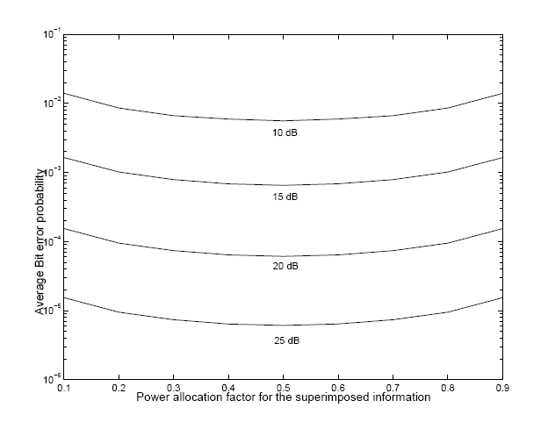
Result- power allocation

Slide 23
Results- SNRad=SNRbd=SNRab=SNR (N=10)

Slide 24
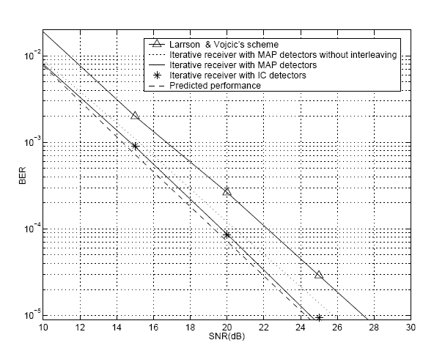
Results-SNRad=SNRbd=SNR, SNRab=SNR+10dB

Slide 25
Results-SNRad=SNRbd=SNR, SNRab=SNR+20dB

Slide 26
Result-power allocation

Slide 27
Result-block length

Slide 28
Results-Different qualities of inter-user channel

Slide 29
Conclusions
Cooperative Communications can provide significant performance gain.
Two approaches are proposed
  Superposition modulation/coding, for high SNR
  Soft relaying, low SNR
The two approaches are mainly for achieving the user cooperative diversity
Coding gain is not addressed yet, particularly for a large system, how to design good distributed but pragmatic codes remains an interesting problem.

