Slide 1


A Current-Centric Approach for EMI Coupling Physics and Concepts in
High-Speed Design
Jim Drewniak
Missouri S&T EMC Laboratory
Missouri-University of Science and Technology

Slide 2
EMI Concepts and Physics: Module Overview
Reminders
  EMI problem at “30,000 feet”
  EMI coupling paths
A short laundry list of representative examples
A current-based paradigm for anticipating and diagnosing EMI coupling paths
  A physics-based paradigm for EMC design, diagnosis, mitigation
  Tracing current paths – intentional and un-intentional
    The basic physics through an example – current changing reference
    USB interface
    DVI interface
Developing models
The Maxwell Equations only – paradigm doesn’t apply
Managing currents

Slide 3
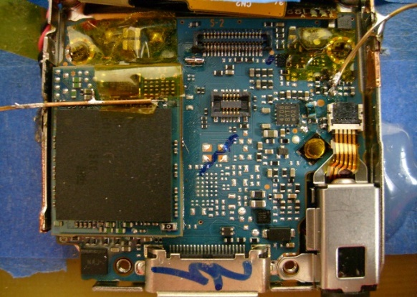
EMI/RFI Problem Constituents
Locating ports for source and antenna that are closest to the coupling path geometry is essential for successful experimentation to determine the coupling path
ideally a pair of terminals with well-defined V, & I – a port
I₁
I₂
COUPLING PATH
(transfer function
description ideal)
SOURCE
EMI ANTENNA
(or RFI victim)
V₁
V₂
ICs
  clocks
  address/data
  power supply
Signal/IO coupling
I/O transition thru power planes
Heatsink illumination
Traces crossing gaps
Line to connector I/O coupling
…
Cables
Apertures, slots & gaps, parallel plates
Ideally solve the problem here,
often on the PCB with layout
(lowest cost)
LCD Clock-line
Port
FM-Tuner Port

Slide 4
Divide and Conquer for EMI Diagnosis and Mitigation
2. Conducors, slots, or parallel plate edges
EMI ANTENNA
GEOMETRY
Z_{A}
1. Identify the source from its spectrum
SPICE model from closed –form or full-wave numerical modeling
3. Identify and characterize the transfer function for the coupling path;
Develop a SPICE model when possible
I₁
I₂
COUPLING PATH
(transfer function
description ideal)
V₁
V₂
Z_{A}

Slide 5
Anatomy of the EMI Frequency Response
a pair of terminals with well-defined V, & I – a port (only the case for a TEM wave or electrically small geometry)
I₁
I₂
COUPLING PATH
SOURCE
EMI ANTENNA
V₁
V₂
I₂
|Z_{A} (jω)|
source
antenna
Careful with this formula

Slide 6
EMI Concepts and Physics: Module Overview
Review
  EMI problem at “30,000 feet”
  EMI coupling paths
A short laundry list of representative examples
A current-based paradigm for anticipating and diagnosing EMI coupling paths
  A physics-based paradigm for EMC design, diagnosis, mitigation
  Tracing current paths – intentional and un-intentional
    The basic physics through an example – current changing reference
    USB interface
    DVI interface
Developing models
The Maxwell Equations only – paradigm doesn’t apply
Managing currents

Slide 7
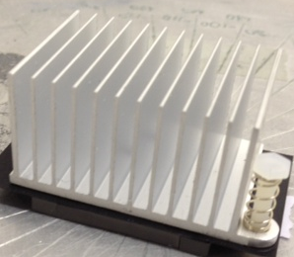
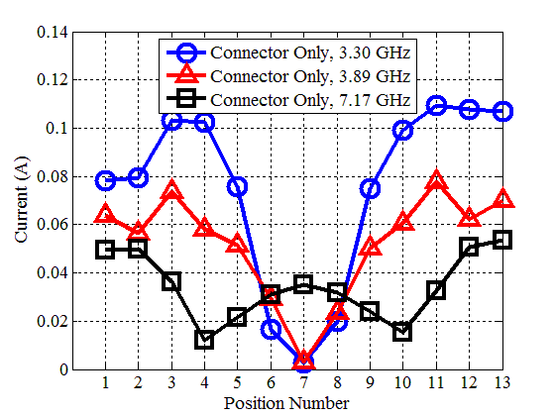
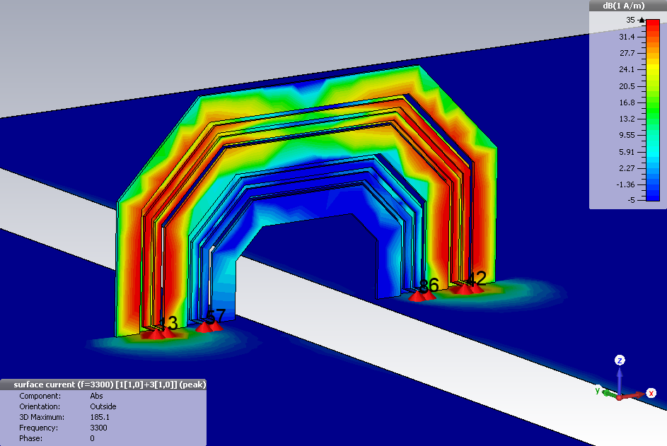
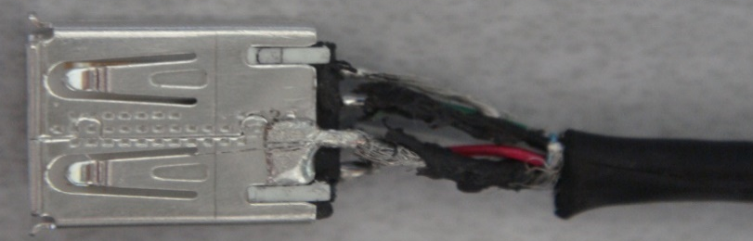

EMI Coupling Paths (discussed in this seminar)
Electrically small (lumped)
E-field/capacitance (displacement current)
H-field/inductance (conduction current)
Electrically “not”-small
1D Distributed transmission-line
Absorbing material for mitigation
Heatpipes running above PCB traces along the length
on strip
on GND
Field coupling/illumination
Pigtail

Slide 8
Coupling to Heatsinks from Traces in Proximity
Conduction current – carried by electrons
Displacement current – carried by time-changing E-field
heatsink
signal trace
on strip
on GND
IC
PCB GND
The intentional signal current and its signal return current on the strip conductor and PCB GND signal return conductor
Q: There are two un-intended current paths. What are they?

Slide 9
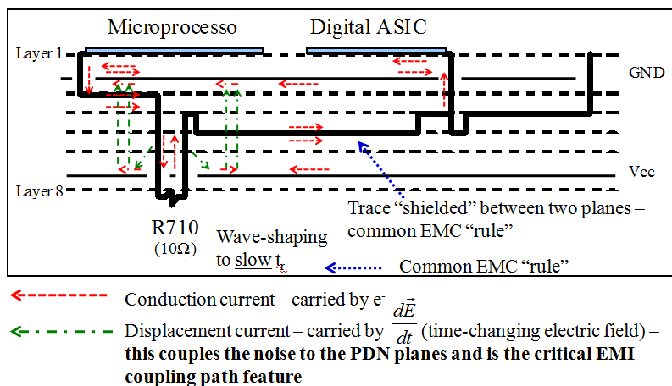
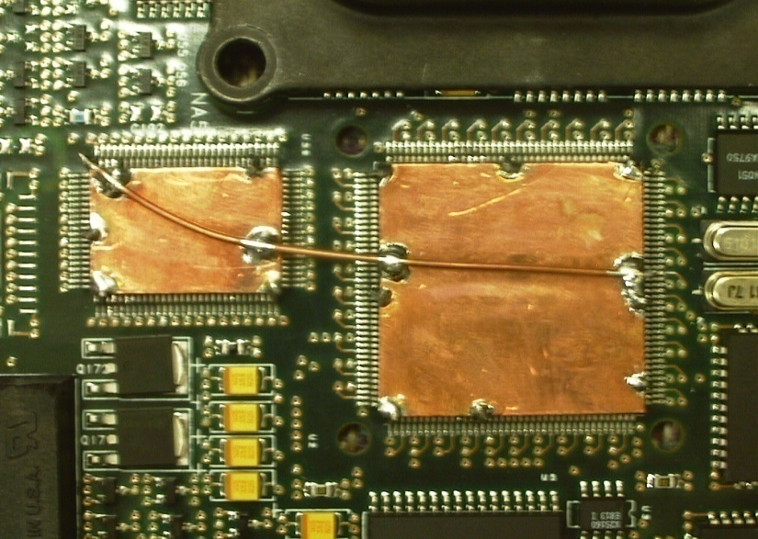
Coupling from Currents “Jumping” Signal Return References
ASIC
microcontroller
Method: When signals transition layers, transition 2 layers to use the lower side of the GND reference plane upper side being used, or transition to another GND layer with a GND stitching via or multiple vias adjacent to the signal transition via.
10-15 dB EMI reduction with new “layout”

Slide 10
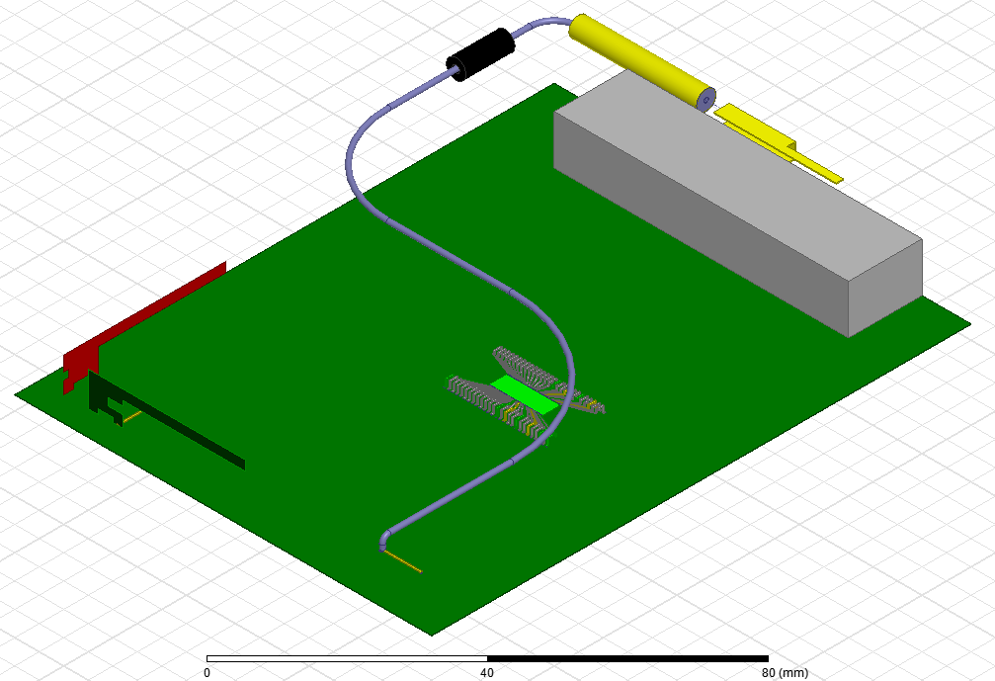
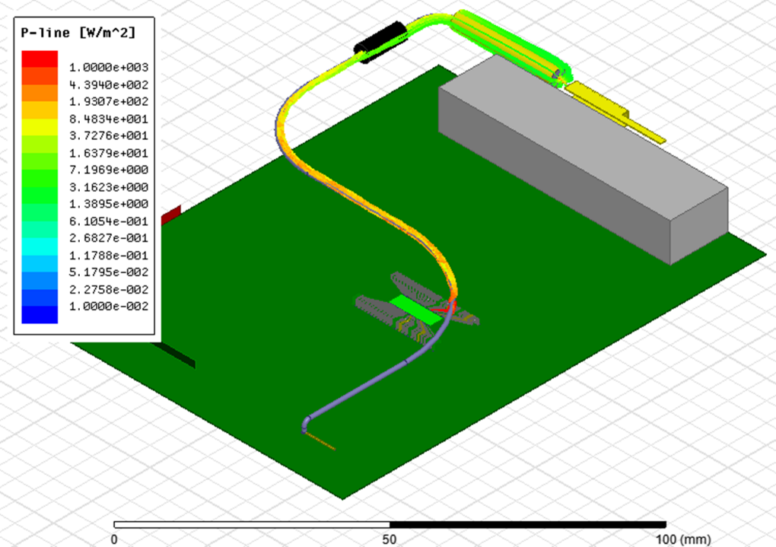
Coupling to Cables Draped across the Layout
Similar to heatpipes, any conductor, .for example cables draped across the layout can be coupled to with EM energy (1D wave coupling, E-field, or H-field) and radiate (or be part of a coupling path to other radiators)
1D distributed Coupling from circuit net
Coupling from IC
Coupling from IC
Q: When would 1D wave coupling be expected?
Q: E-field coupling?
Q: H-field coupling?

Slide 11
Coupling from Traces Crossing Gaps in Signal Return Planes
CM-TL Currents on a Differential Signal Pair
on strips
on GND
Conduction current – carried by electrons
Displacement current – carried by time-changing E-field
EMI
Comments:
Single-ended – work to avoid a trace with high-speed or high-frequency (intended or un-intentional) crossing a gap in its signal return reference. (Note that for DDR the signal return reference is a PWR for the address, so that should be continuous beneath signal.) AC stitching across the gap with a closely spaced decoupling capacitor, or a carefully design balan across the gap can be used successfully if a good model including parasitics is developed and verified, but it is risky in general.
Differential – the CM-TL mode has the same non-net current on the reference plane as a single ended signal. It is worth working to avoid differential signal crossing gap too, and if done, best designed with good modeling in the process.

Slide 12
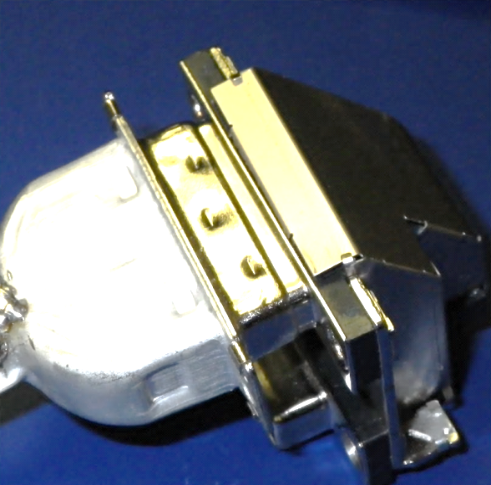
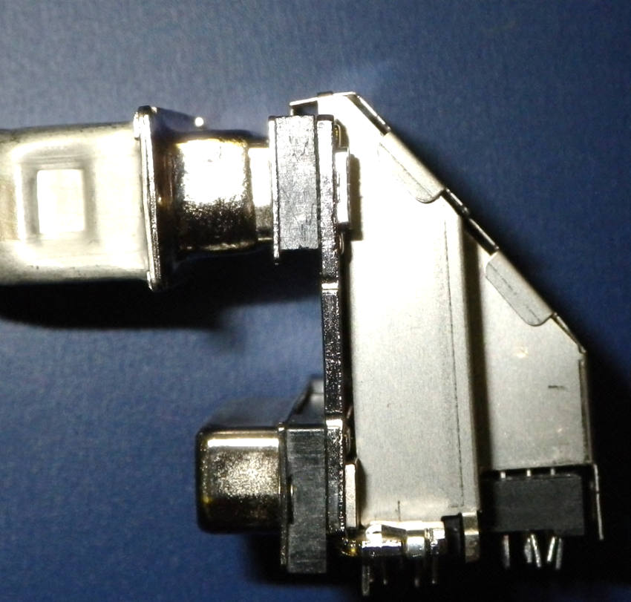
Cable Connector Shell-to-PCB Connector Shell
  The Shell-Shell interface is only connected through 6 contact points (3 on top shown).

Slide 13
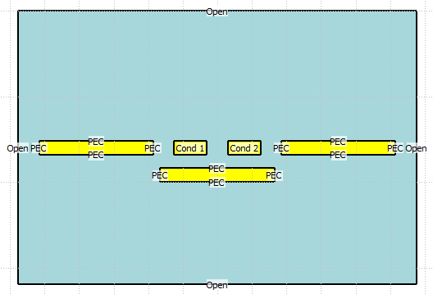
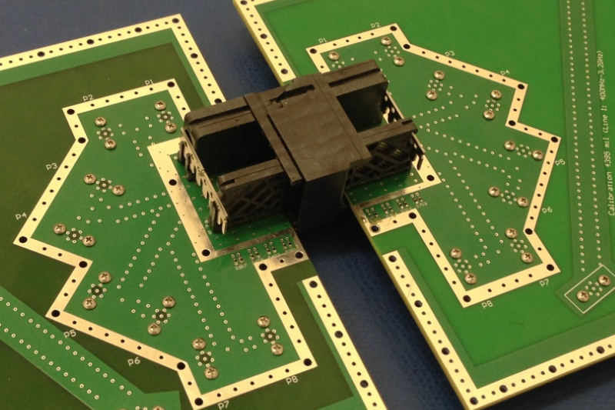
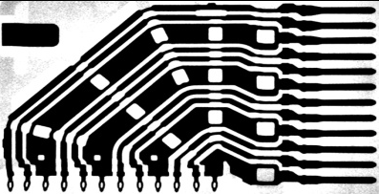
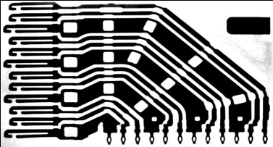
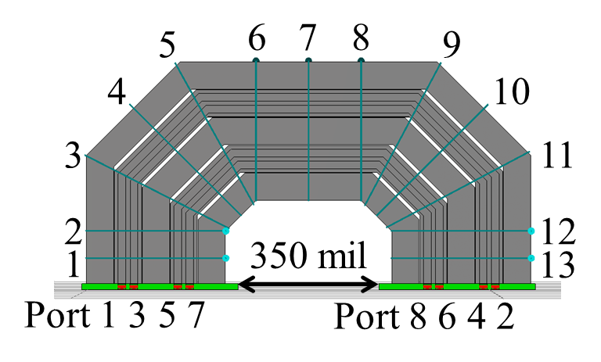
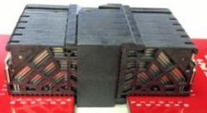
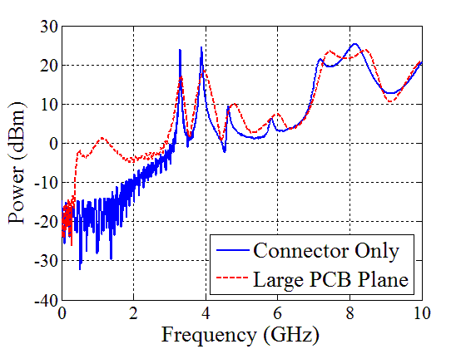
3D Wave Coupling – Radiation from High-Speed Connectors
Connector with Large PCB Plane
S⁺
S⁻
GND
GND
GND
Middle pair
EMI)
radiation
Q: What type of antenna is at this frequency?
Circulation integrals give antenna currents
Resonant length
Total radiated power

Slide 14
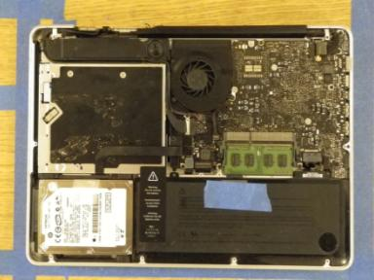
3D Wave Coupling – Coupling through Cavity Mode
Dimensions (all approximate):
Enclosure (30cm x20 cm x 2.5 cm)
Loop 1.5 cm long x 0.5 cm high
Apertures (5 mm x 5 mm)
Coupling to propagating cavity mode
end view
2.4 GHz receive antenna at 1 cm distance
Small driven loop in enclosure at 2.4 GHz
Evanescent wave leakage to Wi-Fi antenna
Antenna
Memory

Slide 15
EMI Concepts and Physics: Module Overview
Review
  EMI problem at “30,000 feet”
  EMI coupling paths
A short laundry list of representative examples
A current-based paradigm for anticipating and diagnosing EMI coupling paths
  A physics-based paradigm for EMC design, diagnosis, mitigation
  Tracing current paths – intentional and un-intentional
    The basic physics through an example – current changing reference
    USB interface
    DVI interface
Developing models
The Maxwell Equations only – paradigm doesn’t apply
Managing currents

Slide 16
Physics-Based Models and Methodology for EMI
Geometry (and Materials)
Response and geometry features correspond
trial-and-error path
Response (Time Domain – Frequency Domain)
Trace all current paths
  conduction – L/H-field
  displacement – C/E-field
Identify nodes/ports with well-defined V, I (check with full-wave)
Geometry features and nodes/circuit elements must have direct correspondence
physics
Response and circuit model correspond
engineering path
Model – mixed SPICE(network), TL, Full-Wave
I₁
Circuit Model
S- Parameters
(or Z-parameters)
I₂
SOURCE
EMI ANTENNA
V₁
V₂
Ports are required in this concept

Slide 17
Current Paths at High Frequency
Current physics
  Conduction current
  Displacement current
  Skin depth and consequences for current paths
Current flows in loops (conservation of charge)
Intentional currents
  Single-ended – TL currents
  Differential (differential-mode TL, common-mode TL currents)
Unintentional antenna currents
  Cables – shielded, un-shielded
  Antenna currents on board-to-board connectors of resonant dimensions
  Slots, gaps, apertures
Un-intentional currents in EMI coupling paths
on strip
on GND
Signal
-
+
GND

Slide 18
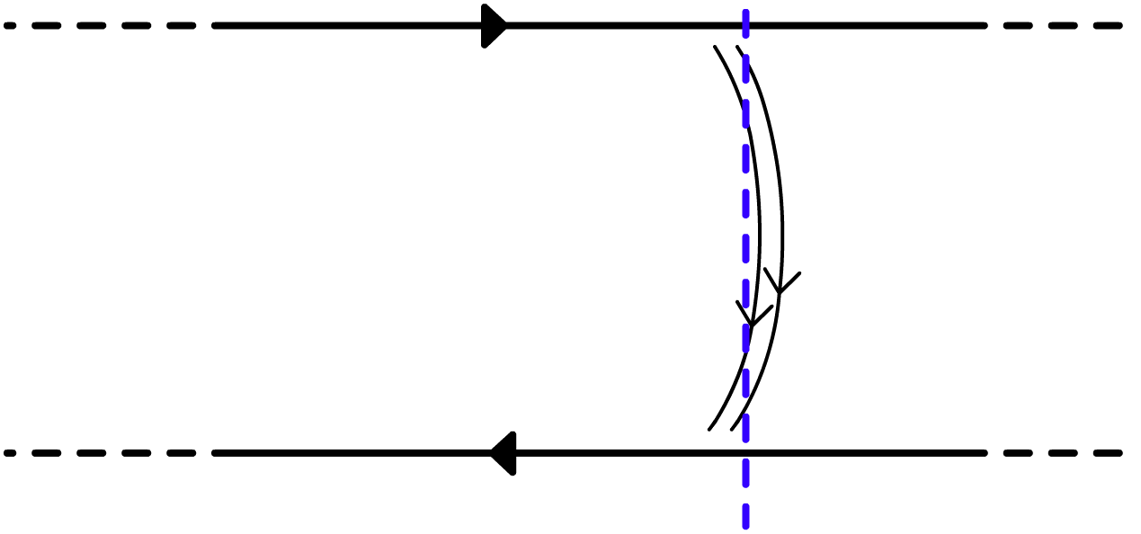
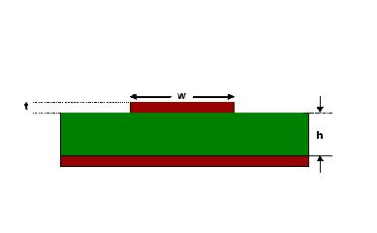
Conduction and Displacement Current – TL
current wave i(x,t)
location of
wavefront
(current reference direction)
signal current
conductor
I_{c}
Source
(unit step in time, 0-to-1 transition)
+
load
I_{d}
(displacement
carried by time-changing electric field)
voltage wave
v(x,t)
(conduction current
carried by e⁻)
-
I_{c}
signal current
return conductor
Conduction current is DC behind the wave front
i(x,t), v(x,t) = 0 ahead
of the wavefront
Q: If the current is zero in front of the wave-front, how can there be a DC (conduction) current in one direction on the signal conductor, and in the opposite direction on the signal return?
Electrons are very athletic and they jump from the signal to return conductors.
A second type of current is displacement current, and the current continuity is maintained by the displacement current at the wave-front where there is a time-changing E-field (voltage for TEM wave).
Microstrip example
signal current conductor
signal return currentconductor
(conduction current
carried by e⁻)

Slide 19
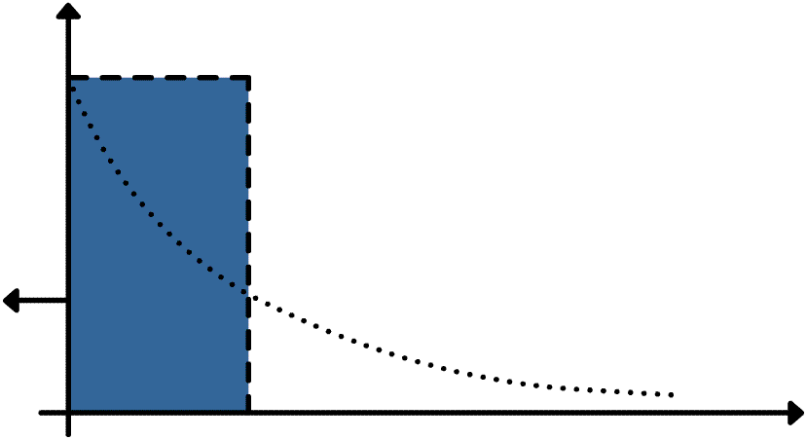
Skin Effect and Skin Depth
A uniform plane wave (UPW) is such that constant magnitude and constant phase fronts are planar.
z
free space
good conductor
E- and H-fields decay away rapidly in good conductor
J(x) – the real current in the conductor
RGW UPW
x
And replace the exponential volume distribution of current with a uniform distribution of depth in the conductor
And consider the E- and H-fields beyond one skin depth to be negligible
(good conductor)

Slide 20
Skin Depth for Copper
For typical high-speed PCB nets, all conductors have 2 surfaces on which current flows and no fields in the interior of the conductor.
δ_{s}=209 μm
δ_{s}=66 μm
δ_{s}=20.8 μm
δ_{s}=6.6 μm
1 oz. Cu = 35 μm
0.5 oz. Cu = 17.5 μm
δ_{s}=2.08 μm
1 oz Cu = 5δ at 100 MHz
δ_{s}=0.66 μm

Slide 21
Skin Depth and Current at High-Frequency
Q: Which is the correct current path? Assume the signal is such that the spectrum is such that the copper thickness is several skin depths thick.
Signal
(a)
-
+
GND
Signal
(b)
-
+
GND

Slide 22
Skin Depth and Current at High-Frequency
Q: What are the correct physics for the (correct) current path below?
Signal
-
+
GND
The current must return as shown because of skin depth.
The current takes the path of least impedance and this is the lowest impedance path.
At high frequencies, when the copper planes/area fills that function as the signal reference conductors are several skin depths thick, no E or H fields can exist inside these planes. In order for this to be the case, currents have to “see” a partner and cannot “look through” conductors.

Slide 23
Current Flows in Loops
Trace all current paths
intentional – signal
Un-intentional – due to parasitic coupling and can lead to EMI
Current flows in loops (no charge collecting), and if there is a source in current loop or path, then current will return to the source.
Conduction current – carried by electrons
Displacement current – carried by time-
changing E-field
Antenna conduction current
Microstrip current
signal current conductor
EMI
signal return currentconductor
Heatsink (grounded in 1 place)
(conduction current
carried by e⁻)
IC
signal trace
PCB GND
Electrically short is inductance
Electrically short is capacitance
Note that high-frequencies are considered here so that the current flows on conductor surfaces.
on strip
on GND
Q: The heatsink is grounded, why is there still a displacement current between the heatsink and the PCB GND shown as part of the return path of the in-intended current coupled to the heatsink?

Slide 24
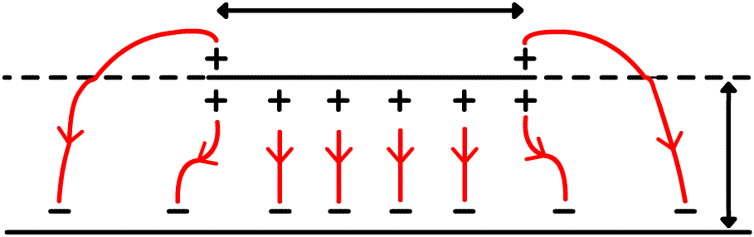
Intentional Currents – TL Signal Currents
Transmission-line (TL) currents for a differential signal pair:
Odd-Mode
Transmission-line differential mode (DM-TL)
Even-Mode
Transmission-line “common”-mode (CM-TL)
anti-symmetry plane
symmetry plane
+ i
- i
i
i
+
-
-
+
+
+
+ V
d₁
- - - - - -
V
d₁
V
-V
-
-
+ + + + + + +
-
-
There are currents on ref. plane but the net current on reference plane
i_{return}
There is net current on the reference plane
Transmission-line (TL) currents for a single-ended signal:
EMC people sometimes refer to intentional single ended currents as “differential”-mode currents, and any un-intentional currents, on heatsinks, anywhere in the PCB design, on cables, etc., as “common”-mode currents. It is worth avoiding using the same name for different physics.
+
V
-

Slide 25
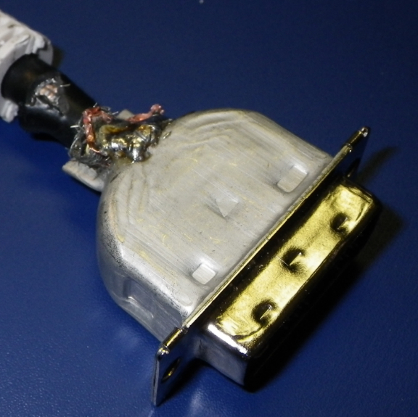
Un-intentional EMI “Antenna” Currents – Shielded Cable
The current on the outer surface of the cable shield is often denoted “common-mode” current. It is a radiating current and denoted here as an antenna-mode current.
Not a perfect 360º connection of shield braid to metal shell
There is a third wire in the 3-conductor system that is attached to PCB GND, and this is the return for the CM-TL currents.
Q: What is the impact of the imperfect shield connection? How can this be quantified – measured, modeled, or calculated?
Q: What are mitigation approaches? How to choose?
Notes:
Q

Slide 26
Un-intentional EMI “Antenna” Currents – Un-shielded Cable
Antenna currents (conductions) go down all conductors and “return” by displacement current to the outer surface of the metal enclosure wall. (These currents are often call “common-mode” currents. Bad choice of words.)
The single-ended signal currents are sometimes denoted “differential-mode” currents. (Bad use of these words.)

Slide 27
Un-intentional Currents across/around Slots
CM-TL Currents on a Differential Signal Pair
on strips
on GND
Conduction current – carried by electrons
Displacement current – carried by time-changing E-field

Slide 28
Un-intentional Antenna Currents on Heatsinks
Radiation
(dipole mode)
heatsink
Radiation
(cavity mode)
IC
Conduction current – carried by electrons
Displacement current – carried by time-changing E-field

Slide 29
Intentional and Un-Intentional Currents on PCBs
Conduction current – carried by electrons
Displacement current – carried by time-changing E-field
heatsink
signal trace
on strip
on GND
IC
PCB GND
The intentional signal current and its signal return current on the strip conductor and PCB GND signal return conductor
Q: There are two un-intended current paths. What are they?

Slide 30
EMI Concepts and Physics: Module Overview
Review
  EMI problem at “30,000 feet”
  EMI coupling paths
A short laundry list of representative examples
A current-based paradigm for anticipating and diagnosing EMI coupling paths
  A physics-based paradigm for EMC design, diagnosis, mitigation
  Tracing current paths – intentional and un-intentional
    The basic physics through an example – current changing reference
    USB interface
    DVI interface
Developing models
The Maxwell Equations only – paradigm doesn’t apply
Managing currents

Slide 31
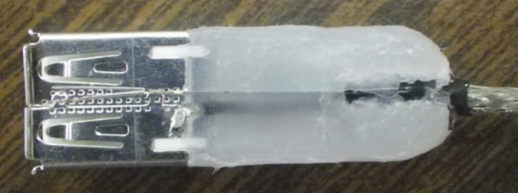

USB Cable/Connector/Enclosure/PCB Interface
Pigtail

Slide 32
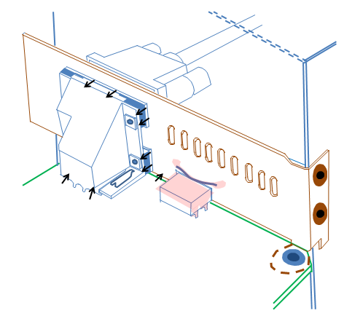
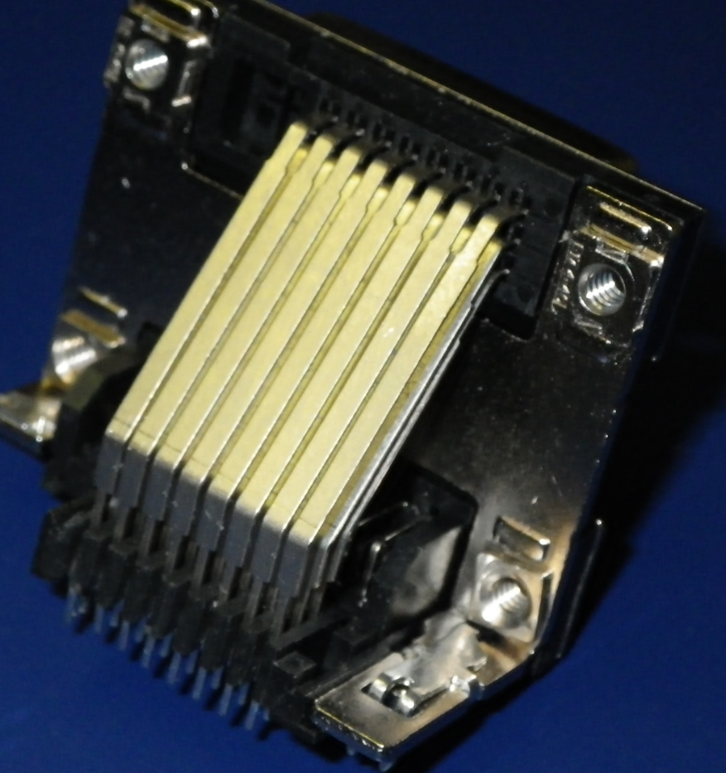
DVI Connector Geometry
GND
Tx+
Tx-

Slide 33
EMI “Antenna” Currents on Cable
PCB GND
Connector shell to PCB GND
Notes:
Q

Slide 34

Cable Shield to Connector Shell
Not a perfect 360º connection of shield braid to metal shell

Slide 35
Cable Connector Shell-to-PCB Connector Shell
  The Shell-Shell interface is only connected through 6 contact points (3 on top shown).

Slide 36
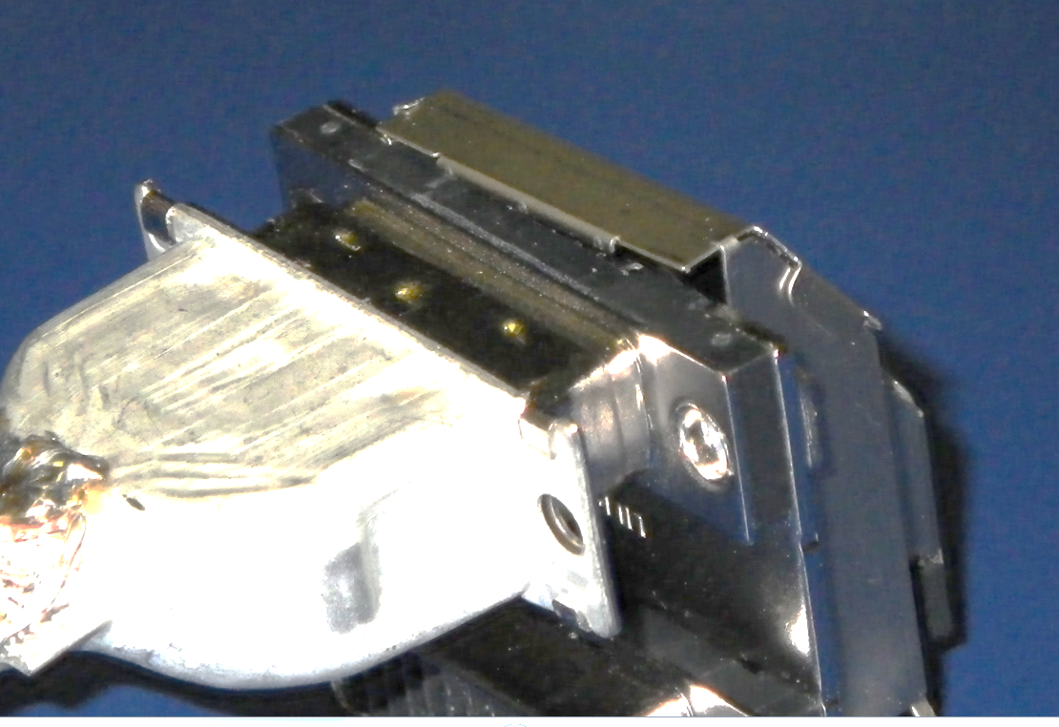
PCB Connector Shell-to-Enclosure
Two screws connector shell to enclosure

Slide 37
PCB Connector Shell-to-PCB GND
Three “dimples” connector shell upper for PCB GND
PCB GND
Connector shell to PCB GND

Slide 38
EMI Concepts and Physics: Module Overview
Review
  EMI problem at “30,000 feet”
  EMI coupling paths
A short laundry list of representative examples
A current-based paradigm for anticipating and diagnosing EMI coupling paths
  A physics-based paradigm for EMC design, diagnosis, mitigation
  Tracing current paths – intentional and un-intentional
    The basic physics through an example – current changing reference
    USB interface
    DVI interface
Developing models
The Maxwell Equations only – paradigm doesn’t apply
Managing currents

Slide 39
Modeling for Engineering Methodology and Calculations
Un-Grounded Heatsink Geometry
heatsink
IC
signal trace
signal current on strip
signal return current on GND
PCB GND
The intentional signal current and its signal return current on the strip conductor and PCB GND signal return conductor
Conduction current – carried by electrons
Displacement current – carried by time-
changing E-field
Antenna conduction current

Slide 40
Engineering Methodology and Calculations – Coupling Path
Q: What should be the spacing s between a high-speed trace and a heatsink?
Assume the coupling path is capacitive? (What are the physics underlying this assumption?)
EMI
signal current on strip
signal return current on GND
IC
Conduction current – carried by electrons
Displacement current – carried by time-
changing E-field
Antenna conduction current

Slide 41
Modeling for Engineering Modeling Methodology– Decomposition
Q: What should be the spacing s between a high-speed trace and a heatsink?
Strategy: “Divide-and-Conquer”
Break coupling path into pieces
Aggressor source (data rate, t_{rise}, t_{fall})
Aggressor TL sections (coupled)
Aggressor TL – heatsink coupling
Radiation calculations
Shielding calculations
source
data rate, t_{rise}, t_{fall}

Slide 42
Engineering Modeling Methodology– Model Development
Q: What should be the spacing s between a high-speed trace and a heatsink?
Develop a model for this piece
Assume the coupling path is capacitive? (What are the physics underlying this assumption?)
IC
Q: How to approximate t_{HS} and w_{HS} in the equivalent MTL model?
Q: Can the geometry for C_{coupling} be normalized so that the coupling scales with geometry?
Coupled TL model
ε_{r}
ε_{PCB}

Slide 43
Modeling Methodology – Model Assembly and Calculations
Q: What should be the spacing s between a high-speed trace and a heatsink?
Determine Z_{A} from microstrip patch antenna
|Z_{A} (jω)|
source
data rate, t_{rise}, t_{fall}
I_{A}
|Z_{A} (jω)|
|Z_{A} (jω)|

Slide 44
Conclusion
Understanding and identifying un-intentional current paths is a helpful supplement to experienced EMC design “best practices” that can aid in:
Anticipating EMI coupling paths
Diagnosing EMI coupling paths through measurements and experiments
Mitigating EMI problems
And in some cases quantifying EMI problems

