Slide 1
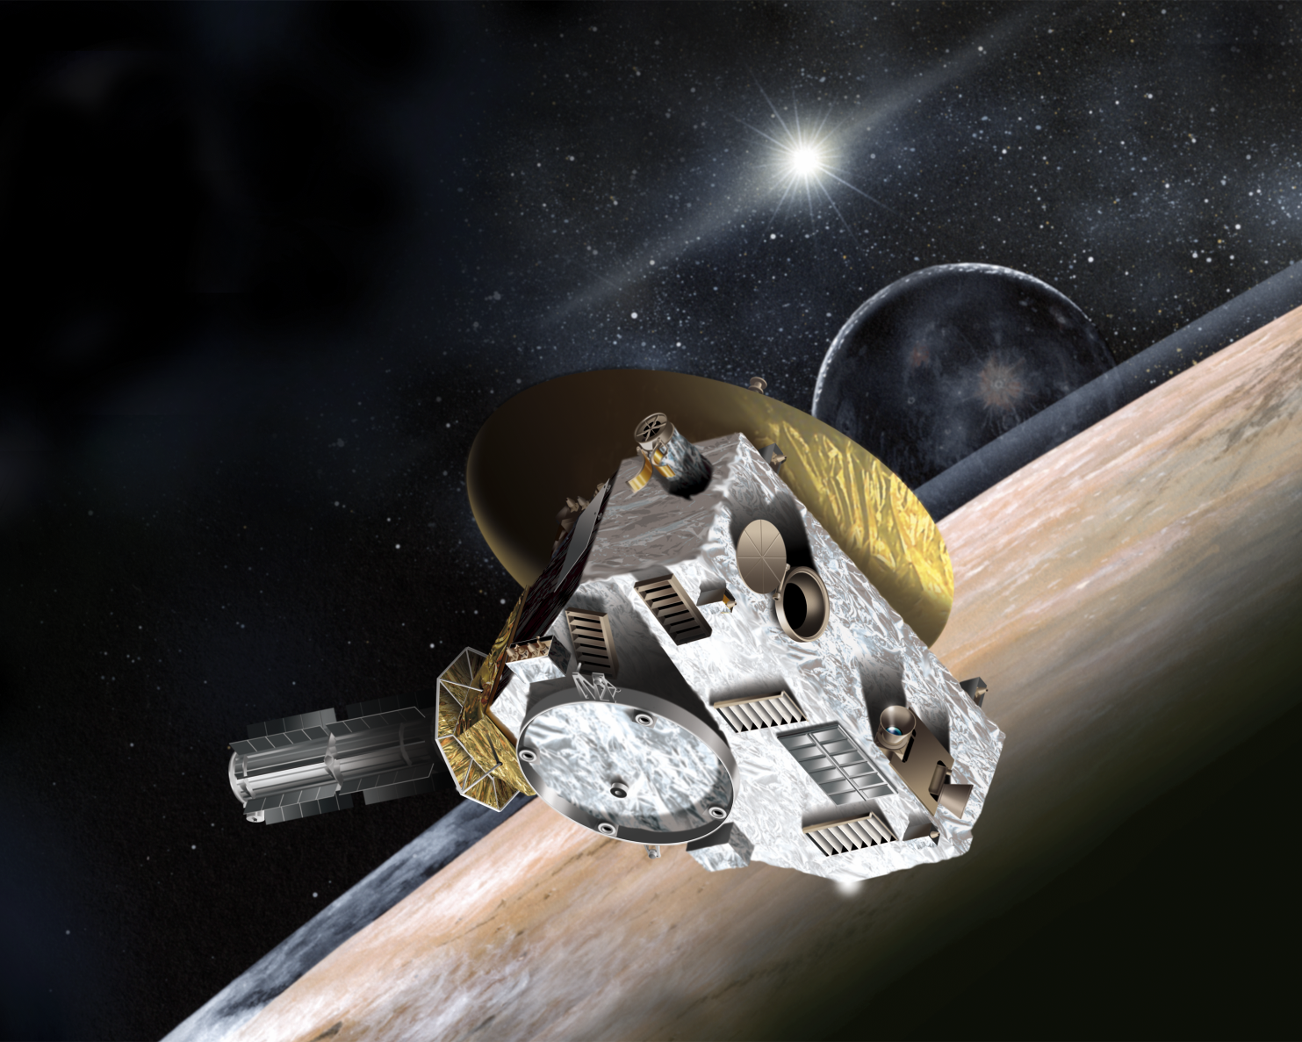
The New Horizons Mission to Pluto

Slide 2
What We Already Know About Pluto
Diameter = 2,368 km (about the size of the U.S.)
Mass = 1.3 x 10²² kilograms
Density = 2 grams per cubic centimeter
Surface composition = H₂O, N₂, CH₄, CO ices
Atmospheric composition = N₂, CH₄, CO
Surface temperature = 40 K ( -233°C)
Spin period = 6.39 days
Orbital period around Sun = 248 years
Distance from Sun = 30 to 50 AU
(AU = “Astronomical Unit” distance from Earth to Sun)

Slide 3
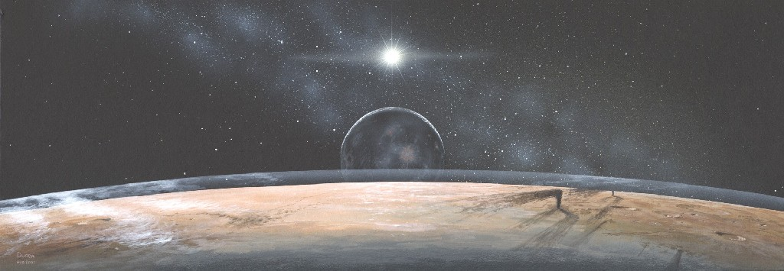
Artist’s Conception
11 NOV SEP 2015 IEEE CTS CEDA Meeting
Scott Weidner, SwRI, IEEE Senior Member
3

Slide 4
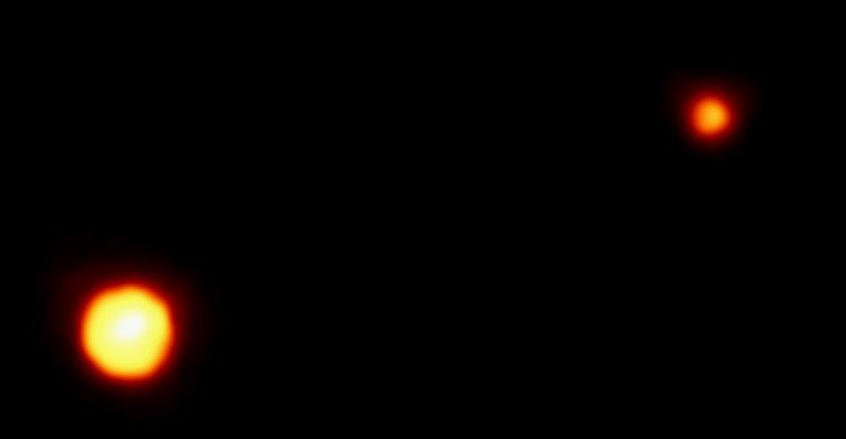
Before New Horizons …
The Best Picture We Really Had!
11 NOV SEP 2015 IEEE CTS CEDA Meeting
Scott Weidner, SwRI, IEEE Senior Member
4

Slide 5
Why Go To Pluto?
First of the “icy” planets
  Rocky planets (Mercury, Venus, Earth, Mars)
  Gas giants (Jupiter, Saturn, Uranus, Neptune)
  Part of the Kuiper Belt
Only known “binary” planet
  Pluto’s moon Charon is so large that their center of gravity is between them … they revolve around each other
Only type of planet in the solar system that has not been visited by a spacecraft
11 NOV SEP 2015 IEEE CTS CEDA Meeting
Scott Weidner, SwRI, IEEE Senior Member
5

Slide 6
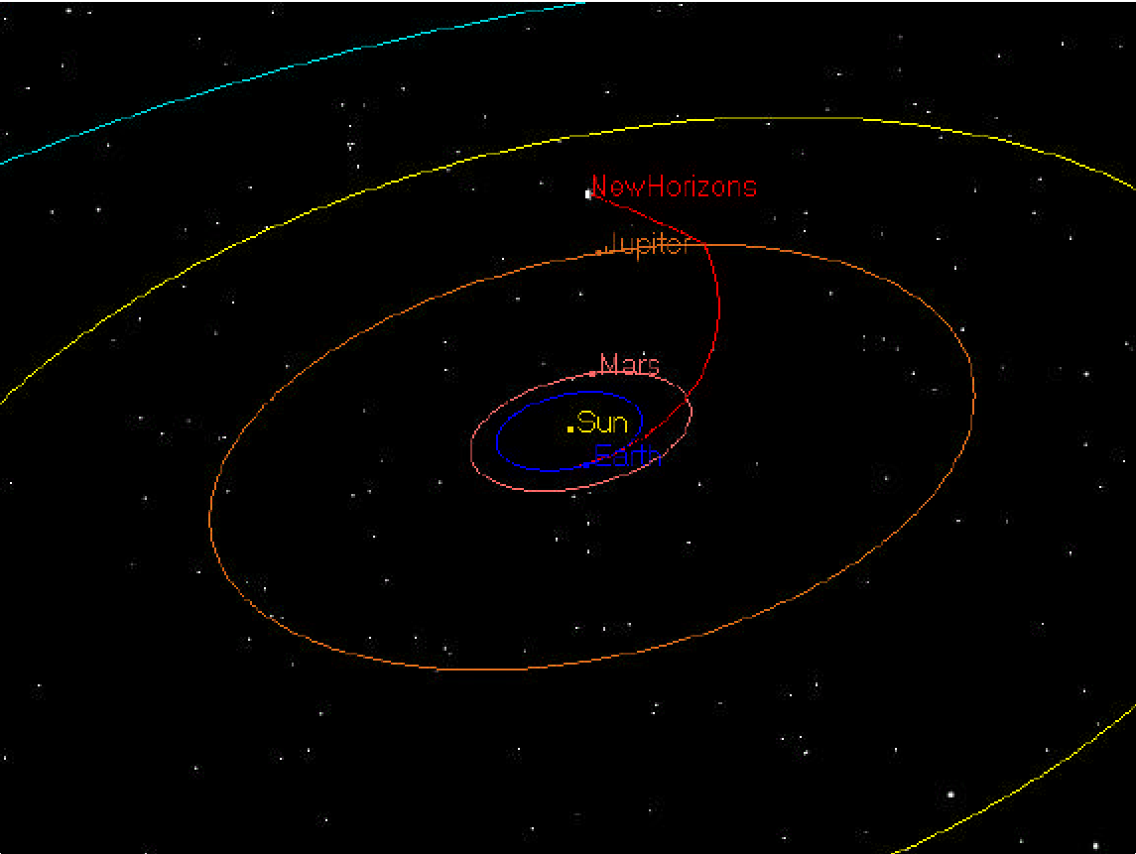
What was the Hurry?
Jupiter was perfectly lined up to slingshot us …
11 NOV SEP 2015 IEEE CTS CEDA Meeting
Scott Weidner, SwRI, IEEE Senior Member
6

Slide 7
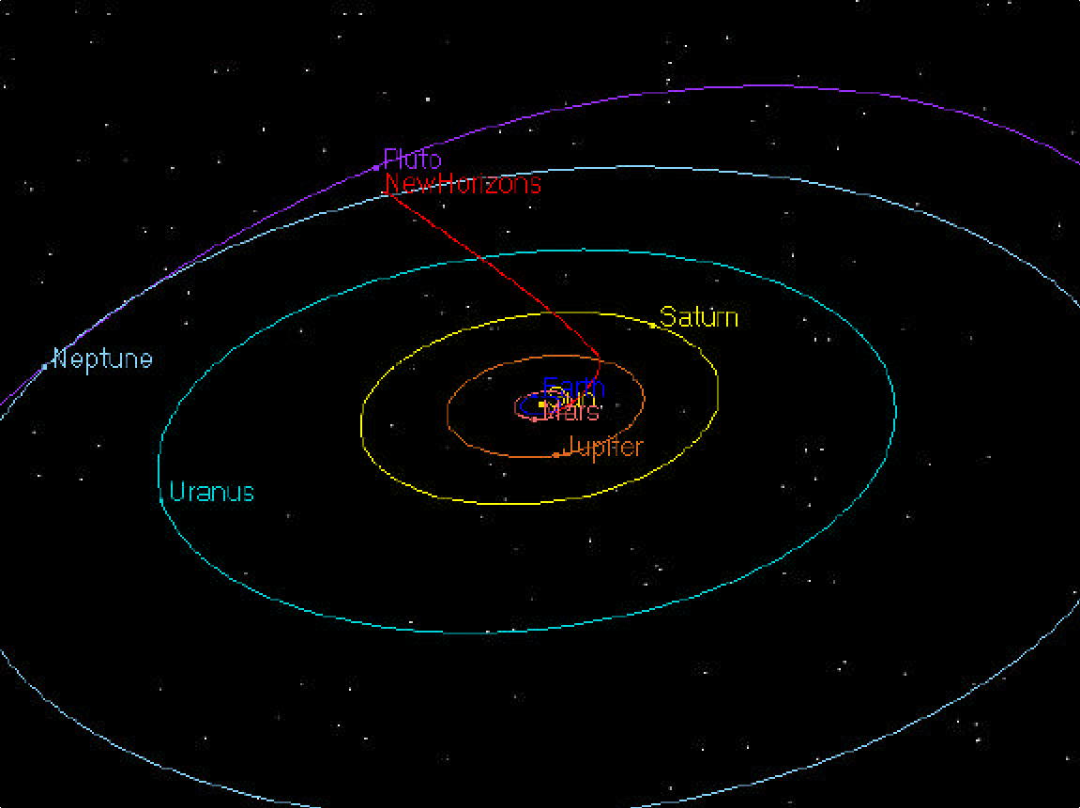
Out to Pluto …
11 NOV SEP 2015 IEEE CTS CEDA Meeting
Scott Weidner, SwRI, IEEE Senior Member
7

Slide 8
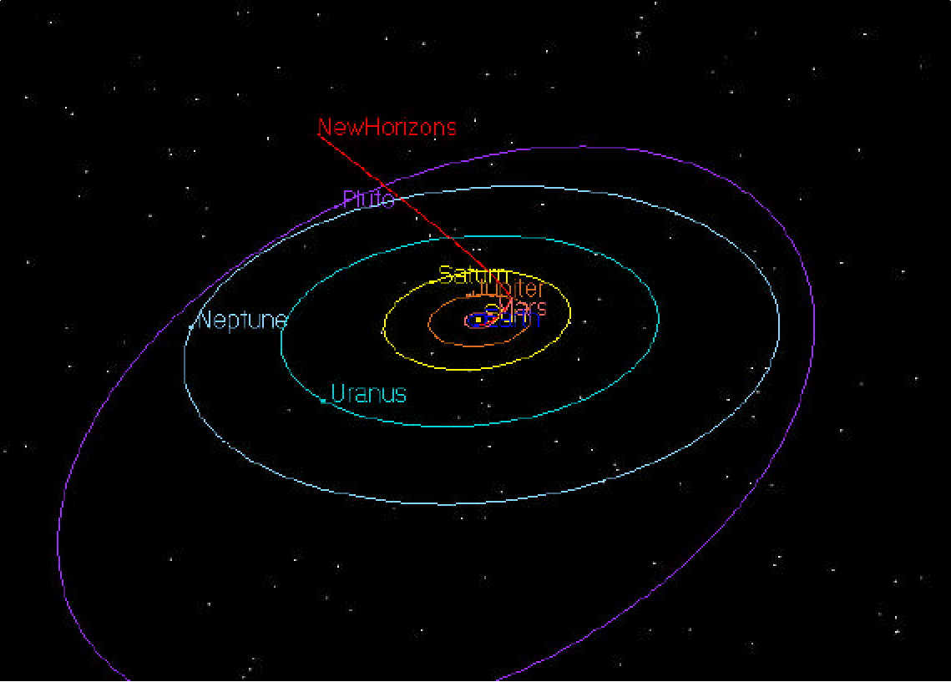
… before its atmosphere freezes for hundreds of years
11 NOV SEP 2015 IEEE CTS CEDA Meeting
Scott Weidner, SwRI, IEEE Senior Member
8

Slide 9
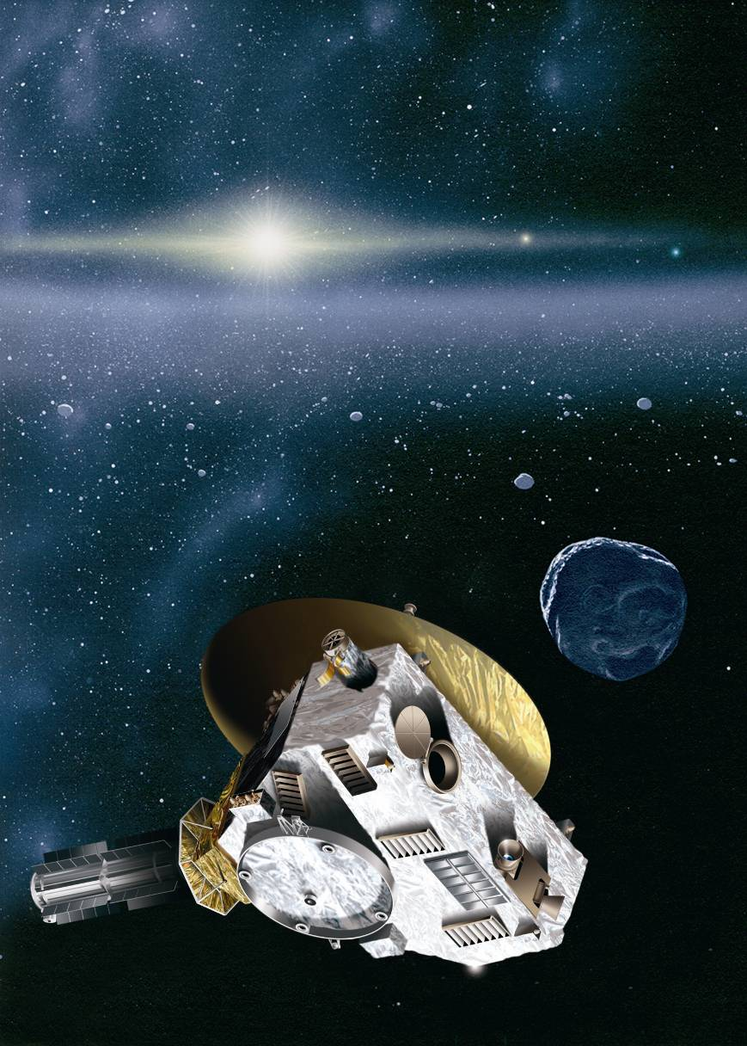
After Pluto …
Kuiper Belt contains rocks and ice left over from the disk of matter our solar system was formed from
We will re-target for a Kuiper Belt object to fly by
Hubble telescope found three that we could reach
11 NOV SEP 2015 IEEE CTS CEDA Meeting
Scott Weidner, SwRI, IEEE Senior Member
9

Slide 10
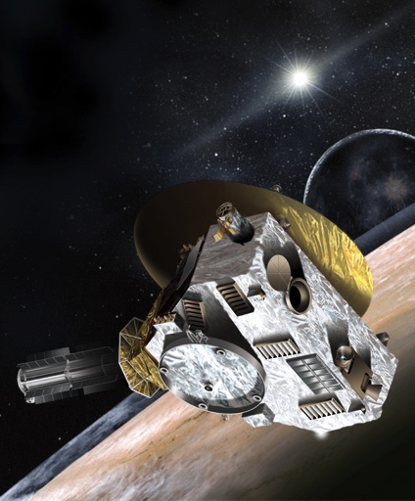
The New Horizons Spacecraft
Southwest Research Institute was in charge of the payload
(all of the science instruments)
Two of the science instruments were made at SwRI
Johns Hopkins University Applied Physics Lab built the spacecraft
11 NOV SEP 2015 IEEE CTS CEDA Meeting
Scott Weidner, SwRI, IEEE Senior Member
10

Slide 11
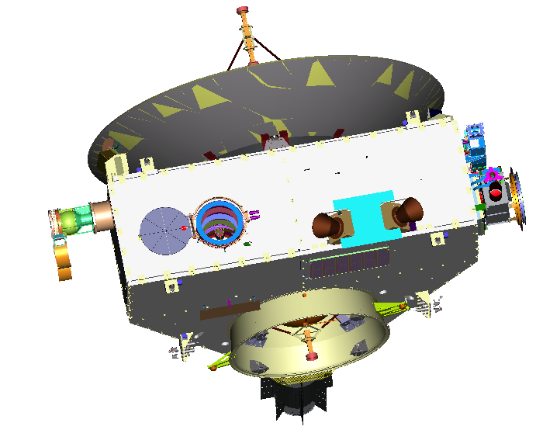
The New Horizons Spacecraft
Instrument Payload
PEPSSI
Alice
LORRI
Ralph
SWAP
SDC
11 NOV SEP 2015 IEEE CTS CEDA Meeting
Scott Weidner, SwRI, IEEE Senior Member
11

Slide 12
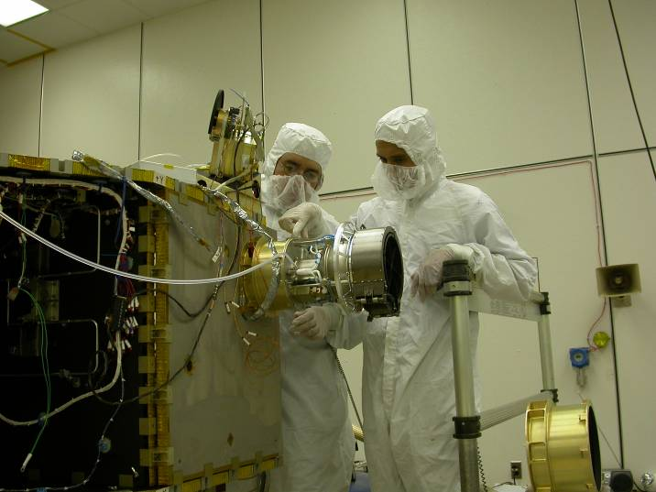
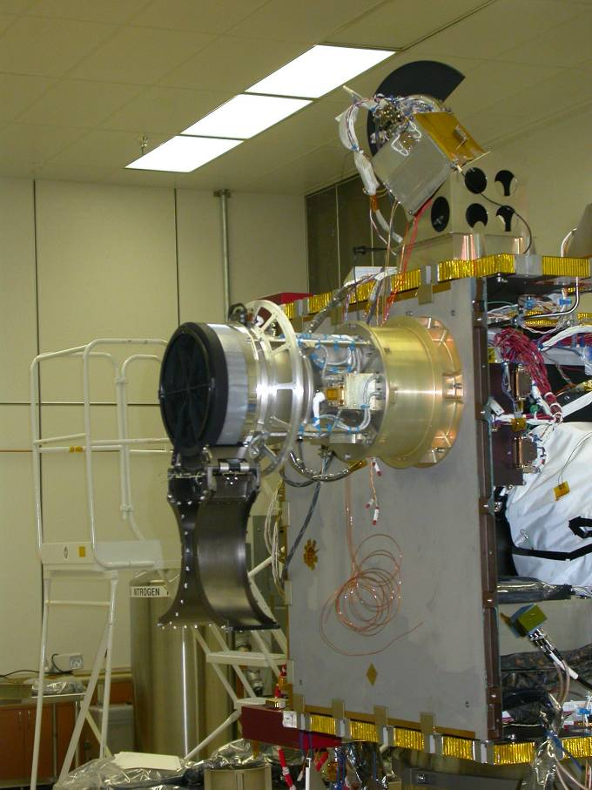
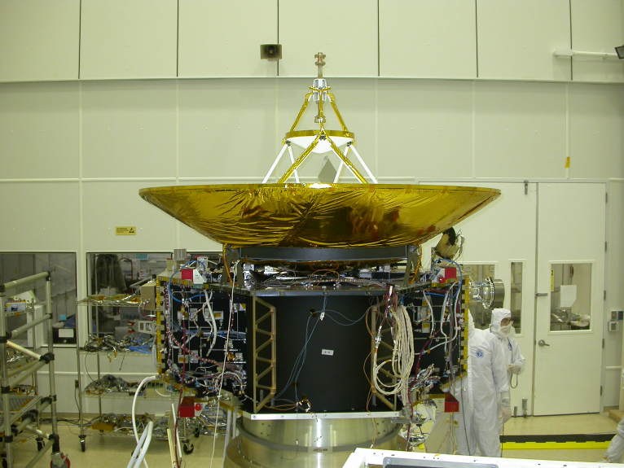
The New Horizons Spacecraft
During Integration at JHUAPL
11 NOV SEP 2015 IEEE CTS CEDA Meeting
Scott Weidner, SwRI, IEEE Senior Member
12

Slide 13
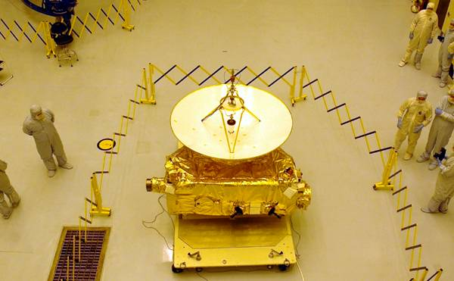
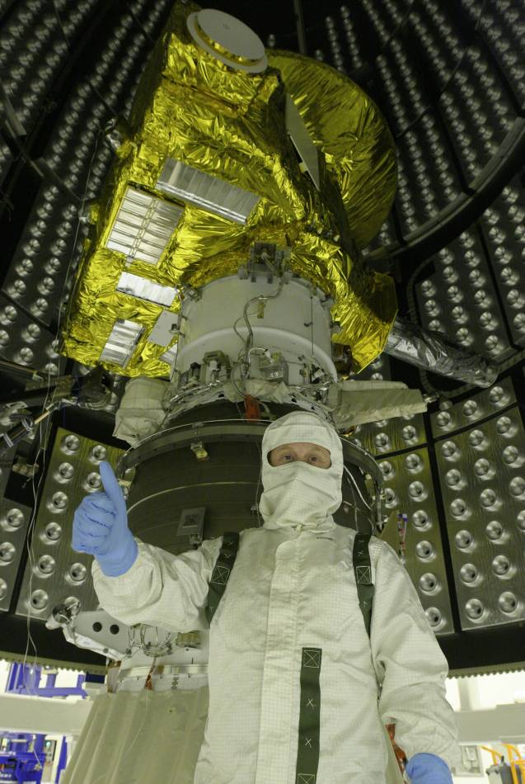
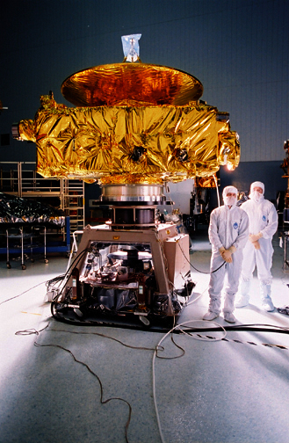
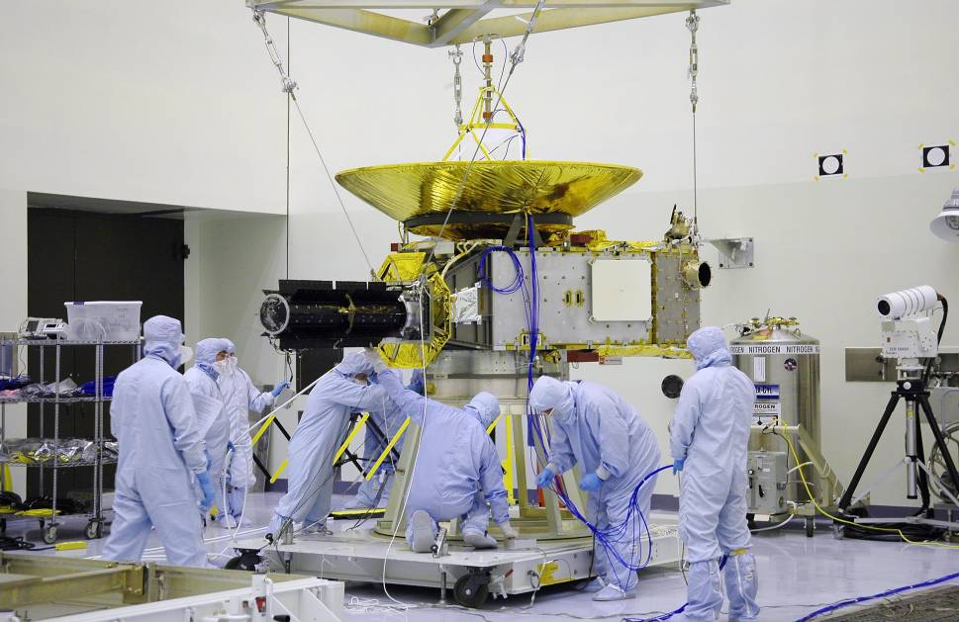
The New Horizons Spacecraft
During Integration at KSC
11 NOV SEP 2015 IEEE CTS CEDA Meeting
Scott Weidner, SwRI, IEEE Senior Member
13

Slide 14
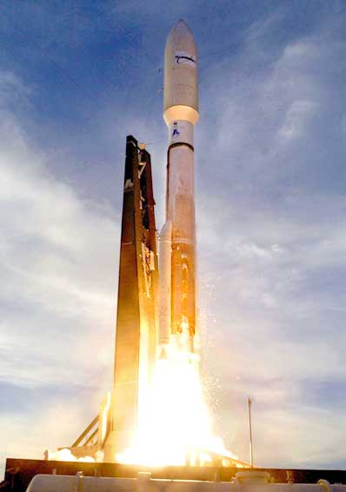
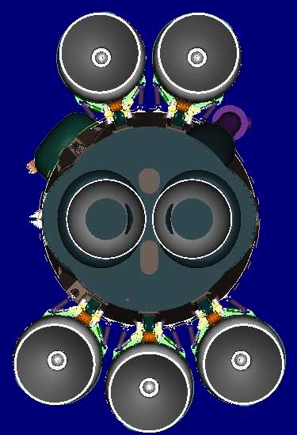
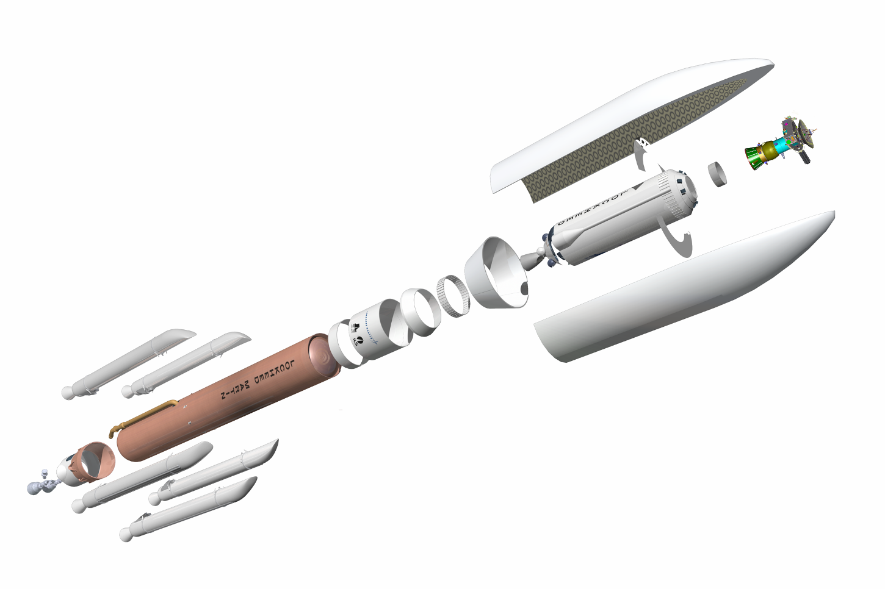
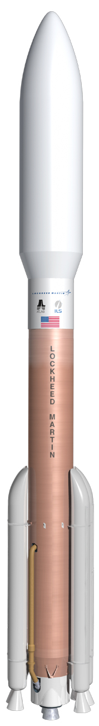
The New Horizons Spacecraft Inside the Launch Vehicle
(which launched us out of orbit at 36,373 mph)
Centaur Forward
Load Reactor
5-meter Short Payload
Fairing (68 ft)
Payload
Adapter (PLA)
Centaur Interstage
Adapter (12.5 ft Dia)
Centaur Conical
Interstage Adapter
CCB Cylindrical
Interstage Adapter
Solid Rocket
Boosters
Centaur
Upper
Stage
Aft Transition
Skirt/Heat Shield
Centaur
Aft Stub
Adapter
Single
RL10 Engine
5-Meter
Payload Fairing
Boattail
RD-180 Engine
Common Core
BoosterTM (CCB)
11 NOV SEP 2015 IEEE CTS CEDA Meeting
Scott Weidner, SwRI, IEEE Senior Member
14

Slide 15
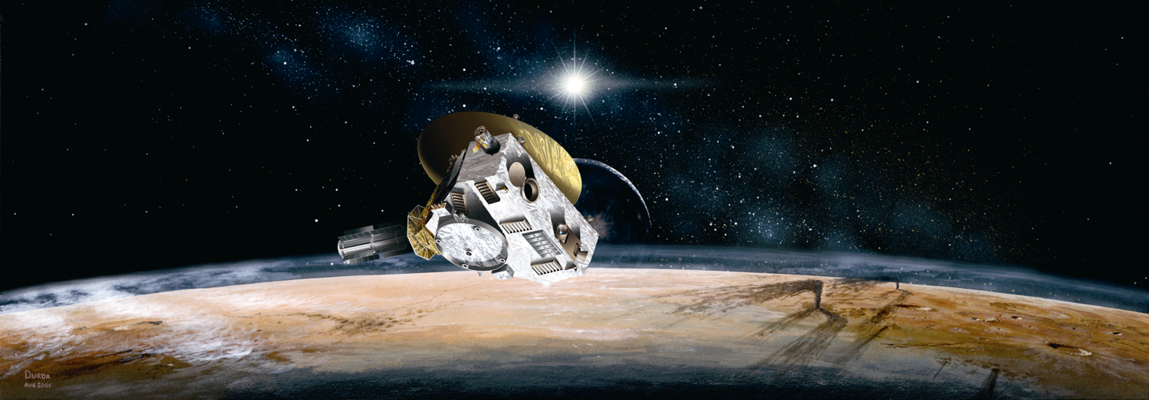
The Mission at Pluto
Flyby mission
We couldn’t carry enough fuel to go into orbit around Pluto
It took almost ten years to get there
And then everything has to work PERFECTLY for one week as we fly by the planet and collect the key scientific data
11 NOV SEP 2015 IEEE CTS CEDA Meeting
Scott Weidner, SwRI, IEEE Senior Member
15

Slide 16
Science Instrument: LORRI
Long Range Telescope
Images of Pluto in the visible spectrum
Gives us an advanced look 100 days out to refine the mission plan
High resolution, close-up photos of the surface of Pluto during the flyby
1024 x 1024 CCD imager
Cooled to -70 ºC
Purge Fittings
Beryllium Radiator & Conduction BAR
Silicon coated SSG SiC Mirrors
Monolithic SSG SiC Structure
Magnesium Interior Baffles
External Isolators
Z
K13C2U Baffle Shell with M55 Baffle Blades
Y
X
11 NOV SEP 2015 IEEE CTS CEDA Meeting
Scott Weidner, SwRI, IEEE Senior Member
16

Slide 17
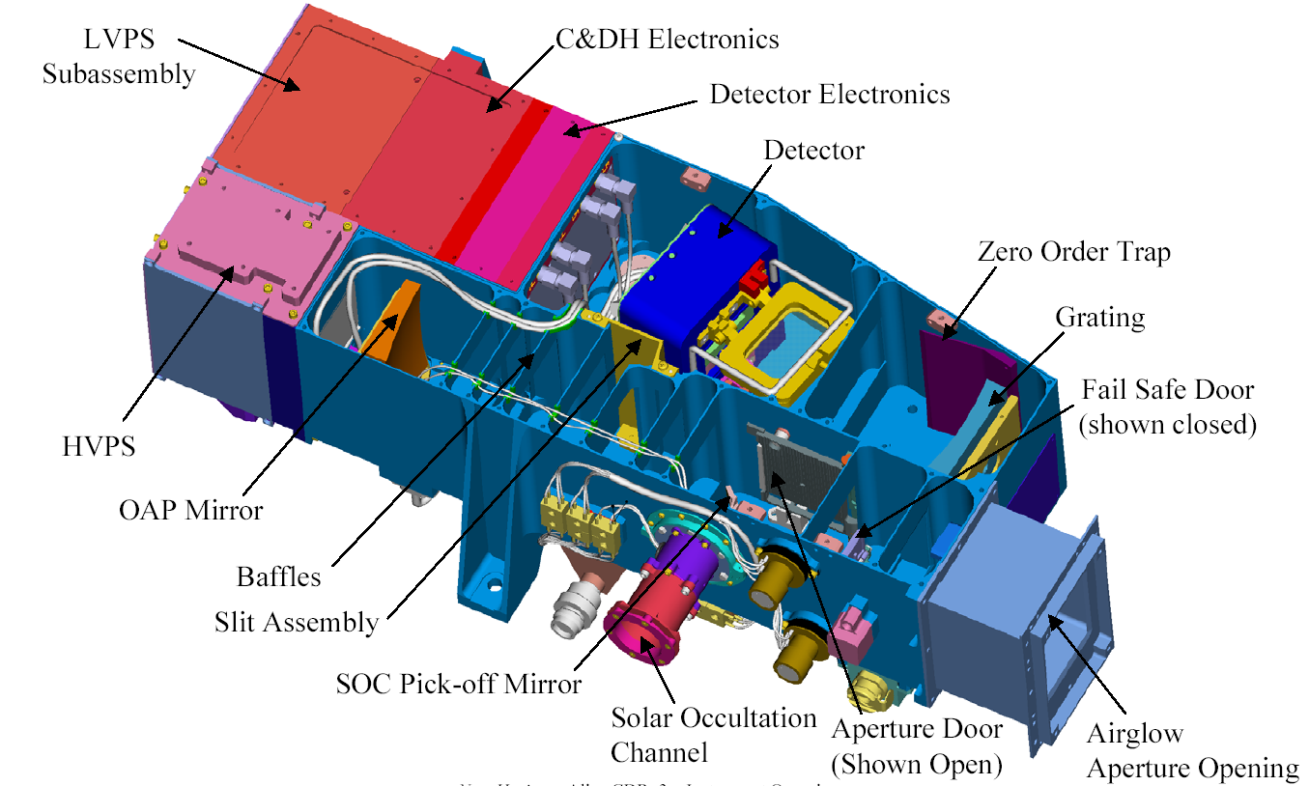
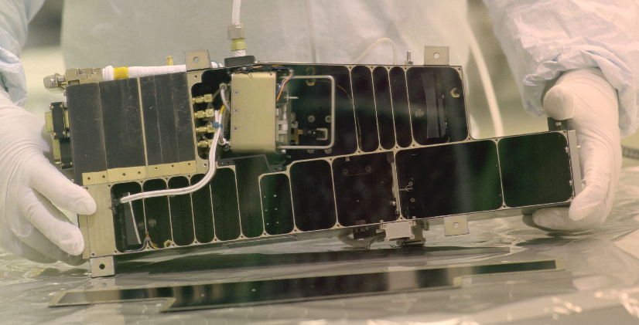
Science Instrument: Alice
Built at SwRI
UV Imager
Field-of-view is like a fan
Use optics to spread the light out in spectrum like a prism
The spacecraft will rotate the fan shaped field-of-view across Pluto to create a picture
Shape of the spectrum at any given location can be used to determine the chemical composition
11 NOV SEP 2015 IEEE CTS CEDA Meeting
Scott Weidner, SwRI, IEEE Senior Member
17

Slide 18
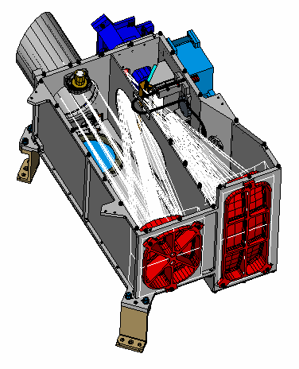
Science Instrument: Ralph
Aperture Baffle
Detector Packages
Infrared and Visible Imager
Field-of-view is also narrow like a fan
Infrared – images a scene through a wedged filter (linear variable filter, placed 100 μm above a 256x256 pixel Mercury Cadmium Telluride (HgCdTe) detector
Visible: Six 5023x32 CCDs to cover Pan, R, B, near-IR, and narrow-band methane, plus one 5032x128 CCD OpNav backup
The spacecraft will rotate the fan shaped field-of-view across Pluto to create a picture
Shape of the spectrum at any given location can be used to determine the chemical composition
Large radiator cools detectors below -140 ºC (130 K)
Tertiary Mirror
Primary Mirror
11 NOV SEP 2015 IEEE CTS CEDA Meeting
Scott Weidner, SwRI, IEEE Senior Member
18

Slide 19
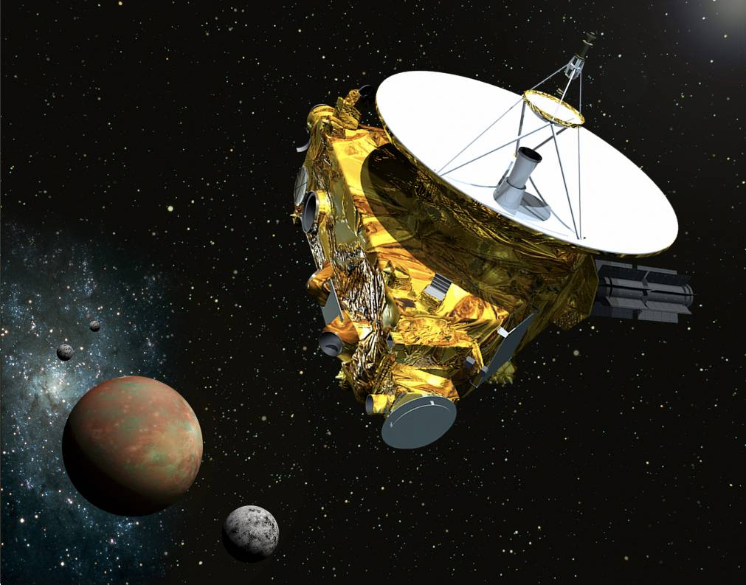
Science Instrument: REX
Radio Experiment
After we fly by Pluto we look back towards Earth
Transmitters on Earth will send signals toward Pluto
High Gain Antenna will “listen” for absorption of radio waves by the atmosphere of Pluto
A similar experiment (occultation) will be done with Alice and the Sun
11 NOV SEP 2015 IEEE CTS CEDA Meeting
Scott Weidner, SwRI, IEEE Senior Member
19

Slide 20
Science Instrument:
Student Dust Counter
Instrument was designed and built by college students
Large panel of PVDF material on the bottom side of the spacecraft
Panel faces forward during cruise phase
Records “hits” on panel
Measures distribution of dust across solar system
Data will be used in search for Exo-Planets
Detector assembly
Intra-harness
Electronics box
11 NOV SEP 2015 IEEE CTS CEDA Meeting
Scott Weidner, SwRI, IEEE Senior Member
20

Slide 21
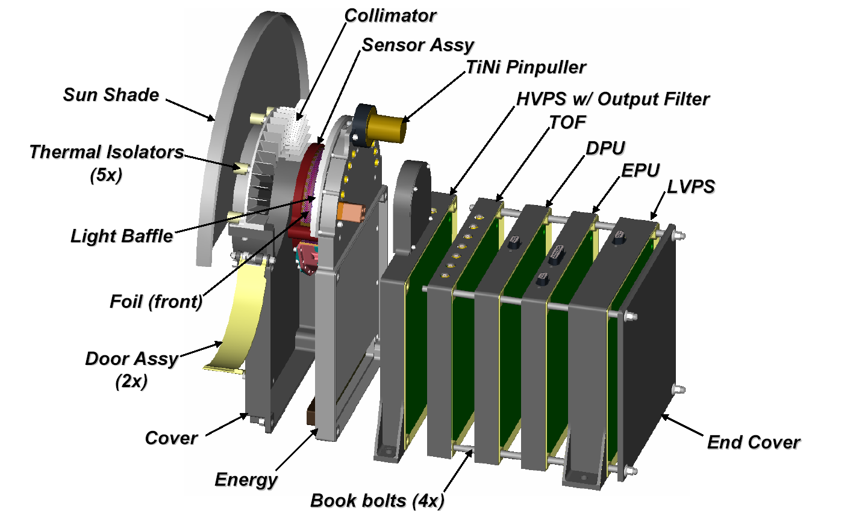
Science Instrument: PEPSSI
Energetic Particle Spectrometer
Identifies species, energy spectrum, and direction of particles with energies up to
5 MeV
Measures pickup ions generated from Pluto’s interaction with the solar wind
11 NOV SEP 2015 IEEE CTS CEDA Meeting
Scott Weidner, SwRI, IEEE Senior Member
21

Slide 22
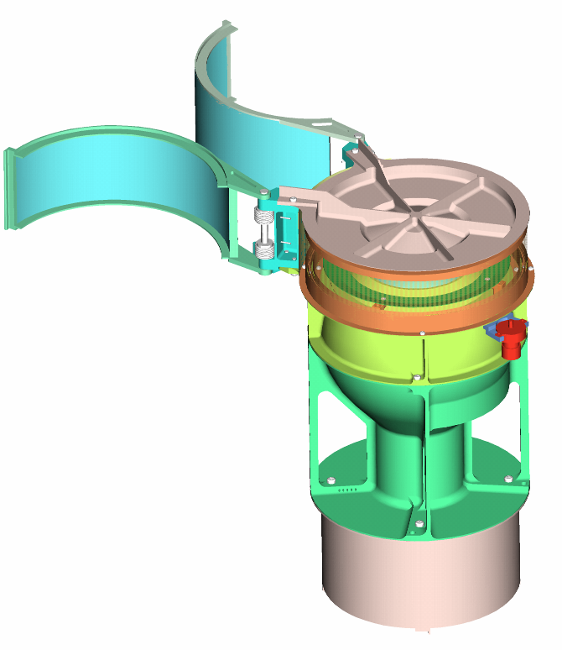
Science Instrument: SWAP
Measures the solar wind at Pluto
Solar wind is plasma from the sun
Travels ~ 440 km/s or about 1,000,000 mph
(but it varies)
We measure speed and density of the solar wind
11 NOV SEP 2015 IEEE CTS CEDA Meeting
Scott Weidner, SwRI, IEEE Senior Member
22

Slide 23
Interaction of the Solar Wind with Pluto
Measure slowdown (mass loading) of the solar wind
Estimate mass loss from the atmosphere of Pluto
Determine the interaction of Pluto with the solar wind
Locate the bow-shock
Look for pickup ions
Look for magnetic effects
11 NOV SEP 2015 IEEE CTS CEDA Meeting
Scott Weidner, SwRI, IEEE Senior Member
23

Slide 24
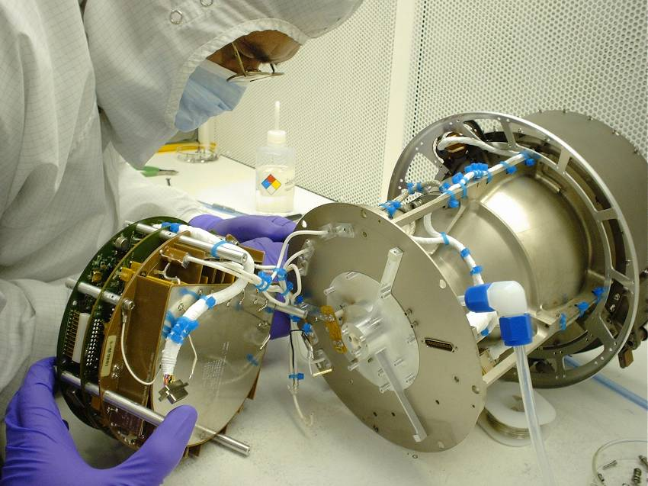
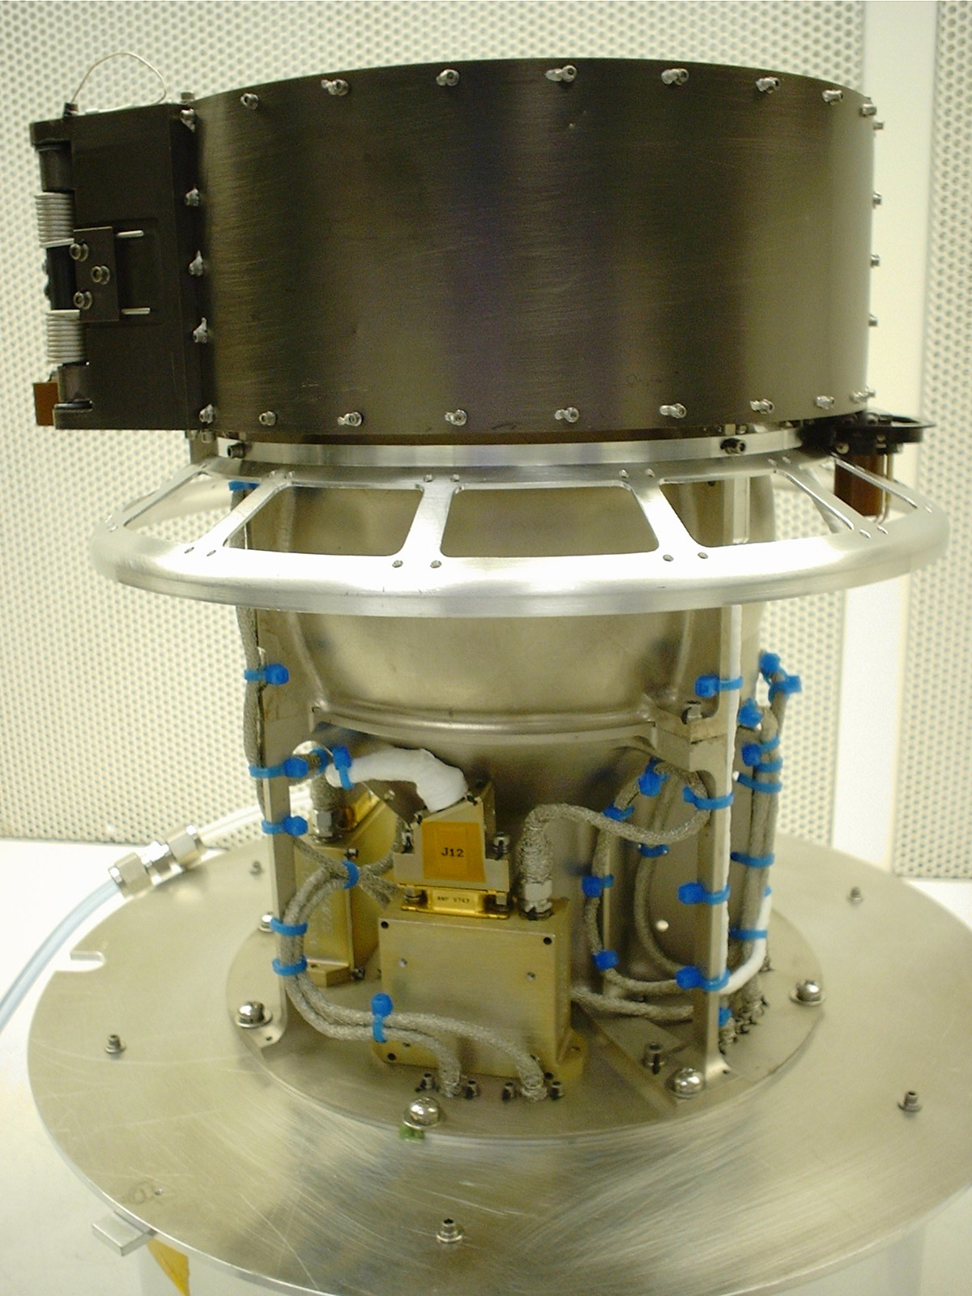
SWAP Resource Summary
Mass: 2.9 kg
Power: 2.2 Watts
Telemetry: 280 bits/s
Height: 35 cm (overall)
For Comparison:
Cat weighs 4 kg
Nightlight burns 7 Watts
Slow dial-up modem runs at 19,200 bits/s
Height about the same as David Robinson’s shoe
11 NOV SEP 2015 IEEE CTS CEDA Meeting
Scott Weidner, SwRI, IEEE Senior Member
24

Slide 25
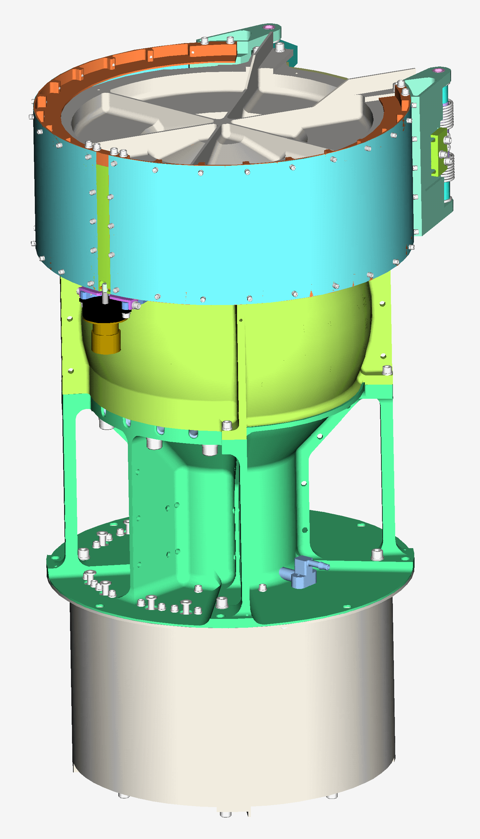
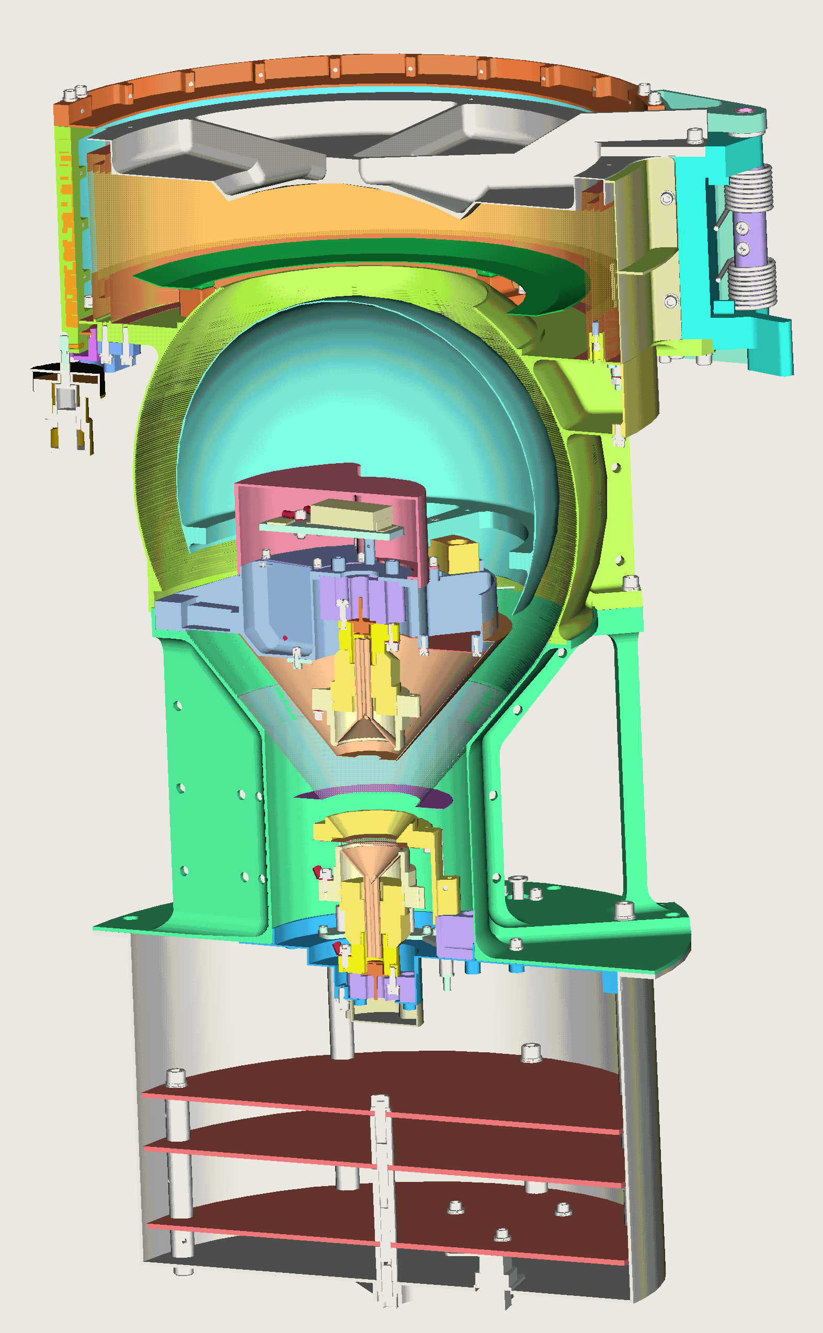
SWAP Detailed Views
Tophat
RPA
Aperture Door
Deflector
ESA
ESA Housing
Secondary CEM
Primary CEM
S/C Interface
Electronics Boards
Electronics Enclosure
11 NOV SEP 2015 IEEE CTS CEDA Meeting
Scott Weidner, SwRI, IEEE Senior Member
25

Slide 26
SWAP Optics
Retarding Potential
Analyzer (RPA)
[0 to +2000 Volts]
Deflector (DFL)
[0 to +4000 Volts]
Electro-Static
Analyzer (ESA)
[0 to -4000 Volts]
Remaining Structure
Is at GROUND
Foil and Focus Ring
Derived from full
Primary CEM Voltage
with ESA backup
Secondary CEM
[0 to +4500 Volts]
Primary CEM
[0 to -4500 Volts]
11 NOV SEP 2015 IEEE CTS CEDA Meeting
Scott Weidner, SwRI, IEEE Senior Member
26

Slide 27
SWAP Data
On-board microcontroller processes commands and controls the instrument
Science data is sent to redundant spacecraft computers over RS-422
Scientists will process data on the ground
  Find bow shock
  Estimate mass loss
  Explore plasma interactions
  Look for magnetic effects
11 NOV SEP 2015 IEEE CTS CEDA Meeting
Scott Weidner, SwRI, IEEE Senior Member
27

Slide 28
Processing and Downlink
All Science Instruments send their data to redundant spacecraft computers
64 Gbits of storage on the spacecraft (two copies)
Spacecraft computers compress the images
Science Data downlinked to Earth at 2000 bits/sec
Download of all the Science Data will continue into next year
  (and you thought your web connection was slow!)
11 NOV SEP 2015 IEEE CTS CEDA Meeting
Scott Weidner, SwRI, IEEE Senior Member
28

Slide 29

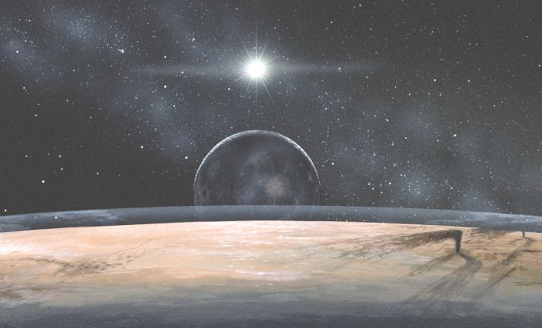
After the flyby …
Not this …
Not this …
?
The Real Thing!
11 NOV SEP 2015 IEEE CTS CEDA Meeting
Scott Weidner, SwRI, IEEE Senior Member
29

Slide 30
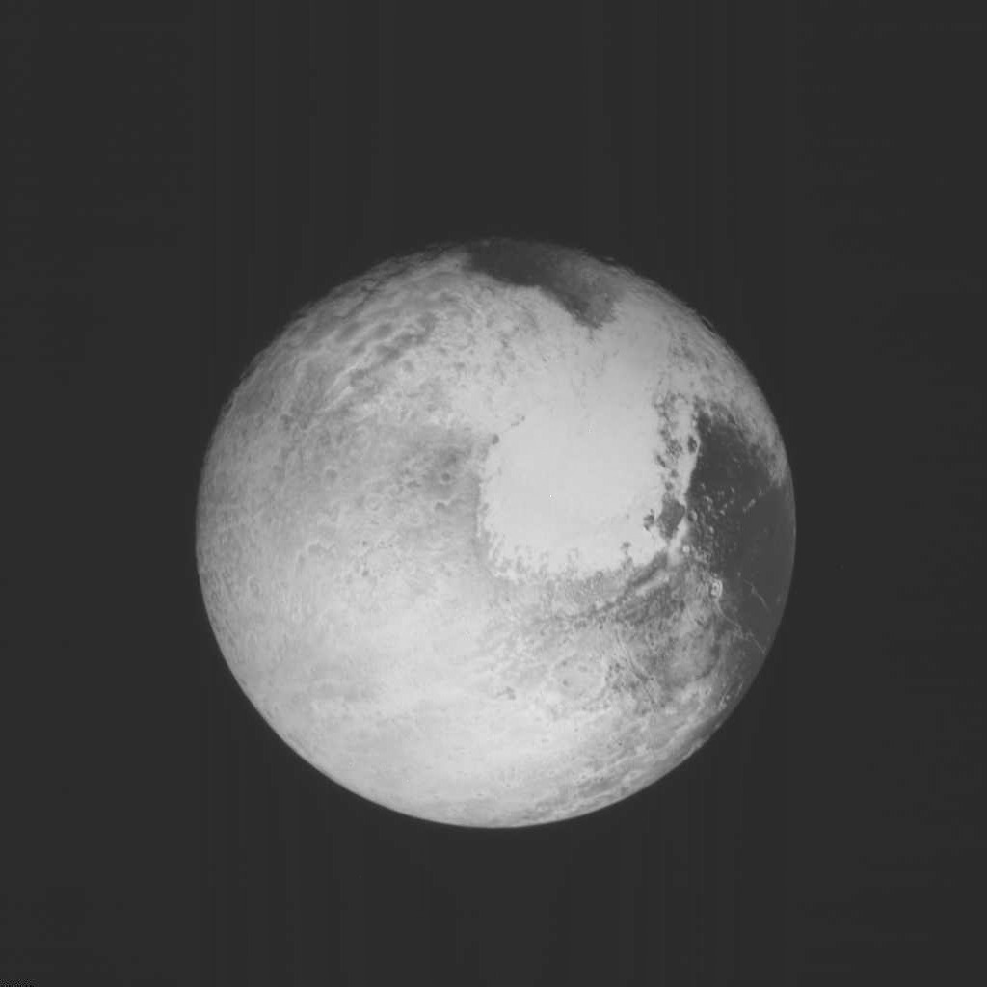
Pluto One Day Away …

Slide 31
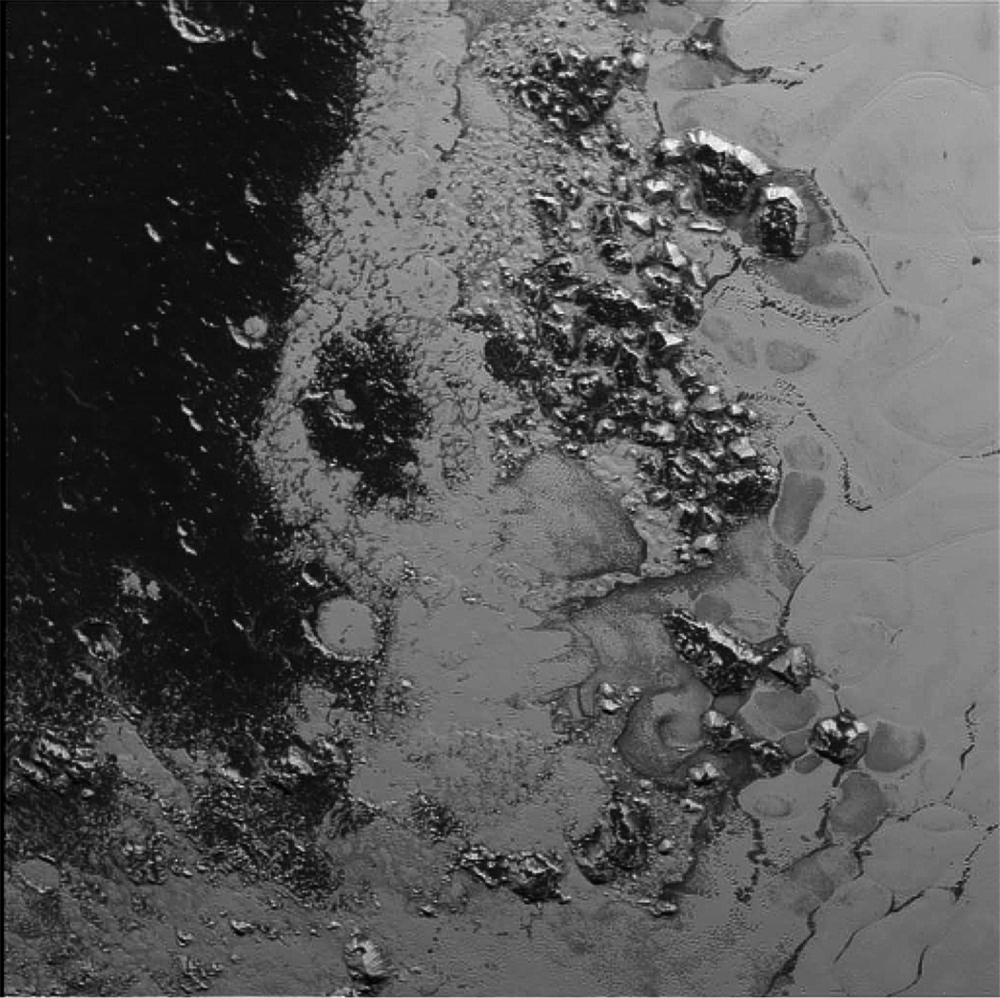
At Closest Approach

Slide 32
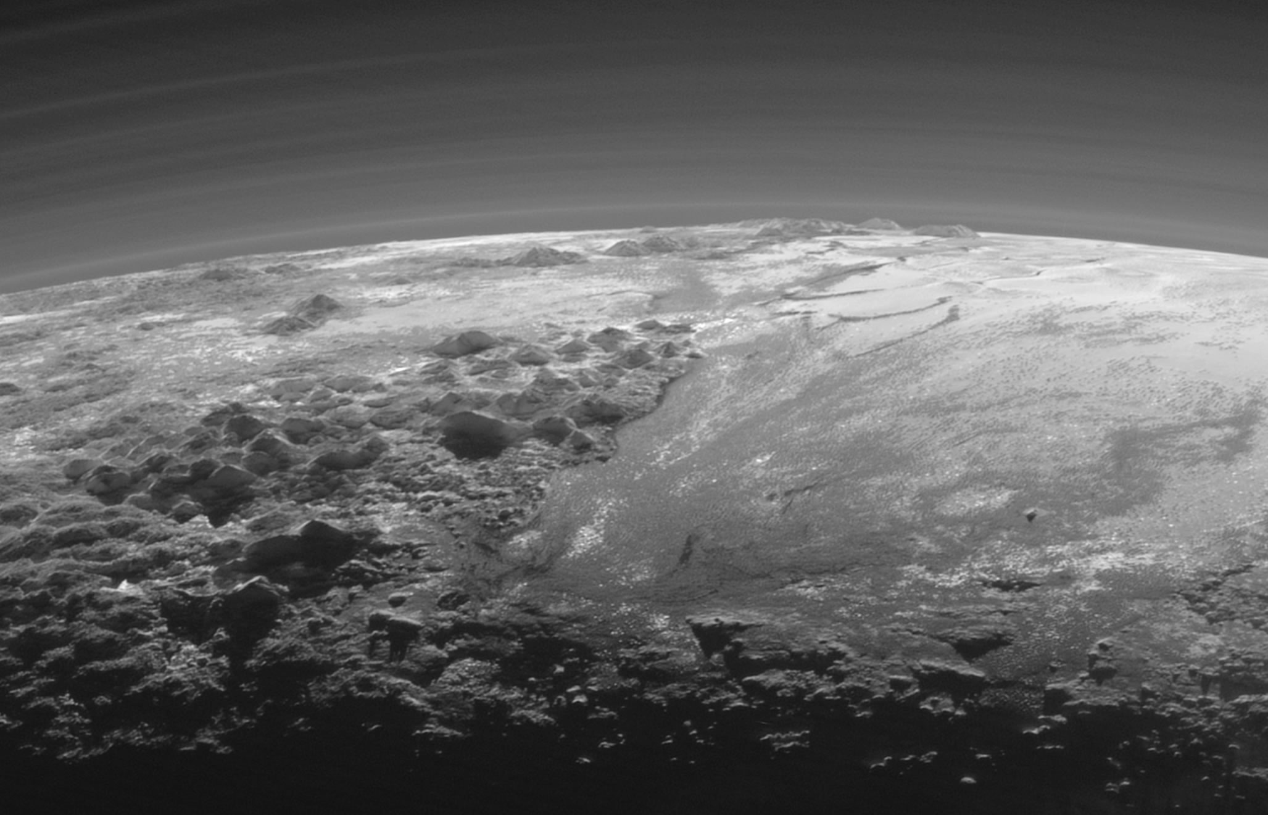
Glaciers and Mountains on Pluto
11 NOV SEP 2015 IEEE CTS CEDA Meeting
Scott Weidner, SwRI, IEEE Senior Member
32

Slide 33
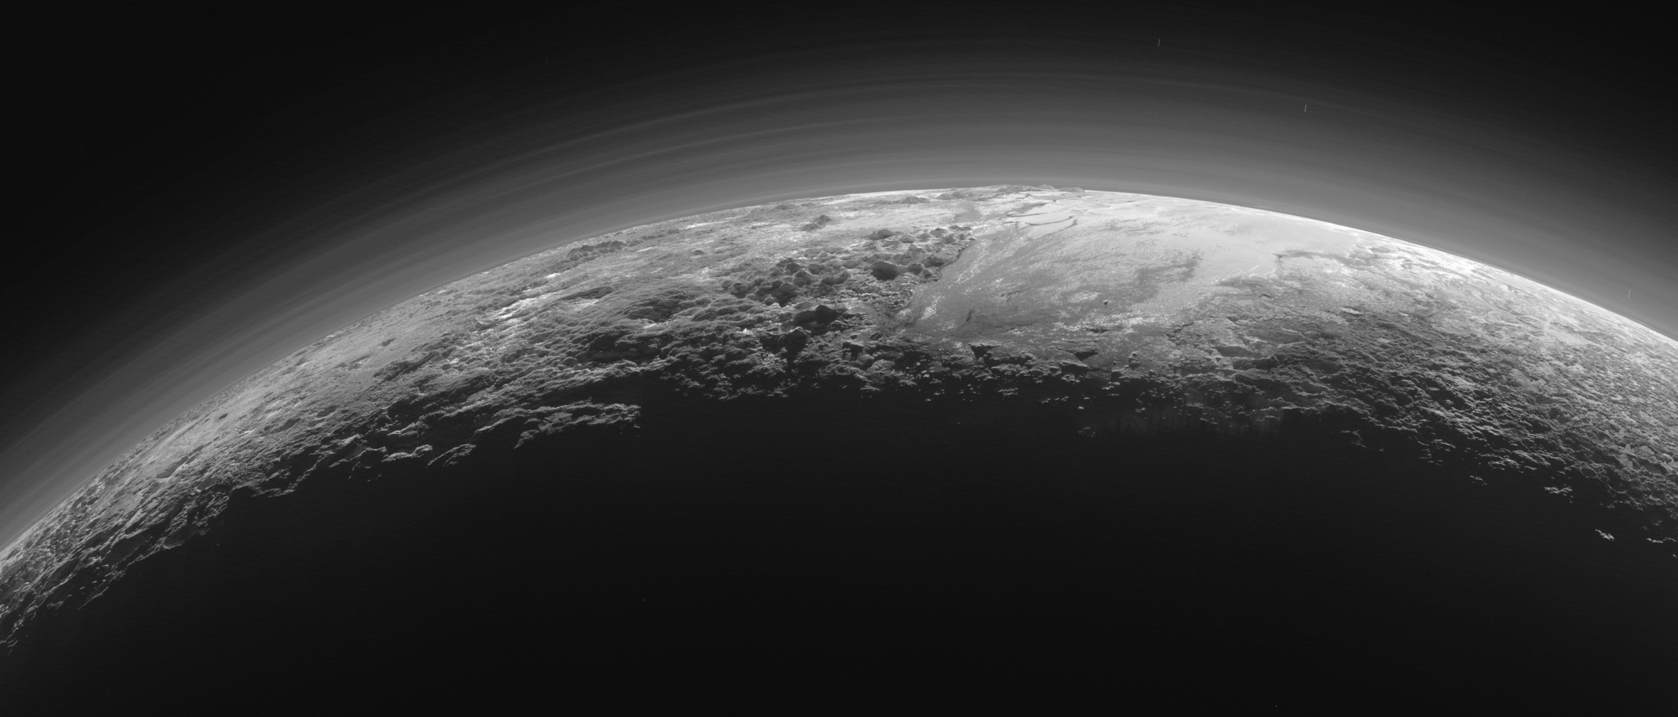
Frozen Plains and Foggy Hazes
11 NOV SEP 2015 IEEE CTS CEDA Meeting
Scott Weidner, SwRI, IEEE Senior Member
33

Slide 34
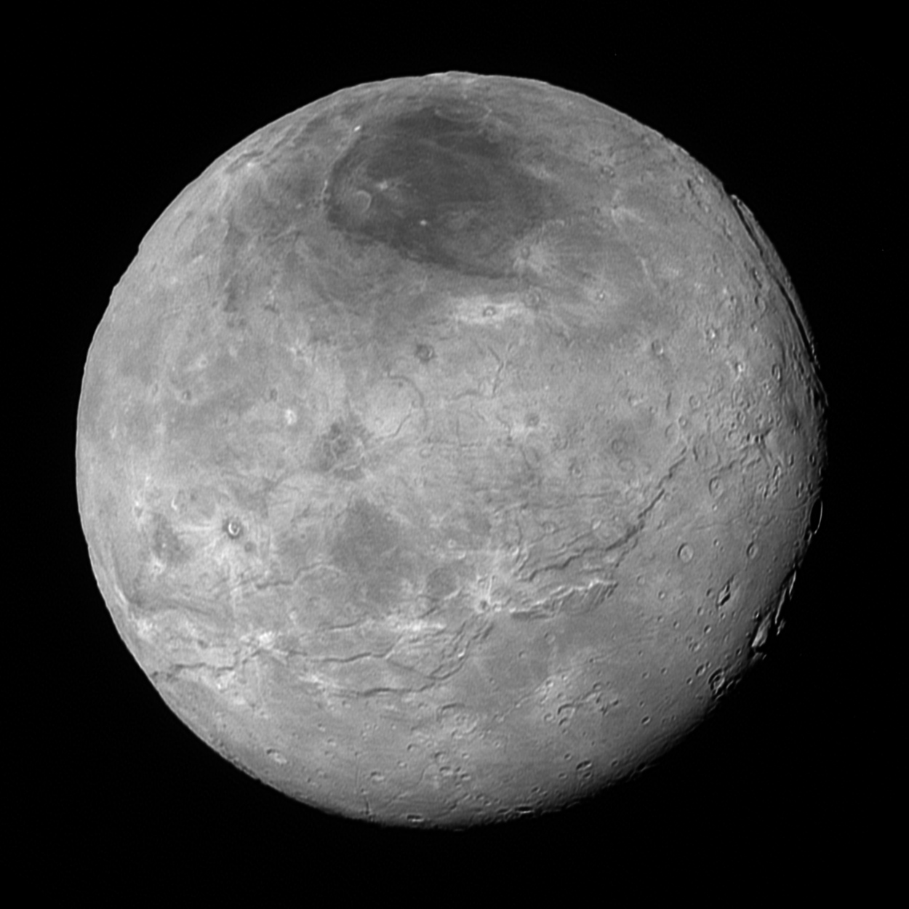
Pluto’s Moon Charon
11 NOV SEP 2015 IEEE CTS CEDA Meeting
Scott Weidner, SwRI, IEEE Senior Member
34

Slide 35
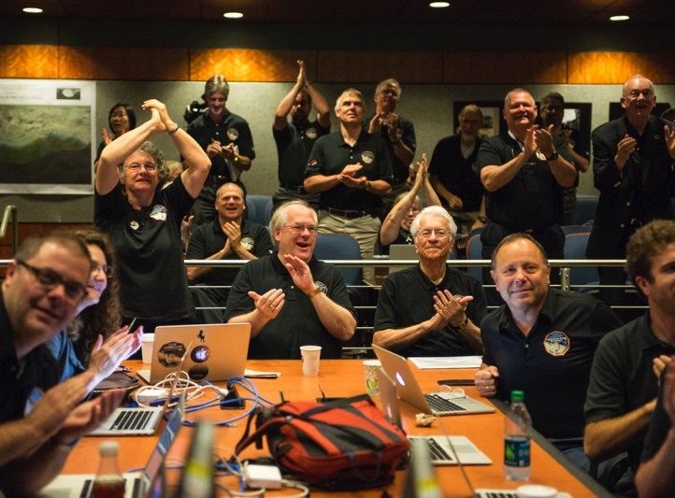
Real Data Makes Scientists Real Happy
11 NOV SEP 2015 IEEE CTS CEDA Meeting
Scott Weidner, SwRI, IEEE Senior Member
35

Slide 36
