Slide 2
OVERVIEW
The GRID’s both past and present
Transition to Direct Current (DC)
Why is DC the right choice today
The Hybrid GRID for small structures
Transition to ALGLO’s LaaS

Slide 3
The GRID’s

Slide 4
Past AC and DC grids
Edison and Tesla were behind which different grid standard of AC or DC
“Edison Vs Tesla”
Edison was DC (Direct Current)
Tesla was AC (Alternating Current)
AC was the biggest, but DC continued

Slide 5
Why did AC win
Not distance but control and conversion
Tesla had Westinghouse or visa versa

Slide 6
Tesla/Westinghouse
Tesla patents in 1887 for AC distribution and AC motor control, licensed 1888
First power plant in 1891 was AC
Worlds Fair 1993, turning point
After the Worlds Fair, 80% was AC

Slide 7
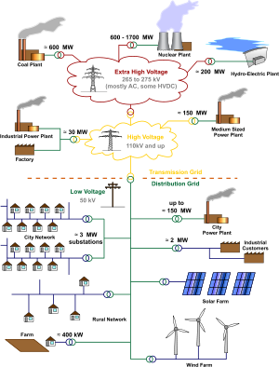
Todays GRID distribution

Slide 8
Power GRIDs TODAY
Are they AC only ?
HVDC becoming common
78 MAJOR systems throughout
the world today

Slide 9
Japans Power GRID
West side is 60hz
East side is 50hz
Only way to distribute power East to West was DC

Slide 10
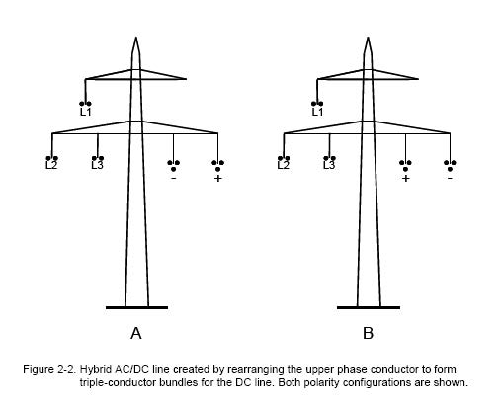
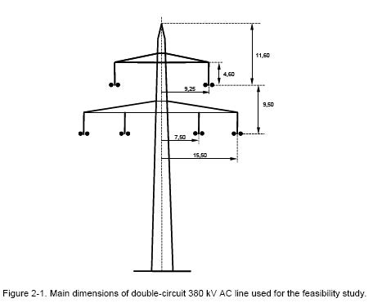
HVDC Power Conversion
AC Distribution
AC and DC Hybrid Distribution

Slide 11
HVDC Power GRIDs today
Twice the power of AC
Far less load losses
Extends the life of existing wire
Some are hybrid AC and DC GRIDs

Slide 12
HVDC Advantages
6.5% grid losses today, AC 4.2% vs DC 1.1%-0.5% voltage dependent,
Conductor skin depth 23%cu 10%al
Longest cost-effective distance

Slide 13
Transition to DC

Slide 14
Aspects of change
Micro Grids
Solar Farms and Solar Storage
Batteries are getting better
Other alternative sources

Slide 15
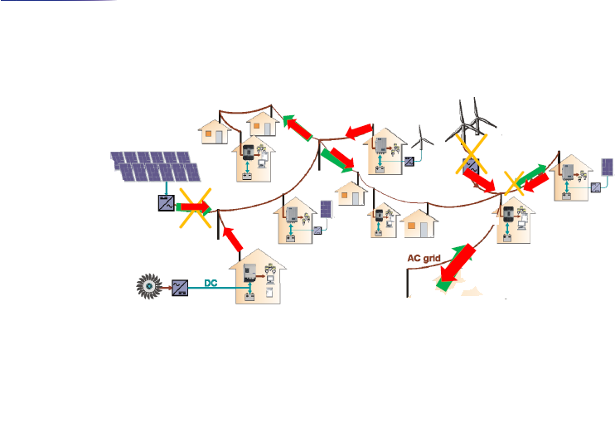
Micro GRID
Micro GRID, mixed GRID Distributed GRID, Mini GRID

Slide 16
Micro Grid
Neighborhood / community based
Hybrid Mixed Sources of power
Regulatory issues get in the way

Slide 17
Why DC today

Slide 18
We are living in a DC world
Our personal electronics
More efficient technology
Electric cars are now common
Major companies are adopting

Slide 19
Our personal electronics
Cell phones, tablets and laptops
TV and audio sound systems
USB toothbrush to piggy banks
? What IoT devices do you know

Slide 20
More efficient technology
Control is easy to integrate
Motors up to 70% more efficient
LED Lighting up to 90% efficient
Solar/Wind better than fossil fuel

Slide 21
Electric cars are common
Every manufacture is in the market
Not just Hybrid
Longer travel distances
Not just for environmentalists

Slide 22
DC Electric Energy Storage
Not just Hybrid, but stand alone
For demand charge reduction
For DC Local GRID

Slide 23
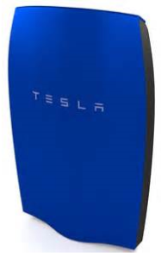
Tesla and Mercedes Benz
Tesla and then Mercedes Benz announce

Slide 24
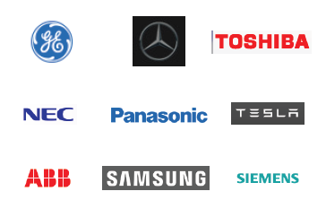
Major companies adopting
And then there is

Slide 25
Hybrid Local GRID

Slide 26
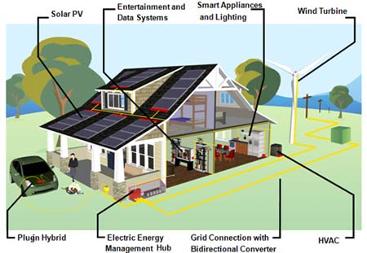
What is a hybrid building

Slide 27
What is a hybrid building
Two power distributions systems
Building codes support both today
Actually have been around since the beginning of the AC – DC wars

Slide 28
LaaS Lighting as a System

Slide 30
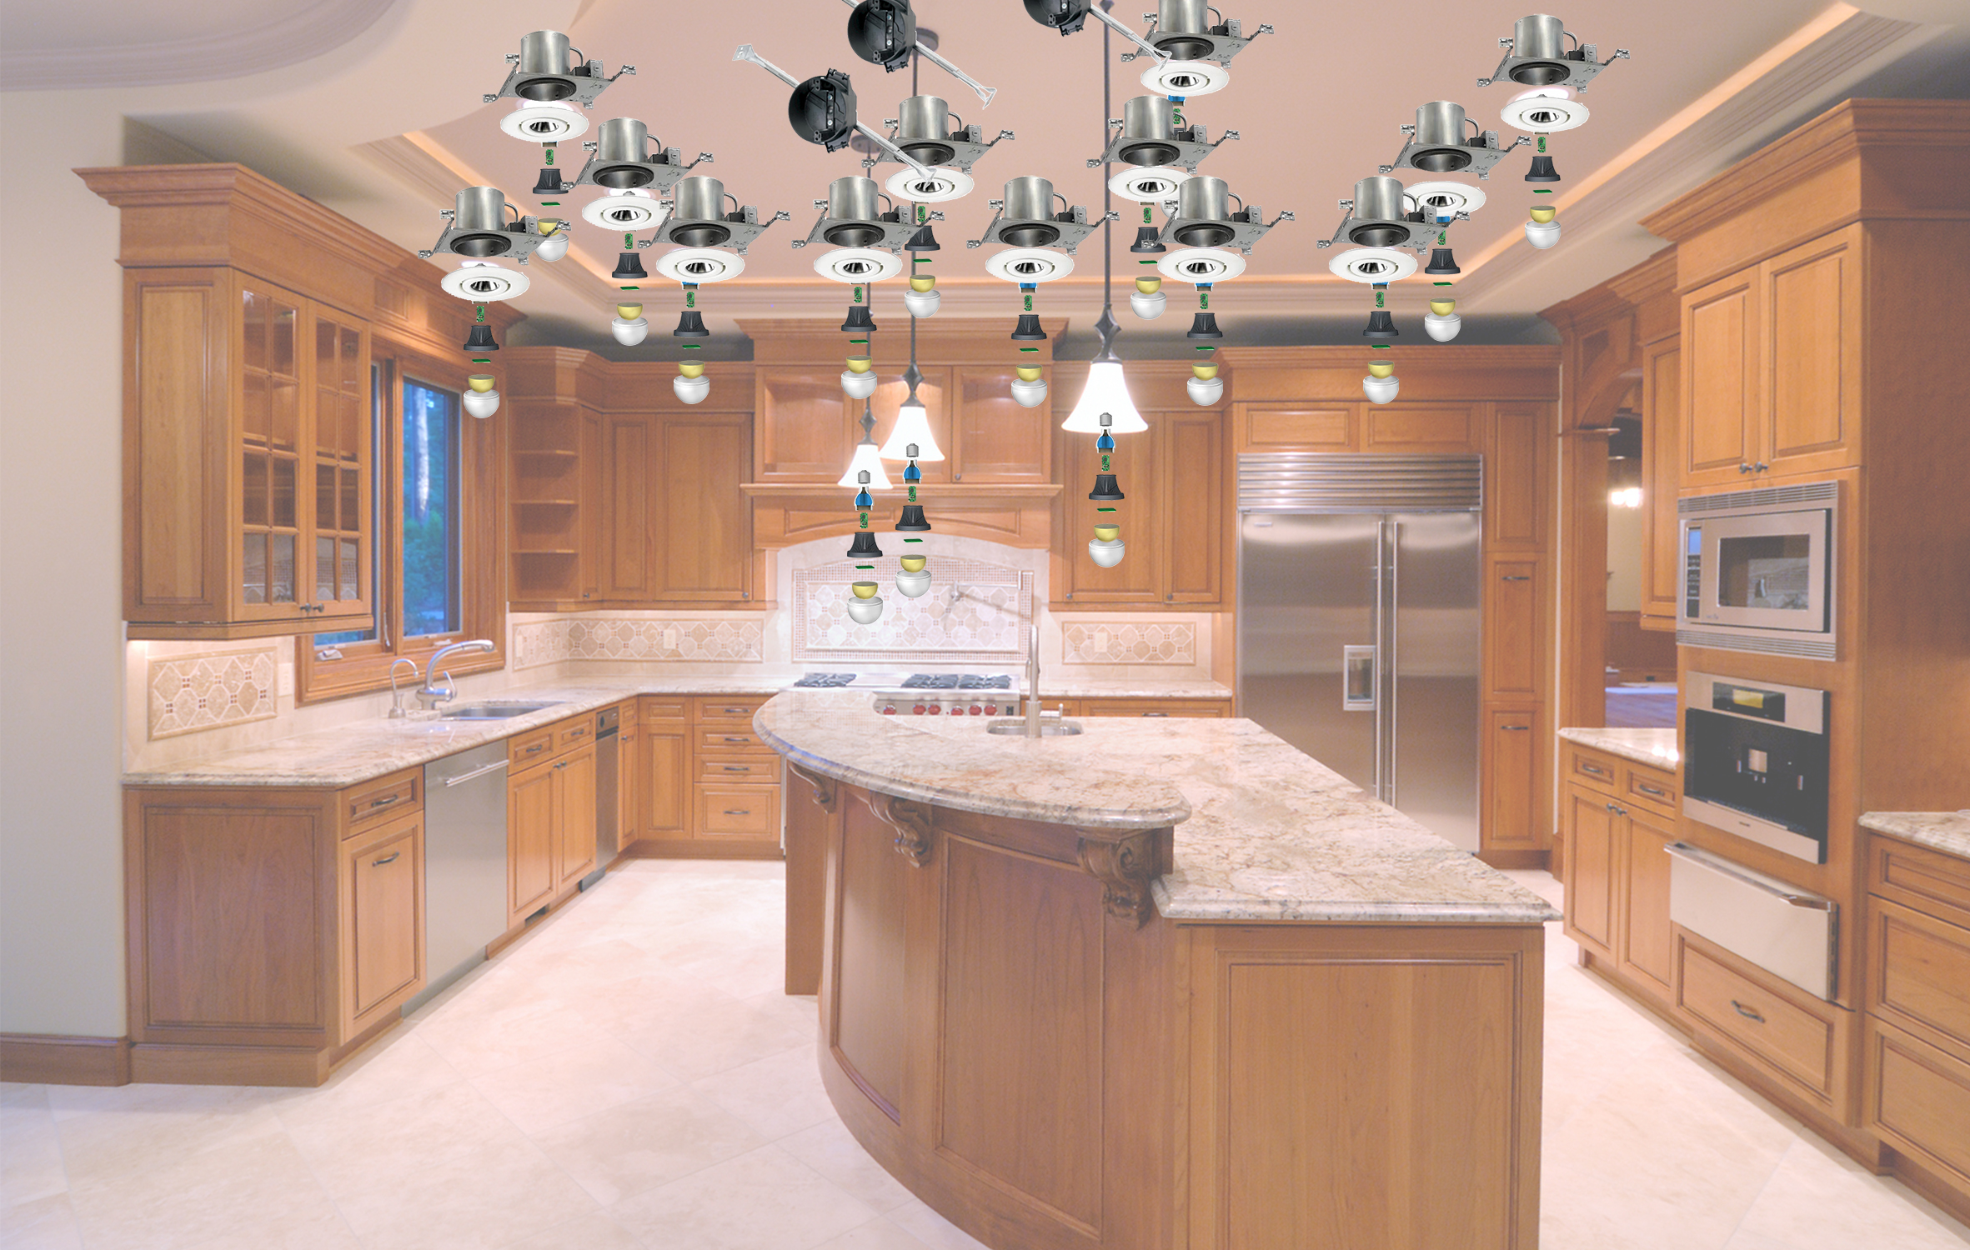
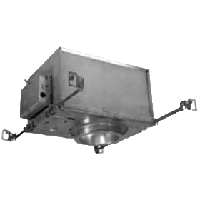
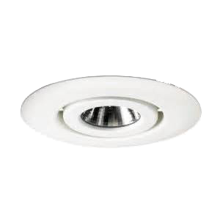
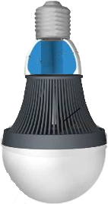
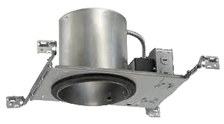

Slide 31
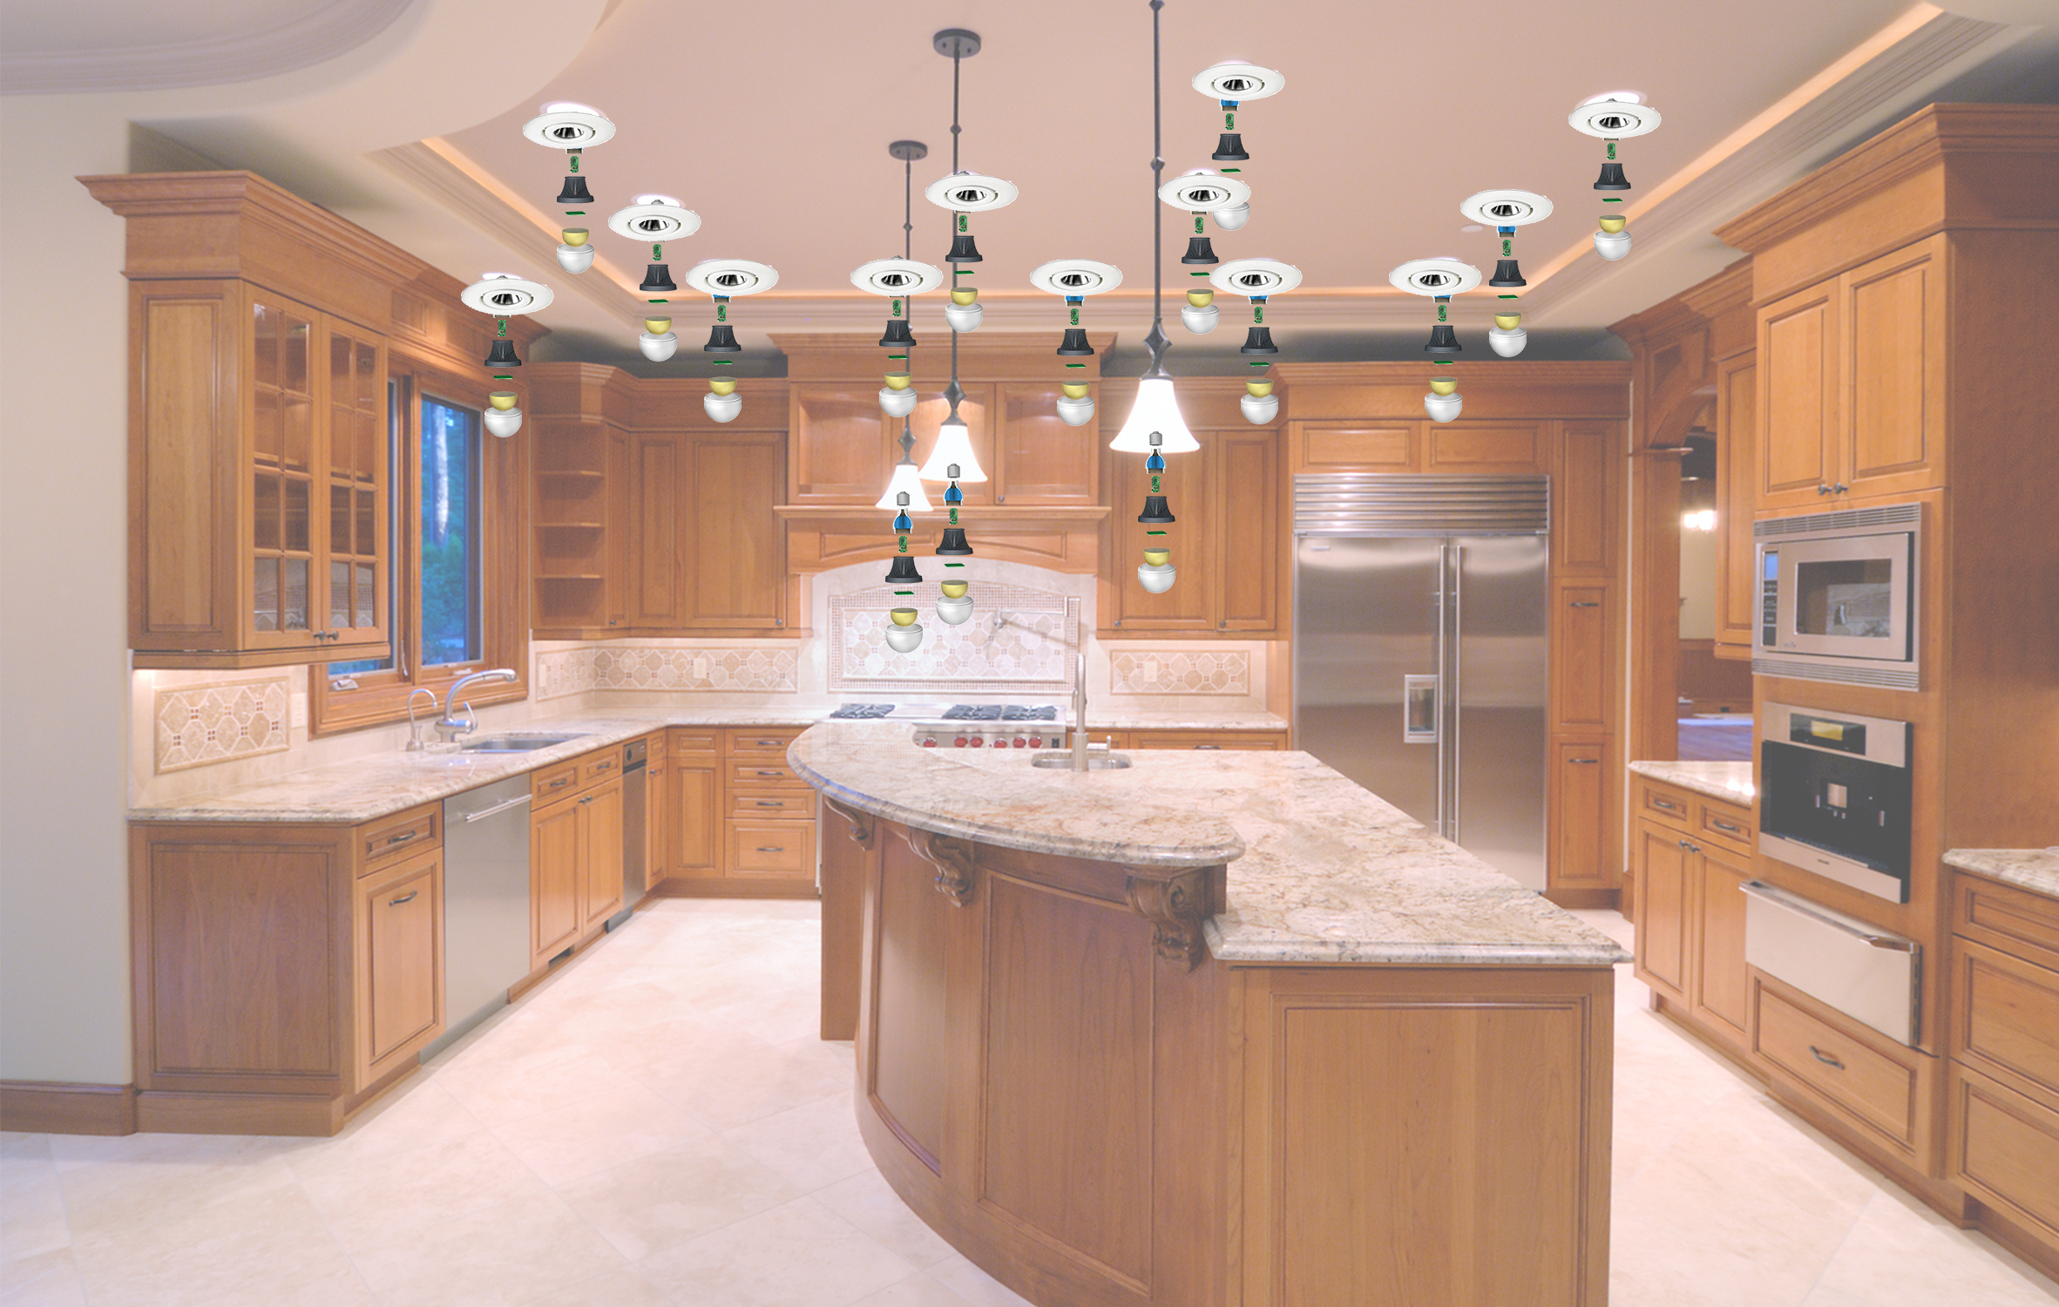

Slide 32
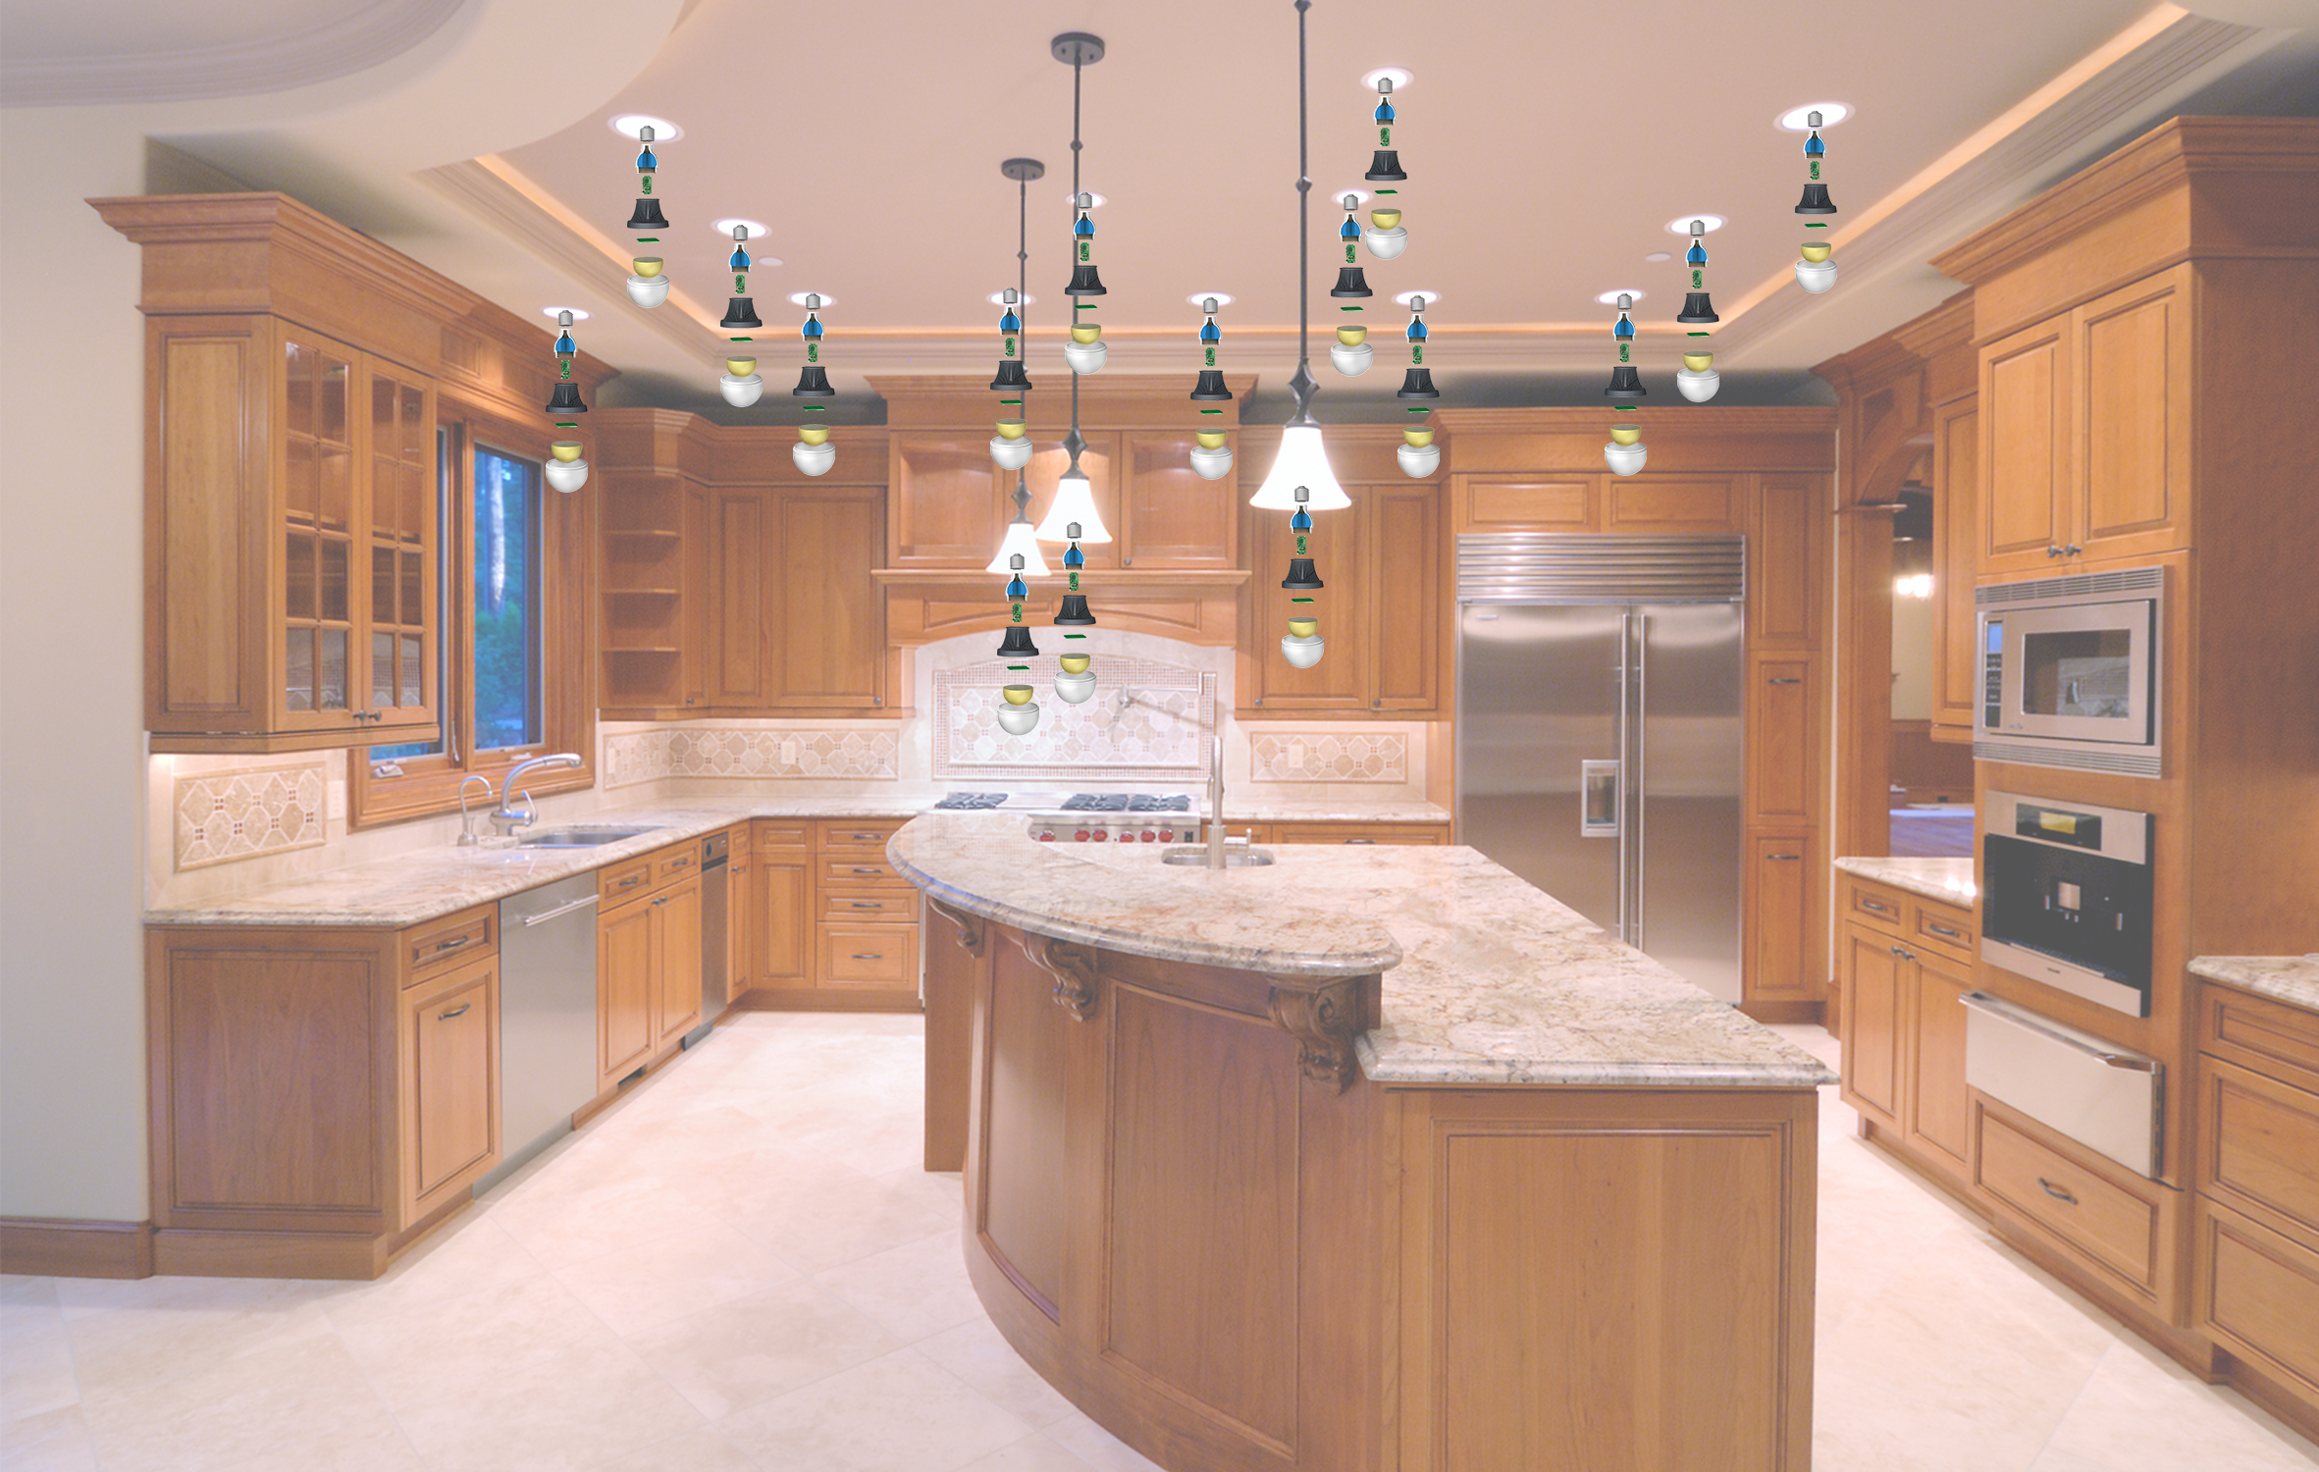
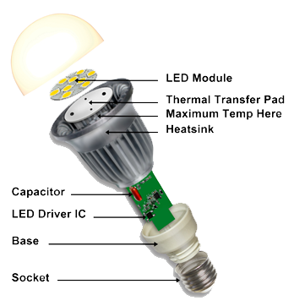
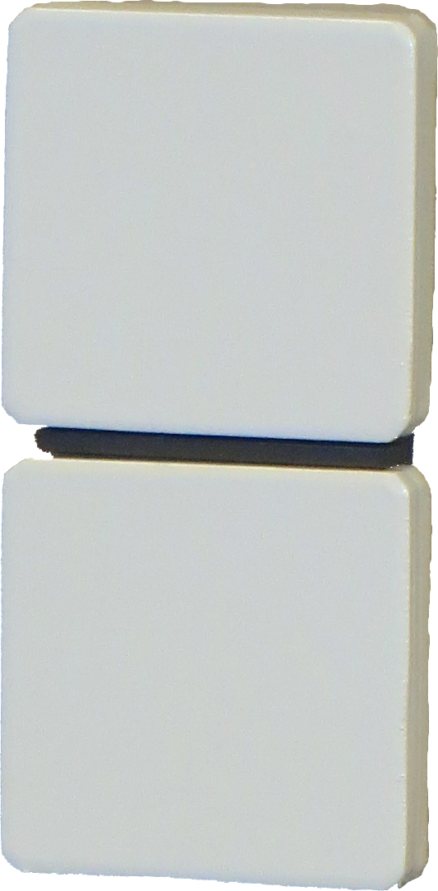
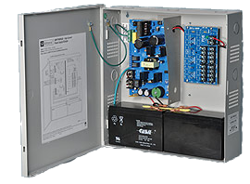

Slide 33
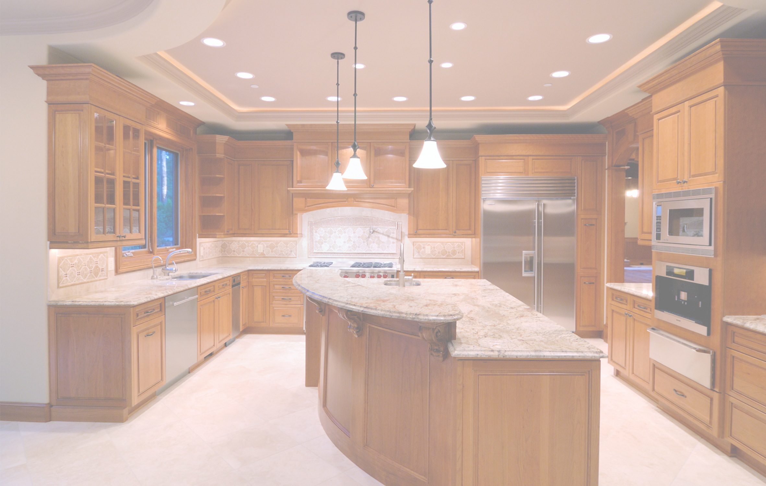

Slide 34
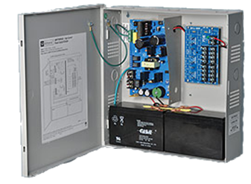

Slide 35
LaaS
Lighting as a System

Slide 36
LaaS SPECIFICATIONS
Low Power – 12 and 24 volt
Direct Current – DC
Class II Wiring
Fewer Materials
Drivers
A/C → D/C Rectifiers
Electrolytic Capacitors
Smart Components
Heat Distribution Materials

Slide 37
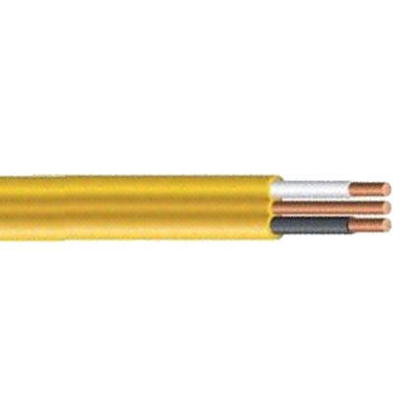
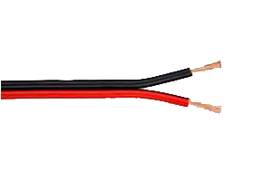
Class I and Class II Voltages
Class I High Voltage
120/240v - 120/208 - 277/480 60hz
Generally #14 or # 12 wire
100 watt @ 24v
60 watt @ 12v
#18 wire, some # 22 to 26
Class II Low Voltage

Slide 38
LOW VOLTAGE VS. ROMEX
Advantages of Class II Low Voltage
Less than ¼ of the size and weight
Less than ½ the cost to purchase
Less than ½ the labor cost to install
No requirement for Permits, Fees or Inspections

Slide 39
Class I vs Class II Protection
Class I High Voltage
Zero crossing assists circuit disconnect
Good short circuit protection
Poor short circuit protection
To fuse or PTC (positive temperature coefficient)
Class II Low Voltage

Slide 40
PRODUCT RELEASES
ALGLO’s Line of SENSATION Switches
On/Off, 3-Level, Dimmers, Timer, and 3-Way
Expansion Controllers
Remote Controllers

Slide 41
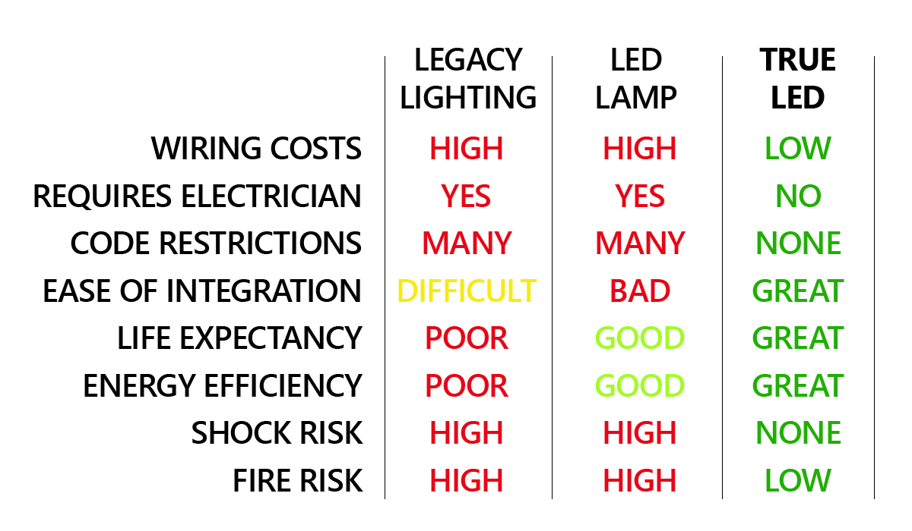
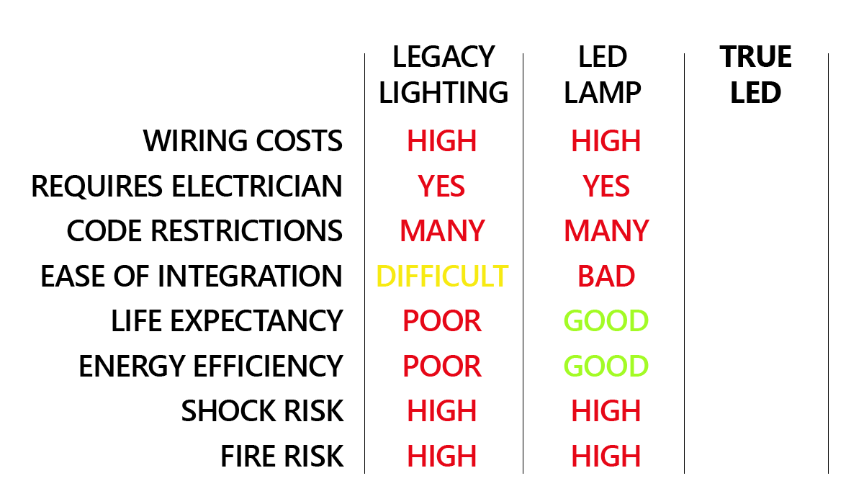
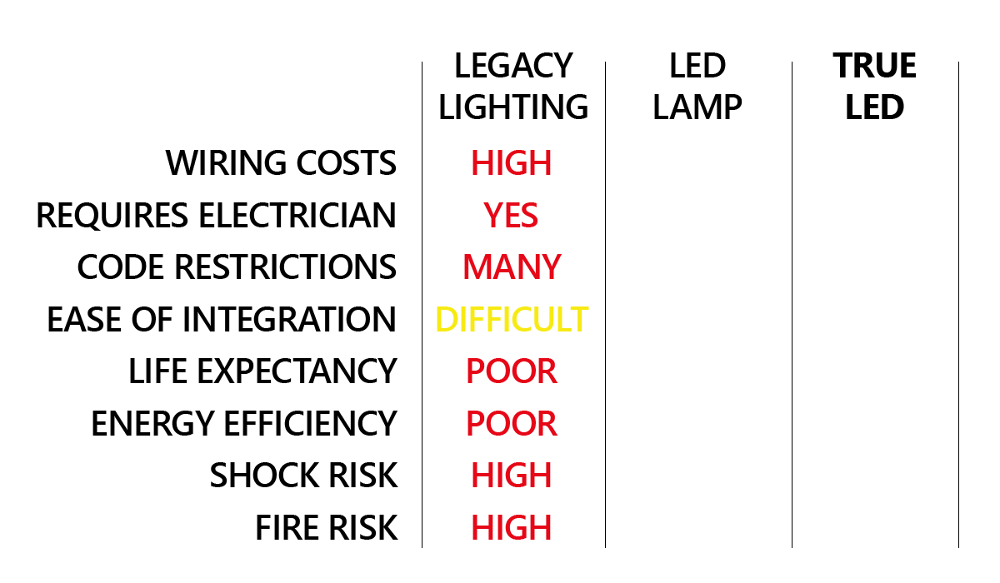
ALGLO
LaaS

Slide 42
THE SMART “IoT” LED BULB
Every LED light bulb connected . . .
Maybe not so smart !

Slide 43
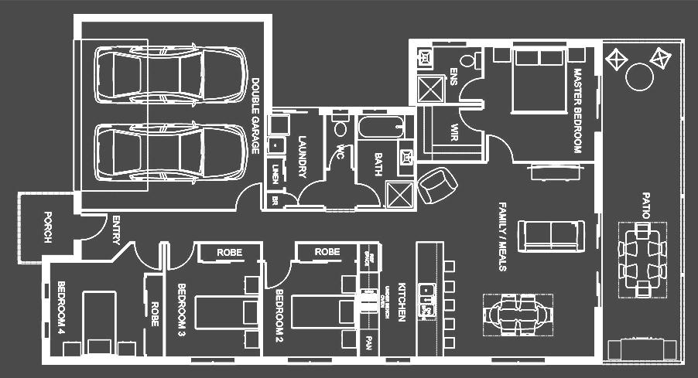
Two Points of Control
=
System Failure
Notes:
Presenter uses phone to turn on and off lights around the floor plan.
Switch comes up and is turned off.
Lighting no longer controlled by phone…

Slide 44
LaaS’s CENTRAL CORE
It’s time to make the switch . . .
to SENSATION switch !

Slide 45
THANK YOU
AUSTIN iEEE

Slide 46
PRODUCT

Slide 47
SENSATION SWITCH
Blue Switch
Simple Switch
Dimmer Switch

Slide 48
PRODUCT ROADMAP

Slide 49
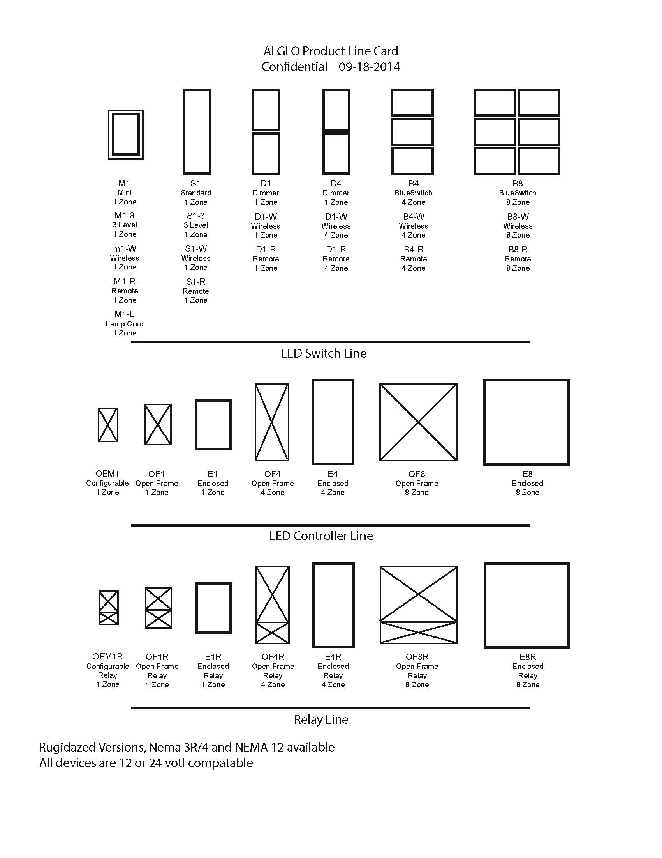
PRODUCT ROADMAP
12 Volt
Residential
24 Volt
Commercial

Slide 50
MARKET

Slide 51
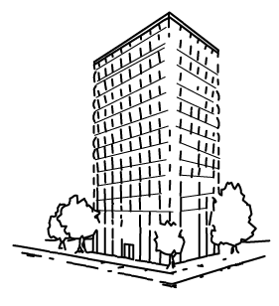
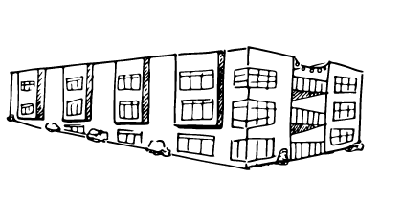
INITIAL MARKET
New Build Tract Houses
New Build Apartments to Condos
New Build Custom Houses

Slide 52
COST COMPARISON
2 BDR APT
Legacy $1,850
ALGLO $1,432
Per Unit $418
23% Savings
3 BDR House
Legacy $3,246
ALGLO $2,490
Per Home $756
23% Savings
3 BDR Upscale
Legacy $6,257
ALGLO $4,618
Per Home $1,639
26% Savings
Labor Time/Cost
Expensive Copper
Junction Boxes
Fixture Costs

Slide 53
TARGET AUDIENCE
Architects
Interior Designers
Builders & Developers

Slide 54
DISTRIBUTION MODEL
Direct Sales to
Top 100 Developers
Electrical Distributor
Systems Distributor
Online
B2B Portal

Slide 55
OPPORTUNITY

Slide 56
INDUSTRY EXPERTS
“Lighting Controls Market Will Explode to $5B by 2020”
-GreenTech Media
“Electrical Distributor Lighting Sector Sales Are $28.8 Billion Annually”
-NAED
Notes:
“DOE Forecast: LEDs 74% of Lighting Sold by 2030”

Slide 57
INITIAL POTENTIAL
HOUSES AND APARTMENT BUILDINGS - 2013
Type | Starts | Completed
Houses* | 618,000 | 569,000
Tract Homes - Top 100 Builders** (built for sale) | 167,660 | 167,660
Tract Homes - Remainder (built for sale) | 289,340 | 246,340
Custom Homes (contractor- or owner-built) | 136,000 | 123,000
Apartment Buildings, etc. | 307,000 | 195,000
Rental Property | 285,000 | 184,000
Individual Owners | 22,000 | 11,000
TOTAL | 925,000 | 764,000
100% U.S. market Share in 2015 would generate around $424,770,000 of gross revenue.
(doesn’t include smart switch)
Incremental Market Estimates:
Distressed Property Renovation - $9.8 Billion
Professional Home Remodeling - $169 Billion
Retirement & Senior Living - $???
* includes single-family units built for rent Source: Full Census.gov Report
** estimated from 2012 revenue report
*** market estimate sources available on request
Notes:
2011 Harvard Joint Center for Housing Studies – home improvement spending: distressed properties 2011
2011 Harvard Joint Center for Housing Studies - http://www.huffingtonpost.com/jiyan-wei/so-how-big-is-the-remodeling_b_5482371.html
34% of remodeling is motivated by increasing energy efficiency
18% of remodeling is motivated by incorporating new technology
77 million baby boomers to retire over the next 20 years

Slide 58
FUTURE OPPORTUNITY
Assisted Living Facilities
Office Buildings
Commercial Restaurants & Stores
Government Buildings
Military Installations
Healthcare Facilities
Notes:
Keep in mind, the board designs we will use across all of these remains the same

Slide 59
COMPETITION/BARRIERS
Resistance to Change
Need For More DC Light Fixtures
Interference from Traditional Control Market

Slide 60
CONSUMER
Even the end user
wants ALGLO !

Slide 61
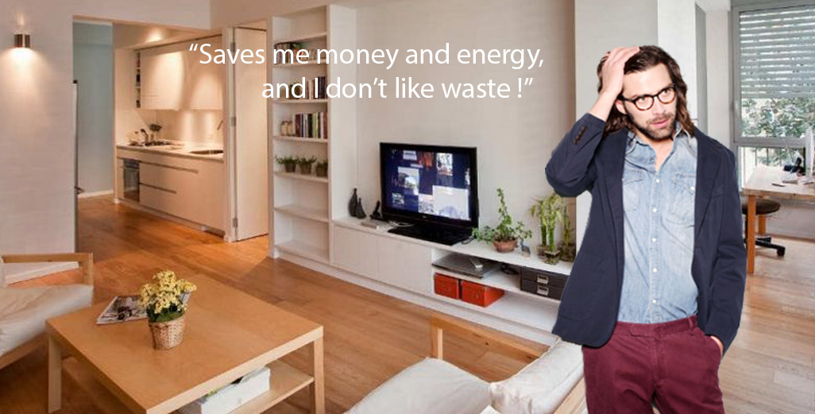

Slide 62
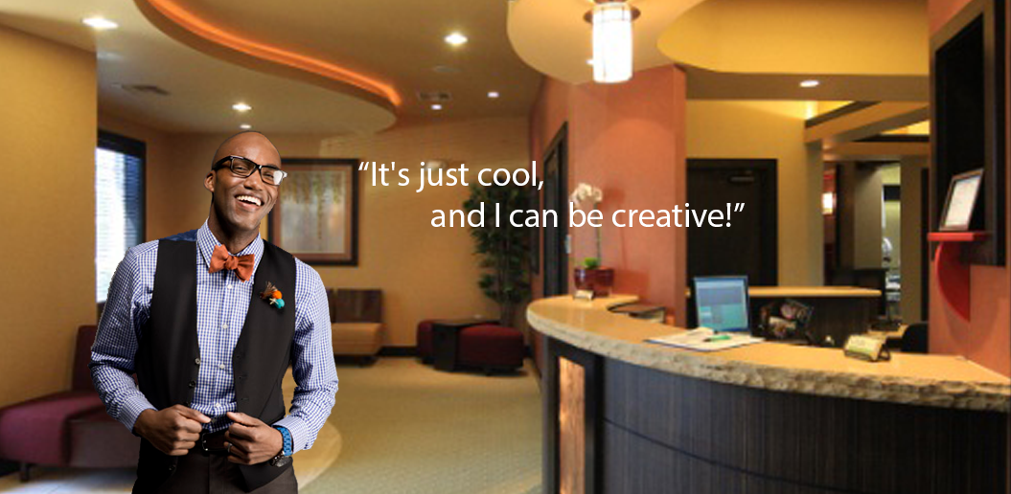

Slide 64
PARTNER OPPORTUNITIES
Big Builder Commitments
Growth Monetization Investments
Other Venture Partnerships
Staffing Expansion
Future Relationship Ideas
Notes:
Being at the forefront of change is a once in a lifetime opportunity. ALGLO is poised to transform an industry; to reduce material and labor costs and promote ongoing savings to the end consumer.

Slide 65
It’s time to make the switch . . .
to SENSATION switch !

Slide 66
THANK YOU
KEEP AUSTIN FUNDED!

Slide 67
APPENDIX

Slide 68
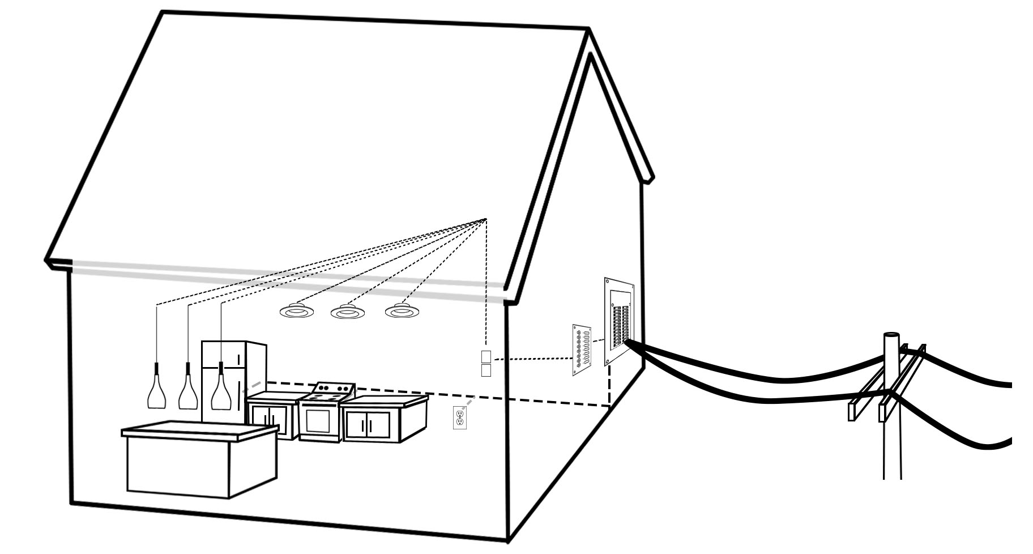
Lighting as a System
LaaS

Slide 69
RESIDENT MARKETING
Energy Bill
Insurance
Energy Rebates
Lightbulbs

Slide 70
ADVERTISING

Slide 71
85%
Notes:
85% Launch Market
Not going after the government subsidized market on day one and top 1% will want us after we release the smart switch

Slide 72
ALL PRODUCTS
No Legacy Issues
Plug Compatible
Internal/External API
Title 24 Compliant (California)
Multiple Products From a Single Board
Low BOM Costs
Less Inventory Requirements
Maintains Consistency

Slide 73
$51 BILLION MARKET
 | # of Customers | Monthly Bill | Lighting Cost
Residential | 126,832,343 | $107.28 | $22,859,043,912
Commercial | 17,729,029 | $629.37 | $28,118,459,834
Industrial | 732,385 | $7,482.55 | $854,896,752
Source: U.S. Energy Information Administration 2013

Slide 74
SHARING W/ INVESTORS
Monthly Marketing Recaps
Monthly Revenue Report
Etc.

Slide 75
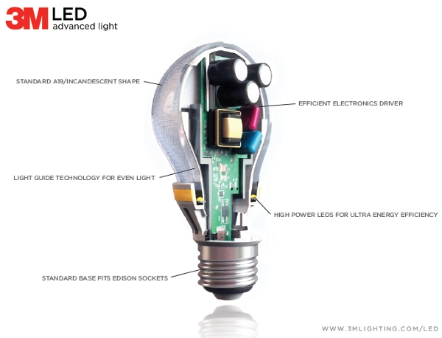

Slide 76
