Slide 1
Add a Computer to your Design through SiP Technology
Neeraj Dantu
Systems & Apps Engineer
Octavo Systems

Slide 2
Octavo Systems: Who We Are
Mission
To Simplify the Design and Manufacturing of Electronic Systems by Delivering Innovative,
High Quality System-In-Package (SiP) Solutions
System Integration Company
  Focused on System-In-Package (SiP) Integration
  Founded by former Texas Instruments Senior Leaders
  Offices in Houston, Dallas and Austin
Solid Foundation, Bright Future
  Original OSD3358 introduced in 2016
    Over 150,000 units shipped to date
    RoHS and REACH compliant
  300+ unique customers worldwide
  Available in both commercial and industrial temperature ranges

Slide 3
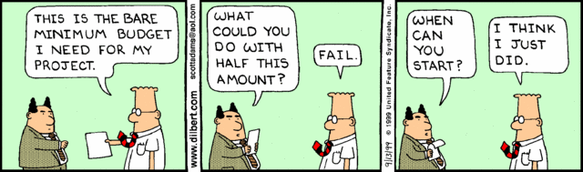
Ever Need to Finish an Embedded System
In Half the Time?
In Half the Space?
With Half the Budget?

Slide 4
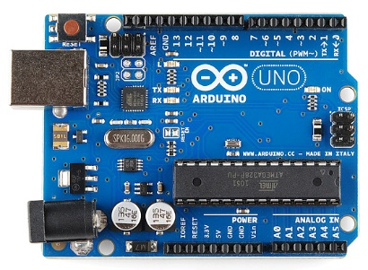
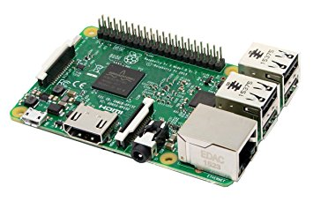
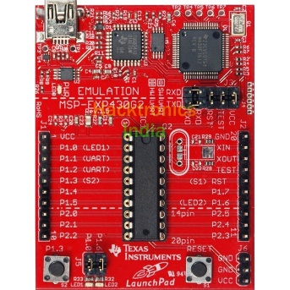
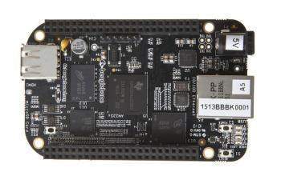
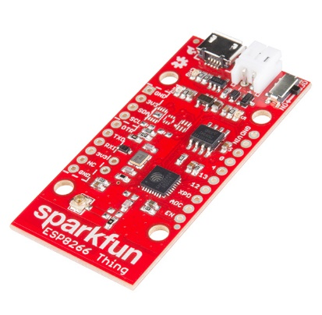
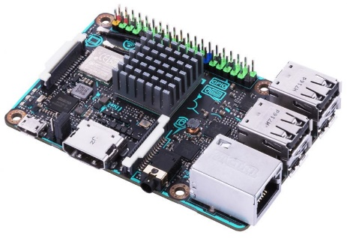
State of Embedded Systems - 2018
Microcontroller
Microprocessor
Arduino Uno
Raspberry Pi
MSP430 Launchpad
Beaglebone Black
ESP8266 Thing
ASUS Tinker Board
Notes:
- We have a crowded Embedded systems market
Broadly, the market can be divided into 2 groups, Microcontrollers and Microprocessors
Microcontrollers keep getting more powerful and feature rich and are mainly used for sensing, actuating and data streams
Microprocessors are adding custom cores and higher data processing throughputs

Slide 5
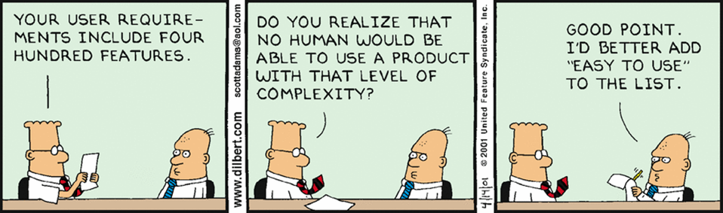
Embedded Applications
Sensing
Actuation
Signal conditioning
Low speed Data stream/IoT sensing
High speed communication/IoT gateways
Digital security
High resolution display/Graphics
Machine learning
Virtual/Augmented reality
Finally Smart everything
Microcontrollers
Lower power
Higher Performance
Microprocessors
Notes:
As we go down the list for more power hungry feature rich applications, we move into Microprocessor territory
Microcontrollers are suited for simple control systems compared to complex Operating System based microprocessor systems
There is some intersection between the 2 application groups, but they are definitely differentiated
There is a clear movement towards applications down the list

Slide 6
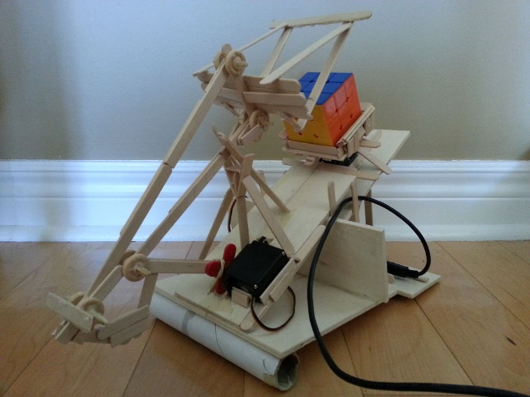
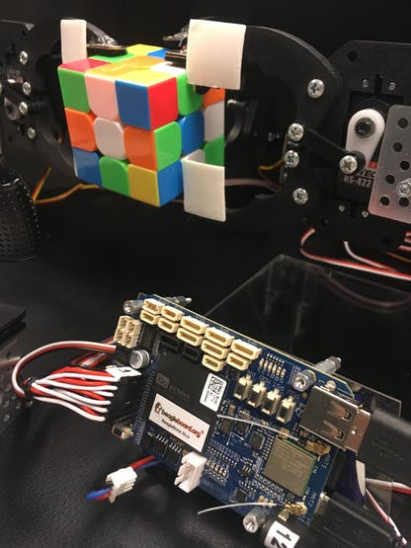
Differentiation between Microcontrollers and Microprocessors
Beaglebone Blue
Rubik’s cube solver
Arduino Rubik’s cube solver
(Instructables)

Slide 7
Why move to a Microprocessor
Ease of use
  Operating System manages all processes – abstraction of interfaces
  Programming language support – program in python, JS
  Peripherals
  Driver support for Linux
Processing power
  Big datasets/Displays needs more RAM
  Need to run fast (GHz vs 10- 100s of MHz)
Value add
  Security
  System size flexibility
  Add “smarts” to device
Notes:
In one line, if you find yourself crossing over the red line in the previous slide, you need a microprocessor for your application
Having an operating system is valuable when you have multiple processes
Using Linux opens the gate to using a wide variety of languages to code
Microprocessors come with hardware and software security features
Interfacing new sensors, communication PHYs, modules is made easy with driver support
You can create Linux images that are a few Megabytes to several Gigabytes in size. Complete system customization and control
Adding features means bigger applications. Bigger applications need more than a few Megabytes of RAM
Arduino UNO runs at 16MHz vs Beaglebone/Raspberry Pi running at 1GHz
Feature rich peripherals allow microprocessors to have interfaces for Highspeed USB, Camera, Displays, WiFi modules etc
All these features allow for putting the smart in smart devices

Slide 8
Microcontroller based Embedded System
Power
input
µController
WiFi / BLE
Sensors
CLK
User I/O
JTAG
Provisioning
Motor / Actuator

Slide 9




A Microprocessor based Embedded System
Microprocessor Subsystem
WiFi / BLE
AC
(SYS)
LDO
OUT
ADJ/BYP
(3.3V)
AC
IN
EN
SYS
GND
Power
Input
USB
USB
Bat
Sensors
L1
(1.5v)
VDDS_DDR
DDR_D8 – DDR_D15
8
DQU0 – DQU7
INT_LDO
VDCDC1
DDR_DQM1
DDR_DQS1
DDR_DQSn1
DMU
DQSU
DQSU#
BYPASS
(1.1v)
VIN_DCDC1
L2
VDD_MPU
VIN_DCDC2
VDCDC2
DDR_D0 – DDR_D7
8
DQL0 – DQL7
L3
(1.1v)
VDD_CORE
User I/O
VIN_DCDC3
VDCDC3
1GHz ARM
Cortex®-A8
Processor
DDR_DQM0
DDR_DQS0
DDR_DQSn0
DDR_CLK
DDR_CLKn
DDR_ODT
DDR_CSn0
DDR_BA0
DDR_BA1
DDR_BA2
DML
DQSL
DQSL#
CK
CK#
ODT
CS#
BA0
BA1
BA2
VIN_LDO
VLDO1
(1.8v)
VDDS
VDDS_RTC
CLK
(3.3v)
VDDA_ADC
VDDS_OSC
VDDS_PLL_DDR
VDDS_PLL_MPU
VDDS_PLL_CORE_LCD
VDDS_SRAM_MPU_BB
VDDS_SRAM_CORE_BG
VDDA1P8V_USB0
AGND
VLDO2
PGND
LS1_IN
Motor / Actuator
LS2_IN
(1.8v)
VIO
LS1_OUT
Power
Management
DDR_A0 – DDR_A15
15
A0 – A15
DDR_CASn
DDR_RASn
DDR_Wen
DDR_CKE
DDR_RESETn
CAS#
RAS#
WE#
CKE
RESET#
ZQ
Flash
Provisioning
LS2_OUT
(3.3v)
VDDSHVx (3.3V)
VDDA3P3V_USB0
USB / Ethernet
SCL
SDA
PWR_EN
PGOOD
LDO_PGOOD
nINT
nWAKEUP
I2C0_SCL
I2C0_SDA
PMIC_PWR_EN
PWRONRSTN
RTC_PWRONRSTN
EXTINTn
EXT_WAKEUP
DDR_VREF
DDR_VREFDQ
VREFCA
NV Storage (eMMC / Flash)
DDR_VTP
DDR3
Notes:
A microprocessor based system is much more complex compared to a microcontroller based system
In general, you have a microprocessor that generally has 100s of pins, that needs to be hooked up to a power management IC which is responsible for powering various subsystems of the processor
The power management IC includes firmware to properly bring up each subsystem according to the power up requirements
In addition, external RAM is added via DDR to the DDR interface of the processor. DDR interface is one of the more complex interfaces with stringent hardware design requirements in terms of trace lengths and impedance.
There is also need for tuning processor interface parameters based on the hardware design
In addition to these components, the system needs a boot source, normally a Flash or an eMMC that contains the kernel, Root File System and Bootloader
As a whole, this is the minimal base on which the system is developed.
The features you need determine the other components connected to the microprocessor interface

Slide 10
Complexities of a Microprocessor embedded system
Software
  Kernel
  Firmware development
Hardware
  Design
  Manufacturability
  Time/money invested
Lot of help on the software side
Not much on hardware
Notes:
As you saw, hardware design can be a big task requiring a lot of expertise.
Which is why people generally stay away from microprocessors if they can help it
The power management and DDR interfaces often require costly simulations and multiple board spins to get to a working system
Designing a system as complex also requires very tight design rules and impedance control
Both design and manufacturing are time consuming and cost a lot of money
On the software side, application development is easier but comes with an overhead
Familiarity with the Linux kernel and building expertise is required
All these complexities are why only companies with expertise and capital are able to build these systems
There is a lot of help on the software side, but hardware is different because embedded systems need to come in all shapes, sizes and forms.
This has given rise to SOMs. We will talk about SOMs in a bit

Slide 11
Move up to a Microprocessor with half the space, half the design time and half the budget
WiFi / BLE
Power
Input
Sensors
Microprocessor Subsystem
User I/O
CLK
Motor / Actuator
Flash
Provisioning
USB / Ethernet
And focus on your application !
Notes:
What if you could move up to a microprocessor while using half the space, half the design time and half the budget

Slide 12
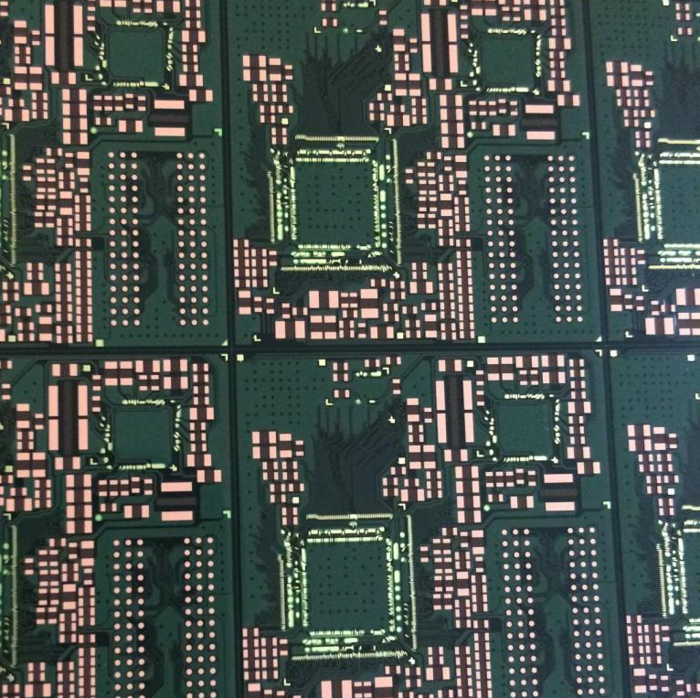
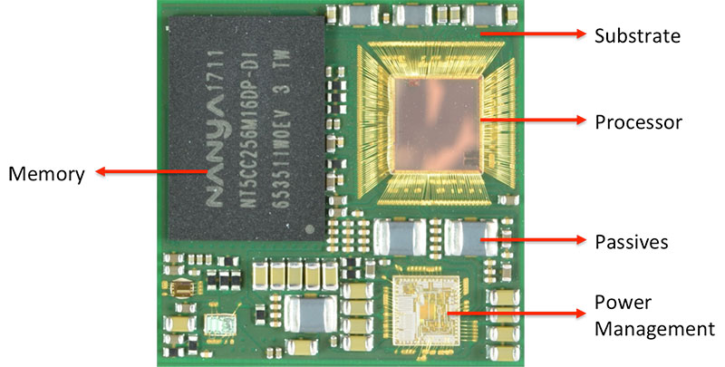
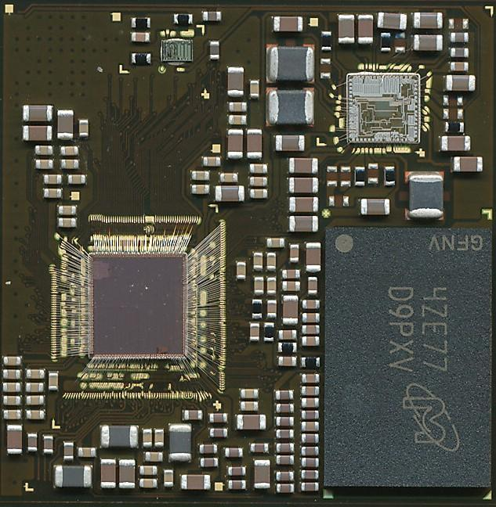
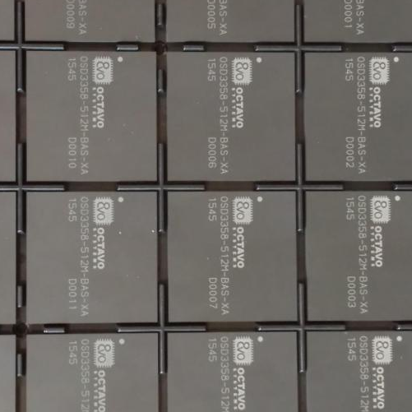
Enter System in Package (SiP)
What is a SiP?
OSD335x integrates
AM335x
DDR
Power management
EEPROM
More…
Notes:
System in Package is an entire system integrated into a package so it looks like another component.
The SiP shown integrates the AM335x processor in die form, the power management IC die, the DDR memory, EEPROM die and the passives required for all the interconnections

Slide 13
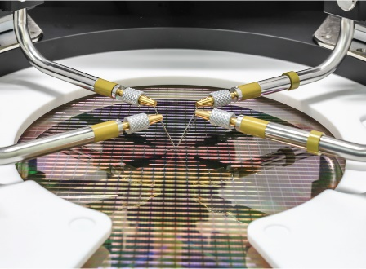
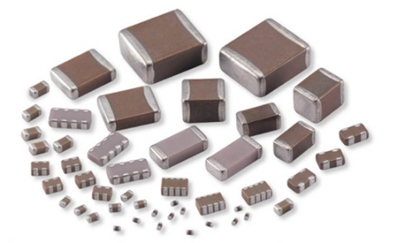
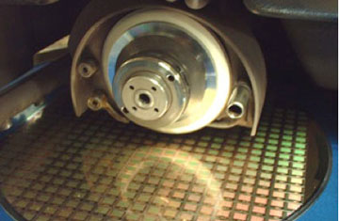
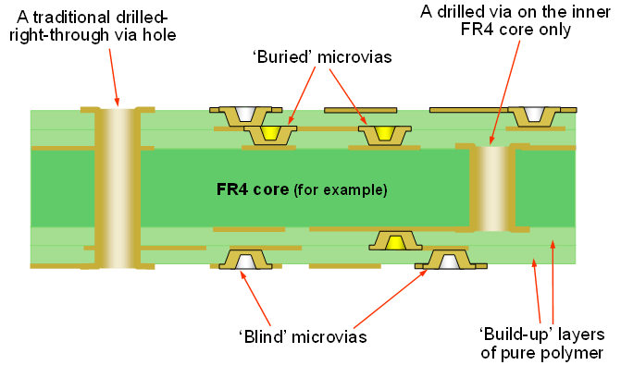
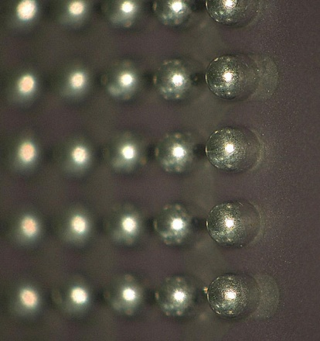
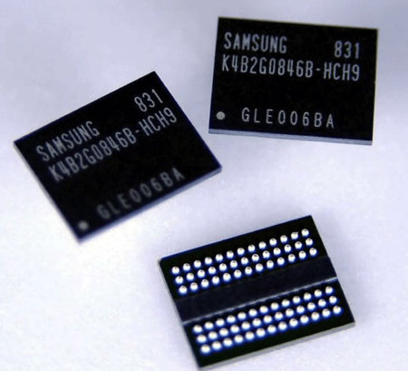
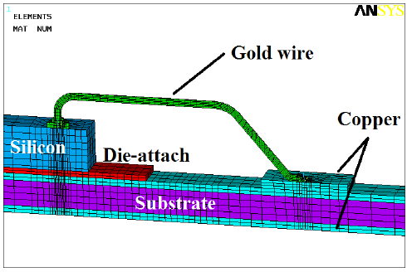
System-in-Package Components
+
+
+
Attached Die
Discrete Components
Substrate
Pins
Notes:
This slide gives an overview of the process of making a SiP
You start with a substrate. A substrate is essentially a Printed Circuit Board, but with micron level design rules.
- Bare die are processed and cut.
All die are attached to a substrate with bond wires.
Discrete components are added
The component goes through some reflow and Quality check points
After all components are on the substrate, it is molded
Finally, the SiP goes through a ball attach process
All this is while complicated is also within the current standardized manufacturing technology

Slide 14
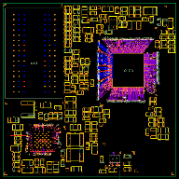
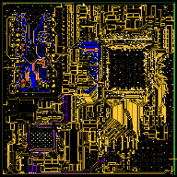
A Closer Look at a SiP
6 Layer Substrate
Manufactured SiP
Cross-Section SEM Picture of SiP

Slide 15
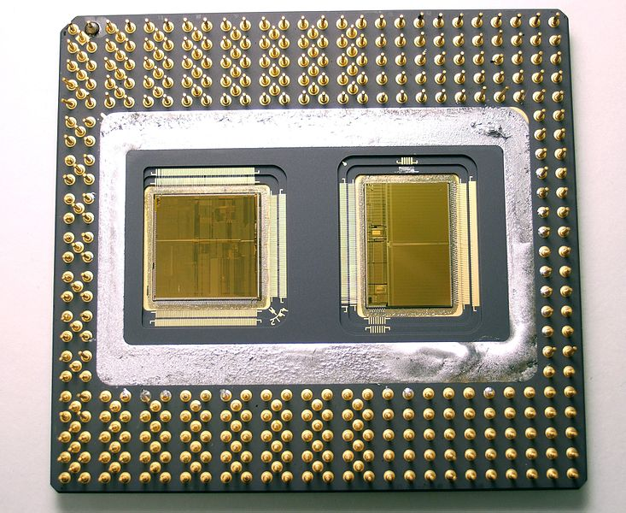
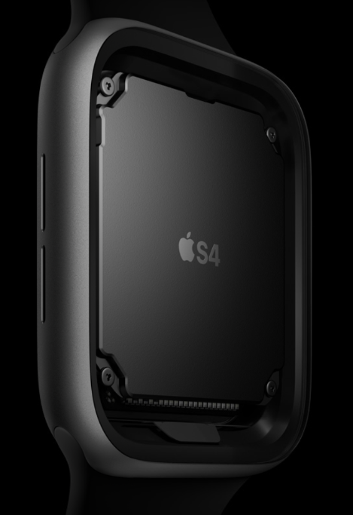
SiP: A little bit of history
SiPs have existed since the early days of semiconductor integration technology
These days it is generally used for specialized high volume applications such as wireless modules
Uncapped Pentium Pro (1995)
Apple’s S4 SiP in Apple watch series 4
Notes:
SiPs have existed since a long time. You don’t know about them because the technology has not been accessible to general hardware design industry
The intel Pentium Pro featured a processor die and a cache die on an independent bus bonded together
On the right, is the latest SiP product, the Apple Watch series 4 built on Apple’s S4 SiP

Slide 16
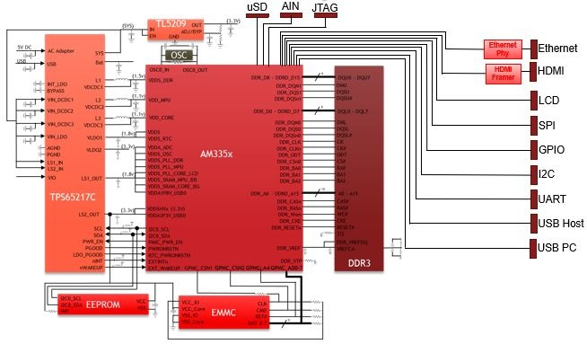
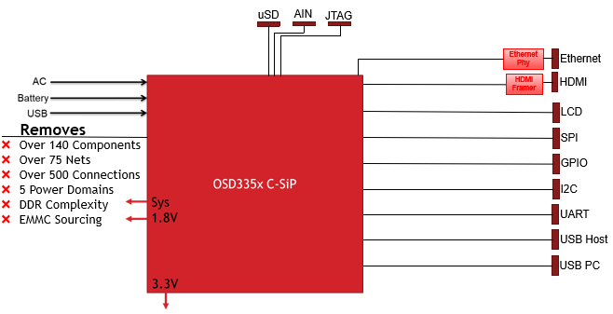
Why do we need a SiP?
Design simplification
Discrete ARM Cortex A8 system
SiP based system
Notes:
On the left, you can see what is called a discrete implementation of a Cortex A8 based design
All the design complexity of DDR and power management is gone
Putting the SiP in a design is equivalent to designing like you would with a microcontroller. Add clock(No need actually), power and any config circuitry (normally pull-ups/pull downs)

Slide 17
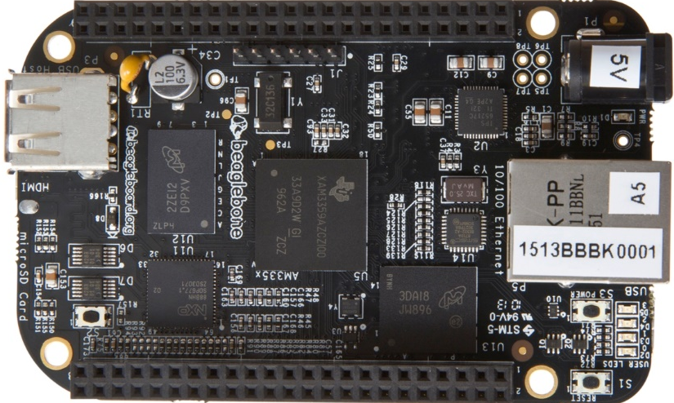
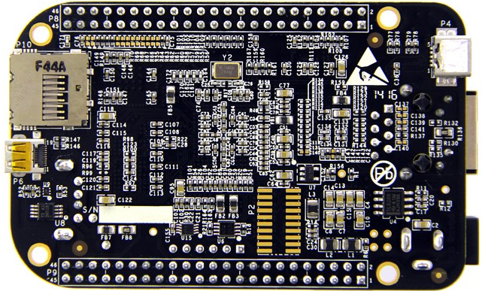
(Size)Case Study:
Integrating over 100 components
BeagleBoard.org
Open-Hardware Single Board
Computer
Open-Source Linux support
Vibrant Community
Diverse Applications: Home Automation, Robotics, 3D printing, Industrial Control
Based on Texas Instruments AM335x 1GHz ARM Cortex A8
BeagleBone® Black Board

Slide 18
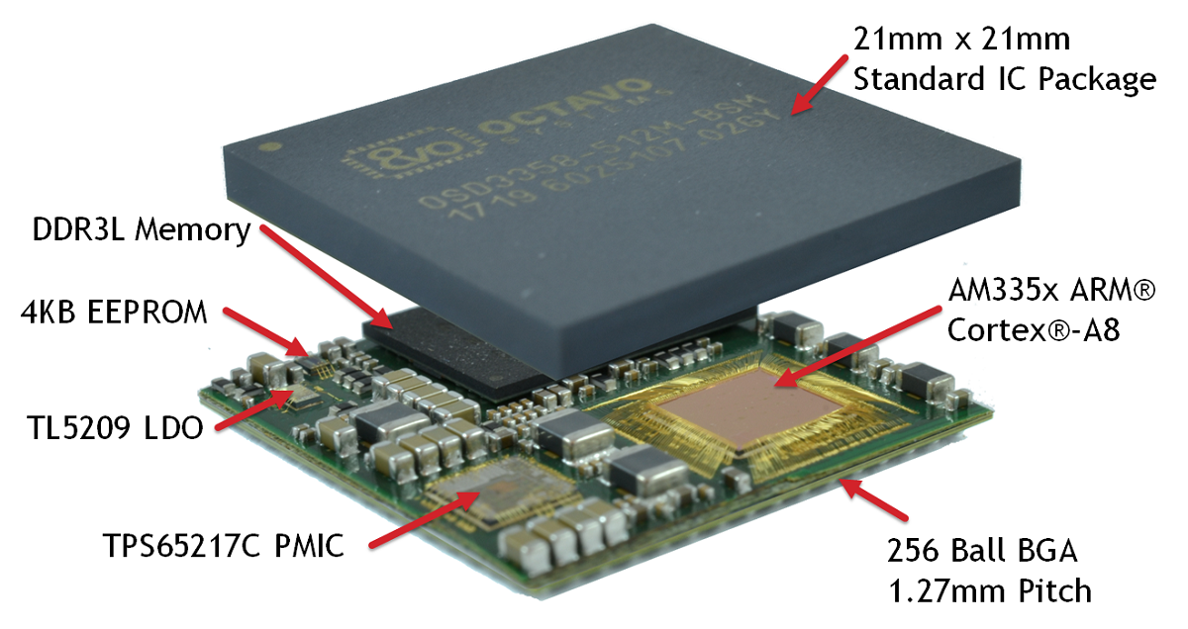
Case Study:
Integrating over 100 components
61% smaller
441 mm²
OSD335x-SM SiP
1130 mm²
BeagleBone® Black Board

Slide 19
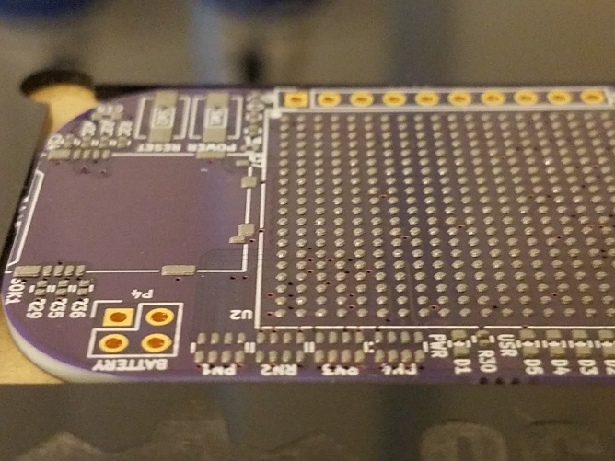
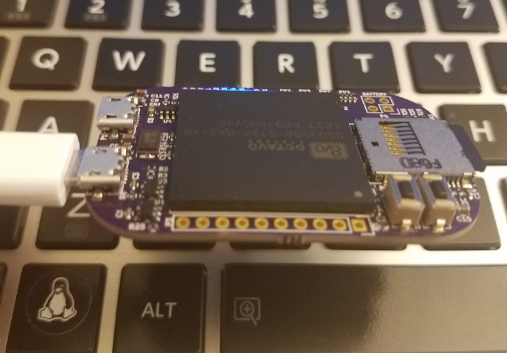
What more? All this..
No need for costly tools and hardware simulations
Can cut design time by as much as half
Easy manufacturing. Even by hand
Can optimize design. No need to depend on SBCs
These advantages enable YOU to design your own 1GHz computer
OSD3358 Hand assembly
Notes:
Can design with free/super low cost CAD tools. No need for costly simulation tools
Can cut design time in half with hard stuff (RAM and power) taken care of, which means more time spent on software
Easy manufacturing. The pictures shown were taken while hand assembling the PocketBone, which later became the PocketBeagle. It is that easy to make your own board for your project
No need to have a 3rd party SBC in your project. Everything made from scratch by you!

Slide 20
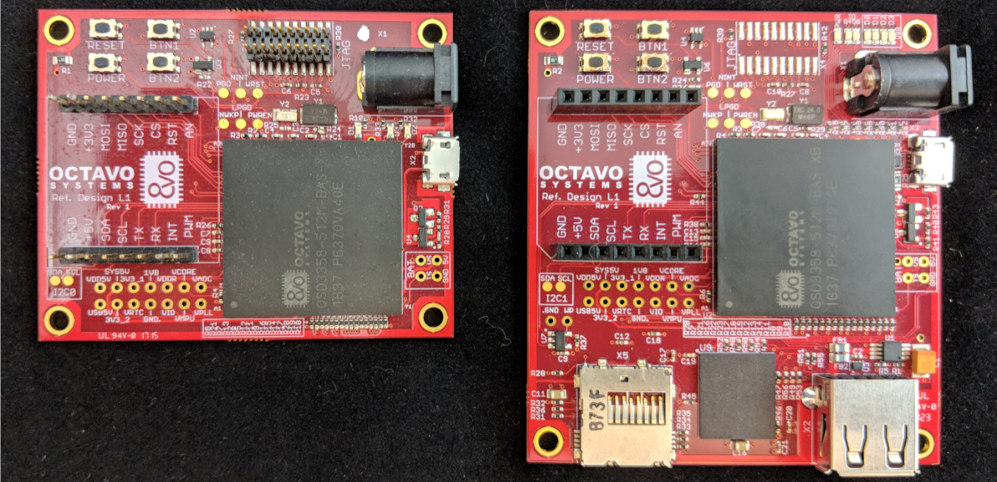
Examples
Custom boards developed for OSD335x
- Sherlock Solver: Currently on Beaglebone Blue
- He is on twitter: https://twitter.com/SherlockSolver
Notes:
Both boards built at Macrofab for less than $100 per board. Both 4 layer boards designed by an intern who has never done layout before.
Same can be done with a specific project you want to do. We had an idea for a Rubik’s cube solving Robot. We built the robotic arms, had a Beaglebone Blue connected to a camera as a prototyping platform. Now we are planning to make our own board with the parts of the BeagleboneBlue we need. And we will be able to do that essentially spending pocket money. I am personally excited for that because I feel like, that is the essence of being a maker.

Slide 21
SiP Simplifies the Design Process
Manufacturability, Cost reduction
  Lax design rules
  Smaller PCB
  Less(~100) components to order and maintain
  Time spent in development
  Compared to a discrete design? Still cheaper
PCB SPECs | Discrete Design | SiP Design
PCB Layers | 8 | 4
Trace Width/Spacing | 4mil/4mil | 6mil/6mil
Via/Drill Size | 18mil/8mil | 24mil/12mil
Notes:
The cost reduction for the hardware comes in the form of lax design rules and smaller PCBs
In addition to that, there is no need to maintain 100s of components in the BOM simplifying the supply chain
The time spent in development is also an important factor. Depending on the system, SiP can shave off some design spins(months of delay) as well as time spend doing menial design/layout of core system components
When compared directly with the discrete components, the cost of SiP is definitely higher. But, the manufacturing savings especially with production level quantities drive the overall system cost lower resulting in cost savings.

Slide 22
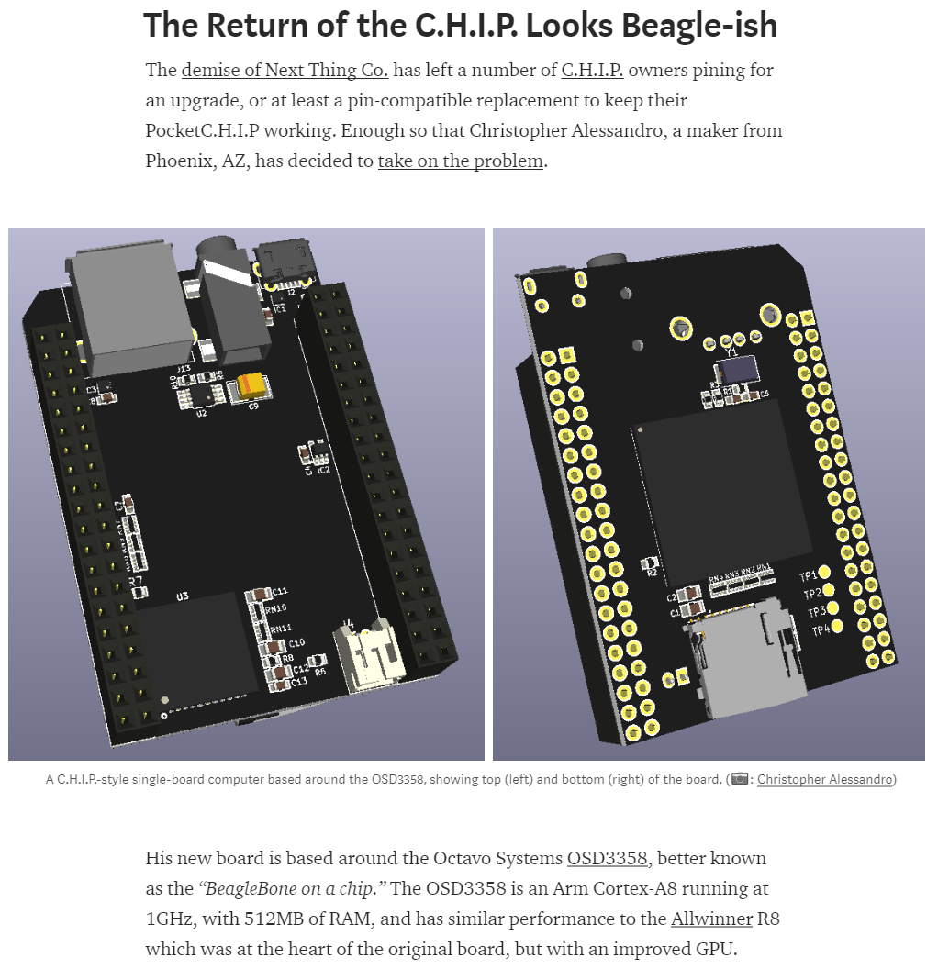
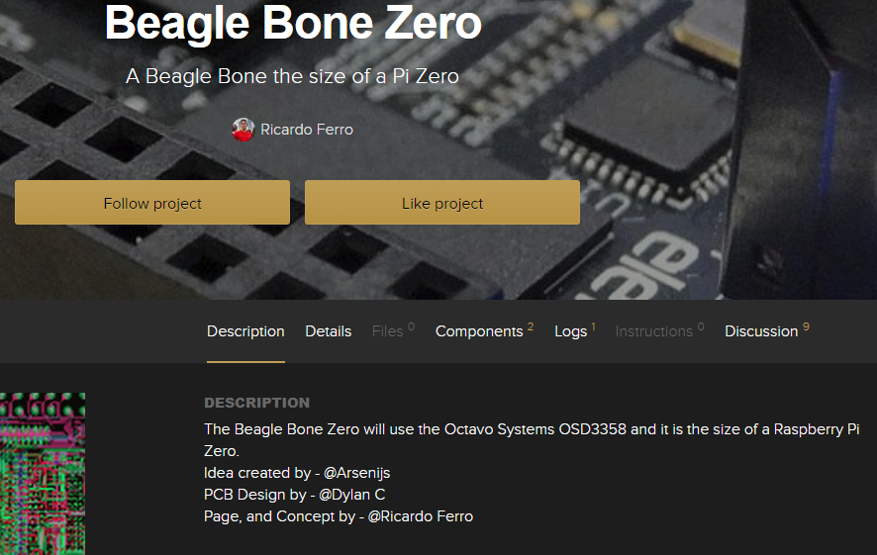
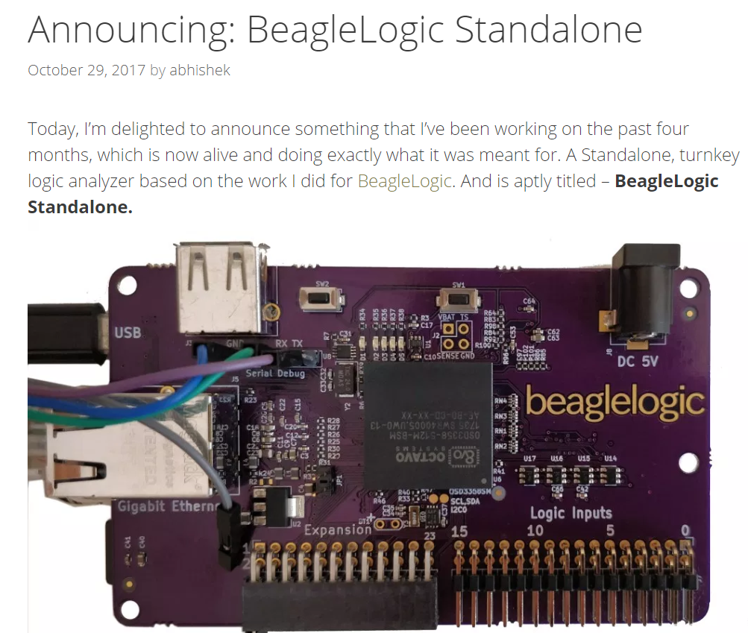
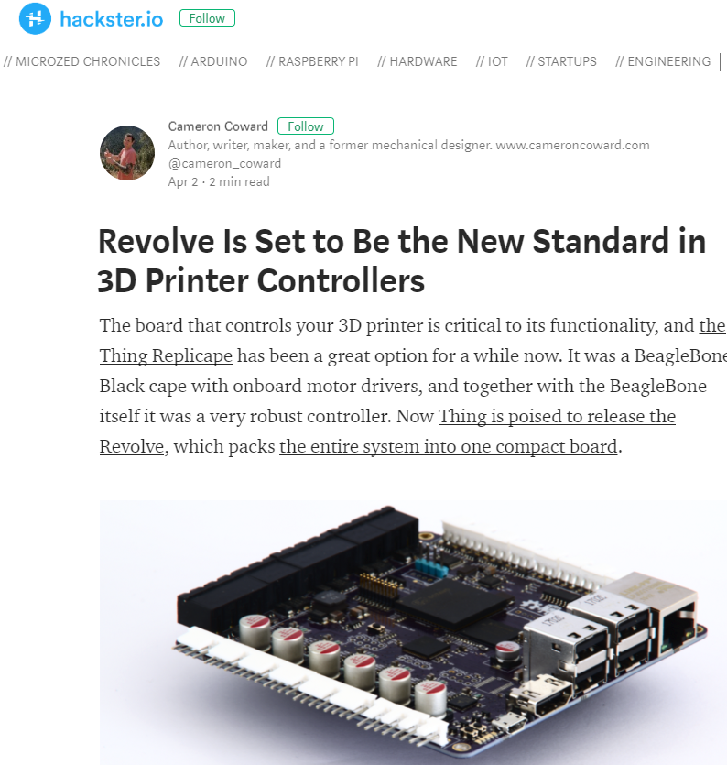
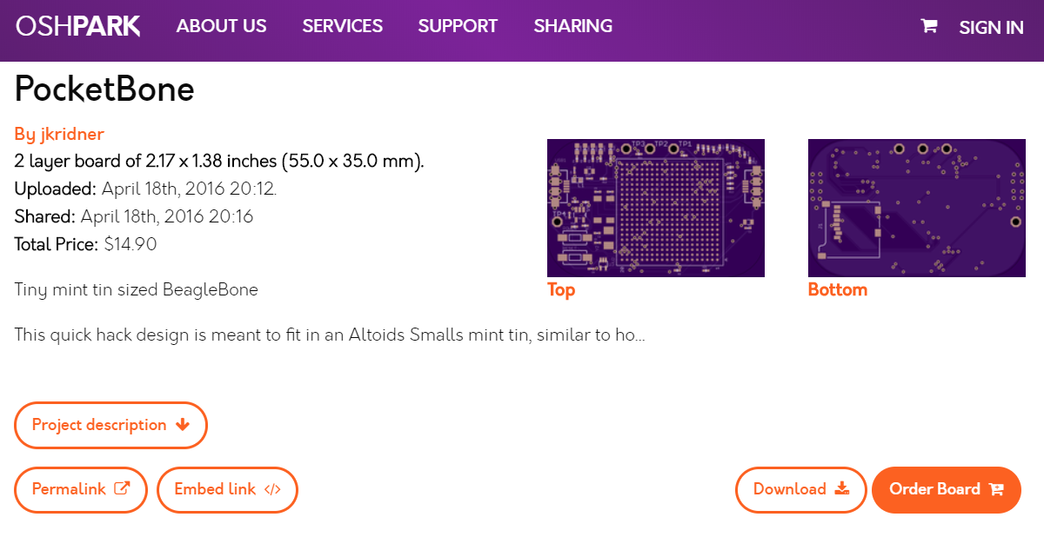
Maker success
Notes:
All these boards were designed by makers and some are being sold
There is a lot of support from folks at Beagleboard.org. They make all their designs opensource.

Slide 23
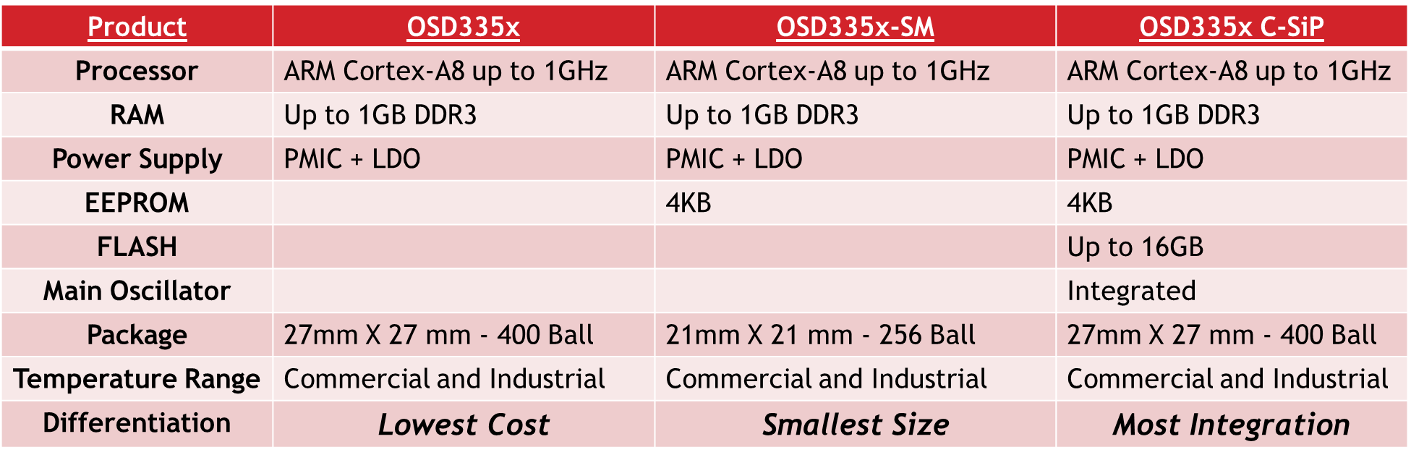
OSD335x family

Slide 24
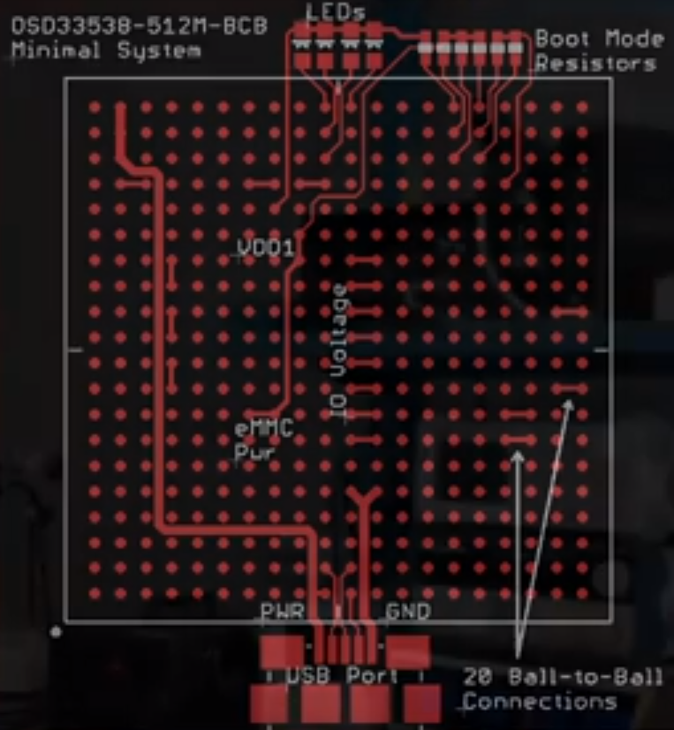
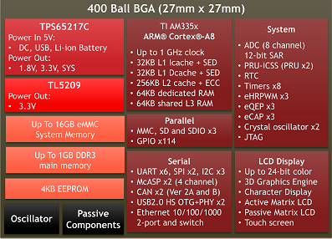
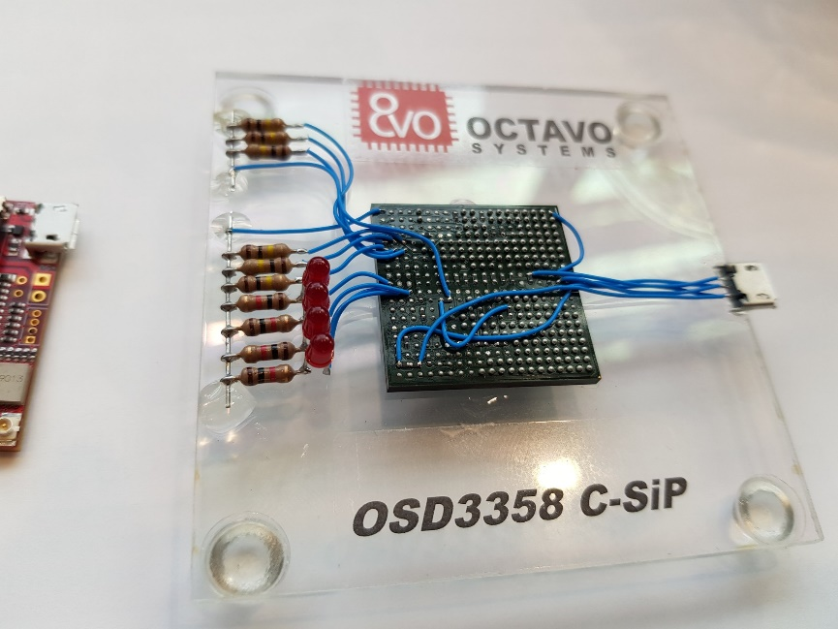
OSD335x C-SiP (Complete SiP)

Slide 25
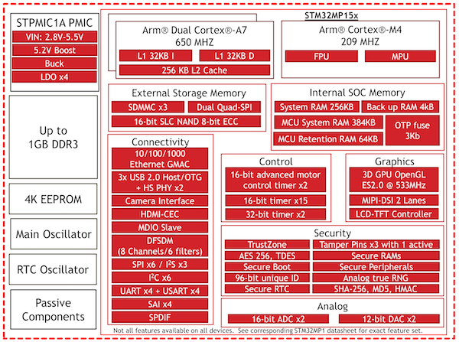
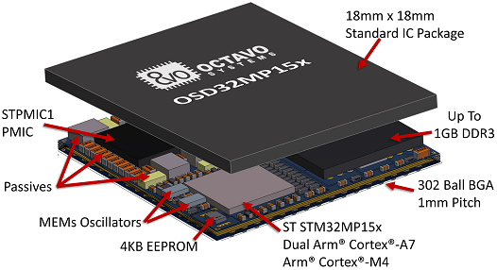
OSD32MP1 based on the STM32MP1

Slide 26
Design an Embedded System
In Half the Time
In Half the Space
Use a SiP
They already started for me
With Half the Budget

Slide 27
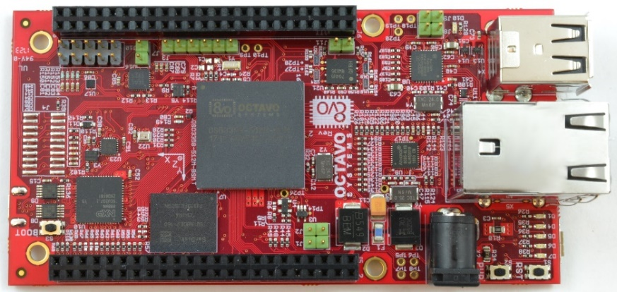

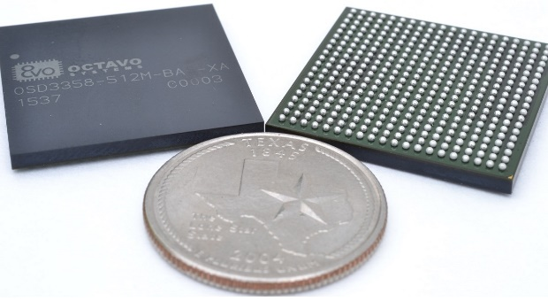
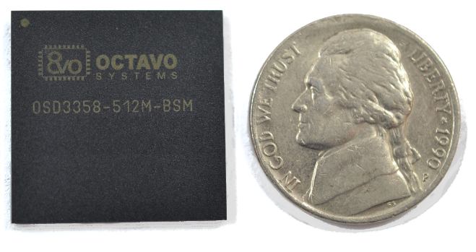

Get started now!
https://octavosystems.com/osd3358-sm-red/
https://www.mouser.com/octavo-systems/

Slide 28
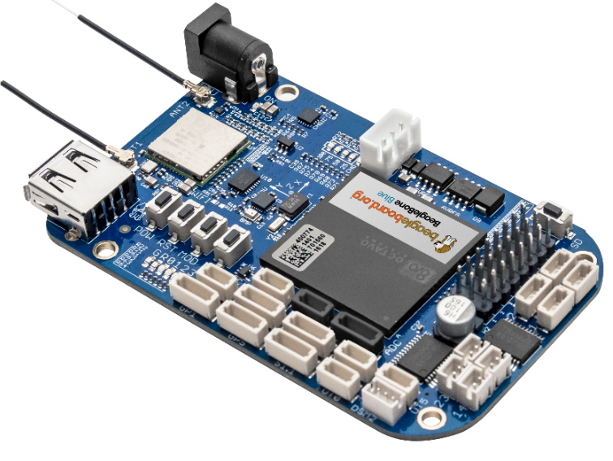
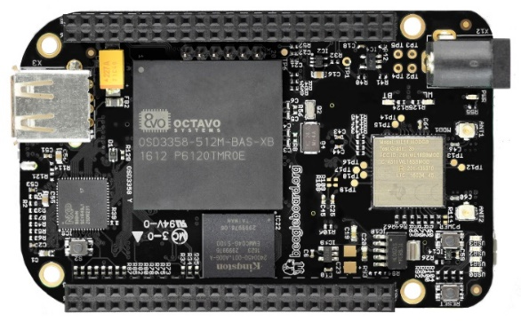
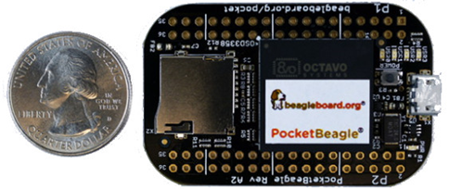
Low Cost Community Boards from
BeagleBoard.org
https://beagleboard.org/blue
https://beagleboard.org/black-wireless
http://bbb.io/pocket

Slide 29

Sherlock solver: video

Slide 30
Thank You
Neeraj Dantu
info@octavosystems.com
Notes:
Thank Macro FAB and Mouser and the Audience

Slide 31


SiP vs SOM
Why is SiP better than SOM?
Size

Slide 32
SiP innovation
High
Clock Frequency
Low
RF
Power
System-In-Package (SiP) – Integrates Best of All Processes
Moore’s Law
Process Improvements
Moore’s Law
Process Improvements
SoC – Compromise in all Areas
Power Dissipation
RF
Power
Transistor Density
Processor
Sensor
Memory
Analog
Moore’s Law
Process
Improvements
Moore’s Law
Process
Improvements
Memory
Sensors
Processors
Analog
Low
High
Voltage
Notes:
-

