Slide 1


BUILDING A SUCCESSFUL
Consulting PRACTICE
Amy Holloway, Chief Sherpa
Avalanche Consulting
February 22, 2012

Slide 2
introduction
Your name
About yourself
What do you hope to gain from this session?

Slide 3
introduction
Session Objective:
Provide inspiration and
advice for building a
successful consulting practice.

Slide 4
agenda
Motivation
Taking the Leap
Tips for Success
Conclusion

Slide 5
motivation

Slide 6
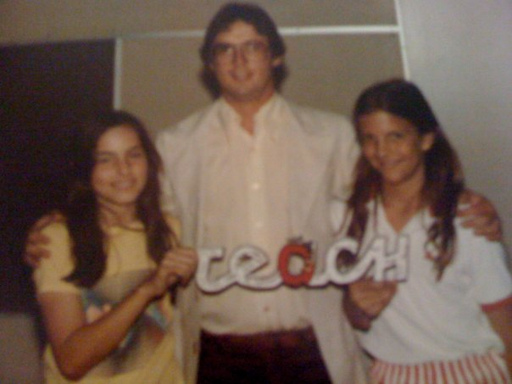
motivation
What’s up
with my hair?
What’s up
with my hair?

Slide 7
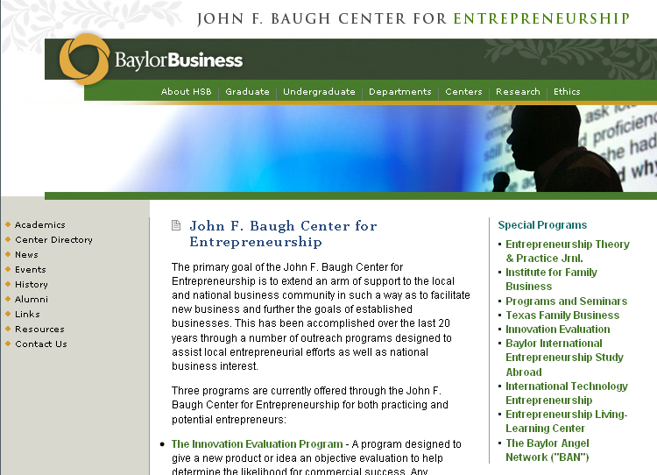
motivation

Slide 8








motivation

Slide 9
motivation
Avalanche Incorporation!
Ring Volume
AE- VP
TPG
AE - Europe
Gray
Freelance
Grad School
AE – Austin!
12-years in the making.

Slide 10

motivation

Slide 11

motivation

Slide 12
motivation
What are the signs for you?

Slide 13


motivation
Notes:
Seems scarier than it really is

Slide 14
motivation
What are your concerns about starting your own consulting practice?

Slide 15
agenda
Motivation
Taking the Leap
Tips for Success
Conclusion

Slide 16
Taking the leap
Are you passionate enough to take the leap?
I can’t stop thinking about my idea.
I am irritated at work knowing I could do better.
I hesitate to initiate improvements at work because it might compete with my future business.
I possess a skill set that no one else has in my firm.
I doodle logo designs during conference calls.
I JUST KNOW IT.

Slide 17
Taking the leap
Defining your practice
In my office, I am called on as the expert in ________.
Customers and clients ask for me to do ____________.
I have been asked to speak on the topic of _________.
My skills and knowledge intersect at ______________.
Notes:
What is a consulting practice? What makes it successful?

Slide 18
Taking the leap
Why are consultants hired?
Expertise
Objective opinion
Consensus building
Save staff time
Carry the heavy load and deflect criticism
Notes:
What is a consulting practice? What makes it successful?

Slide 19
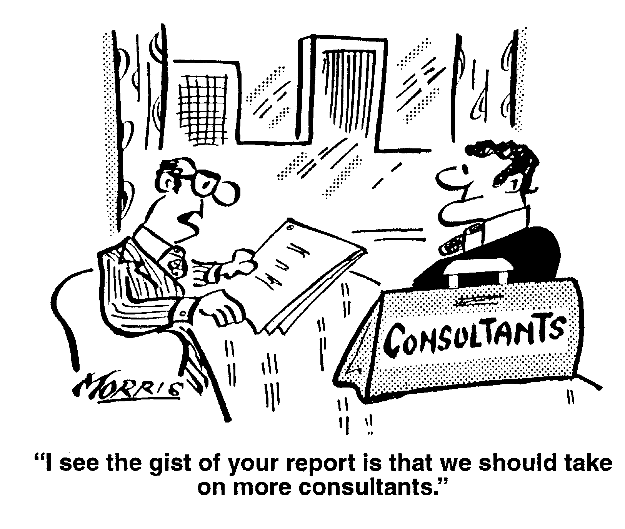
Taking the leap
Notes:
What is a consulting practice? What makes it successful?

Slide 20
Taking the leap
What makes a great consulting practice?
Targeted services
Crossover expertise
Approachability, listening
Communications
Confidence
Implementable product
Notes:
What is a consulting practice? What makes it successful?

Slide 21
Taking the leap
What does a consulting product look like?
Written reports and white papers
Recommendations and implementation
Research and benchmarking
One-to-one conversations
Software platforms
Point person for stakeholders and media
Training programs and coaching
Notes:
What is a consulting practice? What makes it successful?

Slide 22
Taking the leap
Scalability: Making a Profit
Making money is ultimately an issue of hours:
You can only charge so much per hour.
New clients… more labor time:
Adding an employee means profits
stay the same as the revenue increases.
Notes:
What is a consulting practice? What makes it successful?

Slide 23
Taking the leap
Determining Your Fees
Your hourly rate is tied to demand and industry standards.
Start 10-15% lower than standard to start
Determine your salary tolerance level
Go for fixed fee contracts
Consider a 20% “pain in the rear “ fee for, well, you know
Notes:
What is a consulting practice? What makes it successful?

Slide 24
Taking the leap
Study Your Competitors
Map competitors’ strengths, weaknesses, sales messages, and pricing.
Develop your 2-3 differentiating points. If it’s difficult for you, it will be even more so for your prospects.
high
Innovation
Experience
high
Bubble size indicates pricing or # of employees
Notes:
What is a consulting practice? What makes it successful?

Slide 25
Taking the leap
Marketing
Friends and past clients first
Website, electronic marketing
Establish yourself as the expert ~ write and speak
Subcontract and partner
Give away information
Notes:
What is a consulting practice? What makes it successful?

Slide 26
Taking the leap
What differentiates your business idea?
Notes:
What differentiates you?
Look for the intersection of skill sets?
Are there consultants that you call upon on a regular basis?

Slide 27

Taking the leap
Do you understand the marketplace?
Notes:
Do you understand the marketplace?
Do you know your competition? Trends? How to position within?

Slide 28

Taking the leap
Do you have advisors?
Notes:
Be patient. Business can wait for experience.
Advisors

Slide 29
agenda
Motivation
Taking the Leap
Tips for Success
Conclusion

Slide 30



Taking the leap
The extremely sad and unfortunate tale of…
Notes:
The sad tale of unconditional

Slide 31

Taking the leap
The landslide success of…
Notes:
The sad tale of unconditional

Slide 32
Taking the leap
Am I passionate about the idea?
Can I differentiate our product?
Do I have time for business building?
Do I understand the marketplace?
Have I spent time becoming an expert?
Do I have strong relationships in the field?
Notes:
The sad tale of unconditional

Slide 33
Tips for success
It’s easy to get started.
Business plan
DBA
Business cards
Website
Notes:
The sad tale of unconditional

Slide 34

Tips for successs
Start with a client.
Contract $ value:
3 months of
living expenses
Notes:
The sad tale of unconditional

Slide 35
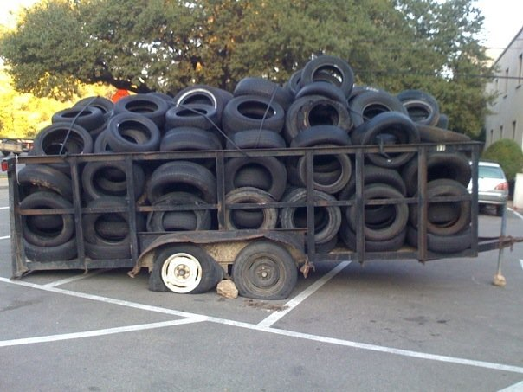
Tips for success
Know your limits.

Slide 36

Tips for success
Work with partners.
Notes:
Partnerships
Relationships are critical. Evaluate your chain of relationships. How well are they built? Do you know decision makers? Do you have access? My view – older industry. I’m going to make sure I have strong relationships with the VP level folks because they are going to be in charge in 5 years from now when I want to take the leap.
Also, don’t break ties within your current employer. You never know where those folks will end up. Plus you don’t want them to be on guard. As you’ll learn in a minute, I literally took a construction job for a year before starting my business because my relationship with my previous employer was important and too sensitive to break right away.

Slide 37

Tips for success
Talk about your idea.
Notes:
Talk it up. So many entrepreneurs are afraid to share their ideas with other people, nervous that someone is going to steal them away. Listen to me. Don’t worry about it. People aren’t going to drop everything they have going on in their lives to learn your field and start your business. Especially if you have the passion, relationships, differentiation, etc. that we discussed in the Taking the Leap Section.

Slide 38

Tips for successs
Set priorities.
Notes:
I want to talk to you both about setting priorities and planning ahead.
You have to be willing to make your new business a priority. It will not grow on its own. Even with the best foundations in place, it will require determination and constant attention.
Plan ahead. Have a contingency plan. Save money.

Slide 39

Tips for success
Hang in there.
Notes:
The road will not always be easy. It will stink occasionally. When your friends working at the state government have full weekends off and pension plans, and you’re slogging away at the office on sunny Saturday morning. Sometimes you have to put up the convertible top and power through.

Slide 40
agenda
Motivation
Taking the Leap
Tips for Success
Conclusion

Slide 41
conclusion
Number of small businesses in the Austin Metro Area:
35,000
Notes:
Don't break ties.
Take another job to bridge if it will impact personal relationships. e.g. Gray.

Slide 42
Percentage of all businesses in the Austin Metro Area:
85%
Notes:
Don't break ties.
Take another job to bridge if it will impact personal relationships. e.g. Gray.

Slide 43
20%
The number of Austin Metro small
businesses is growing 20% faster each
year than the rest of the economy.

Slide 44

?
The question is no longer
“Who am I going to work for?”
Everyone should be prepared to be an entrepreneur.

Slide 45
Discussion

Slide 46
BUILDING A SUCCESSFUL
Consulting PRACTICE
Amy Holloway, Chief Sherpa
Avalanche Consulting
February 22, 2012

