Slide 1
Plugged Into the Matrix
The North American Power Grid:
Past, Present and Future
Paul M. Grant
Principal, W2AGZ Technologies
Visiting Scholar, Stanford (2005-2008)
EPRI Science Fellow (retired)
IBM Research Staff Member Emeritus
w2agz@w2agz.com
www.w2agz.com
IEEE OEB Life Member Meeting
18 April 2018
Livermore, CA

Slide 2
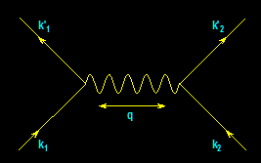
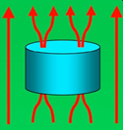
From
Electrons
Paired
To
Electric
Power Delivered
…And…
Back
Again
?
-- A Personal Journey in Applied Physics --
-- IBM, EPRI, and Beyond --
Paul M. Grant
IBM (1953-1993)
Joined 1953 (age 17)
SAGE/NORAD (MIT)
Clarkson/Harvard
Magneto-optics
Displays/Printers
Organic Conductors
DFT
Superconductivity
High-Tc
Sabbatical (UNAM)
EPRI (1993-2005)
High-Tc Power Apps
Wide Bandgap SCs
Power Electronics
“Hot” Fusion
“Smart Grid”
“SuperGrid”
“Climate Change”
Visionary Energy Societies
W2AGZ (2005-?)
Due Diligence
Tet-CuO (Stanford)
“Proxy” DFT
RTSC via DFT
IASS Potsdam
Dual Use of NG Pipeline ROWs for Co-transport of Electricity via HTSC Cables (e.g., Keystone)

Slide 3
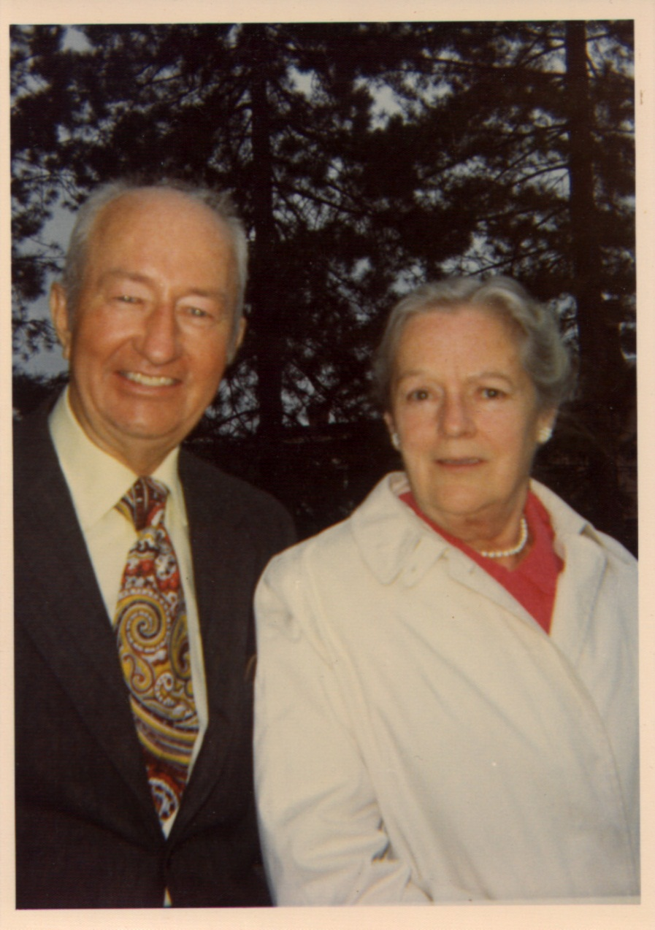
…in their shoes…
Paul Archibald Grant
  W2AGZ
  US Navy, WWII
  IBM, 1948-1974
  Ski Patrol, 1948-1970
Mary Ann Whalen Grant
  CYO BB Champ, 1921
  NYS Bowling Champ, 1939
  Women’s Baseball, ‘33-’47
  CHG&E, 1927-1965

Slide 4
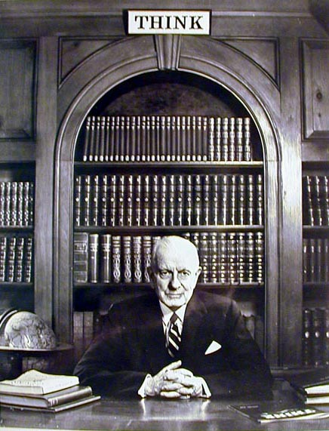
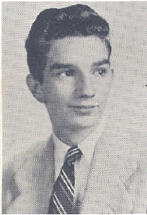
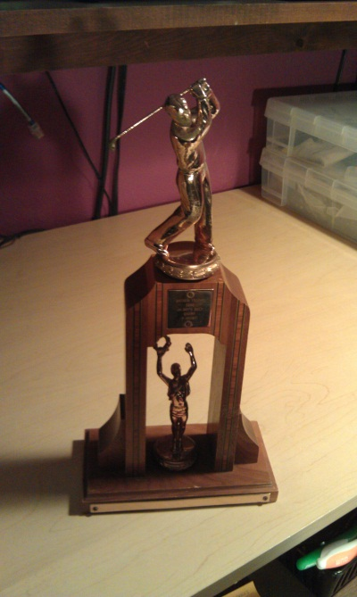
IBM Poughkeepsie - 1952
Visit www.w2agz.com for the whole story

Slide 5
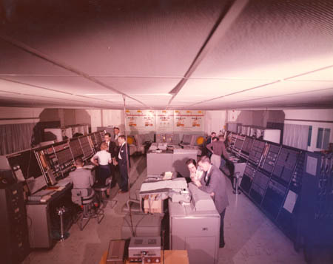
1953
Project Sage – IBM/MIT
My Teenage Toy!

Slide 6
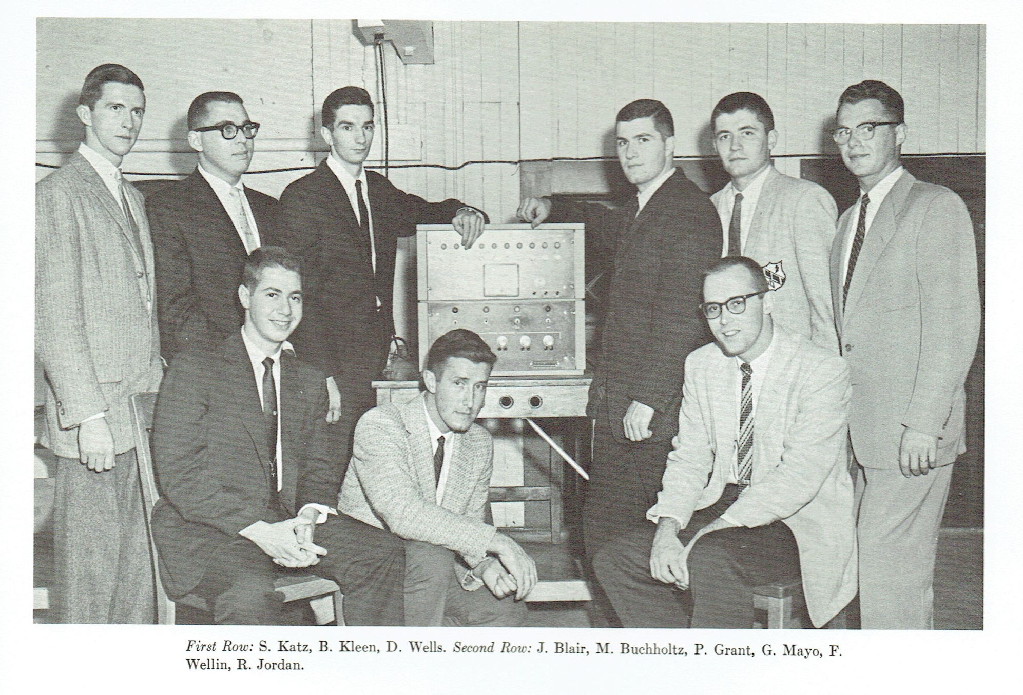
Eta Kappa Nu, ‘60

Slide 7
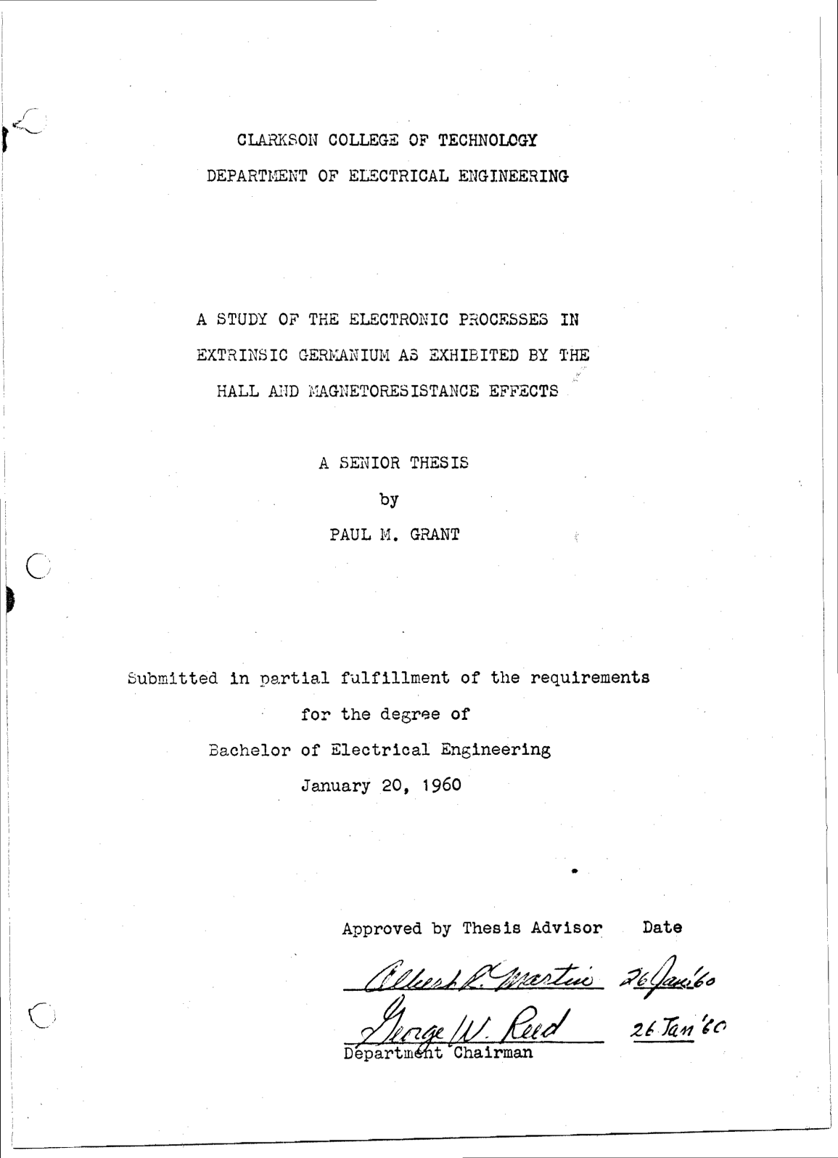
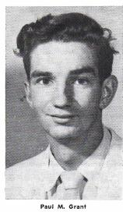
My Senior Thesis Morphed
Into the GMR Read Head
Employed in Hard Drives

Slide 8
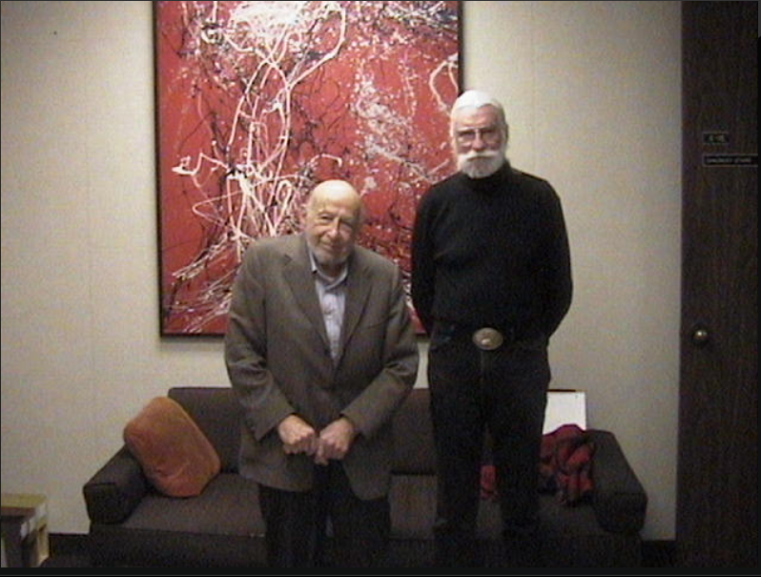
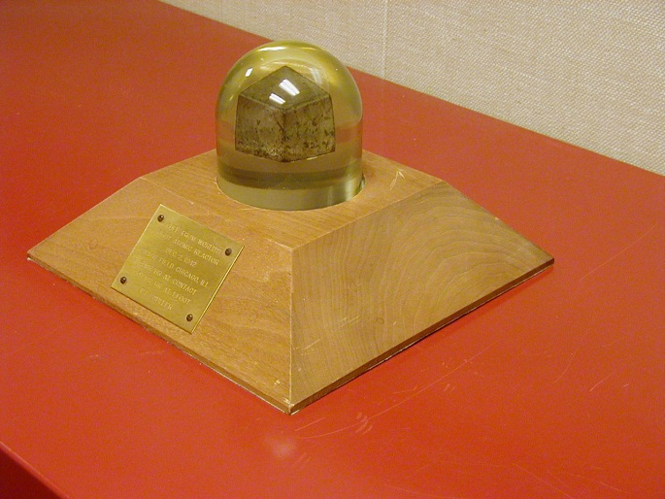
My Virtual Grandfather (@ 94)

Slide 9
US
Electric Power 101

Slide 10
Electricity Today -
The Crown Jewel of the US Economy
§
~$2 trillion total asset value
§
$344 billion annual revenues
§
142 million customers
§
3273 utilities
Without electric power the $14.3 trillion
U.S. economy would come to a halt

Slide 11
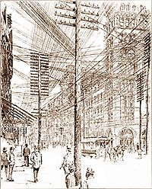
NYC circa 1890s

Slide 12
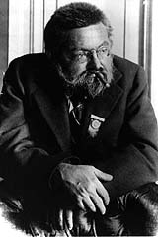
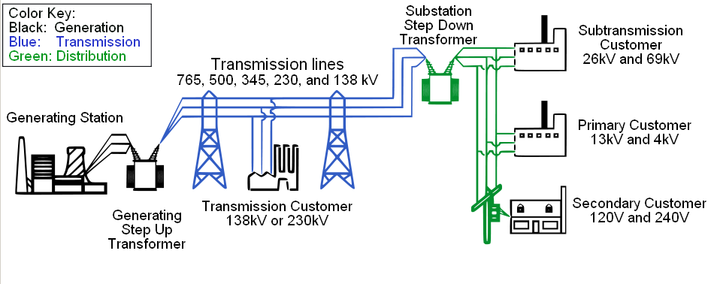
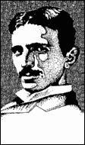
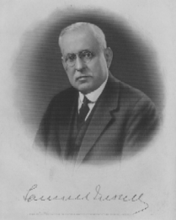
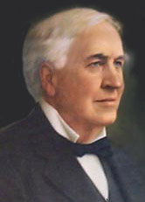
The US Electrical System

Slide 13
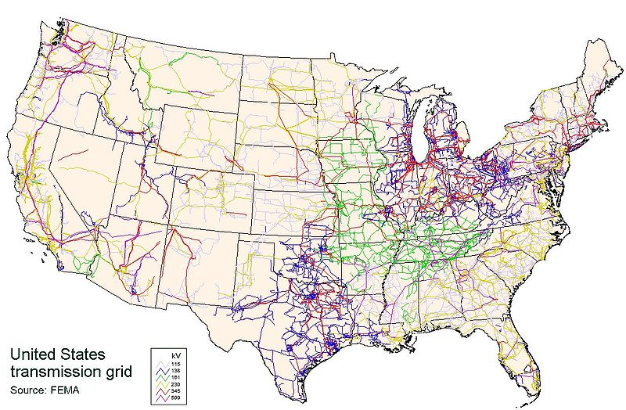
The US Transmission Grid(s)
300,000 km
500 companies
10% Losses

Slide 14
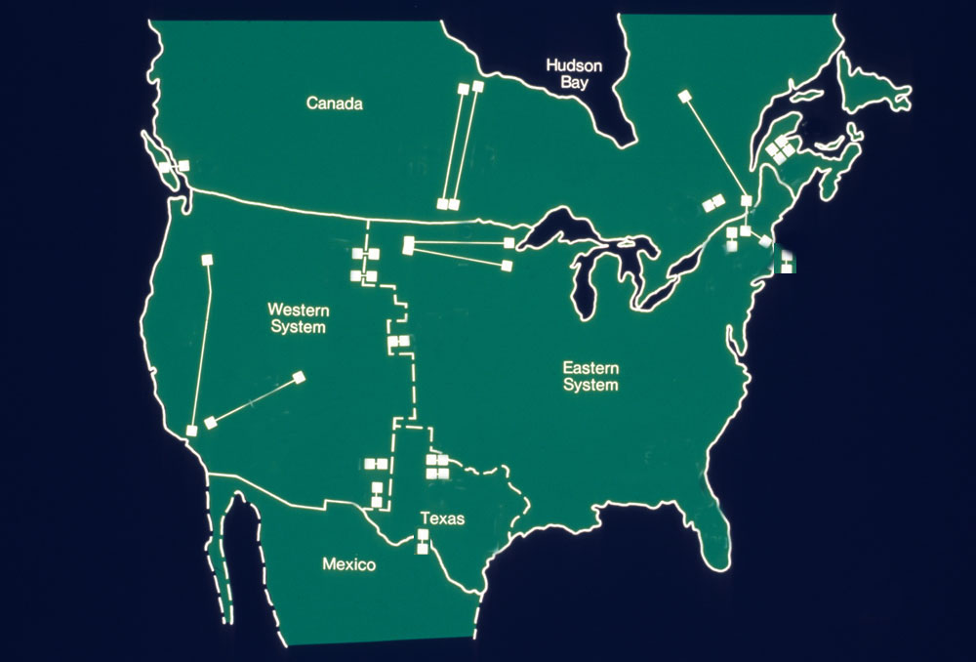
North American HVDC

Slide 15
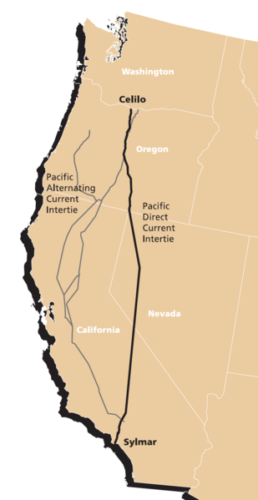
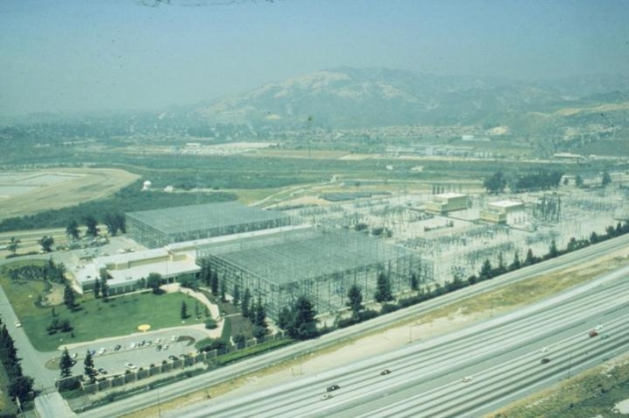
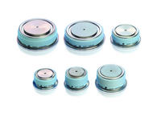
Pacific Intertie
HVDC, +/- 500 kV, 3.1 kA, 3.1 GW
1,362 km
~50% of LA Power Consumption
Converter/Inverter Losses ~ 5%
Ohmic Losses ~ 10%
Celilo I/C Station
“A Mountain of Silicon”

Slide 16
NERC Interconnects
Source: DOE 2006 National Electric Transmission Study

Slide 17
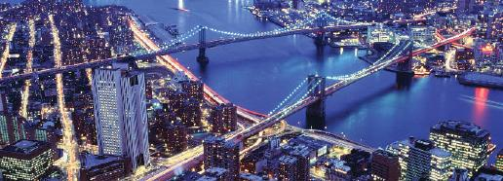
The Grid:
A Journey Though the Heart of Our Electrified World
By Phillip F. Schewe
Joseph Henry Press, 2007 (Buy It!)
Reviewed by Paul M. Grant:
Plugged into the matrix
The rise and potential fall of the US electricity grid
Nature 447, 145 (2007)
http://www.w2agz.com/Publications/Book%20Reviews/06%20%282007%29%20Plugged%20Into%20the%20Matrix.pdf

Slide 18
Superconductivity 101

Slide 19
Models of
Electrical Conductivity
The Most Popular:
R
e⁻
Freezes Out!
T

Slide 20
Models of
Electrical Conductivity
Reality:
R
Limited by
Impurities!
•

e⁻
T

Slide 21
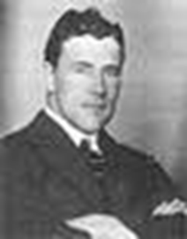
1911
A Big Surprise!
Thus the mercury at 4.2 K has entered a new state, which, owing to its particular electrical properties, can be called the state of superconductivity
Gilles Holst, H. Kamerlingh-Onnes (1911)

Slide 22
Physics of Superconductivity
(1957 – 2006)
Electrons Pair Off!
BCS Equation
•
+
+
e⁻
+
+
•
e⁻

Slide 23
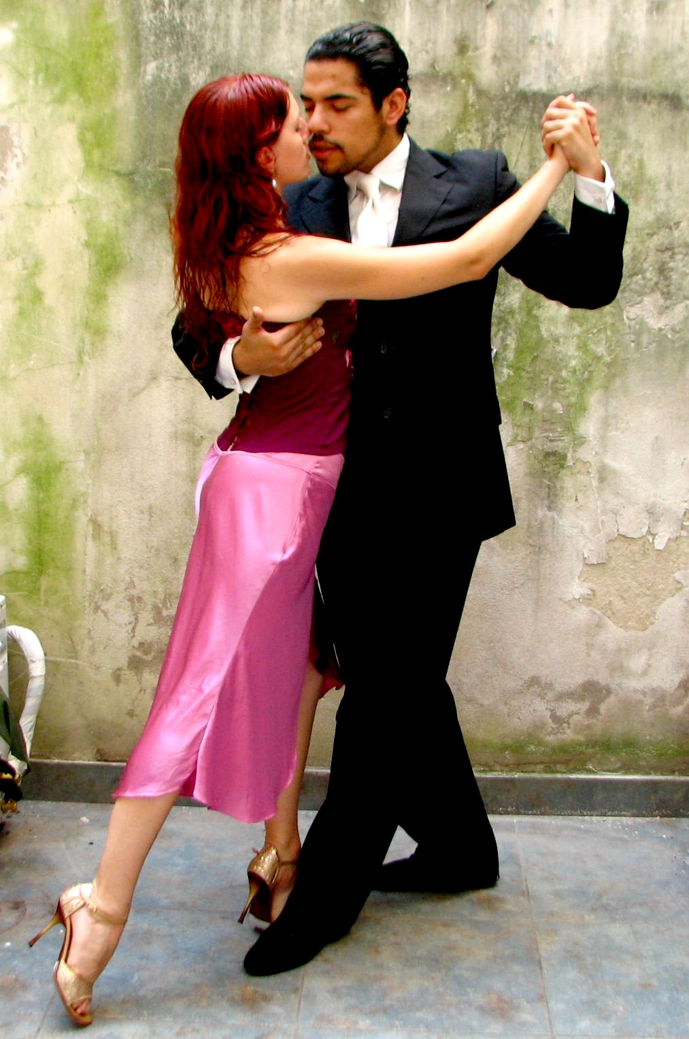
It takes two to Tango
Notes:
Ney Mello, 9/11 survivor decided to leave his career as investment banker and turn to tango

Slide 24

conductor

Slide 25

Semiconductor

Slide 26

SUPERCONDUCTOR

Slide 27
Important Numbers in Superconductivity
Transition Temperature, T_{C} Way below 300 K
Critical Current Density, J_{C} 10⁻² - 10⁶ A/cm²
Critical Magnetic Field, H_{C} 10⁻⁴ - 10 T
London Penetration Depth,  10 - >1000 Å
Pippard Coherence Length, ξ 10 - >1000 Å
G-L Parameter,  = /ξ 0.01 - 100
NB! All these numbers depend on each
other. E.g., H_{C} ~  ξ

Slide 28
T_{C} vs. Year:
1911 - 1980
25
Nb₃Ge
20
Nb₃Sn
NbN
V₃Si
15
Temperature (K)
10
Pb
5
Hg
0
Cubic Metals
1900
1910
1920
1930
1940
1950
1960
1970
1980
Year

Slide 29
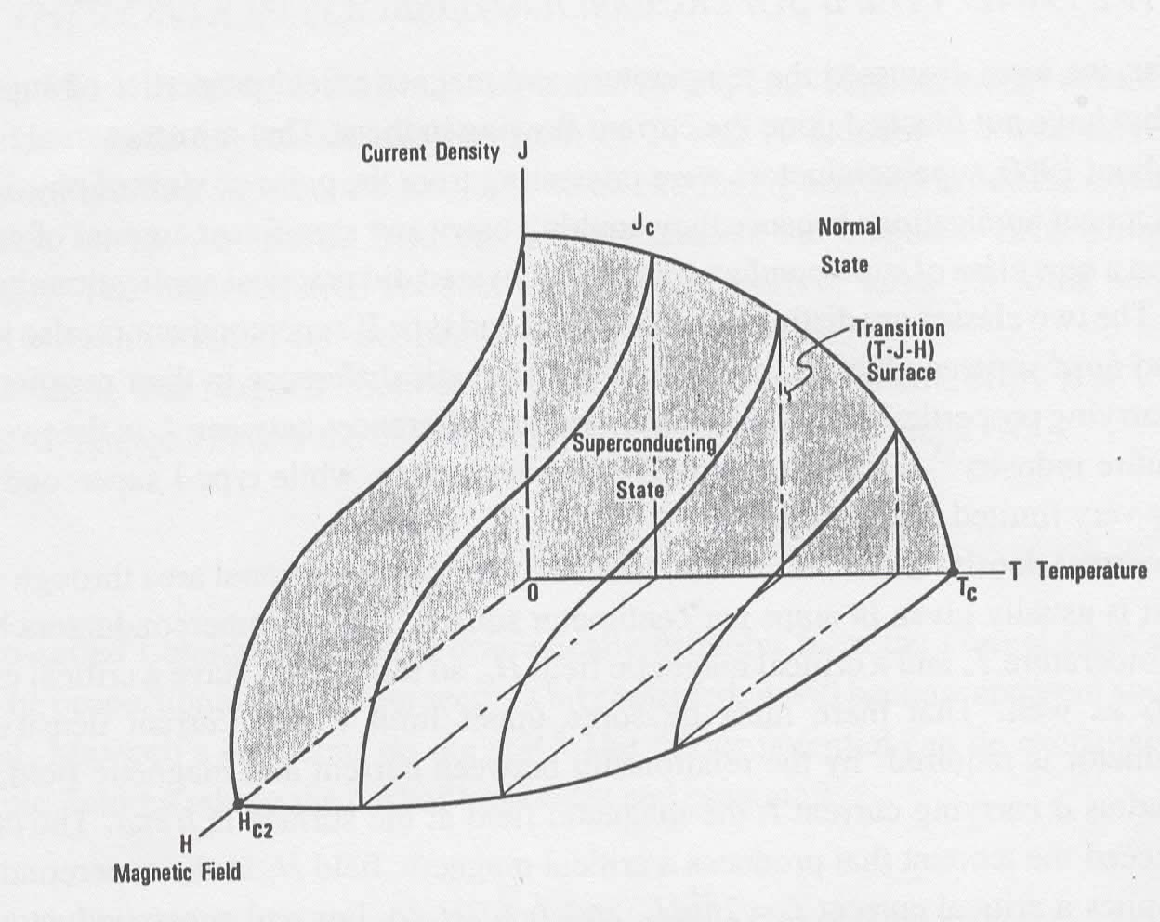
Properties

Slide 30
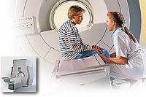
MRI & “Big Physics”
Magnetic Resonance Imaging
Philips
Tevatron
Fermi National Laboratory

Slide 31
1986
Another Big Surprise!
Onset T_{C} = 40 K !
Bednorz and Mueller
IBM Zuerich, 1986

Slide 32
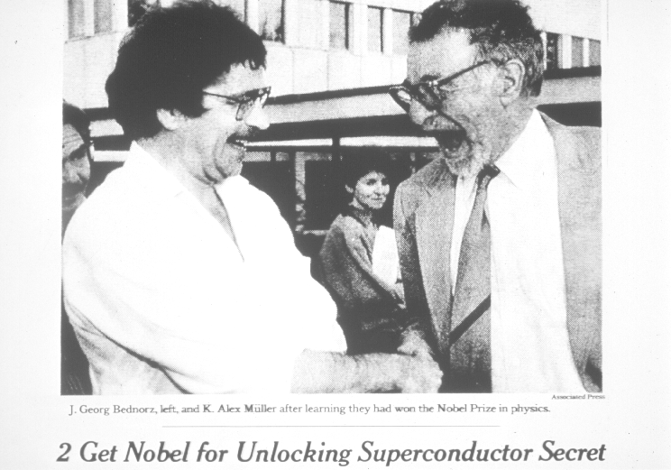
1987
“The Prize!”

Slide 33
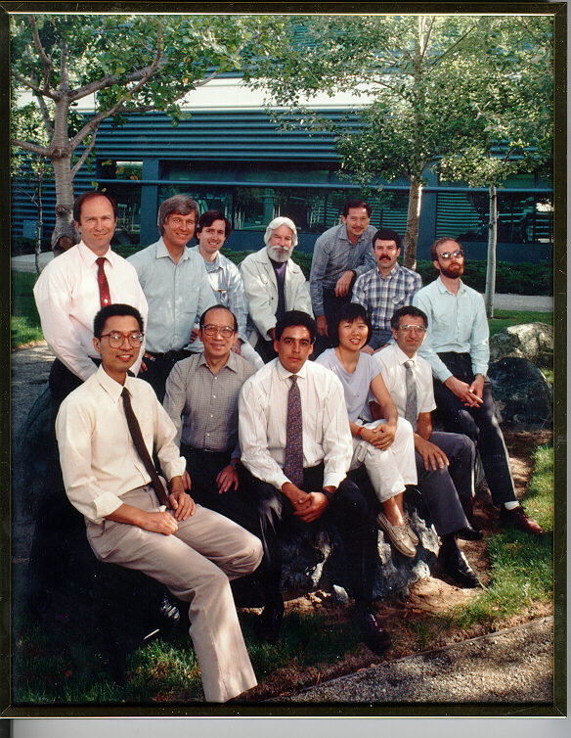
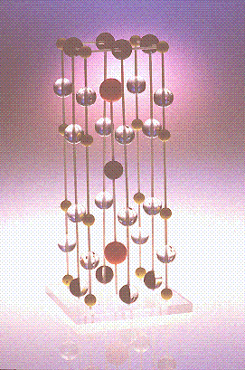
March 3, 1987
“123” Discovered

Slide 34
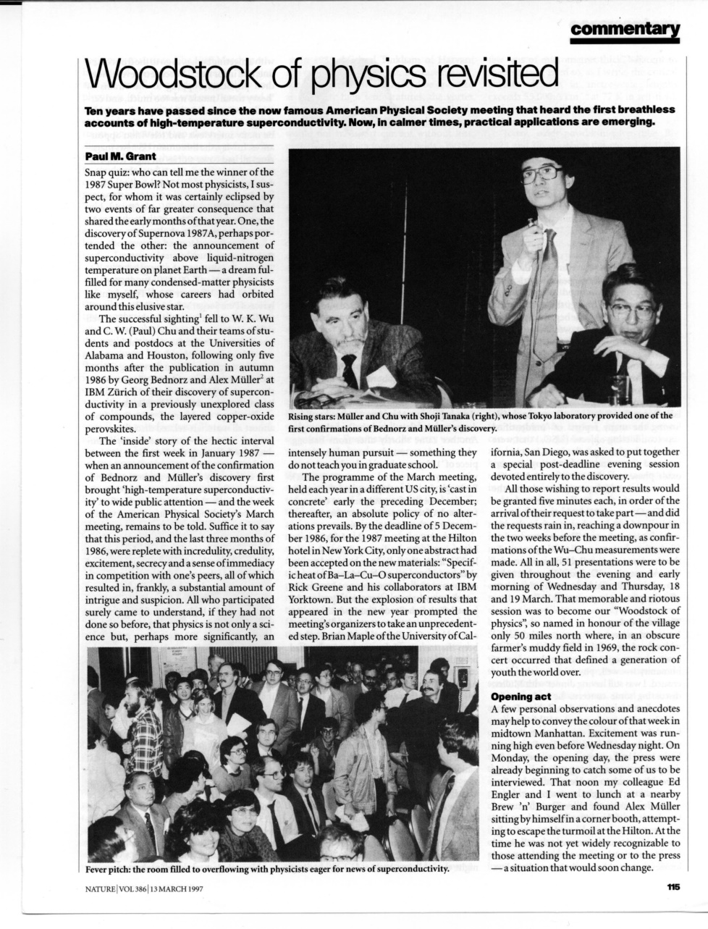

Woodstock of Physics
NYC, 1987
Physicists’ Night Out!

Slide 35
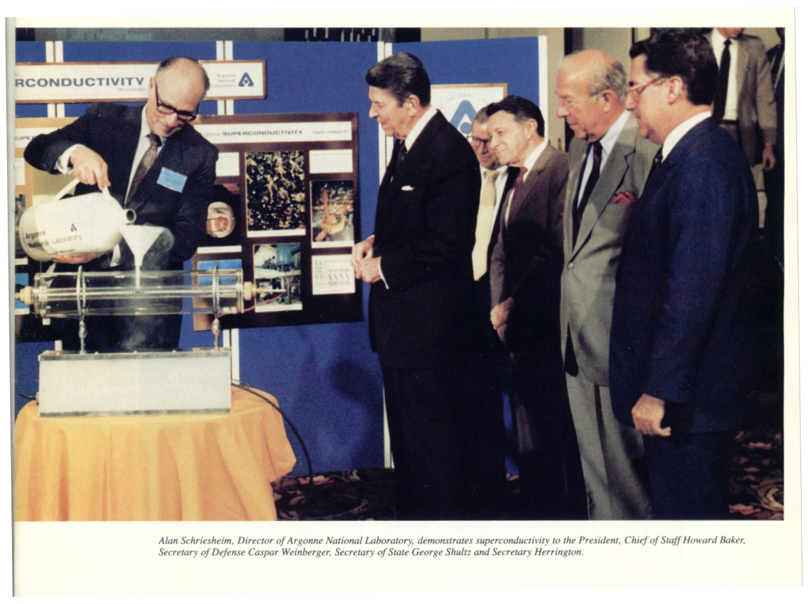
“The Great Communicator”
Notes:
35

Slide 36
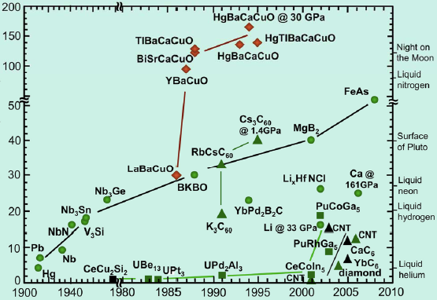
Today
Tc (K)
Year

Slide 37
Where Can We Apply Superconductivity to Electric Power?
Potentially Everywhere
Notes:
37

Slide 38
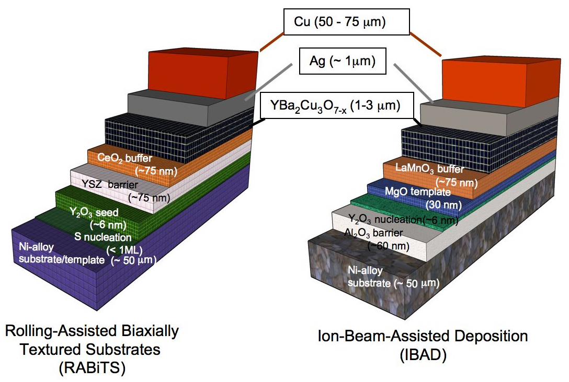
Gen II Coated Conductor
American Superconductor
SuperPower

Slide 39
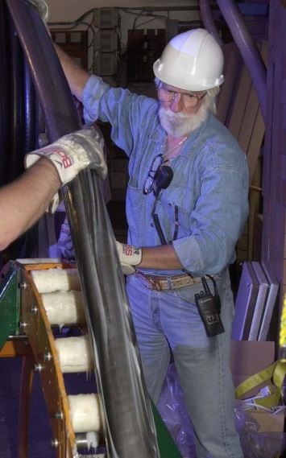
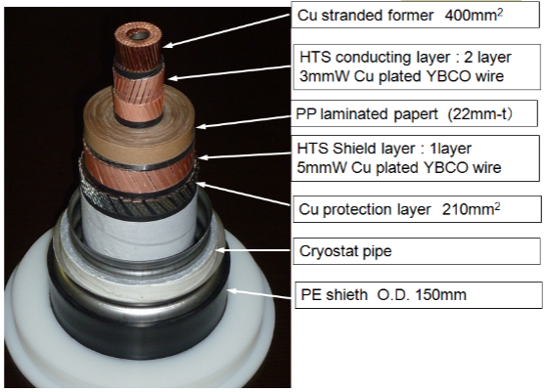
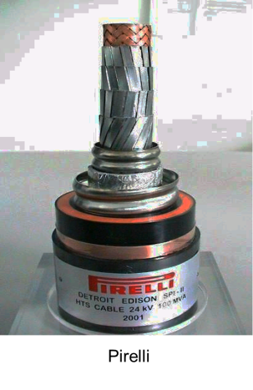
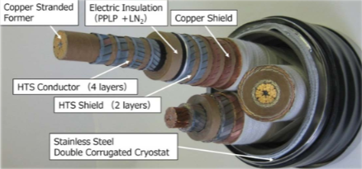
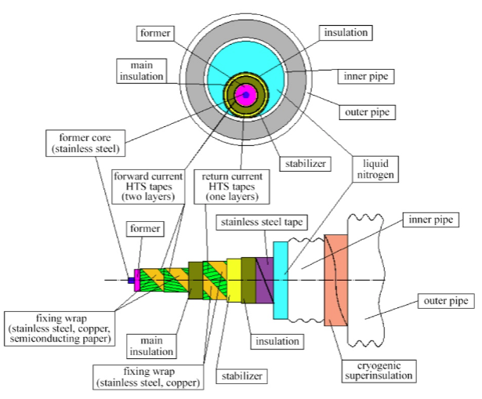
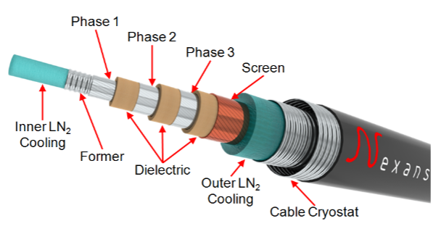
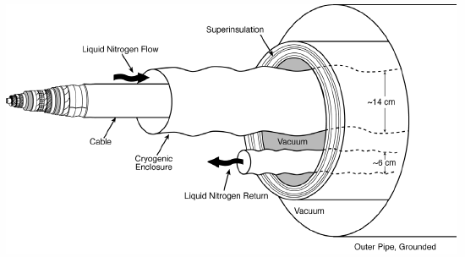
HTSC SuperCables:
Brief History
~ 1997
Sumitomo 66 kV 3-in-1
Furakawa, 275 kV, 3 kA
EPRI SCDC
100 kV, 100 kA, 10 GW
St. Petersburg, Russia
~ 2014

Slide 40
Pacific Intertie
HVDC, +/- 500 kV, 3.1 kA, 3.1 GW
1,362 km
~50% of LA Power Consumption
T&D Losses ~ 10%
Tear down the PI and replace with HTSC underground cables to capture this saving?
Ain’t gonna happen, baby!
Not a “compelling need!”
Even should the cost of the wire be zero!

Slide 41
Required Reading!
(Thanks to Steve Eckroad, EPRI)
Two EPRI Reports (available free from epri.com or w2agz.com)
  (2012) Superconducting Power Equipment; Technology Watch 2012 (1024190)
  (2013) SIU: Superconductivity for PDA (03002001)
Bottom Lines:
  Work continues on wire improvement and power application demonstration, although not at the pace of a decade ago.
  HTSC materials performance and costs have matured.
  What’s needed is a strong business case for HTSC power applications.
  Does there exist a “compelling need,” now or in the next decade, to effect a major and continuing deployment of HTSC in the electricity enterprise?

Slide 42
“The Short Story”
Following the 1911 discovery, Kamerlingh Onnes attempted the construction of an electromagnet...unsuccessfully.
Throughout the second half of the 20th Century and up to the present, many successful demonstrations of superconducting cables, transformers, current limiters, storage units, rotating machinery, etc., have been carried out. Yet, to date, no significant markets (> 10⁸ USD/yr) have emerged for deployment worldwide in the Electricity Enterprise.
  For a 1997 review, see “Superconductivity and Electric Power: Promises, Promises...Past, Present and Future,” P. M. Grant, IEEE Trans. Appl. Supercon. 7, 112 (1997). Available on request from www.w2agz.com.
  Today, the principal “power” applications of superconductivity remain cabling and deflection magnets for hadron colliders and solenoids for medical MRI.
As of today, all US HTSC power app demos have been concluded or are “on hold.”
What might constitute a “Longer Story?”
  Advancing a current “technology addiction.”
  Satisfying a compelling social need.
  Identifying a new opportunity.

Slide 43
Energy Fraternal Twins

Slide 44
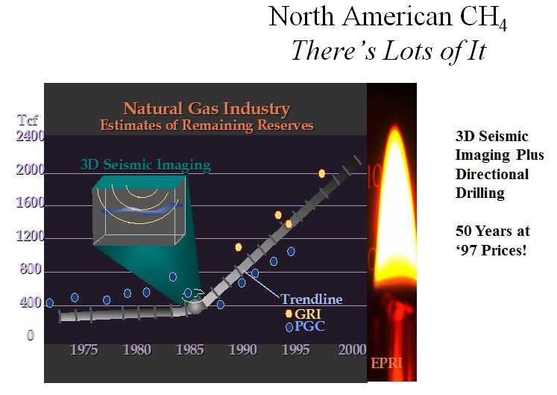
However, we do indeed have a “compelling new opportunity!”
P.M. Grant, EPRI, 1998
...& hydraulic fracturing , aka “fracking”

Slide 45
Natural Gas & Electricity
“Fraternal Twins,”
Smart Grid News
16 April 2013
Wow!
2012 USA Electricity Generation by Primary Fuel Source

Slide 46
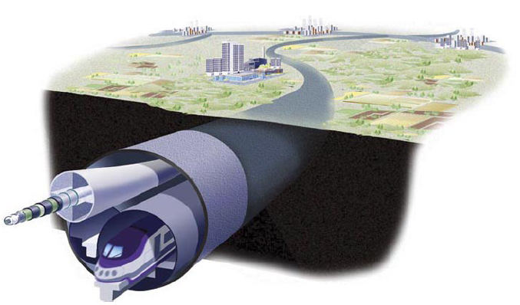
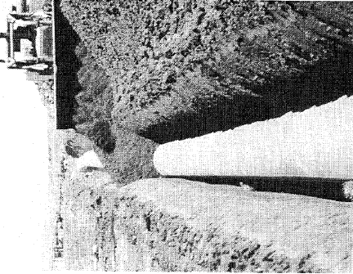
The “Dual Use” Concept Embodied
Almost all NG used for electricity generation is “combusted” at a “local” delivery point using modern, efficient, combined cycle gas turbine (CCGT) technology.
Why not “combust” that gas portion so-used at the “well-head” instead and deliver the “electrons” over a low-loss HTSC dc cable? As well as reducing volume...and...frictional loss due to NG transported by pipeline.
...and...consider “recycling” well-head generated CO₂ emissions into alcohols...and “pipe” those down the same ROW!
The ROW Dual Use concept has been documented in several peer reviewed journals as well as member magazines of the APS, IOP, IEEE, and Nature...contact the author/speaker for a linkable anthology.

Slide 47
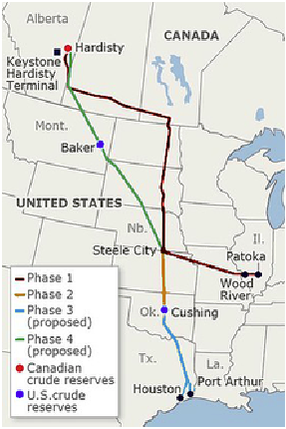
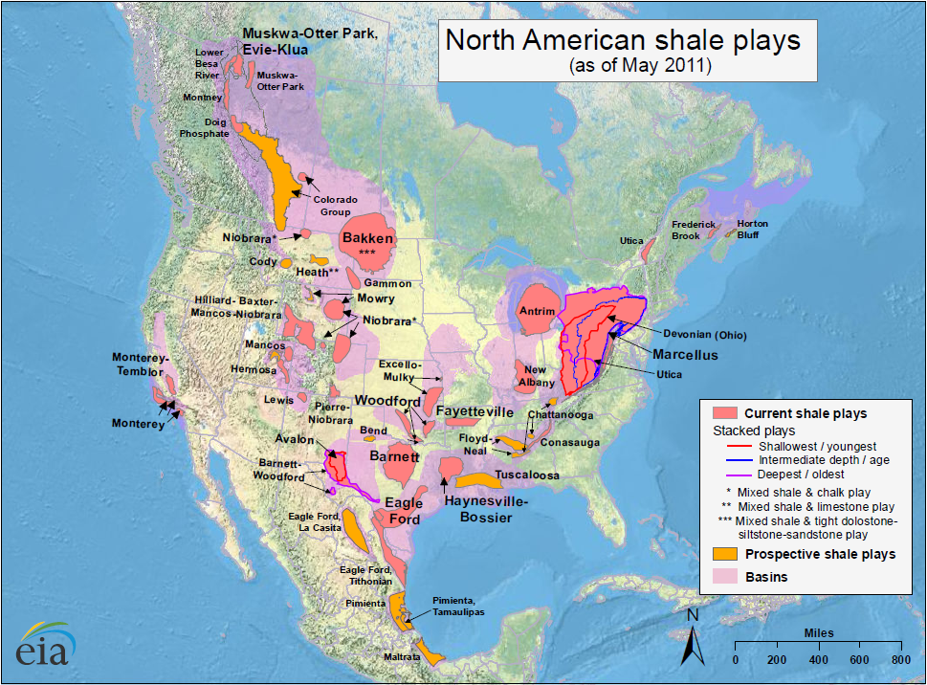
Does “Keystone XL” Provide a “Compelling Opportunity” to
“Raise Our Fraternal Twins?”
Let’s encourage DOE to enlist EPRI, GTI, EIPC, INGAA,...in a collaboration to conduct an “engineering economy” study focused on the dual-use ROW concept.

Slide 48


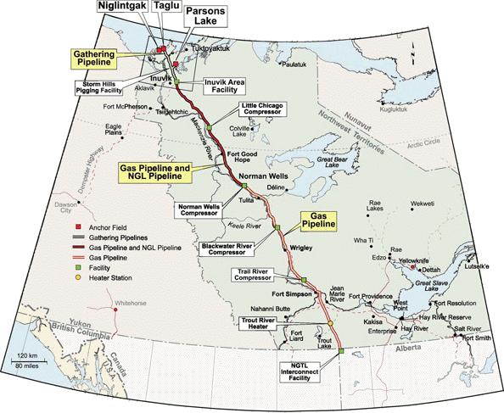
...and in the long term...
Electricity Conversion Assumptions
Wellhead Power Capacity | 18 GW (HHV)
Fraction Making Electricity | 33%
Thermal Power Consumed | 6 GW (HHV)
Left to Transmit as LNG | 12 GW (HHV)
CCGT Efficiency | 60%
Electricity Output | 3.6 GW (+/- 18 kV, 100 kA)
“Cryodelivery Systems for the Cotransmission of Chemical and Electric Power,”
P.M. Grant, AIP Conf. Proc. 823, 291 (2006).

Slide 49
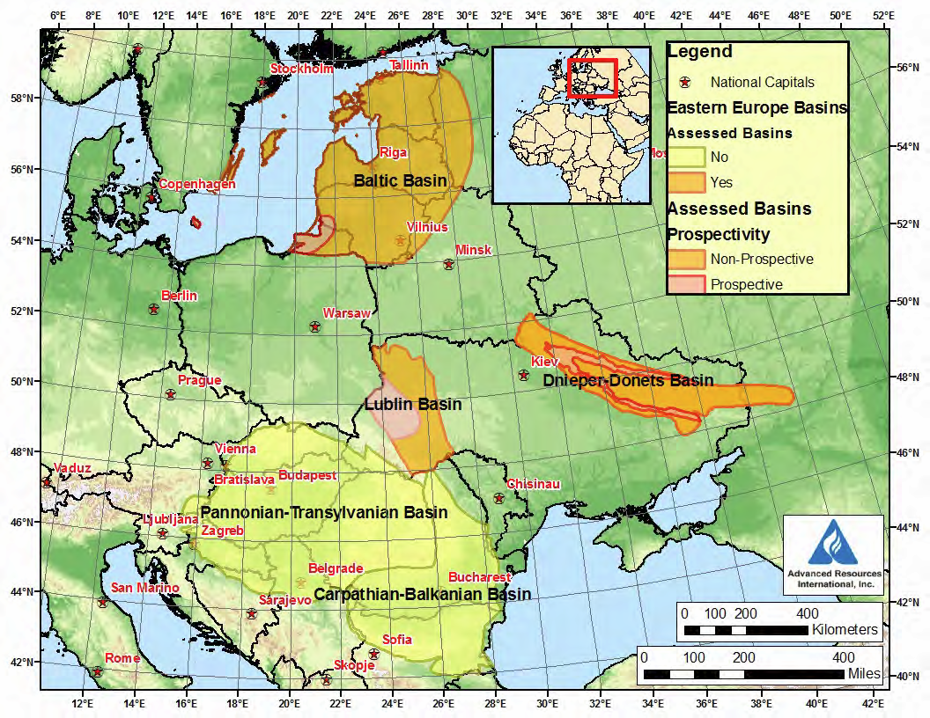


Let’s Not Forget Europe!
The Wola Obszańska (Lublin) gas field in Poland/Ukraine was discovered in 1989. It began production in 1992 and produces natural gas. The total proven reserves of the Wola Obszańska gas field are around 37 billion cubic feet (1×10⁹m³). “Dual-Pipe” to Berlin?
o Wroclaw

Slide 50
2100: The World Runs Out of CH4
The Dual Use ROWs Remain
Replace the CCGTs with 1-2 GW Nukes
Use Half the Power to Electrolyze (Frack) Nearby H2O Reserves to Release H2 ,
Then Liquify and Use to Refridgerate Upgraded HTSC Cables (If Necessary!)

Slide 51
The Energy SuperGrid

Slide 52
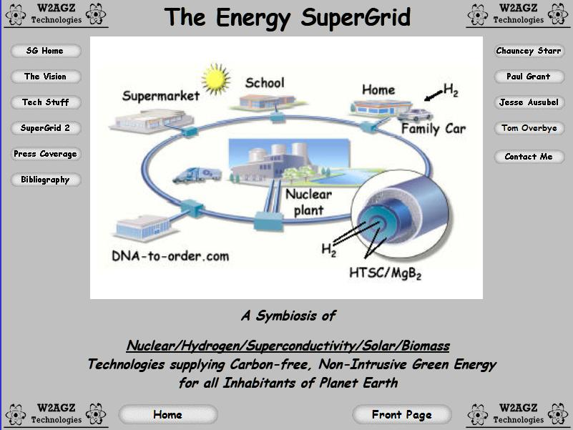
http://w2agz.com/PMG%20SuperGrid%20Home.htm

Slide 53


Published in
SCIENTIFIC
AMERICAN
July, 2006
“System Crash”
Omni Productions,
Vancouver, BC
CBC Broadcast October, 2008
Notes:
53

Slide 54




Exascale Energy for Our
Great-Great GrandKids!
SuperCity
SuperSuburb
SuperGrid
SuperTrain

Slide 55





“The Only Commercial Application of HTSC”
Now it’s graphene!

Slide 56
A Model For the Future

Slide 57




“A Thread Across the Ocean”
Isambard Kingdom Brunel
English Engineer
Cyrus Field
American Capitalist
William Thomson
Irish Physicist
“The Story of the Trans-Atlantic Cable (1854 – 1866)”
John Steele Gordon

Slide 58
What Kept Them Going?
The investors knew, that if communications with Europe could be cut from 2 weeks to 2 minutes, they’d all get…
FILTHY RICH!
  Estimates are that the total cost of the project in 2005 dollars was $100 M
  First year 1867 revenue in 2005 dollars
  as $10 M !

Slide 59


The After-Story
1870
1903
The First Links in the World Wide Web!

Slide 60
The Economic (Venn)Troika That
Drives and Exploits
Technology Innovation
Societal
Sustain the Economy
“enlightenment”
“infrastructure”
Entrepreneurial
Create the Economy
“stuff”
“jobs”
Governmental
Protect the Economy
“agencies”
“military”

Slide 61
Finale

Slide 62
Superconductors
- The Long Road Ahead –
Foner & Orlando (1988)
“Widespread use of these
[high temperature] superconducting technologies will have far more to do with
questions of public policy and economics than with the nature of the new materials.”

Slide 63

“You can’t always get what you want…”

Slide 64

“…you get what you need!”

