Slide 1


Power Integrity for High-Speed Design on Multi-Layer PCBs
Concepts and Physics
James L. Drewniak
Clear Signal Solutions and
Missouri S&T EMC Laboratory
james.drewniak@clearsig.com

Slide 2
Contributors
IBM – B. Archambeault, S. Connor, M. Cocchini, W. Becker, M. Cracraft, A. Ruehli
Cisco – B. Achkir, S. Scearce, Q. Gaumer, M. Sapazhnikov
Missouri S&T – B. Zhao, S. Bai, S. Liang, X. Zhu, K. Shringapure, S. Pan, J. Xu, J. Fan

Slide 3
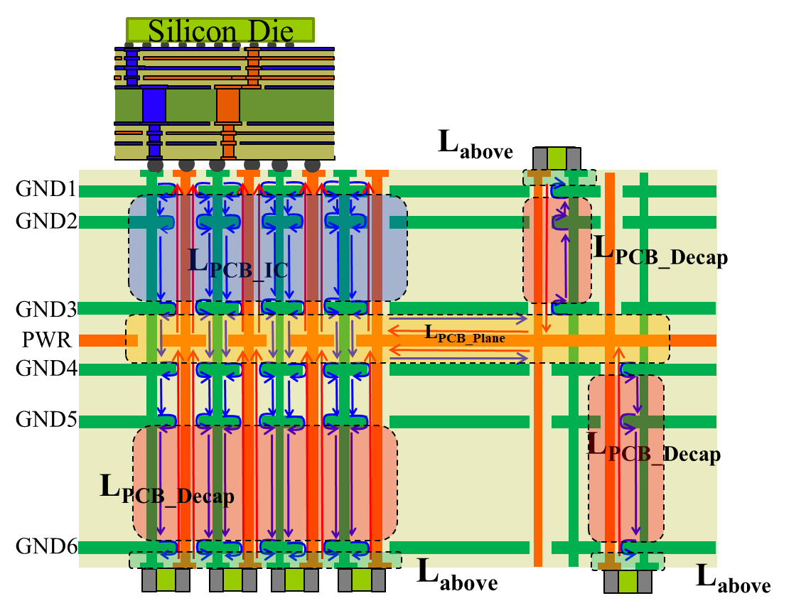
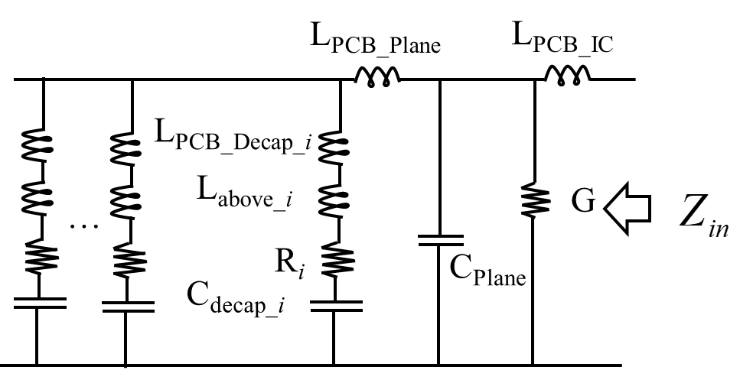
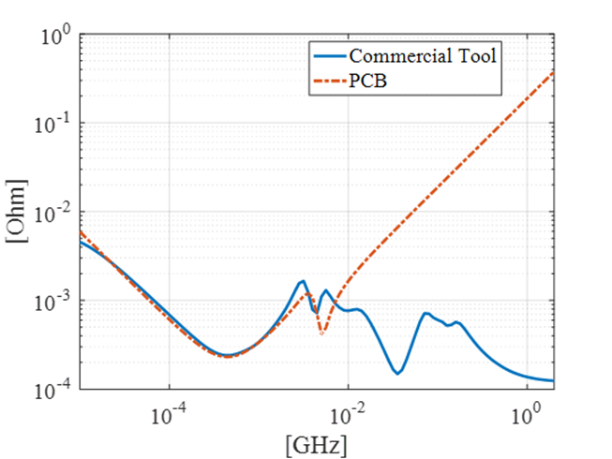
PI Module Overview Part 1 – Concepts and Physics
The PDN problem
Noise on the PDN and an FPGA example
PDN design considerations
A couple of preliminary concepts
Current and inductance physics
A reduced order circuit model from a first principles formulation
Characteristic Z_{PDN} and relationship to physics
Understanding PDN physics and design through examples
Identifying limiting physics in design
Adding decoupling capacitors

Slide 4
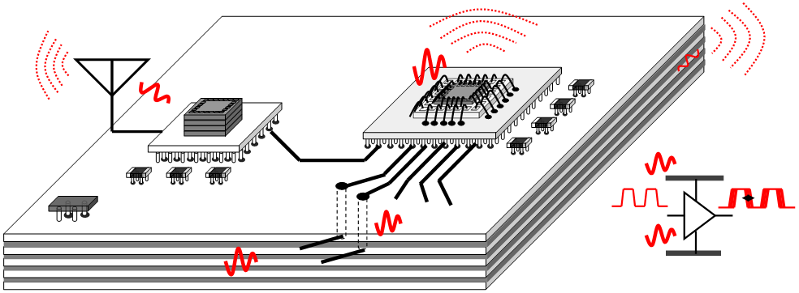
PDN Problem
High-speed, integrated, and mixed electronic system
IC EMI source model?
PKG
3D IC
IC Die
Power Distribution Network
Decap
VRM
Jitter
Effect of PDN noise on I/O jitter
Power Distribution Network
VRM
Decoupling capacitors
Power net area fills

Slide 5
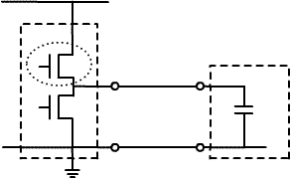
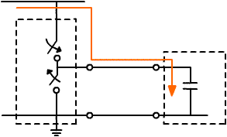
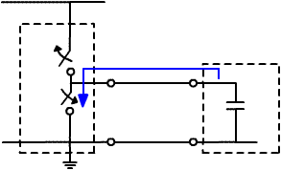
Logic Transitions and Current Draw
V_{CC}
Shoot-thru current (and everything else we can’t account for)
IC
driver
switch
IC load
V_{DC}
Z₀, v_{p}
C_{L}
Load charging current
Load discharge current
GND
V_{CC}
V_{CC}
IC
driver
IC
driver
charge
IC load
discharge
IC load
Z₀, v_{p}
V_{CC}
Z₀, v_{p}
0 V
shoot-thru current
shoot-thru current
GND
GND
LO to HI
HI to LO
This charge to support IC switching must be provided by the PDN – package, PCB

Slide 6
Voltage Switching/Dynamic Current Draw Disturbances
1
0
Dynamic current on power net causes disturbance and can lead to faulty switching, a source of jitter, and trouble in general
T₁ and T₂ are not simultaneous
banks of transistors for the PMOS and NMOS not perfectly synchronized
V_{PWR}
v_{L}
T₁
IC load
V_{PWR}+V_{Noise}
charging current
i_{logic}
IC
driver
V_{CC}
T₂
i_{IC}
GND
shoot thru current
i_{st}
a trouble-maker

Slide 7
PCB for FPGA Core PDN Noise Example
Port 1
Port 2
SMT capacitor pads for 0805, 0603, 0403
Power planes: VCC, VCCN, VCCPD
Power Supply BNC connectors (sensing line)
FR4 dielectric
Bulk Capacitor
Signal layers
VCC SMA connector
Ground planes
FPGA dedicated clock input SMA U33
Port 2 is beneath the FPGA package coax probe

Slide 8
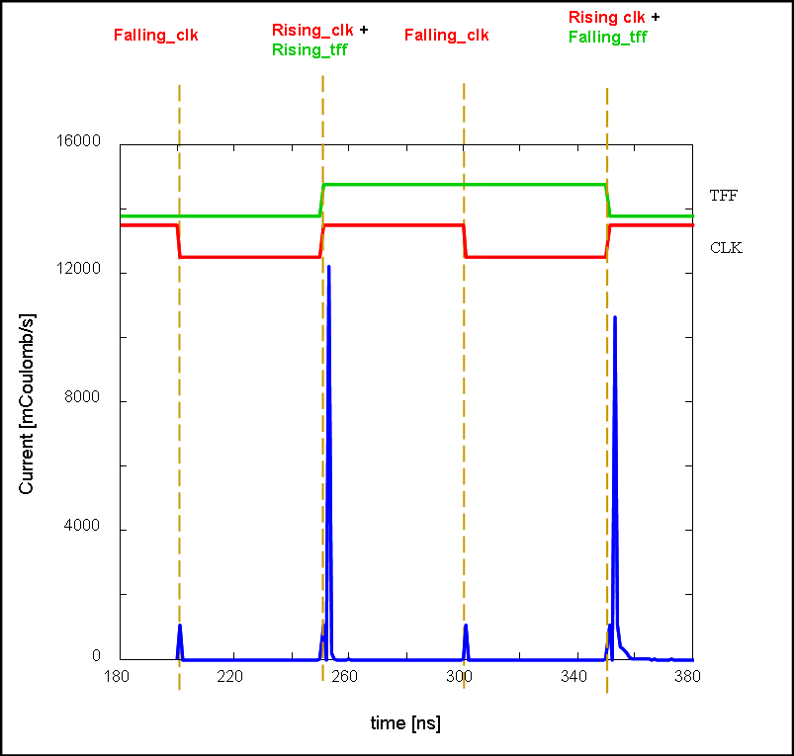
Current Draw and the Logic Waveform
FPGA core power only

Slide 9
Dynamic Current Profile (calculated)
FPGA Core power only
Logic toggles
Falling clock edge
Rising clock edge
Reconstructed time domain current for a large number of toggle flip-flops

Slide 10
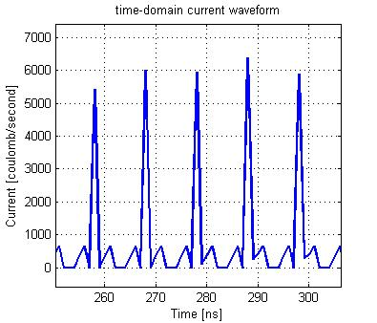
Transient Current Waveform - Simulated
FPGA with 18% grey-code counters implemented

Slide 11
Voltage Disturbance Calculations with Z-Parameters
V1
PCB + (Package + On-die capacitance)
V2
I1
(from IC simulation)
Spectrum Analyzer, Scope, other IC
I2
ZL = 50 Ω
For measurement
PDN impedance IC sees for usual case
otherwise
Then the PDN
noise voltage is
or impedance into another IC
I₂ is from IC simulation. Z₂₁ and Z₁₁ are both from impedance simulation (also are calculated from S-parameters from modeling or measurement).

Slide 12
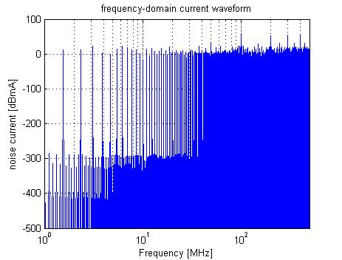
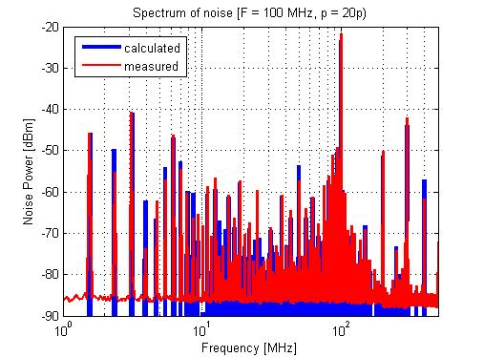
PDN Noise Voltage Spectrum Prediction
|I_{IC}(jω)|=|I₂(jω)|
(source)
x
=
|Z_{transfer-PDN}(jω)|
=|Z₁₂(jω)|
BGA package & IC
|V_{PDNnoise}(jω)|=|V₁(jω)|
Un-freindly things happen at resonances – lumped or distributed

Slide 13
PDN Noise Voltage from Impedance
I_{IC}(jω)
(source)
x
|Z_{transfer-PDN}(jω)|
=|Z₁₂(jω)|

Slide 14
Transient PDN Noise Voltage
Inverse Fourier Transform to get
30 mV
15 mV
NO De-Caps
WITH 16 De-Caps
The estimated and measured noise voltage were compared, with a 100 MHz clock input, multi-frequency FPGA configuration, on the bare board and decoupled board.

Slide 15
PI Module Overview Part 1 – Concepts and Physics
The PDN problem
Noise on the PDN and an FPGA example
PDN design considerations
A couple of preliminary concepts
Current and inductance physics
A reduced order circuit model from a first principles formulation
Characteristic Z_{PDN} and relationship to physics
Understanding PDN physics and design through examples
Identifying limiting physics in design
Adding decoupling capacitors

Slide 16
PCB PDN Design Considerations
2a. Decoupling capacitors
top
bottom,
beneath IC?
2b. Decoupling capacitor connection -
PWR/GND via geometry
Package size
IC
Power net area fill
location in stack
spacing to power return plane
total area fill
special materials
Decaps
2a. Decoupling capacitors
value(s)
number (total C)
IC pins
Effect of other ground/reference planes?
2c. Decoupling capacitor layout
How close to IC?
Shape – ring IC, on one side?
doublet
3. IC PWR/GND
Number pins
pin pattern
Pitch
on-package decaps
PWR
GND

Slide 17
PI Module Overview Part 1 – Concepts and Physics
The PDN problem
Noise on the PDN and an FPGA example
PDN design considerations
A couple of preliminary concepts
  Responses for RLC circuits
  High-frequency current path

Slide 18
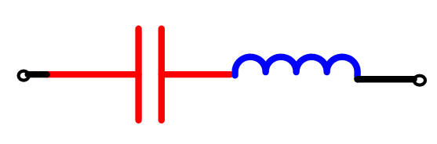
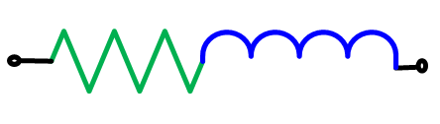
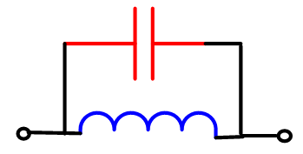
Reminder – Circuit Model Behavior with Frequency
Series
resonance
Parallel
resonance

Slide 19
Reminder: Current Behavior
impeded by
Conduction current – carried by electrons
Displacement current – carried by
admitted by
Signal
Current on a microstrip line for high-speed data
-
+
GND
At high frequencies, when the copper planes/area fills that function as the signal reference conductors are several skin depths thick, no E or H fields can exist inside these planes. In order for this to be the case, currents have to “see” a partner and cannot “look through” conductors.

Slide 20
PI Module Overview Part 1 – Concepts and Physics
The PDN problem
Noise on the PDN and an FPGA example
PDN design considerations
A couple of preliminary concepts
Current and inductance physics
  Conduction current path through layers (vertical) on PCB PDN and associated inductance
  Decomposing the inductance into pieces
  Current path across the power net area fill and the ground power return current

Slide 21
The Objective and Guiding Physics:
Conduction Current Path results in Inductance
Looking from the IC
IC
Top decoupling capacitors
IC
GND
GND
GND
GND
GND
PWR
GND
GND
GND
GND
GND
Decoupling capacitors sharing IC vias
Bottom decoupling capacitors
Notes:
One inductor per via per cavity
MUTUAL TERMS
Rearrange – reduce is series.
Series
Parallel

Slide 22
The Objective and Guiding Physics:
Conduction Current Path results in Inductance
Looking from the IC
IC
Top decoupling capacitors
IC
GND
GND
GND
GND
GND
PWR
GND
GND
GND
GND
GND
Decoupling capacitors sharing IC vias
Bottom decoupling capacitors
Notes:
One inductor per via per cavity
MUTUAL TERMS
Rearrange – reduce is series.
Series
Parallel

Slide 23
The Objective and Guiding Physics:
Condution Current Path results in Inductance
Looking from the IC
IC
Top decoupling capacitors
IC
GND
GND
GND
GND
GND
PWR
GND
GND
GND
GND
GND
Decoupling capacitors sharing IC vias
Bottom decoupling capacitors
Notes:
One inductor per via per cavity
MUTUAL TERMS
Rearrange – reduce is series.
Series
Parallel

Slide 24
Key Point – Current Path and Inductance
Four contributions (current path pieces) to the Z_{PDN} inductance
Looking from the IC
IC
Top decoupling capacitors
IC
Above PCB to decaps
GND
caps-to-PWR net area fill
GND
GND
GND
GND
pkg-to-PWR net area fill
PWR
GND
in PWR net area fill
GND
GND
GND
GND
Decoupling capacitors sharing IC vias
Bottom decoupling capacitors
Notes:
One inductor per via per cavity
MUTUAL TERMS
Rearrange – reduce is series.
Series
Parallel

Slide 25
Geometry and Inductance Decomposition
Silicon Die
L_{above}
GND1
Must account for mutual L
GND2
L_{PCB_IC}
L_{PCB_Decap}
Must account for mutual L
GND3
PWR
L_{PCB_Plane}
GND4
Must account for mutual L
GND5
L_{PCB_Decap}
L_{PCB_Decap}
GND6
L_{above}
L_{above}

Slide 26
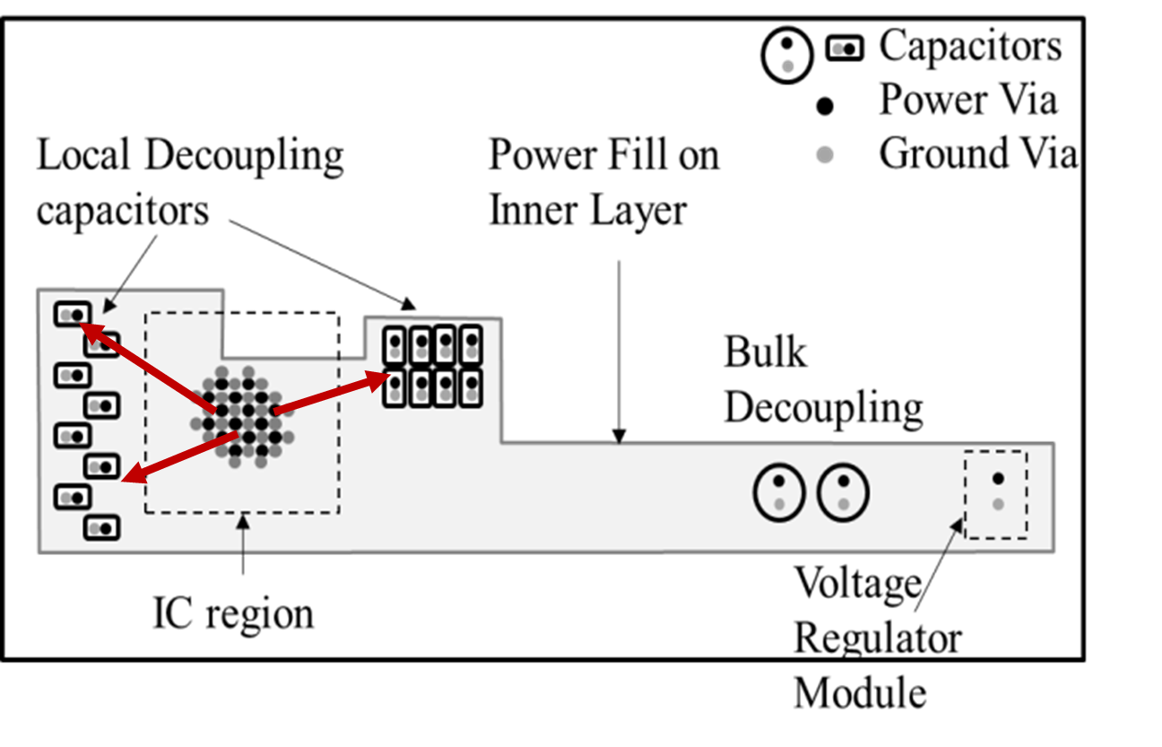
Current Path, and Inductance
Current path from IC to decaps in the power net area fill layer is better to be in line (and not cross cutouts, around corners, etc.). L_{PCB_plane} is increased otherwise.
Notes:
The real board geometry is shown on top. The model and response are shown at bottom right and left respectively. The response for increasing number of capacitors is compared at the bottom left. As number of capacitors increase, the capacitance at low frequency increases as a direct result. Also L_{EQ} , converges into L_{IC} as the capacitors are added. Thus, if L_{IC} is lower, then the L_{EQ} will converge to a lower value. L_{IC} is independent of the capacitors placed on the PCB.

Slide 27
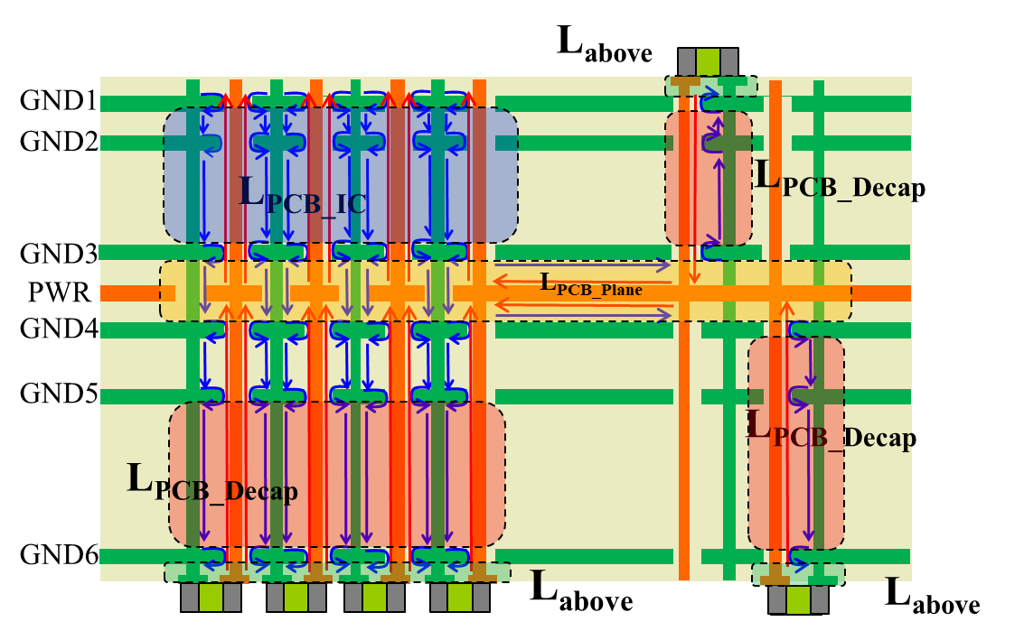
Key Points
Production printed circuit boards that use area fills for the power net will have from 4 to over 40 layers. The IC package may have tens to hundreds of vias, and there may be tens to hundreds of decoupling capacitors. The complexity is high, but the current path physics are very straight-forward, though there will be many parallel paths.
The inductance associated with a current path can be decomposed into four pieces along the path.
Direct, “line-of-sight” current paths between the IC and the decaps will have less L_{PCB Plane} inductance than current paths that cross cutouts, slots, go around corners, etc.

Slide 28
PI Module Overview Part 1 – Concepts and Physics
The PDN problem
Noise on the PDN and an FPGA example
PDN design considerations
A couple of preliminary concepts
Current and inductance physics
A reduced order circuit model from a first principles formulation
  Impedance from a Maxwell’s equation formulation
  A many element physics-based model to a reduced order impedance equivalent circuit with inductance related to geometry decomposition

Slide 29
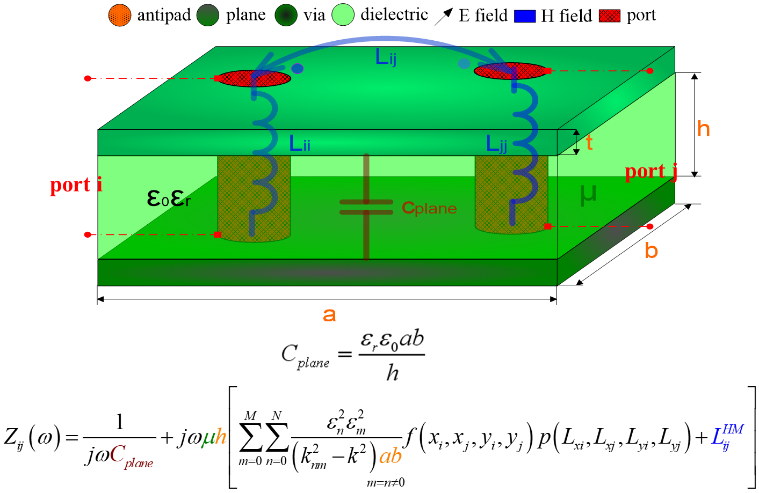
Calculating Inductance from Current Path Physics
All current segments in all layers are modeled (often many thousands or tens of thousands) and self inductances for every segment and mutual between segments are extracted using the (first principles) cavity model.
Self and mutual inductances are included.

Slide 30
Circuit Model for PCB PDN
physics-based circuit model
L_{above}
P_{IC_G1}
P_{IC_G2}
+
+
L_{above}
GND1
GND1
-
-
L_{PCB_IC}
L_{PCB_Decap}
L_{PCB_IC}
L_{PCB_Decap}
GND3
GND3
L_{PCB_Plane}
L_{PCB_Plane}
PWR
PWR
GND4
GND4
L_{PCB_Decap}
L_{PCB_Decap}
L_{PCB_Decap}
L_{PCB_Decap}
GND6
GND6
L_{above}
L_{above}
L_{above}
L_{above}
L_{above}
L_{PCB_Plane}
L_{PCB_IC}
All current segments in all layers are modeled (often many thousands or tens of thousands) and self inductances for every segment and mutual between segments are extracted using the (first principles) cavity model and a SPICE model is assembled.
L_{PCB_Decap_i}
L_{above_i}
G
…
R_{i}
C_{Plane}
C_{decap_i}
Circuit reduction is used to get an impedance equivalent circuit model that coincides with the large-scale current path from IC package to decaps. Inductances are related to the current path on the geometry.

Slide 31
Impedance Equivalent Circuit
Decaps on Top layer
C_{decap1}
L_{above1}
PKG + IC
GND1
GND2
L_{PCB_Decap}
C_{plane1}
GND3
PWR
GND4
L_{PCB_Plane}
C_{plane2}
GND5
L_{PCB_Decap}
GND6
L_{above2}
C_{decap2}
Decaps on Bottom Layer
Includes mutual inductances

Slide 32

Geometry and Impedance Equivalent Circuit
L_{PCB_Plane}
L_{PCB_IC}
L_{PCB_Decap_i}
L_{above_i}
G
…
R_{i}
C_{Plane}
C_{decap_i}

Slide 33
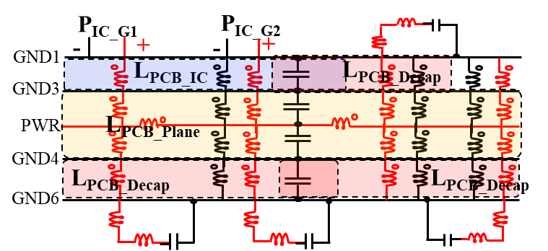
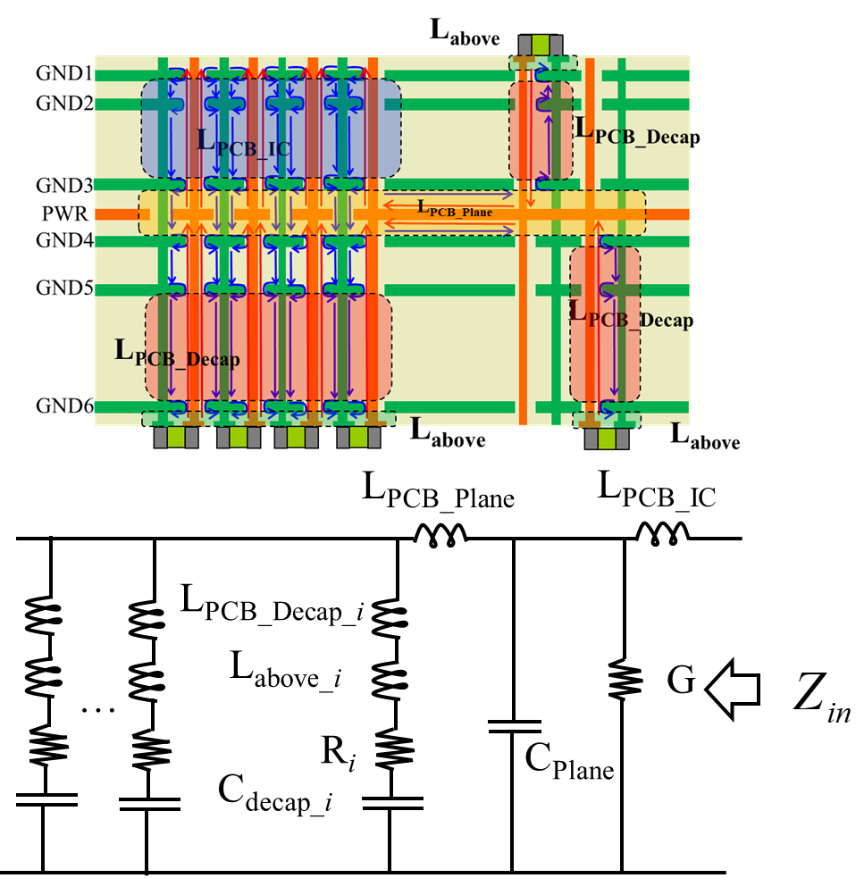
Key Points
All current segments in all layers are modeled (often many thousands or tens of thousands) and self inductances for every segment and mutual inductance between segments are extracted using the (first principles) cavity model and a SPICE model is assembled.
Circuit reduction can be done to produce an impedance equivalent circuit model in which the model values can be calculated. The impedance equivalent circuit model can be directly related to the geometry and current paths

Slide 34
PI Module Overview Part 1 – Concepts and Physics
The PDN problem
Noise on the PDN and an FPGA example
PDN design considerations
A couple of preliminary concepts
Current and inductance physics
A reduced order circuit model from a first principles formulation
Characteristic Z_{PDN} and relationship to physics
  Characteristic Z_{PDN} response resulting from current-path physics and associated inductance
  Relating the Z_{PDN} response to geometry and the impedance equivalent circuit model
  Z_{PDN} frequency response related to physics

Slide 35
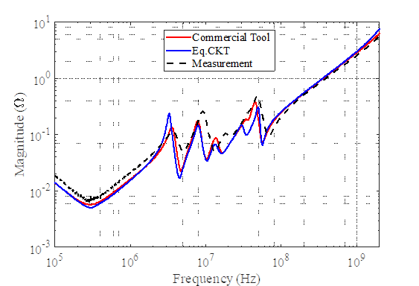
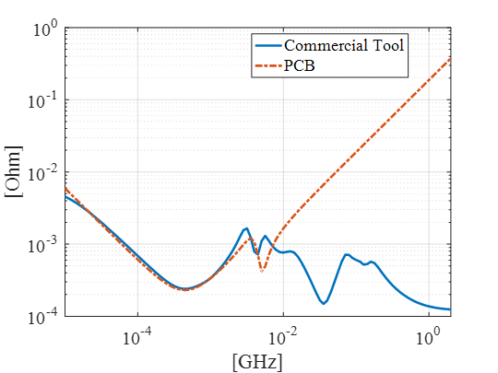
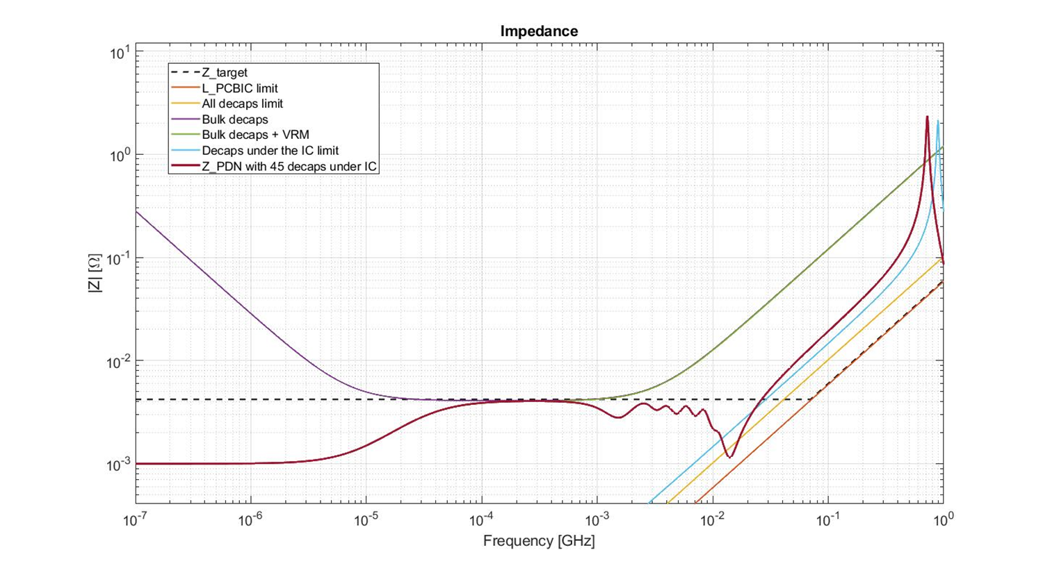
Resulting Z_{PDN} Response
Each of these production real PCBs use only a single layer for the power net area fill (with adjacent layers for power return ground).
100
measurement
10
Eq. circuit
28 layer PCB
1
Input Impedance at an IC port [Ω]
0.1
6 layer PCB
0.01
0.001
0.1
1
10
100
1000
Frequency [MHz]
18 layer PCB
44 layer PCB
0402 decaps
under IC
bulk
decaps
VRM

Slide 36
Resulting Z_{PDN} Response
Z_{PDN} response is very consistent because of the current path and its associated inductance as seen from the impedance equivalent circuit model
6 layer PCB
44 layer PCB
0402 decaps
under IC
PCB
IC
bulk
decaps
pkg
VRM

Slide 37
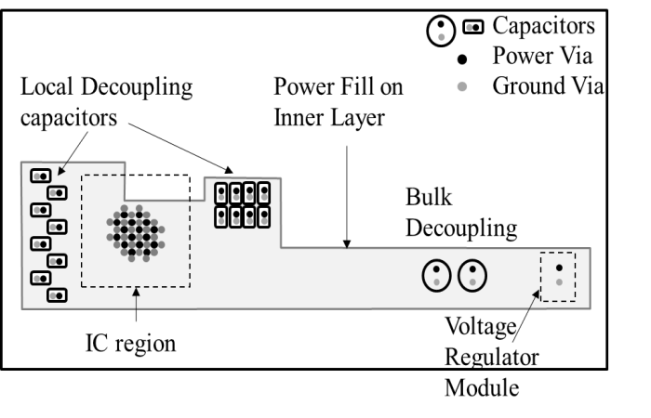
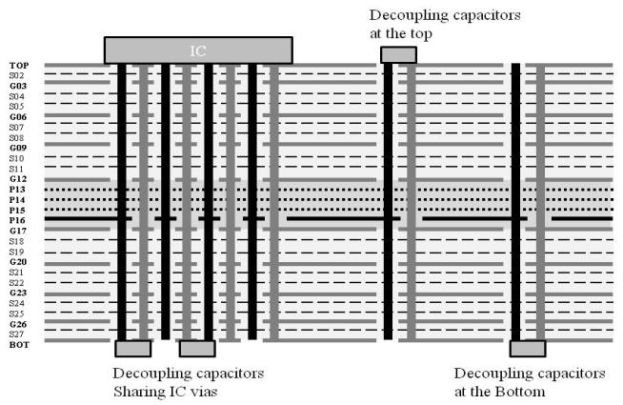
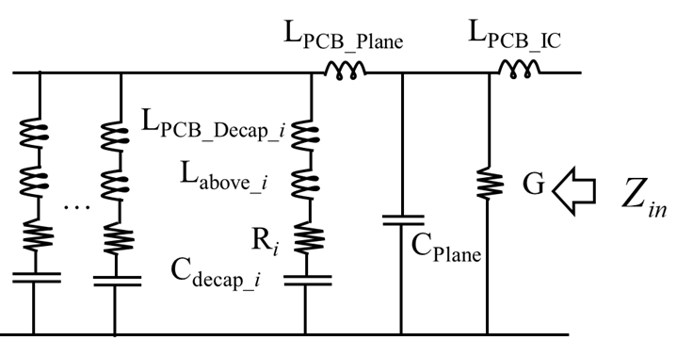
Geometry, Current Path, Model, and Z_{PDN}
Notes:
The real board geometry is shown on top. The model and response are shown at bottom right and left respectively. The response for increasing number of capacitors is compared at the bottom left. As number of capacitors increase, the capacitance at low frequency increases as a direct result. Also L_{EQ} , converges into L_{IC} as the capacitors are added. Thus, if L_{IC} is lower, then the L_{EQ} will converge to a lower value. L_{IC} is independent of the capacitors placed on the PCB.

Slide 38
Frequency Response for PCB PDN - C
L_{above}
GND1
C_{plane}
+C_{Decap}
C_{Plane}
L_{PCB_IC}
L_{PCB_Decap}
GND3
L_{PCB_Plane}
L_{PCB_IC}
PWR
GND4
L_{PCB_EQ}
L_{PCB_Decap}
L_{PCB_Decap}
GND6
L_{above}
L_{above}
S.C
S.C
S.C

Slide 39
Frequency Response for PCB PDN – f₁
L_{above}
GND1
C_{Plane}
L_{PCB_IC}
L_{PCB_Decap}
C_{Decap}
GND3
L_{PCB_Plane}
L_{PCB_IC}
PWR
GND4
L_{PCB_EQ}
L_{PCB_Decap}
L_{PCB_Decap}
GND6
L_{above}
L_{above}
O.C

Slide 40
Frequency Response for PCB PDN – L_{PCB EQ}
L_{above}
GND1
C_{Plane}
L_{PCB_IC}
L_{PCB_Decap}
C_{Decap}
GND3
L_{PCB_Plane}
L_{PCB_IC}
PWR
GND4
L_{PCB_EQ}
L_{PCB_Decap}
L_{PCB_Decap}
GND6
L_{above}
L_{above}
O.C
S.C
S.C
S.C

Slide 41
Frequency Response for PCB PDN – f₂
L_{above}
GND1
C_{Plane}
L_{PCB_IC}
L_{PCB_Decap}
C_{Decap}
GND3
L_{PCB_Plane}
L_{PCB_IC}
PWR
GND4
L_{PCB_EQ}
L_{PCB_Decap}
L_{PCB_Decap}
GND6
L_{above}
L_{above}
S.C
S.C
S.C

Slide 42
Frequency Response for PCB PDN –C_{Plane}
L_{above}
GND1
C_{Plane}
L_{PCB_IC}
L_{PCB_Decap}
C_{Decap}
GND3
L_{PCB_Plane}
L_{PCB_IC}
PWR
GND4
L_{PCB_EQ}
L_{PCB_Decap}
L_{PCB_Decap}
GND6
L_{above}
L_{above}
S.C
O.C
O.C
O.C

Slide 43
Frequency Response for PCB PDN – f₃
L_{above}
GND1
C_{Plane}
L_{PCB_IC}
L_{PCB_Decap}
C_{Decap}
GND3
L_{PCB_Plane}
L_{PCB_IC}
PWR
GND4
L_{PCB_EQ}
L_{PCB_Decap}
L_{PCB_Decap}
GND6
L_{above}
L_{above}
O.C
O.C
O.C
S.C

Slide 44
Frequency Response for PCB PDN –L_{PCB IC}
L_{above}
GND1
C_{Plane}
L_{PCB_IC}
L_{PCB_Decap}
C_{Decap}
GND3
L_{PCB_Plane}
L_{PCB_IC}
PWR
GND4
L_{PCB_EQ}
L_{PCB_Decap}
L_{PCB_Decap}
GND6
L_{above}
L_{above}
O.C
O.C
O.C
S.C

Slide 45
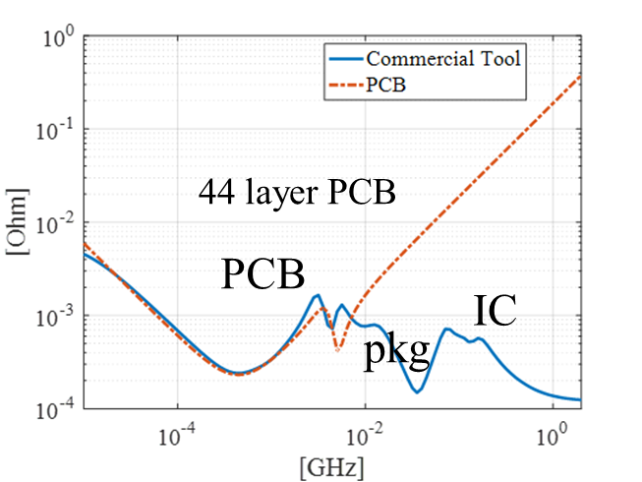
Key Points
The shape of the Z_{PDN} curve is very characteristic but relatively simple, even though the geometry of the PDN on a multi-layer PCB is complicated
The current-path physics governing the impedance are dominated by inductance and lumped element resonances above approximately 1 MHz
The inductance is dominated by the current path – geometry “length/area” (series inductance), and the number of parallel paths (parallel inductance) and this will drive the design approach (“small loops and many loops”)
Where power layers are located in stackup
Package ball pitch
Decoupling capacitor interconnect
Number of PWR/GND vias in package
Number of decoupling capacitors

Slide 46
PI Module Overview Part 1 – Concepts and Physics
The PDN problem
Noise on the PDN and an FPGA example
PDN design considerations
A couple of preliminary concepts
Current and inductance physics
A reduced order circuit model from a first principles formulation
Characteristic Z_{PDN} and relationship to physics
Understanding PDN physics and design through examples
Identifying limiting physics in design
Adding decoupling capacitors

Slide 47
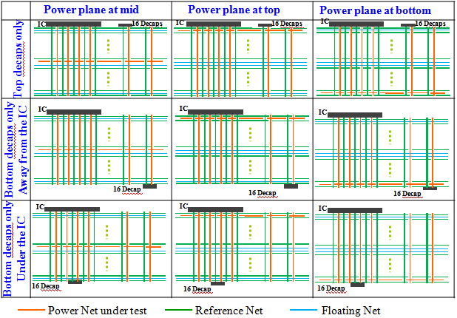
Power Plane and Capacitor Location Matrix

Slide 48
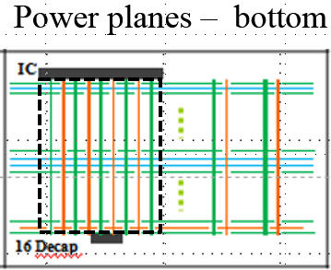
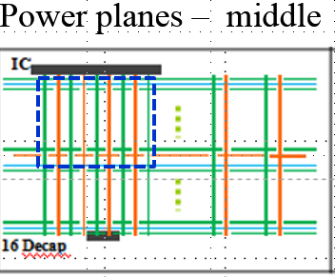
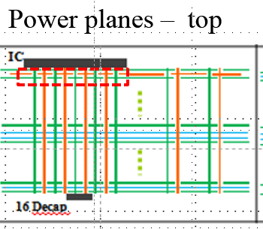
L_{high} – Power Plane Location in Layer Stack
L_{PCB_IC}
Power plane at Top
Power plane Middle
Power plane Bottom

Slide 49
L_{high} – Power Plane Location in Layer Stack
L_{PCB_IC}
Decreasing current path and inductance from package balls to PDN power layer net
Power plane at Top
Power plane Middle
Power plane Bottom
Power layer closest to the IC minimizes IC to power plane inductance. (Recall that jωL_{PCB_IC} is the impedance limit above a few MHz.)

Slide 50
L_{high} – Power Plane Location in Layer Stack
L_{PCB_IC}
Power plane at Top
Power plane Middle
Power plane Bottom
?
Q: How many power pins are there here?
Q: Why is the mid frequency range impedance not changing

Slide 51
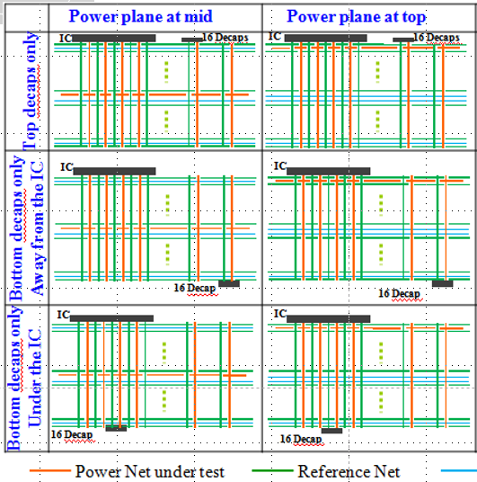
Capacitor Location – Top, Bottom, at IC
L_{PCB_IC}
L_{PCB_EQ}
Capacitors placed on the side closest to the power plane reduces the inductance from the capacitor to power plane and L_{EQ}. The current path length/area is smallest.

Slide 52
Capacitor Location – Top, Bottom, at IC
L_{PCB_IC}
Q: Why are there only two curves in the mid-frequency range and what do they correspond to? Explain the differences.
L_{PCB_EQ}

Slide 53
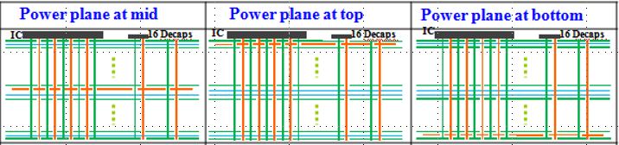
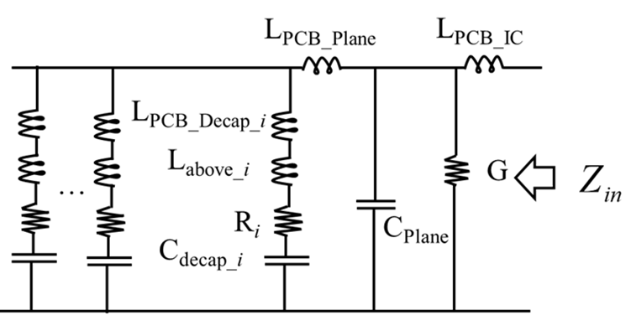
L_{EQ} – Power Plane Location and Decaps
Power planes – mid
Power planes – top
Power planes – bottom
L_{PCB_IC}
Power plane at Top
Power plane Middle
Power plane Bottom
L_{PCB_EQ}
Consider the IC to have >100 PWR pins (and associated GND return) such that LPCB IC is very small. And that many decaps can be added.
Q: What limits the PDN impedance in each case above?

Slide 54
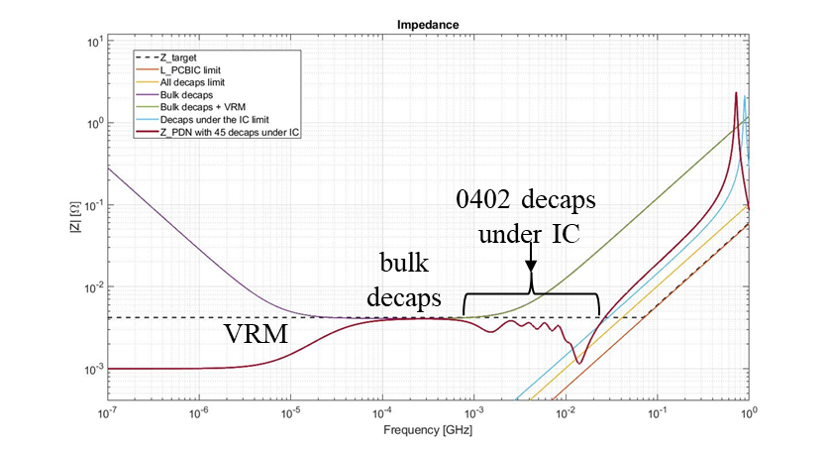
Example
18 layer PCB
Layer 2 is the power layer
45 power pins, 109 surrounding GND
45 decaps under the IC
Q: What happens if the number of IC pins are doubled?

Slide 55
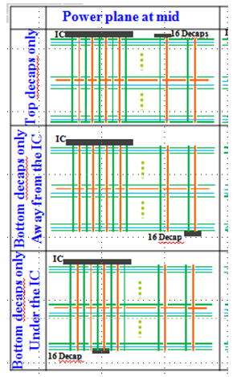
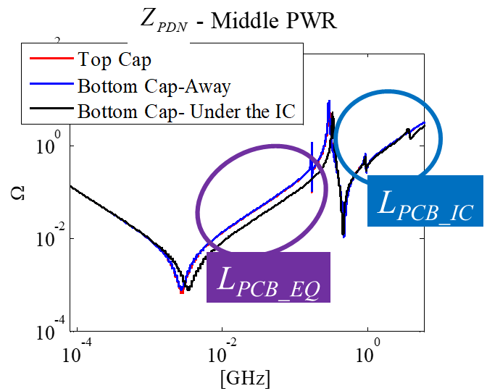
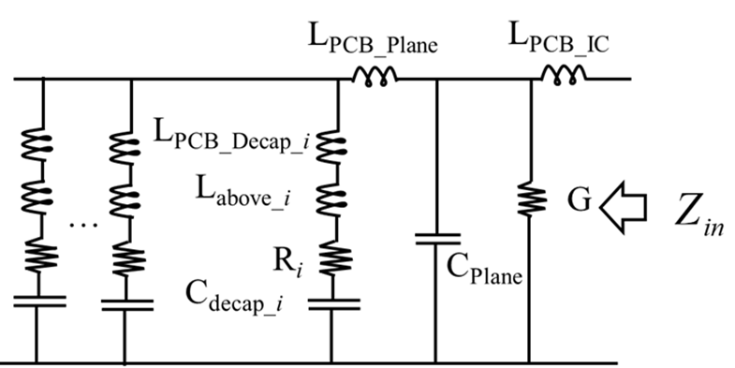
Key Points
The Z_{PDN} response can be related to the geometry, current path and associated inductance.
The dominant component in the impedance equivalent circuit can be identified and used to explain the behavior of the PDN response, and to guide the PDN design.

Slide 56
PI Module Overview Part 1 – Concepts and Physics
The PDN problem
Noise on the PDN and an FPGA example
PDN design considerations
A couple of preliminary concepts
Current and inductance physics
A reduced order circuit model from a first principles formulation
Characteristic Z_{PDN} and relationship to physics
Understanding PDN physics and design through examples
Identifying limiting physics in design
  L_{PCB IC}
  Decaps under the IC
  All decaps

Slide 57
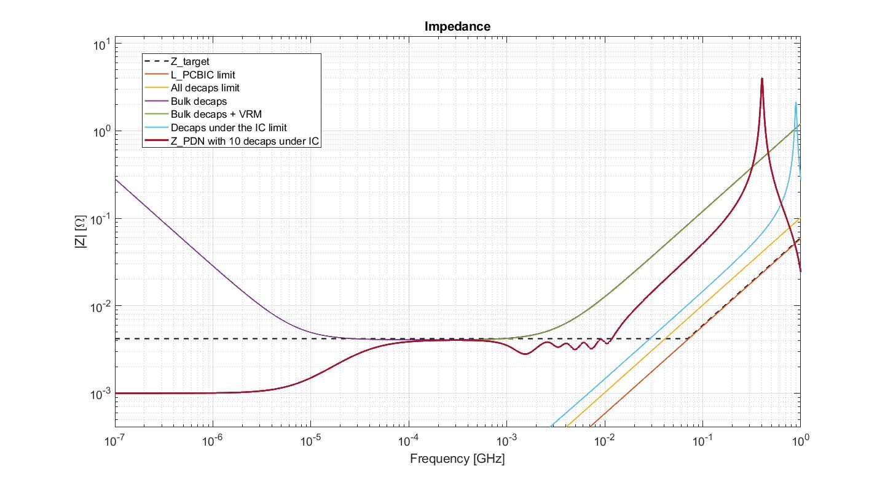
L_{PCB IC} Physical Limit
L_{PCB IC} is the physical limit at high frequencies when the current returns through the interplane capacitance of the power net area fill and return
O.C
O.C
O.C
S.C
L_{PCB IC} limit

Slide 58
Real Board L_{PCB IC} Examples
100
measurement
10
Eq. circuit
28 layer PCB
1
Input Impedance at an IC port [Ω]
0.1
6 layer PCB
0.01
0.001
0.1
1
10
100
1000
Frequency [MHz]
18 layer PCB
44 layer PCB
0402 decaps
under IC
bulk
decaps
VRM

Slide 59
L_{PCB IC} Physical Limit
L_{PCB IC} is the physical limit at high frequencies when the current returns through the interplane capacitance of the power net area fill and return
O.C
O.C
O.C
S.C
L_{PCB IC} limit

Slide 60
All Decaps Physical Limit
The All Decaps physical limit is when shorts are placed across all decap locations under the IC, and a ring of many capacitor locations on the top and bottom of the PCB are shorted at the bonding pads
S.C.
S.C.
S.C.
All decaps limit

Slide 61
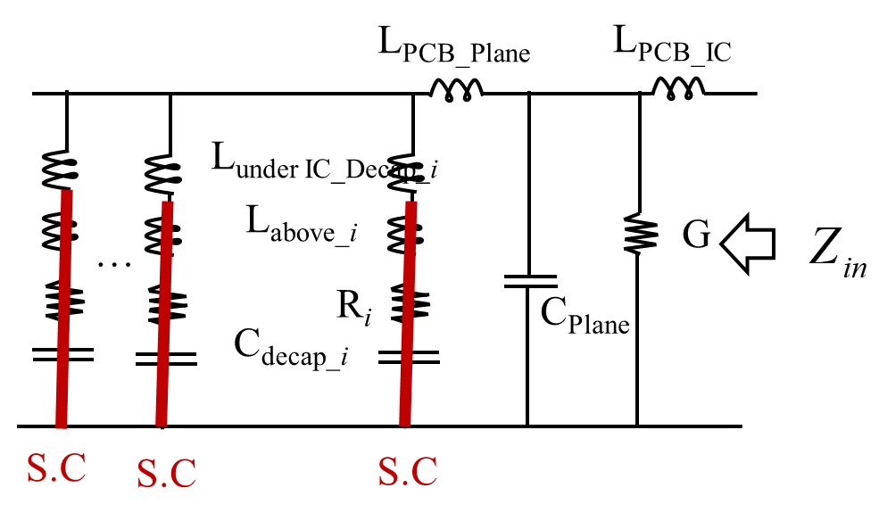
Decaps Under the IC Physical Limit
There is a physical limit when all the power pins under the IC are shorted on the bottom layer that corresponds to placing all possible decaps under the IC
Decaps under
the IC limit

Slide 62
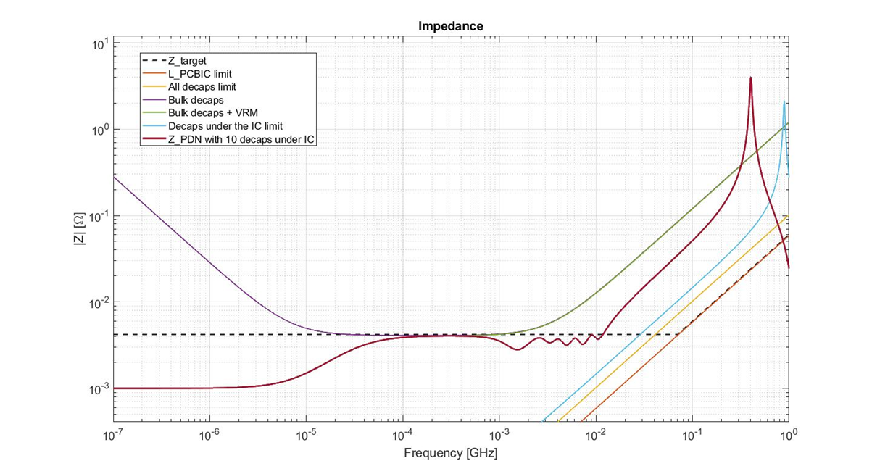
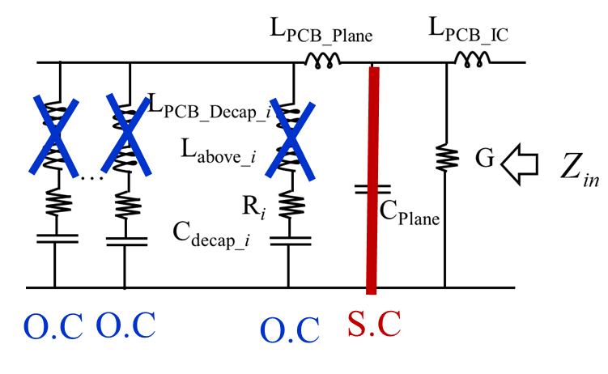
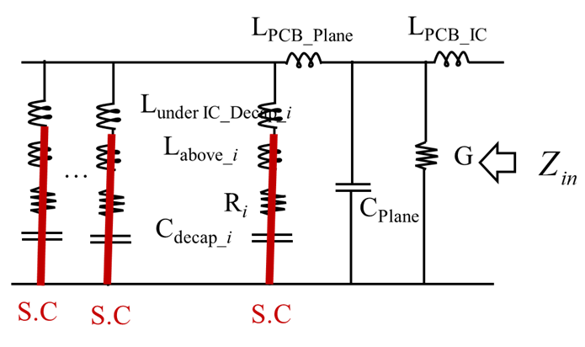
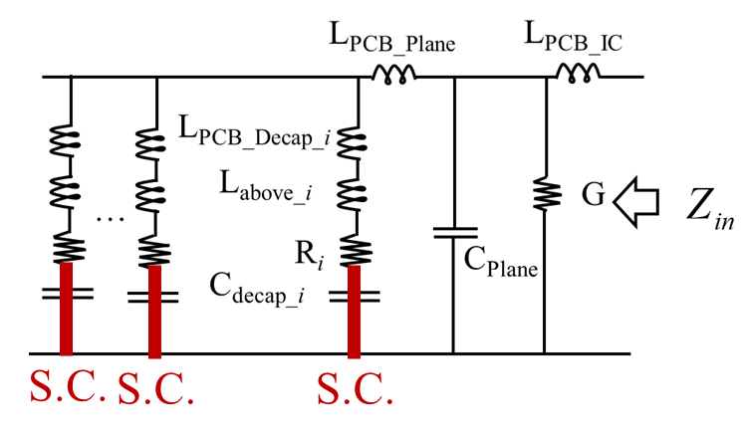
Key Points
Physical limits can be established for the upper bound of placing decoupling capacitors at various locations
  L_{PCB IC}
  Decaps under the IC
  All decaps
If the target impedance cannot be met due to a particular limitation, the nature of the limitation and the impedance equivalent circuit can guide the design direction.

Slide 63
PI Module Overview Part 1 – Concepts and Physics
The PDN problem
Noise on the PDN and an FPGA example
PDN design considerations
A couple of preliminary concepts
Current and inductance physics
A reduced order circuit model from a first principles formulation
Characteristic Z_{PDN} and relationship to physics
Understanding PDN physics and design through examples
Identifying limiting physics in design
Adding decoupling capacitors
  Values of decaps to use
  Where to place around the IC
  Connecting the decap to the PCB
  Convergence of L_{PCB Decap} for large number of decaps

Slide 64
Two Approaches for SMT Decoupling
Use an array of capacitor values:
  This may be the best known approach in the signal integrity design community
  Rationale: to maintain a flat impedance profile below a target impedance over a wide frequency range
  Typically a logarithmically spaced (10, 22, 47, 100, 220, 470nF, etc.) array of several values per decade.
Use a large capacitor value in the package size
  This is less well-known, but an approach in the EMI design community
  Rationale: to keep impedance as low as possible, less emphasis on a target impedance and a flat profile

Slide 65
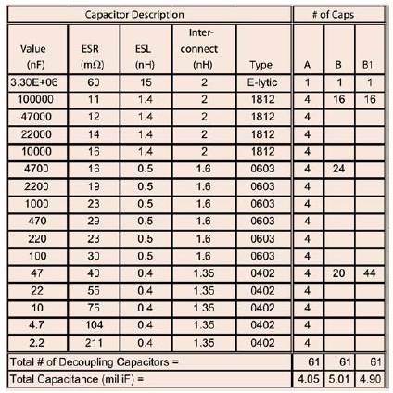
Decoupling Strategy – Geometry
9 in.
GND (PWR Return)
6 in.
PWR
t=10 mils.
tan δ = 0.02
ε_{r}=4.5

Slide 66
Approaches for SMT Decoupling Values
Approach A : values of decoupling capacitors logarithmically spaced, i.e. 3 values per decade: 10, 22, 47, 100, etc.
Approach B : largest values of decoupling available in two package sizes, i.e., 0603 and 0402
Approach B1 : largest values of decoupling available in one package size, i.e., 0402.
Target Impedance
Notes:
66

Slide 67
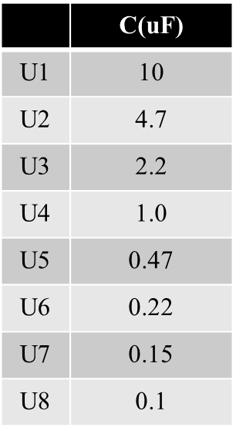
Optimizing Algorithm –10 decaps
Real 18 layer PCB with a maximum of 45 locations for decaps under the IC
0402 decaps
under IC
Bulk
decaps
VRM

Slide 68

Optimizing Algorithm –35 decaps
Real 18 layer PCB with a maximum of 45 locations for decaps under the IC
0402 decaps
under IC
Bulk
decaps
VRM

Slide 69

Optimizing Algorithm –45 decaps
Real 18 layer PCB with a maximum of 45 locations for decaps under the IC
0402 decaps
under IC
Bulk
decaps
VRM

Slide 70
28 Layer Real PCB Design: 1 Capacitor
IC port
100
100
10
10
1
1
Input Impedance at an IC port [Ω]
Input Impedance at an IC port [Ω]
0.1
0.1
0.01
0.01
C1210 (0603)
0.001
0.001
0.1
0.1
1
1
10
10
100
100
1000
1000
Frequency [MHz]
Frequency [MHz]
Measurement
Circuit Model

Slide 71
28 Layer Real PCB Design: 19 Capacitors
19 Decaps
IC port
100
10
1
Input Impedance at an IC port [Ω]
0.1
0.01
0.001
0.1
1
10
100
1000
Frequency [MHz]
Measurement
Circuit Model

Slide 72
28 Layer Real PCB Design: 43 Capacitors
IC
19 Decap
100
10
1
Input Impedance at an IC port [Ω]
Input Impedance at an IC port [Ω]
0.1
17 Decap
7 Decap
0.01
0.001
0.1
1
10
100
1000
Frequency [MHz]
Measurement
Circuit Model

Slide 73
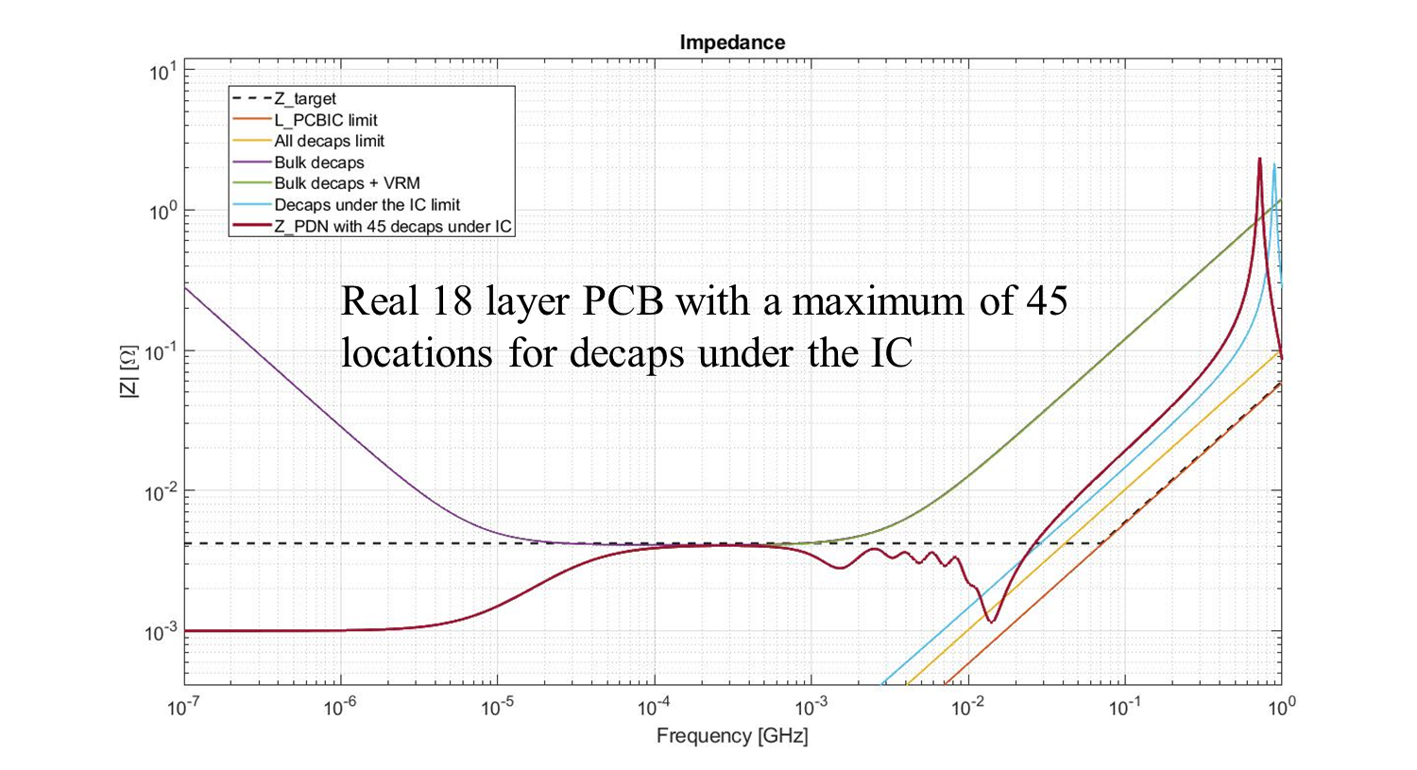
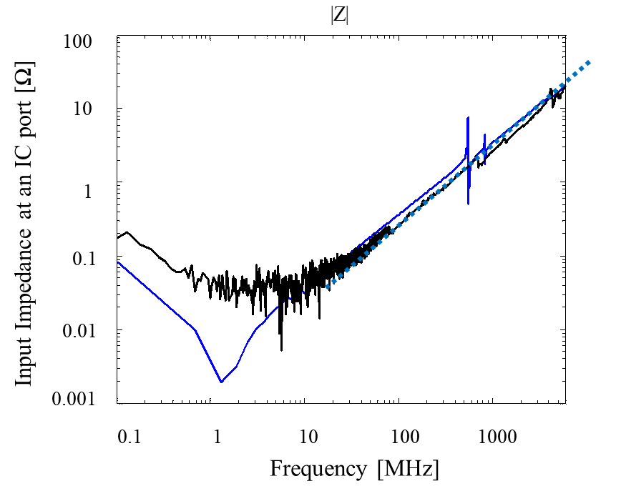
Key Points
Decoupling capacitors can be added using several values in a given decade to decouple over wide frequency ranges
Decoupling capacitors can be added as the largest value in a package size to achieve a target impedance as well.

Slide 74
PI Module Overview Part 1 – Concepts and Physics
The PDN problem
Noise on the PDN and an FPGA example
PDN design considerations
A couple of preliminary concepts
Current and inductance physics
A reduced order circuit model from a first principles formulation
Characteristic Z_{PDN} and relationship to physics
Understanding PDN physics and design through examples
Identifying limiting physics in design
Adding decoupling capacitors
  Values of decaps to use
  Where to place around the IC
  Connecting the decap to the PCB
  Convergence of L_{PCB Decap} for large number of decaps

Slide 75
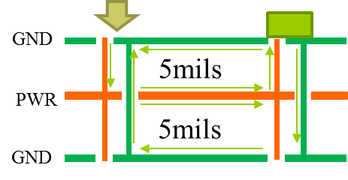
L_{PCB_Plane} Current Physics and Inductance
D
D
8”x8”
8”x8”
D=1’’, Pitch = 1mm
Decaps are placed on the top layer
L_{PCB_Plane} decreases with multiple parallel paths
L_{PCB_Plane} vs D
10
-1
32 IC 32 Decap
32 IC 8 Decap
-1
10
32 IC 1 Decap
L_{PCB_Plane} [nH]
Lplane [nH]
1 IC Pin
4 IC Pin
8 IC Pin
16 IC Pin
-2
32 IC Pin
10
3
0
1
10
10
10
D[mils]
Number of Decaps

Slide 76
L_{PCB_Plane} Current Physics and Inductance
Q: When is placing capacitors in a ring around the IC most beneficial?
D
D
8”x8
8”x8”
L_{PCB_Plane} vs D
10
-1
32 IC 32 Decap
32 IC 8 Decap
-1
10
32 IC 1 Decap
L_{PCB_Plane} [nH]
Lplane [nH]
1 IC Pin
4 IC Pin
8 IC Pin
16 IC Pin
-2
32 IC Pin
10
3
0
1
10
10
10
D[mils]
Number of Decaps

Slide 77
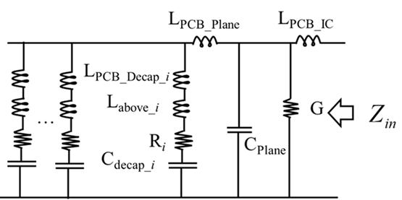
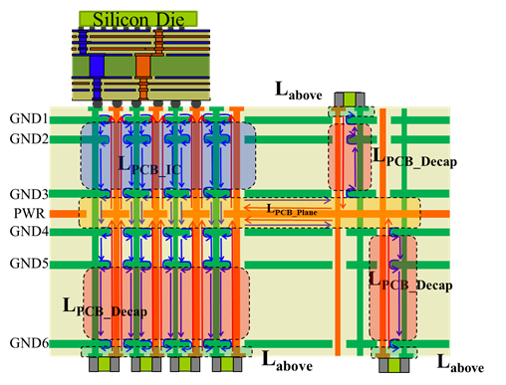
Current Path, and Inductance
Q: If the current path from IC to the decaps is not in direct line (e.g., crosses a cutout or slot, goes around a corners, etc.), which portion of the inductance is affected, and can potentially become dominant?
Notes:
The real board geometry is shown on top. The model and response are shown at bottom right and left respectively. The response for increasing number of capacitors is compared at the bottom left. As number of capacitors increase, the capacitance at low frequency increases as a direct result. Also L_{EQ} , converges into L_{IC} as the capacitors are added. Thus, if L_{IC} is lower, then the L_{EQ} will converge to a lower value. L_{IC} is independent of the capacitors placed on the PCB.

Slide 78


Key Points
If L_{PCB Plane} is dominant, e.g., when the power net area fill is near the top, and the decaps are placed on the top layer, then placing the capacitors in a ring around the IC can minimize L_{PCB Plane}
In general, L_{PCB Plane} is typically not the limiting factor, and decaps are often limited to “keep-in” regions where signal routing channels are not compromised.

Slide 79
PI Module Overview Part 1 – Concepts and Physics
The PDN problem
Noise on the PDN and an FPGA example
PDN design considerations
A couple of preliminary concepts
Current and inductance physics
A reduced order circuit model from a first principles formulation
Characteristic Z_{PDN} and relationship to physics
Understanding PDN physics and design through examples
Identifying limiting physics in design
Adding decoupling capacitors
  Values of decaps to use
  Where to place around the IC
  Connecting the decap to the PCB
  Convergence of L_{PCB Decap} for large number of decaps

Slide 80

Practices for Mounting SMT Capacitors
practical
best
ok
poor
Adding trace length, adds inductance to the interconnect:
“loop area” above the planes – L_{above}
Area between the power and GND return vias vertically connecting to the PWR planes
PWR via
GND via
PWR current
Return current

Slide 81



Example 1: The Doublet – Minimizing L_{PCB Decap}
Placing decaps on in pairs allows to use mutual inductance to minimize overall L_{PCB Decap}
GND via
PWR via
Q: If L_{PCB IC} is negligible, in which cases can the doublet configuration be beneficial? Which cases less so.

Slide 82

Example 2: The Doublet – Minimizing L_{PCB Decap}
Placing decaps on in pairs allows to use mutual inductance to minimize overall L_{PCB Decap}
GND via
PWR via
doublet
doublet
doublet
Q: If L_{PCB IC} is negligible, and decaps can be placed under the IC, in which cases can the doublet configuration be beneficial? Which cases less so.
Q: Which of these cases is not well chosen for the decap location?

Slide 83
PI Module Overview Part 1 – Concepts and Physics
The PDN problem
Noise on the PDN and an FPGA example
PDN design considerations
A couple of preliminary concepts
Current and inductance physics
A reduced order circuit model from a first principles formulation
Characteristic Z_{PDN} and relationship to physics
Understanding PDN physics and design through examples
Identifying limiting physics in design
Adding decoupling capacitors
  Values of decaps to use
  Where to place around the IC
  Connecting the decap to the PCB
  Convergence of LPCB Decap for large number of decaps

Slide 84
L_{PCB_Decap} Convergence
Alternating
Aligned
Doublet
D
*The L_{PCB_Decap} is simulated in PDN Tool and the inductance is extracted from |Z_{PDN}|.
IC Region
D
convergence rate for all SMT package sizes
5’’x 6’’

Slide 85

L_{PCB_Decap} Capacitor Configuration Example
Alternating
Aligned
Doublet
Doublet: 8 pairs
Alternating: 14 pairs
1/n: 25 pairs (no mutual coupling between individual decaps)
Aligned: 30 pairs
D
IC Region
D
5’’x 6’’

Slide 86


Key Points
Adding capacitors decreases L_{PCB Decap} as 1/n
Geometries such as the Doublet or 3-terminal capacitors reduce inductance over geometries where there is no benefit of mutual inductance.

Slide 87
Design Implications
Use the impedance equivalent circuit model to try to identify what component is dominant and use it to guide meeting the target impedance.
PWR/GND plane pair nearer to the IC in stackup will minimize L_{PCB_IC} from package balls to power net area fill (smaller loop)
PWR/GND plane pairs closely spaced will reduce L_{PCB_plane}.
Place caps close to the power layer to minimize the inductance from the capacitor to the power net area fill layer, i.e., L_{PCB_decaps}. (minimize the loop)
Placing caps on the underside of PCB opposite package can benefit the design
  The space is available and requires no additional vias
  If the pkg/planes/decap path is shorter due to PWR/GND near package in stackup decaps around the IC will be more effective
Power and ground vias placed adjacent to the caps reduces the inductance in the current return path (or in the bonding pads). (smaller loops)
Capacitor arrangements that utilize mutual inductance, e.g., doublet, or 3-terminal capacitor, can significantly reduce L_{PCB_decaps}.

Slide 88
Thank you!

