Slide 1


Power Integrity for High-Speed Design on Multi-Layer PCBs
Concepts and Physics
James L. Drewniak
Clear Signal Solutions and
Missouri S&T EMC Laboratory
james.drewniak@clearsig.com

Slide 2
Contributors
IBM – B. Archambeault, S. Connor, M. Cocchini, W. Becker, M. Cracraft, A. Ruehli
Cisco – B. Achkir, S. Scearce, Q. Gaumer, M. Sapazhnikov
Missouri S&T – B. Zhao, S. Bai, S. Liang, X. Zhu, K. Shringapure, S. Pan, J. Xu, J. Fan

Slide 3
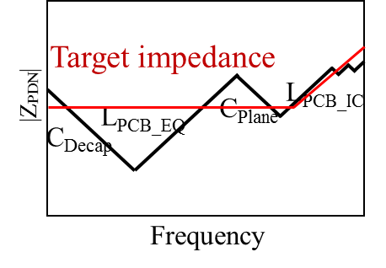
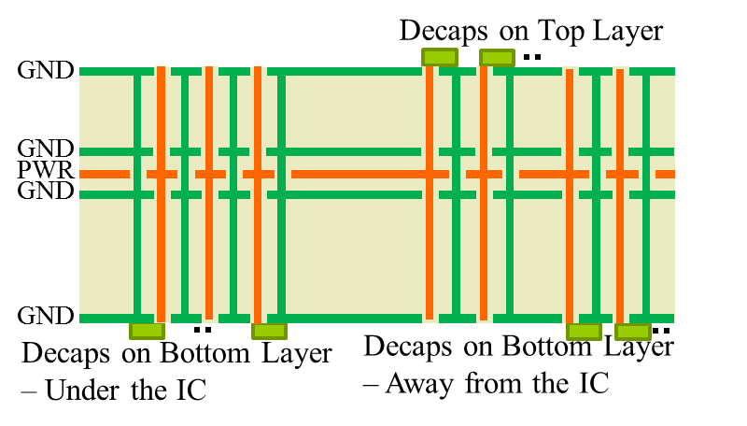
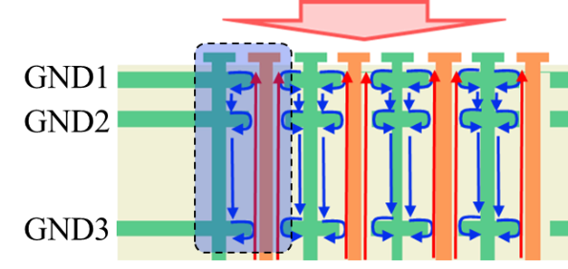
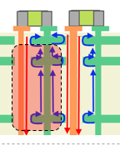
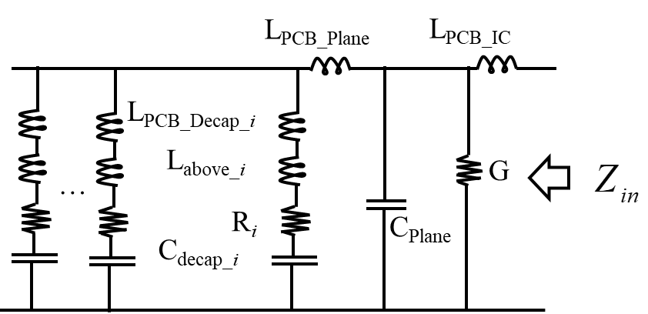

Overview – Pre-layout Methodology
Problem and concepts
PDN pre-layout design methodology
Circuit model
Example
Silicon Die
L_{PCB_Decap}
L_{PCB_IC}
L_{above}

Slide 4
Problem Introduction
_{Voltage}
_{VDD}
V_{ripple}
_{Time}
…
package
PowerSI
SIwave
PiPro
…

Slide 5
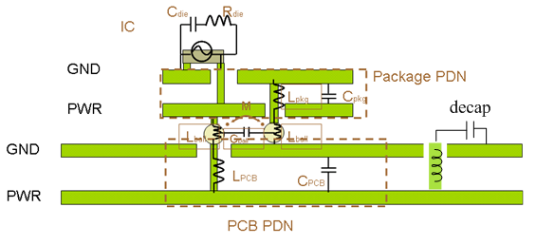
A Systematic Approach for Achieving PI
no on package decoupling
low-frequency capacitance
pkg vias to IC
PCB + board decoupling
PCB vias to pkg
pkg+ on-pkg decap
On-die capacitance
log₁₀f
PCB

Slide 6
PDN Design Considerations
2a. Decoupling capacitors
Top
Bottom,
Beneath IC?
2b. Decoupling capacitor connection -
PWR/GND via geometry
Package size
IC
Power/ground net area fill
Location in stack
Spacing to power return plane
Total area fill
Special materials
Decaps
2a. Decoupling capacitors
Value(s)
Number (total C)
IC pins
Effect of other ground/reference planes?
2c. Decoupling capacitor layout
How close to IC?
Shape – ring IC, on one side?
3. IC PWR/GND
Number pins
Pin pattern
Pitch
On-package decaps
PWR
GND
The pre-layout methodology is for multi-layered PCB PDN geometry.
Notes:
How to achieve a target impedance:
Power plane
Decoupling capacitors
IC pins

Slide 7
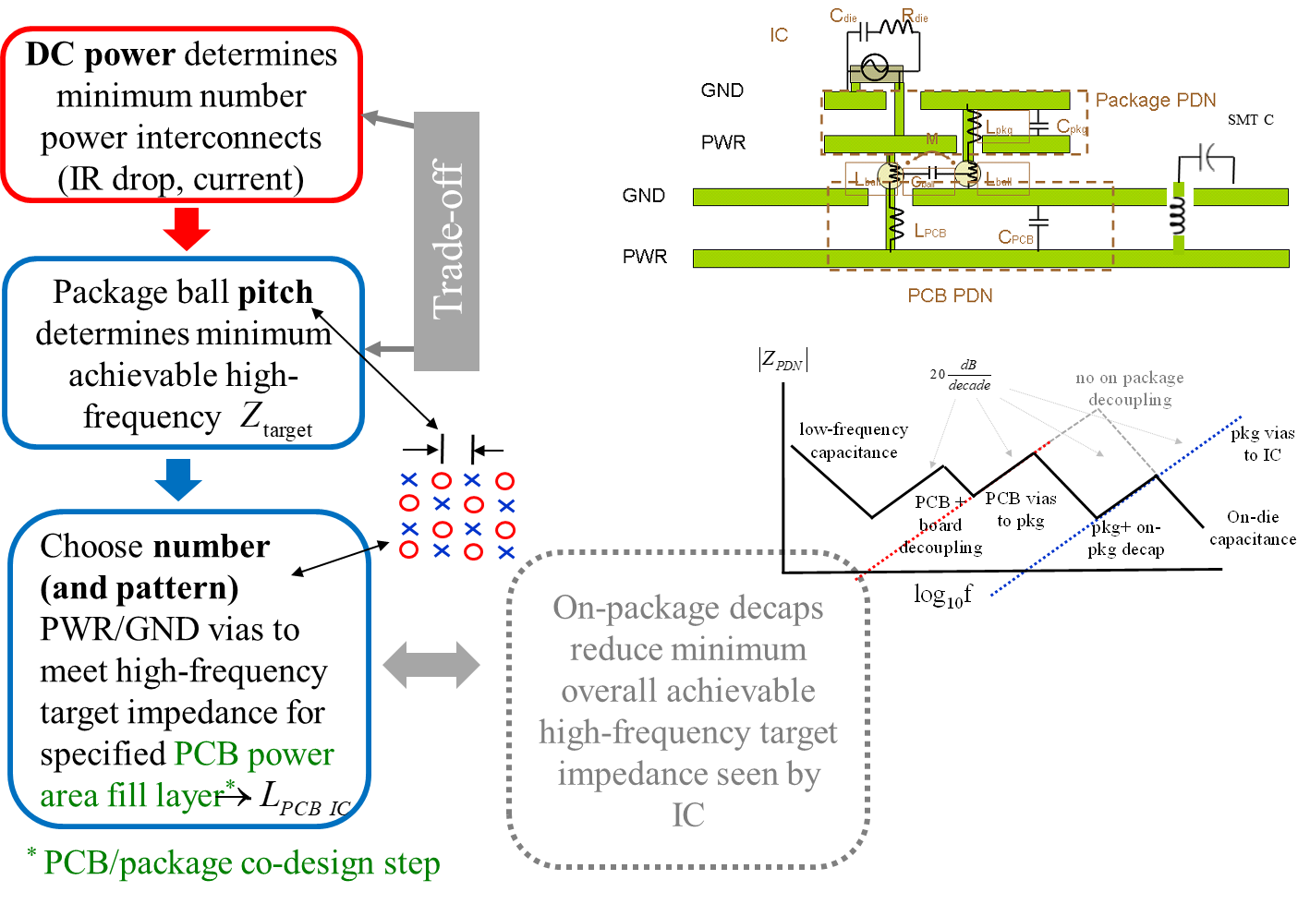
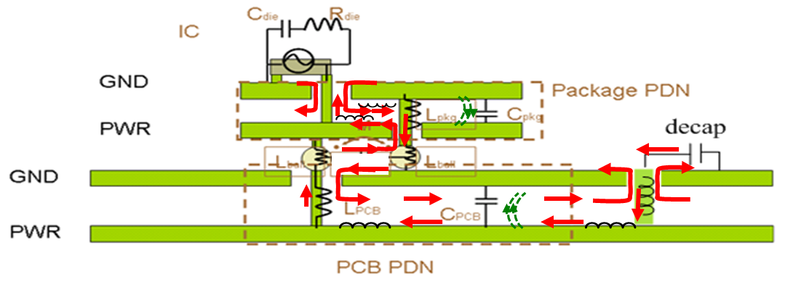
PI Design Flow – Package

Slide 8
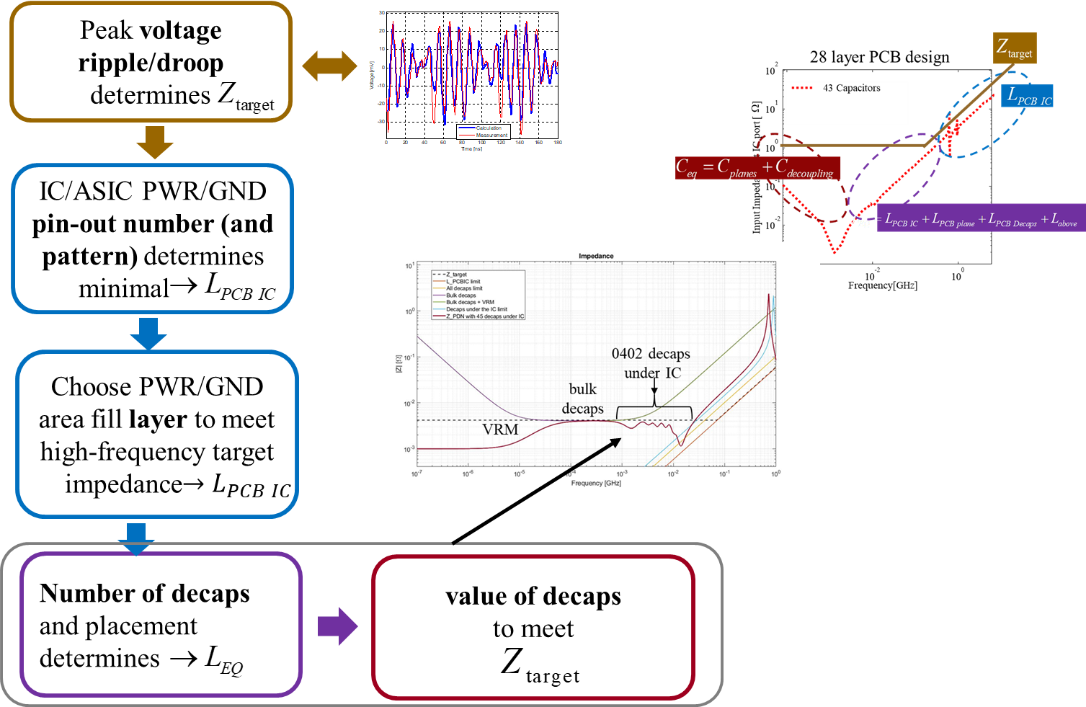
Design Flow – PCB

Slide 9
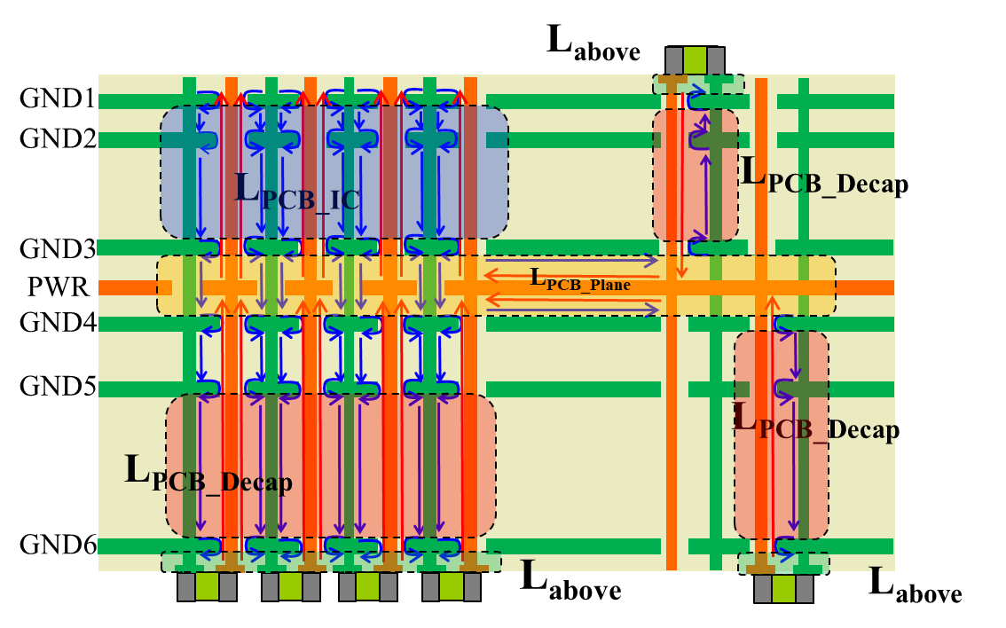
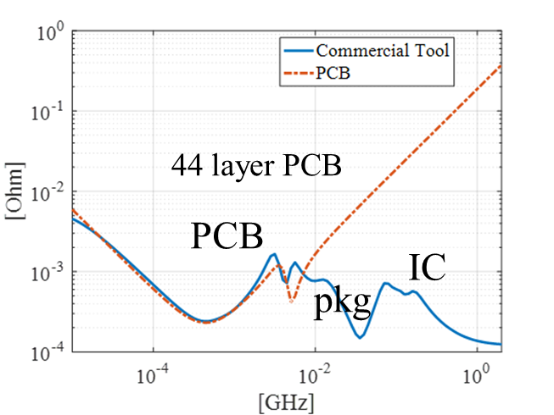
Objective: PCB Impedance Equivalent Circuit
Objective: Determine the values for:
  L_{PCB_IC} calculation
  L_{PCB_plane} calculation
  L_{PCB_decap} calculation
  L_{above} calculation
  Calculate Z_{PND} and voltage ripple
L_{PCB_Plane}
L_{PCB_IC}
L_{PCB_Decap_i}
L_{above_i}
G
…
R_{i}
C_{Plane}
C_{decap_i}
Can add package, IC, and VRM models to this

Slide 10
Overview – Pre-layout Methodology
Problem and concepts
PDN pre-layout design methodology
  Example geometry
  L_{PCB_IC} calculation
  L_{PCB_decap} calculation
  L_{PCB_plane} calculation
  L_{above} calculation
Silicon Die
L_{PCB_Decap}
L_{PCB_IC}
L_{above}

Slide 11

PCB PDN Example - Geometry
IC pin
Decap
D
G1-GND
IC Region
1.2mils
D
S2-SIG
5mils
1.2mils
G3-GND
5mils
1.2mils
S4-SIG
8mils
1.2mils
G5-GND
8mils
2.4mils
5’’x 6’’
P6-PWR
5mils
2.4mils
5mils
Alternating
G7-GND
2.4mils
S8-SIG
8mils
1.2mils
G9-GND
8mils
1.2mils
S10-SIG
8mils
1.2mils
G11-GND
15mils
1.2mils
S12-SIG
5mils
5mils
1.2mils
G13-GND
1.2mils
Doublet
S14-SIG
5mils
8mils
1.2mils
G15-GND
5mils
1.2mils
G16-GND
1.2mils
Decap
Decap

Slide 12
Overview – Pre-layout Methodology
Problem and concepts
PDN pre-layout design methodology
  Example geometry
  L_{PCB_IC} calculation
  L_{PCB_decap} calculation
  L_{PCB_plane} calculation
  L_{above} calculation
Silicon Die
L_{PCB_Decap}
L_{PCB_IC}
L_{above}

Slide 13
L_{PCB_IC} Geometry
Row
Alternating
port
h
…
short
Hex
Hex1
Pitch | Drill size | Anti-pad size
1 mm | 8mils | 20mils
 | 12mils | 32mils
 | 15mils | 39mils
0.8 mm | 8mils | 20mils
 | 12mils | 20mils
Grid
Pitch
GND via
PWR via
Drill size
Pad size
Anti-pad size

Slide 14
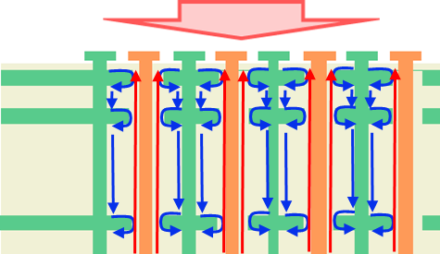
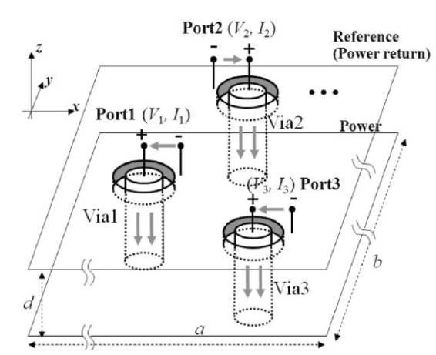
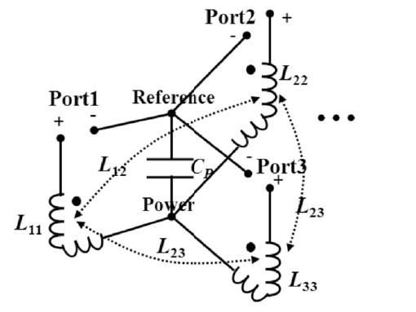
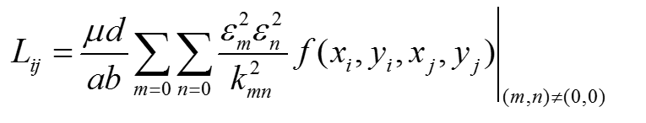
L_{PCB_IC} Inductance Physics – goes as h
IC Port
Cavity Model
GND1
GND2
GND3
P_{IC1}
+
P_{IC2}
+
P_{IC3}
+
P_{IC4}
+
GND1
-
-
-
-
GND2
GND3
-
-
-
-
P_{i1}
P_{i2}
P_{i3}
P_{i4}
+
+
+
+
Calculate a per-unit-layer inductance
Connection to Power/ground cavity (internal port )

Slide 15
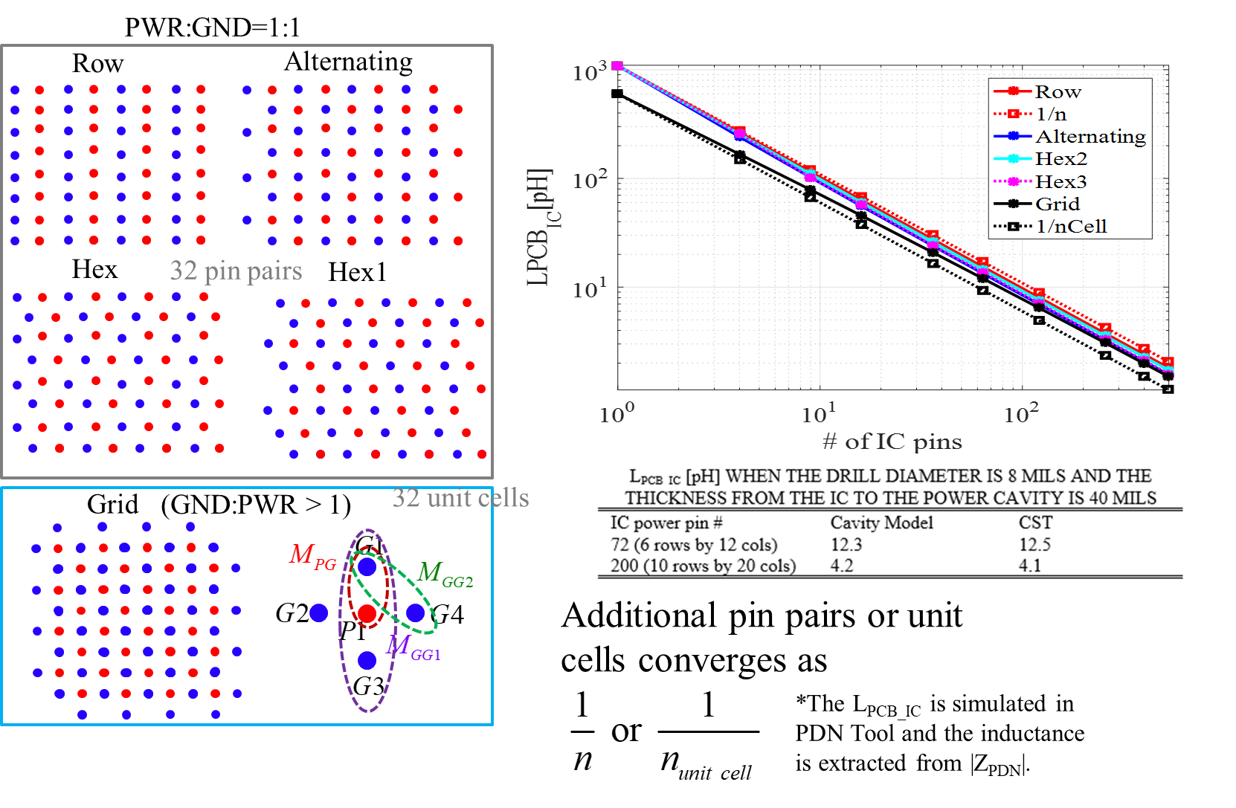
L_{PCB_IC} Convergence for 1mm Pitch
512

Slide 16
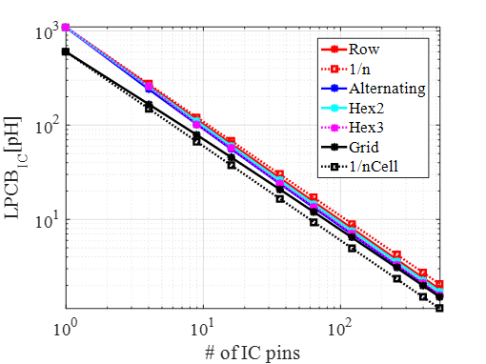
L_{PCB_IC} Caclulation
Calculate inductance of 1 cell
Get any other number of pins as 1/n

Slide 17
L_{PCB_IC} Design Calculations
Layers are “in series”
IC Port
GND1
GND2
All mutual inductances are accounted for
GND3
L_{PCB_IC} per mil for one IC pin [pH]
Pitch | Drill size | 1/n | 1/n_{UnitCell}
1 mm | 8mils | 24.5 | 13.5
 | 12mils | 20.4 | 11.0
 | 15 mils | 18 | 9.5
0.8 mm | 8mils | 22.0 | 12.0
 | 12mils | 17.9 | 9.5

Slide 18
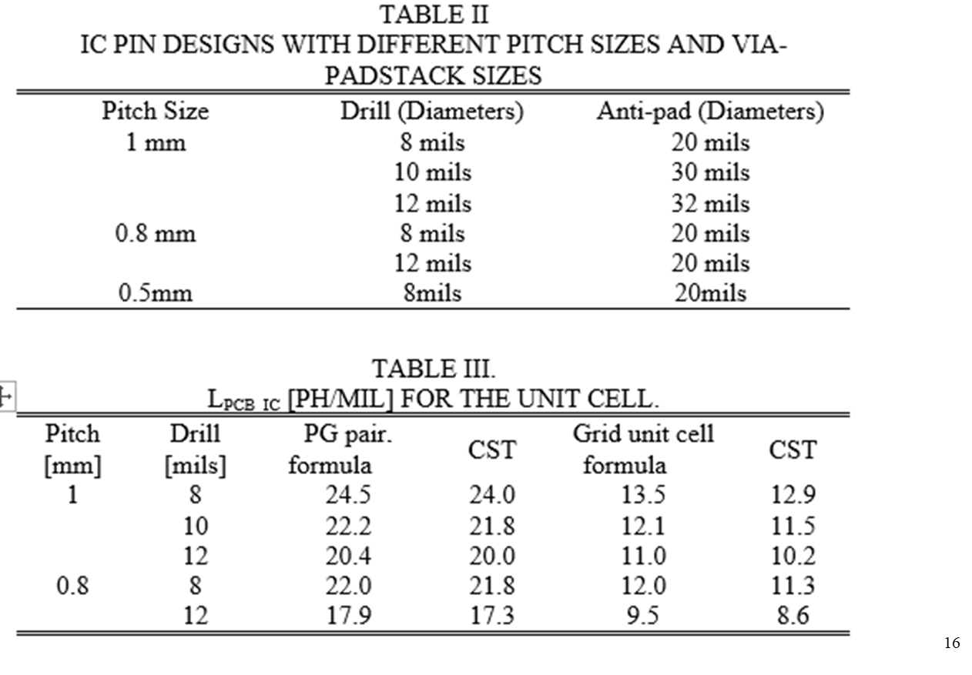
L_{PCB_IC} Design Calculations per-unit-layer

Slide 19

L_{PCB_IC} Design Flow
Use the IC pin placement with the lowest n=1 inductance
Adjust the stack-up to reduce the height from the IC port to the power net area fill
Approximate the range of the L_{PCB_IC} using the 1/n and 1/n_{UnitCell} value to meet the high-frequency target impedance
Calculate the # of IC pins needed according to the 1/n and 1/n_{UnitCell} curve for the geometry
Target Impedance
L_{PCB_EQ}
C_{plane}
C_{decap}
$$\left|Z_{PDN}\right|$$
L_{PCB_IC}
Minimal possible L
Frequency

Slide 20
L_{PCB_IC} Example
G1-GND
IC pin
Decap
S2-SIG
5mils
G3-GND
L_{PCB_IC}
5mils
S4-SIG
8mils
G5-GND
8mils
P6-PWR
5mils
Requirement:
G7-GND
5mils
S8-SIG
8mils
G9-GND
8mils
S10-SIG
8mils
G11-GND
15mils
S12-SIG
5mils
G13-GND
5mils
S14-SIG
5mils
G15-GND
8mils
5mils
G16-GND
Decap
Decap
Alternating
The IC pin # is 32, given by package designer.
Drill size = 15mils,
Anti-pad size = 39mils,
Pitch = 1mm.

Slide 21
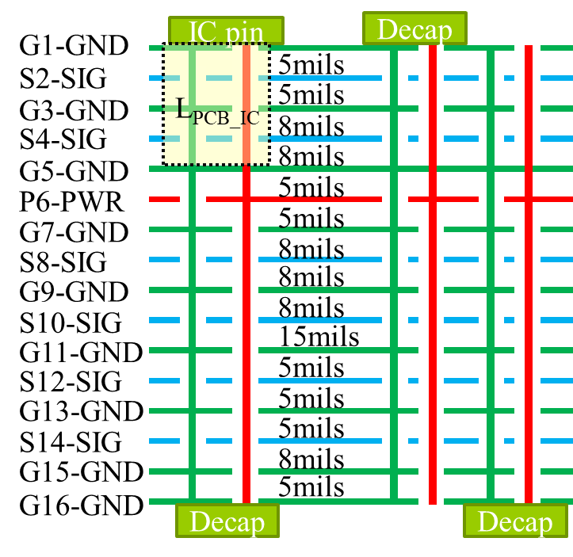
Impedance Equivalent Circuit
L_{PCB_Plane}
L_{PCB_IC}=14.6pH
L_{PCB_Decap_i}
L_{above_i}
G
…
R_{i}
C_{Plane}
C_{decap_i}

Slide 22
L_{PCB_EQ} Components Approximation
L_{high_needed}=79.6 pH
L_{PCB_EQ_min}=79.6pH
Target Impedance
|Z_{PDN}|
L_{PCB_IC}
L_{PCB_IC}=14.6 pH
L_{PCB_EQ}
C_{Plane}
C_{Decap}
Frequency
Assume: L_{PCB_Decap} is the similar to L_{above}, L_{PCB_Plane}
L_{PCB_Decap} = 22pH,
L_{PCB_above} = 22pH,
L_{PCB_Plane} = 22pH.

Slide 23
Overview – Pre-layout Methodology
Problem and concepts
PDN pre-layout design methodology
  Example geometry
  L_{PCB_IC} calculation
  L_{PCB_decap} calculation
  L_{PCB_plane} calculation
  L_{above} calculation
Silicon Die
L_{PCB_Decap}
L_{PCB_IC}
L_{above}

Slide 24
L_{PCB_Decap} Geometry
Alternating
Relative via locations and package size ([mils]) of the three decoupling capacitor placement patterns
X
Placement pattern | Size | a | b | X | Y
Alternating/Aligned | 0201 | 45 | 120 | 159 | 85
 | 0402 | 53 | 136 | 175 | 101
 | 0603 | 88 | 207 | 246 | 171
 | 0805 | 108 | 223 | 262 | 211
Doublet | 0201 | 32 | 32 | 149 | 71
 | 0402 |  |  | 165 | 87
 | 0603 |  |  | 235 | 158
 | 0805 |  |  | 275 | 174
a
Y
b
Aligned
X
a
Y
b
Doublet
X
Y
a
Occupied area
Solder resist pattern
Solder land
Package area
b

Slide 25
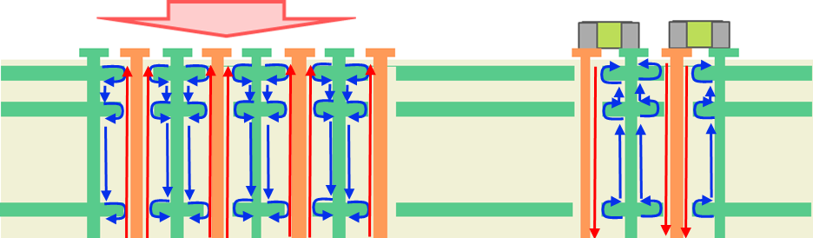
L_{PCB_Decap} Inductance Physics
IC Port
M
M neglected
due to large distance
L_{PCB_Decap}
+
+
P_{decap1}
P_{decap2}
-
-
GND1
Coupling between IC via and decap via neglected
IC vias and decoupling capacitor vias can be modeled separately
GND2
GND3
-
-
P_{i1}
P_{i2}
+
+

Slide 26
L_{PCB_Decap} Inductance Physics
Alternating
Aligned
Cavity model
The sign shows the contributions of the mutual inductances
Doublet
Mutual inductance between the PWR and GND vias for one decap
Mutual inductance between the PWR and PWR, or between GND and GND vias in different decaps
Mutual inductance between the PWR and GND, or between PWR and GND vias in different decaps
Decap 0201, h=40mils | Aligned | Alternating | Doublet
L_{PCB_Decap}|_{nDecapPair=1} | 798pH | 372pH | 246pH

Slide 27
L_{PCB_Decap} Functional Variation
Alternating
Aligned
Doublet
D
IC Region
D
convergence rate for all SMT package sizes
*The L_{PCB_Decap} is simulated in PDN Tool and the inductance is extracted from |Z_{PDN}|.
5’’x 6’’

Slide 28
L_{PCB_Decap} Convergence
Calculate inductance of 1pair
Get any other number of pins as 1/n
convergence rate for all SMT package sizes

Slide 29
L_{PCB_Decap} Design Calculations
L_{Decap_above}
Distance
L_{PCB_Decap}
L_{PCB_Decap} per mil for one decap pair [pH]
L_{PCB_Decap_PUL}|_{npair=1} | Aligned | Alternating | Doublet | Single decap /2
0201 | 20.8 | 11.3 | 6.8 | 14.6
0402 | 21.4 | 11.8 | 6.8 | 15.3
0603 | 23.4 | 14.6 | 6.8 | 17.4
0805 | 23.4 | 15.5 | 6.8 | 17.8

Slide 30
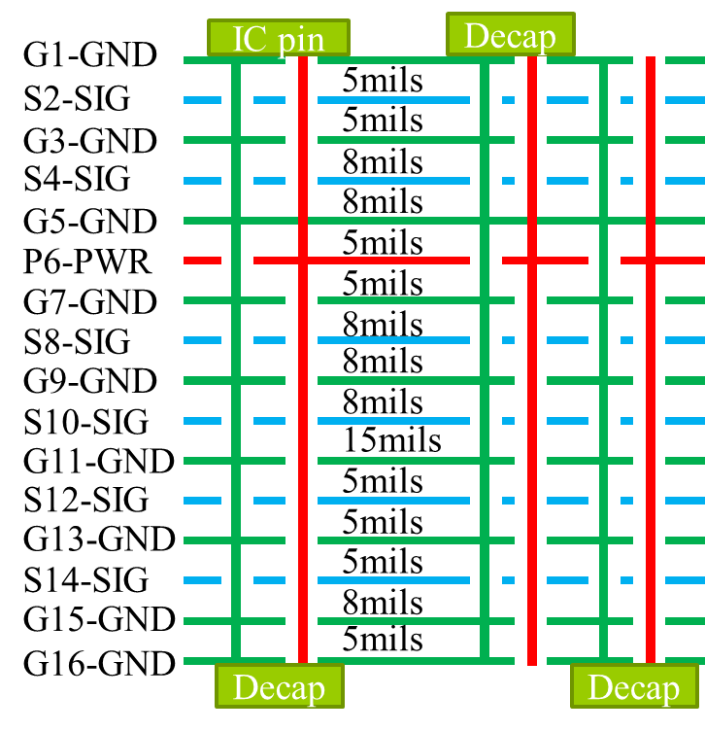
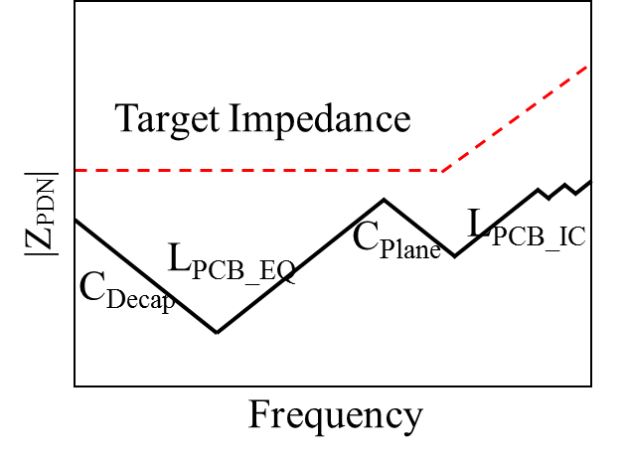
L_{PCB_Decap} Design Considerations
Doublet
Use the decap placement with the lowest L_{PCB_Decap} value
Based on the stack-up, place the decaps on bottom or top layer closer to the power net area fill layer (to make the loop area of the decap interconnect smallest)
Calculate the # of decaps needed to achieve L_{PCB_EQ} below the target impedance

Slide 31
L_{PCB_Decap} Design Example
Doublet
G1-GND
IC pin
Decap
Decap
Requirement L_{PCB_Decap} <= 22 pH
S2-SIG
5mils
G3-GND
5mils
L_{PCB_Decap}
S4-SIG
8mils
G5-GND
8mils
P6-PWR
5mils
G7-GND
5mils
S8-SIG
8mils
G9-GND
8mils
S10-SIG
8mils
G11-GND
15mils
S12-SIG
5mils
G13-GND
5mils
S14-SIG
5mils
G15-GND
8mils
5mils
G16-GND

Slide 32
Impedance Equivalent Circuit
L_{PCB_Plane}
L_{PCB_IC}=14. 6pH
L_{PCB_Decap_i}
L_{above_i}
G
…
R_{i}
C_{Plane}
C_{decap_i}
8 decap pairs
L_{PCB_Decap_i}=177 pH (pair)

Slide 33
Decaps Under the IC
IC Port
GND1
GND1
GND2
GND2
GND3
GND3
PWR
GND4
PWR
GND5
GND4
GND5
GND6
GND6

Slide 34
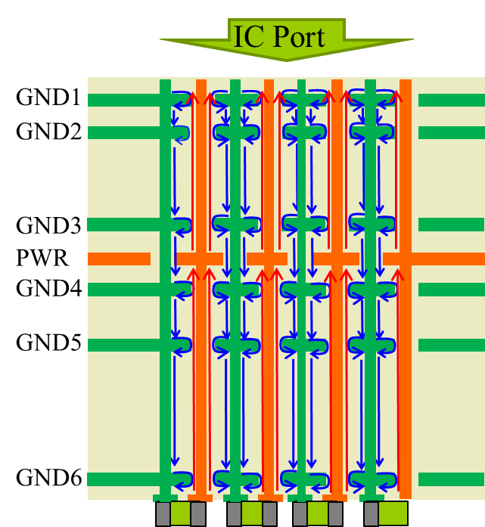
L_{PCB_EQ} Variation for Decaps Under the IC
L_{PCB_EQ} vs # of decaps on IC pins
L_{PCB_IC}
(Grid)
L_{PCB_Plane}
L_{PCB_Decap}
Alternating
Grid
*The L_{PCB_EQ} is simulated and the inductance is extracted from |Z_{PDN}|.

Slide 35
L_{PCB_EQ} Example for Decaps Under the IC
G1-GND
IC pin
Alternating
Drill size = 15mils,
Anti-pad size = 39mils,
Pitch = 1mm.
S2-SIG
5mils
G3-GND
L_{PCB_IC}
5mils
S4-SIG
8mils
G5-GND
8mils
P6-PWR
L_{PCB_Plane}
5mils
G7-GND
5mils
S8-SIG
8mils
G9-GND
8mils
S10-SIG
8mils
G11-GND
15mils
L_{PCB_Decap}
5mils
S12-SIG
G13-GND
5mils
S14-SIG
5mils
G15-GND
8mils
5mils
G16-GND
Decap
Design Library ( under development)

Slide 36
Outline
Problem and concepts
PDN pre-layout design methodology
  Example geometry
  L_{PCB_IC} calculation
  L_{PCB_decap} calculation
  L_{PCB_plane} calculation
  L_{above} calculation
Silicon Die
L_{PCB_Decap}
L_{PCB_IC}
L_{above}

Slide 37
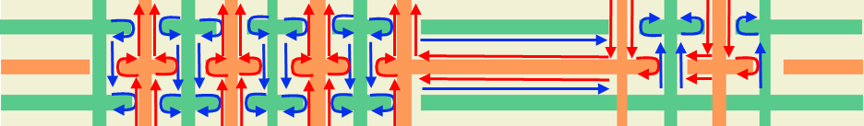
L_{PCB_Plane} Geometry
IC vias
Decap vias
GND3
PWR
GND4
If the current path on the power net is direct to decaps and L is not significantly changed due to power net voids, the following design curves are used.
Horizontal inductance and vertical inductance are merged in the model and final equivalent circuit model is constructed as below.
IC via
GND3
Decaps
PWR
Cavity model can
well estimate the inductance.
GND4

Slide 38
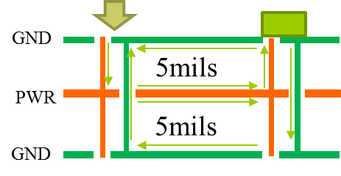
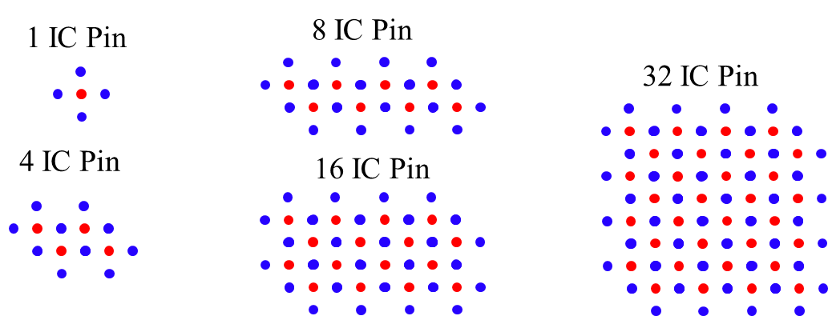
L_{PCB_Plane} Geometry
Decaps
D
D
Doublet
8”x8”
8”x8”
GND3
Port
Short
Stack-up
PWR
GND4
Short
Short
IC Region
D=1’’, Pitch = 1mm
GND via
PWR via

Slide 39
L_{PCB_Plane} Current Physics and Inductance
D
D
Pitch = 1mm
Decaps are placed on the top layer
8”x8”
8”x8”
L_{PCB_Plane} decreases with multiple parallel paths
L_{PCB_Plane} vs D
D=1’’
10
-1
32 IC 32 Decap
32 IC 8 Decap
-1
10
32 IC 1 Decap
L_{PCB_Plane} [nH]
Lplane [nH]
1 IC Pin
4 IC Pin
8 IC Pin
16 IC Pin
-2
32 IC Pin
10
3
0
1
10
10
10
D[mils]
Number of Decaps

Slide 40
L_{PCB_Plane} Design Curves
Alternating
D
IC Region
D
5’’x 6’’
Doublet

Slide 41
L_{PCB_Plane} Example
Requirement: L_{PCB_Plane} <=22 pH
D
IC Region
D
From the design curves, D=500mils, n_{Decap_Pair} >=16.
Combine the requirement from L_{PCB_IC}, L_{PCB_Decap,} n_{ICpin} >=6, n_{Decap_Pair} >=8
5’’x 6’’
n_{ICpin} =32, n_{Decap_Pair} >=16

Slide 42
Impedance Equivalent Circuit
L_{PCB_Plane}=22 pH
L_{PCB_IC}=14. 6 pH
L_{PCB_Decap_i}
L_{above_i}
G
…
R_{i}
C_{Plane}
C_{decap_i}
16 pairs decaps
L_{PCB_Decap_i}=177 pH (pair)

Slide 43
Outline
Problem and concepts
PDN pre-layout design methodology
  Example geometry
  L_{PCB_IC} calculation
  L_{PCB_decap} calculation
  L_{PCB_plane} calculation
  L_{above} calculation
Silicon Die
L_{PCB_Decap}
L_{PCB_IC}
L_{above}

Slide 44
L_{above} Geometry
L_{Decap_above}
PEEC method used to calculate decap pad inductance
Get a single inductance
Distance
L_{PCB_Decap}
short
L_{above}
→
GND1
GND1
Top view of doublet pad
(shorted pad )
L_{above}
-
P_{decap}
+
_{Ground}
_{Power}

Slide 45
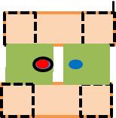
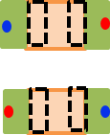
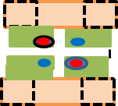
L_{above} Geometries
Decoupling capacitor of sizes 0805/0603/0402/0201 for L_{above} design space
100
# | Name | Figure | # | Name | Figure | # | Name | Figure
1 | Shared Via |  | 2 | Power Via Alternating |  | 3 | Doublet
4 | Via in Pad |  | 5 | Shared Pad |  | 6 | Via in pad alternating
7 | PWR via in Line |  | 8 | 3-terminal |  | 9 | Multi-via
50
40
27
40
24
19
12
[mil]
shorted
2.4
6.7
GND
1.2
Port
[mil]

Slide 46
L_{above} Design Library - Doublet
L
With Different package sizes,
0201, 0402, 0603, 0805
Using wider trace to minimize inductance
W
gap1
gap1
What will change | 0201 | 0402 | 0603 | 0805
L |  | 56 mil | 78 mil | 100 mil
W |  | 20 mil | 30 mil | 50 mil
gap1 |  | 18 mil | 18 mil | 12 mil
gap2 |  | 15 mil | 15 mil | 21 mil
dis1 |  | 12 mil | 20 mil | 31 mil
dis2 |  | 17 mil | 22 mil | 30 mil
gap2
1mm
dis1
1mm
dis2
What will not change | 0201, 0402, 0603, 0805
pitch | 1 mm
Anti-Pad Diameter: 0.762mm
Pad Diameter: 0.538mm
Via Diameter (drill size): 0.25mm

Slide 47
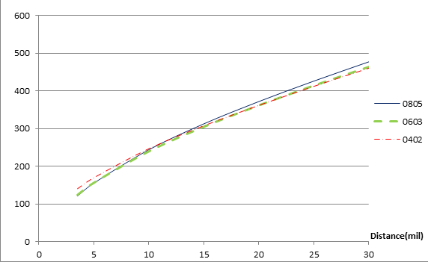
L_{above} Design Library - Doublet
L_{above} for doublet layout [pH]
Side view
Short
Short
Distance (mil) | 0805 | 0603 | 0402
3.5 | 125.6 | 123.8 | 132.9
5 | 161 | 157.4 | 166.2
10 | 248.2 | 239.9 | 244.6
15 | 313.2 | 301.4 | 302.2
20 | 368.4 | 354.3 | 352.3
25 | 419.2 | 403.4 | 399.4
30 | 467.5 | 450.4 | 445
Distance
GND
Port
Port
Design Curve

Slide 48
L_{above} Design Library – Power Via Alternating
Dis =10 mils
With Different package sizes,
0201, 0402, 0603, 0805
Using wider trace to minimize inductance
What will change | 0201 | 0402 | 0603 | 0805
L |  | 56 mil | 78 mil | 100 mil
W |  | 20 mil | 30 mil | 50 mil
gap |  | 10.5 mil | 11 mil | 11 mil
gap
W
L
Power Via
What will not change | 0201, 0402, 0603, 0805
Dis (Pad Edge to Via ) | 10 mils (0.25 mm)
Ground Via
Anti-Pad Diameter: 0.762mm
Pad Diameter: 0.538mm
Via Diameter (drill size): 0.25mm

Slide 49
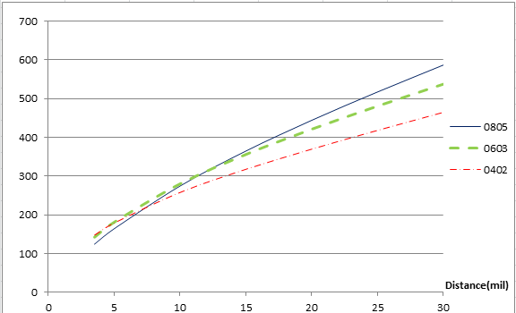
L_{above} Design Library – Power Via Alternating
L_{above} for alternating layout [pH]
Short
Side view
Short
gap=0.3 mm
Distance (mil) | 0805 | 0603 | 0402
3.5 | 124.3 | 142.4 | 147.7
5 | 164.2 | 181.1 | 179.1
10 | 274.5 | 280.1 | 257.9
15 | 364.7 | 355.9 | 317.7
20 | 444.1 | 421.1 | 369.6
25 | 517.2 | 480.8 | 418.2
30 | 586.8 | 537.4 | 464.7
Distance
GND
Port
Port
Design Curve

Slide 50
L_{above} Design Library – Power Via Aligned
Dis =10 mils
With Different package sizes,
0201, 0402, 0603, 0805
Using wider trace to minimize inductance
What will change | 0201 | 0402 | 0603 | 0805
L |  | 56 mil | 78 mil | 100 mil
W |  | 20 mil | 30 mil | 50 mil
gap |  | 10.5 mil | 11 mil | 11 mil
gap
W
L
Power Via
What will not change | 0201, 0402, 0603, 0805
Dis (Pad Edge to Via ) | 10 mils (0.25 mm)
Ground Via
Anti-Pad Diameter: 0.762mm
Pad Diameter: 0.538mm
Via Diameter (drill size): 0.25mm

Slide 51
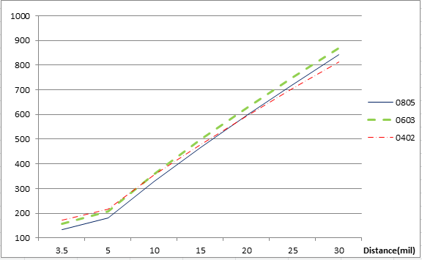
L_{above} Design Library – Power Via Aligned
L_{above} for aligned layout [pH]
Short
Side view
Short
gap=0.3 mm
Distance (mil) | 0805 | 0603 | 0402
3.5 | 132.4 | 157.3 | 172.4
5 | 180.1 | 208.1 | 217.8
10 | 327.8 | 360.3 | 354.8
15 | 464.7 | 497.8 | 478.4
20 | 595 | 626.8 | 594.5
25 | 721.3 | 749.8 | 705.4
30 | 842.8 | 868.8 | 812.9
Distance
GND
Port
Port
Design Curve

Slide 52
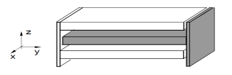
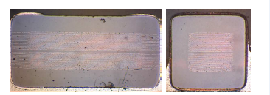
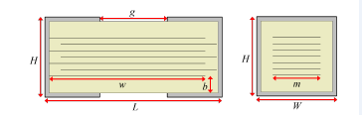
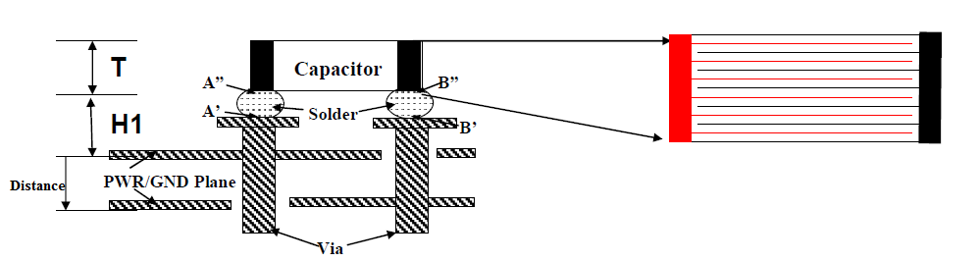
L_{above} Modeling with Decaps
Decoupling capacitor model
Via, pad, trace, one decap
Decoupling capacitor
GND
Wave Port
H
Decap
Distance
Define Distance’=Distance +½*H,
Change the plane to the center of the capacitor (without including Decap in the model).
Via

Slide 53
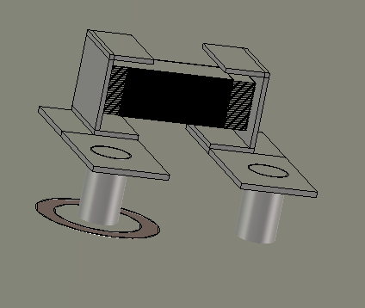
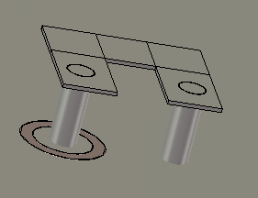
L_{above} Modeling
H=20 mil
Decap
Distance+H/2
0402 Type Decap
Distance
Distance (mil) | Inductance (pH) | Distance’ | Inductance (pH) | Difference
5 | 615.34 | 5+H/2 | 602.32 | 2.12%
8 | 677.26 | 8+H/2 | 655.07 | 3.26%
15 | 883.43 | 15+H/2 | 828.04 | 6.27%
CST
Model
Distance
Distance+H/2

Slide 54
L_{above} Example
H
Decap
Distance
Pick doublet 0805 layout for L_{above} calculation with distance = 5mils, and decap body height H = 10mils. Then distance + H/2=10mils. From the library, the L_{above} for one decap is
Via
L_{Decap_above}
L_{PCB_Decap}
From previous design: n_{ICpin} =32, n_{Decap_Pair} >=16,
Requirement: L_{PCB_Decap} +L_{above} = 22pH+22pH=44pH

Slide 55
Impedance Equivalent Circuit
L_{PCB_Plane}=22 pH
L_{PCB_IC}=14. 6pH
L_{PCB_Decap_i}
L_{above_i}
…
G
R_{i}
C_{Plane}
C_{decap_i}
16 pairs decaps
L_{PCB_Decap_i}=177 pH (pair)
L_{above_i}= 248 pH (pair)

Slide 56
Outline
Problem and concepts
PDN pre-layout design methodology
Circuit model and example
Silicon Die
L_{PCB_Decap}
L_{PCB_IC}
L_{above}

Slide 57
Impedance Equivalent Circuit
L_{PCB_Plane}=22 pH
L_{PCB_IC}=14. 6pH
L_{PCB_Decap_i}
L_{above_i}
…
G
R_{i}
C_{Plane}
C_{decap_i}
16 pairs decaps
L_{PCB_Decap_i}=177 pH (pair)
L_{above_i}= 248 pH (pair)

Slide 58
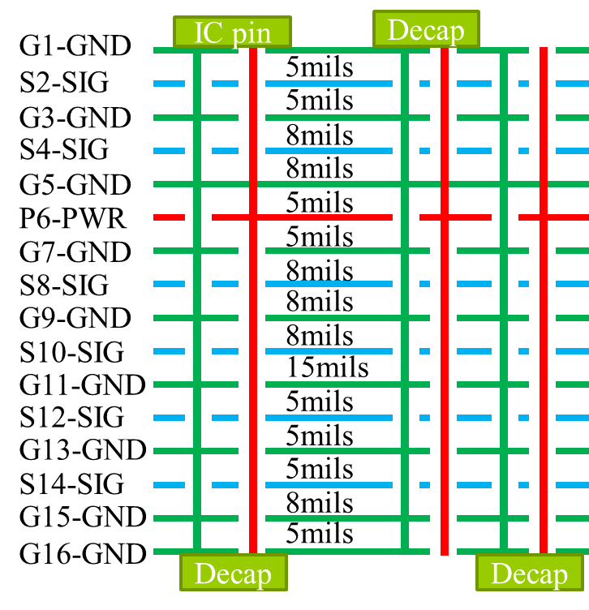
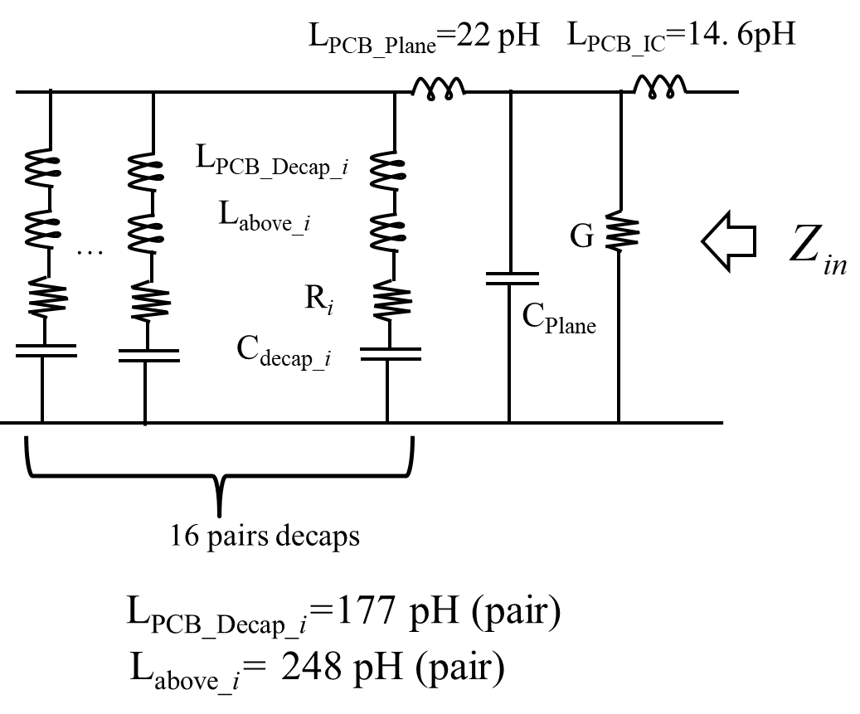
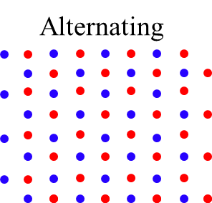
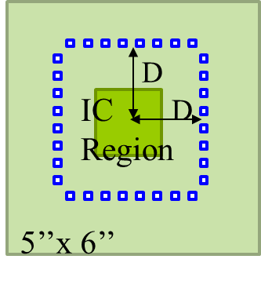
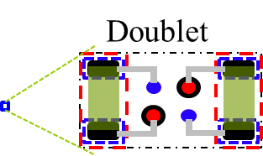
PCB Example
PCB PDN Design:
32 IC pins
D = 500mils
16 pairs of decaps using doublet layout on the top layer

Slide 59
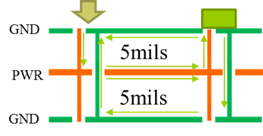
PCB Example Input Impedance
L_{PCB_EQ} = 60pH
L_{PCB_IC} = 14.6pH
For 0805 decap, ESR =30mOhm
For 16 decap pairs, R_{EQ} is around 30mOhm/32 =0.94mOhm.
G_{diel} = 0.1S from real board measurement
R_{IC} = 0.01Ohm from real board measurement
Assume the decap is 100nF, C_{Decap} = 3.2uF
Target Impedance
HSpice simulation
C_{Plane} = 2.7 nF

Slide 60
Thank You!

