Slide 1
IEEE Region 3 Annual Meeting
Friday Afternoon Training
Jim Conrad, Director

Slide 2
WELCOME!
SoutheastCon is the annual meeting where the Region and Section volunteers get together to:
  Learn more about IEEE
  Learn how to be better volunteers
  Transact Region business
  Interact with the student members of the Region
Held in Mid-March to Mid-April
600-900 attendees

Slide 3
So what is going on this weekend?
Region meeting (this!) – training
Technical papers program (papers will appear in IEEExplore)
Student competitions
PROM! OK, the Awards Banquet

Slide 4
Timing?
Friday AM– training
Friday PM– training and Area Meetings
Friday Evening – Reception
Saturday AM– training/professional development
Saturday PM– training/professional development
Saturday Evening – Awards Banquet
Sunday AM – Region Business Meeting

Slide 5
Expectations
Attendees who are being reimbursed by the Region for travel (region volunteers, section chairs) should attend all of the meeting/training
Get involved in the sessions! Ask questions, participate!
Please ensure you stay for the ENTIRE lunch – IEEE and IEEE USA President-elect candidates will talk

Slide 6
What about these general sessions?
Each morning and afternoon, right after the meal, we will meet for 30 minutes
The speakers for that morning/afternoon will give a quick, 1-slide, 1-minute talk selling their training session
Based on the published info and sales-pitch, choose which sessions you will attend (no need to RSVP)
Prizes awarded! Speakers are given a few items to reward a few of you who actively participate in their session.

Slide 7
Onto the EXCITE session!

Slide 8

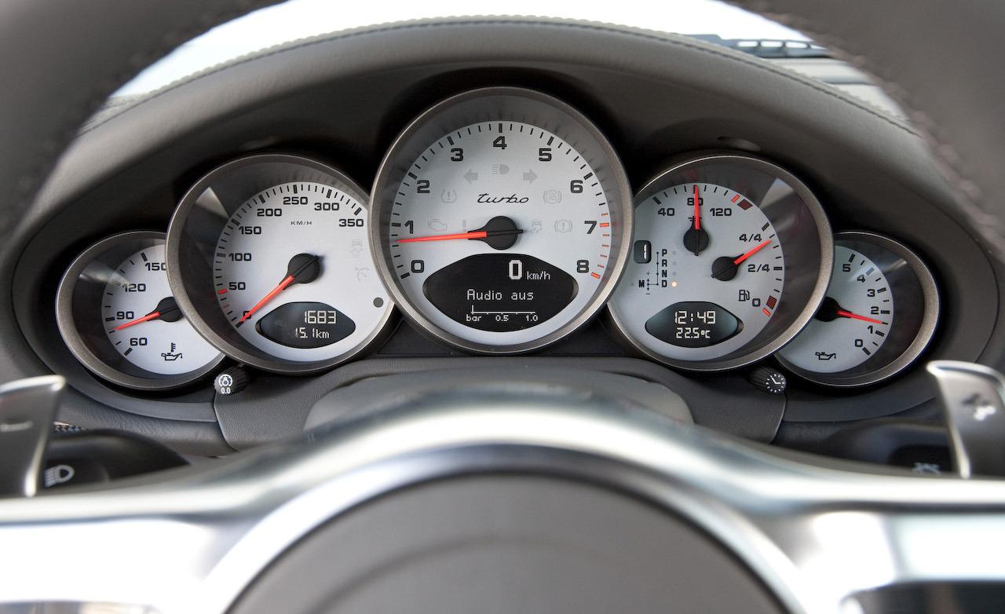
A4 - Your Section Vitality Dashboard
What’s the HEALTH of my section?
Is there some way to give my section a “checkup?” – and on a regular basis?
COME FIND OUT HOW!!!
Learning To Ask The Questions
Needed To Drive A Section

Slide 9



B4 - Learning Lab for Chapter Technical &
Section Professional Meeting Recording and Distribution processes and tools
Demonstrate an opportunity to create a new class of Intellectual Property (IP) that benefits members.
Shows methods for capturing IEEE local Chapter technical meeting presentations and
Provides a way for these recorded presentations to be stored and accessed by IEEE members
Recordings will be a video of the presentation combined with the voice of the presenter.
IP will provide membership value, increase MGA/TAB technical assets, and attract funding for improved Chapter programs.
12-CRS-0106 REVISED 5 FEB 2013
08/12/14
Notes:
IEEE Board’s New Initiatives have been funding this Initiative since Oct14 through this year.
The Board is interested in a new class of curated IP.
At the Section/Chapter level, this IP could be one of the few membership values.

Slide 10
C4 - Writing a Good Senior Member Application & Reference
Who is eligible for Senior Member elevation
12 Tip to completing a successful application
How to find eligible members in your Section
How to find application references
Holding a Senior Member Roundup
1:45 – 2:35 on Friday & Saturday in Norfolk V

Slide 11

D4 – Fellow Information and Application
Fellow is the highest grade of membership.
What is the Fellow program?
Who can become a Fellow?
How do you complete a successful nomination?
Fellow references

Slide 12
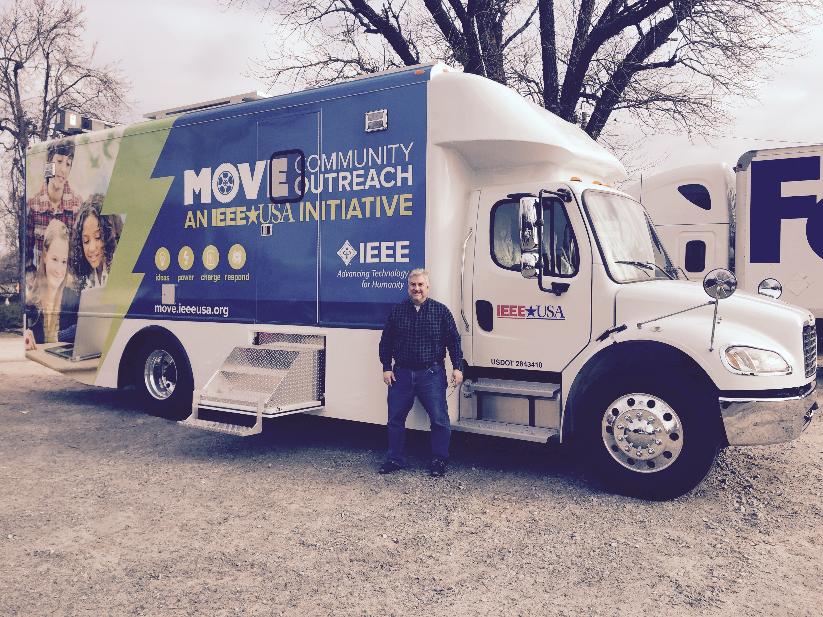
A5 – MOVE

Slide 13
Engineers and Public Policy
(It’s Not as Bad as it Sounds)
Russell Harrison
Director, Government Relations
IEEE-USA

Slide 14
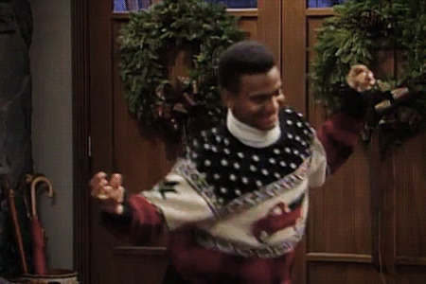


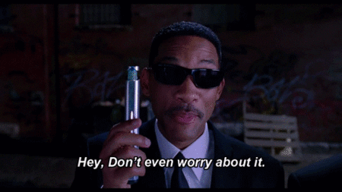
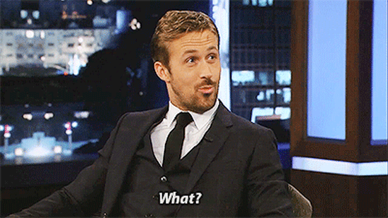
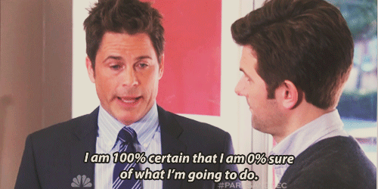
Social Media – More Than Facebook!?
There is MORE than Facebook to Social Media!!!
Is This Going Through Your Head Right Now?
Increase Your OU’s Exposure and DOUBLE Your Members
Reach Out, Inform, & Share With Your Current and Prospective Members By Using Social Media!
Get More Members While Getting More Volunteers!
Don’t Know How!? No Worries! We’ll show you!

Slide 15


So you are interested in Organizing and Holding a Conference…
Each attendee will leave with an understanding of:
Membership development
Member value
Membership planning
Easy-to-use 3 to 4 step
processes to devConcept: Expenses – Income = $URPLU$
elop your plan
Concept: Expenses – Income = $URPLU$
Your IEEE-USA Conferences Committee and its Chair, and your Region Conferences Coordinators, are ready to help you!
The end goal is to develop a Section Strategy to share and discuss with your ExCom that can be used as a succession plan.

