Slide 1
IEEE Region 3 SoutheastCon 2016 Mark Torres mgtorres@ieee.org 2016 Region 3 MELCC Chair
How to write a good Senior Member Application and Reference
Marriott Norfolk Waterside Hotel, Norfolk VA 1-3 April 2016

Slide 2
Writing a Good Senior Member Application & Reference
Who is eligible for Senior Member elevation
12 Tips to completing a successful application
How to find eligible members in your Section
How to find application references
Holding a Senior Member Roundup
2016 Region & Section Goals
Acknowledgement: This material was original presented in the 2015 Winter Region 3 newsletter in Tips for Writing a Good IEEE Senior Member Application by Don Wright and Holding a Senior Member Roundup by James (Jim) Conrad

Slide 3
Writing a Good Senior Member Application & Reference
Who is eligible for Senior Member elevation
12 Tip to completing a successful application
How to find eligible members in your Section
How to find application references
Holding a Senior Member Roundup
2016 Region & Section Goals
Q&A
.

Slide 4
Criteria for Elevation to Senior Member Grade
A candidate shall be an engineer, scientist, educator, technical executive or originator in IEEE-designated fields
Candidates shall have been in professional practice for at least ten years
Candidates shall have shown significant performance over a period of at least five of those years

Slide 5
What are the IEEE-designated Fields?
Engineering
Computer sciences and information technology
Physical sciences
Biological and medical sciences
Mathematics
Technical communications, education, management, law and policy

Slide 6
Ten years of Professional Experience
The ad hoc Admission and Advancement (A&A) Review Panel, that is evaluating your application, will count the years you have been in professional practice.
Time working and attending school at the same time will be counted either as work experience OR education experience.
Your educational experience is credited toward that time as follows:
Three years for a baccalaureate degree in an IEEE-designated field
Fours years if you hold a baccalaureate and masters degree
Five years if you hold a doctorate

Slide 7
Five years of Significant Performance
Substantial job responsibilities such as team leader, task supervisor, engineer in charge of a program or project, engineer or scientist performing research with some measure of success (papers), or faculty developing and teaching courses with research and publications, all are indications of significant performance.
Substantial engineering responsibility or achievement
Publication of engineering or scientific papers, books, or inventions
Technical direction, or management of important scientific or engineering work, with evidence of accomplishment
Recognized contributions to the welfare of the scientific or engineering profession
Development or furtherance of important scientific or engineering courses that fall within the IEEE designated fields of interest
Contributions equivalent to those of the above in such areas as technical editing, patent prosecution, or patent law, provided these contributions serve to advance progress substantially in IEEE designated fields

Slide 8
More Important Information
Significant Performance that would serve to qualify an individual for elevation to Senior member need not have occurred in the years immediately prior to the application. Thus, Life and Retired members are eligible for elevation.
You may be nominated or self-nominate using the Senior Member Application Form.
Self-nomination requires 3 current senior members (or higher grade) to serve as references; being nominated by someone else serves as one of those references.
If you need help finding people to be a reference, contact your local section or chapter leadership. They will be glad to help.
The references do not need to know you personally, their job is to confirm that you meet all the requirements for elevation.

Slide 9
Why Should You Apply?
Senior Membership distinguishes you as an established professional.
There are no additional fees or expectations from you to be a senior member. If you are eligible, there is no reason not to fill out this simple application.
Once a senior member, you can use the title IEEE Senior Member whenever you refer to your membership.
Senior member status is required to obtain higher membership levels and some IEEE volunteer leadership positions.
In addition, there are some nice benefits, including a plaque, to Senior Membership

Slide 10
Writing a Good Senior Member Application & Reference
The Senior Member application must contain the following information:
Document your education and any dates when degrees were received
Document your years of work in the IEEE fields of interest with dates
Document your years of significant contributions with dates

Slide 11
Writing a Good Senior Member Application & Reference
Who is eligible for Senior Member elevation
12 Tips to completing a successful application
How to find eligible members in your Section
How to find application references
Holding a Senior Member Roundup
2016 Region & Section Goals
Q&A
.

Slide 12
12 Tips to a Successful Application
Summarize. Less is more. An extensive write up makes the reviewers have to hunt for the evidence that you qualify. Make their job easy!
Give dates, dates and more dates associated with your degree(s), experience and significant performance. Be sure to include dates within a job assignment for items of significant performance (see below).
Include your resume or CV as an attachment. DO NOT copy from your CV and paste this into the application. Word and PDF documents pasted into a text field on the application form do not retain the formatting making them hard to read.

Slide 13
12 Tips to a Successful Application
When calculating your years of professional experience, you can include:
3 years for Bachelors
4 years for a Masters or
5 years for a PhD.
No more than 5 years credit can be included for your education.
If you work (industry, teaching, research, etc.) at the same time you are going to school, you may either claim credit for the years as work experience or as education. You cannot double count the same calendar time. Therefore when working and going to school, it is often to your advantage to count the work years rather than the 1 additional year for the next degree.

Slide 14
12 Tips to a Successful Application
Work done in areas not associated with IEEE’s field of interest (grocery store, retail sales, etc.) does not count toward your 10 years of professional experience. Likewise, degrees in fields like sociology, finance, foreign languages, etc. also do not count toward the 3, 4 or 5 years for education. Remember, a degree is not required to be elevated to Senior Member.
Generally speaking, a list of skills (software applications, design tools, etc.) are not indicators of significant performance.

Slide 15
12 Tips to a Successful Application
IEEE Senior Membership is not “Fellow-lite” but it does require strong evidence of having moved well beyond the role an entry level engineer or university lecturer would have for a period of at least 5 years.
For a practitioner, significant performance should focus on technical (team lead, architect), people (manager, director) or business (program manager, project manager) leadership. Examples include:
Were you a team leader for a group of engineers?
Did you manage a team of engineers and programmers?
Did you contribute technical content to a project that significantly improved performance, lowered costs, improved schedule, etc.?
Be sure to include the exact dates when you had those assignments.

Slide 16
12 Tips to a Successful Application
For an academic, significant performance should focus on:
Technical contributions to peer-reviewed journals, transactions and conferences.
Breakthrough technical books or significant parts of technical books are other good examples of technical contributions.
Creation of new courses,
Mentoring of successful PhD candidates,
Granted patents,
Leadership of your department and school (chair, dean, etc.) are also types of significant performance that reviewers will consider positively.
The following are not generally considered evidence of significant performance:
Travel grants
Most research grants
Local paper contests awards, etc..

Slide 17
12 Tips to a Successful Application
Candidates working in research should also identify:
Technical contributions to peer-reviewed journals, transactions and conferences.
Breakthrough technical books or significant parts of technical books are other good examples of technical contributions.
Significant performance can also include, for example, granted patents or being the technical editor or chair of a standard project.

Slide 18
12 Tips to a Successful Application
How many years of “significant” experience does the applicant have? For an applicant with 30 years’ experience with a company, for example, how many of those years were “significant?" Spell this out for the reviewer. Again, it doesn’t hurt to make it easy for the reviewer to find this information. So the use of underlining or highlighting key words and phrases like: manager of team of 5 engineers on $5 million project (2003-2008) in your resume/CV is encouraged.
Be sure to include professional licensing information, leadership on major IEEE boards or in IEEE societies, and leadership (editor, editor-in-chief) of technical journals and similar publications.

Slide 19
How do I Submit an Application?
Go To >> http://www.ieee.org/membership_services/membership/senior/index.html

Slide 20
How do I Submit an Application?

Slide 21
How do I Submit an Application?

Slide 22
How do I Submit an Application?

Slide 23
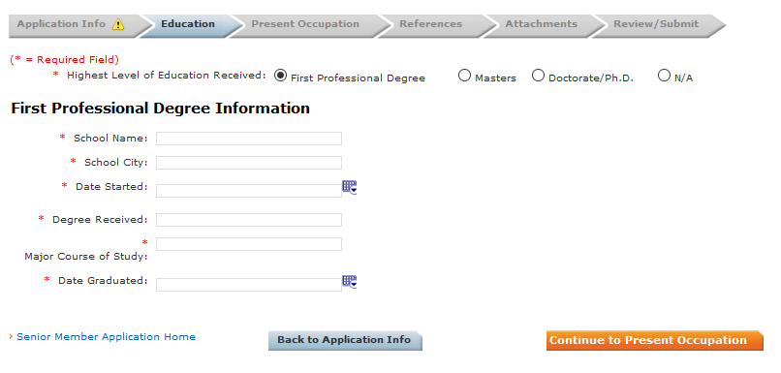
How do I Submit an Application?

Slide 24
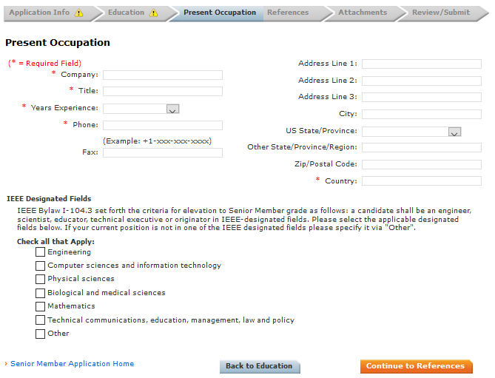
How do I Submit an Application?

Slide 25
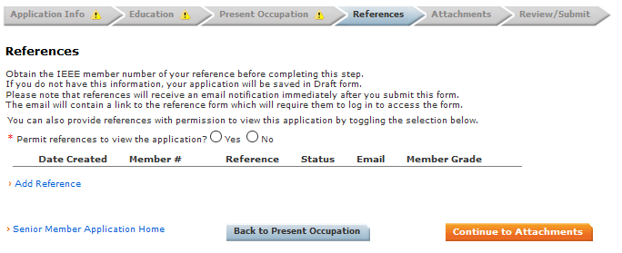
How do I Submit an Application?

Slide 26
How do I Submit a Reference?

Slide 27
What does a good reference contain?
Robert Smith is highly qualified for elevation to Senior Member with a total of 35 years' experience. Since his graduation in 1980 from the University of Alabama with a BSEE degree, his significant contribution to ACME Inc. has resulted in progression from entry level Engineer to Vice-President Major Systems.
6 years 10 months (Nov'08 - Current) at ACME Engineering as Vice-President responsible for Major Systems providing task order management and staffing oversight in support of DOD. Provides direct support in short- and long-range task and staff planning, including budget estimates, schedules and staffing requirements.
3 years 7 months (Apr'05 - Oct'08) at ACME Production as Systems Engineering Senior Manager over a team of 50 engineers performing system engineering activities in support of the DOD program. Successfully built team from 10 engineers to 50 engineers in two years, based on increasing responsibilities and accountability with responsibility for $15M annual budget.
2 years 6 months (Oct'02 - Mar'05) at ACME Production as Systems Engineering Manager over test planning, pre-test scenario and timeline risk reduction analyses, and test data
Robert Smith‘s contribution and management responsibilities more than qualify him for Senior Member status.

Slide 28
Writing a Good Senior Member Application & Reference
Who is eligible for Senior Member elevation
12 Tips to completing a successful application
How to find eligible members in your Section
How to find application references
Holding a Senior Member Roundup
2016 Region & Section Goals
Q&A
.

Slide 29
How to find eligible members?
SAMIEEE is a web-based ad hoc query tool that provides volunteers access to member data. It allows ad hoc querying, reporting, and downloading of IEEE's membership data to authorized or designated IEEE volunteers.
http://www.ieee.org/about/volunteers/samieee/index.html

Slide 30
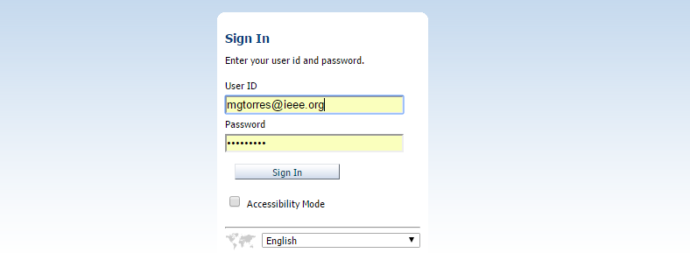
How to find eligible members?
Enter your IEEE UserID
And you password

Slide 31
SAMIEEE: Privacy and Security Disclaimer
All SAMIEEE users must be aware of and accept the terms of conditions and use as described below.
Conditions of data availability and use
IEEE member data is released for use only by IEEE members, officers and committee members. Member information may not be furnished, with or without, compensation, to outside entities, or be used by IEEE members for any other than approved IEEE business.
It is the responsibility of the volunteer to keep informed of IEEE Policies and Procedures governing mailings and the use of labels and email addresses, including the regulations governing electioneering for IEEE offices. The information is found in the Policies and Procedures Manual published every January and is available on request or from the IEEE Governing Documents web site.
It is also the responsibility of the volunteer to keep informed of the IEEE member Privacy and Security policies.

Slide 32
How to find eligible members?
Select Catalog

Slide 33
How to find eligible members?
Select the Geographic Predefined Query folder
Select “Open” on (GEO) SM Upgrade – 1st Level Requirements

Slide 34
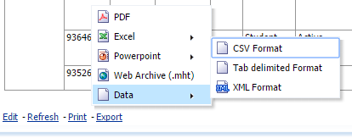
How to find eligible members?
Scroll down to the bottom of the report
Select “Export” then “Data” then “CSV Format”
I don’t recommend “Export” to “Excel”
Open the CSV File in Excel and you will be able to Sort and Filter to find current Senior Member and Fellows to act as references.

Slide 35
Writing a Good Senior Member Application & Reference
Who is eligible for Senior Member elevation
12 Tips to completing a successful application
How to find eligible members in your Section
How to find application references
Holding a Senior Member Roundup
2016 Region & Section Goals
Q&A
.

Slide 36
How to find application references
Select the Geographic Predefined Query folder
Select “Open” on (GEO) Active Member Contact Information

Slide 37
How to find application references
Scroll down to the bottom of the report
Select “Export” then “Data” then “CSV Format”
I don’t recommend “Export” to “Excel”
Open the CSV File in Excel and you will be able to Sort and Filter to find current Senior Member and Fellows to act as references.

Slide 38
Writing a Good Senior Member Application & Reference
Who is eligible for Senior Member elevation
12 Tips to completing a successful application
How to find eligible members in your Section
How to find application references
Holding a Senior Member Roundup
2016 Region & Section Goals
Q&A
.

Slide 39
Holding a Senior Member Roundup
Arrange space for the "Roundup" event with public WiFi available, perhaps a University classroom, Public Library or "back room" of a local restaurant.
Announce the "Roundup" event through IEEE eNotice and social media such as Meetup. Advertise the invitation for members to attend for elevation as well as the need for Senior Members and Fellows to attend to serve as references. Ensure members know to bring the following with them to the event:
Several hard copies of their resume.
An electronic copy of their resume.
Their IEEE member number and IEEE login ID and password credentials.

Slide 40
Holding a Senior Member Roundup
Send individual emails to those members who are eligible to again personally invite them to attend.
Have your officers and other volunteers call known members who are eligible, Senior Members, and Fellows to again personally invite them to attend.
Bring several laptops to the restaurant or meeting room.
During the event, have the officers and Senior Members/Fellows help the eligible members to fill out the online application for elevation. Have the Senior Members/Fellows serve as references.
After the event, thank those who attend and remind the Senior Members/Fellows to complete their references.
.

Slide 41
Writing a Good Senior Member Application & Reference
Who is eligible for Senior Member elevation
12 Tips to completing a successful application
How to find eligible members in your Section
How to find application references
Holding a Senior Member Roundup
2016 Region & Section Goals
Q&A
.

Slide 42
2016 Senior Member Elevation
The 2016 Region 3 Goal is 250 Senior Member elevations. In the February panel we got off to a great start with 35 Senior Member elevations.
As of March 24th >> 21 applications are complete and currently 15 were in the March 19th panel with 45 pending applications needing references. Please work on these application so that these members will be reviewed in the April 13th panel in Atlanta.
The panel targets are: Apr 25, May 30, Jun – Sep 20 each, Oct 40 & Nov 30. Please schedule Section Roundups now. Lets start strong this spring and finish strong in the fall.
The 2015 Winter Region 3 newsletter provided two excellent articles to support Senior Member elevation. See the following link for the IEEE Senior Membership Nomination Event Guide

Slide 43
2016 Panel Schedule
2016 Submission Deadline Dates | 2016 Panel Dates | Location
3 February | 13 February | San Diego, CA, USA (R6)
1 March | 19 March | Bombay, India (R10)
13 April | 23 April | Atlanta, GA (R3)
6 May | 21 May | Paris, France (R8)
15 June | 25 June | Philadelphia, PA, USA (R2)
13 July | 23 July | Ottawa, Canada (R7)
26 August | 10 September | Hong Kong (R10)
9 September | 19 September | New Brunswick, NJ, USA (R1)
 | October | TBD, USA
 | November | TBD, USA
November is the last 2016 panel meeting.

Slide 44
Senior Member Elevations 2016 February YTD
2016 Goal: With the February Panel we have 35 new Senior Members this represents 14% of our 2016 Region goal of 250.
See slide 10 for details

Slide 45
Senior Member Elevations 2016 Total
Event Held
Event Planned
No Event Planned or no Report

Slide 46
Pending Applications Needing References
Area | SECTION | LAST NAME | FIRST NAME | REF #1 | REF #2
Area 1 | Central Virginia Section | MAHARJAN | LAXMAN | J.D.
Area 1 | Central Virginia Section | Maiwald | Frank | R.W. | M.S.
Area 1 | Richmond Section | Md Kamal | Mahanijah | J.D.
Area 1 | Richmond Section | Mehrotra | Monica | D.W.
Area 2 / NC Council | Central North Carolina Section | Madrigal | Marcelino | G.M.
Area 2 / NC Council | Charlotte Section | Malan | Katherine | J.C.
Area 2 / NC Council | Eastern North Carolina Section | Manase | Emmanuel | S.R. | S.S.
Area 2 / NC Council | Eastern North Carolina Section | Manick | Tara | D.N.
Area 2 / NC Council | Eastern North Carolina Section | Manoharan | Arumugam | M.C.
Area 2 / NC Council | Eastern North Carolina Section | Manousakas | Ioannis | P.L. | J.V.
Area 2 / NC Council | Eastern North Carolina Section | Manza | Ramesh | R.G. | M.S.
Area 3 | Atlanta Section | Lun | Desmond | A.Y. | J.K.
Area 3 | Atlanta Section | Ma | Richard | R.H.
Area 3 | Atlanta Section | Ma | Zhongjing | T.H. | W.B.
Area 3 | Atlanta Section | Maceachren | Alan | A.P. | J.M.
Area 3 | Atlanta Section | Macia-Perez | Francisco | D.B.
Area 3 | Atlanta Section | Maclennan | Bruce | B.U. | K.M.
Area 4/Florida Council | Canaveral Section | Madiman | Mokshay | R.F.
Area 4/Florida Council | Florida West Coast Section | Marai | Georgeta-Elisabeta | K.D. | K.A.
Area 4/Florida Council | Jacksonville Section | Marini | Anthony | W.S. | P.S.
Area 4/Florida Council | Jacksonville Section | Marinoni | Andrea | W.S.
Area 4/Florida Council | Jacksonville Section | Markandan | Ramakrishnan | P.S. | W.S.
Area 4/Florida Council | Melbourne Section | Marsh | John | R.D. | A.P.
Area 4/Florida Council | Northwest Florida Section | Marx | David | J.H. | D.Z.
Area 4/Florida Council | Palm Beach Section | Masum | Salahuddin Mohammad | E.A.
Area 4/Florida Council | Palm Beach Section | Mathoor | Aswatha
Area 4/Florida Council | Palm Beach Section | Matuvi | George | G.H. | P.H.
Area 4/Florida Council | Tallahassee Area Section | Meiners | Steven | C.L. | B.H.

Slide 47
Pending Applications Needing References
Area | SECTION | LAST NAME | FIRST NAME | REF #1 | REF #2
Area 5/Tennessee Council | Central Tennessee Section | Maganti | sushanth | M.L.
Area 5/Tennessee Council | Central Tennessee Section | Mahabir | Sham | R.B. | M.P.
Area 5/Tennessee Council | Chattanooga Section | Malanowski | Mateusz | J.N. | S.J.
Area 5/Tennessee Council | East Tennessee Section | malik | Abdul | T.B. | D.C.
Area 5/Tennessee Council | East Tennessee Section | Maljkovic | Zlatko | C.F. | D.N.
Area 5/Tennessee Council | East Tennessee Section | Mallick | Debasish | L.T.
Area 5/Tennessee Council | East Tennessee Section | Mallikarjun | Kittur | L.P. | L.T.
Area 5/Tennessee Council | East Tennessee Section | Maltoni | Davide | I.B.
Area 5/Tennessee Council | Memphis Section | Martyniuk | Mariusz | A.D.
Area 5/Tennessee Council | Tri Cities Section | Mejia Silva | Jesus | W.B. | M.H.
Area 6 | Alabama Section | Lucani | Daniel | T.S. | S.D.
Area 6 | Huntsville Section | Marashdeh | Qussai | G.P.
Area 6 | Huntsville Section | Marco-Alba | Jose Carlos | L.B.
Area 7/SC Council | Columbia Section | MALAPAKA | VIJAYA | E.T. | L.F.
Area 7/SC Council | Piedmont Section | Mavis | Neil | A.C. | T.H.
Area 8 | Lexington Section | MARSH | ALLISON | J.G. | M.F.
Area 9 | Jamaica Section | Marmora | Guillermo | D.D.

Slide 48
Helpful Links
2015 Winter Region 3 Tips for Writing a Good IEEE Senior Member Application by Don Wright and Holding a Senior Member Roundup by James (Jim) Conrad
IEEE Senior Membership site
SAMIEEE Web site

Slide 49
Writing a Good Senior Member Application & Reference
Who is eligible for Senior Member elevation
12 Tip to completing a successful application
How to find eligible members in your Section
How to find application references
Holding a Senior Member Roundup
2016 Region & Section Goals
Q&A
.

Slide 50
Appendix

Slide 51
Glossary
Arrears – members who have not paid the current year dues, services will end
Inactive – members who have not paid dues from the past year and receive no services
Deactivation – All IEEE members who have not paid dues for the current membership year by the deactivation service date (23 February in 2013) have their member status changed to Arrears
MD – Membership Development
MGA – Member & Geographic Activities
TA – Technical Activities
MRRC – Membership Recruitment & Recovery Committee
MGM – Member-Get-A-Member program
A&A – Admission & Advancement program
SM – Senior Member grade
Young Professionals (YP) – used to be IEEE GOLD
HG – Higher-grade member (Member, Senior Member, Fellow. Life Member)
RSR – Region Student Representative
RSAC – Region Student Activities Chair
SAMIEEE – Section/Society Access to Membership Information

Slide 52
Glossary (Cont’d.)
(GEO) – Geographic Predefined Queries Folder, (MD) – Membership Development Predefined Queries Folder, (SOC) – Society Predefined Queries Folder
OU – Organization Unit within IEEE (region, section, affinity group, student branch, etc.)
OBIEE – Oracle Business Intelligence Enterprise Edition
SCOOP – Newsletter from MGA
MMD – Member Market Development
ACK Pac– Acknowledgement Package sent to new members
ExCom – IEEE unit’s Executive Committee composed of officers
YOY – Year over Year – usually for comparing yearly statistics
YOS – Years of Service – for number of membership years
MLP – Member Loyalty Program

Slide 53
Total Membership: 2016 Membership Year February 2016
Total Active Members by Region: February 2016
 | HIGHER GRADE MEMBERS |  |  | STUDENT MEMBERS |  |  | TOTAL MEMBERS
REGION 3 | 2016 | 2015 | % Change | 2016 | 2015 | % Change | 2016 | 2015 | % Change
Tri Cities Section | 81 | 82 | -1.2% | 16 | 7 | 128.6% | 97 | 89 | 9.0% | X
East Tennessee Section | 680 | 682 | -0.3% | 151 | 109 | 38.5% | 831 | 791 | 5.1%
Richmond Section | 589 | 590 | -0.2% | 93 | 64 | 45.3% | 682 | 654 | 4.3% | X
Central North Carolina Section | 213 | 217 | -1.8% | 35 | 26 | 34.6% | 248 | 243 | 2.1%
Florida West Coast Section | 1460 | 1457 | 0.2% | 154 | 136 | 13.2% | 1614 | 1,593 | 1.3% | X
Louisville Section | 259 | 262 | -1.1% | 72 | 65 | 10.8% | 331 | 327 | 1.2%
Eastern North Carolina Section | 2136 | 2104 | 1.5% | 321 | 328 | -2.1% | 2457 | 2,432 | 1.0% | X
Melbourne Section | 484 | 473 | 2.3% | 50 | 57 | -12.3% | 534 | 530 | 0.8%
Charlotte Section | 497 | 496 | 0.2% | 121 | 118 | 2.5% | 618 | 614 | 0.7%
Central Savannah River Section | 148 | 142 | 4.2% | 17 | 22 | -22.7% | 165 | 164 | 0.6%
Daytona Section | 143 | 138 | 3.6% | 45 | 50 | -10.0% | 188 | 188 | 0.0%
Gainesville Section | 267 | 281 | -5.0% | 97 | 84 | 15.5% | 364 | 365 | -0.3%
Central Tennessee Section | 522 | 527 | -0.9% | 129 | 126 | 2.4% | 651 | 653 | -0.3%
Virginia Mountain Section | 329 | 340 | -3.2% | 163 | 154 | 5.8% | 492 | 494 | -0.4%
Jacksonville Section | 296 | 284 | 4.2% | 43 | 57 | -24.6% | 339 | 341 | -0.6%
Central Virginia Section | 457 | 462 | -1.1% | 63 | 66 | -4.5% | 520 | 528 | -1.5%
Atlanta Section | 2779 | 2766 | 0.5% | 499 | 565 | -11.7% | 3278 | 3,331 | -1.6% | X
Palm Beach Section | 548 | 569 | -3.7% | 55 | 44 | 25.0% | 603 | 613 | -1.6%
Chattanooga Section | 262 | 259 | 1.2% | 25 | 33 | -24.2% | 287 | 292 | -1.7%
Northwest Florida Section | 227 | 240 | -5.4% | 35 | 27 | 29.6% | 262 | 267 | -1.9%
Tallahassee Area Section | 205 | 190 | 7.9% | 56 | 76 | -26.3% | 261 | 266 | -1.9%
Region 3 Total | 19,036 | 19,246 | -1.1% | 3,576 | 3,951 | -9.5% | 22,612 | 23,197 | -2.5%

Slide 54
Total Membership: 2016 Membership Year February 2016
Total Active Members by Region: February 2016
 | HIGHER GRADE MEMBERS |  |  | STUDENT MEMBERS |  |  | TOTAL MEMBERS
REGION 3 | 2016 | 2015 | % Change | 2016 | 2015 | % Change | 2016 | 2015 | % Change
Region 3 Total | 19,036 | 19,246 | -1.1% | 3,576 | 3,951 | -9.5% | 22,612 | 23,197 | -2.5%
Mississippi Section | 295 | 297 | -0.7% | 93 | 105 | -11.4% | 388 | 402 | -3.5%
Memphis Section | 302 | 304 | -0.7% | 99 | 112 | -11.6% | 401 | 416 | -3.6%
Broward Section | 354 | 364 | -2.7% | 67 | 74 | -9.5% | 421 | 438 | -3.9%
Jamaica Section | 88 | 92 | -4.3% | 34 | 36 | -5.6% | 122 | 128 | -4.7%
Canaveral Section | 144 | 145 | -0.7% | 5 | 12 | -58.3% | 149 | 157 | -5.1%
Miami Section | 373 | 373 | 0.0% | 129 | 156 | -17.3% | 502 | 529 | -5.1%
Orlando Section | 827 | 840 | -1.5% | 163 | 204 | -20.1% | 990 | 1,044 | -5.2%
Hampton Roads Section | 499 | 520 | -4.0% | 82 | 98 | -16.3% | 581 | 618 | -6.0%
Evansville-Owensboro Section | 141 | 141 | 0.0% | 26 | 38 | -31.6% | 167 | 179 | -6.7%
Huntsville Section | 834 | 867 | -3.8% | 54 | 93 | -41.9% | 888 | 960 | -7.5%
Coastal South Carolina Section | 306 | 313 | -2.2% | 40 | 63 | -36.5% | 346 | 376 | -8.0%
Winston-Salem Section | 108 | 111 | -2.7% | 14 | 22 | -36.4% | 122 | 133 | -8.3%
Lexington Section | 248 | 265 | -6.4% | 72 | 84 | -14.3% | 320 | 349 | -8.3%
Central Georgia Section | 182 | 197 | -7.6% | 24 | 28 | -14.3% | 206 | 225 | -8.4%
Alabama Section | 613 | 638 | -3.9% | 142 | 200 | -29.0% | 755 | 838 | -9.9%
Piedmont Section | 378 | 399 | -5.3% | 85 | 119 | -28.6% | 463 | 518 | -10.6% | X
Savannah Section | 140 | 147 | -4.8% | 27 | 42 | -35.7% | 167 | 189 | -11.6% | X
Columbia Section | 285 | 300 | -5.0% | 90 | 125 | -28.0% | 375 | 425 | -11.8% | X
Western North Carolina Section | 225 | 250 | -10.0% | 50 | 70 | -28.6% | 275 | 320 | -14.1%
Mobile Section | 112 | 122 | -8.2% | 40 | 56 | -28.6% | 152 | 178 | -14.6%

