Slide 1
Introduction to Impact Assessment & Social Return on Investment (SROI)
Shaikh Fattah, Ph.D., SMIEEE, FIEB
Education Committee Chair, IEEE HAC
James Conrad, Ph.D., Chair, IEEE HAC Events Committee
Notes:
I would like to thank Teofilo & the Region 9 Executive Committee for this opportunity to raise awareness of HAC activities and actively engage with stakeholders at regional and section level. The Committee is very interesting in better understanding the types of Sustainable Development related activities IEEE Members are undertaking at local level, better understanding the types of support and training that would be benefit to those volunteers. They would also like to encourage that IEEE volunteers think about how they can best measure and showcase the impact of current and planned activities.
Today I am going to be sharing about impact assessment, the challenges of measuring impact in a comprehensive, meaningful way, and one methodology that the HAC is piloting this year as a potential option for demonstrating value and impact and how to use the information collected to make informed, data-based strategic decisions.

Slide 2


IEEE HAC
The Humanitarian Activities Committee (HAC) supports the IEEE Board-endorsed vision of IEEE volunteers around the world carrying out and/or supporting impactful humanitarian activities at local level.

Slide 3
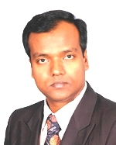

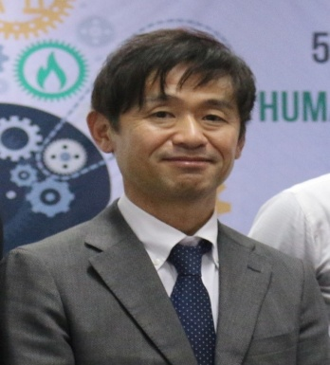
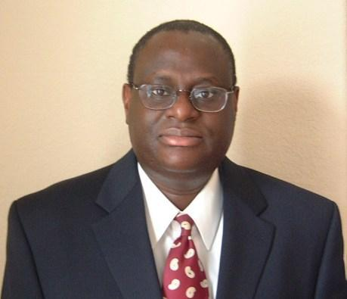

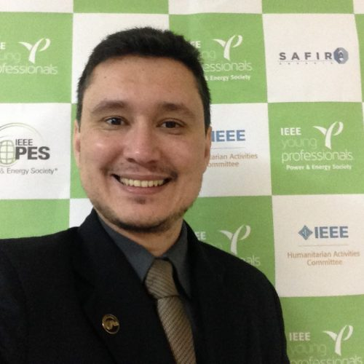
HAC Education Committee
Chair
Member
Member
Shaikh Fattah, PhD
Professor, EEE, BUET
Yasuhiro Soshino, Ph.D.
Dir., IMRD, JRCK Hospital
Alexander Anderson
Chair, ISV Partner Engag.
Member
Member
Member
Tokunbo Ogunfunmi, Ph.D.
Professor, EE, SCU
Yu Zheng Chong
Lect, UTAR, Malaysia
Thiago Alencar, Ph.D.
MDC, IEEE Brazil Council

Slide 4
Objectives of HAC Education Committee
To offer necessary education materials and interactive training to professional engineers or engineering students who want to serve local community with the help of impactful humanitarian projects.
To cover fundamental knowledge and skills required to deal with humanitarian technology projects/events focusing on impact assessment in the sustainable development space.

Slide 5
Impact Assessment
HAC is prioritizing impact assessment in 2019.
Currently, HAC is piloting the Social Return on Investment (SROI) impact assessment methodology.
HAC will evaluate the feasibility of the SROI approach for humanitarian and sustainable development activities at IEEE by mid-year.
The following slides introduce the concept of SROI.
We welcome your feedback on how IEEE can best assess impact!

Slide 6
Social Return on Investment (SROI)
Overview session
9th February 2019
Alex Chapman
Notes:
Intros voluntary network

Slide 7
Big Picture
Why are we interested in measuring social, economic and environmental impact?
Notes:
Why is it not enough to measure financial impact? That would keep things fairly straightforward – definitely easier to measure. Not interested in just the financial aspect because that is a very limited view.
Thinking about things on a larger scale, a change in GDP may show a financial change on a national level, but it doesn’t come close to capturing all the nuances and complexities of what that change meant for the population. Perhaps an increase only benefitted a small group of people, while others were negatively affected and continue to be trapped in poverty.
So to bring it back to a smaller scale, we really want to consider a broader view to better capture the impact our activities and projects and programs are having – something that captures social, economic and environmental impact to determine if its truly sustainable.

Slide 8



Problems with measurement
Financial measurement:
limited measure of value
2. We allocate resources only
to the things we can measure
3: Stakeholders are left out of
decision making
Notes:
We’ve discussed how financial measurement is a limited measure of value.
A second problem we have with measurement and that is that we often measure the things that are easy to measure. These can be financial things, but are also other things that are easy to count – say number of doctor visits that someone makes but we aren’t taking into account if someone is ‘healthy’.
This can lead to a vicious cycle: invariably it tends to be the things that get measured that also get valued and for which resources then get allocated.
Rather than things that matter most to us – economic, social and environmental well-being – often get left out of decision-making.
A third problem is that measurement is often done without (or with only very little input) from those directly affected by an intervention or initiative. So, for example, the government might look at the effectiveness of residential care for looked after children, but will do so without actually involving the children themselves in the measurement process.
This can result in the things that matter most stakeholders being left out of the equation and, therefore, not valued or it can lead to them being mis-interpreted.

Slide 9
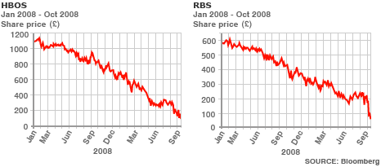

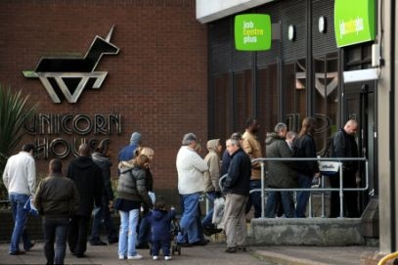
The challenge
Measurement across the ‘triple bottom line’
The economy
The environment
People

Slide 10
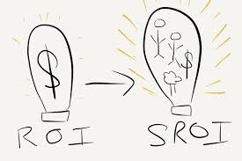

Social Return on Investment
SROI is a framework for measuring the value of an investment in an initiative or service in terms of expected outcomes. “It seeks to reduce inequality and environmental degradation and improve wellbeing by incorporating social, environmental and economic costs and benefits.”
Investment: money, time, hours, expertise, facilities...
Outcomes: quality of life, intellectual property, reputation…
Source: A Guide to Social Return on Investment, the SROI Network
Dr. Shaikh Fattah, Education Chair, IEEE HAC
Notes:
There is increasing recognition that we need better ways to account for the social, economic and environmental value that
results from our activities. The language varies – ‘impact’, ‘returns’, ‘benefit’, ‘value’ – but the questions around what
sort of difference and how much of a difference we are making are the same. Understanding and managing this
broader value is becoming increasingly important for the public and private sectors alike. This is true whether it is civil
society organisations working to create value, Governments commissioning and investing in activities to create social value,
investors seeking to ensure that their investments will make a difference, or private businesses recognising both risk and
opportunity in the wider effects of operations.

Slide 11
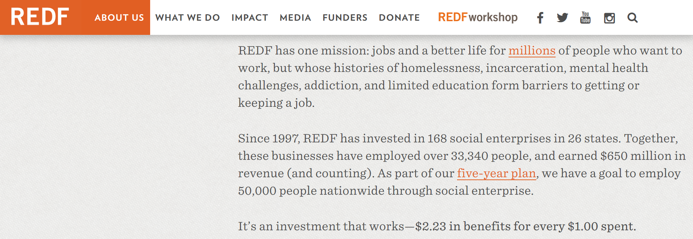
SROI as an institutional culture
Mission and Strategy – having max impact
Funding
Unique Selling Point
Notes:
REDF invests in and advises high-impact social enterprises to employ and empower people overcoming barriers to work. This example was shared by the NEF consultant as an organization that conducted a SROI analysis on their program. They found that an for every $1 they invested, $2.23 of impact was created.
If this was something that could be added to your mission and strategy, it could serve as encouragement and motivation for donors or volunteers to contribute to your project.

Slide 12
Doing what you do best, even better
Prove impact to funders and investors, customers, government and other stakeholders.
Understand what value you are uniquely well suited to generating.
Improve impact to increase benefits created and build non-financial capitals (social and enviro.)
Effective long-term creation of value.
Strategy
USP
Funding
Mission
Notes:
Bringing this all together, mission, strategy and funding, leads to your Unique Selling Proposition. As an organisation, you want to find what you do best in the world.
Want to prove impact and then use this information to improve
M&E only has a purpose if it helps an organisation prove and improve impact, otherwise it is pointless box-ticking. Funder-defined/output-type M&E are often just box-ticking as they don’t focus on impact.
Seeing “prove” as the sole purpose for social impact monitoring can be detrimental in the long-term for beneficiaries and the organisation. Need to embed “improve” too.
The successful social enterprises are the ones that have a powerful story backed up by evidence that they are serving a need and creating a real difference. Understanding your impact means properly understanding your USP- most social enterprises are cleverly employing the use of new technology and serving those in need. But how are you generating social resource, as well as financial resource, to sustain what you do as well? How are you going above and beyond your competitors?

Slide 13
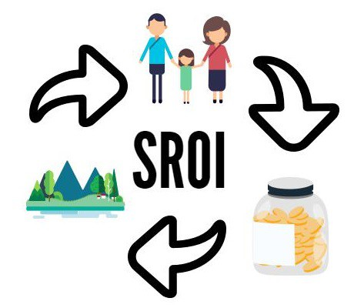
Social Return on Investment
SROI provides consistency and a shared way to talk about value.
It’s a way of understanding how effectively money is spent.
Must be about proving, (reporting), and improving
What is of value will be very different for different people in different situations and cultures.
Includes environmental and economic outcomes (an outcomes-based evaluation)
Measures change that matters to stakeholders
SROI = [value of outcomes]/[value of investments]
An SROI of 3 means that every investment of $1 delivers $3 of social value
Dr. Shaikh Fattah, Education Chair, IEEE HAC

Slide 14
Impact Assessment - SROI Pilot at IEEE
Better aggregate IEEE’s overall impact across social good programs
Achieve consistency although each program has different initiatives and metrics
HAC Projects Committee has revised its application form to incorporate more impact assessment
  Focus on stakeholder involvement and incorporating their feedback into pre- and post-project implementation
Optional to conduct SROI analysis of the project – would create a stronger proposal
Dr. Shaikh Fattah, Education Chair, IEEE HAC
Notes:
SROI analysis – could prove to increase chance of receiving HAC funding

Slide 15
SROI: Forecast and Evaluative
Evaluative SROI:
Evaluate the social value based on actual outcomes that have already taken place.
Forecasted SROI:
Used to predict how much social value will be created if the activities meet their intended outcomes.
Useful in the planning stages of an activity
Shows how investment can maximize impact
Helps identify required data to be collected once the project has begun
Dr. Shaikh Fattah, Education Chair, IEEE HAC

Slide 16
Principles of SROI
Involve stakeholders.
Understand what changes.
Value the things that matter.
Only include what is material.
Do not over claim.
Be transparent.
Verify the result.
Dr. Shaikh Fattah, Education Chair, IEEE HAC

Slide 17
Stages in SROI Calculation
Establishing scope and identifying key stakeholders
Mapping outcomes [inputs, outputs, outcomes]
Evidencing outcomes and giving them a value
Establishing impact
Calculating the SROI
Reporting, using and embedding
Dr. Shaikh Fattah, Education Chair, IEEE HAC

Slide 18




Stage 1: Establishing scope and identifying key stakeholders
Before you start an SROI analysis, you need to clarify what you are going to measure and how, and why you are embarking on a measurement process.
Is it just about identifying unintended consequences? Are you targeting a certain amount of social value generation? Are you comparing between projects or one project?
If you are carrying out an evaluative SROI it may be useful to set up an SROI planning team. Winning management support at an early stage can:
Help make resource available for the SROI analysis
Enable you to embed processes
Take action based on findings
Once you have considered the above, you need to identify all stakeholders involved and establish which are key to the analysis.
Stakeholder: An individual, group of people or organisation that affects or is affected by an intervention.
Notes:
Material Stakeholders: Stakeholders who experience, or are expected to experience, material outcomes (intended or unintended, positive or negative).
Should we mention material or would it be confusing?

Slide 19
Stage 2: Mapping outcomes with stakeholders
Impact maps can be useful for mapping out your intervention and for reporting purposes many funders will request it. If you want to get your SROI project accredited you will need to include one in your final report.
In SROI we do not value outputs, we value outcomes. Therefore it is really important to ensure you have identified the appropriate outcomes for each stakeholder group.
Output: Tells you an activity has taken place and quantifies the activity
Outcome: The change that occurs as a result of an activity (e.g. improved emotional well-being of training participants)
The following slide provides an example of an impact map.
Inputs
Activities
Outputs
Outcomes

Slide 20
Stakeholder | Inputs | Activities | Outputs | Outcomes
Family members (clients) | Time Transport for user | Counselling sessions Group support sessions Referrals to other agencies Family support group work | No. people attending counselling No. people attending group work No. people completing programme Hours support received No referrals to other agencies | Improved mental health & well-being Independence Improved relationships with user, family & friends Better household financial situation
 |  |  |  | Engagement with treatment Improved health Improved independence Improved relationships Improved career prospects
Drug or alcohol user | Time
 |  |  |  | Less resources spent on healthcare for clients Less resources spent on healthcare for user Less resources spent on CJS
The state / government | Funding
Notes:
This slide shows a very simple layout for mapping outcomes, in away that clearly demonstrates the relationship between inputs, outputs and outcomes. At the very least, it’s a great thought exercise as one is desining and planning a Project to ensure you have capture all the relevant stakeholders and what outcomes you expect for each group.

Slide 21
Example questions
Stage 2 continued…
Stakeholder engagement allows you to identify outcomes and build an impact map or theory of change. The objectives are to:
Understand what outcomes look like to stakeholders and how important they are
Understand potential longer term outcomes
Understand why the outcomes have happened
What is your involvement with [activity]?
What are the best things about [activity]? Any less good things? OR How do you feel about [activity]?
Why do you feel like that?
What, if anything, has changed for you? Have any other stakeholders been affected?
What would it look like or feel like if the intervention never happened?
Probe for details: how they know change is happening, what things were like before, who else is involved? Ask for examples? Ask people how they feel? Ask about negative outcomes as well as positive. Don’t be afraid to ask ‘why?’

Slide 22
Stage 3a: Evidencing outcomes
Once you have identified the outcomes in stage 2, you then have to select indicators in order to quantify them.
Indicators tell us about the amount of change that has been achieved.
Find out what is important, then seek to measure it
We can use objective and/or subjective indicators, these may include pre-existing questions from Government, national surveys and other recognised sources (or adjusting them to suit your requirements) and designing your own survey questions.
NEF Consulting typically asks stakeholders to provide indicator ratings ‘before’ and ‘after’ intervention to calculate the change or distance travelled.
Distance-travelled data enables a measure of how much change has occurred during your intervention. It can be done in two ways:
Pre then post design: stakeholders are asked to provide indicator ratings before AND after.
Retrospective design: stakeholders are asked to provide both ratings at the end of the programme.

Slide 23
Stage 3b: Giving outcomes a value
Once distance travelled is calculated, the next step is to apply an appropriate financial proxy.
Pricing is a limited way of understanding value for a number of reasons. The one most relevant to SROI is that not everything that we value can be bought or sold, and therefore it does not have a price attached to it. This does not mean it is not valuable to us.
What we are doing is trying to find a value that, although it is not a ‘true’ reflection of what the outcomes is worth, let’s us get on with what we are trying to do: evaluating change.
There are various ways to apply a financial proxy to an outcome including, market values, asking stakeholders their willingness to pay for a good or service, hedonic pricing and more.
A good starting point for financial proxies is the HACT value bank:
https://www.hact.org.uk/social-value-bank

Slide 24
Stage 4: Establishing impact
How much of the change observed is a direct consequence of your organisation? How will outcomes change over time?
In order to answer the above questions, five concepts need to be taken into account:
Concept | Explanation
Deadweight (or counterfactual) | Deadweight is an estimate of what would have happened anyway. It may be positive or negative and is usually determined through benchmarks. This is presented as a percentage.
Attribution | How much credit can your organisation take for the outcomes? This considers input of other stakeholders, especially where a project is a catalyst to change. This is presented as a percentage.
Displacement | This is where all or part of the value is not actually created by the activities, but is moved elsewhere. For example, in an employment project the outcome of securing employment carries a displacement value as there are only a limited number of jobs to go round.
Benefit period | The length of time over which outcomes are expected to endure (e.g. the benefits of an employment programme may ensure for some years after the course). This is different to the investment period.
Drop off | The rate at which benefits decrease over time. For instance, it is likely that benefit for training participants wears off as time goes on.

Slide 25
Stage 5: Calculating SROI
Calculating the net present value
In order to calculate the net present value (NPV) the costs and benefits paid or received in different time periods need to be added up. To ensure costs and benefits are comparable a process called discounting is used. Discounting recognises that people generally prefer to receive money today rather than tomorrow because there is a risk. (e.g. money will not be paid) or because these is opportunity cost (e.g. potential gains from investing the money elsewhere).
Calculating the SROI
Calculating the SROI is done by dividing the value of outcomes (taking into account the concepts described in Stage 4) by the total investment. In addition to monetary values, both volunteer time/in-kind contributions and pro-bono support must be included in investment at a market rate. (e.g. hourly wage for volunteers)
SROI = [Value of outcomes]
[Investment]
Sensitivity and other checks
A sensitivity analysis is usually carried out during this stage. It tests how the SROI ratio changes when key assumptions are altered (e.g. value of proxies, deadweight, attribution, etc.).

Slide 26
Stage 6: Reporting, using & embedding
Best practice reporting
Audience: Be clear on who you expect to read the report
Transparency: create a technical appendix with calculations and assumptions. Be clear about the risks of over-claiming
Verification: put in place an assurance process or work with an expert to gain credibility
Messaging: tell the story of the organisation → have a narrative
SROI helps you make decisions on:
Which programmes are creating the most value
How to maximise value for different stakeholders
Investment in preventative activities
Your role in creating change
To enable decisions:
Ensure you have senior buy-in
Embed SROI knowledge and practice across organisation (e.g. training of staff)
Create a system for updates
For more details on the stages described please read ‘A guide to SROI’ via this link.
Examples reports can be found at: http://www.socialvalueuk.org/report-database/

Slide 27
Discussion & Questions

Slide 28
Discussion Questions
What do you think about establishing a consistent, cross-IEEE framework for impact measurement?
What educational tools and resources would you and other project leaders in your Section need in order to implement the SROI assessment methodology?
What do you see as the methodology’s strong points?
What doubts or concerns do you have about SROI?

Slide 29
Call to Action
Appoint someone in your section to find out more and stay up to date on developments in pilot program.
HAC is looking for volunteers across IEEE to help pilot the methodology – Is there a Project in your Section that could be a candidate?

Slide 30
Questions?
Contact:
Julianna Pichardo – sight@ieee.org, j.pichardo@ieee.org
Holly Schneider Brown – h.s.brown@ieee.org
Notes:
Just let me know if you would like to direct your question to the IEEE HAC Committee.
IF you are interested in learning more and reviewing resources to see if this methodology would be a good fit for a program, Project, or activity in your Section, please send us an email. Social Value UK has an easy-to-read guide called Introduction to Social Return on Investment in english, spanish, portguese, and 7 other languages that could serve as a good place to start. Exercises, example cases, graphs, and drawings.

Slide 31
Thank You!

Slide 32
Appendix

Slide 33
NEGATIVE accountable unintended outcomes
ACTIVITY!
Theory of change for SROI
Activities
Outputs
Accountable intended outcomes
Long-term outcomes
POSITIVE accountable unintended outcomes
What did you find?

