Slide 1
IEEE Humanitarian Activities Committee (HAC)
2019 Introduction
Notes:
HAC is pronounced “H-A-C.”

Slide 2
How HAC fits into the IEEE Strategic Plan 2015 - 2020
HAC is a committee of IEEE since 2016 and reports to the IEEE Board of Directors (BoD)
IEEE Mission: We foster technological innovation and excellence for the benefit of humanity.
IEEE 2015 – 2020 Goal: Lead humanitarian efforts around the world to use technology to solve the world’s most challenging problems.
IEEE 2015 – 2020 Key Initiative: Develop programs in public service focused on knowledge and technology in our fields of interest related to public policy and humanitarian efforts.
HAC Mission: The IEEE HAC supports the IEEE Board-endorsed vision of IEEE volunteers around the world carrying out and/or supporting impactful humanitarian activities on the local level.

Slide 3
HAC Strategic Goals
Awareness
Output: Marketing, communications, and outreach efforts
Outcome: More members and organizational units (OUs) aware of how they can use their technical skills for social good.
Training
Output: Online and in-person educational and training opportunities
Outcome: More skilled humanitarian activities participants who can have greater positive impact
Projects
Sustainable Development Community
Output: Project creation, funding, and assessment opportunities
Outcome: Many impactful projects with local communities around the world
Outcome: IEEE is a leader in the humanitarian/sustainable development community
Output: Opportunities for partnerships and information sharing
New volunteers and members who want to take part in IEEE humanitarian activities.
HAC provides a scaffolding for humanitarian activities at IEEE
Notes:
Make this a brief overview – don’t read everything

Slide 4
HAC Operational Committees
Each operational committee is chaired by a member of HAC
Education
Assessment
Partnerships
Communications
Events
Projects
IEEE SIGHT
In 2019, HAC also has an Ad Hoc Committee on Platform for Engagement and Metrics.

Slide 5
IEEE HAC Funding Opportunities at a Glance
HAC Projects
SIGHT Projects
Conference Participation
$20,000 - $60,000 per project
HAC Events
$1,000 - $19,999 per project
Up to $15,000 per event
Up to $750 per individual
Notes:
These are general guidelines. Occasionally, financial support is more or less than the program standard.

Slide 6
HAC Funding Support in 2018
HAC Projects
11 projects supported
SIGHT Projects
10 projects supported
HAC Events
40 events supported
Conf. Participation
31 individuals supported
50 submissions
53 submissions
77 submissions
112 submissions
Average award: $33,000
Average award: $10,100
Average award: $4,900
Average award: $529

Slide 7
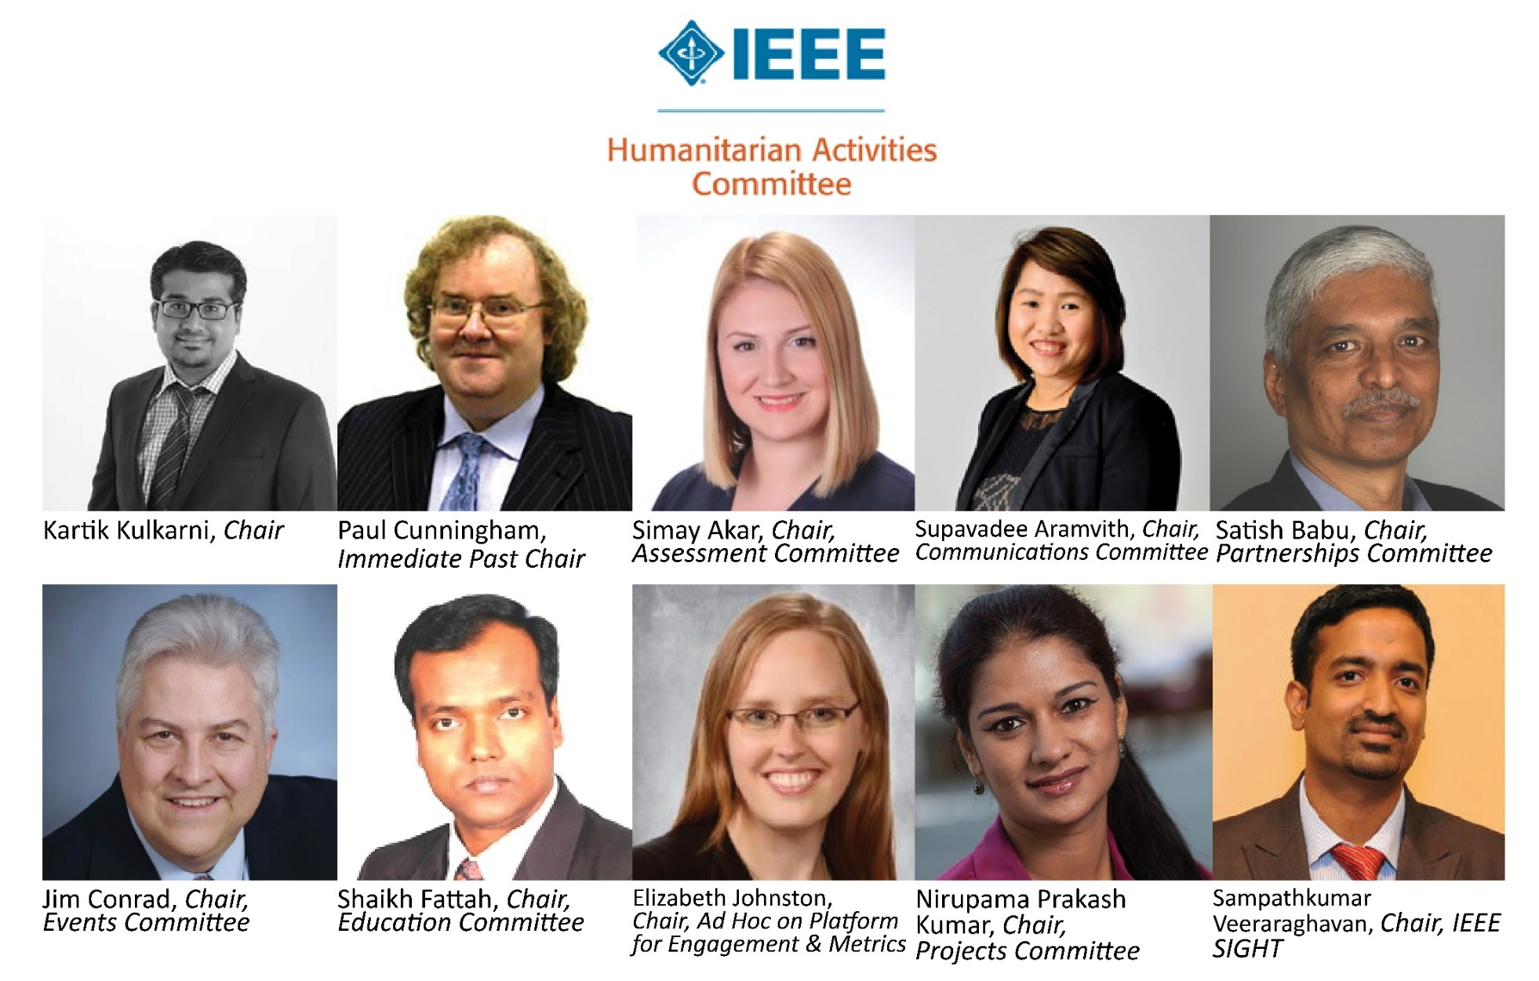
HAC 2019 Committee

Slide 8
HAC Professional Staff Team in Piscataway, NJ, USA
Holly Schneider Brown
Julianna Pichardo
Betsy Toland
HAC Staff Lead
IEEE SIGHT Staff Lead
Administrative and Operational Support

Slide 9
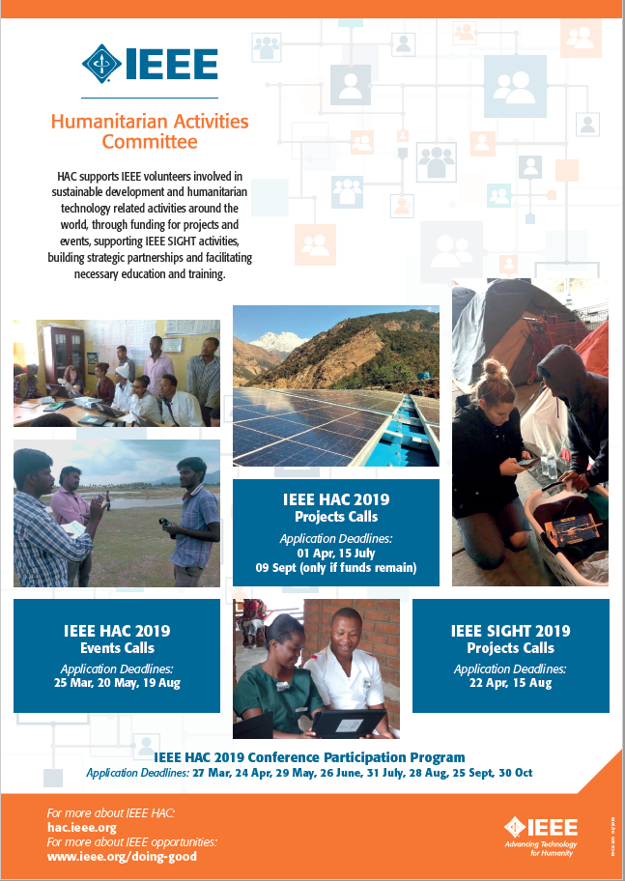
2019 IEEE HAC Funding Opportunities Deadlines (remaining)
HAC Project Deadlines – 15 July, 09 September (only if funds remain)
HAC Event Deadlines – 20 May, 19 August
SIGHT Project Deadlines – 22 April, 15 August
HAC Conference Participation Program – 24 April, 29 May, 26 June, 31 July, 28 August, 25 September, 30 October
Visit hac.ieee.org to review Calls for Proposals and links to application forms

Slide 10
Building a locally-focused community of engineers for global development

Slide 11
Special Interest Group on Humanitarian Technology
SIGHT is network of IEEE volunteers around the globe that partner with underserved communities and local organizations to leverage technology for sustainable development.

Slide 12
Vision & Mission
Vision
Underserved communities around the world are able to benefit from technology as they seek sustainable solutions to development challenges.
Mission
The Special Interest Group on Humanitarian Technology (SIGHT) program is a network of IEEE volunteers around the globe that partner with underserved communities and local organizations to leverage technology for sustainable development.

Slide 13
2019 IEEE SIGHT Committee
Notes:
The SIGHT Steering Committee (SSC) is structured into specific operational subcommittees that each provide regular updates and an annual report to the SSC. The Committee manages all aspects of IEEE SIGHT including approving new teams, training teams, organizing community engagement workshops, evaluating requests for project funding, tracking project performance, communicating SIGHT activities within SIGHT and across IEEE, working effectively across IEEE OUs, and maintaining a quality improvement process for all SIGHT activities.

Slide 14
SIGHT Members, Groups, and Projects
Notes:
Building a locally-focused community of engineers for global development

Slide 15
IEEE SIGHT Members & Global Community
Live in 10 Regions & 93 countries
4,346 new members in 2018
1,255 new members so far in 2019
60% are IEEE Student Members
Active on Social Media: 19,200 members in the SIGHT Facebook group - facebook.com/groups/ieeesight/

Slide 16
2018 Update – SIGHT Members
6,917

Slide 17
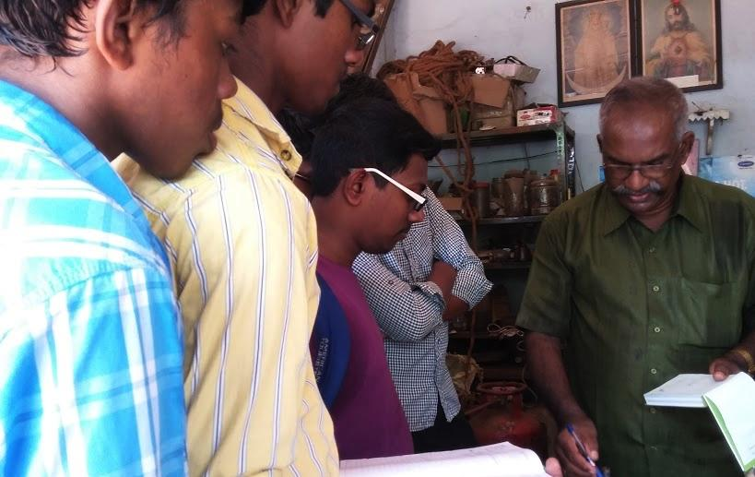
What is a SIGHT Group?
A group of at least 6 IEEE members (additional IEEE and non-IEEE volunteers are welcome) who come together to
learn about sustainable development,
build relationships with local underserved communities and,
implement projects that leverage technology to tackle key problem within the community.
Photo: Artisanal Fishers SIGHT, India

Slide 18
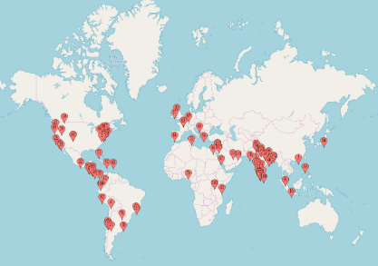
2018 Update – SIGHT Groups Around the World
At the end of 2018, there were 116 groups in 46 different countries
Located in 63 Sections
24 new groups formed in 2018 – a record since the beginning of the program

Slide 19
IEEE SIGHT Groups 2016 - 2018
116

Slide 20
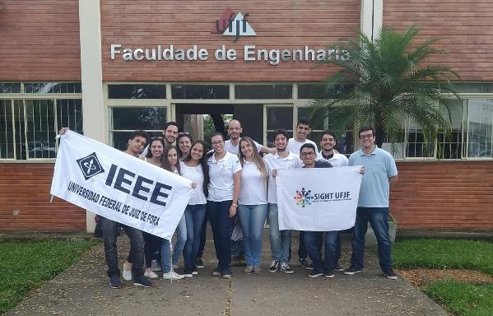
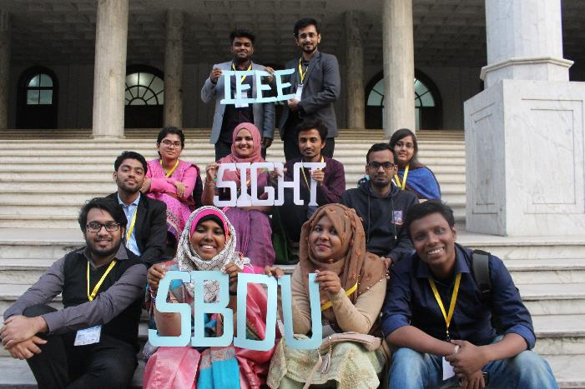
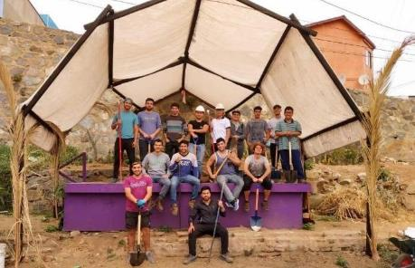
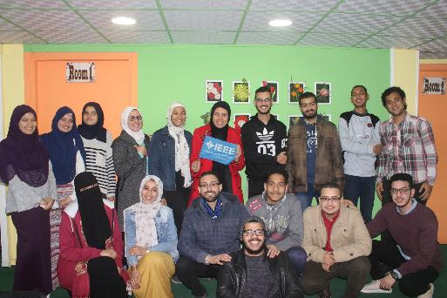
IEEE SIGHT Groups
SIGHT UFJF, Brazil, R9
SIGHT University of Dhaka, Bangladesh, R10
SIGHT PUCV, Chile, R9
Egypt Section SIGHT, Egypt, R8

Slide 21
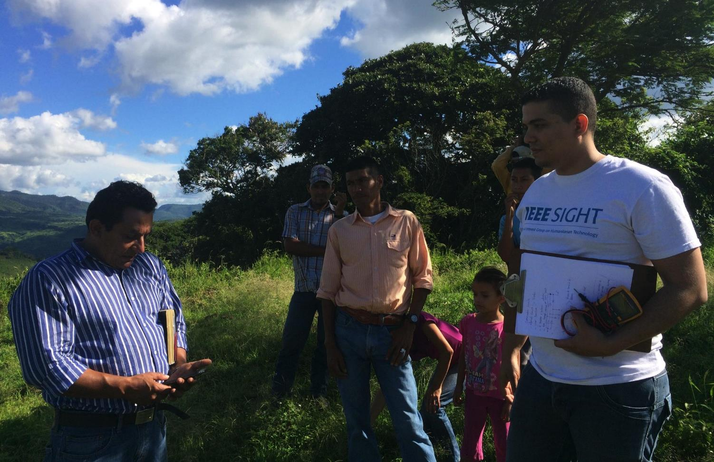
Why a project?
“Feet on the ground” engagements allow SIGHT groups to apply their unique skill sets to tackle complex local challenges and create positive social impact.
BRIDGES SIGHT, Nicaragua

Slide 22
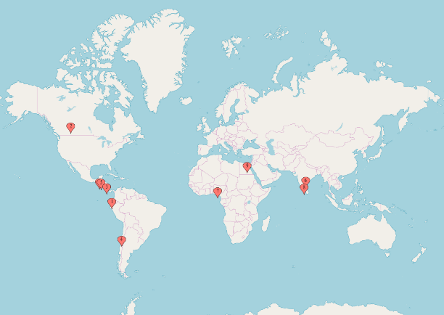
2018 Update - Funded IEEE SIGHT Projects
IEEE SIGHT offered four proposal calls in 2018, received 50 proposals from 24 different countries and selected 10 projects to be funded.
Projects include initiatives to install lighting for a playground in Chile, implement an intelligent animal attack prevention system for crop protection in India, provide three rural communities in Guatemala with potable water via a solar-powered submersible pump and filter in the local well - and others!

Slide 23
R3 IEEE HAC Volunteer Leaders
Jim Conrad, Chair, HAC Events Committee & Humanitarian Activities Coordinator
Sunnty Arokia Swamy Bellary, Member, HAC Events Committee
Sonya Dillard, Member, HAC Events Committee
Eric Grigorian, Member, IEEE HAC Events Committee
Notes:
Past Volunteer was Fernando Bouche – Panama, on IEEE HAC Committee for several years

Slide 24
IEEE Humanitarian & Philanthropic Opportunities
IEEE Foundation
Illuminate: the possibilities of using technology to tackle global challenges
Educate: the next generation of innovators and engineers
IEEE Smart Village Access to electricity creates opportunity and improves lives in remote communities around the world.
EPICS in IEEE empowers students to work with local service organizations to apply technical knowledge to implement solutions for a community’s unique challenges.
MOVE offers a mobile emergency relief program committed to assisting victims of natural disasters with short-term communications, computer, and power solutions.
Empower a Billion Lives. Competition to help the global community create and demonstrate sustainable solutions for energy access that are technically and economically viable, and that can rapidly scale to impact more than 1 billion people across the globe who live in extreme energy poverty.
IEEE Power and Energy Society Scholarship Plus Initiative recognizes highly qualified electrical engineering undergraduate students with multi-year scholarships and assists in connecting them with relevant and meaningful career experiences.
REACH (Raising Engineering Awareness through the Conduit of History) explores technology and engineering history and the relationships they have with society, politics, economics, and culture.
Students and Young Professionals
IEEE offers a variety of scholarships for IEEE Student members.
Notes:
El futuro de la tecnología depende de la nutrición de mentes brillantes, la creación de oportunidades para soñar y el cultivo de una generación de profesionales de la tecnología socialmente responsables.

Slide 25
Other Social Programs
IEEE Foundation
Committment: a larger audience that appreciates the value and importance of engineering and technology
IEEE History Center make known to the public the important legacy of engineering, thereby contributing to better understanding and appreciation of engineering and to increased technological literacy..
IEEE Life Member Committee
Energize – innovation that celebrates technological excellence
IEEE Medals, Technical Field Awards, & Recognitions
IEEE Society Awards
IEEE-Eta Kappa Nu
Notes:
El futuro de la tecnología depende de la nutrición de mentes brillantes, la creación de oportunidades para soñar y el cultivo de una generación de profesionales de la tecnología socialmente responsables.

Slide 26
Stay Connected!
Find out more about IEEE SIGHT, become a SIGHT member, or form a SIGHT group!
sight.ieee.org
ieee-sight-toolkit.org
facebook.com/groups/ieeesight/ o ieeesight en Instagram
Questions? Contact: sight@ieee.org

