Slide 1
Professional Activities Committee
Theresa Brunasso
SoutheastCon 2019, Huntsville, AL

Slide 2
Professional Activities Committee
Committee Responsibilities
Encourage and support sections in ensuring the professional growth of members.
Work with others in the region to encourage, develop, and nurture programs that stimulate interest in STEM.
Submit the Professional Development Financial Report required by IEEE-USA.
Coordinate work to optimize the effectiveness of professional activities with federal, state and local governments.
Encourage student branches to hold events promoting professional awareness.

Slide 3
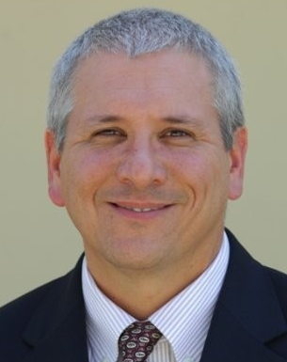
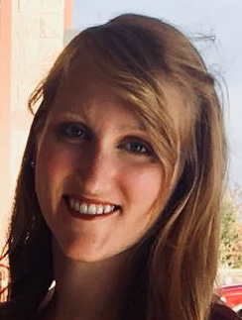
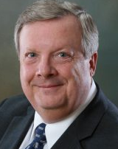
Professional Activities Committee
Committee Members for 2019
Chair: Theresa Brunasso
Professional Activities (USA-PACE)
Founder, D&S Microwave
Ed Kirchner
Employment & Career Services (USA-ECSC)
Engineering IPT Leader, Harris Corporation
Bailey Ulferts
Student Professional Awareness Coordinator
Controls Engineer, US Navy
Lee Stogner:
Government Activities Coordinator (USA-GAC)
President, Vincula Group
Open Position!
STEM Educational Liaison (USA-K-12 STEM)

Slide 4
Professional Activities Committee
Activities and Goals for 2019
Distribute 100% of PACE funds to sections for professional events ($11,300 this year)
Work with PACE committee and region to secure funds for future professional activities
Establish a short-term plan for employment activities in the region
Increase networking between students and professionals
Share information of region government activities

Slide 5
What is PACE?
Professional Activities Committees for Engineers
A network of IEEE volunteers and committees organized at the section and chapter levels with support from Regions and IEEE-USA
PACE goals
Promote the professional interests of U.S. members
Provide a mechanism for communication of members' views on their professional needs

Slide 6
PACE Focus Areas
Employment Assistance Activities
Career Development Activities
Student Professional Awareness (SPAx)
K-12 STEM Education Activities
Government Activities

Slide 7
Employment Assistance Activities
Resume Writing
Interviewing Skills
Leveraging LinkedIn
Networking Skills
Hiring Managers’ Panel

Slide 8
Career Development Activities
Presentation Skills
Technical Writing
Hiring Skills
Leadership Skills
Program Management Skills
Preparing for Performance Reviews
Starting Your Own Business
Patent Writing
Ethics
Financial Planning

Slide 9
Student Professional Awareness (SPAx)
Any PACE activity organized by and for student members
Online Reputation Management
Ethics in Engineering
Life Long Learning
Road Trip to a Dream Job
Differences between the Classroom and the Office
Check out the new SPAx website developed by student members!

Slide 10
K-12 STEM Education Activities
FIRST Robotics
Future City Competition
MathCounts Competitions
Science Olympiad Competitions
Science & Engineering Fairs
Family Science Nights
School Career Days
Introduce a Girl to Engineering Day

Slide 11
Government Activities
Federal and State Legislative Visits
Department of Labor Assistance
Legislative Dinner
Tort Reform
Chamber of Commerce Participation

Slide 12
Plan for New PACE Chairs
Get to know your section’s past PACE Chair and previous PACE activities
Get to know the Region 3 PACE Coordinator (me) and your section officers
Assess professional interests of your Section and Chapter members
Explore the IEEE-USA PACE Website for available resources
Get familiar with funding options, forms and processes
Develop an activity plan for your first year
Recruit volunteers to assist with the activity plan
Execute, assess and review your first year’s plan
Create a three year activity plan
Identify and train your replacement

Slide 13
PACE Financial Resources
I have money for your section!
Section Funds
PACE Chapter Funds
PACE Region Funds
Up to half the costs of your event up to $1500
PACE Committee Funds
We want to give all PACE funds to the sections.

Slide 14
Region Funding Process
It’s so easy!
Have an idea
Get Section approval to provide half the funds
Submit request to Region PACE Chair (me) for approval
theresa.brunasso@ieee.org
Conduct activity
File L31 report and submit PACE report
Get money

Slide 15
Thank you!
Theresa Brunasso
theresa.brunasso@ieee.org

