Slide 1
Member Activities Committee
Sonya Dillard, Chair
SoutheastCon 2019 – Huntsville, AL

Slide 2
Member Activities Committee (MAC)
R3 MAC Committee Members for 2019 R3 Website: http://ewh.ieee.org/reg/3
MAC Chair: Sonya Dillard
Newsletter Editor: Bill LaBelle
Webmaster: Eric Ackerman
Fellows Coordinator: David Conner
Information Coordinator/Social Media: Steve Jackson
R3 Advisor/Mentor: Bill Ratcliff
R3 Advisor/Mentor: Lee Stogner
The Member Activities Committee (MAC) shall support and facilitate the effective, seamless and interactive sharing of information and knowledge with members of Region 3 and others. This committee will also support other activities related to individual members of Region 3.

Slide 3
Member Activities Committee
Committee Responsibilities
MAC shall identify and communicate the personal and professional benefits of active engagement with fellow IEEE members. The MAC shall contribute material, and if requested, present communications information and demonstrations to the Region leadership and members.
MAC Chair shall assist the Region 3 Secretary in maintenance of various email lists used by the Region 3 Committee and the Region 3 Executive Committee.
Newsletter Editor shall publish the IEEE Region 3 Newsletter, on a scheduled basis, in paper and electronic format via the Region 3 website.
Webmaster shall support the creation and maintenance of web content for Region 3 and its entities to inform the members of events and activities.
Information Coordinator shall support the creation and maintenance of social media content for Region 3 and its entities.
Fellows Coordinator shall encourage members to seek the membership level of Fellow.

Slide 4
Member Activities Committee
Activities and Goals for 2019
R3 Sections Support all categories of Members Activities:
Huntsville Section – Alabama Science & Engineering Fair, April 4 – 5th (Supports K12 Future Members)
Atlanta Section – Spring Banquet, with Technical Keynote Speaker, April 18th (Professional Members)
Florida West Coast – “Becoming an Independent Consultant”, April 22nd (Professional Members)
Charlotte Section – Engineering Senior Design Expo, UNC Charlotte, May 2nd (Student Members)
Melbourne Section – Melbourne Annual Picnic, May 18th (Serving all Members and their Families)
Alabama Section – Life Member Affinity Group Luncheon, May 20th (Life Members)
Goals for 2019:
Goal 1/MAC Chair – Communicate monthly to the R3 membership about activities, benefits and facilitate the sharing of knowledge on various social media platforms.
Goal 2/Committee – engage membership by increasing usage of already established social media platforms.
Goal 3/Webmaster – increase member engagement by encouraging them to submit current and relevant information, activities and photos to be posted on our R3 website.
Goal 4/Information Coordinator – Increase visibility of R3 social media from previous year
Increase number of internet “hits”, “likes”, and “followers.”

Slide 5
Member Activities Committee (MAC)
Updating the Website R3 Website: http://ewh.ieee.org/reg/3
Types of information Member Activities and Photos for posting to the Region 3 website:
Pre-Collegiate or K-12 Activities
College Student Programs and Chapter events
Women in Engineering Events
Young Professionals Events
Senior Member Roundups
Life Member Socials and Activities
Sections can delegate a different person at each event to snap photos and post immediately to social media.
We need YOUR help! Post event photos immediately to social media. Then send us an email with the link the post to the R3 Website. This keeps info current, exciting and entices others that are following, want to come to the next event. Eventually, this will increase our overall membership participation and many will join the IEEE.

Slide 6
Member Activities Committee
Challenges to Overcome
Keeping the Region 3 Website Current at least quarterly
Biggest challenge is people sending in the information to post.
Updating the site is difficult if we do not receive exciting new things to post.
Reaching out to Sections to ensure that Members needs are being met.
Helping Sections get information needed to support our Member Activities in all categories of membership
Supporting Students Members, YP, WIE, Senior Members and Life Members
Engaging members to share their IEEE experience with others
MAC has all the resources to help support Sections on IEEE benefits.
Sections should also support our IEEE Member-Get-A-Member (MGM) Referral Program.
This is your opportunity to share the value of IEEE membership with friends and colleagues.
https://www.ieee.org/membership/join/member-get-a-member.html

Slide 7
Member Activities Committee
Member Benefits: Discounts & Reduced Rates
Reduced rates on IEEE Products
As much as 50% off
Member Discounts* on:
Financial Services
Insurance Services
Home & office Services
Travel Services
* Benefits vary by country

Slide 8
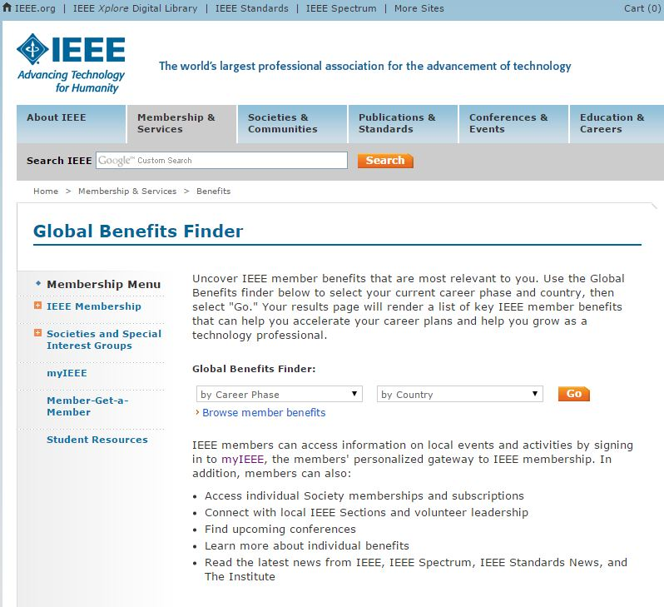
Member Activities Committee
Global Benefits Finder
Access to all of the benefits of IEEE Membership
Broken down by
Career Phase
Country
90+ Benefits for US Members
www.ieee.org/benefits

Slide 9
Member Activities Committee
Do you Want to see more of the IEEE Experience?
Check out Member Activities on the following sites:
IEEE.tv Membership Experience Channel
https://ieeetv.ieee.org/channels/ieee-experience
http://www.ewh.ieee.org/reg/3/
https://www.instagram.com/r3ieee/
https://www.facebook.com/r3ieee/
https://www.facebook.com/IEEEStudentsRegion3/
https://twitter.com/r3ieee?lang=en
@IEEExp
IEEE Membership

Slide 10
Thank you!
Let’s HEAR from YOU! ☺
Send us your membership ideas, new trending activities and programs, event photos and Region 3 success stories.
Sonya Dillard, R3 MAC Chair
Sonya.Dillard@ieee.org

