Slide 1
IEEE-USA President Candidate IEEE Region Meeting
Katherine J. Duncan, Ph.D.
2019 IEEE-USA Women in Engineering Committee Liaison
2017-2018 Region 2 Director
2013-2015 Region 2 Women In Engineering Coordinator
April 13, 2019
Huntsville, AL
1

Slide 2
1. Increased Engagement
Students:
Create a program similar to the Student Transition & Elevation Partnership (STEP) in which we connect the students earlier in their academic career with higher-grade members.
Members (Affiliate, Associate, Senior, and Fellow grade):
Engaging members by highlighting the efforts of IEEE-USA with regard to policy. Also developing a network for Senior and Fellow grade members. This network would enable the lower-grade members to reach out for assistance in obtaining information on elevation of grade, for technical and professional assistance.
Life:
Develop a mentor program in which life members guide pre-college or college students; generate a database of skills and interest of the Life member to connect these members with Student members.
5

Slide 3
2. The 21st Century IEEE-USA
Growth
Grow IEEE by seeking members in complementary disciplines
Address underserved segments in the United States
Focus on practitioners, both in the private and government sectors
Knowledge Distribution
Create and deliver knowledge rather than more information
Combine traditional papers with on-line interaction, videos, databases, simulation tools and wikis to enrich knowledge content - with a focus on Young Professionals and practitioners
6

Slide 4
3. A More Adaptive and Innovative IEEE
Create a Structure and Culture of Innovation
Create an organizational structure that proactively identifies and develops new and potentially disruptive innovations
Develop a culture that encourages diversity, experimentation, risk-taking, and collaboration
Build Strategic Partnerships
With other professional societies, including organizations in nontechnical areas
With industry, academia, and government entities
7

Slide 5
What Have I Accomplished in IEEE?
IEEE Region 2 Director
Women in Engineering and Young Professional Activities
Chair of the 2015 - IEEE WIE Summit USA East 2015: This event is now in its 5th year and rotates between Region 2 and Region 1.
Enabled the development of the Region 2 YP/WIE conference (RISE): The event has been implemented for the past two years with the intent of a short planning and implementation cycle along with training new volunteers.
IEEE Board of Director
Co-Organized the SPARKS! Sessions: Also, facilitated the WIE SPARKS! section, prior to the opening ceremony of 2017 Sections Congress in Sydney.
Committee Membership:
IEEE Ad Hoc Committee on Strategic Planning: Began to operationalize the IEEE Strategic Plan, specifically: dissemination, alignment of OUs, performance, measurement, and stimulation.
IEEE Ad Hoc Committee on Continuous Improvement: The concept of a venue for major board collaboration, this brings leaders of the major Boards together to discuss their OU activities and potential collaborates.
4

Slide 6
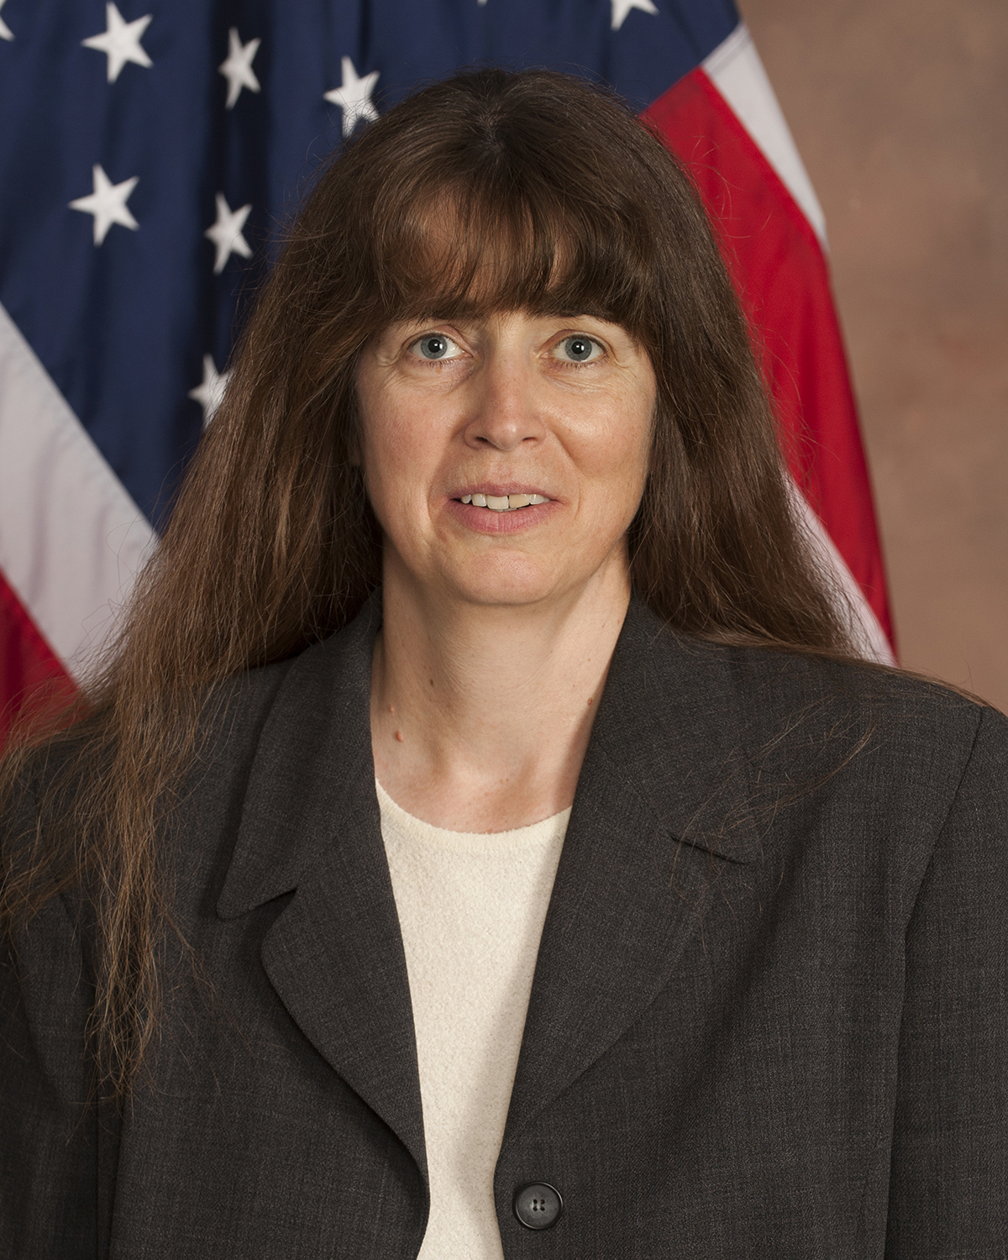
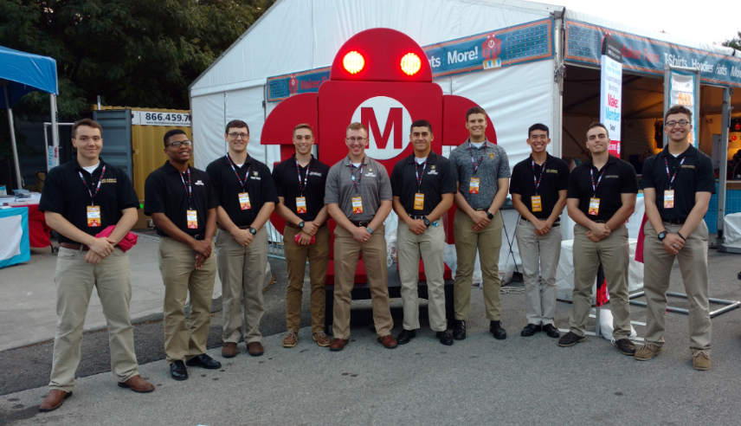
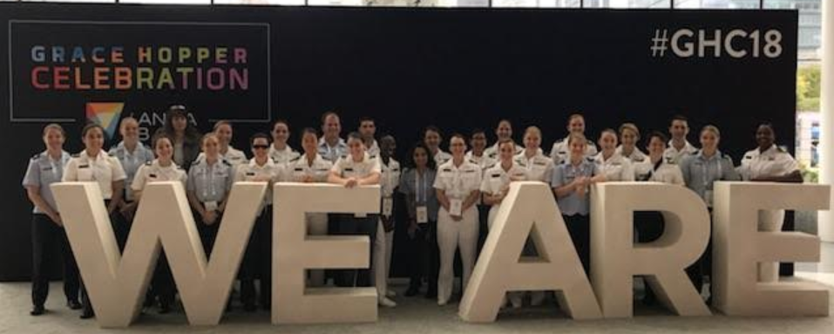
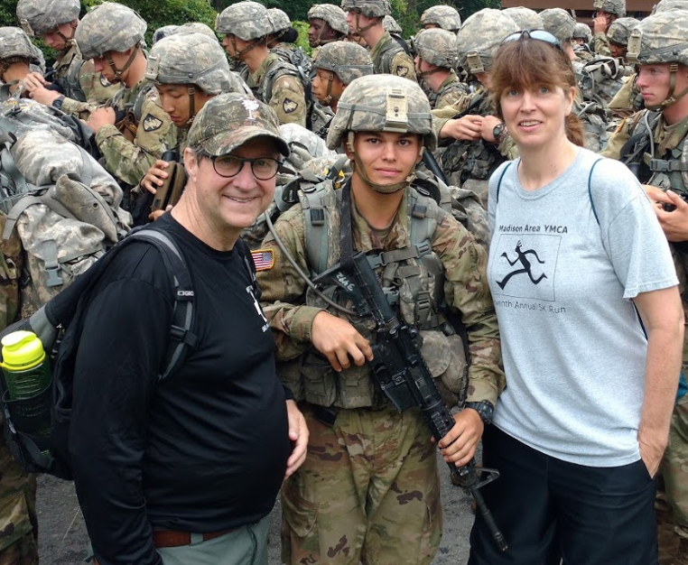
Who Am I?
Visiting Research Fellow at West Point
10th year with ARMY CERDEC
Visiting Research Fellow USMA, West Point
Teach Courses: Electromagnetic Fields & Waves, Fundamentals of Electrical Engineering, Advanced Individual Study and Integrative Systems Design (Senior Design).
Conduct Research: Developing analytical techniques for the detection of anomalies within Cyber Physical Systems (CPS), with a microgrid as the CPS testbed.
CERDEC Wireless Power Transmission Program Lead
Developed internal laser laboratory to conduct far field power beaming experiments.
Managed a sizable external research efforts researching laser power transfer.
CERDEC Principal Investigator, Printed RF Structures
While embedded within the Army Research Laboratory developed the capability to print functional electromagnetic structures.
Synthesized novel nanomaterials for the next generation antennas systems – complex oxides and carbon based materials.
Support of both CERDEC and the USMA EECS Department Head
2

Slide 7
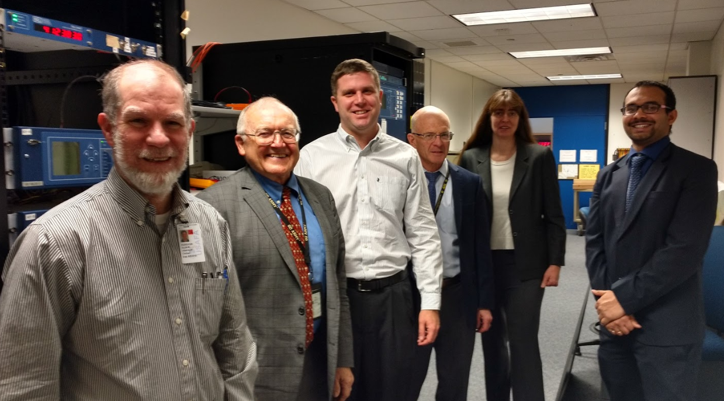
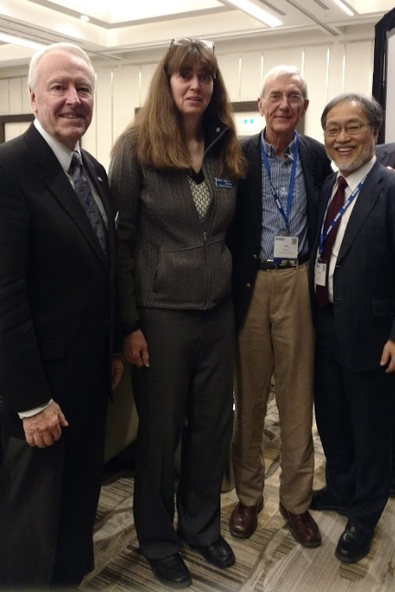
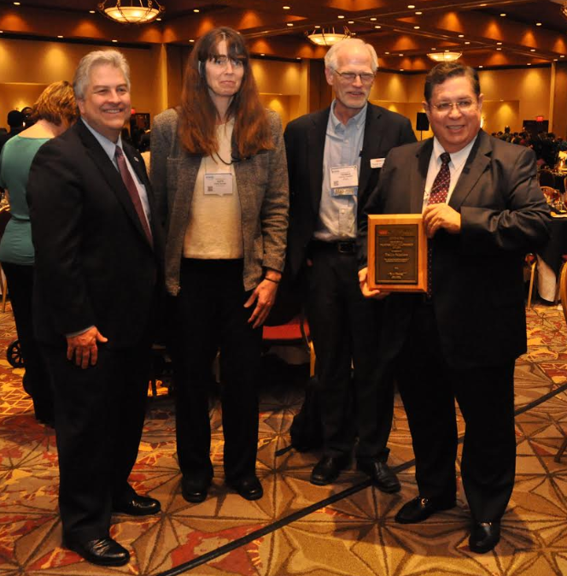
Who Am I?
Faculty Member & Practitioner
Technical publications and a Patent
Member of IEEE (Senior), APS and NDIA
2011 ARMY Chief Scientist coin by Dr. Scott Fish, Army Chief Scientist, ASA(ALT)
2010 CERDEC S&TCD Honorary Award for Science
ABET Electrical Engineering program evaluators (PEV)
Liaison, IEEE-USA Women in Engineering Committee
Member, IEEE-APS New Technology Directions Committee
Past member of the IEEE Board of Directors
RF/Materials Engineer, Johanson Manufacturing, Boonton, New Jersey
Past Adjunct Faculty member: University of Delaware, Stevens Institute of Technology, Rutgers University
3

Slide 8
Thank You! Contact me at: kduncan@ieee.org
8

