Slide 1
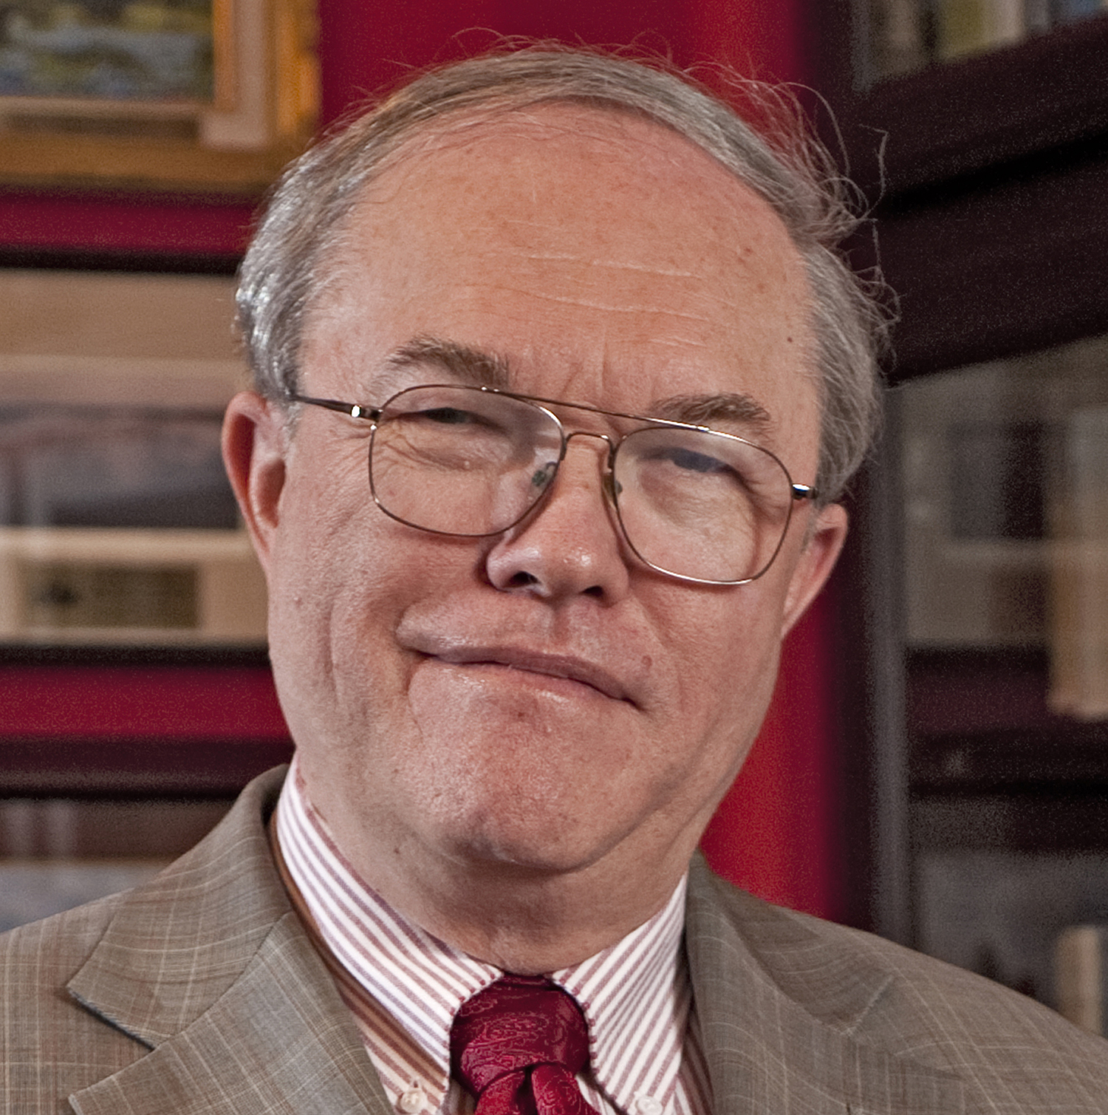
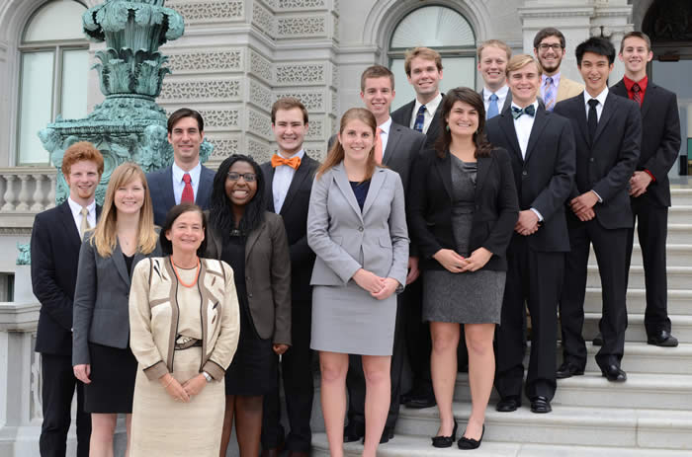
Dr. Brendan Godfrey
Candidate for IEEE-USA
2020 President-Elect, 2021 President

Slide 2
Career in Government, Industry
Management and research in FFRDC, small business, U.S. Air Force
Responsible for as many as 1500 people (mostly professionals), budgets as large as $500M
Served on many advisory committees (National Academies, governments, universities, etc.)
Air Force Reserve (retired as Colonel)
Numerous government awards
PhD – Princeton University

Slide 3
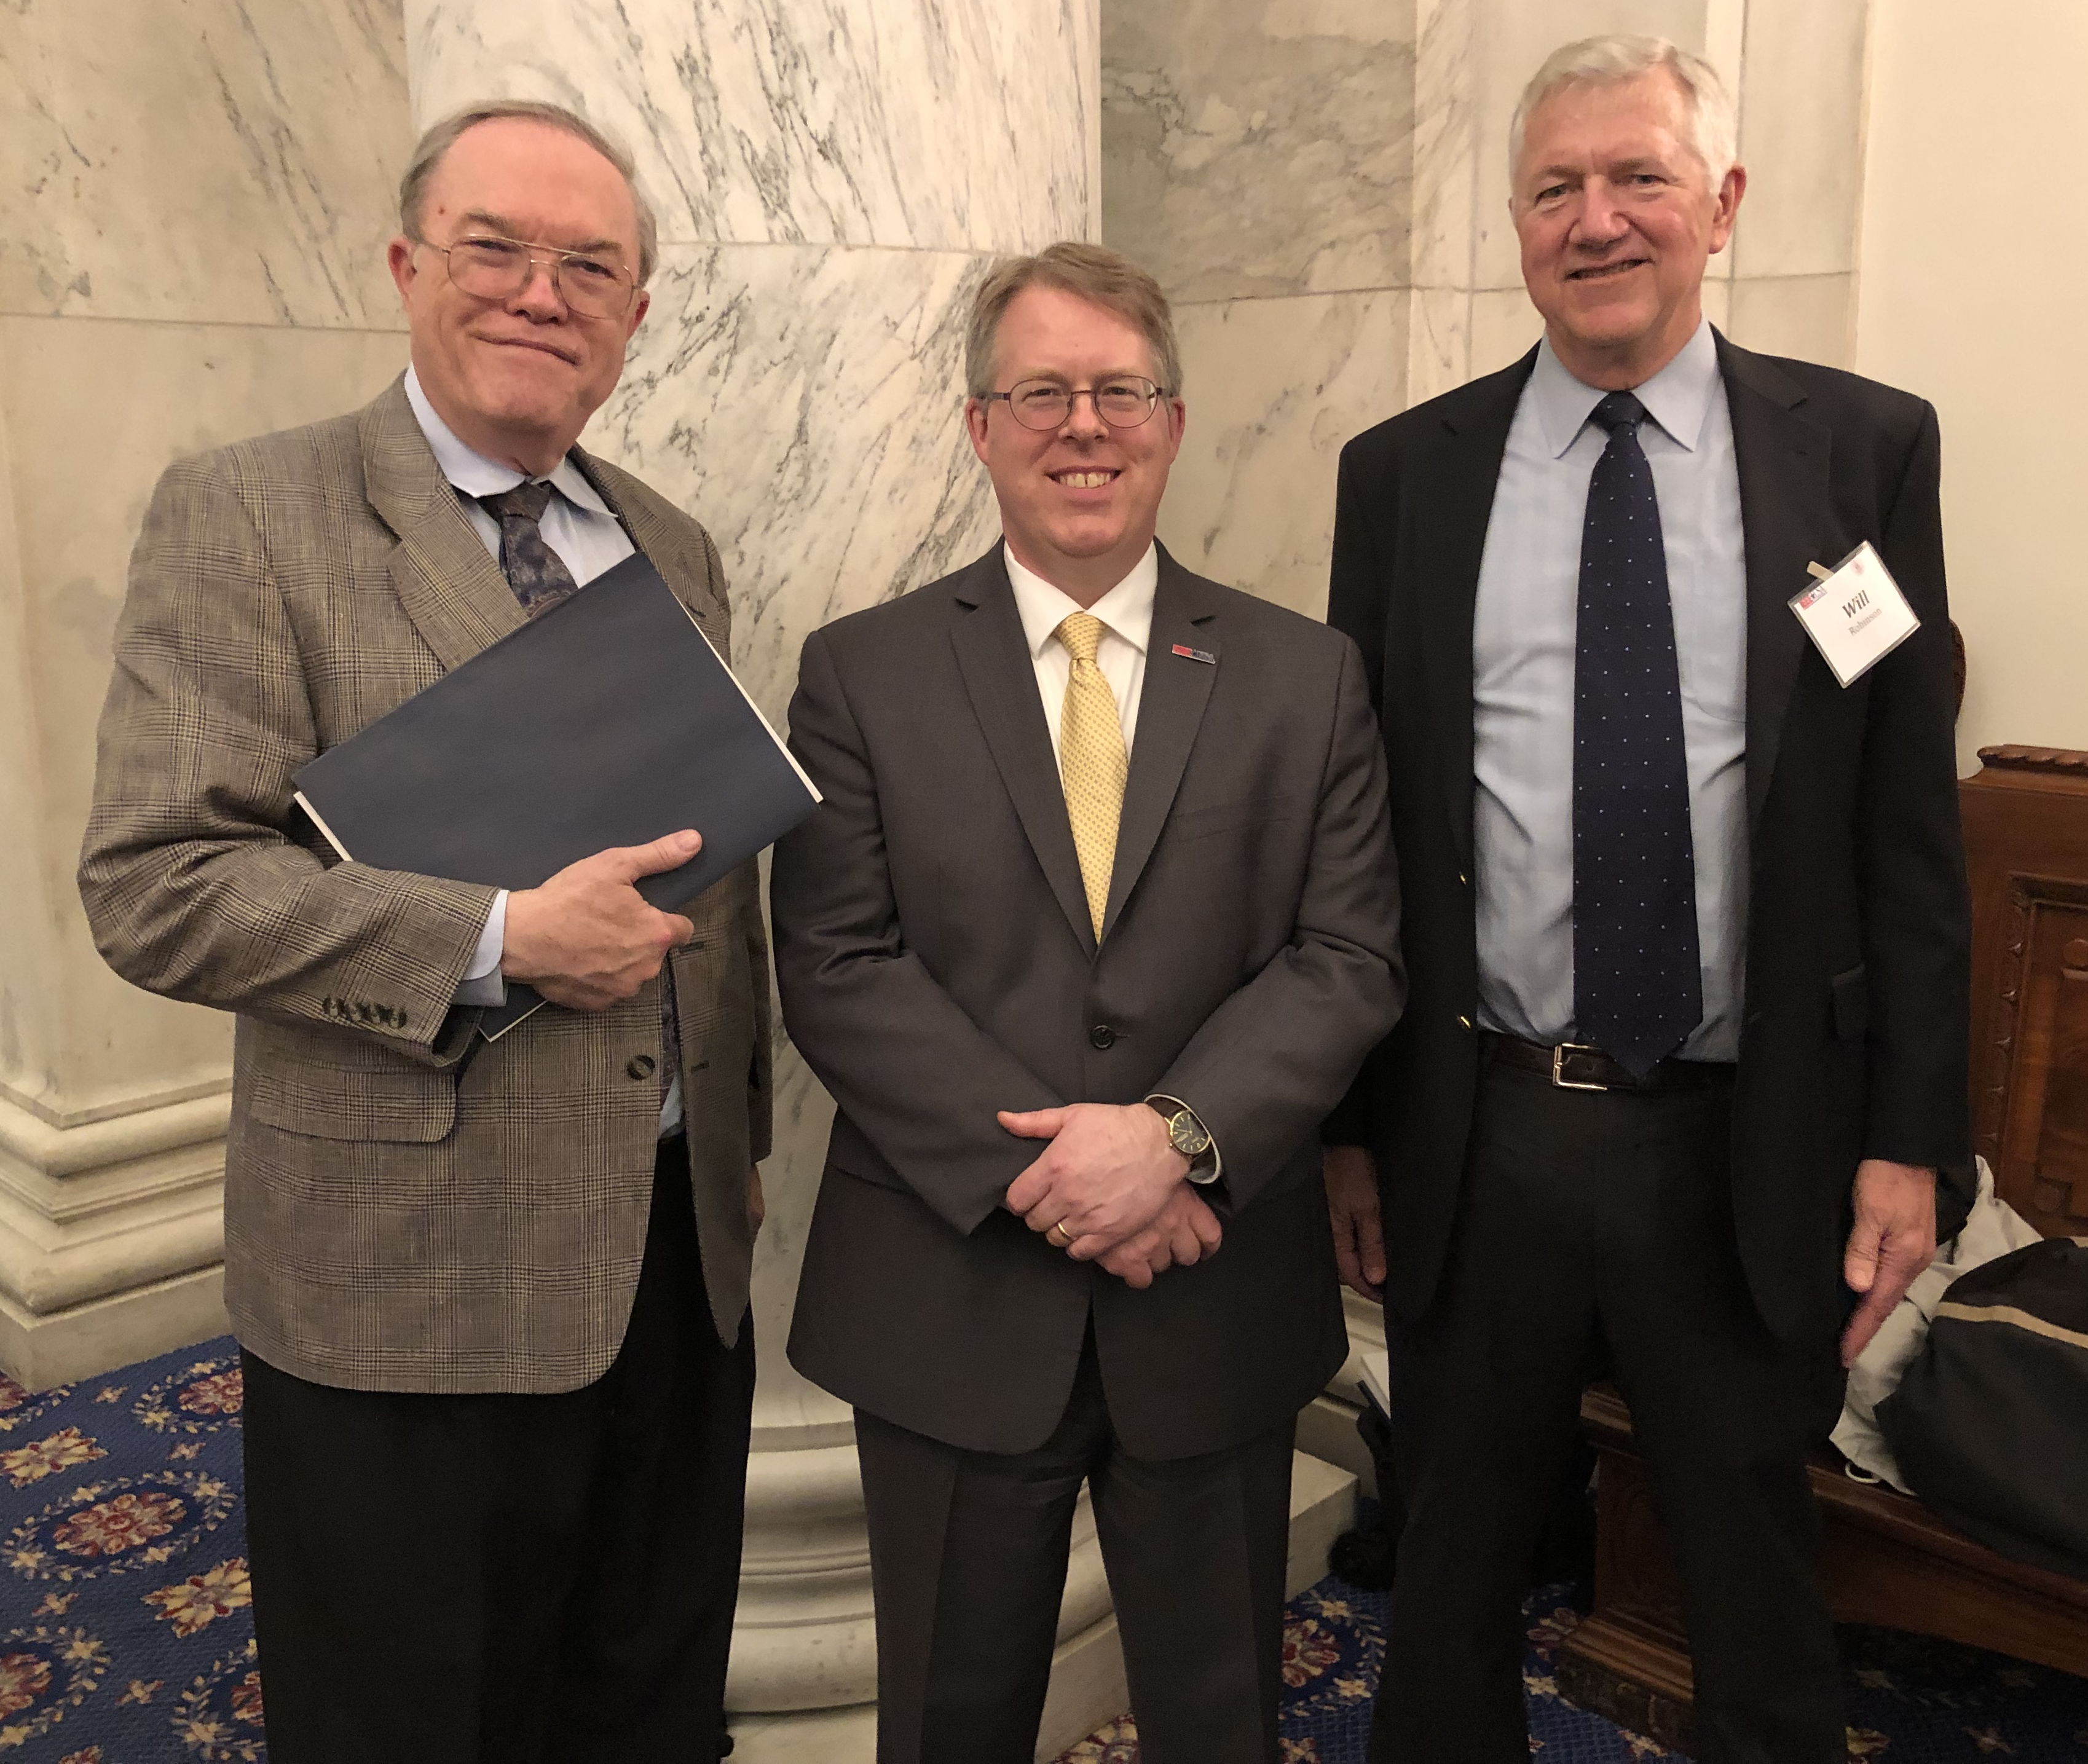
Active Contributor to IEEE
IEEE-USA Volunteer
Vice-President, Government Relations
R&D Policy Committee Chair
Artificial Intelligence Policy Committee Chair
Authored several position statements
Numerous Congressional visits
Nuclear and Plasma Sciences Society
AdCom (three terms)
Plasma Science and Applications TC Chair
IEEE Life Fellow (also APS Fellow)

Slide 4
Why I am Running for IEEE-USA President
Focus on enhancing Government Relations
DC Voice for U.S. IEEE members
Opportunities for increased impact
Well qualified to provide leadership
While not ignoring Career Services
Continue initiatives of current President, President-Elect
Work closely with six U.S. Region Directors
Focused agenda maximizes results

Slide 5
Government Relations Successes
Solid Government Relations results past four years
Increased federal support for S&T research
Federal S&Es again can attend IEEE conferences
Educated Congress on H-1B visa abuses
Permanent R&D tax credit
Internal operations also improved
Much more to be accomplished
Provide increasingly effective voice for IEEE-USA members

Slide 6
Enhancing Government Relations
Increase visibility, internally and externally
InSight articles, talks, Op-Eds, social media, etc.
Mobilize membership for advocacy
Recruit more volunteers, esp. younger members
Provide training for advocacy at section level
Address other important issues: privacy, H-1B reform, cyber security, export control, R&D tax credit, etc.
Effective advocacy can improve membership value proposition

Slide 7
Effectively Represent U.S. Members on IEEE Board of Directors
Collaborate with Region Directors to identify and advocate issues important to IEEE U. S. members
Explore alternative membership and financial models for a changing environment
Promote openness and transparency

Slide 8
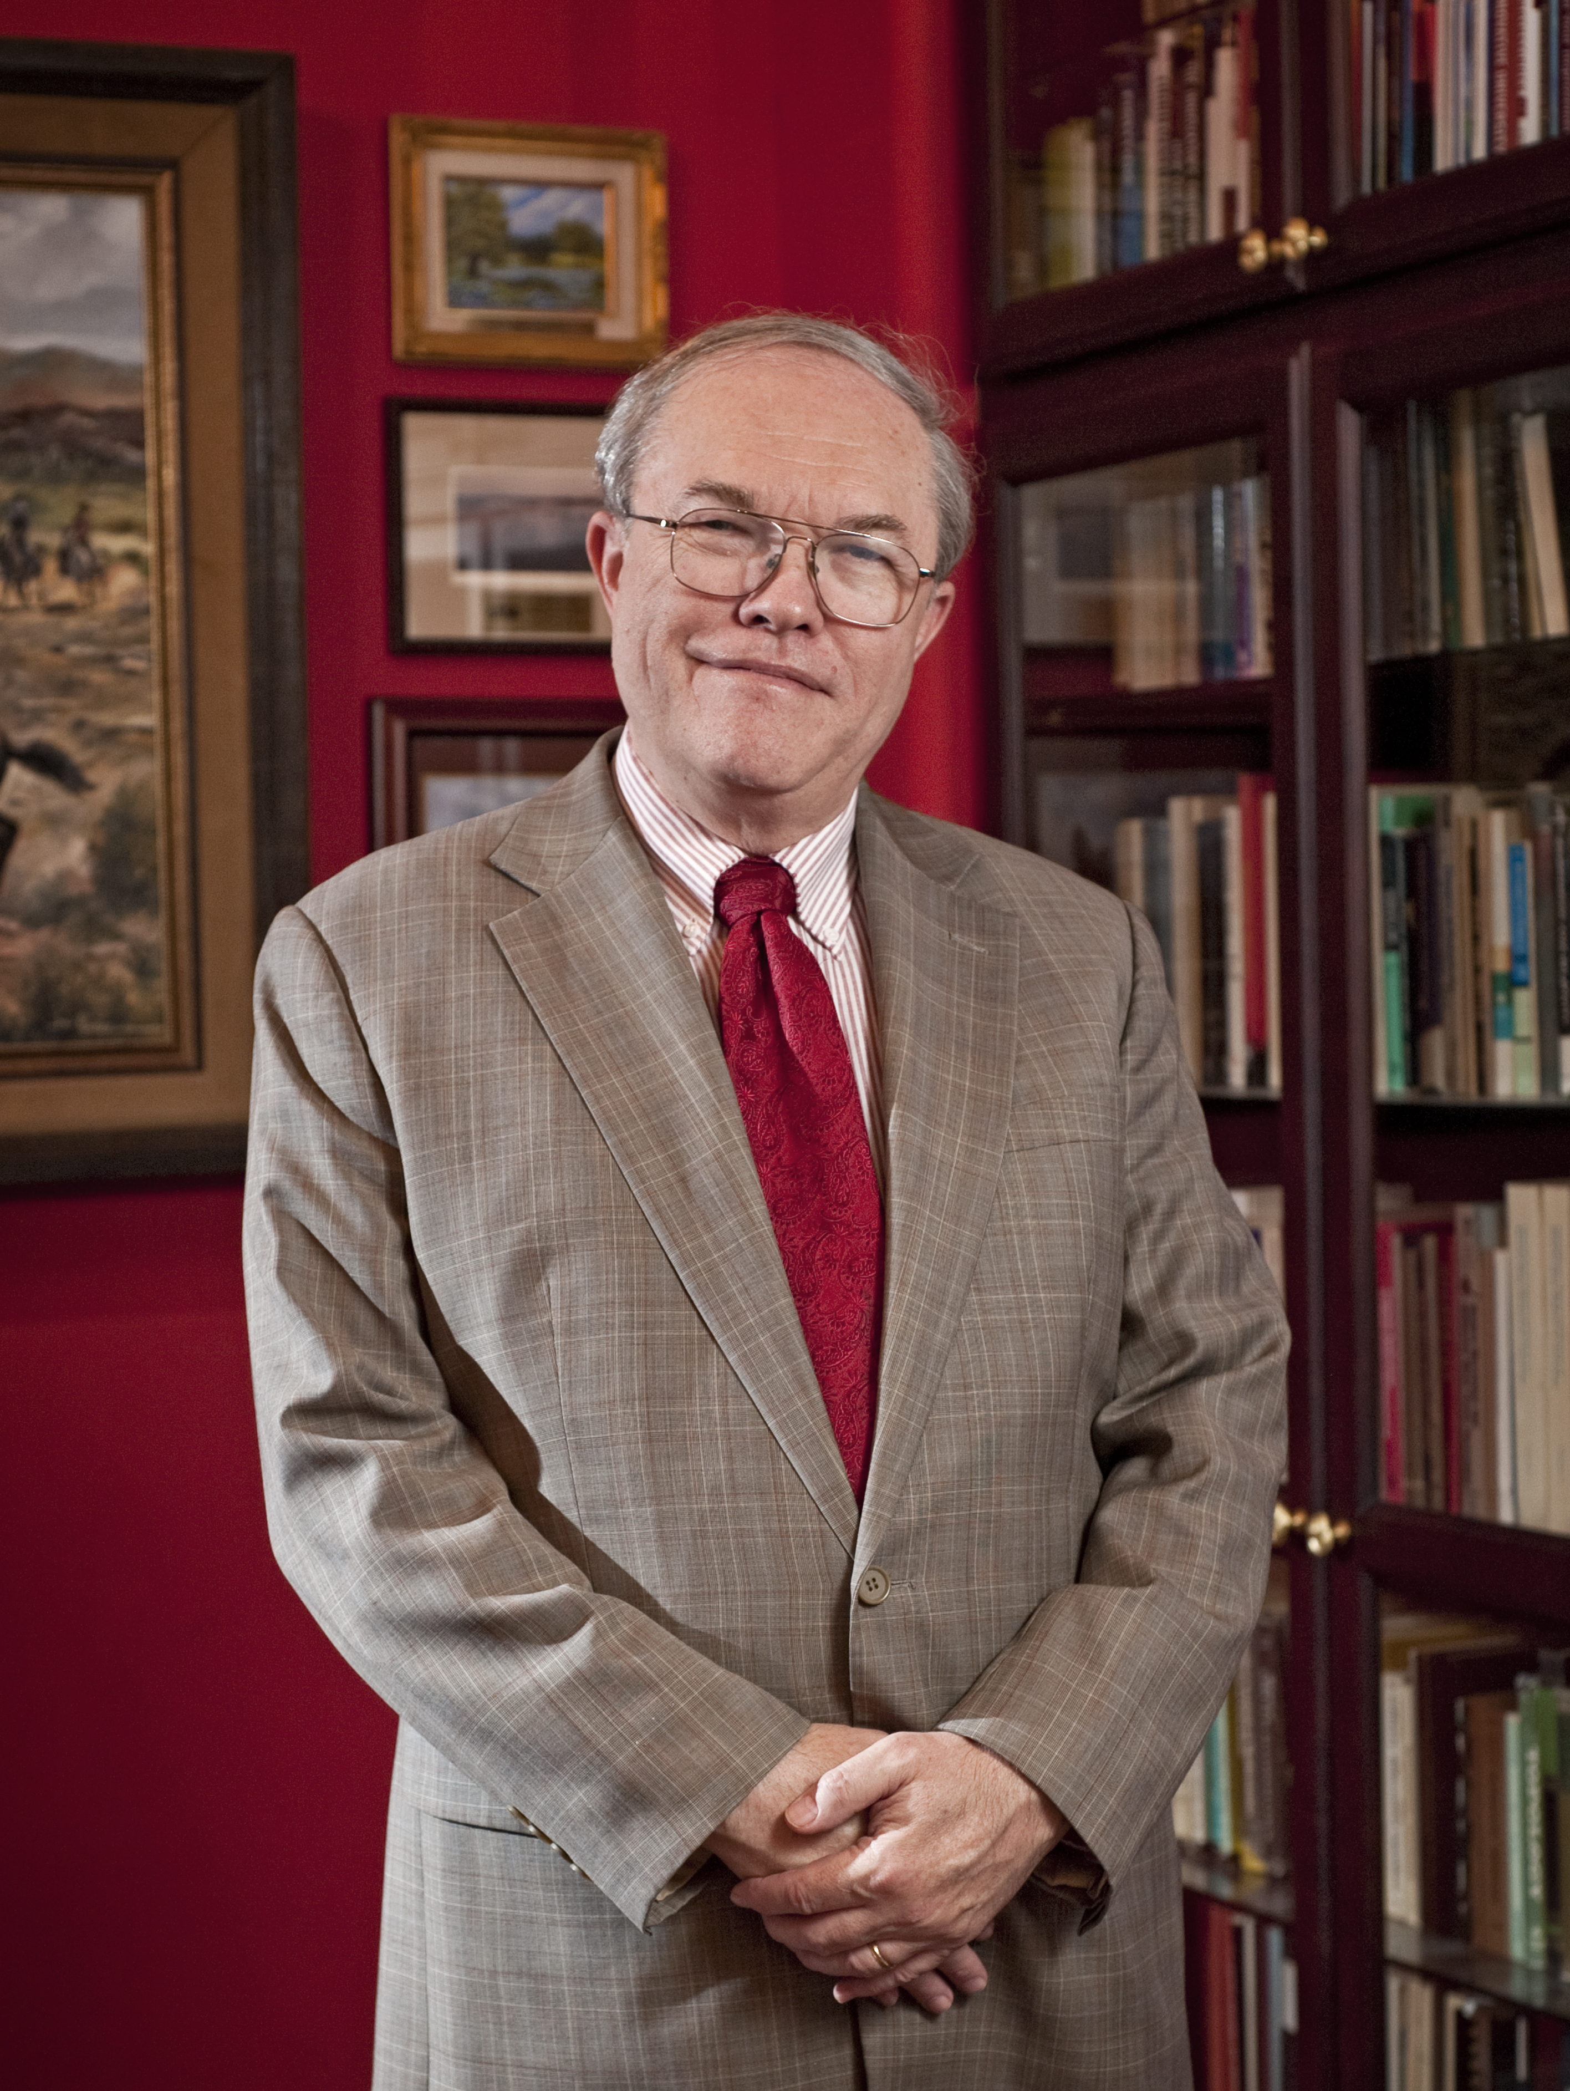
Vote for Brendan Godfrey
Experienced in leading large organizations
Focused agenda
Time and energy to get things done
brendan.godfrey@ieee.org
Website in development
But, whomever you favor,
Do vote!

